Slide 1
Configuring The User Profile Service
Notes:
This module discusses how to take advantage of the User Profile Service and the Social Networking features in SharePoint Server 2013. You will learn how to create and configure a User Profile Service Application as well as how to synchronize user profiles against Active Directory user accounts using the User Profile Synchronization Service. The module discusses several other topics which rely on User Profile Service Applications such as notes and tagging, audience targeting and MySites

Slide 2
Agenda
User Profile Service Architecture
User Profile Service Application (UPA)
Creating and Managing My Sites
User Profile Synchronization Service (UPS)

Slide 3
User Profile Service Overview
User Profile Service Application (UPA)
Contains a collection of properties for each user
User Profile Synchronization Service (UPS)
Synchronizes user profile data from external source
My Sites
each user gets a personal site collection
Social networking features
users can tag documents and items and add notes
Users can follow users, sites, documents and tags

Slide 4
User Profile Service Application Storage
User Profile DB
Profile and Activity Feed
Social Data DB
Tags, Keywords, Comments, Bookmark, Ratings
Mainly stores GUIDs to the taxonomy term, notes, etc.
Term values used with Newsfeed and Tags & Notes Page
Sync DB
Staging sync data for AD, LDAP, BCS

Slide 5
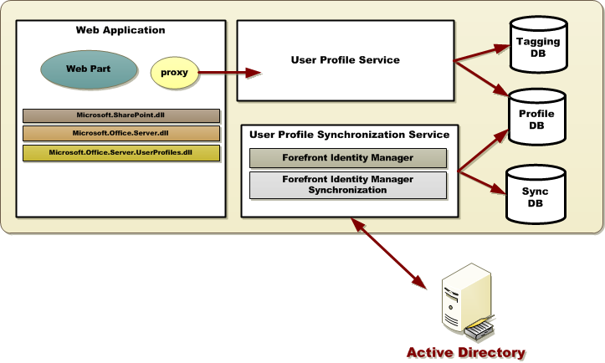
User Profile Service Application Architecture
New

Slide 6
User Profile Service Application Architecture

Slide 7
SharePoint Active Directory Import
New with SharePoint 2013
Direct Synchronization with Active Directory
Bypasses FIM
No need to provision the synchronization service!
Significantly improves performance of the import process
Simpler to use but less flexible
Key Limitations
Active Directory only (No LDAP support)
One way only (AD -> SharePoint)
Cannot import from more than one user repository
AD Property Mapping is limited
Cannot map two different attributes to the same profile property
Notes:
Look to Spence’s Article

Slide 8
Agenda
User Profile Service Architecture
User Profile Service Application (UPA)
Creating and Managing My Sites
User Profile Synchronization Service (UPS)

Slide 9
Steps to Creating a UPA
Create a web application to host my sites
Create site collection at root using My Site Hosts
Create managed paths for my sites
Enable self-service site creation
Create User Profile Service Application instance
Configure parameter to connect to my site host
Ensure to create service connections for the UPA

Slide 10
Creating and Configuring a User Profile Service Application (UPA)

Slide 11
Agenda
User Profile Service Architecture
User Profile Service Application (UPA)
Creating and Managing My Sites
User Profile Synchronization Service (UPS)

Slide 12
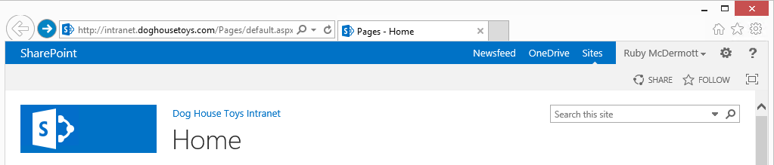
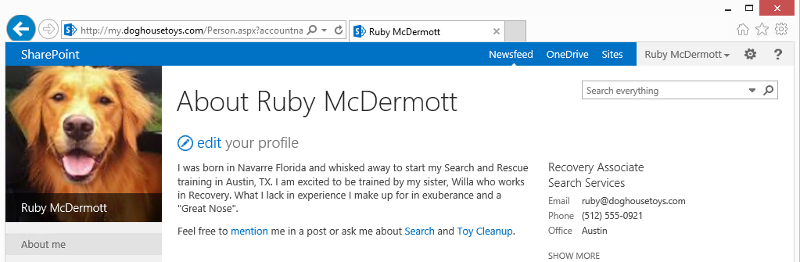
Personal Sites (aka My Sites)
Personal sites are created on user-by-user basis
Personal site is created as stand-alone site collection
Links to personal site added to all sites
Redirect users to their person sites
Personal sites can be created on-demand

Slide 13
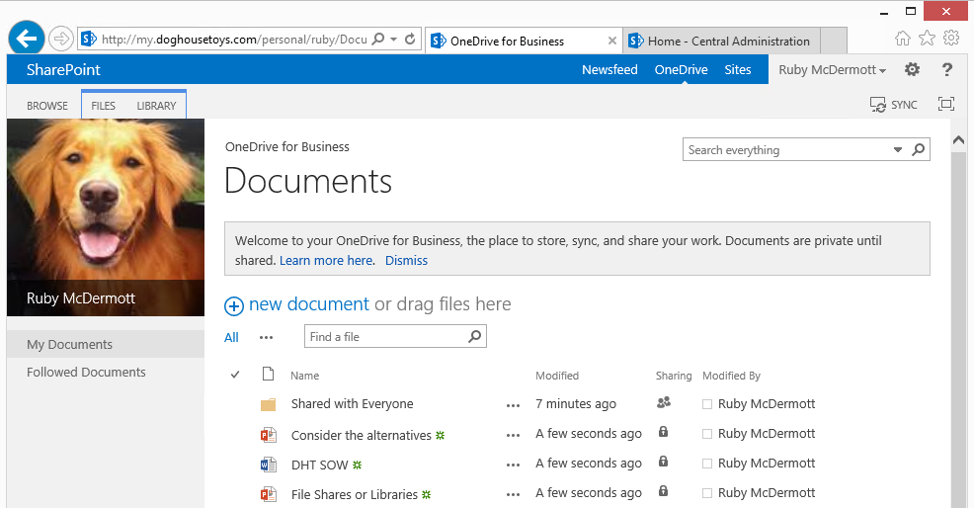
OneDrive for Business
OneDrive is content area of a user's personal site
Provides convenient location to upload and share documents
OneDrive can be synchronized with local My Documents folder
This features is not related to OneDrive.com
The name OneDrive (SkyDrive Pro) often confuses SharePoint customers

Slide 14
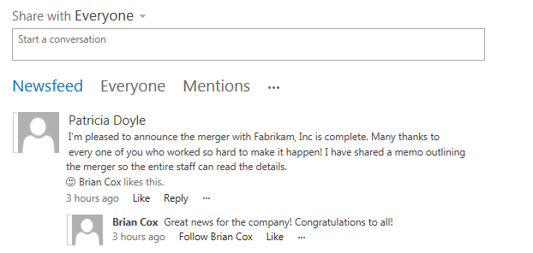
Newsfeeds
Newsfeed displays activities of interest
Activity feed shown in personal site based on followings
User can follow users, sites, documents or tags
What is shown in newsfeed?
Updates to items you are following
New posts from users
Profile changes
Mentions
My Activities
My Likes

Slide 15
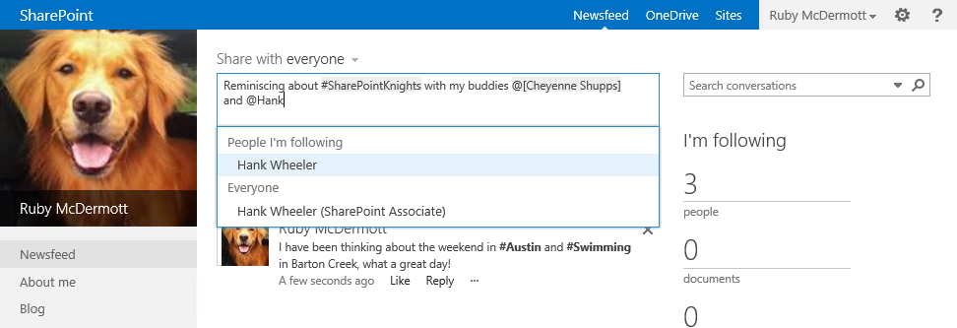
Microblogging
Microblog allows user to start conversation
Supports use of mentions and tags
Notes:
Reminiscing about #SharePointKnights with my b

Slide 16
My Tasks
Single view of tasks across SharePoint, Project, and Exchange
Enterprise Search gathers SharePoint tasks
Connects to Project and Exchange for other tasks
New “Work Management” Service Application performs aggregation
Hidden List caches data
New items can also be added
Updates are reflected back to original task
Notes:
My Tasks is a single view of all tasks assigned to you across SharePoint, Project & Exchange. A new Work Management service application aggregates content from across all three sources and stores the data in a hidden list.

Slide 17
Agenda
User Profile Service Architecture
User Profile Service Application (UPA)
Creating and Managing My Sites
User Profile Synchronization Service (UPS)

Slide 18
User Profile Synchronization Service (UPS)
UPS Synchronizes user profile properties
Often based on connections to Active Directory
Can work with connections to other identity providers
UPS is notoriously tricky to set up
Must add SP_Farm account to local Administrator group

Slide 19
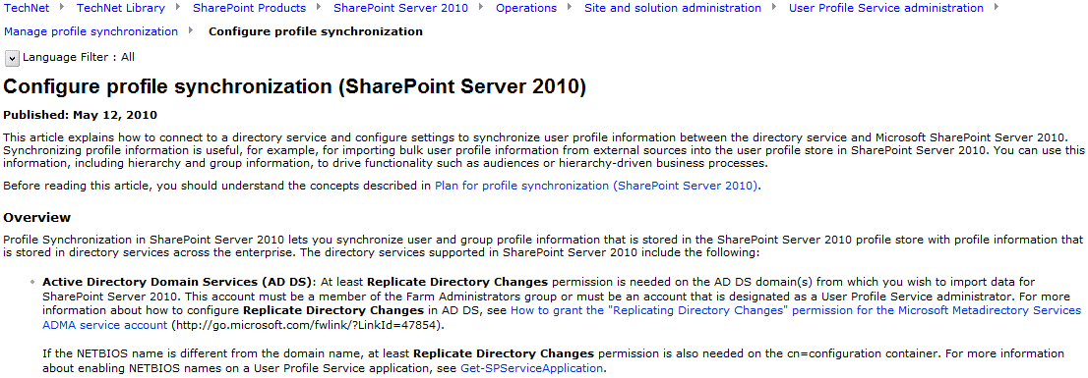
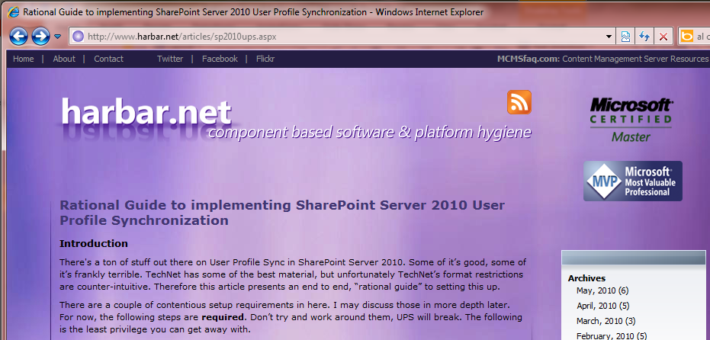
Getting Started Setting Up the UPS
http://technet.microsoft.com/en-us/library/ee721049.aspx
http://www.harbar.net/articles/sp2010ups.aspx

Slide 20
Summary
User Profile Service Architecture
User Profile Service Application (UPA)
Creating and Managing My Sites
User Profile Synchronization Service (UPS)

