Slide 1
Configuring Web Applications
Notes:
This module discusses the essential issues to consider when creating and configuring Web applications within an on-premise farm. You will learn how to create and manage the content databases associated with a Web application as well as how to configure list throttling and site quotas. This lecture also discusses the disciplines and governance strategies which an organization can employ when creating and managing 1000s of sites and site collections in an enterprise environment.

Slide 2
Agenda
Creating and Configuring Web Applications
Path-based Site Collections
Host-named Site Collections (HNSC)
Managing Content Databases
Software Limits of SharePoint 2013

Slide 3
Web Applications
Web applications are used to host SharePoint sites
Web application integrated with IIS to provide HTTP entry points
Web application implemented using one or more IIS Web sites
Web application stores site-specific data in content database(s)
Web application defines scope for configuring user authentication
SharePoint Farm
Web Applications
Content DB
Central Administration
http://WingtipServer:9999
SharePoint – 80
http://WingtipServer
Content DB
Wingtip Intranet
http://intranet.wingtip.com
Content DB
Wingtip Extranet
https://extranet.wingtip.com
Content DB
Notes:
A Web application is comprised of one or more Internet Information Services (IIS) sites. When you create a new Web application, SharePoint Foundation automatically creates a new content database and defines the authentication method used to connect to the database.

Slide 4
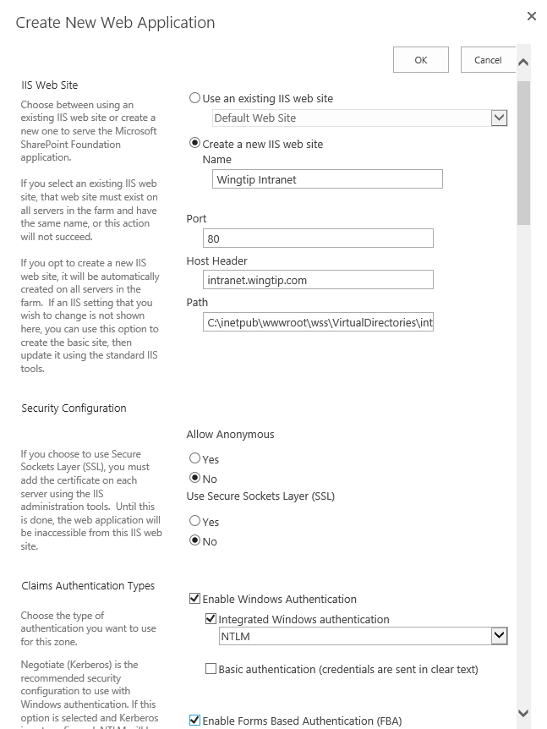
Information to Create a Web Application
Creating web application requires this information:
Name
Port
Host Header
Path (physical root directory)
Authentication information
Public URL
Application pool information
Settings for content database creation
Failover server
Service application connections
Notes:
When creating a SharePoint web application you need to determine if you are going to allow users to logon using Windows authentication or using claims.
You can also define a public URL which is a user-friendly URL. This URL needs to be defined in DNS as an A Record before you can use it as public URL for the sites in the web application.
Other important settings are the application pool and the service account that the web application pool is going to use.

Slide 5
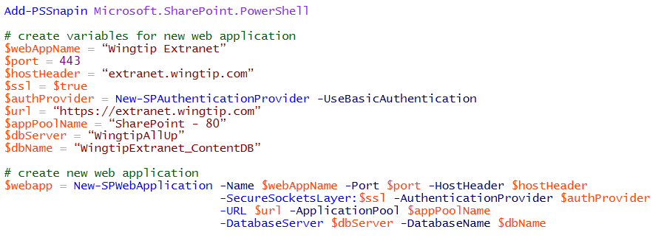
Creating Web Applications
How do you create a new web application?
Using Central Administration
Using PowerShell

Slide 6
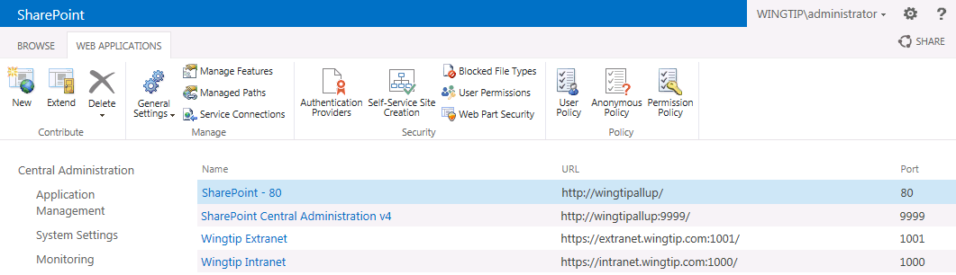
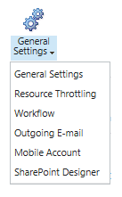
Web Application – General Settings
General Settings
General Settings
Resource Throttling
Workflow
Outgoing Email
Mobile Account
SharePoint Designer
Notes:
The Web Application management page can be accessed from within the SharePoint Central Administration by navigation to Application Management > Manage web applications. When you select one of the existing web applications listed, a ribbon becomes available from where you can manage the selected web application.
The General Settings button offers the possibility to manage settings for:
Resource throttling
Workflow
Outgoing Email
Mobile Account
SharePoint Designer

Slide 7
General Web Application Settings
Default Time Zone
User Settings Provider
Default Quota Template
Person Name Actions and Presence Settings
Alerts
RSS Settings
Blog API Settings
Browser File Handling
Web Page Security Validation
Send User Name and Password in E-Mail
Master Page Setting for Application _Layouts Pages
Recycle Bin
Maximum Upload Size (250MB default)
Usage Cookie

Slide 8
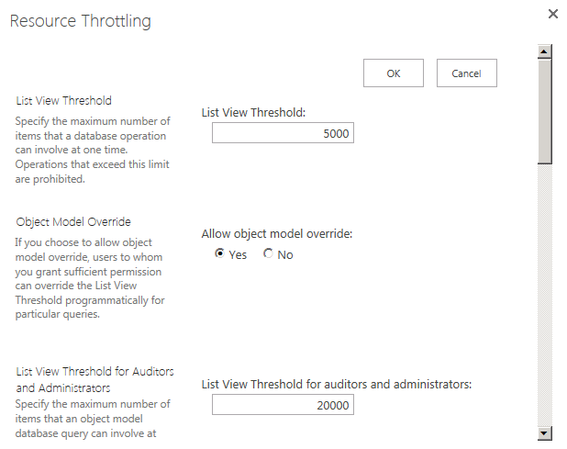
Resource Throttling
SharePoint Foundation introduces list throttling
Prevents users from running expensive queries
Queries fail if result set exceeds predefined thresholds
Default threshold for standard users is 5000 items
Default threshold for site administrator is 20,000 items
Notes:
SharePoint can support lists with lots of data, but the larger the dataset, the bigger burden queries put on the server. List throttling is one of the new features in SharePoint 2010. It enables to set a limit on how much records can be returned when a query is executed.
New controls for admins to block expensive queries: Central Admin offers additional configuration options that can be set per Web application.
Doesn’t help you view more data (doesn’t directly address the “2000 item issue”) but instead more of a heath & monitoring thing.
SharePoint will attempt to execute the query provided.
If query returns records in excess of 5,000 items, it will throw an exception saying it’s too big and it has been throttled.
Thus, SharePoint will ALWAYS try to run the query, but when it exceeds the threshold, it aborts it… even if the real result set would be 5,001 items.
Threshold configurable by Windows PowerShell.

Slide 9
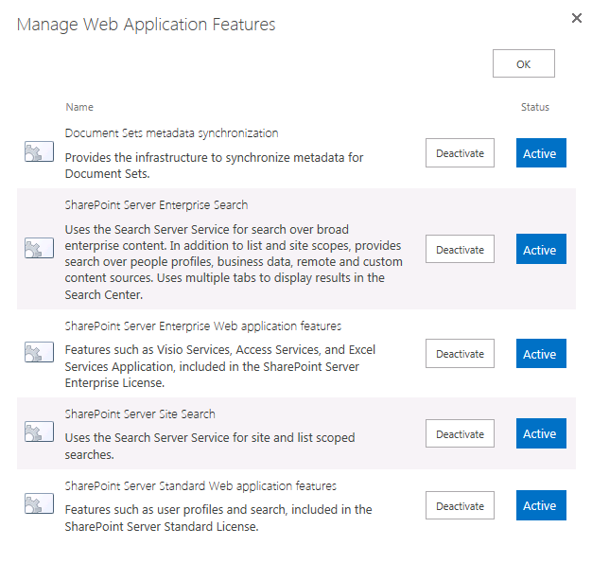
Web Application Features

Slide 10
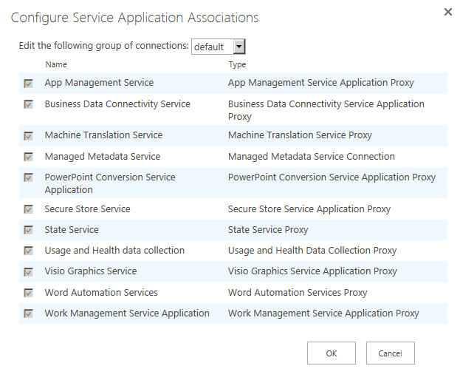
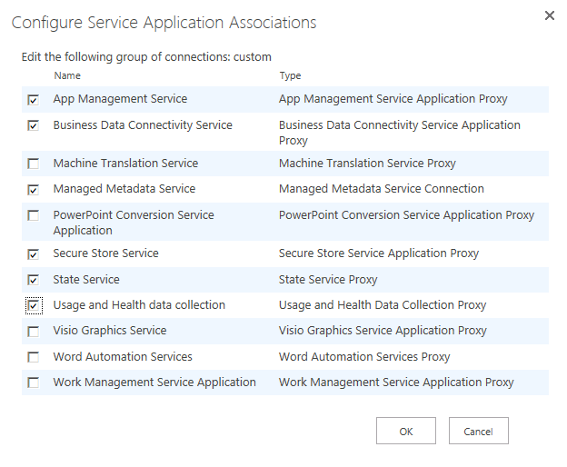
Service Connections
Service connections configured per Web app
Use Default service group or configure custom setup
Notes:
Next to the General Settings button you can find a Service Connection button. It provides you with a list of all service applications instantiated in the farm. By default a web application can connect to all instantiated service applications. You can limit that by selecting custom from the dropdown. That will allow you to select the desired service application instances.

Slide 11
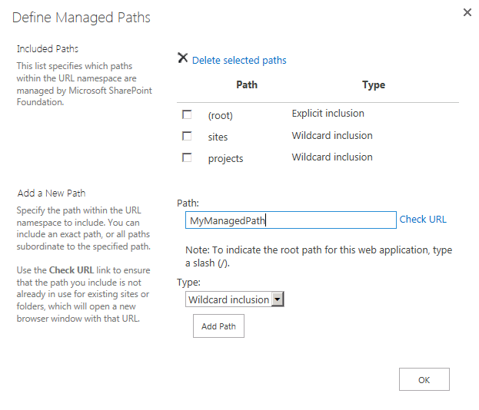
Managed Paths
Web application structured using managed paths
They define allowed URLs for site collections
Paths can be explicit inclusion or wildcard inclusion

Slide 12
Self Service Site Creation (SSSC)
SSSC allows end users to create new site collections
Must be enabled by IT staff at the web application level
Users allowed to create site collections on demand
Provides more flexibility to business users (a good thing)
Can lead to uncontrolled growth (a bad thing)
SSSC provides user with default site creation form
User uses this form to input details for site collection creation
You can replace default SSSC form with custom form
When is SSSC most commonly used?
In web application which host MySites
In web applications which host tenancies

Slide 13
Agenda
Creating and Configuring Web Applications
Path-based Site Collections
Host-named Site Collections (HNSC)
Managing Content Databases
Software Limits of SharePoint 2013

Slide 14
Managing Site URLs
Using the traditional SharePoint approach
Create a path-based web application with host header
Add path-based site collections
All site collections live in common host header domain
Using host-named site collections (HNSC)
Create web application with an empty host header path
Create host-named site collections using PowerShell
Each site collection can be created in its own domain

Slide 15
Path-based Site Collections
Hosting web application configured with host header path
Host header path serves as root URL for all site collections inside
Managed paths provide structure to web application’s URL space
SharePoint Web Application http://intranet.wingtip.com
site collection (root)
site collection /sites/operations
site collection /sites/sales
site collection /sites/finance
top-level site
(root)
top-level site
(root)
top-level site
(root)
top-level site
(root)
child site
/WestDivision
child site
/EastDivision
child site
/FY2012
child site
/FY2013
child site
/Reports
child site
/Dashboards
Notes:
All user-generated content resides in SharePoint sites. The primary types of content include items within lists and documents inside document libraries. However, there are other forms of user-generated content as well such as customization data and personalization data tracked by server-side web parts as well.
Sites are grouped into site collections. Whenever a site is created, it is always created within a scope of a specific site collection. Furthermore, each site collection is associated with exactly one content database which is used to store the content of all the sites inside.
Each site collection must have exactly one site referred to as the “top-level” or “root” site. The URL of the top-level site is always the same as the URL of the site collection. A site collection may additionally contain child sites below the root site. Child sites can be nested within other child sites within a site collection resulting in the creation of a site hierarchy. While SharePoint supports nested child sites more than 10 levels in depth, experience has taught the SharePoint community that creating deep site hierarchies can be very hard to manage and to scale.
A key reason why the SharePoint architecture requires that sites are always partitioned into site collections has to do with security. More specifically, site collections provide a scope for administrative privileges. If you are configured as the site collection administrator (aka site collection owner), you are guaranteed to have full administrative control over all the sites inside. Web application can support 1000s of site collections.

Slide 16
Web Application Zones
Web application configured in terms of zones
Zones provides alternate URLs to same set of sites
Each zone implemented with its own IIS web site
Web application always created with default zone
Web application can be extended with up to 5 zones
Five possible zones can exists in a web application
Default (created automatically)
Intranet
Extranet
Internet
Custom

Slide 17
Alternate Access Mapping (AAM)
Alternate access mapping used to add secondary URLs
AAM used to configure additional URLs to sites
AAM used extensively in previous versions of SharePoint
AAM configured at the web application level
Issues with AAM
Some AAM configuration done in IIS outside of SharePoint
You are limited to 5 URLs per web application
AAM configuration affects every site collection in web application
No ability to configure AAM at site collection level

Slide 18
Extending a Web Application
Web Application is configured with zones
SharePoint creates one IIS Web site for each zone
Web Application always has one "default" zone
You can extend a Web Application with up to 5 zones
Adding zones allows supporting multiple URLs
SharePoint deals with all IIS settings behind the scenes
IIS settings do not have to be backed up independently
Notes:
When you extend a Web Application, SharePoint creates a new zone. SharePoint creates one IIS Web site for each zone. When a Web Application is created, it always has a single "default" zone and you must explicitly extend the Web application to create others. You can extend a Web Application with up to 5 zones.
It is by adding a new zone that allows you to support a new URL within a Web Application. What's nice is that SharePoint deals with creating and track all IIS settings behind the scenes. That means unlike what you have seen with AAM configuration, you do not have to independently backup up and restore IIS settings when you use this approach.

Slide 19
Agenda
Creating and Configuring Web Applications
Path-based Site Collections
Host-named Site Collections (HNSC)
Managing Content Databases
Software Limits of SharePoint 2013

Slide 20
Host-named Site Collections (HNSCs)
SharePoint 2013 supports host-named site collections (HNSCs)
HNSCs require a hosting web application with no host header path
You specify the hosting domain whenever you create a HNSC
A single web application can host sites from different Internet domains
SharePoint Web Application
site collection operations.wingtip.com
site collection sales.wingtip.com
site collection finance.wingtip.com
top-level site
(root)
top-level site
(root)
top-level site
(root)
child site
/WestDivision
child site
/EastDivision
child site
/FY2012
child site
/FY2013
child site
/Reports
child site
/Dashboards
Notes:
All user-generated content resides in SharePoint sites. The primary types of content include items within lists and documents inside document libraries. However, there are other forms of user-generated content as well such as customization data and personalization data tracked by server-side web parts as well.
Sites are grouped into site collections. Whenever a site is created, it is always created within a scope of a specific site collection. Furthermore, each site collection is associated with exactly one content database which is used to store the content of all the sites inside.
Each site collection must have exactly one site referred to as the “top-level” or “root” site. The URL of the top-level site is always the same as the URL of the site collection. A site collection may additionally contain child sites below the root site. Child sites can be nested within other child sites within a site collection resulting in the creation of a site hierarchy. While SharePoint supports nested child sites more than 10 levels in depth, experience has taught the SharePoint community that creating deep site hierarchies can be very hard to manage and to scale.
A key reason why the SharePoint architecture requires that sites are always partitioned into site collections has to do with security. More specifically, site collections provide a scope for administrative privileges. If you are configured as the site collection administrator (aka site collection owner), you are guaranteed to have full administrative control over all the sites inside. Web application can support 1000s of site collections.

Slide 21
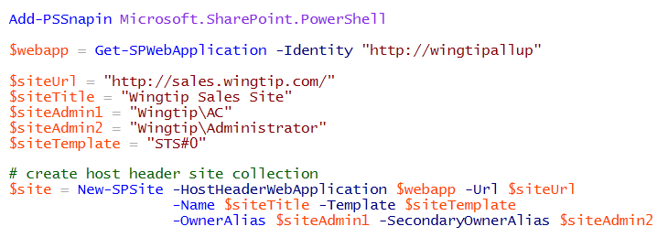
Creating HNSCs using PowerShell
New-SPSite used to create HNSCs
You create a new HNSC using New-SPSite
Hosting web application passed as parameter
Any domain can be assigned to Url parameter

Slide 22
Managing URLs for HNSC
You can configure a HNSC with its own secondary URLs
Allows you to provide alternate URLs to the same site
Requires using PowerShell cmdlets to list, add and remove URLs
Get-SPSiteUrl
Set-SPSiteUrl
Remove-SPSiteUrl
This approach is more flexible than AAMs
Secondary URLs add per site collection not per web application
Still limited to 5 URLs as you are with AAM

Slide 23
Path-based Web Application vs. HNSC
Reasons to use traditional Path-based Site Collections
Content migrated from earlier versions usually in this form
Less to manage with domain names, DNS and SSL certificates
Sites from different domains can be run in different IIS app pools
Reasons to use Host-named Site Collections (HNSC)
You can get by with fewer web applications
Farm can be built using a single path-less web application
Secondary URLs configured per site collection
Best support for Request Management

Slide 24
Agenda
Creating and Configuring Web Applications
Path-based Site Collections
Host-named Site Collections (HNSC)
Managing Content Databases
Software Limits of SharePoint 2013

Slide 25
Managing Content Databases
New Web App = new content database
Web App’s can not share databases
DB is default location of new site collections
To create sites in dedicated DB you can utilize PowerShell or STSADM
Notes:
Careful planning / forward thinking should be considered with regards to DB. One common issue found in the field over and over is implementations that have one single content database which grows to the maximum recommended size (100GB MOSS 2008 – 200GB SP2010) and in a lot of cases well over 1TB. Forward thinking and planning here will save a lot of headache down the road.
For a small organization it may make sense to store everything in a single site collection however at some point the needs and data size may grow. One method to consider is looking at departments that may have a need to be isolated with their own site collection and database. One other method to accomplish this in Central Admin is to create additional databases associated with the web application. This can also be accomplished using PowerShell and STSADM.cmd

Slide 26
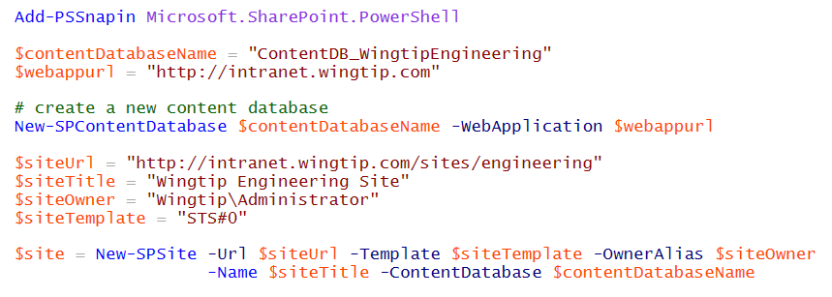
Creating a New Content Database

Slide 27
Agenda
Creating and Configuring Web Applications
Path-based Site Collections
Host-named Site Collections (HNSC)
Managing Content Databases
Software Limits of SharePoint 2013

Slide 28
Boundaries, Thresholds and Limits
Microsoft has a published whitepaper
Software boundaries and limits for SharePoint 2013
http://technet.microsoft.com/en-us/library/cc262787(v=office.15)
Limits are defined using limit types
Boundary is an absolute limit
Threshold is default value that can be modified
Supported limit defines value that’s been tested

Slide 29
Documented Limits with SharePoint 2013
Limit | Maximum Value | Limit Type
Web application | 20 per farm | Supported
Zone | 5 per web application | Boundary
Managed path | 20 per web application | Supported
Application Pools | 20 per farm | Supported
Number of content databases | 500 per farm | Supported
Content database size | 200GB per content database | Supported
Site collections per farm | 750,000 | Supported

Slide 30
Summary
Creating and Configuring Web Applications
Path-based Site Collections
Host-named Site Collections (HNSC)
Managing Content Databases
Software Limits of SharePoint 2013

