Slide 1
Configuring Workflow in SharePoint 2013
Notes:
This module take a look at the new SharePoint 2013 workflow architecture and steps you through configuring workflow support in an on-premises farm with SharePoint 2013.

Slide 2
Agenda
Workflow Changes in SharePoint 2013
Installing and Configuring Workflow Manager
Creating Workflows with SharePoint Designer
Interop with SharePoint 2010 Workflows

Slide 3
Workflow in SharePoint 2010
SharePoint 2010 based in Workflow Foundation
Tightly coupled workflow to SharePoint 2010
Workflow data kept in SharePoint content databases
Tied to .NET Framework 3.5 SP1 version of WF
Problems with SharePoint 2010 WF Architecture
It doesn't scale well in the cloud (Office 365)
Many configuration chores require farm admin
Analytics on workflow instances hard to acquire
Workflows executed in SharePoint as super user
Notes:
SharePoint 2010 leveraged Workflow Foundation (WF) found in the .NET Framework 3.5 SP1. There wasn’t much difference in SharePoint 2010’s workflow story from SharePoint 2007 from an architectural perspective as SharePoint 2007 introduced workflow to the SharePoint platform via .NET Framework 3.0. The biggest improvements around workflow in SharePoint 2010 included:
Site-based workflows: Workflows that run within the context of an SPWeb (previously they could only run within the context of an SPListItem)
Power User Tooling Improvements:
Workflows could be modeled using Visio 2010 and exported/imported to SharePoint Designer 2010.
Ability to create “Reusable Workflows” or those that are tied to content types.
Ability to import reusable workflows into Visual Studio 2010 coded workflows.
Workflow Events: Override able events developers can handle to run custom processes.

Slide 4
Workflow in SharePoint 2013
WF processing done by Workflow Manager (WM)
No longer runs in the SharePoint content farm / servers
SharePoint farm can be on same/diff servers
Improves stability, scalability & transparency
SharePoint 2013 leverages WM v1.0
Workflow Foundation v4 (WF4)
Notes:
SharePoint 2013 takes a very different approach to workflow. Existing SharePoint 2010 workflows will still run using the same legacy SharePoint 2010 / .NET Framework 3.5 architecture and developers/users are free to continue creating workflows using this approach although it is not recommended.
SharePoint 2013 workflows are based on Windows Workflow Foundation 4.0 (WF), which has been substantially redesigned from earlier versions. WF, in turn, is built on the messaging functionality provided by WCF. The workflow story in SharePoint 2013 now treats workflow as a separate service and leverages Workflow Manager which includes the WF included in .NET Framework 4.0. The workflow service provided by Workflow Manager is decoupled from SharePoint and no longer runs in the content farm, rather it runs on it’s own servers. Workflow Manager also leverages the latest and greatest advancements in workflow capabilities, performance and scalability from Microsoft.
Workflow Manager is very much a customer and leverages the new SharePoint App Model architecture in that workflow (like apps) are treated as a “service”. SharePoint instructs Workflow Manager to execute a workflow and the two products communicate with each other over a service model infrastructure (WCF).

Slide 5
Agenda
Workflow Changes in SharePoint 2013
Installing and Configuring Workflow Manager
Creating Workflows with SharePoint Designer
Interop with SharePoint 2010 Workflows

Slide 6
SharePoint Deployments & Workflow
Office 365 / SharePoint Online
Workflow Manager already deployed & configured
No custom setup / configuration actions necessary
SharePoint On-Premises Farms
Customer must install a Workflow Manager farm
After Workflow Manager farm installed, must connect SharePoint 2013 farm to Workflow Manager farm
One Server (or three servers for high availability)
Three servers required for a quorum
Two server or more than three not supported
Notes:
This new architecture is available both in the on-premises model using Workflow Manager as well as in a hosted model. By moving to this new architecture, SharePoint benefits from improvements in stability & scalability in the workflow platform. In addition Workflow Manager is much more transparent where developers can use a service-based API to gain insight into metrics and analytics of WF.
Regardless of how you are using SharePoint, either in a hosted deployment such as SharePoint Online as in Office 365, or on-premises (where you install SharePoint on your own corporate servers), workflows are created and are processed the same way.
Microsoft has already installed & configured Workflow Manager and connected it to SharePoint Online in Office 365 so there is no extra work for you to do; you can create and deploy workflows right away in this scenario.
If you are running SharePoint on-premises, as in the case where you install it on your own servers, you need to install & configure a Workflow Manager farm. After installing & configuring it, you will need to then connect your on-premises SharePoint farm to the Workflow Manager farm. Once this is done you’ll be in the same state as SharePoint Online & can then create & deploy workflows on-premises.

Slide 7
Installing Workflow Manager 1.0
Distributed via Web Platform Installer (WebPI)
Workflow Manager (WM) & Service Bus
Workflow Manager Client required on all SharePoint Servers
Install Account Permissions
Local Administrator on WM Hosts
SecurityAdmin and DBCreator SQL Roles
After installing WM, connect SharePoint farm to the WM farm via Windows PowerShell
Notes:
Workflow Manager is distributed via the Microsoft Web Platform Installer (http://www.microsoft.com/web/downloads/platform.aspx). There are a few important things to keep in mind when installing & configuring Workflow Manager:
Service Account
Workflow Manager runs under a special service account, just like SharePoint. This account must be added to the local Administrators group on the server where Workflow Manager is being installed. Because of this, Workflow Manager cannot be installed on a domain controller (something you’d never do in production, but maybe in a test or developer environment). Further, you should be logged into the server with the account that will act as the Workflow Manager service account when you run the Workflow Manager installer & configuration wizard.
SharePoint Configuration
When you install & configure Workflow Manager, you are simply creating a new Workflow Manager farm. For SharePoint to be able to use this farm, you need to go to one of the servers in your SharePoint farm and run a Windows PowerShell cmdlet (Register-SPWorkflowService) to connect the SharePoint farm to the Workflow Manager farm.

Slide 8
SharePoint 2013 & Workflow Manager
WM talks to SharePoint via CSOM
WM calls are authenticated with OAuth token that includes:
App ID: let’s SharePoint know the call is from WM
User Context: user who initiated workflow
Notes:
SharePoint 2013 also has new CSOM and REST APIs exposing running workflows without having to go directly to the Workflow Manager instances. SharePoint communicates with Workflow Manager via standard protocols (WCF Services HTTP / HTTPS depending how it was configured at installation). These workflows are declarative.

Slide 9
Agenda
Workflow Changes in SharePoint 2013
Installing and Configuring Workflow Manager
Creating Workflows with SharePoint Designer
Interop with SharePoint 2010 Workflows

Slide 10
Creating Custom Workflows
Possible to create SharePoint 2010 style workflows in both current tools
SharePoint farm must be connected to Workflow Manager farm to create SharePoint 2013 style workflows
All SharePoint 2013 workflows are declarative
Visio 2013
Used for modeling process & sharing with disconnected customers
SharePoint Designer 2013
Text-based & new visual designer
Audience: end users, power users & developers
Visual Studio 2012+
Visual designer for creating declarative workflows
Audience: developers
Notes:
SharePoint 2013 supports creating workflows based on both Workflow Foundation (WF) v3.5 and WF v4.0. The recommended approach is to create WF for SharePoint 2013 using WF v4. In order to this SharePoint must be connected to an installed and configured Workflow Manager. If this step has not been completed you will only be able to create workflows using the WF v3.5 engine which is hosted by SharePoint.
You can leverage your existing workflow investments such as workflows created in the previous version of SharePoint that are based on WF v3.5 in your SharePoint 2013 deployment as well as in new WF v4 based workflows. This is done via the new Workflow Interop Bridge (covered later in this module).
The focus in SharePoint 2013 workflows is to build workflows declaratively. This is different from previous versions of SharePoint where one tool (SharePoint Designer) was used to create declarative workflows while the Visual Studio could only create programmatic workflows. Programmatic workflows are still possible, but they are not SharePoint workflows, they are workflows that run within on the context of Workflow Manager and can call SharePoint using the REST and CSOM APIs provided they have been granted access via OAuth2.

Slide 11
Workflow Authoring Tools Compared
 | SharePoint Designer 2013 | Visual Studio 2012+
Declarative
Custom Code
Reusability | Reusable / Content Type based workflows | Workflow templates, include workflows in apps
Include in Apps
Visio Integration
Custom Actions | Consume, not create | Create & consume
Debugging
Supported Versions | 2010 & 2013 | 2010 & 2013
Target Audiences | Power Users, End Users, Developers | Developers
Notes:
The two primary tools, SharePoint Designer 2013 & Visual Studio 2012, used to create custom workflows in SharePoint 2013 are similar but have some distinct differences from their previous versions:
Declarative vs. Custom Code: Both SharePoint Designer & Visual Studio can create declarative workflows. In fact, Visual Studio can *only* create declarative workflows for SharePoint 2013… a significant change from previous versions. Custom code is only possible when creating SharePoint 2010 workflows using farm solutions which is still support but not recommended as you cannot leverage any of the new capabilities in Workflow Manager or SharePoint 2013.
Reusability: Similar to previous versions, SharePoint Designer can create reusable workflows that can be used multiple times within the same site or exported for deployment to other sites. Visual Studio workflows are created as templates which can be deployed and associated with any list or library.
Include in Apps: One benefit Visual Studio has over SharePoint Designer is that developers can include workflows within SharePoint Apps; SharePoint Designer has no support for apps.
Visio Integration: Only SharePoint Designer supports Visio integration in that workflows can be modeled using Visio and imported into SharePoint Designer. Only SharePoint Designer authored workflows will have a user-friendly visualization for executing workflows.
Custom Actions: Both SharePoint Designer & Visual Studio can consume & use custom actions in authored workflows. However Visual Studio will use the underlying action’s activity and not the action in it’s workflow. Further custom activities/actions can be created using Visual Studio.

Slide 12
SharePoint Designer 2013
Improved visual designer
Integrated the Visio designer into SharePoint Designer
Visio installation required for visual designer
Can switch between visual designer & text-style
Activity properties editable in visual designer
Support for Stages & Loops
Support for calling Web Services
Workflow designer supports Office operations:
cut / copy / paste / undo / redo / select-all
Improved email editor (rich formatting)
Notes:
SharePoint Designer 2013 now provides a visual workflow designer. The previous version, SharePoint Designer 2010, offered integration with Microsoft Visio 2010, so that you could design workflows visually in Visio and then import them into SharePoint Designer. Now, you can visually design your workflows by dragging, dropping, and connecting shapes directly within SharePoint Designer 2013. You can set all the properties of a workflow action in the new visual workflow designer—just select the shape and then click the action tag. Also, if you click Properties on the action tag, the property grids for conditions and actions appear in the visual designer, just as they do in the declarative workflow designer.
Loops: SharePoint Designer 2013 now provides looping. A loop is a container that you can use to group conditions and actions that you want the workflow to process repeatedly.

Slide 13
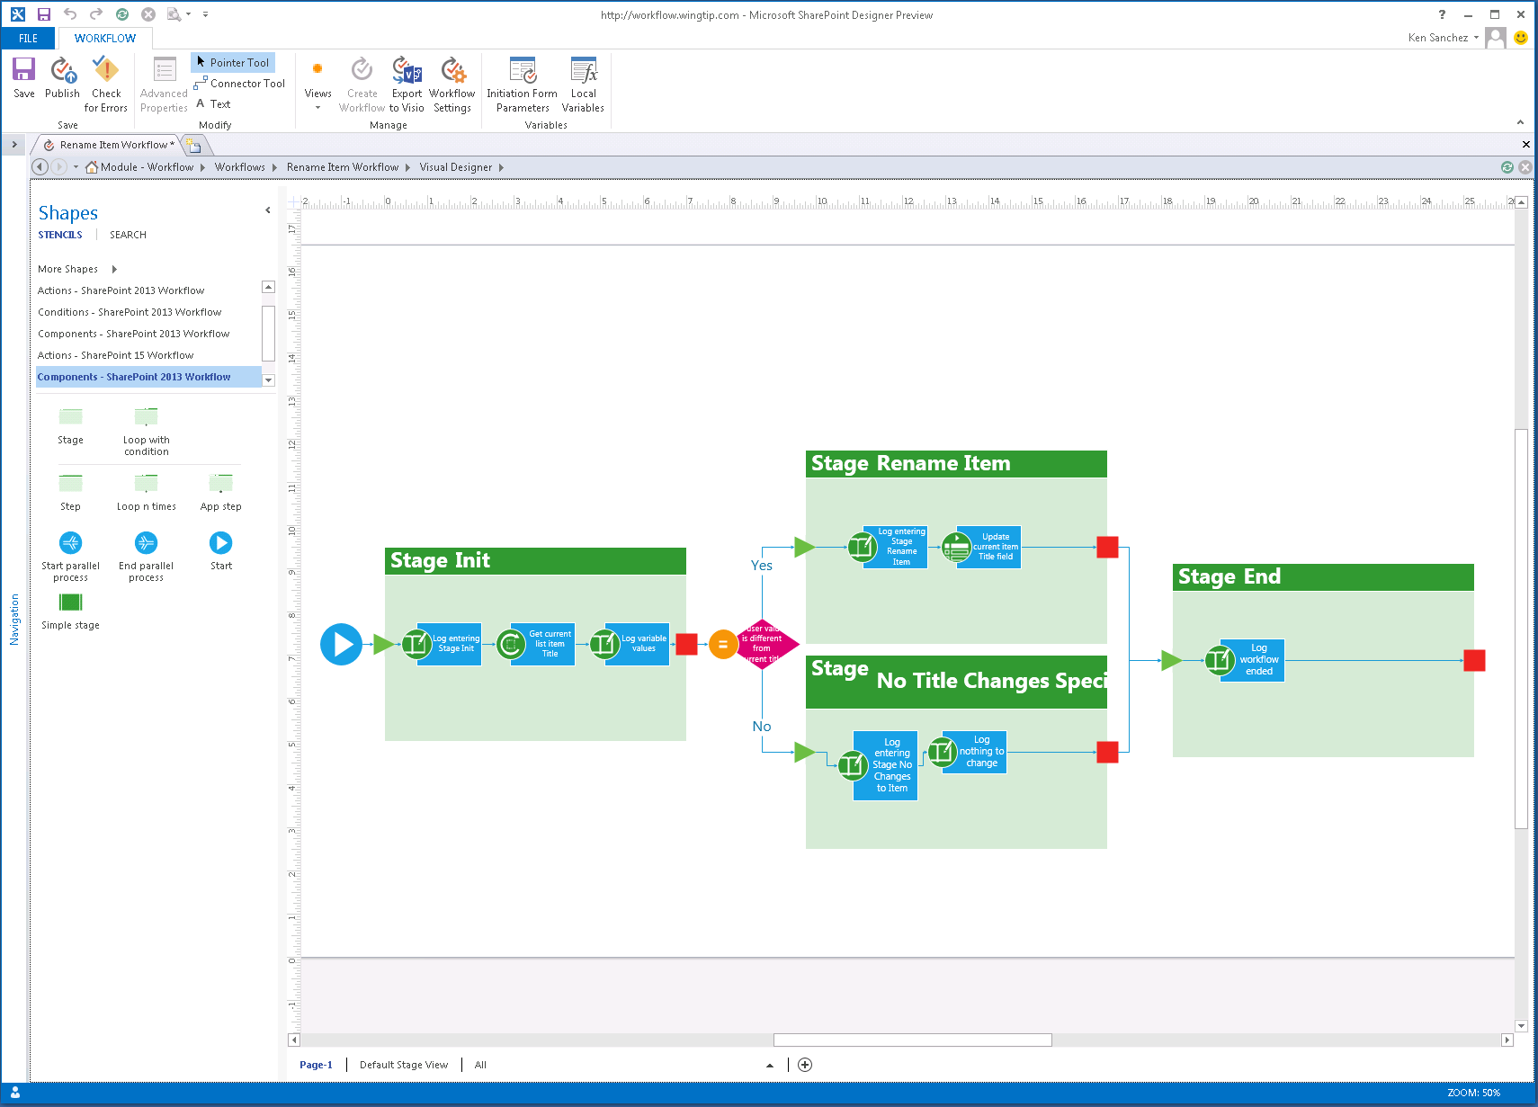
SharePoint Designer – Visual Designer
Notes:
In addition to the existing Test-Based Designer, SharePoint Designer has been improved to include a visual designer for authoring and customizing workflow, similar to how Visio allowed you to create workflows in previous versions of SharePoint. This new designer in SharePoint Designer, available when Visio is installed, allows you to not only customize the workflow actions & stages but you can modify the properties of the actions directly in the Visual Designer.

Slide 14
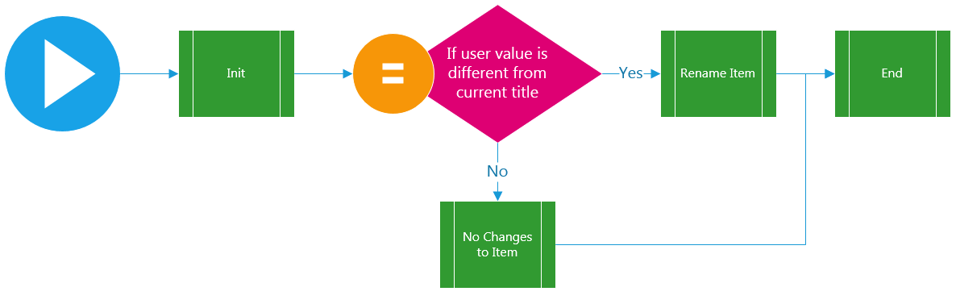
SharePoint Designer – Stage View

Slide 15
Workflows & Web Services
Move custom code in workflows to web services
SharePoint 2013 & Workflow Manager only support declarative workflow
Recommendation: move code to OData web service
New activities added to authoring tools to call & process web service responses
Web service
Must support JSON format
Can support authentication / anon
Can access SharePoint via CSOM / REST & OAuth2
Support for HTTP GET, PUT, POST, DELETE & MERGE*
Notes:
The recommended approach to creating workflows in SharePoint 2013 is to create declarative workflows. Both Visual Studio and SharePoint Designer support creating declarative workflows. This approach means workflow authors do not have to have an in-depth understanding and familiarity with the WF or SharePoint API to create workflows.
In the cases where custom code is required for business logic, developers should wrap this code within a custom web service and host it somewhere (Azure, IIS, etc.). The workflow activities for calling web services can then be used to interact with these Web services.

Slide 16
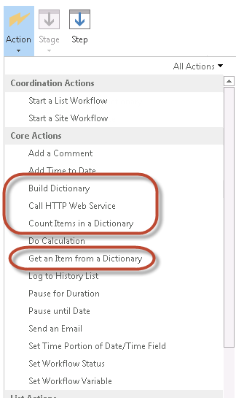
SharePoint Designer 2013 & Web Services
Uses Dictionary to submit name-value pairs to service
Converts name-value response to Dictionary
Process:
Optionally build dictionary
Call service & store response in local Dictionary variable
Retrieve named items from response

Slide 17
Agenda
Workflow Changes in SharePoint 2013
Installing and Configuring Workflow Manager
Creating Workflows with SharePoint Designer
Interop with SharePoint 2010 Workflows

Slide 18
SharePoint 2010 vs. 2013 Workflows
SharePoint 2013 includes the workflow host included in SharePoint 2010
Based on Workflow Foundation in .NET 3.5 SP1
Ensures all legacy workflows will continue to run
Types of workflows in SharePoint 2013
SharePoint 2010 Workflow:
Workflow Foundation v3.5 hosted by SharePoint
SharePoint 2013 Workflow:
Workflow Manager: Hosted / On-Premise WF v4
Notes:
Customers creating new workflows in SharePoint 2013 are presented with two options in SharePoint Designer 2013:
SharePoint 2010 Workflow: Workflows based on the same SharePoint 2010 model using .NET Framework 3.5 SP1 WF. These execute the same way they did in SharePoint 2010 (they run within the same SharePoint processes) and cannot leverage any of the improvements outlined in the remainder of this module.
SharePoint 2013 Workflow: This option is available when SharePoint 2013 is connected to a configured instance of Workflow Manager. These workflows execute within Workflow Manager and not within the SharePoint process. They can leverage all the improvements outlined in the remainder of this module.
If the SharePoint farm has not been connected to a Workflow Manager farm, SharePoint Designer 2013 will allow the creation of SharePoint Server 2010 style workflows. These workflows will not have any of the new capabilities offered in SharePoint 2013 or Workflow Manager and will be executed within the SharePoint workflow host which was carried forward from SharePoint 2010.
When building workflows with Visual Studio 2012, developers can create SharePoint 2010 style workflows that are coded and must be deployed using farm solutions. These workflows will run within the same workflow host that was included in SharePoint 2010 and are only available for on-prem SharePoint deployments. Visual Studio 2012 also supports creating SharePoint 2013 style workflows which will be covered later in the module.

Slide 19
Workflow Interop Bridge
Enables controlling 2010 WF from 2013 WF
2013 workflow can start 2010 WF
Enables communication between WF engines
Based on InvokeSharePointWorkflow activity
SharePoint 2010 Workflow Host
Workflow Manager
2013 Workflow
InvokeSharePointWorkflow
2010 Workflow
2013 Workflow
Notes:
Existing SharePoint 2010 workflows will continue to run within the context of SharePoint within SharePoint 2013 and cannot leverage new additions to the workflow story in SharePoint 2013. However at times a SharePoint 2010 workflow may need to communicate with a SharePoint 2013 workflow. The Workflow Interop Bridge is a tool to connect SharePoint Workflow to Workflow Manager workflow. The bridge exists to allow customers to reuse existing workflow assets available in SharePoint and provide a smooth transition path to Workflow Manager. It allows Workflow Manager workflows to delegate part of the process to SharePoint, enabling reuse of existing workflow assets that may not be available in Workflow Manager. It removes the complexity of creating workflows that span the SharePoint workflow host and the Workflow Manager workflow host. Customers will not have to write any service gateways, solve distributed security models, and cross-product integration challenges.
Essentially, the Interop Bridge allows SharePoint workflows based on Workflow Foundation 3 to run. Workflow Manager simply calls back into SharePoint which hosts the Workflow Foundation 3 runtime and receives a message when the process has completed.
The message flow documented on this slide is kicked off when the Workflow Manager workflow encounters a branch of the workflow that calls the interop bridge by invoking the activity InvokeSharePointWorkflow. From there, the following happens:
The InvokeSharePointWorkflow activity tells the Workflow 3 engine in SharePoint to start (by calling a Web service). This message includes the workflow instance ID which acts as a correlation ID when SharePoint sends a completed message back to Workflow Manager (#4).
The SharePoint workflow Web service authorizes the request & then starts the workflow.
When finished, workflow events are used to publish a message through the SharePoint event publisher. This message includes the workflow instance ID.
The SharePoint event publisher notifies Workflow Manager using the same pipeline that is used to notify Workflow Manager of list events (for instance: item updated/added).
Workflow Manager dispatches a Completed message to the instance within Workflow Manager using the instance ID as the correlation ID.

Slide 20
Summary
Workflow Changes in SharePoint 2013
Installing and Configuring Workflow Manager
Creating Workflows with SharePoint Designer
Interop with SharePoint 2010 Workflows

