Slide 1
The SharePoint App Model
Notes:
The module examines the architecture and fundamental concepts of the new App Model which was introduced with the release of SharePoint 2013. Students will learn about the two hosting models for SharePoint apps which includes both SharePoint-hosted apps and provider-hosted apps. Students will learn the steps to get developing and testing SharePoint apps with Visual Studio 2013 in an SharePoint 2013 on-premises environment as well as in the SharePoint Online environment in Office 365. This introductory module concludes with a quick primer on creating a user interface design using HTML5 and CSS3.

Slide 2
Student Introductions
Basic Info
  What’s your name?
  Where do you work? (optional)
  How long have you been a developer?
  Have you used SharePoint? Which versions?
List the skills with which you already feel comfortable
  HTML5 and CSS3
  JavaScript and jQuery
  REST and OData
  .NET programming with C# or VB.NET
  SharePoint solution development
  MVC5 (or earlier) in ASP.NET

Slide 3
Agenda
Introduction to SharePoint Apps
Overview of App Development
Developing SharePoint Apps using Visual Studio
Working with Bootstrap and NuGet packages

Slide 4
Pain Points with SharePoint Solutions
Custom code runs inside SharePoint environment
  This poses risks and compromises scalability
Custom solutions are SharePoint version dependent
  Server-side code has must be rewritten for next version
  SharePoint solutions hard code version specific paths to resources
  Makes it hard to migrate to new versions of SharePoint
Permissions model based entirely on user identity
  You cannot configure permissions for the solution itself
  Impersonation solves the too-little-permissions problem
  Impersonation causes too-many-permissions problem
SharePoint solutions are hard to manage
  They lack effective support and easily understood semantics for distribution, installation and upgrade
Notes:
The first problem with SharePoint solutions is that much of the code you write runs inside the SharePoint environment. For example, managed code deployed in a farm solution runs inside the main SharePoint worker process (w3wp.exe). Managed code deployed using a sandboxed solution runs inside the SharePoint sandbox worker process (SPUCWorkerProcess.exe). However, The SharePoint app model mandates that code from an app cannot run inside any process that is launched or managed by SharePoint.
There are a few simple reasons why Microsoft wants to get rid of custom code that runs inside the SharePoint environment. The first reason has to do with increasing the stability of SharePoint farms. The one is pretty obvious. Getting rid of any type of custom code running inside the SharePoint environment results in lower risk, fewer problems and greater stability for the hosting farm.
The second reason has to do with a company’s ability to upgrade to newer versions of SharePoint. The underlying problem is that SharePoint solutions which contain code that programs against the SharePoint server-side object model have been notorious at creating migration problems when a company is upgrading from one version of SharePoint to the next. More to the point, Microsoft has witnessed many of their biggest SharePoint customers postponing the upgrade of their production farm for months and sometimes years until they have had time to update and test all their SharePoint solutions on the new version of SharePoint. Since this problem negatively affects SharePoint sales revenue, you can bet it was pretty high on the fix-it priority list when Microsoft began to design SharePoint 2013.
Security causes problems with impersonation. The problem is that solution code is always recognized as a specific user and that compromises your options.

Slide 5
SharePoint App Model Overview
SharePoint app model based on these assumptions:
  Apps supported in Office 365 and in on-premises farms
  App code never runs in SharePoint host environment
  App talks to SharePoint using Web service entry points
  App is authenticated and has established identity
  Apps has permissions independent of user permissions
  Apps deployed to catalogs using a publishing scheme
  Published apps are easier to find, install and upgrade
Notes:
Unlike farm solutions, apps are supported and will work in both on-premises deployments and in Office 365. The business logic within an app does not run within the SharePoint server or host environment, rather it runs external to SharePoint on another server or in the client. There is also a notion of app identities in the sense that apps can be authenticated and assigned permissions, similar to users.

Slide 6
SharePoint Tenancies
A tenancy is a set of site collections
  Configured and administrated as a unit
  Created with administrative site collection
  A scope for provisioning new site collection
  Central concept to site management in Office 365
  A requirement for installing SharePoint apps
What about tenancies in on-premises farms?
  Most farms do not have explicitly created tenancies
  To add support for SharePoint apps, on-premises farm can be configured with a farm-wide default tenancy
Notes:
For the benefit of Office 365 and SharePoint Online SharePoint 2010 introduced the notion of a multi-tenant deployment in the sense that multiple customers (tenants) use the same SharePoint farm and the same hardware. Each customer (i.e. tenant) is assigned a tenancy and all the site collections for that customer are created inside the customer’s tenancy.
With SharePoint 2010, you never needed to worry about tenancies in an on-premises farm with the exception of the very rare scenario where a hosting company wanted to provide SharePoint sites for multiple customers. However, things are different in SharePoint 2013. That’s because the new SharePoint app model requires a tenancy before you can install and run apps in an on-premises farm. However, it’s not that complicated to set up because you never have to explicitly create and manage tenancies. You simply create a special service application (as discussed on the next slide) which will create a single default farm-wide tenant that services the entire farm and configures the support you need to install and run apps.

Slide 7
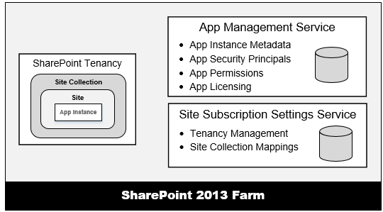
Service Application Support for Apps
App support requires two service applications
  App Management Service
  Site Subscription Management Service
  These services must be created in on-premises farms to support apps
Notes:
The App Management Service is what manages the installation of apps. Any time an app is installed, SharePoint calls to the App Management Service which updates its database with metadata for the app to track various aspects of the app such as the app’s start page URL and security information for app authentication.
The Site Subscription Management Service is used by the SharePoint host environment to track tenancies. In the Office 365 environment, each customer is assigned its own tenancy. However, in on-premises farms the vast majority of SharePoint customers do not manage their site collections using tenancies. However, an on-premises farm still requires the Site Subscription Manage Service to be created. You can create an instance of the Site Subscription Manage Service in an on-premises farm using the following PowerShell script. Simply creating the service will create a single farm-wide default tenancy which meets the requirements for installing and running SharePoint apps. Note that there is a PowerShell script available in the Demo folder for this module under the name of CreateSubscriptionSettingsService.ps1 if you want to open it up and see how the service is actually created.

Slide 8
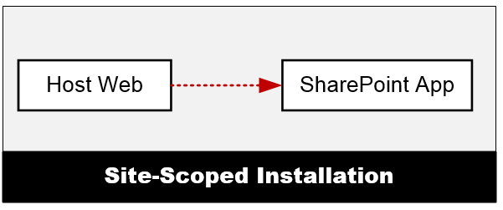
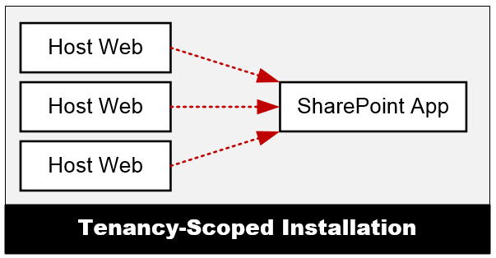
App Installation Scopes
Site-scoped Installation
  App installed in specific SharePoint site which becomes host web
  App can be installed multiple times across site collections
  Each installed instance of an app gets itw own app web
Tenancy-scoped Installation
  Provides centralized approach to app deployment & management
  Requires app to first be installed in an app catalog site
  Once installed, the app is then configured for use multiple sites
  Tenancy install scoped to web application in on-premises farms
Notes:
There are two scoping options for installing apps which include site-scope installation and tenancy-scoped installation.
When a app is installed at site scope, the app is installed within the context of a single SharePoint site (SPWeb) which can be either a top-level site or a child site. After installation, the app is available to all users of that site. If the same app is installed in other sites, each installed instance of the app is isolated from the others. In other words, an installed instance of an app does not share resources with other installed instances of the same app. Note that when you debug an app project in the Visual Studio debugger, the app is always installed at site scope.
When an app is installed at tenancy scope, the tenant administrator can then configure the app to make the app available to many sites and site collections at once. The key point is that you don’t have to install it once per site to make it available across many sites and site collections. The details of installing and configuring apps at tenancy scope will be configured in a later module of this course named Publishing, Installing and Versioning Apps.

Slide 9
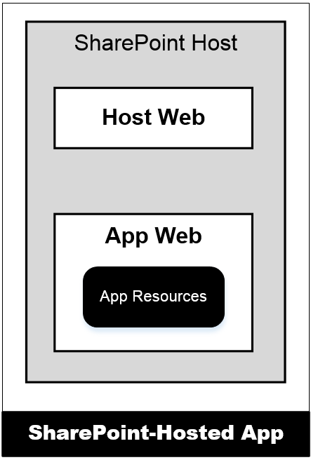
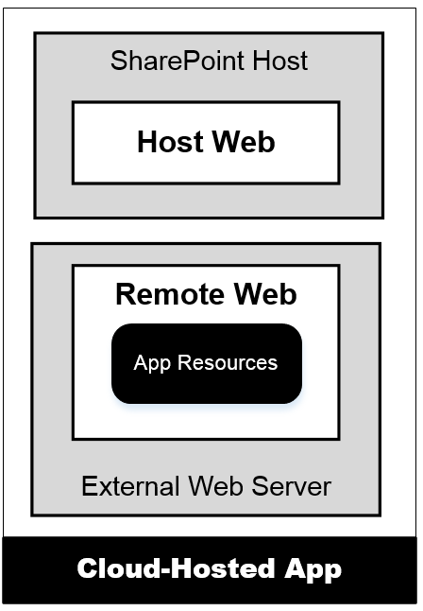
Hosting Options for SharePoint App
SharePoint-Hosted Apps
  App resources added to SharePoint host
  Stored in child site known as app web
  App can have client-side code
  App cannot have server-side code
Provider-Hosted Apps
  App resources deployed on remote server
  Remote site known as remote web
  App can have client-side code
  App can have server-side code
Notes:
There are two different types of apps and a few terms you should be aware of. First, apps are either hosted within SharePoint or they are hosted outside of SharePoint. The first type of app, a SharePoint-Hosted app is the type where all the app’s resources (pages, JavaScript, style sheets and images) are all provisioned to the SharePoint host. The business logic within SharePoint-Hosted apps runs within the client (browser). The hosting model for a Provider-hosted app is quite different in the sense that the bulk of the app logic and maintainable reside outside of SharePoint, for instance as an ASP.NET MVC site on another Windows Server, in Azure, as a PHP site in Amazon Web Services or any number of other options.
The site in which an app is installed form is called the host web. When an app with SharePoint-hosted resources is installed, the SharePoint host will create a subsite known as the app web. For provider-hosted apps, the remote site is known as the remote web.

Slide 10
Autohosted App Support Discontinued
SharePoint App Model had a third hosting option
  Autohosted apps designed as hybrid of provider-hosted
  Support to "magically" deploy/configure remote web
  Office 365 communicates with Azure behind the scenes
Autohosted app support discontinued at Q3 2014
  You will still see "autohosted app" in docs & tools
  Don't design apps based on autohosted app model
  What does this mean?
    More developers will need to learn the skills for working directly with Windows Azure when deploying remote web for a provider-hosted app

Slide 11
App Start Page
Every app requires a start page
  Start page provides entry point into app
  SharePoint adds app launcher to Site Contents in host web
  SharePoint-Hosted app start page hosted by SharePoint
  Provider-Hosted app start page hosted in remote web
Notes:
As you will learn in a later module, there are a few different ways an app can be surfaced in SharePoint. At minimum, every app must contain a start page. This start page is where the user is taken when they click on the app from the Site Contents page. This page contains an app launcher that redirects the user to the start page of the app which may reside in an app web (if SharePoint-Hosted) or a remote web (if Provider-Hosted).

Slide 12
Provider-Hosted App
Developer responsible for deploying remote web
  App deployed to remote web on remote web server
  Developer deploys remote web prior to app installation
  Developer often required to deploy database as well
Notes:
A provider-Hosted app requires the deployment of an external website known as the remote web before it can be published and installed in a SharePoint 2013 host environment. This does not mean that a provider-hosted app cannot interact with SharePoint objects such as sites, lists, libraries, items and documents. It just means that the app’s business logic and executable code live and execute somewhere other than web server and applications servers in a SharePoint farm. Before a provider-hosted app can be published and installed , the developer (or provider of the app) is responsible for deploying, installing & configuring all resources that are external to SharePoint which always includes adding support to host the remote web.
For instance, imagine a scenario where a provider-hosted app is based on an ASP.NET MVC5 application that has been deployed to Windows Azure that leverages Azure services like Service Bus, Access Control Services and SQL Azure. This is a scenario where the developer is responsible for standing up and configuring all the non-SharePoint pieces of the application.

Slide 13
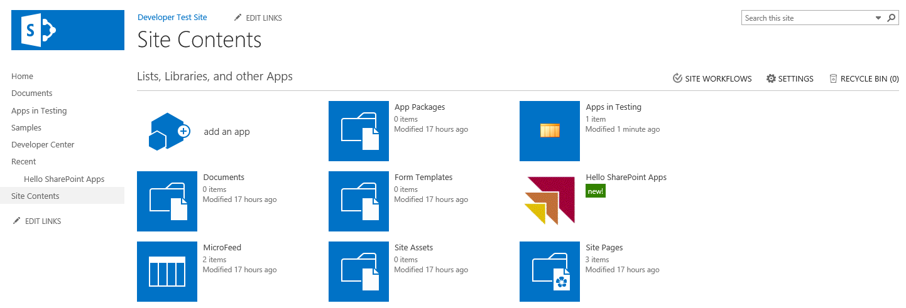
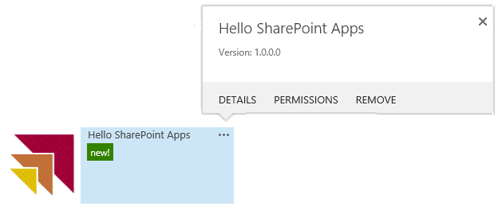
The User Experience with SharePoint Apps
Users launch app from tile on Site Contents page
  SharePoint apps grouped together with list and libraries
  App tile provides fly-out menus for details and uninstall
  Clicking on app tile redirects user to app's start page

Slide 14
Working with Apps from the Business User Perspective

Slide 15
Agenda
Introduction to SharePoint Apps
Overview of App Development
Developing SharePoint Apps using Visual Studio
Working with Bootstrap and NuGet packages

Slide 16
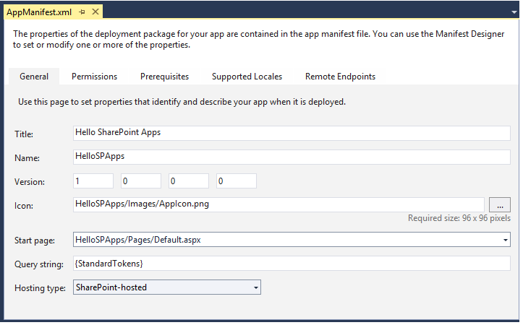
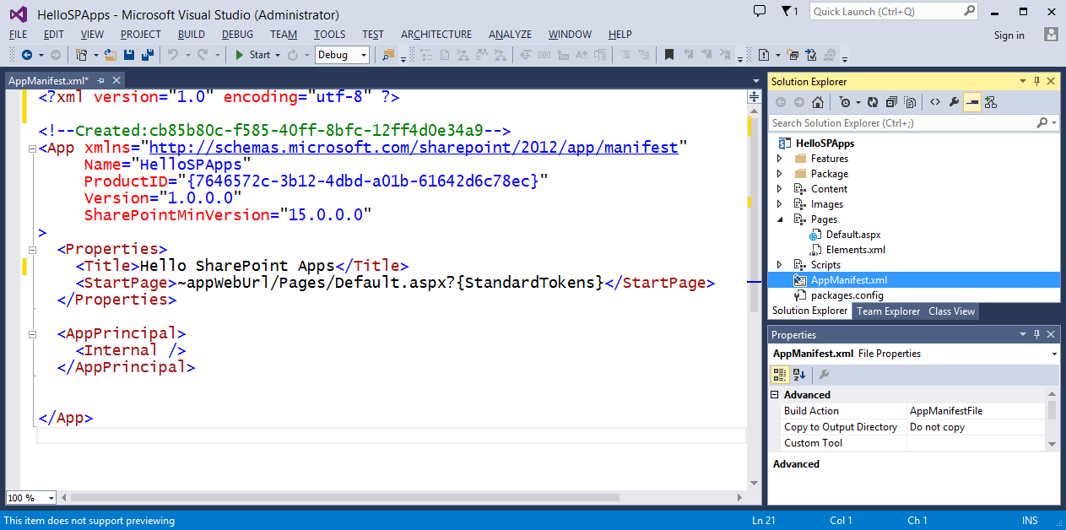
App Manifest
All apps require app manifest (AppManifest.xml)
  SharePoint reads manifest metadata during app install
  Metadata used to configure installed app instances
  Visual Studio 2013 provides app manifest designer
  Some things must be modified in markup view
Notes:
Every app must have an app manifest file that tells SharePoint the basic information about the app (name & ID) as well as the version number and all app permissions specified by the developer.

Slide 17
Start Page URL
Dynamic tokens used in start page URL
  SharePoint-Hosted apps use ~appWebUrl token
    ~appWebUrl/Pages/Default.aspx
  Provider-Hosted apps use ~remoteAppUrl token
    ~remoteAppUrl/Pages/Default.aspx
  All apps should use {StandardTokens} token
    ~appWebUrl/Pages/Default.aspx?{StandardTokens}
    ~remoteAppUrl/Pages/Default.aspx?{StandardTokens}
Notes:
There are two types of tokens that can be used in projects: those found at the start of a URL and those that can be used within a URL. The ones that can be used at the start of a URL start with a ~ character while those used within a URL are wrapped in curly brackets {}. A complete token list follows and additional details can be found here: http://msdn.microsoft.com/en-us/library/jj163816(v=office.15).
Tokens that you can use at the beginning of a URL in an app:
~appWebUrl: URL of the app web of an app.
~remoteAppUrl: URL of a remote web app in an app.
~site: URL of current website.
~sitecollection: URL of the parent site collection of current site.

Slide 18
{StandardTokens}
Start Page URL contains {StandardTokens}
  Dynamic placeholder for querystring parameters
Parameter | Purpose
SPHostUrl | URL back to host web
SPAppWebUrl | URL to app web
SPLanguage | Language in use (e.g. en-US)
SPClientTag | Client cache control number for the current website.
SPProductNumber | Version of SharePoint (e.g. 15.0.4433.1011)
Notes:
The SPHostUrl parameter passes the URL to the host web and it very commonly used because the start page of every SharePoint app requires a link back to the host web.
The SPAppWebUrl parameter passes the URL to the app web. This can be used in scenarios when you need the base URL to the app web so you can parse that together with web service entries points. Note that with provided-hosted apps and Autohosted apps, there might not be an app web created upon app installation. If the app does not have an associated app web, the SharePoint host environment will omit this query stringparameters.
The SPLanguage parameter passes a string which indicates the current language and locale in use. For example, a parameter of en-US indicates that the host site use English localized for the United States.
The SPClientTag parameter contains the client cache control number for the host web and indicates how long the SharePoint host will cache resoures.
The SPProductNumber parameter passes the current version of SharePoint which is running the host web. The version number will be in a form of 15.0.4433.1011 and can be used to figure out which updates have been applied to the local farm. Note that the version numbers will be different and larger when the host web is in the Office 365 environment.

Slide 19
Agenda
Introduction to SharePoint Apps
Overview of App Development
Developing SharePoint Apps using Visual Studio
Working with Bootstrap and NuGet packages

Slide 20
Getting Started with App Development
Minimum requirements for an app
  App must have a start page
  App must have an app manifest file (AppManifest.xml)
  App must have a site where it can be installed
Optional UI elements you can add to an app
  App Parts (i.e. Client Web Parts)
  UI Custom Actions
Notes:
The minimum requirements for every SharePoint app is that it must have a start page and an app manifest. You also need a site in a SharePoint 2013 (or later) environment to install your app.
While the start page is the only required UI element for a SharePoint app, you can also add two other types of user interface elements known as App Parts (also known as Client Web Parts) and UI Custom Actions. These UI elements will be discussed later in this course in the module titled Developing SharePoint-hosted Apps.

Slide 21
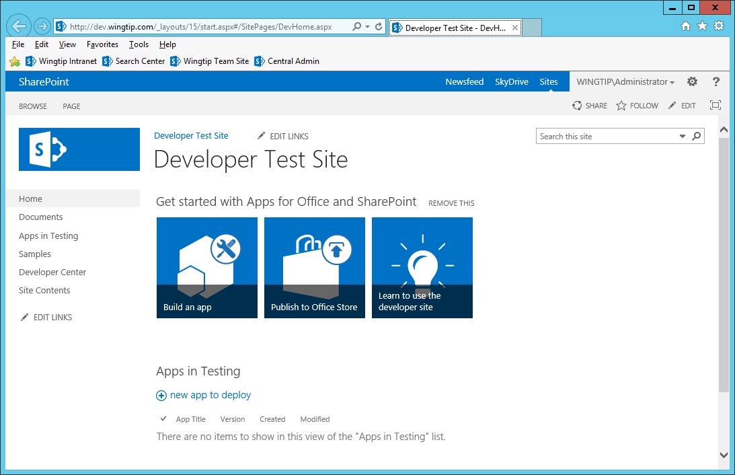
Developer Sites
Allows for remote app installation by Visual Studio
Notes:
SharePoint introduces a new site template which can be used to create Developer Sites. The main thing to know about Developer sites is that they are the only type of SharePoint sites that allow for the remote development of SharePoint apps. In other words, you do not need to create and configure a local SharePoint farm running on your development computer which is also running Visual Studio.
A Developer site can be created in a SharePoint farm running in a private network or up in the cloud in Office 365. When you begin a debugging session for your SharePoint app in Visual Studio, Visual Studio is able to reach across the network and install the SharePoint app in the Developer site that you have configure as the Visual Studio projects Site URL property. However, Visual Studio is not able to install an app from across the network if you have configure the Site URL to point to another type of SharePoint sites such as Team sites and Publishing sites.
When you are doing SharePoint app development in the Office 365 environment, you must use a developer site or things will not work. However, developer sites are not essential when you have a local version of SharePoint running on the same computer on which you are running Visual Studio. When you have a local SharePoint farm, Visual Studio does not require Developer sites and you might prefer to work with a team site or a Publishing site for your testing and debugging as these types of test sites might provide a better simulation for real-world testing.

Slide 22
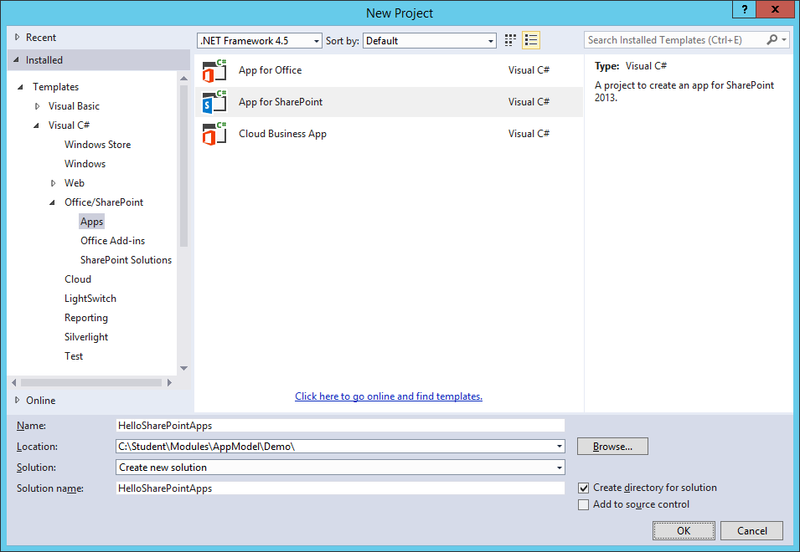
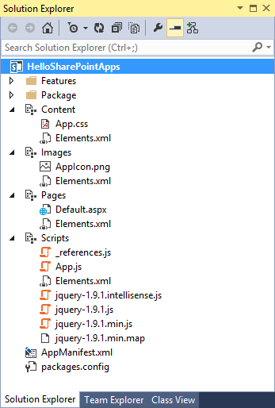
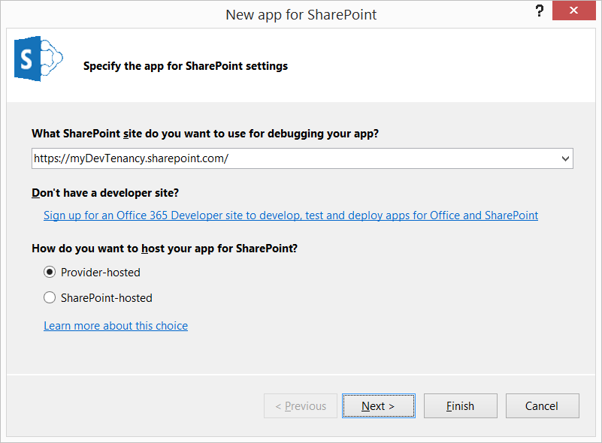
Creating a New Visual Studio Project
Create a new App for SharePoint 2013 project
  Configure URL which points to a test site
  Select the desired hosting model (e.g. SharePoint-hosted)
Notes:
It is pretty easy to get up and running with SharePoint app development using Visual Studio. You can create a new SharePoint app project by start with the Visual Studio New Project command. You select the Visual Studio project template named App for SharePoint 2013 and click OK. You are then prompted by the New app for SharePoint wizard which prompts you to configure the test site URL and to select the desired hosting model (e.g. SharePoint-hosted).

Slide 23
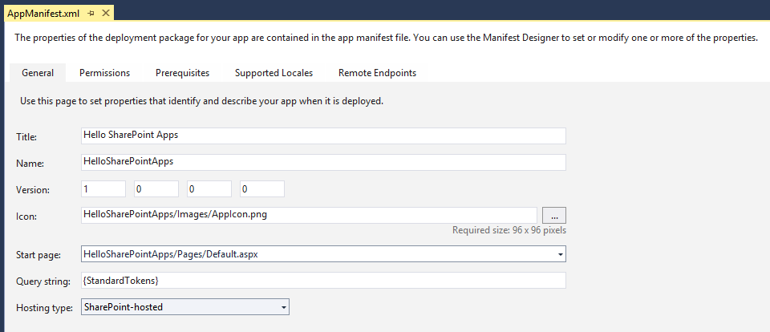
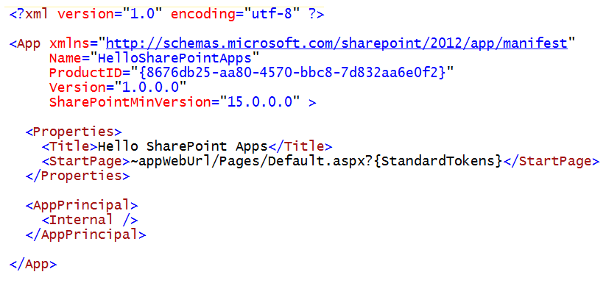
App Manifest Designer
UI designed to abstract away XML inside app manifest
  Makes some things much easier to edit (e.g. Permissions)
  You must occasionally edit app manifest in raw XML view
Notes:
Every SharePoint app requires an app manifest file named AppManifest.xml. This file holds essential metadata that is read by SharePoint when the app is installed.

Slide 24
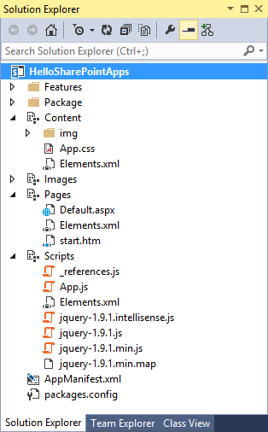
Client-side Coding Skills
Developer requires skills with HTML, CSS and JavaScript
  HTML to create the elements of the user interface
  CSS to visually style the HTML elements on the page
  JavaScript to add client-side behavior behind the page
CSS
HTML
JavaScript
Notes:
Client-side web development skills are essential when developing SharePoint apps. If you are not comfortable working with HTML5, CSS3 and JavaScript, it is now time for you to invest and learn these client-side skills.

Slide 25
Using ASPX Pages versus HTML Pages
Advantages of using ASPX pages
  You can leverage the standard app master page (app.master)
  You can add server-side controls to the page
Disadvantages of using ASPX pages
  They add extra HTML, CSS and JavaScript you might not want
Advantages of using HTML pages
  You have the ability to create HTML experience from ground up
Disadvantages of using HTML pages
  Loss of productivity since you cannot use server-side controls
  You must write more custom JavaScript code to compensate
Notes:
When you use an ASPX page as the app start page, you can use the app master page (app.master) which gives your app a SharePoint look and feel. You can also use server-side controls in your page. However, the downside to use an ASPXS page is that it adds a good deal of extra HTML, CSS and JavaScript that can be seen as unnecessary and bloated. This si especially true when targeting mobile devices where you want complete control; over what gets sent back to the client.
You can also elect to use an HTML page as the start page of an app instead of an ASPX page. The advantage of using an HTML page is that you have the ability to create the HTML layout from ground up. You decide what HTML and JavaScript are sent to the client. The obvious disadvantage here is a loss of productivity since you cannot use server-side controls provided by ASP.NET or SharePoint and you must write more custom JavaScript code to compensate.

Slide 26
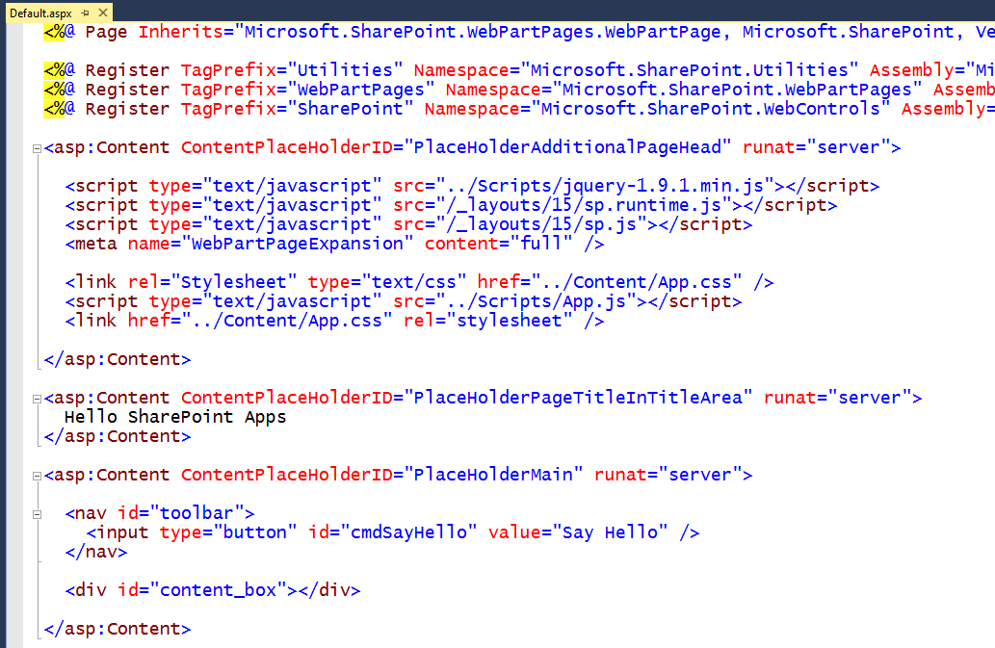
Using Default.aspx as a Start Page
Notes:
This is an example of an ASPX file that acts as the app start page which is created automatically by Visual Studio when you create a new SharePoint-hosted app project.

Slide 27
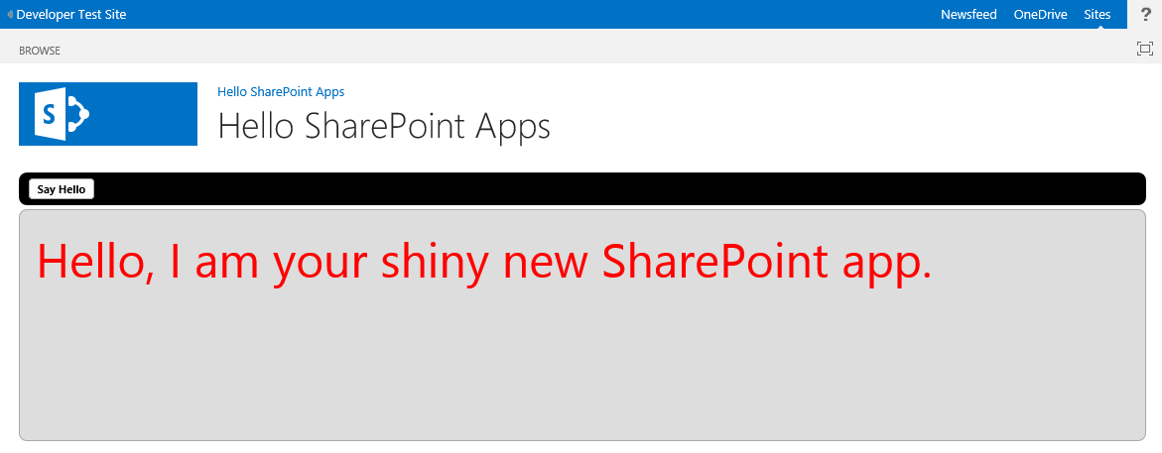
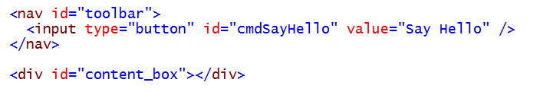
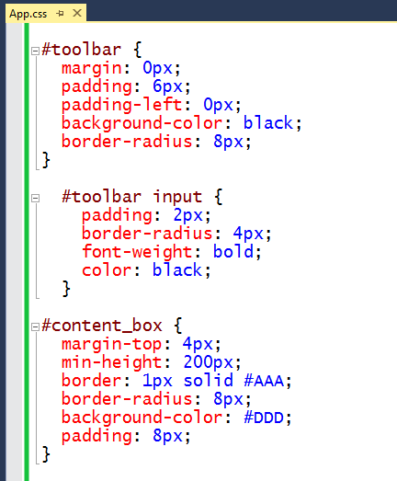
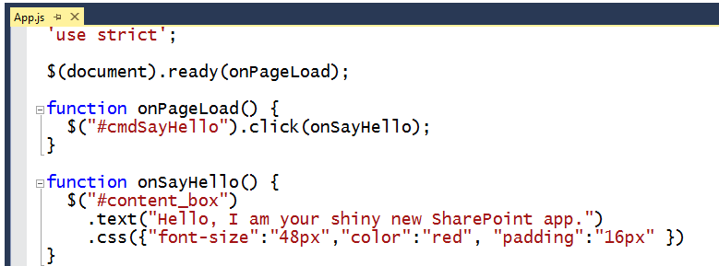
Adding in some CSS and JavaScript
Notes:
And of course, you will need to create and style the layout of the start page and any secondary pages in your app using CSS rules.

Slide 28
Creating a Visual Studio Project for a SharePoint-Hosted App

Slide 29
Agenda
Introduction to SharePoint Apps
Overview of App Development
Developing SharePoint Apps using Visual Studio
Working with Bootstrap and NuGet packages

Slide 30
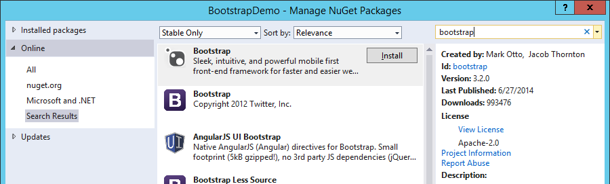
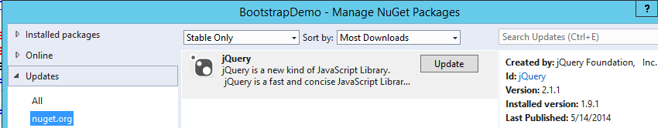
NuGet Package Manager
Utility for integrating & managing 3rd party libraries
  Fully integrated with Visual Studio
  Allows you to install, update and uninstall NuGet packages
  Install a package
  Update a package
To display the NuGet Package Manager dialog
  Right-click a project and select Manage NuGet Packages…
Notes:
The NuGet Package manager is an essential utility for integrating & managing 3rd party libraries such as jQuery, Knockout and AngualrJS which is fully integrated with Visual Studio. The NuGet Package manager allows you to install, update and uninstall NuGet packages.
When you want to add a new package to your project, right-click a project and select Manage NuGet Packages… to display the NuGet Package Manager dialog.

Slide 31
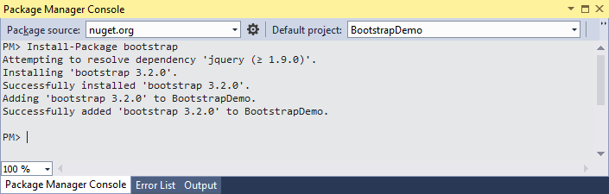
Package Manager Console
Provides command-line for NuGet package management
  Install-Package command used to install a package
  Allows you to install a specific version of a package
To display the Package Manager Console…
  Tools > NuGet Package Manager > Package Manager Console
Notes:
While you can manage NuGet packages using the NuGet Package Manager dialog, many developer prefer to manage packages using the command line. For example, the command line allows you to specify a package version number whereas the NuGet Package Manager dialog only allows you to install the most recent package. You can choose the following menu command to display Package Manager Console.
Tools > NuGet Package Manager > Package Manager Console
To install a package, run the Install-Package command and pass the package name as shown in the slide above

Slide 32
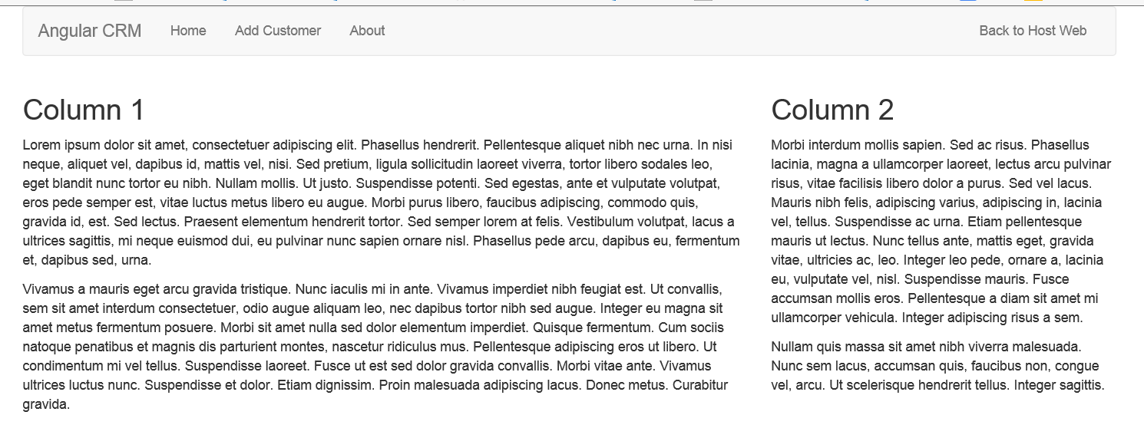
What is Bootstrap?
A CSS-based Framework for faster web development
  Predefined classes for layout with navbars, columns, tables, etc.
  Provides much faster way to create HTML-based user interfaces
  Very good for creating mobile-friendly layouts
Notes:
Bootstrap is a very popular CSS-based Framework that is used for web development. It includes a comprehensive set of predefined CSS classes for layout with page items such as navbars, columns, tables and forms.
Bootstrap provides a much faster way to create HTML-based user interfaces that have a consistent look and feel. Bootstrap is also recognized as one of the premiere frameworks for creating user interface experiences for mobile devices.

Slide 33
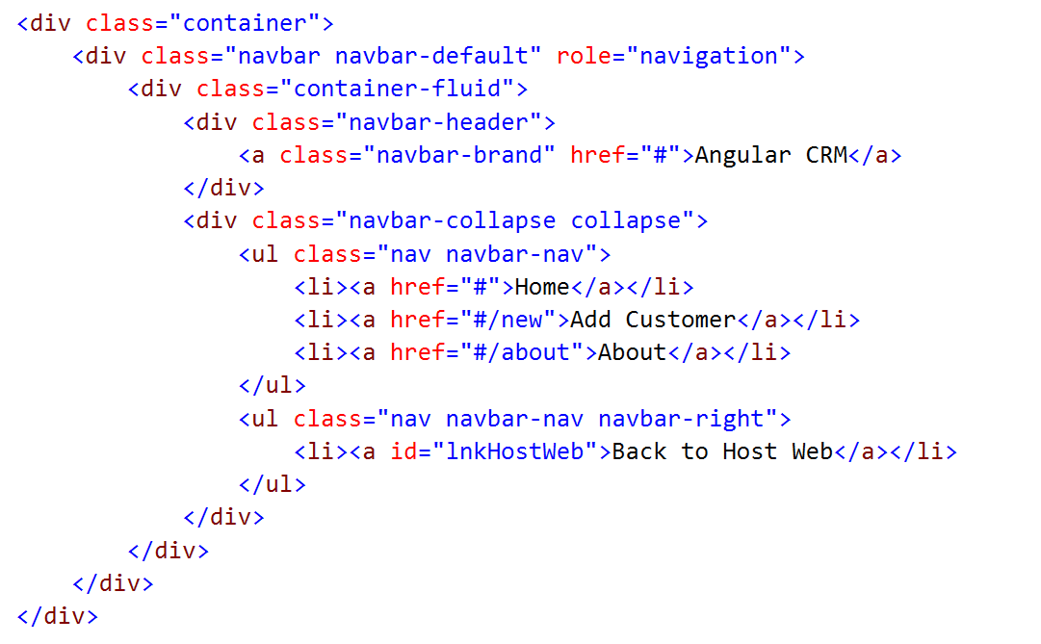
Creating a Navbar using Bootstrap
To create a navbar like this…..
You add HTML like this with bootstrap classes applied
Notes:
Here is a simple example of creating a navbar using bootstrap.
Note the use of the container class. Bootstrap requires a containing element to wrap site contents and house our grid system. You may choose one of two containers to use in your projects. Note that, due to padding and more, neither container is nestable.
Use .container for a responsive fixed width container.
<div class="container">
</div>
Use .container-fluid for a full width container, spanning the entire width of your viewport.
<div class="container-fluid">
...
</div>

Slide 34
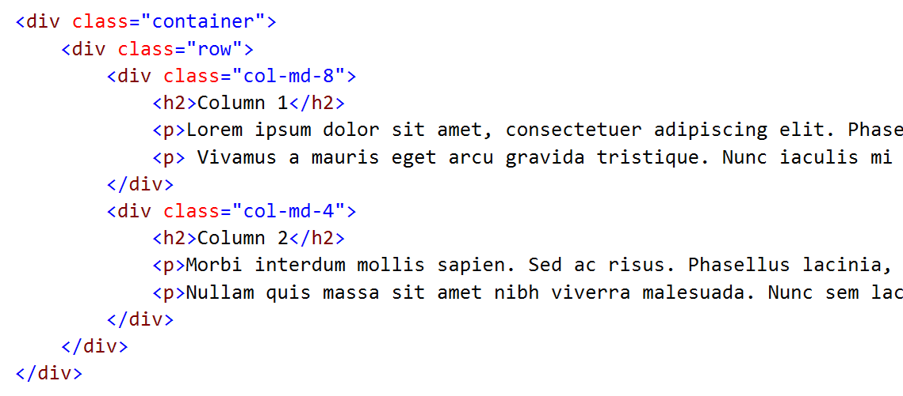
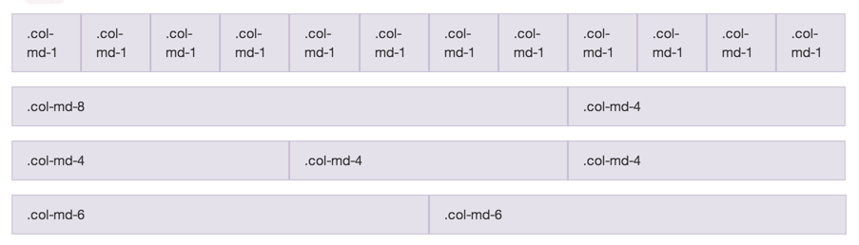
Grid Layout
Notes:
One of the most valuable aspects of Bootstrap is that it employs a grid system which makes it possible to layout page elements in terms of columns. What's really nice is that the columns collapse in an elegant fashion on smaller devices such as mobile phones.

Slide 35
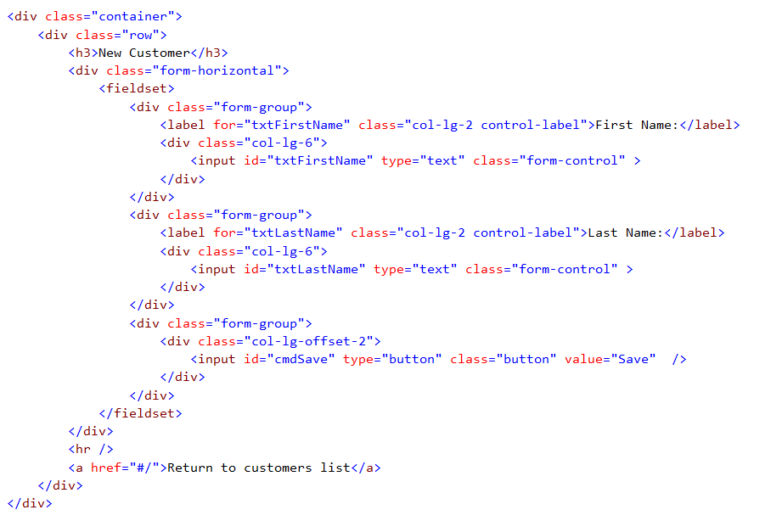
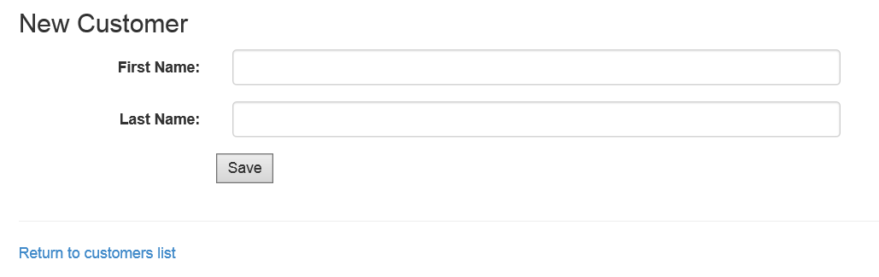
Bootstrap Forms
Notes:
Bootstrap also provides CSS classes for forms and form controls which can be used to create user interface experiences that work on both standard browsers and mobile devices alike.

Slide 36
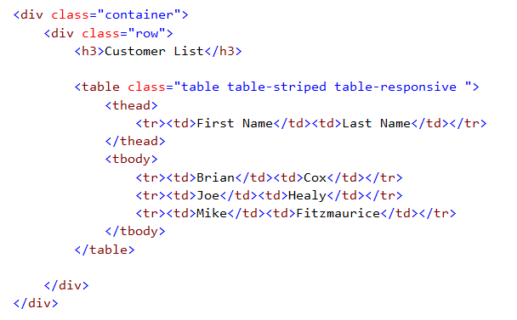
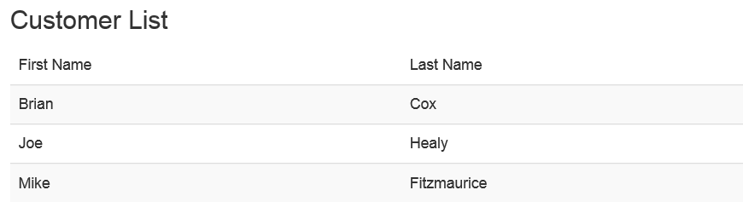
Bootstrap Table Classes
Notes:
Bootstrap provides a convenient set of CSS classes such as table, table-striped and table-responsive.

Slide 37
Installing the Bootstrap Package in a SharePoint-hosted App Project

Slide 38
Summary
Introduction to SharePoint Apps
Overview of App Development
Developing SharePoint Apps using Visual Studio
Working with Bootstrap and NuGet packages

