Slide 1
App Security and Authentication
Notes:
This module examines how to develop provider-hosted apps with a server-to-server (S2S) trust in a SharePoint 2013 on-premises environment. Student will learn how to create a test certificate and how to configure an S2S trust. Student will also learn how to create a provider-hosted app project that uses an S2S trust which makes it possible to execute authenticated web service calls back to the SharePoint host environment. The module also includes a discussion of using the TokenHelper class to create access tokens and pass them to the SharePoint host when making authenticated calls.

Slide 2
Agenda
App Security Overview
Configuring App Permissions
Understanding App Security Principals
Server-to-Server (S2S) Trust Configuration
Programming with Access Tokens
App Authentication using OAuth

Slide 3
Security Problems in SharePoint 2010
Code in farm solutions considered fully-trusted
By default, code runs with permissions of current user
Developer can call SPSecurity.RunWithElevatedPrivledges
Code runs as all-powerful SHAREPOINT\SYSTEM account
Code reverts to Windows identity of host application pool
Sandbox solution code runs as current user
Code always runs with permissions of current user
Activation code runs as site administrator
No ability to elevate permissions if user is visitor
Notes:
Code in a farm solution is considered to be fully-trusted. That means the code a developer writes in a farm solution runs with permissions of current user by default. However, a developer can call the method named SPSecurity.RunWithElevatedPrivledges which allows the code in a farm solution to run as all-powerful SHAREPOINT\System account. From the perspective of the Web server, the code reverts to Windows identity of host application pool which can be a powerful technique but it required a very high level of trust.
Code in sandboxed solutions always runs as current user. This means that the code in a feature activation event handler runs with permissions of the activator which is usually the site administrator or site collection owner. Therefor, this code which runs during activation can read/write any content in current site collection. Other code such as the server-side code behind a Web Part runs with the permissions of the current user. There is no way for the developer to elevate permission or impersonate a different user.

Slide 4
Let’s start with a basic question
What is a security principal?
An entity that is understood by a security system
An entity for which you can configure authorized access to resources
Examples of security principals
User with an account in Active Directory
User with account in another identity management system (FBA)
Active Directory group or an FBA role
Computer which has been added to an Active Directory domain
SharePoint app (as of SharePoint 2013)

Slide 5
Authentication and Authorization
Authentication creates identity for principal
SharePoint 2010 only supports user authentication
SharePoint 2013 adds support to authenticate apps
SharePoint apps are given first class identities
Authorization provides the access control
Used to verify an principal has the proper permission
SharePoint 2010 only supports user permissions
SharePoint 2013 adds support for app permissions
Notes:
The two most basic concepts in computer security are authentication (AuthN) and authorization (AuthZ). Authentication is a process which answers the basic question "who are you". Authorization answers the basic question, "what can you do".
Authentication used to create identity for security principal. SharePoint 2010 supports authenticating users. However, SharePoint 2013 adds support to authentication Apps in addition to users. This means that Apps in SharePoint 2013 are given first class identities.
SharePoint provides an authorization infrastructure which allows privileged users configure access control for other users and apps to access SharePoint sites and the elements inside them such as pages and documents. SharePoint 2013 tracks user permissions using access control list (ACL) entries stored in the content database. SharePoint also tracks permissions for Apps but not in the same way that it does for user permissions.

Slide 6
App Authentication in SharePoint 2013
SharePoint 2013 supports App Authentication
Apps promoted to first class security principals
App authentication makes it possible for app authorization
App authentication only supported in CSOM / REST API endpoints
App authentication not supported in custom web services
SharePoint 2013 uses 3 basic types of app authentication
Internal authentication
External authentication using Server-to-Server (S2S) Trusts
External authentication using OAuth

Slide 7
Internal Authentication
Internal authentication is used if the following are true
Incoming call targets a CSOM or REST API endpoint
Incoming call carries claims token with established user identity
Incoming call targets URL of an exiting app web
Important points about using internal authentication
It just works – no need to program in terms of access tokens
It’s always used with client-side calls from pages in the app web
It can be used from remote web pages using cross domain library
It does not support app-only authentication to elevate privledge

Slide 8
External Authentication
In which scenarios does external authentication occur?
When server-side code in the remote web issues CSOM or REST API calls against the SharePoint host
Incoming calls free to target host web and other sites in tenancy
How does it work?
App code must written to create and manage access tokens
Access token carries app identity
Access token can (and usually does) carry user identity as well
App must transmit access token when calling to SharePoint

Slide 9
SharePoint 2013 Authentication Flow
Notes:
When SharePoint 2013 begins to authenticate an incoming request, it first looks to see if the incoming request contains a SAML token with a user identity. If the SharePoint 2013 authentication pipeline finds a SAML token, it can then assume that the incoming request was initiated by a user and not an app. Once it finds a SAML token, SharePoint 2013 then inspects the target URL of the incoming request to see whether it references a standard SharePoint site or a child site associated with a specific app (i.e. an AppWeb). If the incoming request targets a standard site, SharePoint 2013 conducts its authentication and authorization identically to how things worked in SharePoint 2010. If the incoming request targets an AppWeb, SharePoint 2013 initializes the call context with both a user identity and an app identity.
When an incoming request does not contain a SAML token, SharePoint 2013 knows that a user did not initiate the request. In this scenario, the SharePoint 2013 authentication pipeline inspects the incoming request to see if it contains a security token identifying a provider-hosted app. The security token for an app can be created using OAuth when Office 365 and ACS is involved. If the security token for an app was created in a server-to-server (S2S) configuration, it will be similar to but slightly different from a valid OAuth token. Once SharePoint 2013 finds a security token identifying an app, it sets up call context with the app identity and optionally the user identity as well.

Slide 10
Agenda
App Security Overview
Configuring App Permissions
Understanding App Security Principals
Server-to-Server (S2S) Trust Configuration
Programming with Access Tokens
App Authentication using OAuth

Slide 11
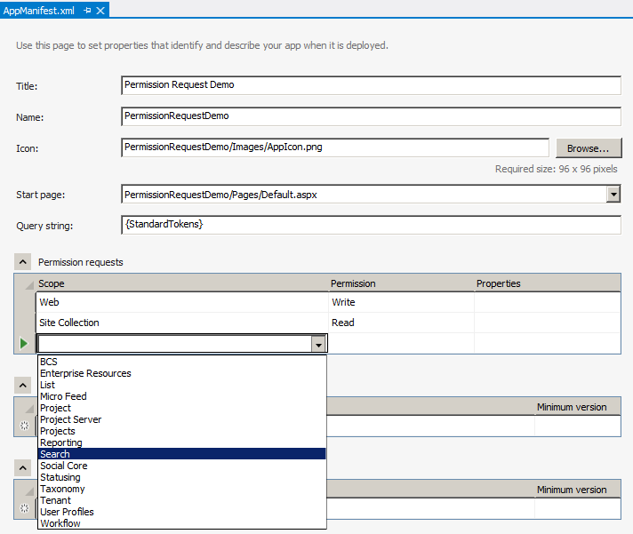
Adding Permission Requests
Permissions requests are added to app manifest
App manifest designer makes this relatively easy
<AppPermissionRequests>
<AppPermissionRequest
Scope="http://sharepoint/content/sitecollection/web"
Right="Write" />
<AppPermissionRequest
Scope="http://sharepoint/content/sitecollection"
Right="Read" />
</AppPermissionRequests>
Notes:
This slide shows an example of the XML required to add permission requests to an app manifest. Note that app permission requests can allow app-only policy which means that only the app and not the current user requires the needed permissions. If app-only policy is not used, then both the app and the current user require the necessary permissions to complete a task such as adding an item or creating a list. An important aspect of app-only policy is that it can elevate the permissions of the app so it can do more than the current user. It also makes it possible for an app to call in to SharePoint and access the app web or host web when there is no current user.

Slide 12
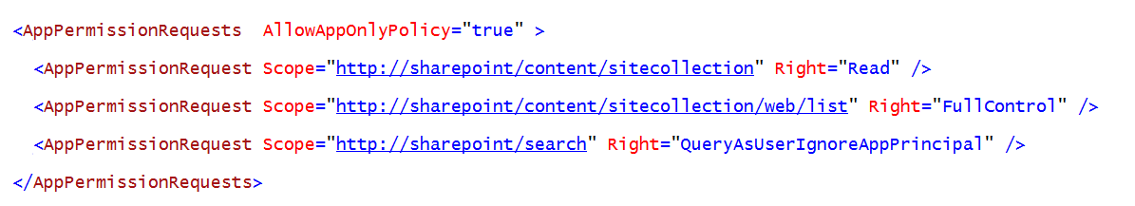
App-Only Permissions
Used for two key scenarios
To call into SharePoint with permissions greater than the current user (elevation)
To call in to SharePoint when there is no current user
Steps to accomplish this
Add AllowAppOnlyPolicy to AppManifest.xml
Write code to acquire an app only access token

Slide 13
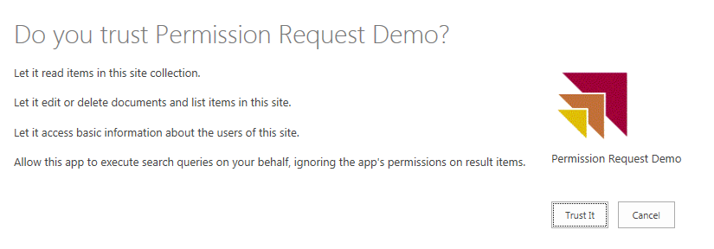
Granting Consent in SharePoint 2013
User prompted to trust the app during installation
Trust It grants requested permissions to app
Cancel prevents app from being installed
Notes:
When a user installs an app that requests permissions beyond the standard default permissions, SharePoint 2013 shows the installing user which permissions have been requested and also prompts the installing user to select either Cancel or Trust It. . If the installing user grants permissions, the app is installed and SharePoint tracks that the app has these additional permissions. If the installing user denies the permission requests, SharePoint does not install the app. A key point here is that an app is never installed with a partial set of permissions. It either gets installed with the permissions it needs or it does not get installed.

Slide 14
Adding Permissions Request to the App Manifest

Slide 15
Agenda
App Security Overview
Configuring App Permissions
Understanding App Security Principals
Server-to-Server (S2S) Trust Configuration
Programming with Access Tokens
App Authentication using OAuth

Slide 16
App Principals
External authentication requires app principals
App principal is a tenancy-scoped account for app identity
App principal identified using a GUID
App principals must be created in SharePoint host
App principal properties
Client ID: GUID-based identifier for app principal
Client Secret: (not used in S2S)
App Host Domain: Base URL of remote web
Redirect URL: URL to a page used to configure on-the-fly security

Slide 17
Managing App Principals in Office 365
Get to know the built-in app management pages
AppRegNew.aspx
AppInv.com
AppPrincipals.aspx
There is also management support using PowerShell
Use PowerShell cmdlets to administer SharePoint apps and app principals

Slide 18
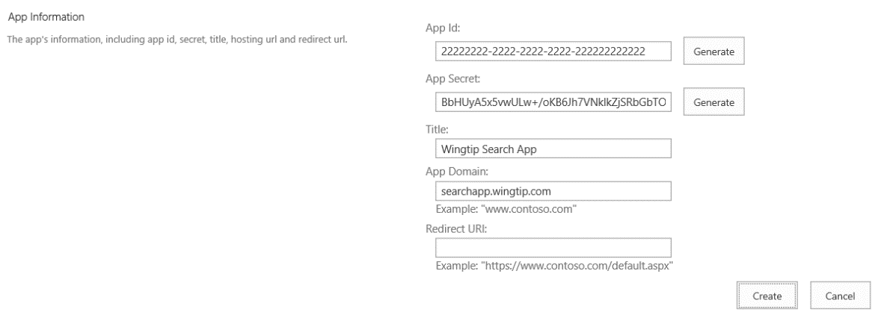
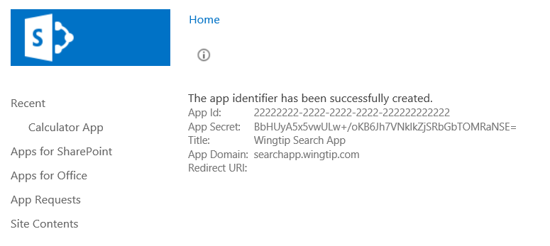
Registering an App Security Principal
Done automatically by Visual Studio during development
When you press {F5}, VS automatically registers app principal
Visual Studio also updates web.config file
Can also be done using AppRegNew.aspx page
App deployment covered in more detail in App Publishing module

Slide 19
Registering an App Principal

Slide 20
Agenda
App Security Overview
Configuring App Permissions
Understanding App Security Principals
Server-to-Server (S2S) Trust Configuration
Programming with Access Tokens
App Authentication using OAuth

Slide 21

What is a Server-to-server (S2S) Trust
Trusted connection between app and SharePoint
Eliminates need for ACS when running apps in on-premises farm
Trust between servers configured using SSL certificates
App code requires access to private key of SSL certificate
Requires creating Security Token Service on SharePoint server(s)
On-premises Farm
SharePoint Web Server
S2S STS
1
User
3
4
2
Client App
SSL Cert
Public/Private key pair (.pfx)
Notes:
SharePoint 2013 makes it possible for Web servers in a SharePoint farm to a client app requests using a server-to-server (S2S) trust. This type of configuration can be used when deploying developer-hosted apps in a private network when it is beneficial to avoid any dependencies on ACS or any other servers running across the Internet. That means that all the servers involved can run behind a single firewall and on the same local area network.
A S2S trust represents a trusted connection between a client app running on a local app server and the Web servers in the SharePoint farm. Configuring the trust requires an SSL certificate which is based on the URL with the DNS name (e.g https://appserver.wingtip.com) where the client app is located. The client app contains code which has access to the private key associated with the SSL certificate and it uses this private key to sign security tokens. On the SharePoint Web Server, you must create a security token service which can use the public key to authenticate and decrypt these security tokens generated by the client app.

Slide 22
Why Is It Called a “High Trust” App
App must authenticate the user
App passed user identity to SharePoint farm with user identity
SharePoint farm trusts that the app is telling the trust about user identity
“High Trust” is very different from “Full Trust”
Full trust code is not limited by permissions – it can do anything
High trust app has set of permissions that say what it can do

Slide 23
Architecture of an S2S Trust
App has x.509 certificate with public/private key pair
Private key used to sign certain aspects in access token
Public key registered with SharePoint farm
This creates a trusted security token issuer
App creates access token to call into SharePoint
App creates access token with a specific client ID and signs it with private key
Trusted security token issuer validates signature
SharePoint establishes app identity
App identity maps to a specific client ID
You can have many client IDs associated with a single x.509 certificate

Slide 24
Configuring a Server-to-Server Trust
Steps to configure an S2S trust
Create an x509 certificate
Make certificate’s public key accessible to SharePoint
Use PowerShell to create a trusted security token issuer based on public key
Develop provider-hosted app which has access to private key file
Create S2S access tokens with the help of TokenHelper class
Pass access token with calling into SharePoint using CSOM or REST API
Two ways to make a certificate available
Pass file path of certificate to SharePoint
Expose certificate from app as metadata endpoint

Slide 25
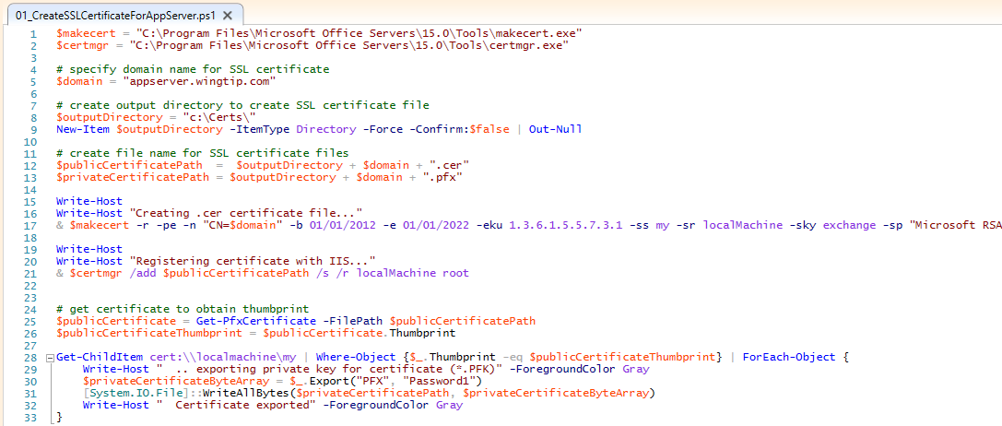
Creating Certificates
Notes:
This is an example of a PowerShell script that creates a self-signed SSL certificate for an app running at the DNS name of http://appserver.wingtip.com. The self-signed certificate is made by calling the makecert.exe utility. Note that the script creates the self-signed certificate with a private key. This certificate is then installed into the certificate store on the local machine using the certmgr.exe utility. The code at the bottom of the script shows how to enumerate through the SSL certificates stored on the local machine and to find those that have private keys. The call to Export is what produces a private key file that is signed with the password of Password1.

Slide 26
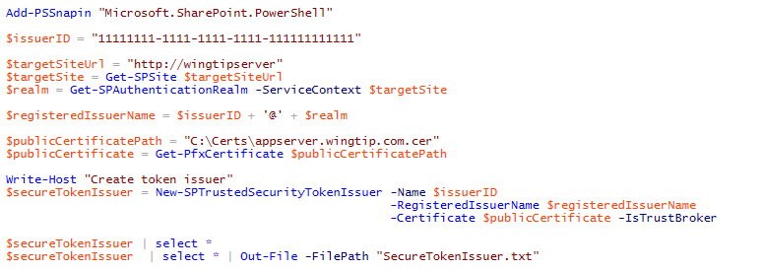
Creating the Secure Token Issuer
Steps to creating security token issuer in SharePoint farm
Get the authentication realm (aka tenancy)
Create realm-qualified app identifier
Create certificate object using .pfx file containing password-protected private key
Call New-SPTrustedSecurityTokenIssuer
Notes:
To configure an S2S high trust connection in an on-premise SharePoint farm, you must use Windows PowerShell and SharePoint 2013 cmdlet named New-SPTrustedSecurityTokenService. When you call the New-SPTrustedSecurityTokenService cmdlet ou mus pass it a string-based name and the URL to the metadata discovery endpoint for the app. SharePoint then uses the metadata in the JSON token returned from the metadata discovery endpoint to properly create the new STS configured with the correct public key.
After creating the S2S trust between the client app and the SHarePoint Web servers, it is then required to register one on more app principals using the Register-SPAppPrincipal cmdlet. Note that app principals are scoped to a tenancy. If all the sites in the on-premise local farm are running within the default tenancy, you can create a single farm-wide app principal.
Once you have create the app principal, you can then assign permissions to it using the Set-SPAppPrincipalPermission cmdlet.

Slide 27
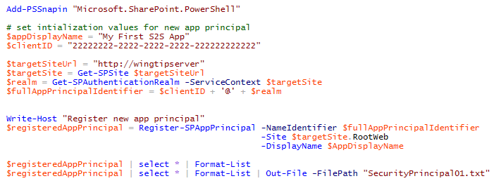
Creating an S2S App Principal
Can be done several different ways
Use built-in page named AppRegNew.aspx
Use Register-SPAppPrincipal
Use SPAppPrincipalManager
Let Visual Studio do it for you when developing

Slide 28
Configuring a Secure Token Issuer

Slide 29
Agenda
App Security Overview
Configuring App Permissions
Understanding App Security Principals
Server-to-Server (S2S) Trust Configuration
Programming with Access Tokens
App Authentication using OAuth

Slide 30
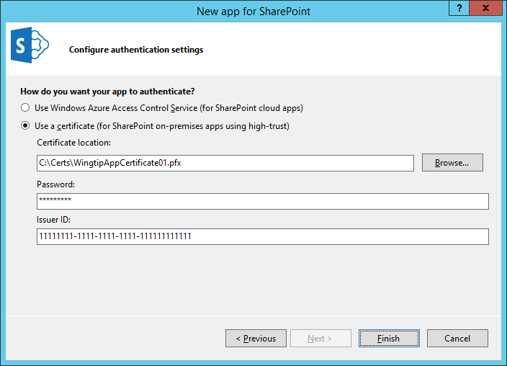
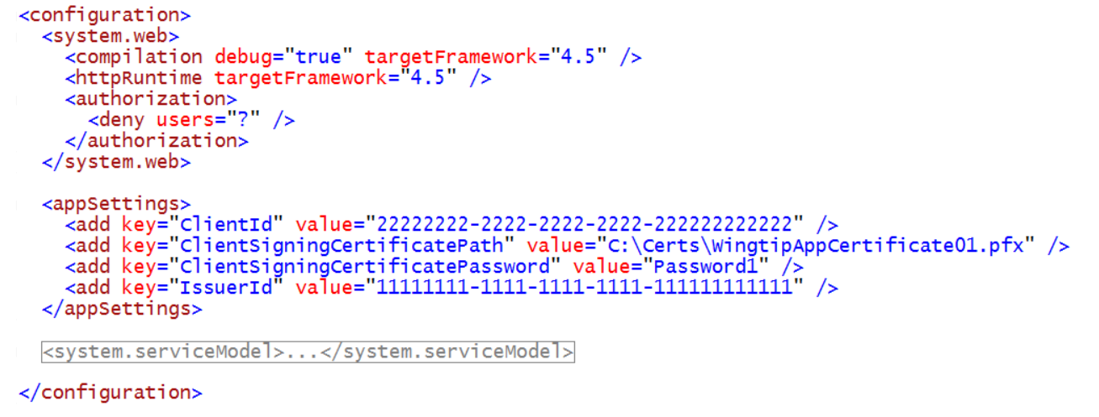
Configuring the S2S Certification in VS
Visual Studio provides two app authentication options
Use Windows Azure Access Control Service (this means OAuth)
Use a certificate (this means S2S)

Slide 31
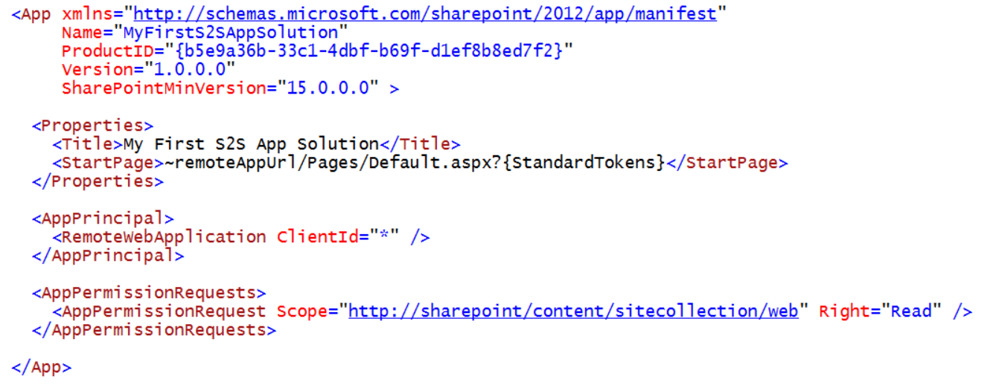
App Manifest during Development

Slide 32
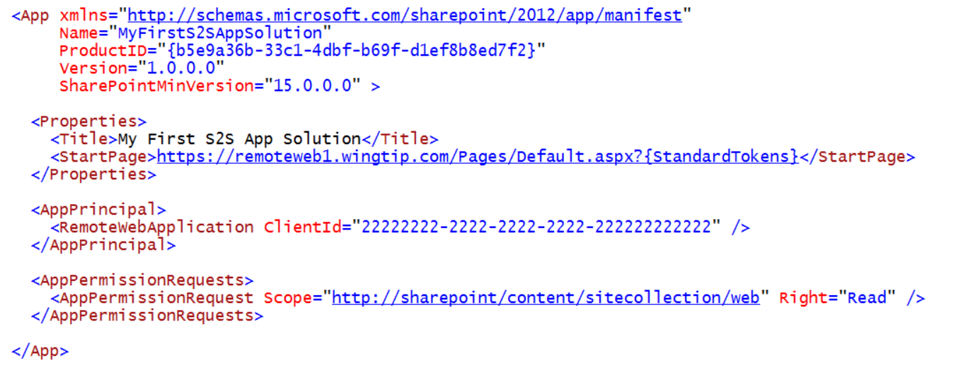
App Manifest in Real-world Deployment

Slide 33
Developing Apps that use S2S Trusts
What is developer responsible for with S2S app?
Authenticating the user (can use Windows Auth, FBA, etc.)
Create access tokens
Send access tokens with every CSOM and REST call
What's an S2S access token?
S2S access token created using format in OAuth2 specification
S2S access token contains app identity (client ID)
S2S access token contains issuer identity (issuer ID)
S2S access token can optionally include user identity
S2S access token must be signed using PFX key of SSL certificate
Notes:
There are several responsibilities for the developer when creating an S2S app. First, you must deploy the Web project that contains the implementation of the client app itself. Next, the client app must be configured to perform its own user authentication. This can be done using any supported style of authentication including Windows Integrated Authentication, Basic Authentication, FBA, etc. Finally, the client app must create its own security tokens and sign them with the private key associated with the SSL certificate.
Create security tokens to send to SharePoint server
Note that the security token created by a client app in the S2S trust scenario is like OAuth token but it differs from the OAuth specification in a few different ways. The security token created by a client app in an S2S trust must contain information about app identity. The security token created by a client app in an S2S trust usually contains information about the identity of the current user but this is not a requirement. Once the security token it created with the required information inside, it then must be signed with the private key before it is sent to the SharePoint server. This private key signing is what allows the SharePoint server to perform the authentication on calls originating from the client app.

Slide 34
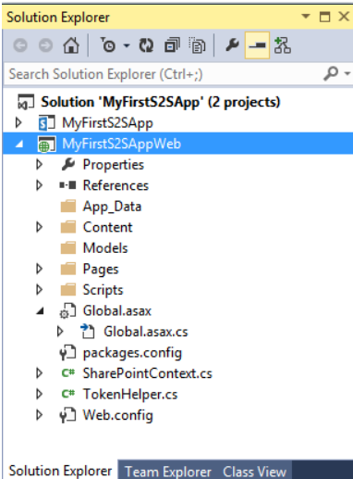
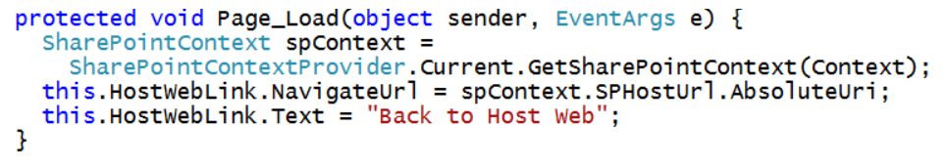
Programming with Access Tokens
Visual Studio adds two utility helpful classes
TokenHelper (it's been around since VS 2012)
SharePointContext (this is new with Visual Studio 2013)

Slide 35
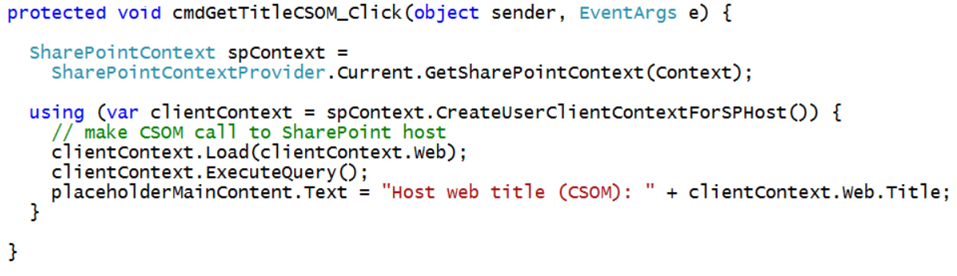
CSOM Calls using S2S Authentication
TokenHelper class has methods specific to S2S
SharePointContext has methods that are not S2S-specific

Slide 36
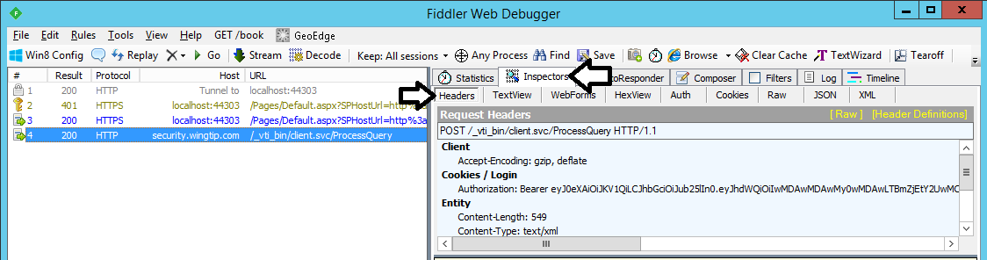
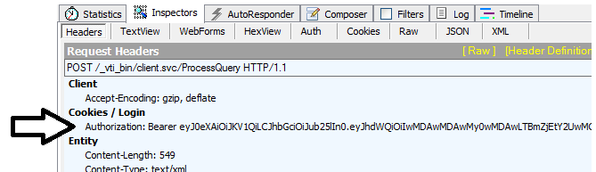
Examining S2S CSOM Calls using Fiddler

Slide 37
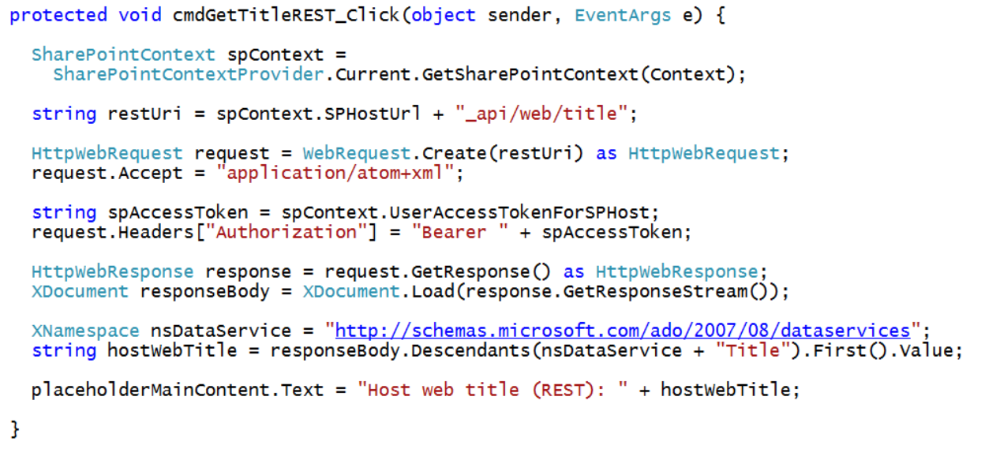
REST Calls using S2S Authentication
Authorization header must be added explicitly

Slide 38
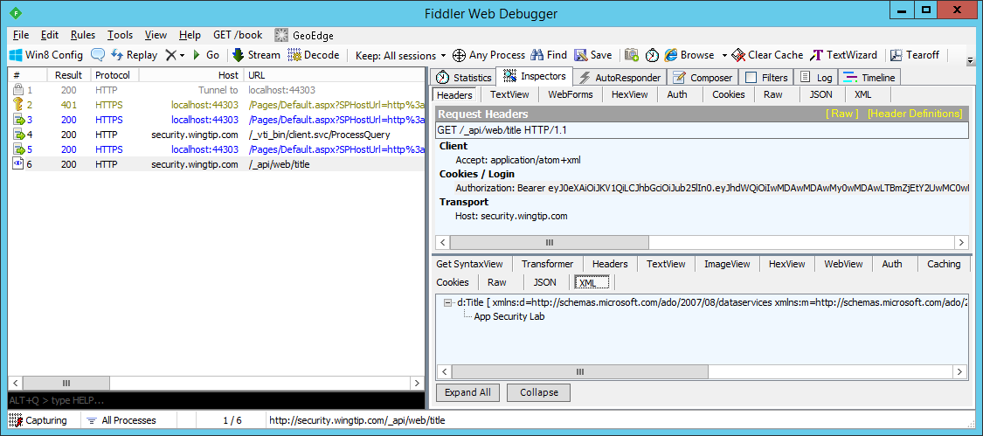
Examining S2S REST Calls using Fiddler

Slide 39
Creating a Provider-hosted App which uses S2S Authentication

Slide 40
Agenda
App Security Overview
Configuring App Permissions
Understanding App Security Principals
Server-to-Server (S2S) Trust Configuration
Programming with Access Tokens
App Authentication using OAuth

Slide 41
What is OAuth?
Open standard for authorization (not authentication)
Allows delegated access to server APIs on behalf of a user
Does NOT require user to provide credentials
Implemented through tokens, which are issued by authorization servers

Slide 42
Why is OAuth important?
Internet applications live in different domains and have different authentication systems.
A standard is needed to support delegated access to allow interoperability.
SharePoint 2013 utilizes OAuth when a provider-hosted app using server-side code to access the host web.

Slide 43
OAuth Protocol Flow in SharePoint 2013
1
SharePoint authenticates user using claims
Content Server
SharePoint 2013
Web Server
2
SharePoint requests context token for user
2
3
ACS returns context token
1
4
SharePoint pass context token to User
User
desktop computer
laptop computer
mobile device
tablet or iPad
4
3
Authentication Server
Trusted ACS server that authenticates applications and creates OAuth tokens
5
User POSTS to app passing context token
6
Client app is able to pull refresh token out
of context token. Client app then passes
refresh token to ACS to request OAuth token
8
9
7
ACS returns OAuth token to client app
5
Client App
Web Server running remote app code
6
8
Client App makes CSOM/REST calls to SharePoint site passing OAuth token
10
7
9
SharePoint returns site content to app
10
Client App returns HTML to user device

Slide 44
Security Tokens used in OAuth
Context Token
Contextual information passed to app
Refresh Token
Used by client app to acquire an access token
Access Token
Token passed to SharePoint to app when using external authentication
Authorization Code
Used to register an app with on the fly permissions

Slide 45
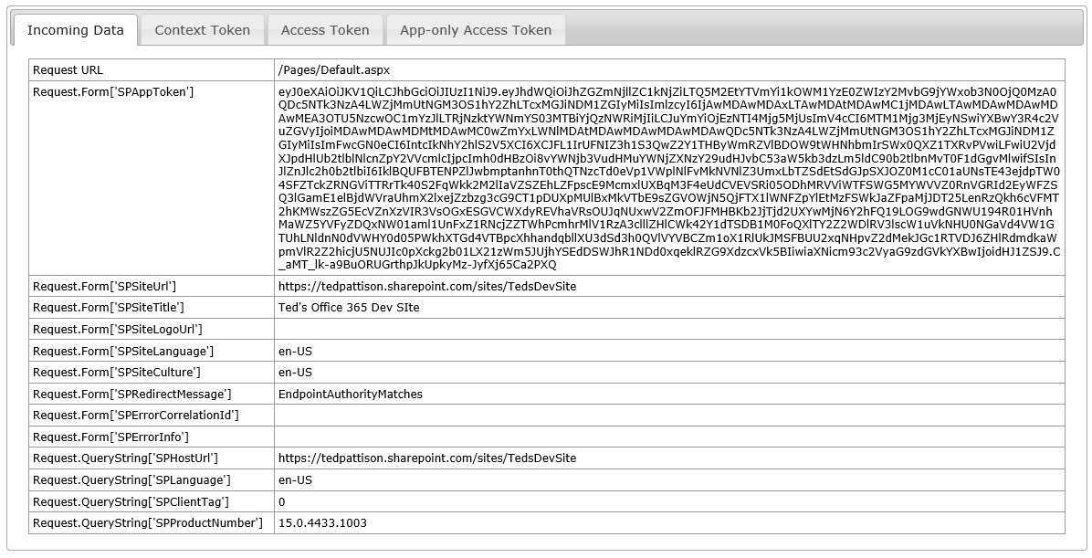
POST Data Sent to Start Page

Slide 46
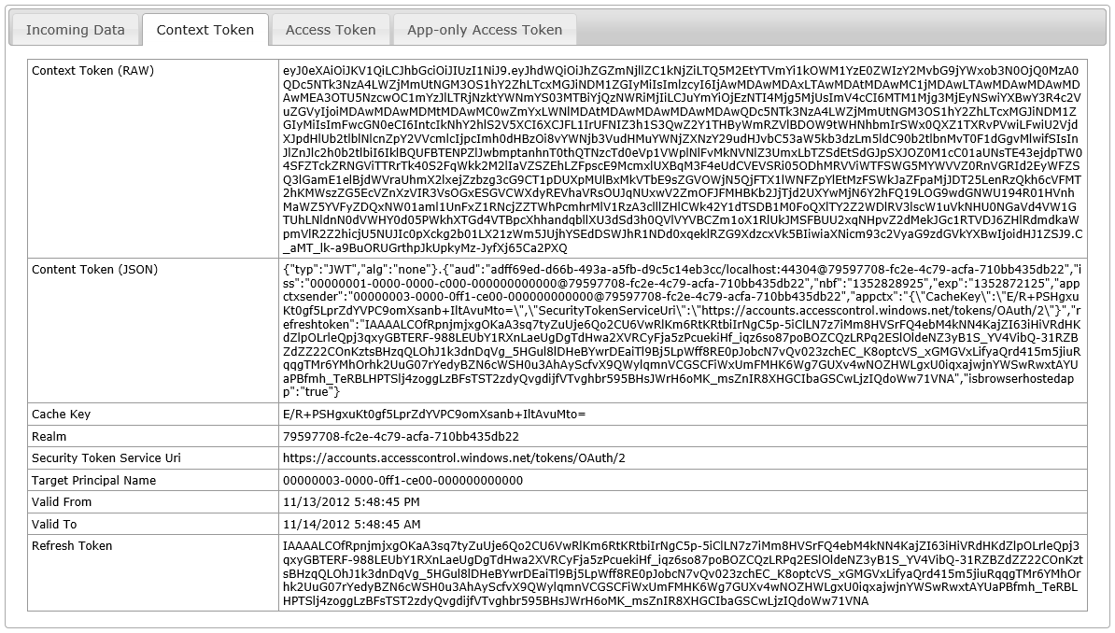
Context Token

Slide 47
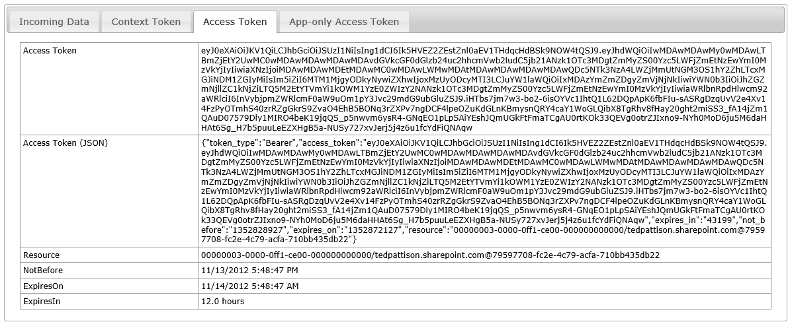
Access Token

Slide 48
Summary
App Security Overview
Configuring App Permissions
Understanding App Security Principals
Server-to-Server (S2S) Trust Configuration
Programming with Access Tokens
App Authentication using OAuth

