Slide 1
JavaScript and jQuery Primer
Notes:
This modules begins by reviewing essential concepts and syntax for JavaScript programming including working with functions, object, closures, prototypes and modules. Students will also be given a quick primer on leveraging the jQuery library to achieve higher levels of productivity when programming with JavaScript. The last section of this module discusses how to create more sophisticated user interface designs using the jQuery UI library.

Slide 2
Agenda
JavaScript Programming
Writing Reusable JavaScript Libraries
The jQuery Library
Developing with the jQuery UI Library

Slide 3
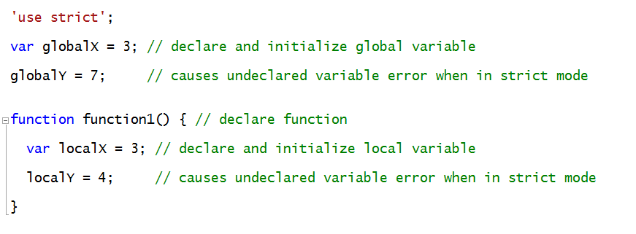
js101
JavaScript Language Fundamentals
Language is case sensitive
Use of semicolons is optional but usually recommended
Variables should be declared using var keyword
Develop code using strict mode by adding 'use strict‘

Slide 4

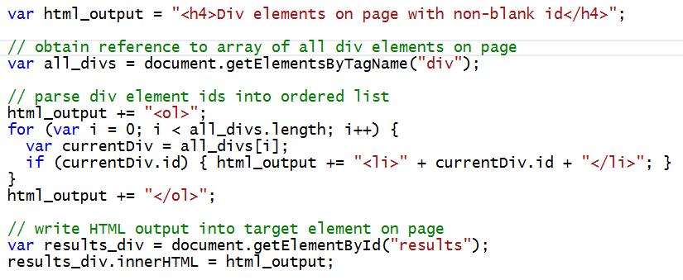
Document Object Model (DOM)
JavaScript in browser has access to DOM
DOM represents tree of HTML elements on page
document provides read/write access to DOM elements

Slide 5
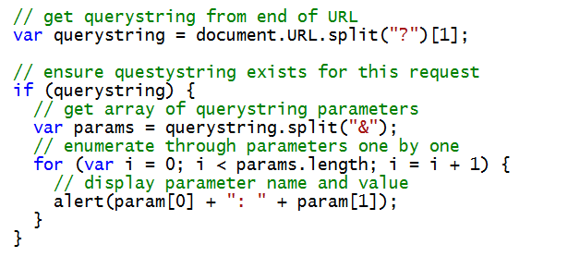
Reading Query String Parameters
DOM exposes query string parameters
Query string read from end of URL
Use string.split() function to return arrays

Slide 6
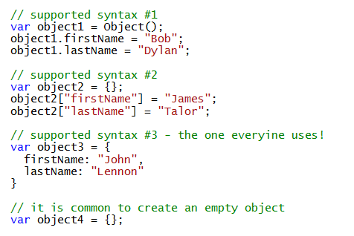
JavaScript Objects
An object is a collection of dynamic properties
Properties created as name-value pairs
Properties created on the fly as needed
Very different from class-oriented programming in C#
Become familiar with this syntax

Slide 7
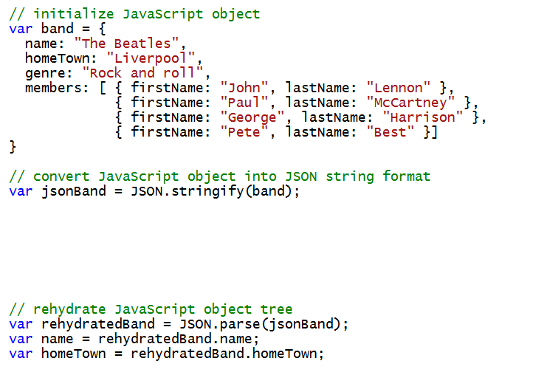
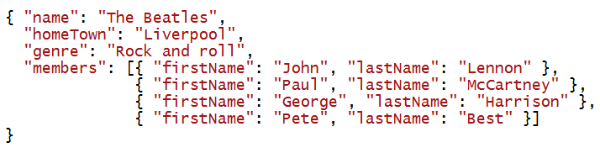
JSON – JavaScript Object Notation
JSON used to serialize JavaScript objects
JSON based on string serialization format
Commonly used to move data across network
Convert between formats using JSON.stringify and JSON.parse

Slide 8
Exploring the jsFiesta App Project

Slide 9
Agenda
JavaScript Programming
Writing Reusable JavaScript Libraries
The jQuery Library
Developing with the jQuery UI Library

Slide 10
Writing Reusable Libraries
JavaScript patterns for reusable libraries
Immediately-Invoked Function Expressions (IIFE)
Closures
JavaScript Namespaces
Modules

Slide 11
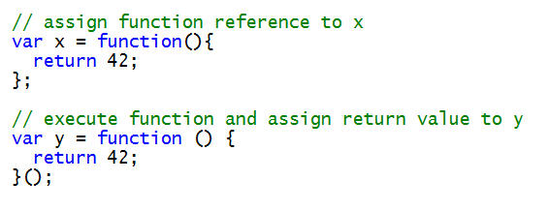
Immediately-Invoked Function Expressions (IIFE)
Advanced syntax used in modular code
Created by placing () after anonymous function
After the code shown above runs…
x = function(){return 42;};
y = 42
The parenthesis make this a self-executing function

Slide 12
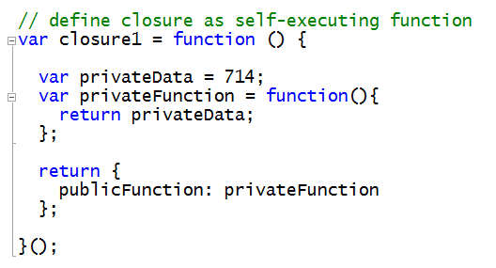

Closures
Closures used to encapsulate private implementation
Closure is IIFE which returns object
Local variables inaccessible outside of closure function
Closure function returns object with public interface

Slide 13
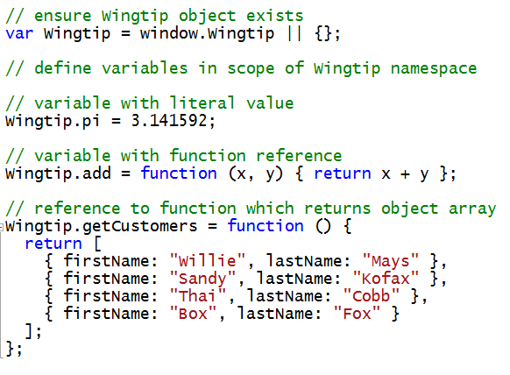
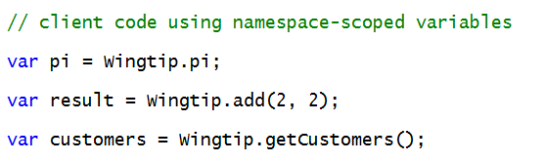
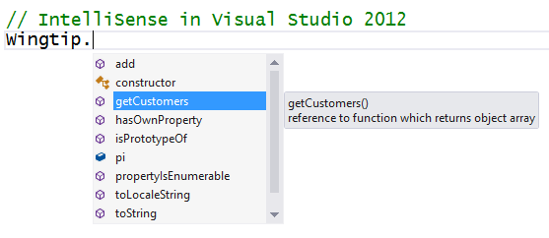
JavaScript Namespaces
JavaScript Namespaces are important
Allows you to avoid creating global variables
Named objects serve as namespace containers
Supported by Visual Studio IntelliSense

Slide 14
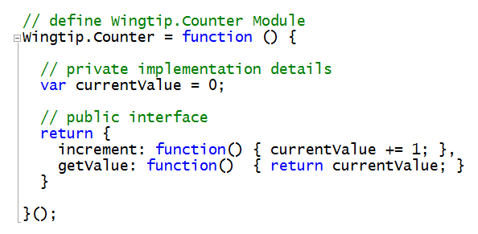
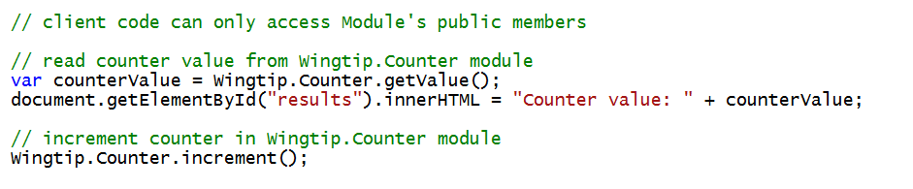
Designing Libraries using Modules
Module created using a JavaScript closure
Module function returns object with public interface
Local variables of Module function are hidden
Local variables track private implementation details

Slide 15
Working with JavaScript Modules

Slide 16
Agenda
JavaScript Programming
Writing Reusable JavaScript Libraries
The jQuery Library
Developing with the jQuery UI Library

Slide 17

jQuery Fundamentals
jQuery deigned to hide browser differences
Eliminates need to write browser-specific code
your code can target wide variety of browsers
jQuery focuses on 2 main things
Retrieving sets of elements from HTML pages
Performing operations on these sets of elements

Slide 18
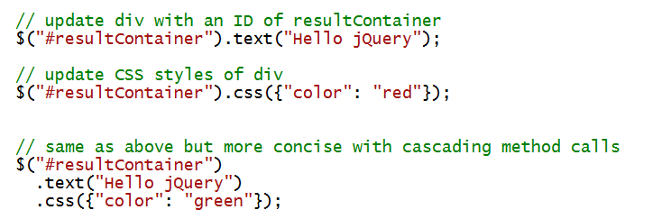
Hello World Revisited – The jQuery Edition
jQuery makes DOM programming much easier
Syntax more concise than raw DOM programming

Slide 19
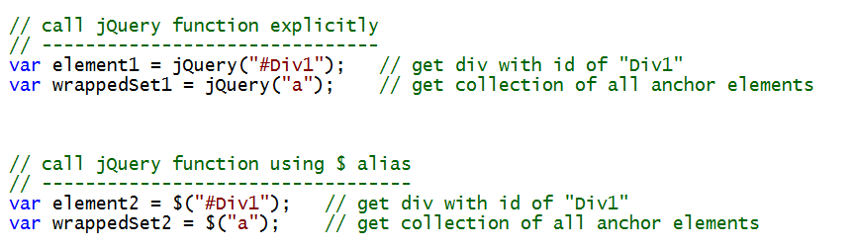
jQuery Function
jQuery library defines jQuery as a global function
Execution of jQuery function returns a jQuery object
$ symbol can be used as alias for jQuery function

Slide 20
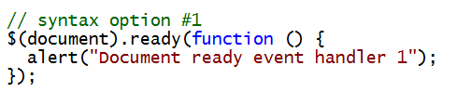
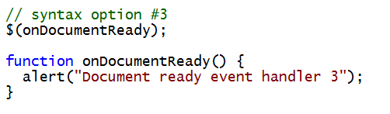
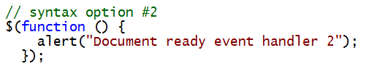
The Document Ready Event Handler
jQuery provides document ready event handler
Executed when DOM document is ready for access
Several different styles of syntax supported
Avoids problems associated with window.onload
Does not wait on all images and resources to download
Designed to supports registering multiple handlers

Slide 21
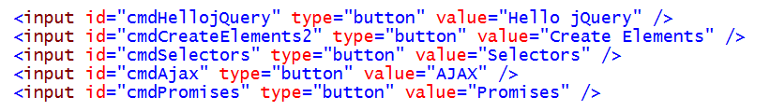
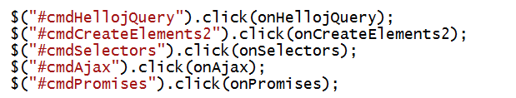
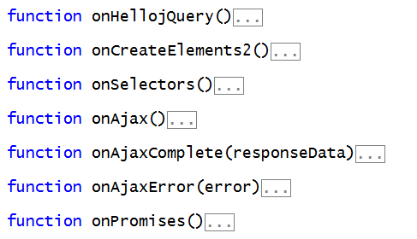
jQuery Event Handlers
Event handlers bound using jQuery functions
click()
live()
on()

Slide 22
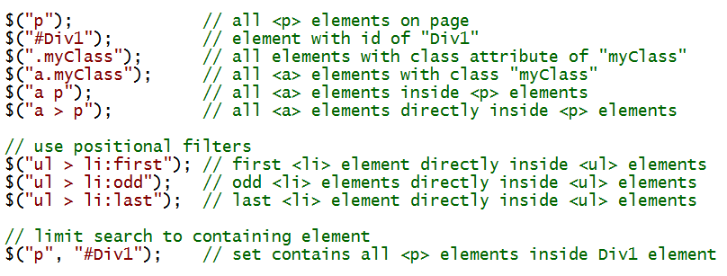
jQuery Selectors
Element retrieval based on Selectors
jQuery leverages familiar CSS selector syntax
Supports CSS3 selectors even in non-CSS3 browsers
jQuery function takes second parameter for container

Slide 23
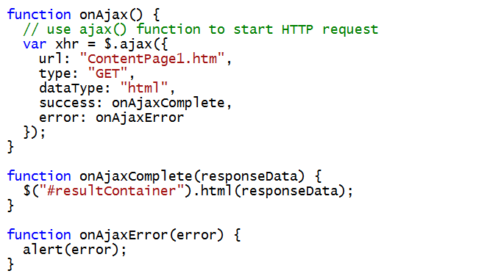
AJAX Calls Across the Network
jQuery provides $.ajax() function
Calls to $.ajax() function are asynchronously
Callback methods can be used to process returned data

Slide 24
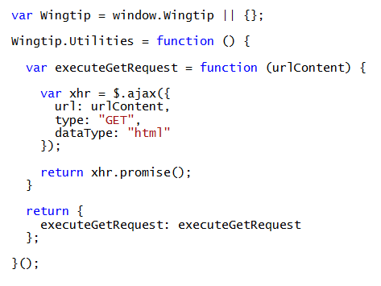
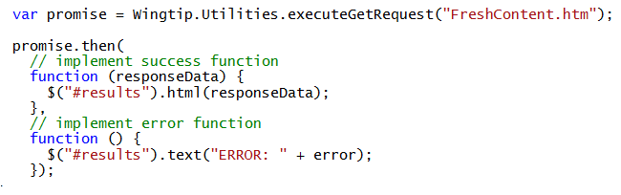
Promises and Deferred Objects
jQuery provides support for async programming
Promise object (e.g. xhr) represents work in progress
When work is done, promise object notifies deferred objects
Promises provide more flexibility than using simple callbacks
Reusable code in Wingtip.Utilities Module
Consumer code in app which uses Wingtip.Utilities module

Slide 25
Writing Code using the jQuery

Slide 26
Agenda
JavaScript Programming
Writing Reusable JavaScript Libraries
The jQuery Library
Developing with the jQuery UI Library

Slide 27
jQuery UI Widgets
Buttons and buttonsets
Sliders
Progress bars
Auto completers
Date Pickers
Tabs
Accordion
Dialog Box

Slide 28
Adding UI elements with jQuery UI

Slide 29
Summary
JavaScript Programming
Writing Reusable JavaScript Libraries
The jQuery Library
Developing with the jQuery UI Library

