Slide 1
Developing SharePoint Apps using Knockout
Notes:
This module introduces the concepts and techniques involved in using the Model-View-ViewModel (MVVM) pattern in SharePoint apps development. Students will learn how to use the MVVM pattern to make the JavaScript code in large SharePoint development projects easier to manage and update over time. Students will also learn to use MVVM together with the Knockout JavaScript library to create SharePoint apps that leverage declarative bindings and templating support.

Slide 2
Agenda
Understanding the MVVM Pattern
Introduction to the Knockout JavaScript Library
Understanding Observable Objects
Creating Declarative Bindings
Creating SharePoint Apps using Knockout

Slide 3
What is MVVM?
MVVM = Model - View - ViewModel
MVVM is a software pattern - not a specific technology
Based on a separation of concerns
Used to promote maintainability in larger projects
Used to facilitate unit testing in larger projects

Slide 4
MVVM in JavaScript Development
MVVM based on three components
View - HTML and JavaScript to create user interface
ViewModel - provides view with access to data
Model – pure JavaScript objects with data and behavior
SharePoint
List Data
View
ViewModel
Model

Slide 5
MVVM Components
View
View calls to ViewModel functions to query and update data
ViewModel
ViewModel provides View with functions to query and update data
Purpose of ViewModel is to isolate data access details from View
ViewModel returns results based on schema defined by Model
Model
A pure JavaScript object representation of a data entity (e.g. customer)
Exposes properties and functions accessible to View
Model should never include code for data access or user interface
View
ViewModel
SharePoint
List Data
Model

Slide 6
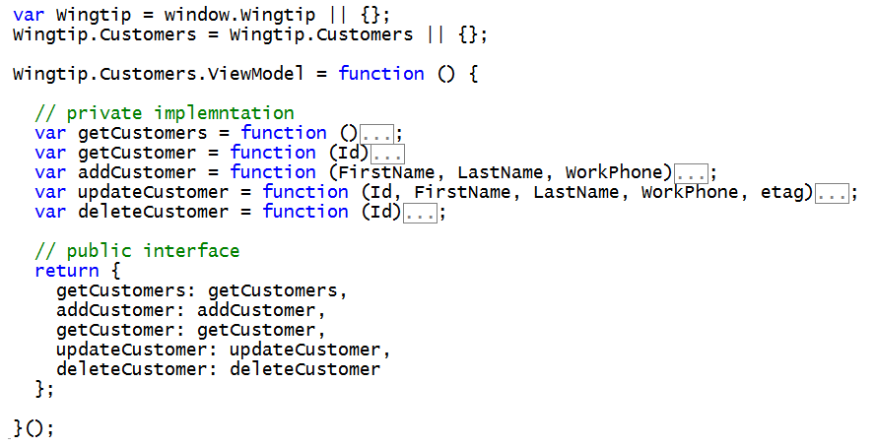
A Sample Module of a View-Model
Designed to hide data access code from view
Challenges arise due to asynchronous calls
View-Model functions return promises

Slide 7
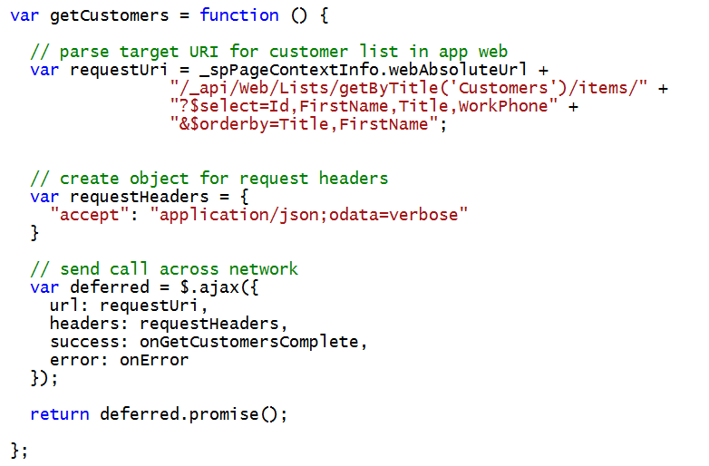
Implementing ViewModel Functions
Functions should return promise
Requires a deferred object with promise() method
$.ajax function returns a deferred object

Slide 8
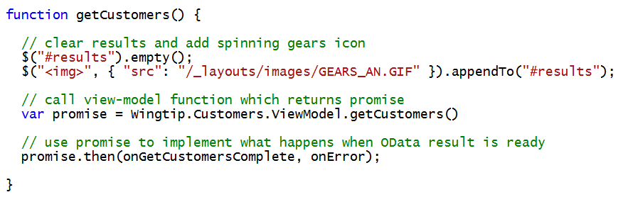
Calling ViewModel Functions
ViewModel functions return promises
Promise object exposes then() function

Slide 9
Exploring RestMVVM App Project

Slide 10
Agenda
Understanding the MVVM Pattern
Introduction to the Knockout JavaScript Library
Understanding Observable Objects
Creating Declarative Bindings
Creating SharePoint Apps using Knockout

Slide 11
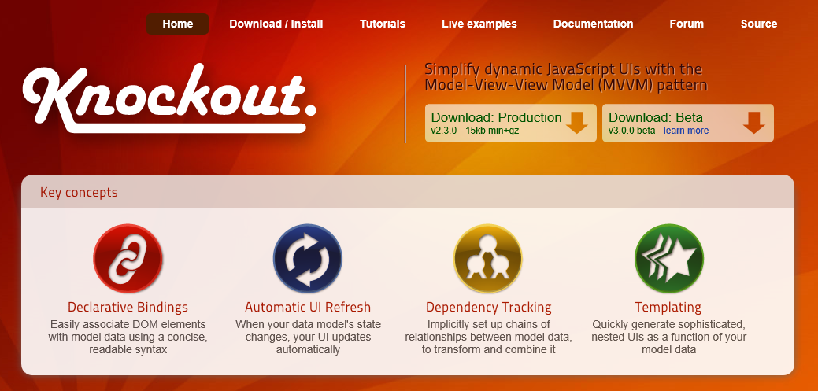
Essential JS Library: Knockout.js
Declarative bindings
Fast and easy way to connect UI elements to data
Powerful when used together with MVVM pattern
Built-in dependency tracking
automatically updates UI when data model changes.
See Knockout.js website at http://knockoutjs.com

Slide 12
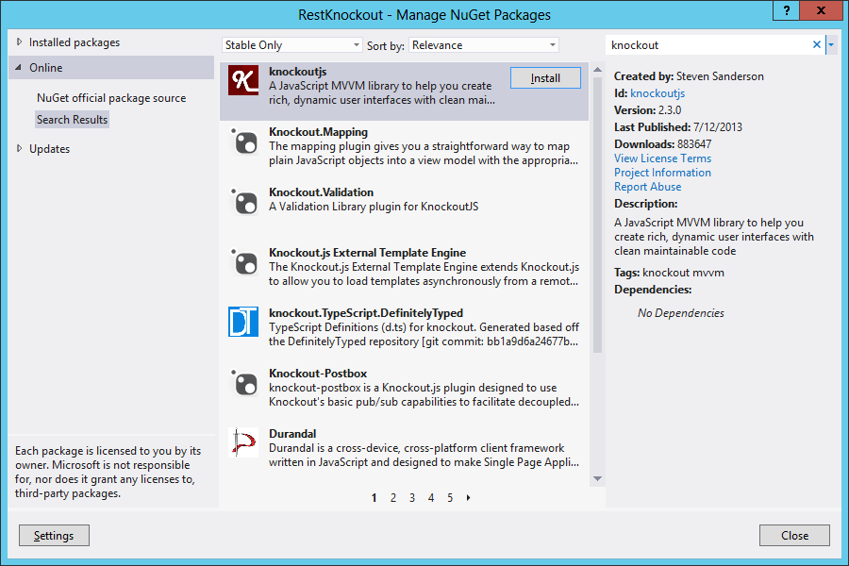
Adding Knockout to A SharePoint App Project

Slide 13
Data Binding and Observables
Knockout based on model of data binding
JavaScript object properties bound to HTML elements
Knockout binding model based on “Observables”
Observable binding provides two-way synch
Update to JavaScript object will update HTML element
Update to HTML element will update JavaScript object
Target HTML Elements
JavaScript Object
Property | Value
firstName | Mary
lastName | Jones
workPhone | 123-456-7890
Source Object Property

Slide 14
Simple Example of Knockout Binding
ViewModel is object with observable properties
Bindable properties created using ko.observable()
Declarative bindings created in HTML tags using data-bind attribute
Bindings applied using ko.applyBindings()

Slide 15
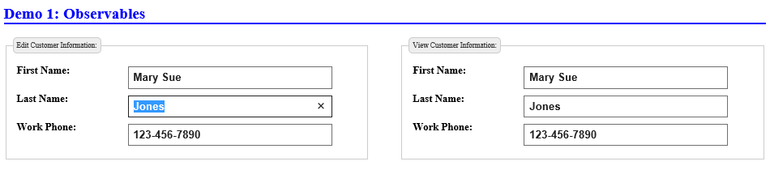
Two-way Binding Synchronization
How does two-way binding work?
Update to bound HTML element updates observable property
Observable property update cascades to other bound elements
JavaScript Object
Property | Value
firstName | Mary Sue
lastName | Jones
workPhone | 123-456-7890

Slide 16
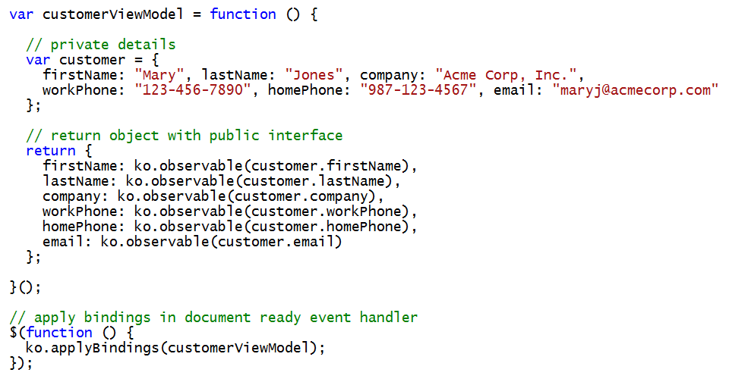
Creating a Better ViewModel
ViewModel often created as a JavaScript Module
Self-executing function with private implementation
Returns object with public interface

Slide 17
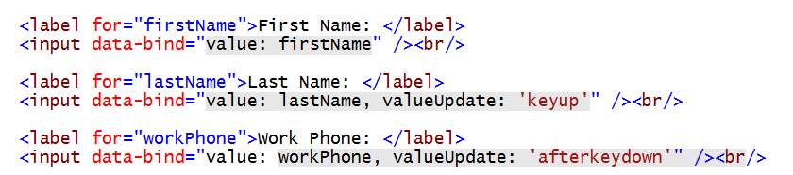
Value Update Events
valueUpdate event controls when update is applied
change (default if not specified)
keyup
keypress
afterkeydown

Slide 18
Simple Data Binding in the LearningKnockout.sln Project

Slide 19
Agenda
Understanding the MVVM Pattern
Introduction to the Knockout JavaScript Library
Understanding Observable Objects
Creating Declarative Bindings
Creating SharePoint Apps using Knockout

Slide 20
Types of Observables
There are 3 different types of observables
Standard Observables
Computed Observables
Observable Arrays

Slide 21
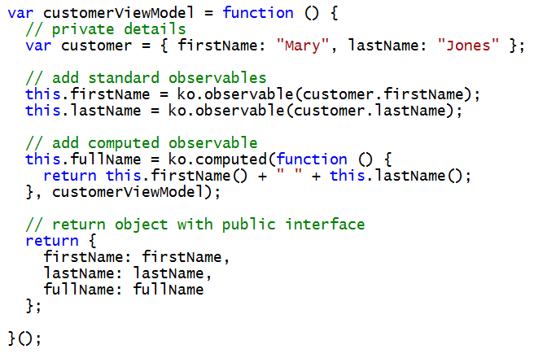
Computed Observables
What is a computed observable?
A function created using ko.computed()
A function dependent on one or more other observables
Computed observable updates when dependencies change

Slide 22
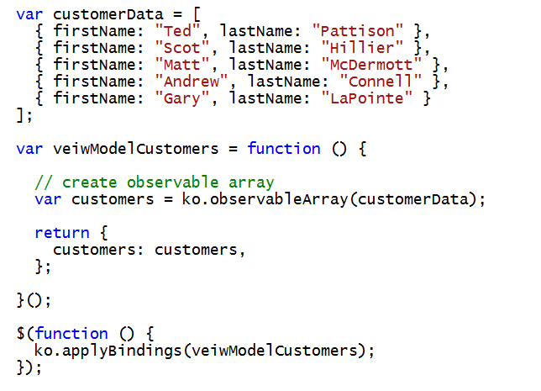
Observable Arrays
Observable array tracks array membership
Notification occurs when items are added/removed
Observable array does not track state of array items
No notification occurs when item in array is updated
Created using ko.observableArray() function

Slide 23
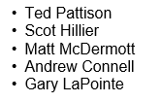
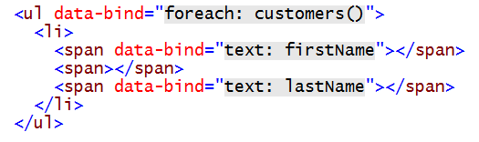
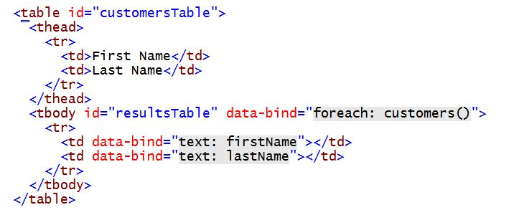
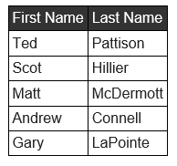
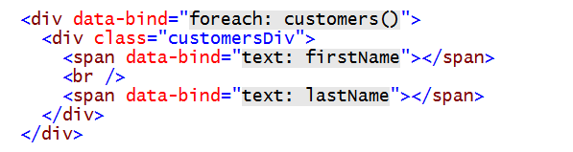
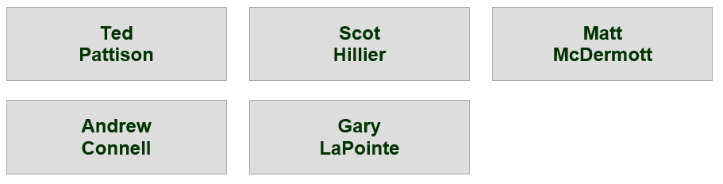
Binding to an observableArray Object
Binding to an unordered list
Binding to an HTML table
Binding to a collection if simple div element with a little extra CSS thrown in to make it pretty

Slide 24
observableArray Functions
Adding, removing and returning items
push: adds a new item to the end of array
indexOf: returns index of first array item that equals incoming parameter
pop: removes last value from array and returns it
unshift: inserts a new item at the beginning of the array
shift: removes first value from the array and returns it
Splice: removes and returns given number of elements
remove: removes one or more values and returns them as an array
removeAll: removes all values and returns them as an array
Rearranging items
reverse: reverses the order of the array
sort: sorts the array contents

Slide 25
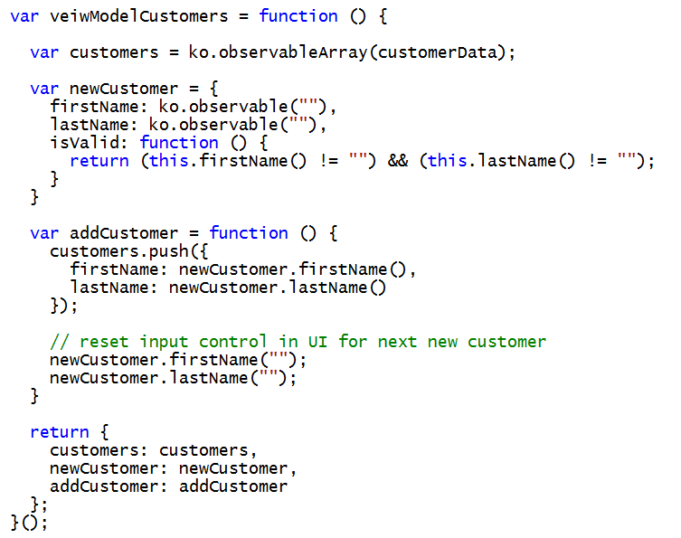
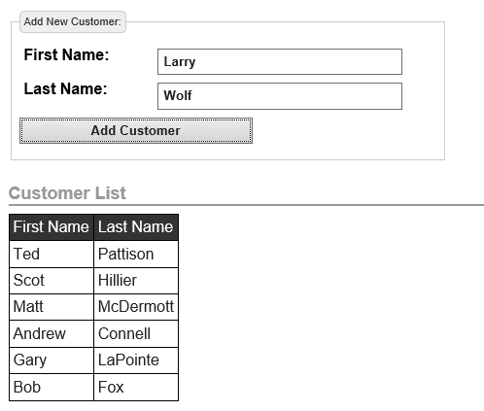
Adding an Item to an observableArray

Slide 26
Agenda
Understanding the MVVM Pattern
Introduction to the Knockout JavaScript Library
Understanding Observable Objects
Creating Declarative Bindings
Creating SharePoint Apps using Knockout

Slide 27
Built-in Binding Types
Elements contents
text
html
value
uniqueName
Element properties
checked
disable
enable
visible
hasfocus
attr
style
cssx
List elements
options
optionsText
optionsValue
selectedOptions
Element Events
click
submit
event
submit

Slide 28
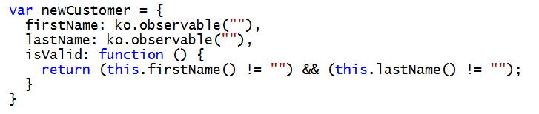
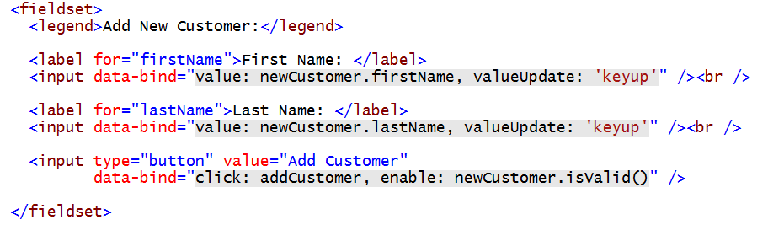
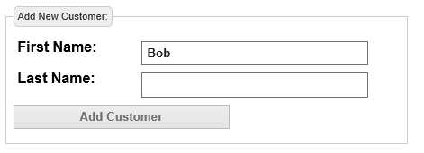
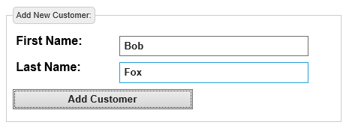
Binding to Element Properties
ViewModel defines dependency property to indicate when data is valid
Dependency property can then be bound to element attribute such as enable
Button is disabled while data is in invalid state
Button is enabled once data reaches valid state

Slide 29
Agenda
Understanding the MVVM Pattern
Introduction to the Knockout JavaScript Library
Understanding Observable Objects
Creating Declarative Bindings
Creating SharePoint Apps using Knockout

Slide 30
Exploring RestKnockout App Project

Slide 31
Summary
Understanding the MVVM Pattern
Introduction to the Knockout JavaScript Library
Understanding Observable Objects
Creating Declarative Bindings
Creating SharePoint Apps using Knockout

