Slide 1
Developing SharePoint Apps with ASP.NET MVC
Notes:
The module begins with an in-depth examination of the architecture of the ASP.NET MVC Framework provided by ASP.NET and Visual Studio 2013. Students will learn the essential concepts and programming techniques involved with creating MVC controllers and MVC views as well as how to integrate these MVC components into a project for a SharePoint Provider-hosted App. Students will also learn about creating and integrating a strongly-typed MVC model which makes it much easier and error proof to create an MVC view.

Slide 2
Agenda
Introduction to MVC
Controllers and Views
Using Strongly-typed Models
MVC in SharePoint App Development

Slide 3
Web Forms Versus MVC
ASP.NET provides two different platforms
ASP.NET Web Forms (e.g. ASPX files)
ASP.NET MVC
MVC provides better platform for the web
More flexible routing
Lighter-weight
Richer templating
Better C# integration
Unit testing

Slide 4
History of MVC
MVC is a design pattern as old as the hills
MVC = Model-View-Controller
Very popular pattern for many web platforms
ASP.NET introduced MVC platform in 2007
Provides alternative to ASP.NET Web Forms
Visual Studio 2013 includes MVC4
Visual Studio 2013 includes MVC5

Slide 5
MVC Request Processing
How does MVC handle an incoming HTTP request
Incoming HTTP request routed to specific Controller
Controller (optionally) creates Model (i.e. presentation object)
Controller creates View and delegates rendering responsibilities
If Model exists, it is passed to View
View renders response as HTTP Response
HTTP Request
Controller
Model
HTTP Response
View

Slide 6
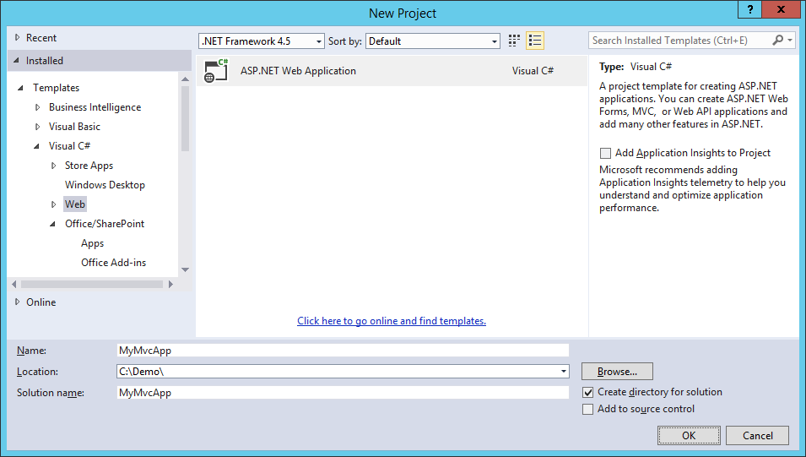
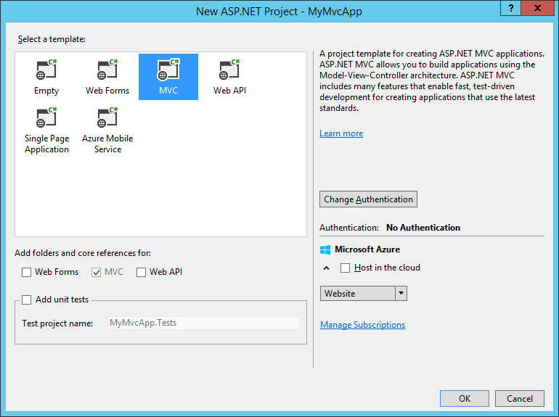
Creating an MVC Project

Slide 7

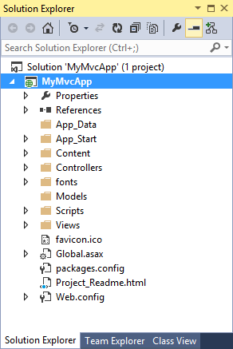


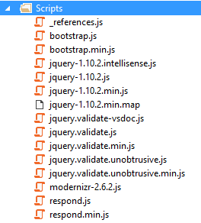
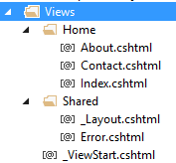
MVC App Project Files

Slide 8
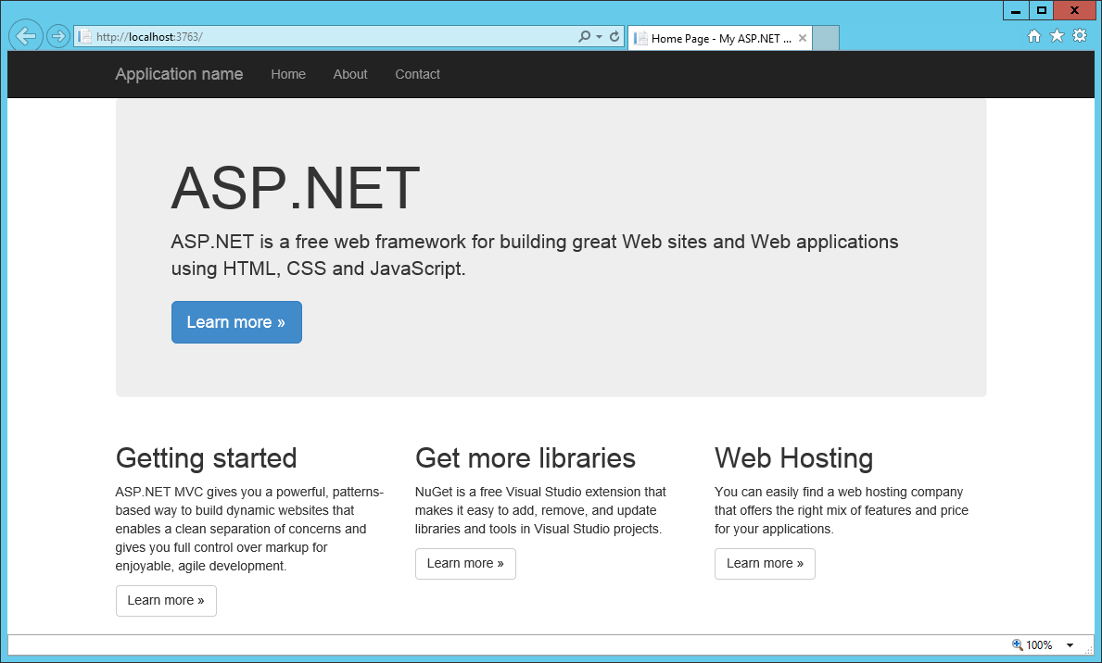
Running an MVC Project

Slide 9
Creating a Simple App with ASP.NET MVC

Slide 10
Agenda
Introduction to MVC
Controllers and Views
Using Strongly-typed Models
MVC in SharePoint App Development

Slide 11
Understanding Controllers
A set of classes that manage…
processing incoming HTTP requests
communication to and from user
overall application flow and application-specific logic
Every controller has one or more Actions
It’s critical to understand the role of Actions in MVC

Slide 12
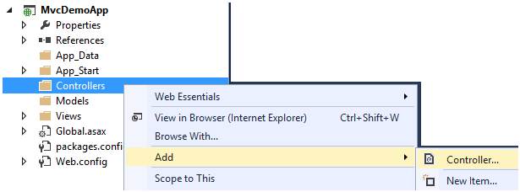
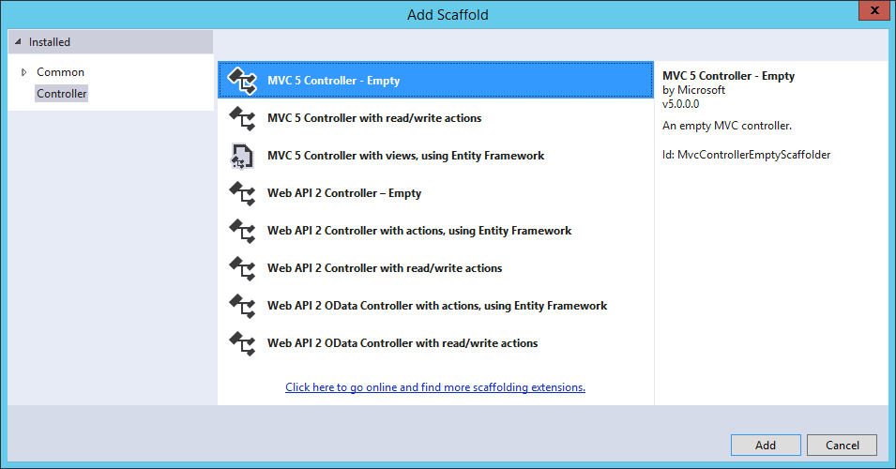
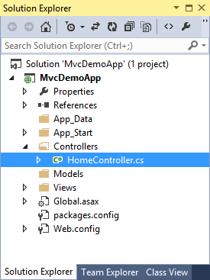
Adding a Controller

Slide 13
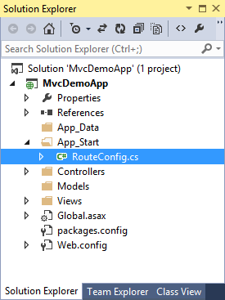
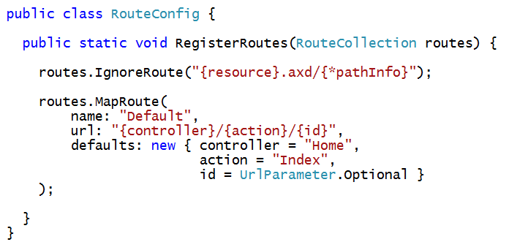
Wiring Up a Controller
When you ad a controller…
Visual Studio updates RouteConfig class
Routing scheme defined using standard format
{controller}/{action}/{id}

Slide 14
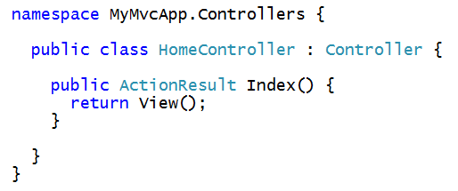
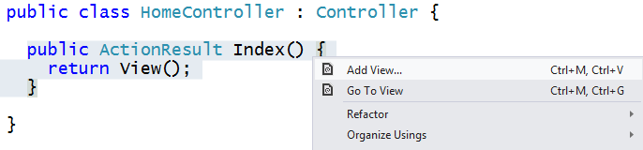
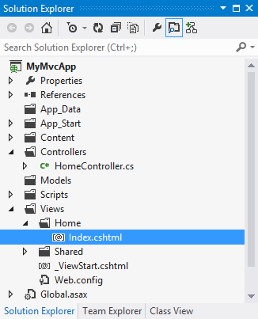
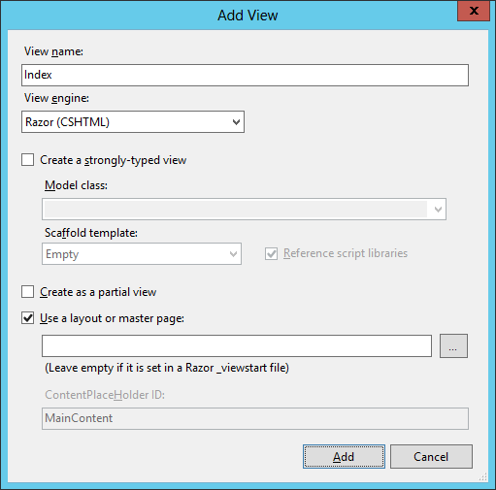
Creating a View from a Controller Action
Controller method often return ActionResult
Right-click on Controller method to generate its view

Slide 15
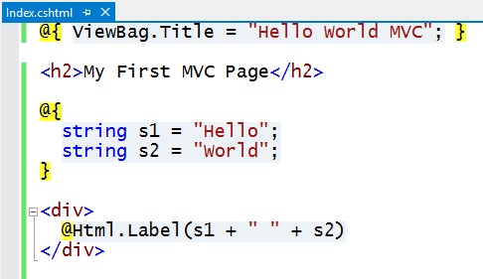
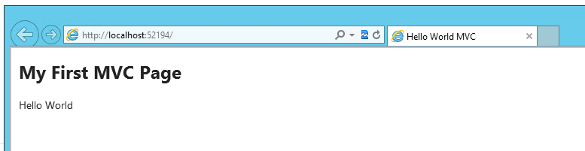
Customizing the View
Views are creating using the Razor engine
Provides a lean and elegant way to create HTML pages
Use data passed from controller
Write in-line C# code
Construct pages using HTML Helpers

Slide 16
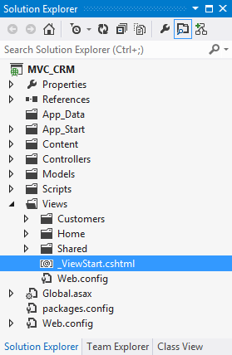
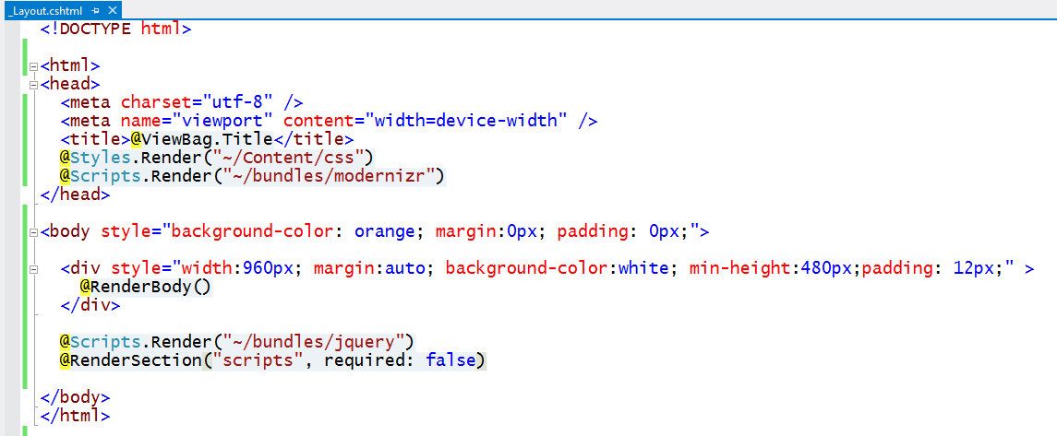
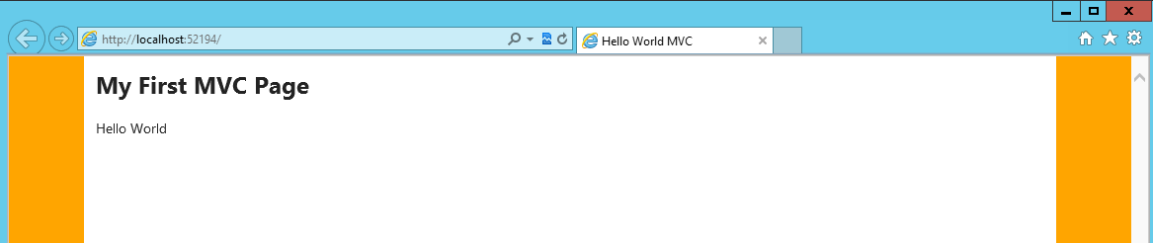
Customizing the Shared View
MVC provides Shared Views
Provides same purpose as master pages in ASP.NET web forms
Default MVC shared view is named _ViewStart.cshtml

Slide 17
Working with Controllers and Views

Slide 18
Agenda
Introduction to MVC
Controllers and Views
Using Strongly-typed Models
MVC in SharePoint App Development

Slide 19
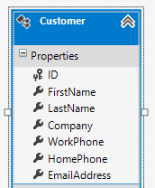
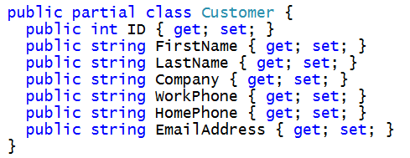
Motivation for Strongly-typed Models
MVC designed based on strongly-typed models
Controller creates model object and passes it to view
Razor view engine supplies IntelliSense for model behind view
HTML helpers make it easy to create views and forms
HTTP Request
Controller
Model
HTTP Response
View

Slide 20
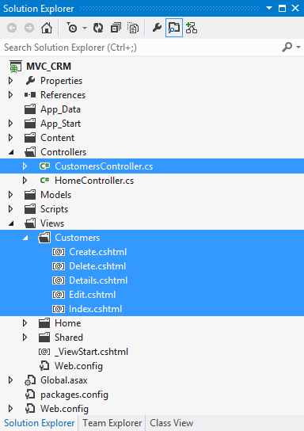
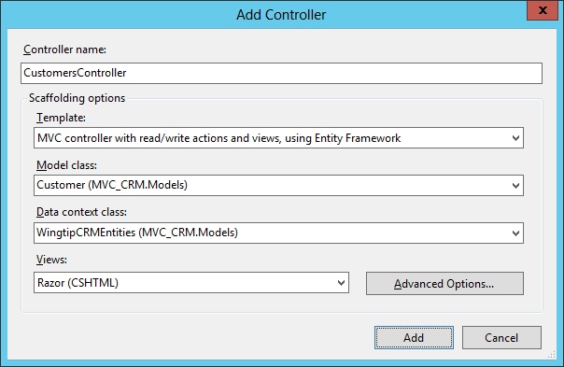
Creating a Strongly-typed Controller Class

Slide 21
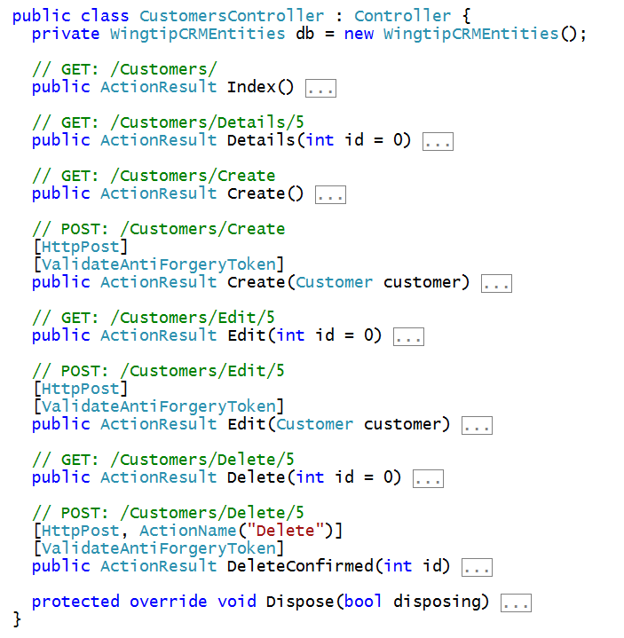
Customers Controller Class

Slide 22
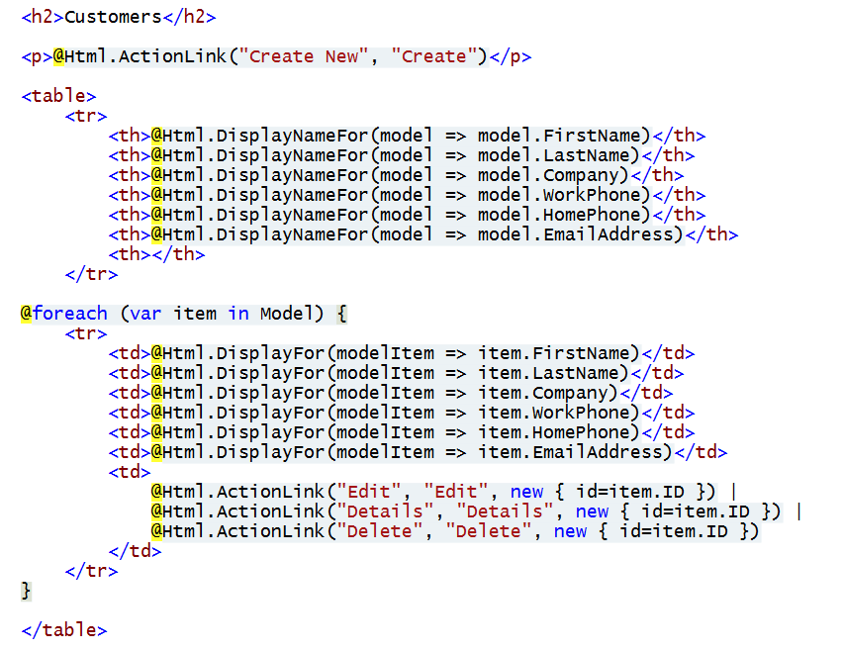
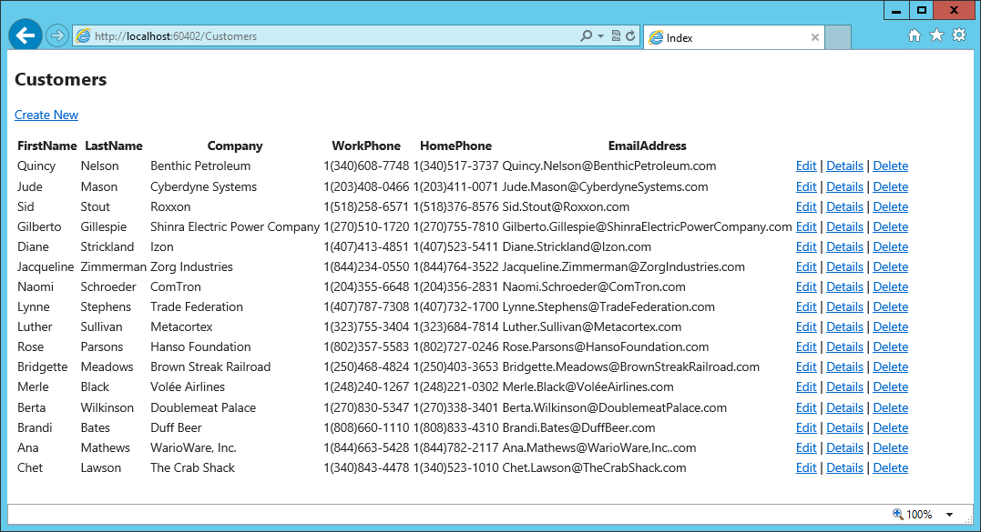
Customers Controller – Index View

Slide 23
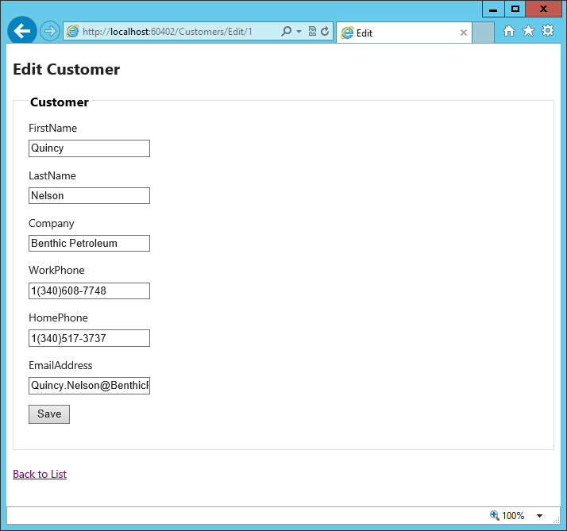
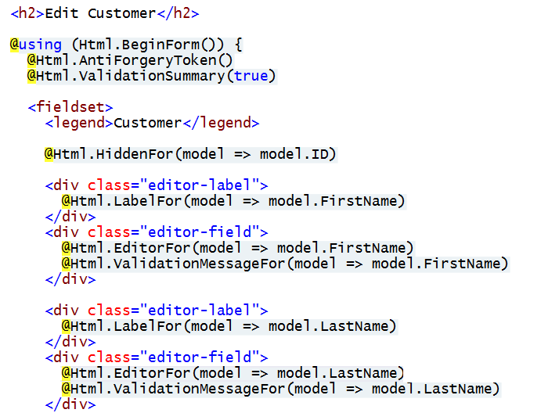
Customers Controller – Edit View

Slide 24
Using a Strongly-typed Model

Slide 25
Agenda
Introduction to MVC
Controllers and Views
Using Strongly-typed Models
MVC in SharePoint App Development

Slide 26
Integrating MVC with SharePoint Apps
Visual Studio 2012 poses two noteworthy limitations
One VS project cannot contain both Web Forms and MVC4
None of the SharePoint App project templates integrate with MVC4
Steps to create SharePoint app using MVC4
Create new VS solution for provider-hosted SharePoint App
Delete with original Web project which is based on Web Forms
Add a new MVC4 project into the same VS solution
Configure the MVC4 project to be the new Web Project
Visual Studio 2013 provides much better experience
VS2013 can mix Web Form items and MVC5 in single VS project
SharePoint app projects integrated with MVC5

Slide 27
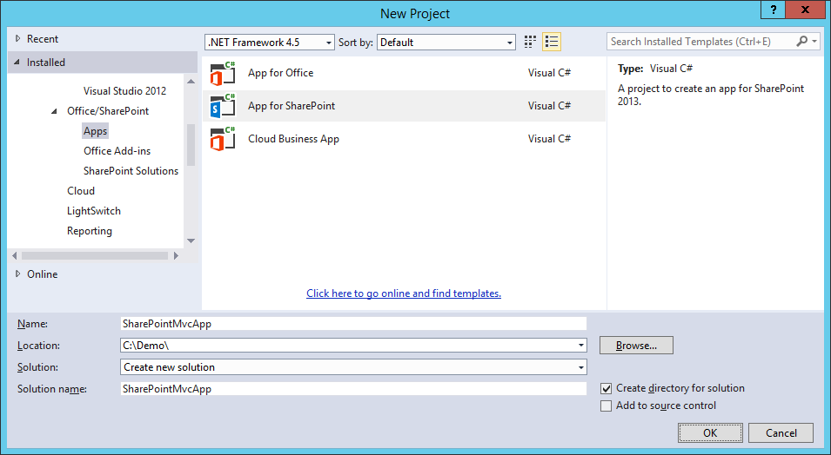
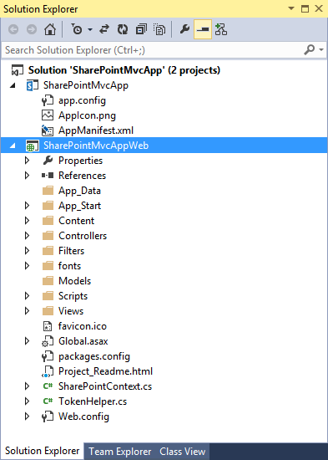
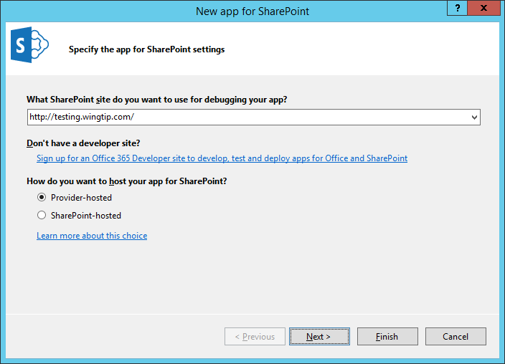
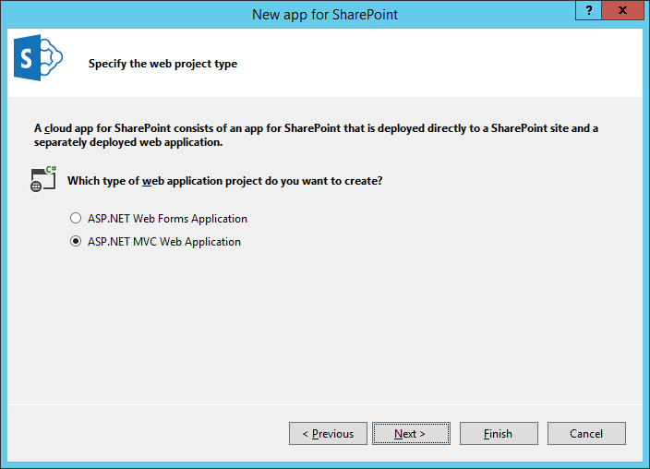
Creating a Provider-hosted App with MVC

Slide 28
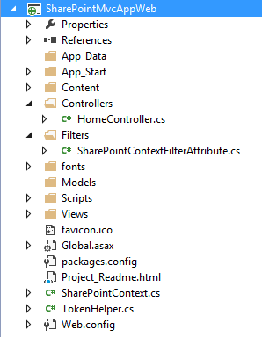
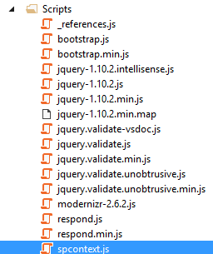
SharePoint-specific Files
TokenHelper.cs and SharePointContext.cs
Same as discussed earlier in course
SharePointContextFilterAttribute.cs
Provides OAuth redirect logic for when context token is missing
Filter has no purpose when using app authentication based on S2S trust
spcontext.js
Client-side JavaScript code to propagate SPHostUrl query string parameter

Slide 29
Creating a Provider-hosted SharePoint App Using MVC5

Slide 30
Agenda
Introduction to MVC
Controllers and Views
Using Strongly-typed Models
MVC in SharePoint App Development

