Slide 1
Developing Office 365 Applications using the Office 365 APIs

Slide 2
Agenda
Introduction to the Office 365 APIs
Authentication and Authorization with Azure AD
Developing Applications with the Office 365 APIs
Office 365 APIs versus SharePoint Apps
Next Steps

Slide 3
Evolution of the SharePoint/Office Platform
Web Part Packages with the release of SharePoint 2003
Farm Solutions (aka Full Trust Solutions) with the release of SharePoint 2007
Sandbox Solutions with the release of SharePoint 2010
SharePoint App Model with the release of SharePoint 2013
Applications built using the Office 365 APIs released in preview by Microsoft in October of 2014

Slide 4
Office 365 API Overview
New web service APIs for accessing data in Office 365
Implemented as RESTful services based on ODATA version 4.0
Provides authentication and authorization based on OAuth 2.0
Provides extra authentication support for OpenID Connect
Open standards provide wide range of accessibility
Many choices for tools, languages and development platforms
Microsoft has created Office 365 SDKs for specific platforms
Office 365 APIs less complex than Exchange and SharePoint APIs
No need to become a “career programmer"
Azure API
Office 365 APIs
Graph
API
user management
General
Exchange
SharePoint
Discovery
API
Mail
API
Events
API
Contacts
API
Files
API

Slide 5
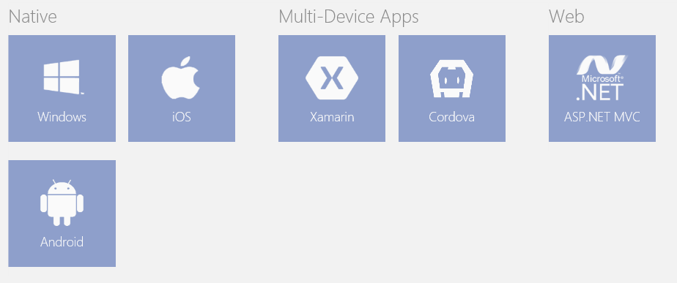
Support for Non-Microsoft Platforms
Office 365 APIs universally accessible via open standards
Any development platform can use REST, ODATA and OAuth2
Office 365 developers can use wide array of tools and languages
No hosting environment dependencies (e.g. Windows or IIS)
SDKs and extra help available for selected platforms
SDKs available for Windows, ASP.NET, iOS and Android
Choose between Visual Studio, XCode, Eclipse or Android Studio

Slide 6
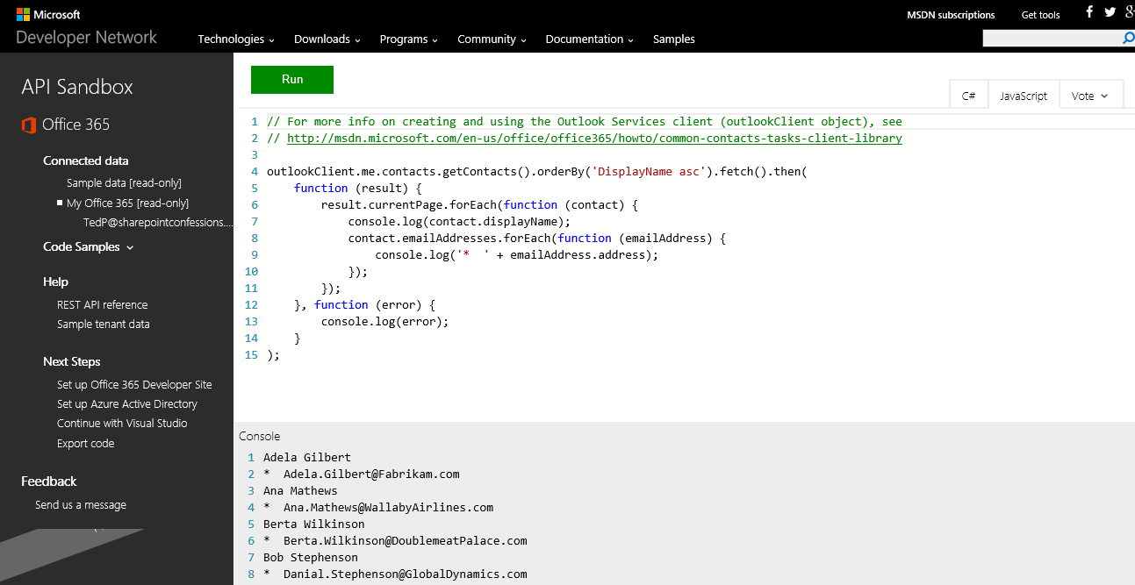
Office 365 API Sandbox
Simple online utility provided by MSDN
https://apisandbox.msdn.microsoft.com/

Slide 7
Agenda
Introduction to the Office 365 APIs
Authentication and Authorization with Azure AD
Developing Applications with the Office 365 APIs
Office 365 APIs versus SharePoint Apps
Next Steps

Slide 8
Office 365 and Azure Active Directory
Office 365 environments are based on tenancies
Tenancy provides scope for creating and managing users
Tenancy provides a scope for site collections in SharePoint Online
Office 365 is integrated with Azure Active Directory (AAD)
Each Office 365 tenancy is backed by an AAD directory
AAD directory can be managed using Office 365 administration
AAD directory can be managed using Windows Azure Portal
Azure support registering application within scope of AAD directory
Application using Office 365 APIs must be registered with AAD
This means you must become familiar with Azure Active Directory

Slide 9
Azure Management Portal
Provides management over one or more directories
View & configure AAD directory behind Office 365 developers site
Create, view and configure AAD applications during development

Slide 10
Azure AD Application Configuration
Azure AD application configured with properties
Name
Sign-on URL
Logo
Single Tenant vs. Multi-tenant
Client ID
Keys (serves as password)
App ID URI
Reply URL
Application Permissions
Delegated Permissions

Slide 11
Single Tenant versus Multi-tenant
Single tenant application
intended for use within a single organization
line-of-business applications written by an Office 365 developer
only needs to be accessed by users in one Office 365 tenancy
typically registered by a developer in the organization
Multi-tenant application
intended for use across many organizations
software-as-a-service (SaaS) applications written by ISVs
need to be provisioned in each directory where they will be used
requires user or administrator consent to register them

Slide 12
AAD Application Permissions
Applications can be granted permissions to other applications
Application permissions are app-only permissions
Delegated permissions are (app + user) permissions

Slide 13
OAuth2 Authentication Flows
Azure AD supports several different authentication flows
Application leverages AAD as a federated authentication provider
Each authentication flow defined inside the OAuth2 specification
Goal is to obtain access token to access a specific resource
OAuth2 authentication flows support by Azure AD
Authorization Code Grant Flow
Client Credentials Grant Flow
Implicit Grant Flow

Slide 14
Authentication Flows in Azure AD
Authorization Code Grant Flow
Commonly used for website application server-side code
Application first obtains authorization code and then access token
Application never sees user’s password
Client Credentials Grant Flow
Used to obtain access token when using app-only permissions
Authentication based on SSL certificate with public-private key pair
Public key registered as a property of an AAD application
Application uses private key to interact with access token endpoint
Implicit Grant Flow
Mainly intended for websites that have no server-side code
Used in single page apps (SPAs) built with JavaScript and AngularJS
Application obtains access token without acquiring authorization code

Slide 15
Authorization Code Grant Flow
Sequence of Requests in Authorization Code Grant Flow
Application redirects to AAD authorization endpoint
User prompted to log on at Windows logon page
User prompted to consent to permissions (first access)
AAD redirects to application with authorization code
Application redirects to AAD access token endpoint
Request authorization code
Sign-in via browser pop-up
Return authorization code
Redeem authorization code and acquire access token for Office 365 resource
Return access token and refresh token
Call Office 365 API using the access token
Return Http Response
Authorization Endpoint
Token Endpoint
Client Application
Office 365 API

Slide 16
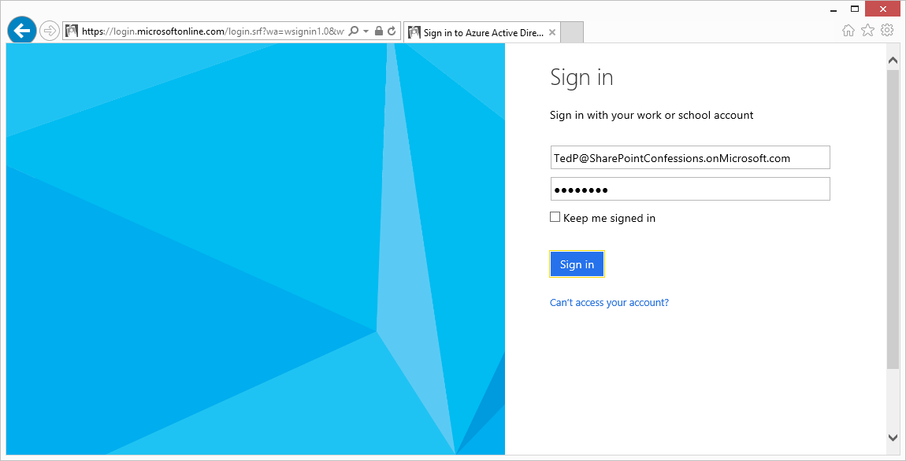
User Sign-in at https://login.microsoftonline.com

Slide 17
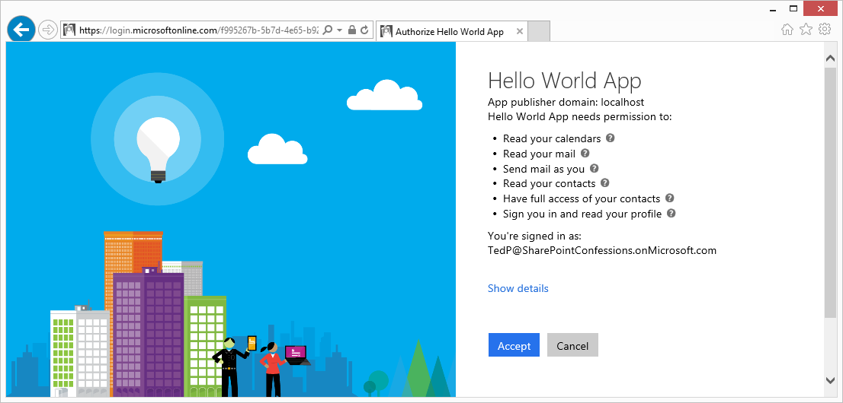
Common Consent Experience (user)

Slide 18
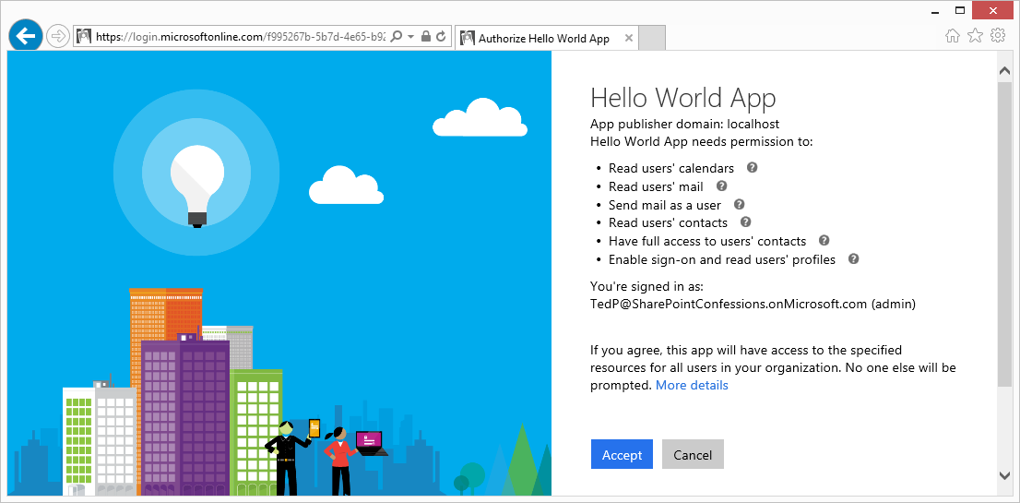
Common Consent Experience (admin)

Slide 19
Authorization Code Grant Flow Example
Sign-on URL
Development: https://localhost:44300/
Production: https://www.MyDomain.com/
Reply URL
Development: https://localhost:44300/AcceptDirect
Production: https://www.MyDomain.com/AcceptDirect
Application ID URI
String-based identifier for an application – not a retrievable URL
https://sharepointconfessions.onmicrosoft.com/HelloWorldApp
Client ID
GUID-based identifier for a specific AAD application
33d561fb-59a7-4817-bddf-2117193d62e0
Key (aka Client Secret)
Key that acts as a secret password between Azure AD and application
ouWdhd2LxDl0Pcu2SKlujEiQ5GmSbKRbBM24nETb5dw=

Slide 20
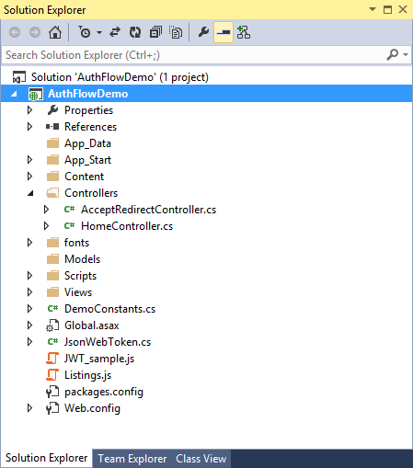
Proof of Concept Sample App

Slide 21
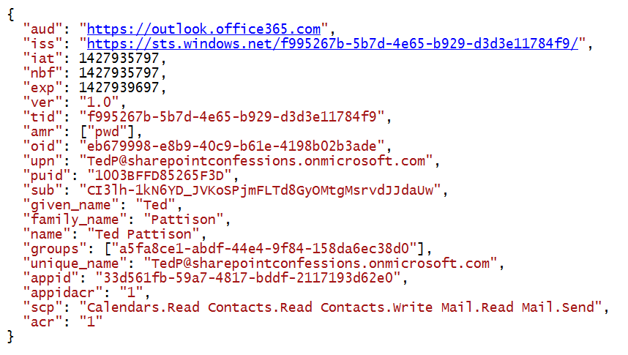
View into an Access Token

Slide 22
Agenda
Introduction to the Office 365 APIs
Authentication and Authorization with Azure AD
Developing Applications with the Office 365 APIs
Office 365 APIs versus SharePoint Apps
Next Steps

Slide 23
Getting Started as an Office 365 Developer
Setting Up an Office 365 Development Environment
Create a new Office 365 Developer Site
Sign up for a Windows Azure Subscription
Connect Office 365 tenancy to the Azure Management Portal
Install Visual Studio 2013 with Update 4 or later
Install the Office Developer Tools for VS 2013
Follow the steps on Dev.Office.com
http://dev.office.com/getting-started

Slide 24
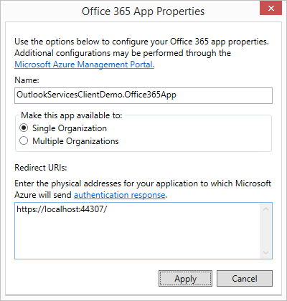
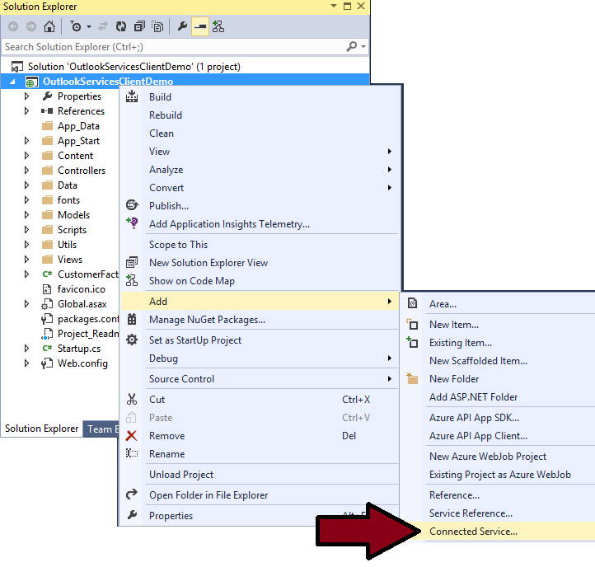
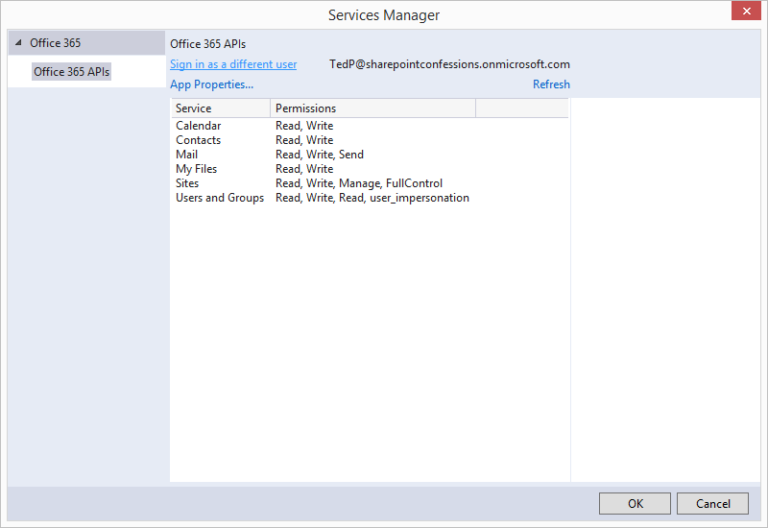
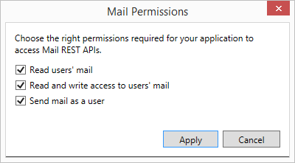
Office Developer Tools for VS 2013
Connected Service Wizard…
Creates an AAD application in directory behind tenant
Adds Office 365 app permissions
Updates web.config with AAD app configuration data
Adds NuGet packages to project for AAD and Office 365 APIs

Slide 25
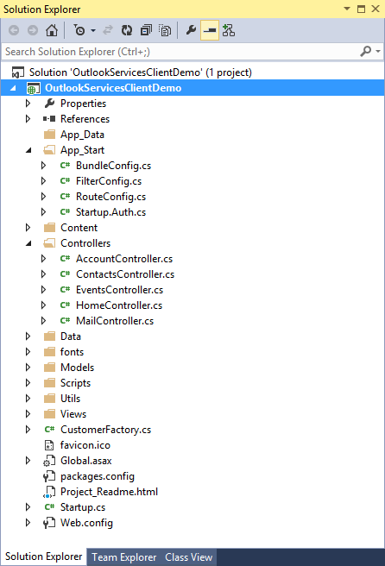
Sample MVC5 Application

Slide 26
Agenda
Introduction to the Office 365 APIs
Authentication and Authorization with Azure AD
Developing Applications with the Office 365 APIs
Office 365 APIs versus SharePoint Apps
Next Steps

Slide 27
Office 365 Apps vs SharePoint Apps
Types of applications
Authentication Architecture
Installation/deployment scope
Permission granularity
Launching an App
Maturity of Platform
Inline with Microsoft’s Strategy and direction

Slide 28
Agenda
Introduction to the Office 365 APIs
Authentication and Authorization with Azure AD
Developing Applications with the Office 365 APIs
Office 365 APIs versus SharePoint Apps
Next Steps

Slide 29
Your Learning Curve
Skills required for Office 365 API development
Working with Azure AD Applications
Understanding OAuth Authentication Flows
Working with the Connected Services Wizard
Developing MVC5 apps with controllers and views
Working with the OWIN framework and Katana
Working with the Active Directory Authentication Library
Working with the Discovery Service
Working with the Entity Framework (Version 6)

Slide 30
Learning Resources
Microsoft online resources
http://Dev.Office.com
https://apisandbox.msdn.microsoft.com
Office 365 Developer content on GitHub
https://github.com/OfficeDev
On-demand Puralsight Course by Andrew Connell
Office 365 APIs: Overview, Authentication & the Discovery Service
Training course from Your Friends at Critical Path Training
I bet you saw this one coming ;)

Slide 31
Summary
Introduction to the Office 365 APIs
Authentication and Authorization with Azure AD
Developing Applications with the Office 365 APIs
Office 365 APIs versus SharePoint Apps
Next Steps

