Slide 1
Developing Provider-hosted Apps
Notes:
The module begins with an in-depth examination of the architecture of a provider-hosted app. Student will learn how to create a user interface experience in the pages of the remote web using a customer master page and the SharePoint 2013 Chrome Control. The module discusses how to write and test server-side code which leverages ASP.NET and the libraries of the .NET Framework. Student will learn how to create remote event receivers as well as how to implement the remote web of a provider-hosted app in Visual Studio 2012 using an ASP.NET MVC4 project.

Slide 2
Agenda
Getting Started with Provider-hosted Apps
User Interface Design for the Remote Web
Remote Event Receivers
Using the Cross Domain Library

Slide 3
Provider-Hosted App
Developer responsible for deploying remote web
App deployed to remote web on remote web server
Developer deploys remote web prior to app installation
Developer often required to deploy database as well
Notes:
Provider-Hosted apps create a remote web and reside external to SharePoint. This doesn’t mean they cannot interact with SharePoint artifacts like lists and libraries, it just means that they primarily live outside of SharePoint like other Cloud-Hosted apps. In this scenario, the developer (or provider of the app) is responsible for deploying, installing & configuring all resources that are external to SharePoint.
For instance, if a Provider Hosted app references an ASP.NET MVC application deployed to Windows Azure that leverages Azure services like Service Bus, Access Control Services and SQL Azure, the developer is responsible for standing up and configuring all the non-SharePoint pieces of the application.

Slide 4
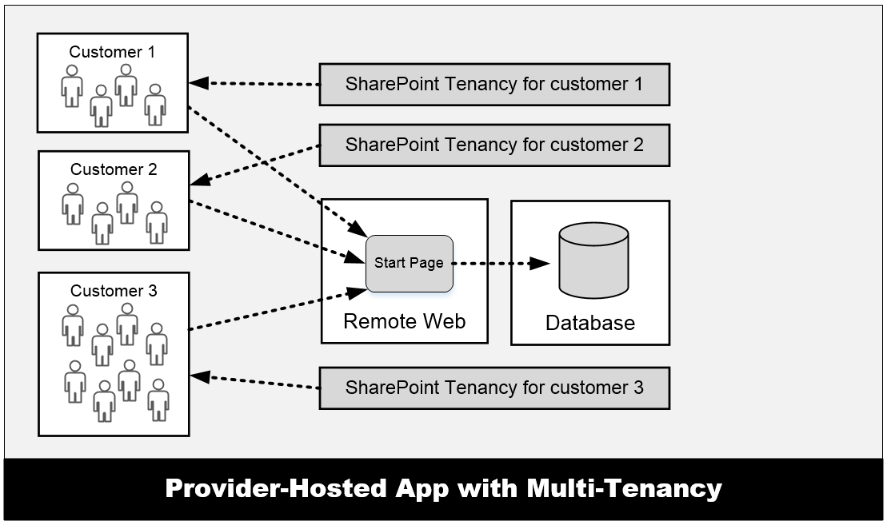
Provider-Hosted App with Multi-tenancy
Many customers access the same remote web
Remote web must be able to scale as needed
App design must isolate data on per-customer basis
Complexity increases time and cost of development
Notes:
One important aspect of provider-hosted apps is that you can have the same app installed multiple times across multiple SharePoint farms and/or SharePoint tenancies. However, all users that access the remote web of the app all connect through the same entry points as shown in the graphic in the slide. This can pose design issues when you are designing and developing a provider-hosted app for a multi-tenant environment and you are storing data for customers in a custom database. The database design often becomes more complex because you are usually required to isolate the data from different customers in separate tables and possibly separate database as well.

Slide 5
Pros and Cons of Provider-hosted Apps
Benefits of provider-hosted over SharePoint-hosted apps
You can write server-side .NET code using C# or VB.NET ([wahoo!])
You can make HTTP calls w/o cross-domain scripting constraints
Your server-side code can access data in a custom database
You can leverage the support for remote event receivers
You can make CSOM/REST API calls using App-only permissions
Provider-hosted apps more strategic for Microsoft moving forward
Negatives when compared to SharePoint-hosted apps
You must deploy and manage the remote web
Requires extra code to acquire and manage security tokens
Multi-tenant aware app design can introduce significant complexity

Slide 6
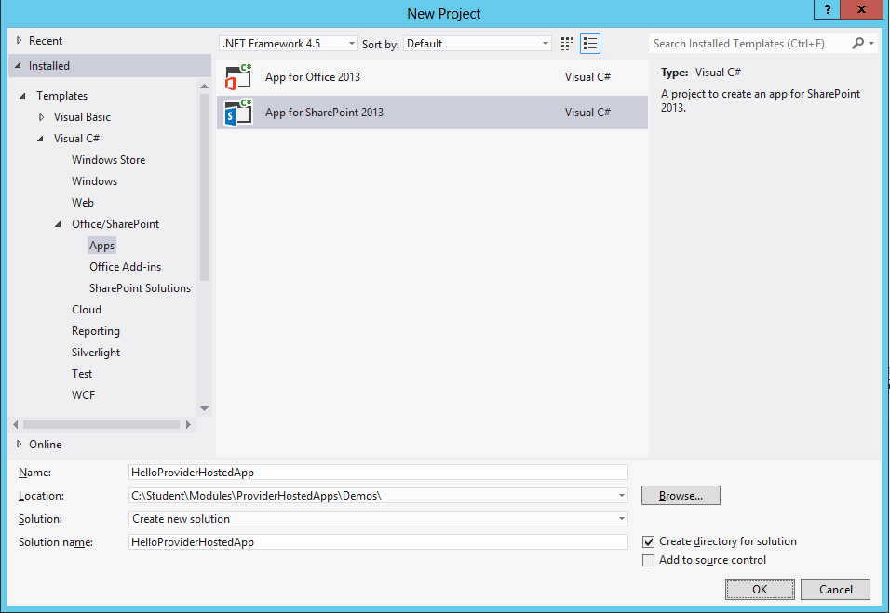
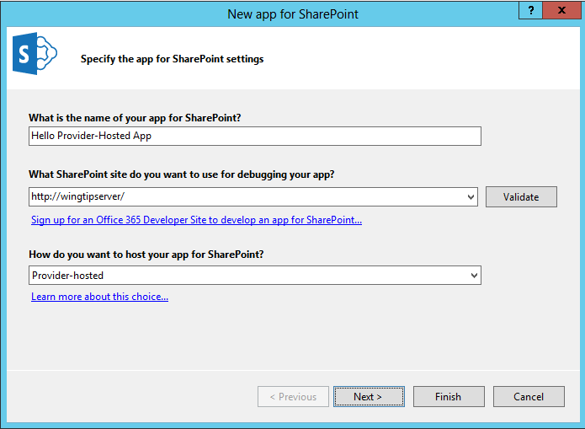
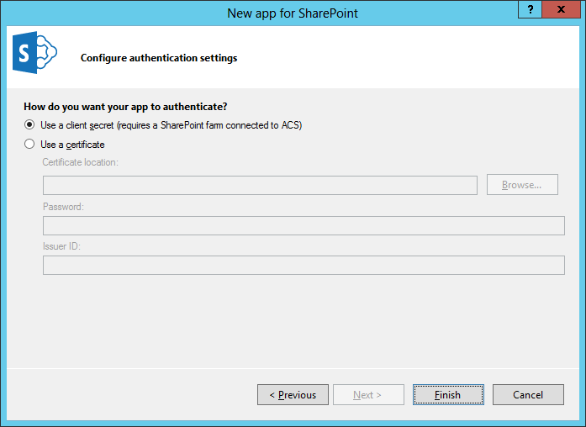
Creating a Provider-hosted App Project

Slide 7
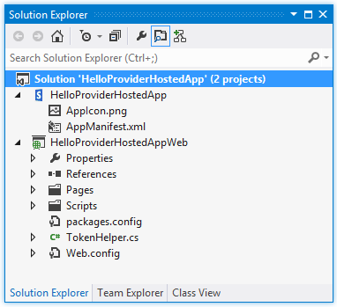
Provider-hosted App Projects
Visual Studio create solution with two projects
SharePoint app project
ASP.NET Website project for remote web this project is known as the “web project”

Slide 8
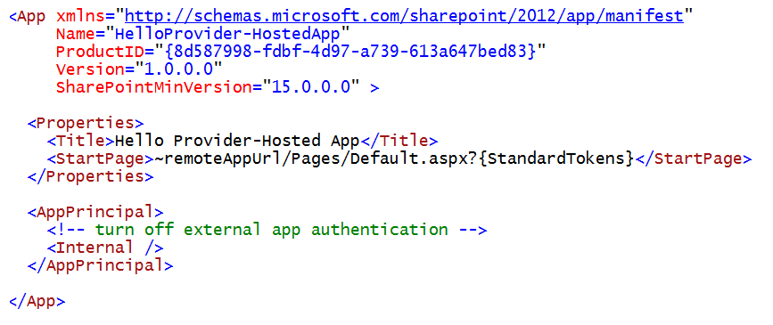
AppManifest.xml
Provider-hosted app adds requirements to App Manifest
StartPage must point to page in remote web
AppPrincipal requires app authentication settings
External app authentication can be disabled using Internal setting

Slide 9
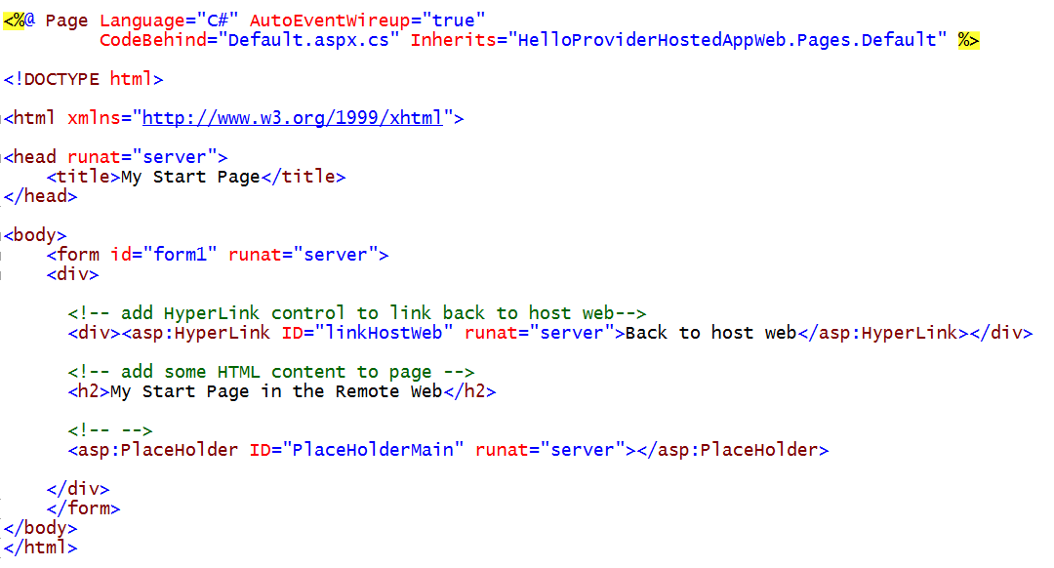
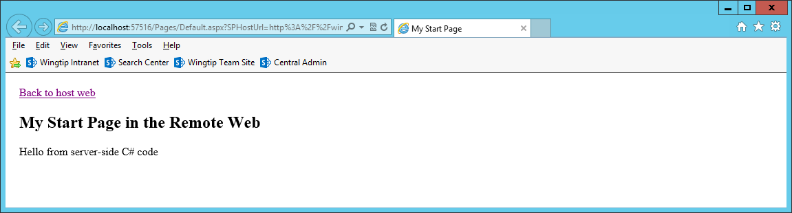
A Sample Start Page

Slide 10
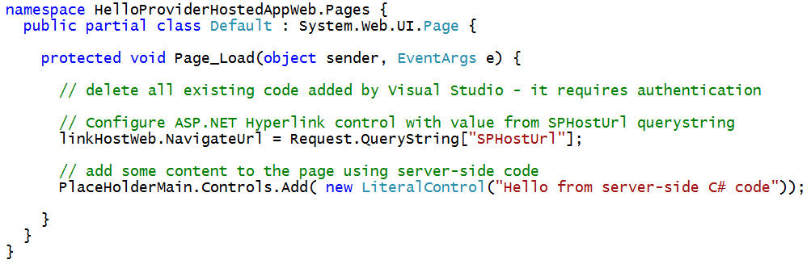
C# Code Behind Sample Start Page

Slide 11
Debugging the Remote Web in IIS Express
Visual Studio debugging involves IIS Express
URL created in localhost domain (e.g. https://localhost:57516)
Port number for Remote Web project selected automatically behind scenes
IIS Express debugging support allows you to debug…
Server-side C# code behind pages in the remote web
Web service calls from browser to remote web
Web service calls from SharePoint to remote web
SharePoint
Worker Process
Browser
Client-side JavaScript
Remote Web running locally in IIS Express
attach
Visual Studio .NET Debugger

Slide 12
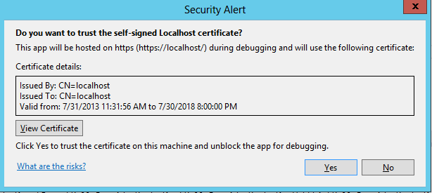
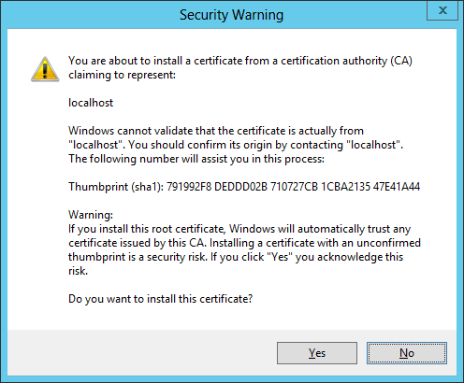
Debugging Code in the Remote Web
Remote Web can optionally use SSL
Pages can be served using HTTPS or HTTP
Use of SSL is usually preferred
IIS Express can configure SSL through https://localhost
Visual Studio registers self-signed certificate on first use

Slide 13
Creating the ‘Hello World’ Provider-Hosted App

Slide 14
Agenda
Getting Started with Provider-hosted Apps
User Interface Design for the Remote Web
Remote Event Receivers
Using the Cross Domain Library

Slide 15
Designing the Remote Web User Interface
Create user interface using single page app pattern
Start page serves as exclusive user entry point into remote web
Start page designed with HTML markup and ASP.NET controls
Start page can be written with server-side C# code
Start page can also include client-side JavaScript code
JavaScript code can call to custom web services in remote web
Create user interface as a multi-page app
Users can navigate from start page to other pages in remote web
ASP.NET master page can create consistent UI across pages
Master page can leverage SharePoint Chrome control
Multi-page app loses major benefits of single-page app pattern
Extra work required to track start page POST data across requests

Slide 16
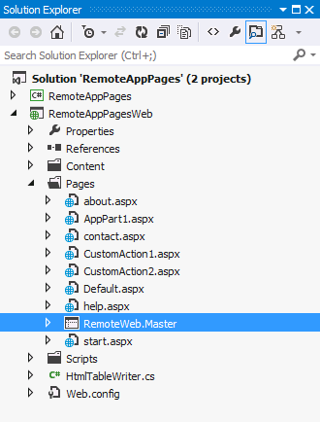
Using Master Pages in the Remote Web
Pages in remote web live outside SharePoint
You have responsibility and freedom to build entire UI
Often makes sense to create remote web master page
<%@Master language="C#" %>
<!DOCTYPE html PUBLIC "-//W3C//DTD XHTML 1.0 Strict//EN" "http://www.w3.org/TR/xhtml1/DTD/xhtml1-strict.dtd">
<html>
<head>
<title>Remote App Pages</title>
<link href="/Contents/app.css" type="text/css" rel="stylesheet" />
<asp:ContentPlaceHolder ID="PlaceholderAdditionalPageHead" runat="server" />
</head>
<body>
<form id="form1" runat="server">
<div id="pageWidth">
<div id="chrome_ctrl_container"></div>
<div id="contentBody">
<asp:ContentPlaceHolder ID="PlaceholderMain" runat="server" />
</div>
</div>
</form>
</body>
</html>
Notes:
MSDN: Apps for SharePoint UX design guidelines
http://msdn.microsoft.com/en-us/library/office/apps/jj220046(v=office.15)

Slide 17
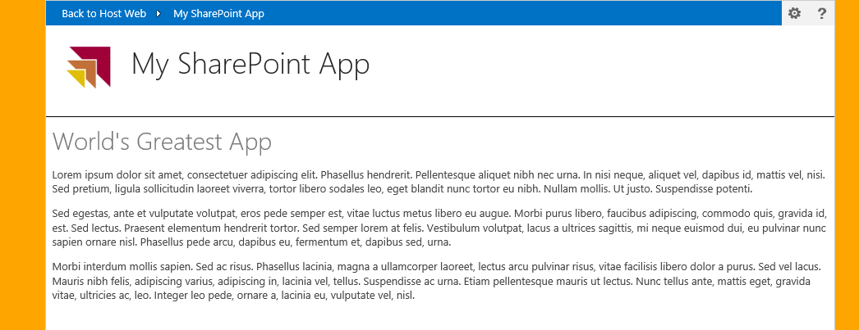
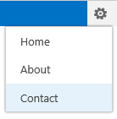
Leveraging the Chrome Control
Optional JavaScript component for use in Remote Web
Used to create top banner of page with SharePoint look and feel
Provides link to host web, configurable navigation and help link
Can pull custom styles used in host web
Notes:
Pages in the remote web of Cloud-Hosted Apps do not have access to the app.master and thus don’t have the same look & feel of their hosted SharePoint sites. To address this Microsoft provides something called the chrome control which is a JavaScript library that writes the HTML that includes the header of the hosting SharePoint site as well as a reference to an ASP.NET HTTP Handler that pulls all the CSS from the parent site so the pages in the remote web can look the same as the host web.

Slide 18
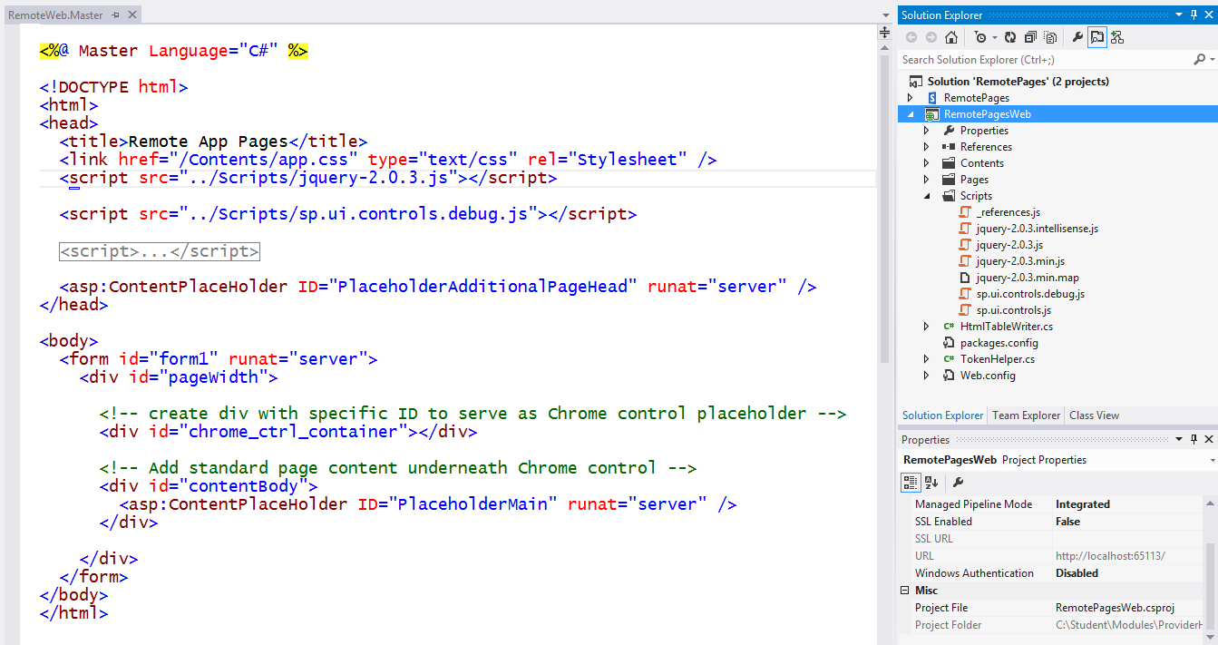
Using the Chrome control

Slide 19
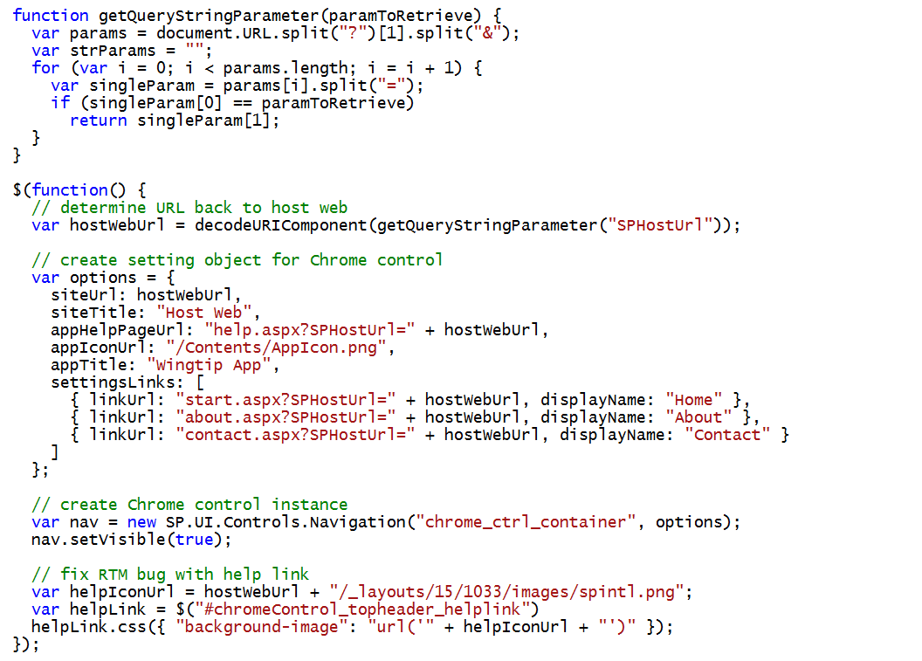
Initializing the Chrome Control

Slide 20
Creating Pages in the Remote Web using the Chrome Control

Slide 21
Agenda
Getting Started with Provider-hosted Apps
User Interface Design for the Remote Web
Remote Event Receivers
Using the Cross Domain Library

Slide 22
Event Handling Support in SharePoint 2013
Classic server-side events for SharePoint solutions
Supported as early as SharePoint 2003
Based on ‘before’ events and ‘after’ events
Event handlers implemented using event receiver class in C#
Event handler assembly loads into SharePoint worker process
New remote event infrastructure introduced for app model
Event handler code runs in remote web not in SharePoint host
SharePoint calls web service in remote web to trigger event
Set of supported remote events is subset of server-side events
Remote “before” events implemented as two-way events
Remote after events implemented as one-way events

Slide 23
Supported Remote Events
Site
Create
Move
Delete
Create
Delete
List / Library Schema
Create
List Item
Create
Update
Delete
Move
CheckIn
Attachment Added
File Moved
SharePoint App
Install
Uninstall
Update
Delete
UnCheckIn
CheckOut
Attachment Removed
File Converted
List / Library
Update
Notes:
The goal is to make the remote event receivers equivalent to the standard event receivers in SharePoint.
In cases where latency is high, remote synchronous events could cause significant delays in the operations that the event is responding to. Synchronous events are available today, though, and they’re important, especially for complex data validation rules.

Slide 24
Remote “Before” Events
Remote before events modeled as two-way events
Execution flow goes to remote web and then back to SharePoint
Client is blocked while event processing occurs in remote web
Sample execution flow for two-way event
Client attempts action which triggers an event (e.g. update item)
SharePoint host calls to web service in remote web
SharePoint host blocks until call returns from remote web the key point is that two-way events block the SharePoint host and delay response back to user
SharePoint host commits action and returns to Client
Two Way Event (aka before event)
Client
1
SharePoint Host
Remote Web
2
3
4

Slide 25
Remote “After” Events
Remote after events modeled as one-way events
Execution flow goes to remote web but does not return
Unlike before events, after events do not block client response
Sample execution flow for one-way event
Client attempts action which triggers an event (e.g. update item)
SharePoint host commits action and returns to Client
SharePoint host executes one-way WCF call on remote web the key point is that one-way events do not block the SharePoint host nor delay response back to user
One Way Event (aka after event)
Client
1
SharePoint Host
Remote Web
2
3

Slide 26
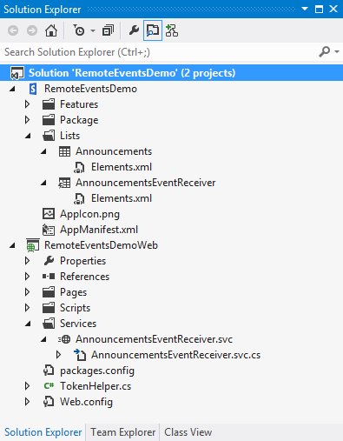
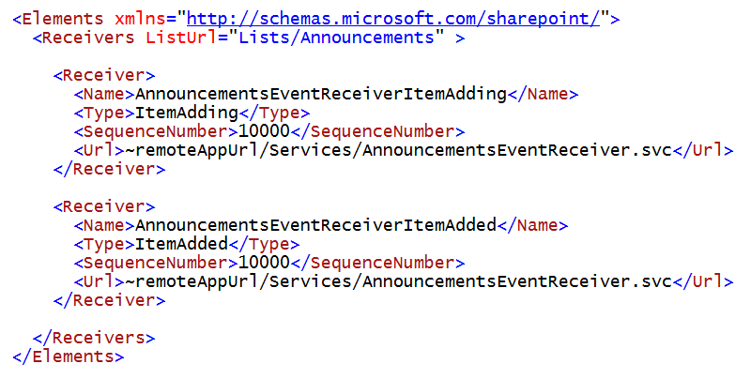
Registering Remote Events Receivers
Event receivers must be registered with SharePoint host
Registration can be declaratively for events occurring in app web
Registration for events occurring in host web requires code

Slide 27
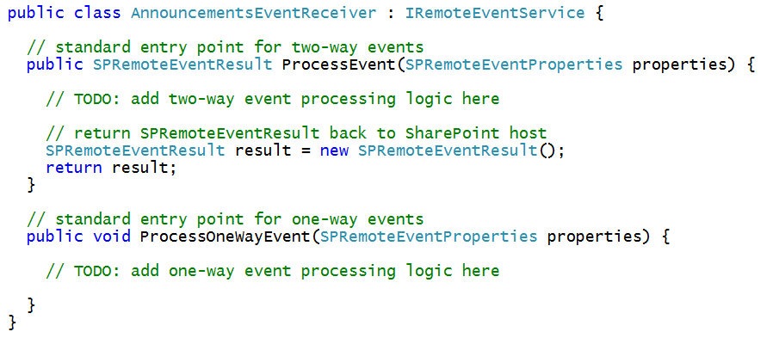
The Remote Event Receiver Entry Point
Remote event receiver implemented with .svc file
Event receiver code written as C# code code-behind .svc file
Event receiver is class that implements IRemoteEventService
ProcessEvent method executes when two-way event is triggered
ProcessOneWayEvent method executes when one-way event is triggered

Slide 28
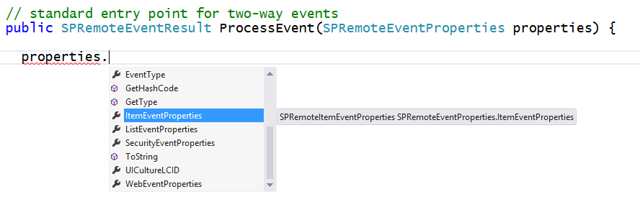
SPRemoteEventProperties
SPRemoteEventProperties parameter passed to event handlers
Provides you with contextual information about the current event
Allows you to read and update user input during before event
Makes it possible to perform validation in before events

Slide 29
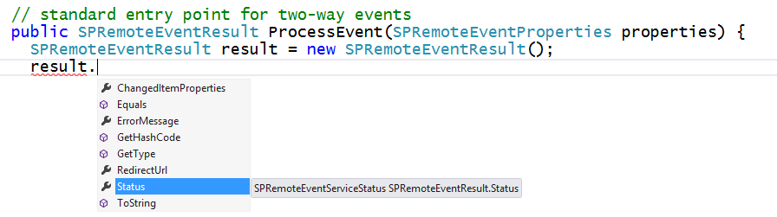
SPRemoteEventResult
Two-way event handlers return SPRemoteEventResult object
SPRemoteEventResult object makes it possible to cancel action

Slide 30
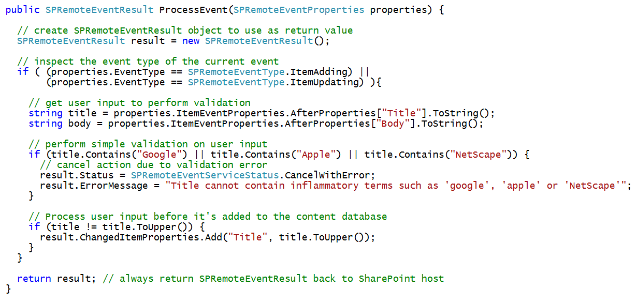
Example Before Event with a List Item

Slide 31
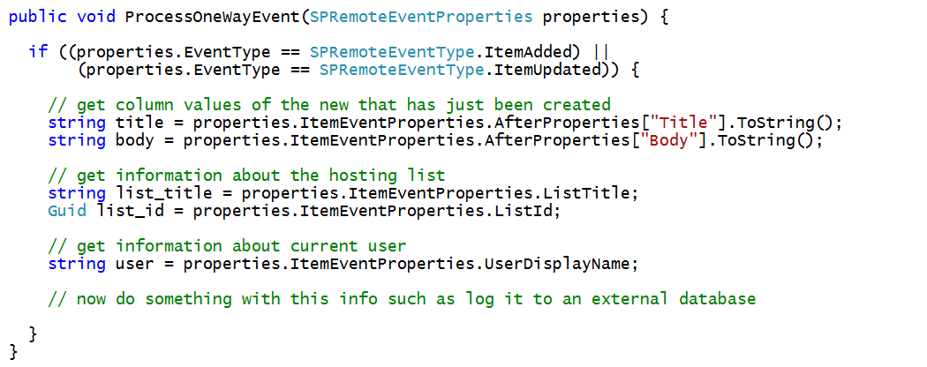
Example After Event with a List Item

Slide 32
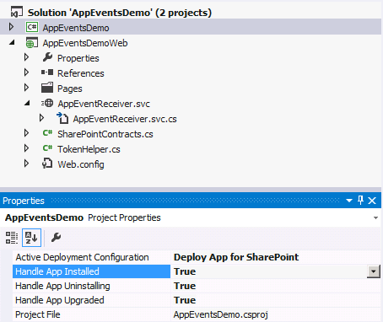
App Lifecycle Events
SharePoint app models support app events
App events for installation, upgrade and uninstall
Added to app project using property sheet
Implemented as a remote event receiver
Notes:
The installation, upgrade and uninstallation of an app raises events that developers can trap. These are surfaced as remote event receivers where the app calls out to a well known endpoint where the developer can do something upon these events.

Slide 33
App Lifecycle Event Registration
Declaratively register remote event receivers
Definitions found in AppManifest.xml
<Properties>
<Title>App Lifecycle Event</Title>
<StartPage>~appWebUrl/Pages/Default.aspx?{StandardTokens}</StartPage>
<InstalledEventEndpoint>~remoteAppUrl/AppEventReceiver.svc</InstalledEventEndpoint>
<UninstallingEventEndpoint>~remoteAppUrl/AppEventReceiver.svc</UninstallingEventEndpoint>
<UpgradedEventEndpoint>~remoteAppUrl/AppEventReceiver.svc</UpgradedEventEndpoint>
</Properties>
Notes:
Remote Event Receivers can also be set up for Installed, Uninstalling, and Upgrading events in the App lifecycle.
To handle a SharePoint app event, set its event value to True in Visual Studio. The default value for the events is False. When you set the value of an app event to True, Visual Studio creates an app event receiver. To disable an app event receiver, set its value to False

Slide 34
Exploring the RemoteEventsDemo App Project

Slide 35
Agenda
Getting Started with Provider-hosted Apps
User Interface Design for the Remote Web
Remote Event Receivers
Using the Cross Domain Library

Slide 36
Cross Domain Library
Where is it used?
In client-side JavaScript code in pages of remote web
When do you need it?
To enable CSOM and REST API calls from browser to host web
In scenarios where external app authentication is not possible
How does it work?
You use SharePoint Cross Domain library to execute calls
Calls are routed through app web which use internal app authentication
Cross domain library calls proxy page to deal with cross-domain issues

Slide 37
Exploring the RestCrossDomain App Project

Slide 38
Summary
Getting Started with Provider-hosted Apps
User Interface Design for the Remote Web
Remote Event Receivers
Using the Cross Domain Library

