Slide 1
Developing with REST and OData
Notes:
This module introduces the essential concepts and programming techniques required to call web services that have been created according the principles of REST and the OData protocol. Students will learn how to create the URIs required to execute queries against an OData service that involve selecting columns, filtering and ordering. Students will also learn how to leverage the jQuery library to execute client-side calls and to manage OData results.

Slide 2
Agenda
REST and OData Primer
Creating an OData Service using WCF
Executing OData Queries
Client-side OData Programming using jQuery

Slide 3
Are You Getting Enough REST?
In the beginning there was SOAP
  XML-based protocol for executing web service operations
  SOAP = Simple Object Access Protocol
  SOAP makes simple things more complicated than they could be
  Acronym status of SOAP revoked in 2003
REST is simpler and much easier to use
  REST = REpresentational State Transfer
  Simple approach based on HTTP request/response pairs
  HTTP requests target specific resources using unique URIs
  Resources move back and forth using representations
  Representations of resources defined using Internet Media Types
Notes:
Over the last few years REST-based Web services have become increasing popular through the IT industry and particularly within Microsoft. REST-based Web services are much easier to use than SOAP-based Web service and therefore lower the barrier of entry to different types of potential clients. REST-based Web services are also much easier to call from JavaScript code especially when using the jQuery library.

Slide 4
RESTful Web Services
RESTful Web Service
  implemented using the principles of REST
  REST URI = [base URI] + [resource path] + [query options]
  Calls based on standard HTTP verbs (GET, POST, PUT, DELETE)
  Passes data to and from client using representations
  Can be designed to implement custom APIs and/or standard APIs
Data passed across network using representations
  Representations model resources – but they’re different
  Based on common formats: HTML, XML, ATOM and JSON
  Based on specific Internet media types

Slide 5
Internet Media Types
Internet media type defines format of representation
  Commonly referred to as Content Types
  previous known as MIME types
  Examples of common Internet media types
    text/html
    text/xml
    application/xml
    application/atom+xml
    application/json
HTTP headers used to indicate Internet Media Type
  ACCEPT request header indicates what client wants in response
  Content-Type header indicates type of request/response body

Slide 6
OData Primer
What is OData?
  A standardized REST API interface for common CRUD operations
  Defined by Open Data Protocol specification
  OData services becoming more popular on Internet (e.g. NetFlix)
  SharePoint 2010 introduced a REST API for dealing with list items
  SharePoint 2013 introduces new and expanded REST API
for an excellent resource go to
http://www.odata.org
Notes:
OData is quickly becoming the industry’s new data access API. It’s popularity is based on the fact that it is the first mainstream data access API for HTTP-based Clients. OData serves to standardize performing CRUD (Create, Read, Update, Delete) operations from across the network using HTTP verbs such as GET, PUT and POST.
OData services are becoming more popular on the Internet. Examples of OData services include NetFlix, Dallas, and the Azure Data Mart. Client application such as Excel 2010 and Excel 2013 are examples of client application that can consume data from any OData-based data source.

Slide 7
OData URIs
URI has three significant parts
  Service root URI
  Resource path
  Query string options
Notes:
To understand how to use OData as a developer, you must understand how OData URIs are constructed. Each URI has three significant parts, The first part of the URI is the Service root URI which points to a site on the Internet and a path to an entry point such as a .svc file. The next part of the URI is the Resource path which identifies a specific object such as a site, a collection (e.g list) or an entry (e.g. item). The final part of the URI are the optional query string parameters that allow you to request special processing instructions such as filtering and sorting.

Slide 8
Returning OData Results as ATOM vs. JSON
ATOM-PUB (XML)
  Good when you want to read and write using XML
  Set ACCEPT header to application/atom+xml
JavaScript Object Notation (JSON)
  Smaller payload than XML for same data
  Set ACCEPT header to application/json;odata=verbose
Notes:
When you run REST-based queries against SharePoint 2013 sites, you have the option of having the data returned as either XML in the ATOM format or JSON (JavaScript Object Notation). The default behavior is to return XML but you can change this default behavior to return JSON by including the ACCEPT header with a value of "application/json". If you include the ACCEPT header with an explicit value of "application/atom+xml", this has the same result as the default behavior in that the results are returned as ATOM-based XML.
Both XML & JSON can be consumed client-side and server-side:
Both can be serialized & deserialized into strongly typed objects in managed code
ATOM-PUB: using standard XML serialization objects & techniques
JSON: using the JavaScriptSerializer object
In client-side code, XML is a bit more cumbersome to work with
ATOM-PUB: manual parsing of XML
JSON: community libraries, such as datajs (covered later), make it easier to consume

Slide 9
Agenda
REST and OData Primer
Creating an OData Service using WCF
Executing OData Queries
Client-side OData Programming using jQuery

Slide 10
What is the Entity Framework (EF)?
EF is an Object Relational Mapper (ORM)
  Abstracts away need to write explicit data access code
  Increases developer productivity - no more ADO.NET code
There are three basic ways to use EF
  Database First
  Model First
  Code First
Entity Framework
EntityFramework.dll
Code First Support
DbContext
.NET Framework 4 and 4.5
Visual Studio
Object Services API
Entity Client API
Entity Designer

Slide 11
EF Conceptual Model
A model is a container of entities
  An entity represent a business objects (e.g. Customer)
  Entity abstracts away how object is stored in database
In a model with a simple scenario
  Each entity maps directly to a single database table
In more advanced scenarios
  One entity can be mapped to multiple tables
  Several entities can be mapped to a single table

Slide 12
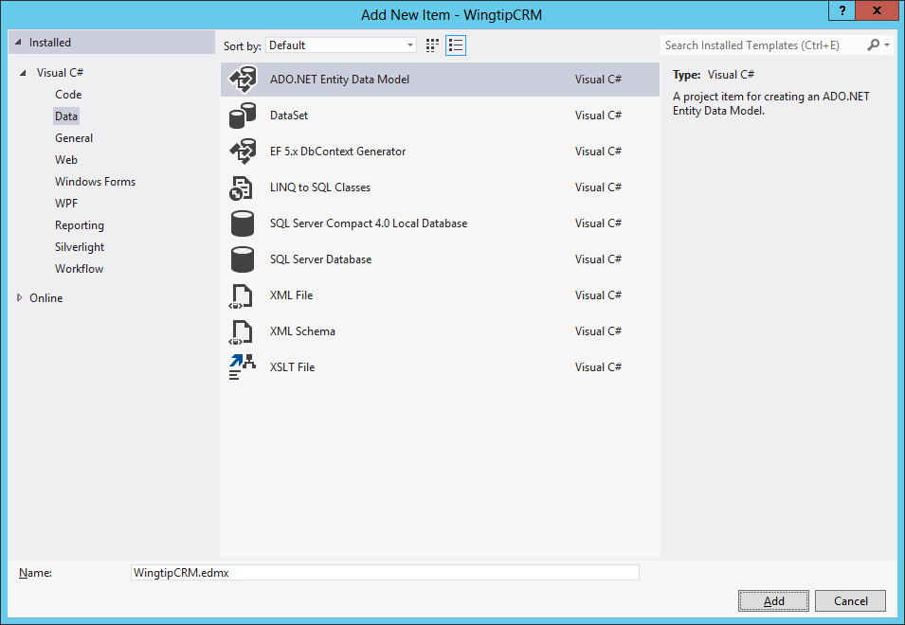
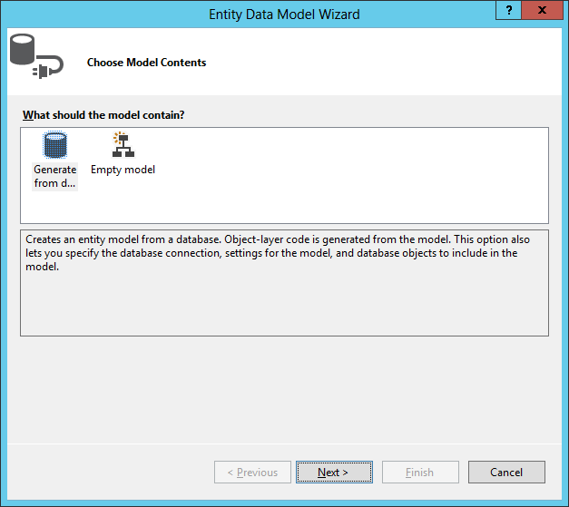
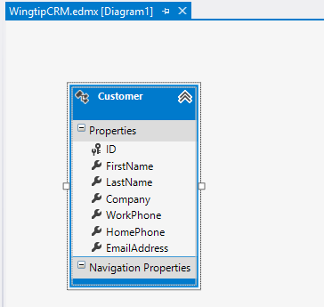
Creating a Database First Entity Model
Add new ADO.NET Entity Data Model to project
Use Entity Data Model Wizard to generate model
Inspect/Modify model using visual designer in Visual Studio
1
2
3

Slide 13
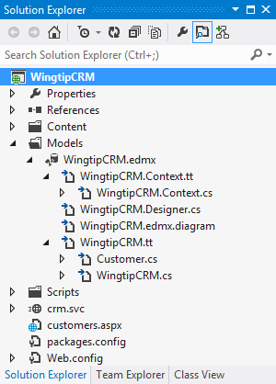
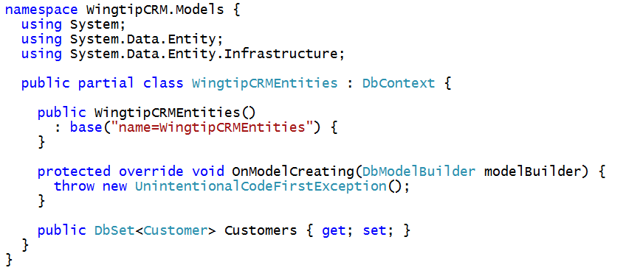
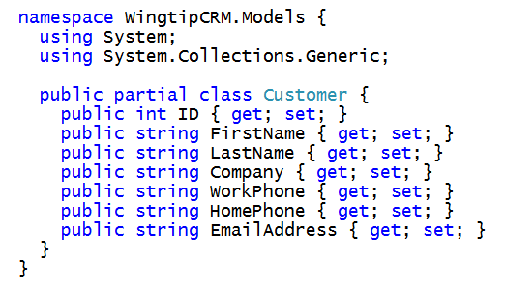
Code Generated for an Entity Model
Entity Model framework generates code for you
  Entity model class generated which inherits from DbContext
  Entity class generated for each entity you specify
  Entities tracked by entity model class using DbSet<Customer>

Slide 14
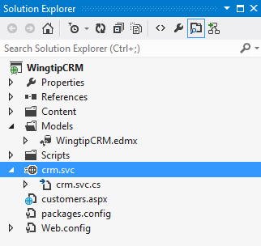
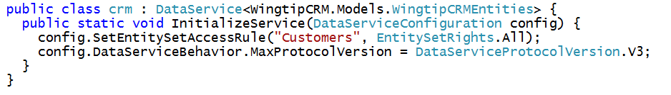
Creating an OData Service with WCF
Created using WCF Data Service project item
  .svc file add as web service entry point
  Implementation added as Data Service class in code behind
  Data Service class must be modify with entity model class
  InitializeService method used to customize service initialization

Slide 15
Implementing an OData Service to Wrap a SQL Server Database

Slide 16
Agenda
REST and OData Primer
Creating an OData Service using WCF
Executing OData Queries
Client-side OData Programming using jQuery

Slide 17
OData Query Option Parameters
$select
  http://services.odata.org/OData/OData.svc/Products?$select=Price,Name
$filter
  http://services.odata.org/OData/OData.svc/Products?$filter=startswith(CompanyName, 'Alfr')
$orderby
  http://services.odata.org/OData/OData.svc/Products?$orderby=Rating
$top
  http://services.odata.org/OData/OData.svc/Products?$top=5
$skip
  http://services.odata.org/OData/OData.svc/Products?$skip=5
  http://services.odata.org/OData/OData.svc/Products?$skip=5&$top=5
$expand
  http://services.odata.org/OData/OData.svc/Categories?$expand=Products

Slide 18
Using the $filter Parameter

Slide 19
$filter Parameter String Functions

Slide 20
Other $filter Parameter Functions

Slide 21
Executing OData Queries against a SharePoint List using the Browser

Slide 22
Agenda
REST and OData Primer
Creating an OData Service using WCF
Executing OData Queries
Client-side OData Programming using jQuery

Slide 23
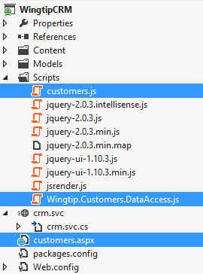
Creating A Reusable Data Access Library
Data access code is kept separate from view
  Data access code returns promise to view code
  View code encapsulated from details of data access
  View code responsible for updating user interface when required
View code
Data access code

Slide 24
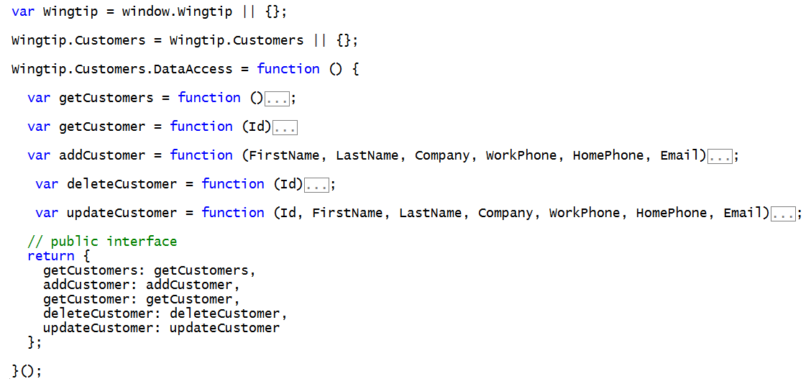
Data Access Library Starting Point
Wingtip.Customers.DataAccess.js

Slide 25
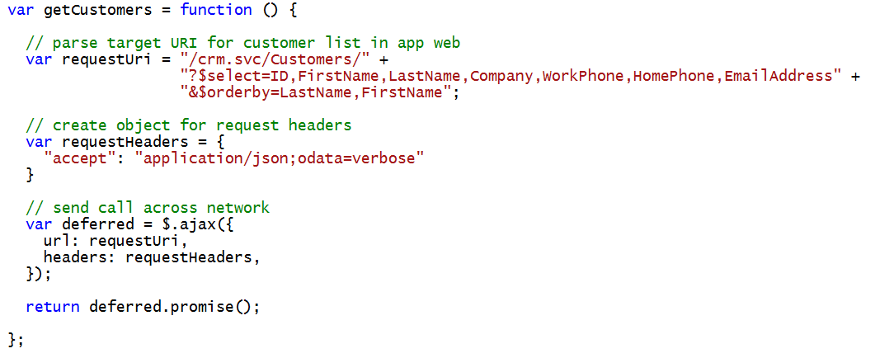
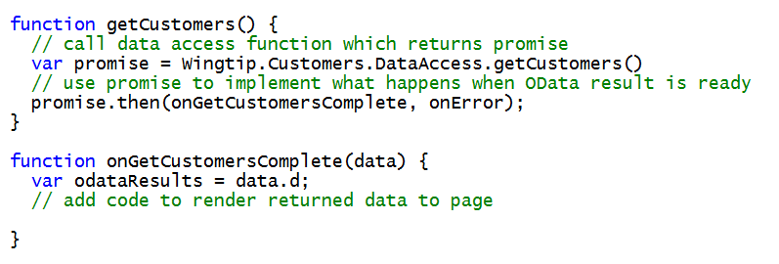
Querying Data from an OData Data Source
Wingtip.Customers.DataAccess.js
customers.js

Slide 26
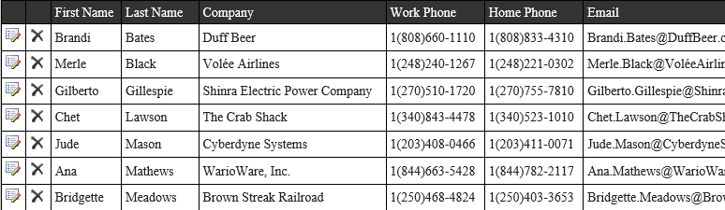
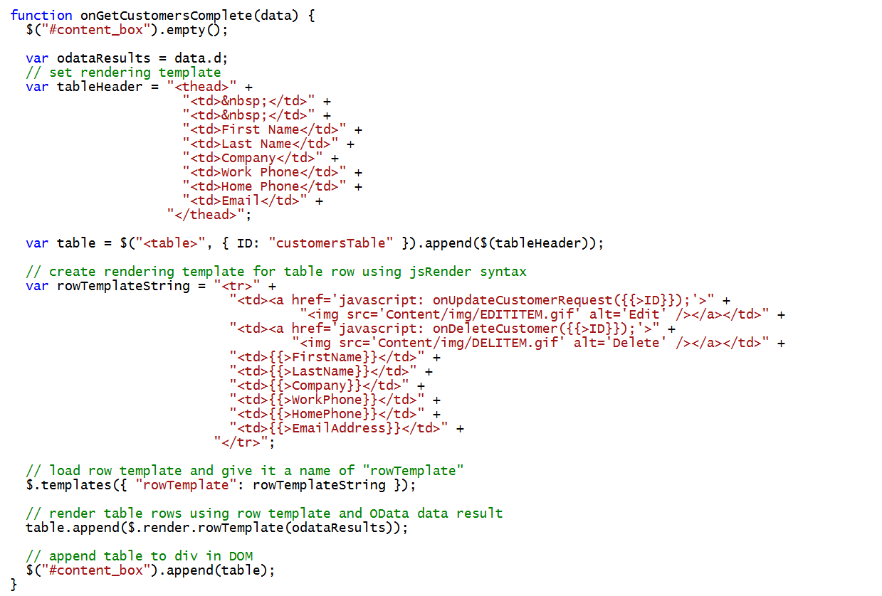
Generating an HTML Table using jsRender
customers.js

Slide 27
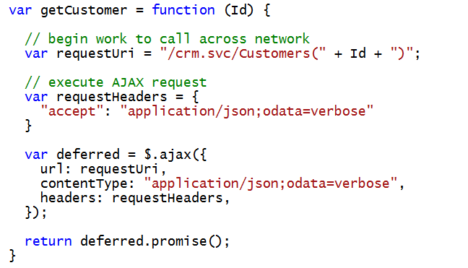
Reading a Single Item
Wingtip.Customers.DataAccess.js

Slide 28
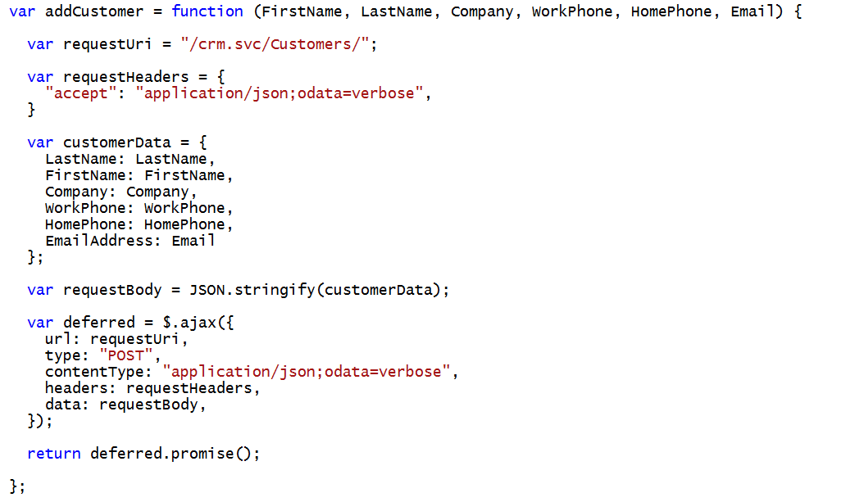
Adding an Item
Wingtip.Customers.DataAccess.js

Slide 29
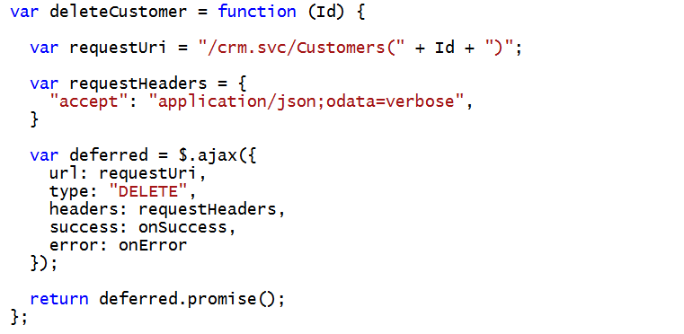
Deleting an Item
Wingtip.Customers.DataAccess.js

Slide 30
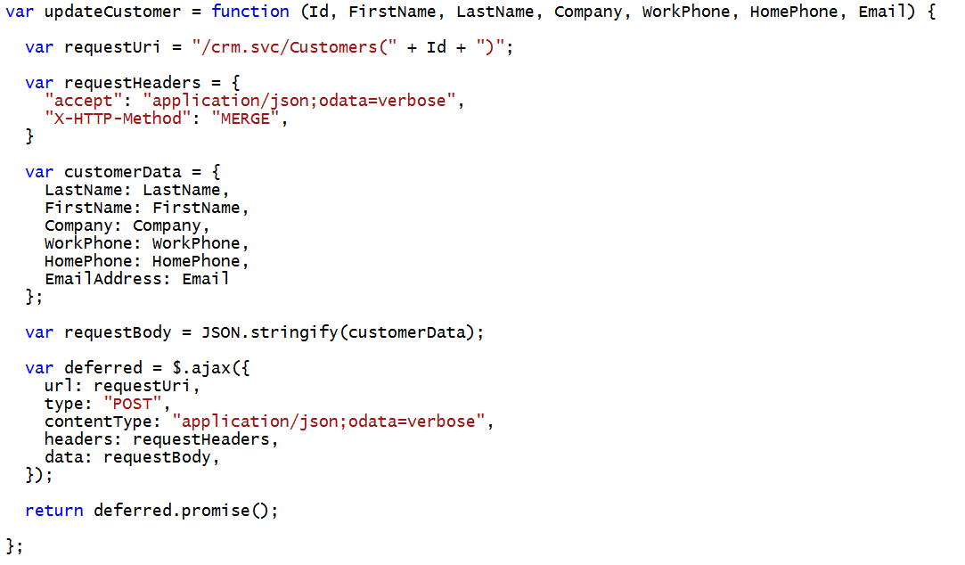
Updating an Item
Wingtip.Customers.DataAccess.js

Slide 31
Exploring the Client-side Code in the WingtipCRM project

Slide 32
Summary
REST and OData Primer
Creating an OData Service using WCF
Executing OData Queries
Client-side OData Programming using jQuery

