Slide 1
Developing SharePoint-hosted Apps
Notes:
This module provides an in-depth examination of the supporting architecture for SharePoint-hosted apps. Students will learn about the role of the app web and how to design the user interface for an app start page. Students will also learn how to leverage the app web as a storage container for creating lists and document libraries that are private to the app. The module concludes with a discussion of how to develop and test app parts in the host web where the app is installed.

Slide 2
Agenda
SharePoint-hosted App Architecture
Understanding the App Web
User Interface Design Techniques
Developing App Parts
Adding UI Custom Actions

Slide 3
SharePoint-hosted App Architecture
SharePoint-hosted app fundamentals
SharePoint host creates app web during installation
App start page and resources are added into app web
All app logic must be written in client-side JavaScript
App authentication happens behind the scenes
SharePoint Tenancy
Site Collection
Site (Host Web)
App Web
Start Page

Slide 4
Agenda
SharePoint-hosted App Architecture
Understanding the App Web
User Interface Design Techniques
Developing App Parts
Adding UI Custom Actions

Slide 5
App Web
App web is created during app installation
App web created as child to site where app is installed
SharePoint-Hosted apps must create app web
App must add start page and related resources
App can add other SharePoint elements (e.g. lists)
Provider-hosted apps can create app web
Provider-hosted apps will not create app web by default
Provider-hosted app can create app web if needed
Notes:
As previously covered, an app web is where the app is installed. This is only created when an app package contains a WSP. Therefore provider-hosted apps don’t necessarily create an app web unless they contain something that gets provisioned in SharePoint and is deployed with a WSP.

Slide 6
App Web Hosting Domain
App web pages served out of isolated domain
Isolates JavaScript code on app web pages
Allows SharePoint to authenticate callbacks from app
URL to app web made up of 4 parts
Tenancy name: wingtiptenant
APPUID: ee060af276f95a
App web hosting domain: apps.wingtip.com
App name: MyFirstApp
https://wingtiptenant-ee060af276f95a.apps.wingtip.com/MyFirstApp
Notes:
When app webs are created, they are given their own top-level domain name. The reason for this is to block cross-site-scripting attacks. The parts of this URL are specified on this slide.

Slide 7
Start Page URL
Dynamic tokens used in start page URL
SharePoint-Hosted apps use ~appWebUrl token
~appWebUrl/Pages/Default.aspx
All apps should use {StandardTokens} token
~appWebUrl/Pages/Default.aspx?{StandardTokens}
Notes:
There are two types of tokens that can be used in projects: those found at the start of a URL and those that can be used within a URL. The ones that can be used at the start of a URL start with a ~ character while those used within a URL are wrapped in curly brackets {}.
A complete token list follows and additional details can be found here:
http://msdn.microsoft.com/en-us/library/jj163816(v=office.15)

Slide 8
Agenda
SharePoint-hosted App Architecture
Understanding the App Web
User Interface Design Techniques
Developing App Parts
Adding UI Custom Actions

Slide 9
SharePoint App User Interface Design
Start page (required)
Represents user entry point into app
Can be implemented with .aspx file or .htm file
App part
External page (e.g. from app web) surfaced in host web
Displayed on host web pages using iFrame
UI custom action
URL-based command surfaced in host web
Used to create ECB commands and ribbon controls
Notes:
A host web Feature, just a standard SharePoint Feature, is something that is deployed to the host web by an app. The only things that can be included in a host web Feature are the start page, app parts and custom UI actions.

Slide 10
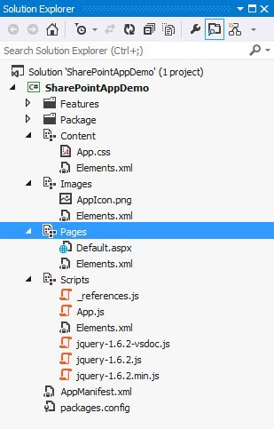
Modules in a SharePoint-Hosted App
Visual Studio adds Modules to each new project
Content
Images
Pages
Scripts
Notes:
Visual Studio adds a few SharePoint modules to a project when creating a SharePoint-Hosted App. These are used to provision style sheets, scripts, pages and images used by the application.

Slide 11
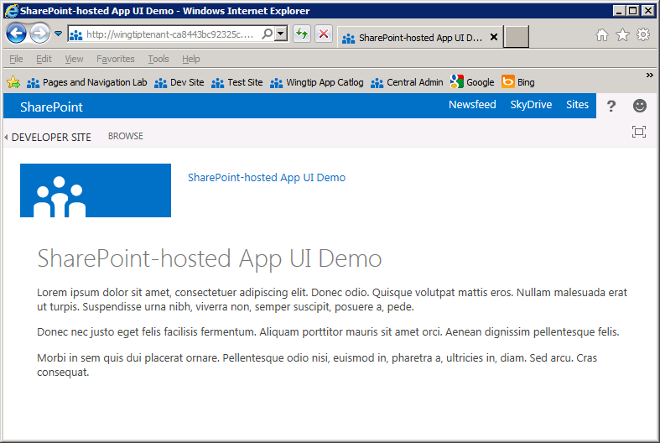
App.master
App web uses app.master by default
Gives app SharePoint look and feel
Provides app with required link back to host web
Does not have Site Actions menu or top link bar
Notes:
SharePoint-Hosted apps, by default, use a specific master page (app.master) that SharePoint provides. One thing you’ll notice is that many things from a typical SharePoint page are missing such as the Quick Launch, the top navigation bar, the site actions menu, etc.

Slide 12
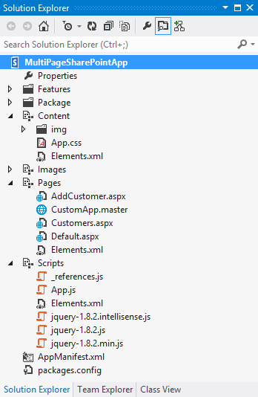
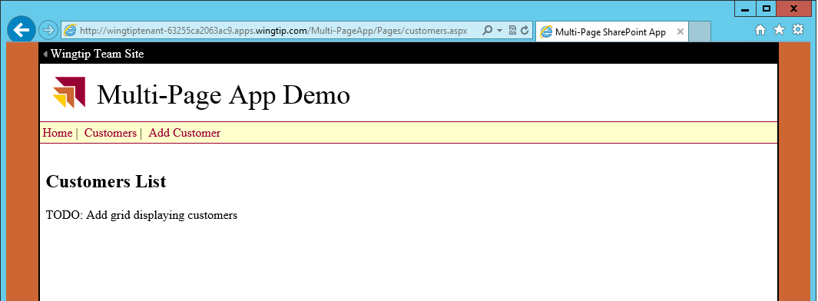
Multi-page App with Custom Master Pages
Multiple pages can use same master page
Link to host web can be added to master page
Navigation can be added to master page
Issue: query string parameters only sent to start page
Notes:
Developers are free to create custom master pages used by the pages within a SharePoint-Hosted app. Things work the same way they work in traditional ASP.NET sites in the sense that the developer is responsible for wiring things up manually.

Slide 13
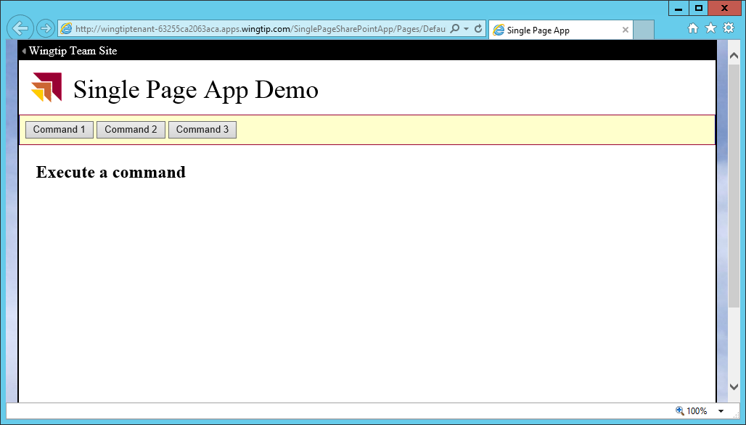
The Single Page Web App Model
Benefits of single page app
Request data posted to start page is always there
JavaScript variables do not unload/reload
App makes AJAX calls and uses client-side JavaScript
Design leads to better and more fluid user experience
Web Server
Page
AJAX
Web Service Entry Points

Slide 14
Creating a Single Page App

Slide 15
Agenda
SharePoint-hosted App Architecture
Understanding the App Web
User Interface Design Techniques
Developing App Parts
Adding UI Custom Actions

Slide 16
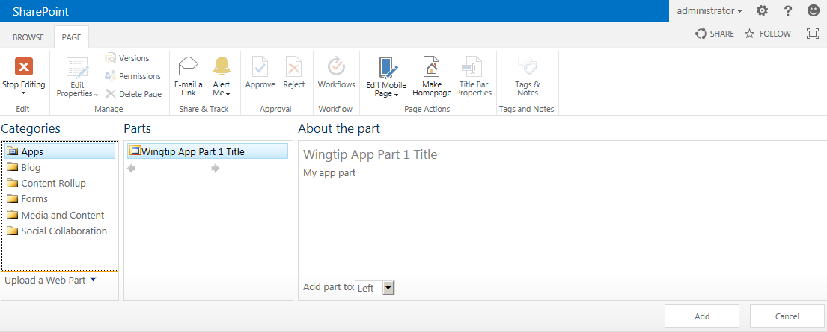
Creating App Parts Using Client Web Parts
App parts are implemented using client Web Part
App parts added to host web pages as Web Parts
<?xml version="1.0" encoding="utf-8"?>
<Elements xmlns="http://schemas.microsoft.com/sharepoint/">
<ClientWebPart Name="AppPart1"
Title="Wingtip App Part Title"
Description="My app part"
DefaultWidth="600"
DefaultHeight="360">
<Content Type="html" Src="~remoteAppUrl/Pages/AppPart.aspx?{StandardTokens}" />
</ClientWebPart>
</Elements>
Notes:
SharePoint 2013 introduces a new artifact to supplement the server-side nature of the Web Part and Visual Web Part. The Client Web Part is meant to provide Web Part like functionality but without the server-side code and thus, to make apps more useful. Effectively what happens is the Client Web Part renders an HTML IFrame that loads another page but looks and acts like a regular Web Part. This other page can come from a page hosted in the app web or in the remote web.

Slide 17
Agenda
SharePoint-hosted App Architecture
Understanding the App Web
User Interface Design Techniques
Developing App Parts
Adding UI Custom Actions

Slide 18
Developing App Parts

Slide 19
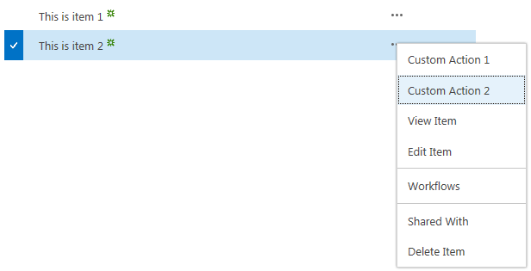
Creating UI Custom Actions
UI custom actions used to extend host web UI
Used to create ECB menu items and ribbon buttons
Cannot use JavaScript or other types of custom actions
Supports many dynamic tokens related to host page, item and list
<?xml version="1.0" encoding="utf-8"?>
<Elements xmlns="http://schemas.microsoft.com/sharepoint/">
<CustomAction Id="CustomAction1"
RegistrationType="List"
RegistrationId="100"
Location="EditControlBlock"
Sequence="10"
Title="Custom Action">
<UrlAction Url="~remoteAppUrl/Pages/CustomAction.aspx?Source={Source}
&amp;ListURLDir={ListUrlDir}&amp;ListID={ListId}
&amp;ItemURL={ItemUrl}&amp;ItemID={ItemId}
&amp;{StandardTokens}"/>
</CustomAction>
</Elements>
Notes:
Like previous versions of SharePoint, SharePoint 2013 includes Custom Actions which allows developers to add navigation elements to various places in SharePoint. New in SharePoint 2013 is the ability to make these custom actions launch a dialog and not just redirect to another page.

Slide 20
URL Tokens for Custom Actions
Certain tokens must be used with certain actions
Token use changes between ECB actions and Ribbon actions
Token | Purpose
{AppWebUrl} | URL of the app web in an app for SharePoint
{HostLogoUrl} | Logo for the host web of an app for SharePoint
{HostTitle} | Title of the host web of an app for SharePoint
{HostUrl} | URL of the host web of an app for SharePoint
{ItemId} | Integer-based ID of item in a list or library (ECB menu actions only)
{SelectedItemId} | Array of item IDs in a list or library (Ribbon menu actions only)
{ItemUrl} | URL of target item being acted upon (ECB menu actions only)
{SelectedItemUrl} | URL array of target items being acted upon (Ribbon menu actions only)
{Language} | current language/culture of the host web of an app for SharePoint
{ListId} | ID of the current list (a GUID).
{RecurrenceId} | Recurrence index of a recurring event
{Site} | URL of the current website
{SiteCollection} | URL of the parent site of the current website
{SiteUrl} | URL of the current website
Notes:
Tokens that can be used within the URL you create for your apps:
{AppWebUrl}: URL of the app web in an app for SharePoint.
{HostLogoUrl}: logo for the host web of an app for SharePoint.
{HostTitle}: title of the host web of an app for SharePoint.
{HostUrl}: URL of the host web of an app for SharePoint.
{ItemId}: integer-based ID of item (ECB menu actions).
{SelectedItemId}: array of item IDs in list (Ribbon menu actions).
{ItemUrl}: URL of target item (ECB menu actions).
{SelectedItemUrl}: URL array of target items (Ribbon menu actions).
{Language}: current language/culture of host web.
{ListId}: ID of the current list (a GUID).
{RecurrenceId}: recurrence index of a recurring event.
{Site}: URL of the current website.
{SiteCollection}: URL of the parent site of the current website.
{SiteUrl}: URL of the current website

Slide 21
Adding UI Custom Actions

Slide 22
Summary
SharePoint-hosted App Architecture
Understanding the App Web
User Interface Design Techniques
Developing App Parts
Adding UI Custom Actions

