Slide 1
Building Apps with SharePoint Services
Notes:
This module discusses how to incorporate SharePoint 2013 services into the design and implementation of a SharePoint App. You will learn how to create SharePoint Apps that consume services from the Business Data Connectivity Services (BCS), the Secure Store Service the Managed Metadata Service, the User Profile Service and the SharePoint Search Service.

Slide 2
Agenda
SharePoint Services Overview
User Profile Service
Managed Metadata Service
SharePoint Search Service
Business Connectivity Services (BCS)

Slide 3
SharePoint Services
SharePoint Services accessible to app developers
Provides familiar functionality (e.g. user profiles, search)
Apps might be installed in varying environments
SharePoint farm might not have specific services available
SharePoint tenancy can be restricted from using specific services
SharePoint site might not have certain features enabled
App can define App Prerequisites
App will not install unless prerequisites are met by host

Slide 4
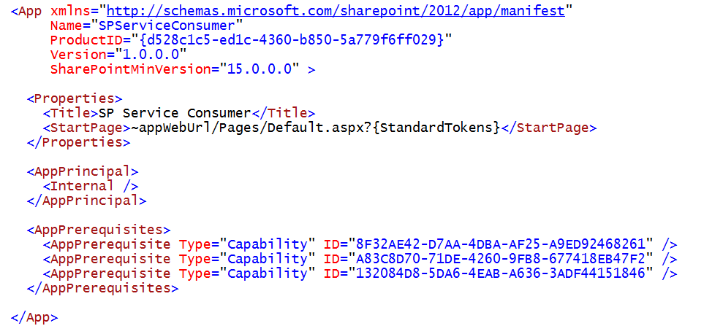
App Prerequisites
App prerequisites defined in AppManifest.xml
Service prerequisites defined as type Capability
Each SharePoint service identified using a GUID

Slide 5
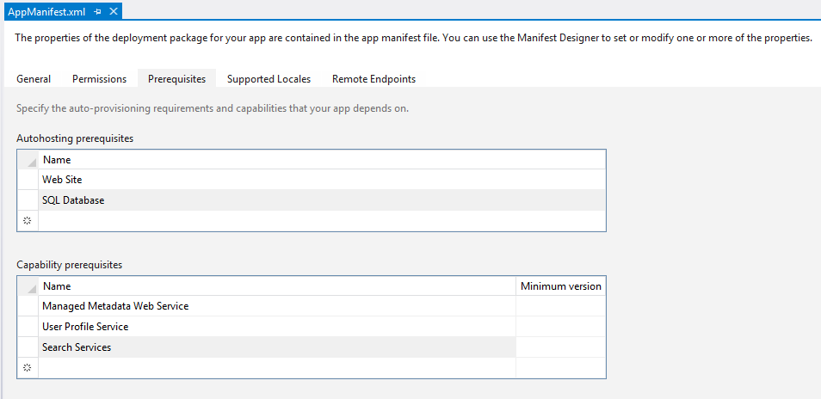
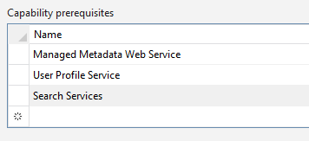
Configuring Capability Prerequisites

Slide 6
Configuring a SharePoint App with Capability Prerequisites

Slide 7
Agenda
SharePoint Services Overview
Managed Metadata Service
User Profile Service
SharePoint Search Service
Business Connectivity Services (BCS)

Slide 8
Managed Metadata Service
Term Store Management
Default Keyword Store
Shared Enterprise Term Store
User Profile Service Term Store
Enterprise Content Types
Syndication of Content Types
Content Type Publishing (Push Down)

Slide 9
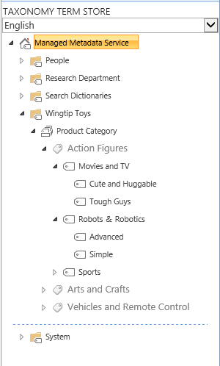
Understanding Terms and Term Sets
Term Store
Term Group
Term Set
Term
Term
Term

Slide 10
Term Sets
Flat
Red
Blue
Hierarchical
North America>USA>Texas>Paris
Europe>France>Paris
Taxonomy
Structured Controlled
Generally Closed
Folksonomy
Unstructured
Generally Open

Slide 11
Programming Managed Metadata

Slide 12
Agenda
SharePoint Services Overview
Managed Metadata Service
User Profile Service
SharePoint Search Service
Business Connectivity Services (BCS)

Slide 13
The User Profile Service
User Profile Data
User Profile Synchronization
Active Directory
Third Party Stores for augmentation via BCS
Audiences
Based on User Attributes
Based on User Profile Properties
Supports MySite Data
Social Tags
Followers and Following
Social Feeds

Slide 14
Working with MySites
My Site Host (http://my)
Profile
Newsfeed Social Views
Personal Site (http://my/personal/kens)
Personal Content and Apps
Manage Following
Task Management
MySite links are everywhere
About Me
People search results
Anywhere you see a person’s presence

Slide 15
REST Services for Social Networking
REST APIs in SharePoint 2013
User Profile
Social
Creating the required URIs
http://<site>/_api/social.feed/my/Feed/Post
http://<site>/_api/social.feed/post/Reply
http://<siteUri>/_api/SP.UserProfiles.PeopleManager
PeopleManager/GetUserProfilePropertyFor( accountName=@v, propertyName='PreferredName')?@v='domain\user'

Slide 16
What you can do…
Get Profiles and Properties
Get Feeds and Replies*
Update the Current Users Picture
Create posts for the Current User
* (some assembly required)

Slide 17
What you cannot do…
Find out if an account exists
Create a User Profile
Change a User Profile*
Delete a User Profile
Create posts for another user

Slide 18
Programming User Profiles

Slide 19
Agenda
SharePoint Services Overview
Managed Metadata Service
User Profile Service
SharePoint Search Service
Business Connectivity Services (BCS)

Slide 20
SharePoint 2013 Search Architecture
Public API
Unit of scale/role boundary
Content Processing
Search Index
Crawl
Index
Query Processing
WFE
API
Content
UX
Analytics
Processing
Search
Admin
Notes:
The crawl component crawls content sources to collect crawled properties and metadata from crawled items. It sends this information to the content processing component.
The content processing component transforms the crawled items so that they can be included in the search index. The component also maps crawled properties to managed properties. In addition, the content processing component interacts with the analytics processing component.
The analytics processing component analyzes the crawled items and how users interact with their search results. The information is used to improve the search relevance, and to create search reports and recommendations.
The index component receives the processed items from the content processing component and writes them to the search index. The component also handles incoming queries, retrieves information from the search index and sends the results back to the query processing component.
The query processing component analyzes incoming queries to help optimize precision, recall (which items are returned in the results) and ranking (the order of those items). The query is then sent to the index component which returns a set of search results for the query. The results can then be further processed before they are presented to the user as the search results for his/her query.
The search administration component runs the required search processes and adds and initializes new instances of search components.
The crawl database contains detailed tracking and historical information about crawled items such as documents and links. The database holds information such as the last crawl time, the last crawl ID and the type of update during the last crawl (add, update, delete).
The link database stores the information extracted by the content processing component and click-through information.
The analytics reporting database stores the results of search and usage analysis, such as the number of times an item has been viewed.
The search administration database stores settings for the Search service application, such as the topology, crawl rules, query rules and the mappings between crawled and managed properties.

Slide 21
Configuring the SharePoint Search Service
Central Administration (SSA)
Content Sources
Result Sources
Query Rules
New Managed Properties
Site Collection and Site
Result Sources
Result Types
Query Rules
Reassign Managed Properties

Slide 22
Managed Properties
Not only for Administrators anymore
Farm
Site Collection
Site
Managed Property Controls
Type & Multivalue
Query, Search, Retrieve, Refine, Sort, Safe

Slide 23
Keyword Query Language (KQL)
Free text
SharePoint
Wildcard
Share*
Property
Author:McD*, ContentType:Image
NEAR, ONEAR
SharePoint NEAR Social

Slide 24
Executing Queries against the SharePoint Search Service

Slide 25
Agenda
SharePoint Services Overview
Managed Metadata Service
User Profile Service
SharePoint Search Service
Business Connectivity Services (BCS)

Slide 26
Business Data Connectivity Services (BCS)
Integrates SharePoint with external data sources
External data can be surfaced through SharePoint sites
Supports write back to external data source
External data can also be surfaced in Office clients
Notes:
Systems such as customer relationship management (CRM) and enterprise resource planning (ERP) have special roles that are not replaced easily by Microsoft SharePoint. As a result, strategies must be adopted to provide interoperability between SharePoint and these systems.In the absence of a strategy for integrating systems with SharePoint, many organizations duplicate information in SharePoint lists. Customer contact information, for example, may exist in a CRM system and also be entered into a contact list in SharePoint. Worse still, the data may be duplicated many times in different team sites by different groups. This kind of duplication leads to significant data maintenance issues because updates must be performed in many lists.
Along with these existing systems, custom applications, databases, and Web services are common within organizations. When a separate database is required, developers have historically created ASP.NET applications or custom Web Parts that act as front ends for the database to have the data appear in the SharePoint environment. However, these types of solutions generally offer little integration with SharePoint capabilities; they are largely limited to presenting data within a SharePoint Web page.
Business Connectivity Services (BCS) changes all the rules for integrating systems, databases, and Web services with SharePoint. Beyond simply bringing data into SharePoint for display, BCS allows for capabilities that simply can’t exist in an ASP.NET application or custom Web Part without a significant investment. These capabilities include enterprise search, External Data columns, user profile integration, client synchronization, offline support, and Microsoft Word integration.BCS is a set of out-of-box features, services and tools that streamline the creation of SharePoint Solutions with deep integration of External Data and Services. Power users, IT, Devs can create no code solutions using BCS.The basics of ECT store and BDC runtime are baked into SharePoint Foundation 2013.
Why BCS?
Integrate other Line of Business application systems with SharePoint sites.
Search for data in other systems via the SharePoint Search service.
Save the time, cost, and monotony of writing yet another data layer!

Slide 27
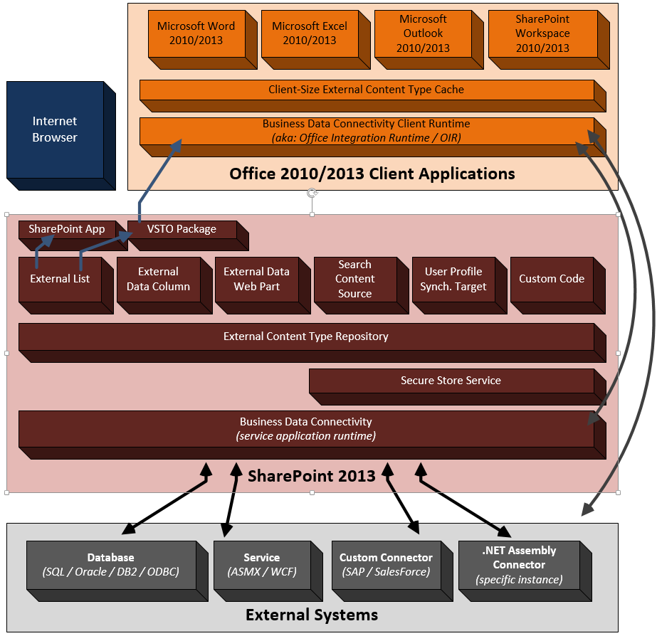
BCS Architecture

Slide 28
Creating ECTs with OData Data Sources
OData support is new to SharePoint 2013
Important protocol for services on Internet
Visual Studio can generate ECT metadata
You simply point it to an OData data source
It builds the ECT and adds it to your app project
Notes:
BCS in SharePoint Online
BCS and SSS will be enabled at the tenant level for SharePoint Online

Slide 29
SharePoint App Scoped ECTs
In SharePoint 2010, all ECTs were farm scoped
SharePoint 2013 model offers more granularity
You can define ECTs within a SharePoint App
SharePoint Site
FileBackedMetadataCatalog
BDC Runtime
External System
BusinessDataMetadataCatalog
SP List
External List
Notes:
In SharePoint 2013, External Content Types could only be installed and used at the farm level. This caused a problem for developers because, even for simple applications, an administrator had to be involved because of the access rights needed to install at the farm level.
In SharePoint 2013, a new paradigm is introduced that more or less isolates applications into more autonomous units, more simply, Apps. They generally will contain all the resources they need within the App itself and will be insulated from other Apps. The benefit of this architecture is that 1) Developers can create Apps that are aligned with the new Apps model of SharePoint 2013, 2) developers can create Apps that access external data from SAP, Netflix, proprietary and other types of data without involving the tenant administrator and 3) access to external applications is maintained through BCS, which provides a consistent and uniform interface that can be used by other SharePoint Apps .
BDC Metadata Models will be saved in library named BusinessDataMetadataCatalog. This means you can upload a BDC Metadata Model to the site, or include it within the definition of an App.
External List will have new property named MetadataCatalogFileName that refers to the BDCM model file located in the library.
The FileBackedMetadataCatalog class will load the BDC Metadata Model and then the External List will render.
Support for OData, WCF, and SQL only. No support for .NET Assembly Connectors or Custom Connectors.

Slide 30
OData Sources
Creating External Content Types
<?xml version="1.0" encoding="utf-8"?>
<LobSystem Name="ODataWebNorthwindModel" Type="OData">
<Properties>
<Property Name="ODataServiceMetadataUrl" Type="System.String">
http://services.odata.org/Northwind/Northwind.svc/$metadata
</Property>
<Property Name="ODataMetadataAuthenticationMode" Type="System.String">PassThrough</Property>
<Property Name="ODataServicesVersion" Type="System.String">2.0</Property>
</Properties>
<LobSystemInstances>
<LobSystemInstance Name="http://services.odata.org/Northwind/Northwind.svc">
<Properties>
<Property Name="ODataServiceUrl" Type="System.String">
http://services.odata.org/Northwind/Northwind.svc
</Property>
<Property Name="ODataServiceAuthenticationMode“
Type="System.String">PassThrough</Property>
<Property Name="ODataFormat" Type="System.String">application/atom+xml</Property>
</Properties>
</LobSystemInstance>
</LobSystemInstances>
</LobSystem>
Notes:
This is a portion of a BDC Metadata Model showing how an OData source can be accessed
Type - This attribute must be set to ODATA when working with OData datasources.
ODataServiceMetadataUrl- Provides the end point of the metadata service.
ODataAuthenticationMode - The authentication mode used by the datasource to allow access and what type of access to the calling API.
ODataServicesVersion - The version of OData
ODataServiceUrl- The endpoint for the service
ODataFormat- The format for the returned data

Slide 31
External List Instances for App Scoped ECTs
<ListInstance Id="AppScopedList"
Title="My App Scoped List"
Description="My App Scoped List"
Url="$Resources:core,lists_Folder;/AppScopedList"
OnQuickLaunch="TRUE">
<DataSource>
<Property Name="LobSystemInstance" Value="" />
<Property Name="EntityNamespace" Value="" />
<Property Name="Entity" Value="" />
<Property Name="SpecificFinder" Value="" />
<Property Name="MetadataCatalogFileName" Value="BDCMetadata.bdcm" />
</DataSource>
</ListInstance>

Slide 32
New BCS CSOM and REST API
CSOM:
REST API:
var ctx = new SP.ClientContext();
var web = ctx.get_web();
entity = web.getAppBdcCatalog().getEntity(entityNameSpace, entityName);
ctx.load(entity);
lobSystem = entity.getLobSystem();
ctx.load(lobSystem);
lobSystemInstances = lobSystem.getLobSystemInstances();
ctx.load(lobSystemInstances);
ctx.executeQueryAsync(success, failure);
AppLevelECT.Grid.prototype = {
init: function () {
var query = siteUrl + "_api/lists/getbytitle('Person')/items?$select=FirstName,LastName"
$.ajax({
url: query,
headers: { "ACCEPT": "application/json",
"X-RequestDigest": $("#__REQUESTDIGEST").val()
},
success: this.showItems
});
},
showItems: function (data) {
var resultString = "";
$.each(data.d.results, function (key, val) {
resultString += val.FirstName + " " + val.LastName + "\n";
});
alert(resultString);
}
}
Notes:
This slide shows how to use the BCS object model through CSOM & REST APIs

Slide 33
Creating an External Content Type Scoped at the App Level

Slide 34
Summary
SharePoint Services Overview
Managed Metadata Service
User Profile Service
SharePoint Search Service
Business Connectivity Services (BCS)

