Slide 1
Creating Web Services with the Web API
Notes:
The module provides an introduction to the techniques and concepts required to develop custom web services using the Web API. Students will learn how to create API Controllers as well as how to call API Controllers from client-side code on the pages of an MVC App. Students will learn the difference between implementing a RESTful service and an OData service with the Web API. The module concludes with an examination of using Cross Origin Resource Sharing (CORS) with the Web API in a provider-hosted app.

Slide 2
Agenda
Introducing WebAPI
Calling API Controllers from MVC Apps
Creating a RESTful Service
Creating an OData Service
Using Cross-Origin Resource Sharing

Slide 3
Introducing WebAPI
Framework and tooling for building RESTful services
Part of ASP.NET MVC
Uses Controller and Routing paradigm
Tooling, wizards, scaffolding
Simplified creation of REST and OData services
Simplified use of Entity Framework to wrap database operations
Can be a stand-alone service or part of an app
When added to an app, you perform additional manual modifications to Global.asax

Slide 4
Controllers
Controllers inherit from ApiController
By default methods are mapped to HTTP verbs
public class ValuesController : ApiController
public IEnumerable<string> Get() {}
public string Get(int id) {}
public void Post([FromBody]string value){}
public void Put(int id, [FromBody]string value){}
public void Delete(int id){}

Slide 5
Routing
Routes are controlled through maps
Router makes decisions if information is missing
Similar to MVC
By default methods are mapped to HTTP verbs
config.Routes.MapHttpRoute(
name: "DefaultApi",
routeTemplate: "api/{controller}/{id}",
defaults: new { id = RouteParameter.Optional }
);

Slide 6
Responding
Content Negotiation is automatic
accept: "application/json"
accept: "application/xml"
Return IQueryable to support query syntax
Return HttpResponseMessage for headers and status
public IQueryable<string> Get()
{
var d = new List<string>() {"a", "b" };
return d.AsQueryable();
}
public HttpResponseMessage Get(int id)
{
return Request.CreateResponse<string>(HttpStatusCode.OK, data[id - 1]);
}

Slide 7
Agenda
Introducing WebAPI
Calling API Controllers from MVC Apps
Creating a RESTful Service
Creating an OData Service
Using Cross-Origin Resource Sharing

Slide 8
Scenarios to Consider
Additional API Controllers NOT Required
You don’t require JavaScript access to the data
App has direct EF access to database anyway
Additional API Controllers MAY be Required
You require JavaScript access to the data
Data source cannot be accessed directly using EF
Want to support clients outside of the App

Slide 9
Adding an API Controller
Create a new Provider-Hosted App
Based on ASP.NET MVC Web Application template
Add a new Web API 2 Controller
Use any template
Modify the Global.asax file
Additional using statements
Additional configuration commands

Slide 10
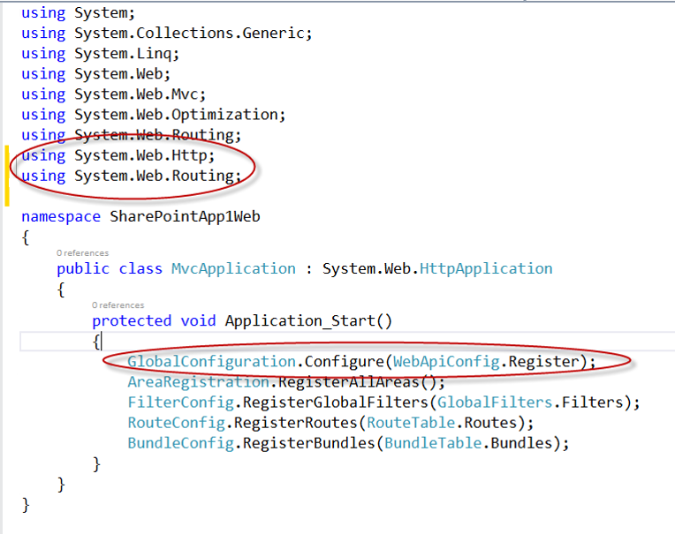
Modifying the Global.asax File
Must be first line

Slide 11
Calling an API Controller
Add a new MVC5 Controller
Use existing Index method
Or add a new method to an existing controller
Add a View for the Method
Call from Managed Code
HttpWebRequest
Call from JavaScript
jQuery ajax

Slide 12
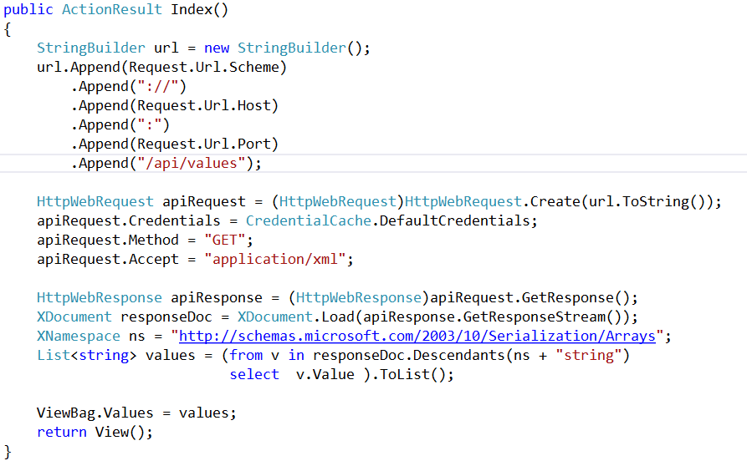
Calling with Managed Code

Slide 13
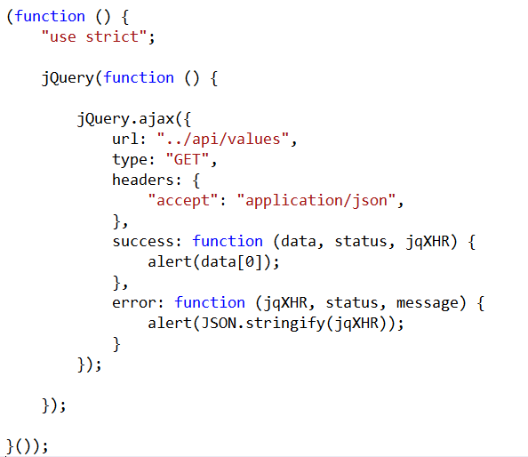
Calling with JavaScript

Slide 14
Calling API Controllers from MVC Apps

Slide 15
Agenda
Introducing WebAPI
Calling API Controllers from MVC Apps
Creating a RESTful Service
Creating an OData Service
Using Cross-Origin Resource Sharing

Slide 16
REST Constraints
Client-Server
Client pulls representations from the server
Separation of concerns
Stateless
Client provides all necessary context
Server returns all necessary state
Cache
Responses indicate whether or not they can be cached
eTag, Date, Expires headers
Interface
Resources are accessible through URIs
Resources operations are through HTTP verbs
The same representations can be used for all operations
Resources are interconnected to allow linking
Layered
Resources are unaffected by proxy servers, gateways, etc.

Slide 17
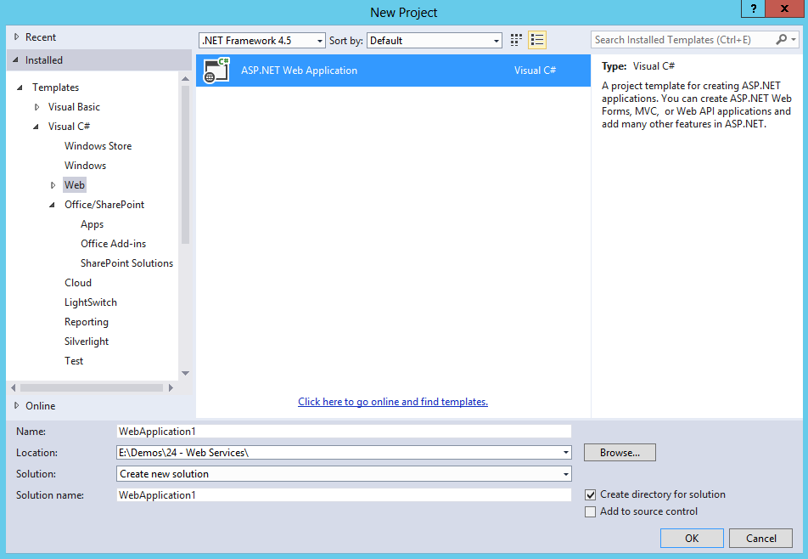
Creating a Stand-Alone RESTful Service

Slide 18
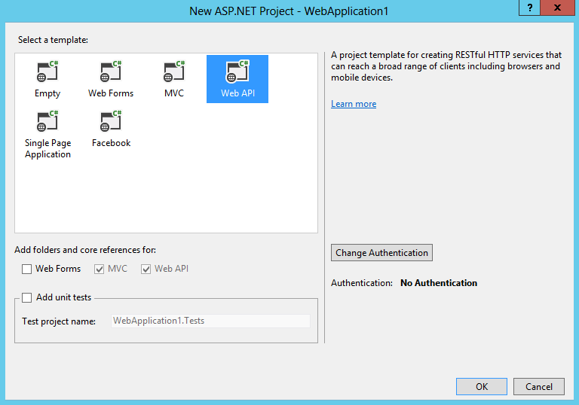
Creating a Stand-Alone RESTful Service

Slide 19
Creating and Testing a RESTful Service

Slide 20
Agenda
Introducing WebAPI
Calling API Controllers from MVC Apps
Creating a RESTful Service
Creating an OData Service
Using Cross-Origin Resource Sharing

Slide 21
Open Data Protocol (OData)
Standardized REST API for CRUD operations
Standardized Data Types
Standardized URI format
<Property Name="Id" Type="Edm.Guid" Nullable="false"/>
<Property Name="Title" Type="Edm.String"/>
<Property Name="TreeViewEnabled" Type="Edm.Boolean" Nullable="false"/>
<Property Name="UIVersion" Type="Edm.Int32" Nullable="false"/>

Slide 22
OData Entity Model
Service Document
$metadata
Entity Types define entities
Entity Key defines unique property
Associations link entities together
<EntityType Name="Site">
<EntityType Name="Web" BaseType="SP.SecurableObject">
<EntityType Name="List" BaseType="SP.SecurableObject">
<EntityType Name="ListItem" BaseType="SP.SecurableObject" OpenType="true">
<Key><PropertyRef Name="Id"/></Key>
<NavigationProperty Name="RootWeb" …

Slide 23
OData Query Options
$select
$filter
$orderby
$top
$skip
$expand

Slide 24
Controllers
Controllers inherit from ODataController
Methods are mapped to HTTP verbs just like ApiController
Content Negotiation is automatic
IQueryable generated by default
public class ContactsController : ODataController

Slide 25
Routing
Routes are controlled through maps
Router makes decisions if information is missing
By default methods are mapped to HTTP verbs
ODataConventionModelBuilder builder = new ODataConventionModelBuilder();
builder.EntitySet<Contact>("Contacts");
builder.EntitySet<Company>("Companies");
config.Routes.MapODataRoute("odata", "odata", builder.GetEdmModel());

Slide 26
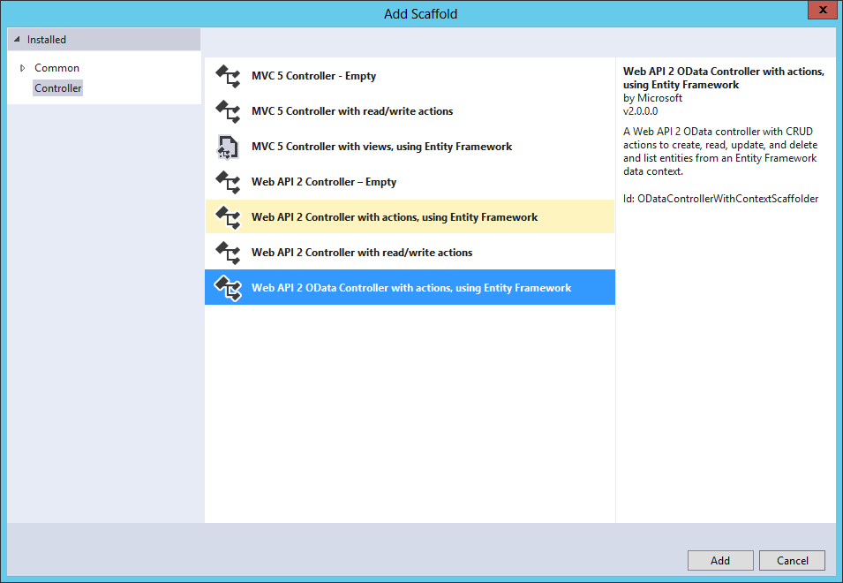
Adding an OData Controller

Slide 27
Creating and Testing an OData Service

Slide 28
Agenda
Introducing WebAPI
Calling API Controllers from MVC Apps
Creating a RESTful Service
Creating an OData Service
Using Cross-Origin Resource Sharing

Slide 29
Cross-Origin Resource Sharing
Allows JavaScript to make a call across domains
Superior to JSONP, which only supports GET
Supported in current versions of all major browsers
Browser and resource exchange headers
Origin header from browser contains origin requesting
Access-Control-Allow-Origin header returned from resource if call is allowed
Enabling in WebAPI2
Install Microsoft ASP.NET WebAPI2 CORS NuGet Package
Enable CORS in WebApiConfig
Use [EnableCors] attribute in controllers

Slide 30




Security Considerations
Secure Sockets Layer – always!
Always validate calling domain
Allowing all domains can open network to attack
Service not validating domains
Script gains access
Page with malicious script

Slide 31
Cross-Origin Resource Sharing

Slide 32
Summary
Introducing WebAPI
Calling API Controllers from MVC Apps
Creating a RESTful Service
Creating an OData Service
Using Cross-Origin Resource Sharing

