Slide 1
Designing and Building Multidimensional Cubes
Notes:
The purpose of this module is to demystify the concepts and components used in traditional BI solutions that involve a data warehouse. Students will be introduced to important BI terminology such as facts, dimensions, cubes and KPIs. Student will also learn about the differences between Tabular Modeling and Multidimensional Modeling. The module demonstrates how to create a simple data warehouse using SQL Server Analysis Services and the SQL Server Data Tools (SSDT). Along the way students will create a data model which includes cubes and KPIs. Students will also learn how to deploy the data model to SQL Server Analysis Services where is can be consumed from an Excel Workbook.

Slide 2
Agenda
Data Warehouse Concepts and Terminology
Tabular Modeling
Data Modeling with the SQL Server Data Tools
Multidimensional Modeling and Cubes
Creating a Cube with the SQL Server Data Tools

Slide 3
OTLP Table Types
Types of tables in OLTP
Fact Table
Dimension Table
Both types of tables have surrogate keys
Efficient integer column

Slide 4
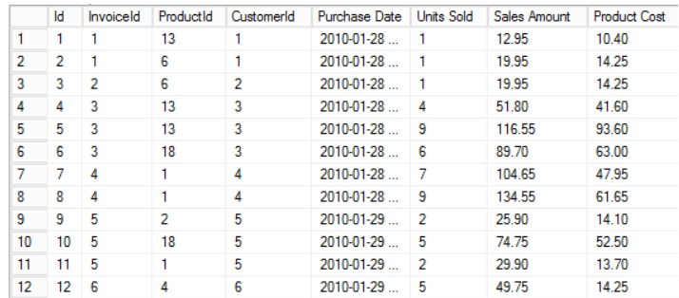
Fact Table
Fact Tables
Each row marks event that happened at a specific time
Facts hold numeric values which constitute measures
Facts are joined to dimensions using keys

Slide 5
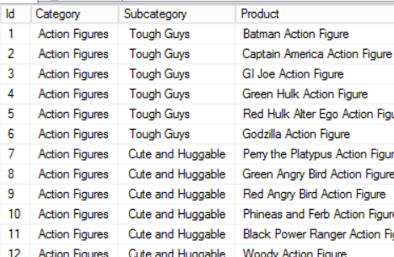
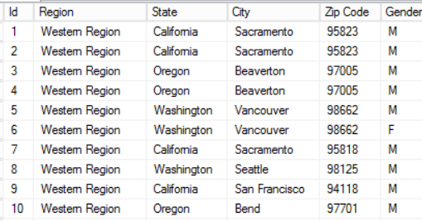
Dimension Tables
Dimensions hold the values that describe facts
Commonly-used dimensions
Time
Geography
Customer
Customer Attribute
Invoice Attribute

Slide 6
Hierarchical Dimensions
Year > Month > Week > Day
Sales Region > State > City > Zip
Product Categories

Slide 7
Agenda
Data Warehouse Concepts and Terminology
Tabular Modeling
Data Modeling with the SQL Server Data Tools
Multidimensional Modeling and Cubes
Creating a Cube with the SQL Server Data Tools

Slide 8
Creating a Tabular Data Model
Use Excel 2013 and PowerPivot
Use the SQL Server Data Tools

Slide 9
Agenda
Data Warehouse Concepts and Terminology
Tabular Modeling
Data Modeling with the SQL Server Data Tools
Multidimensional Modeling and Cubes
Creating a Cube with the SQL Server Data Tools

Slide 10
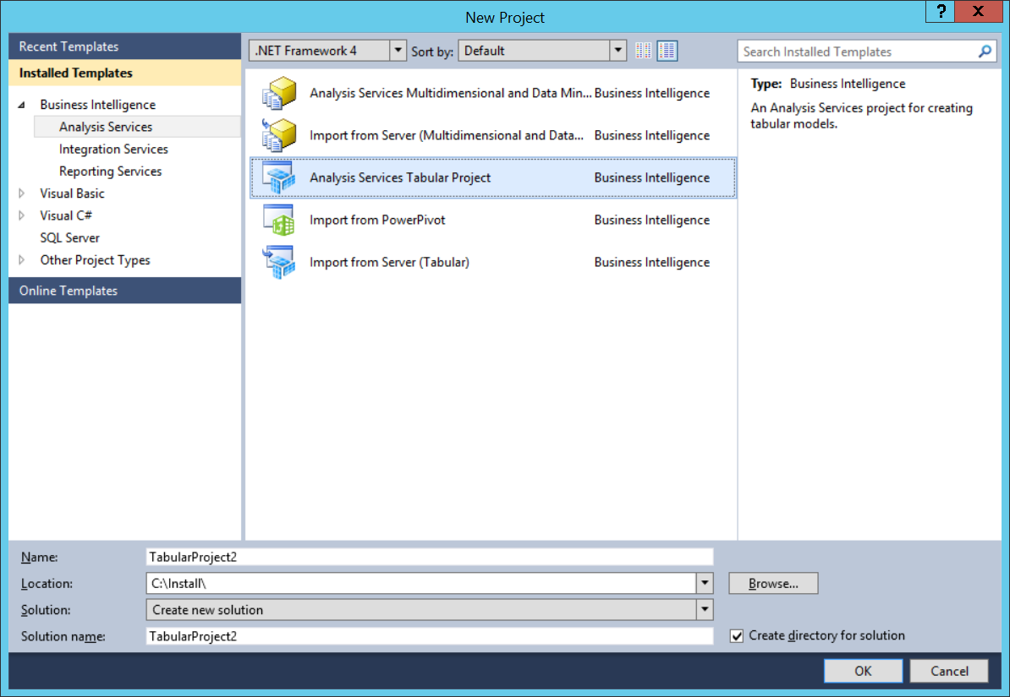
Creating a New Project

Slide 11
Agenda
Data Warehouse Concepts and Terminology
Tabular Modeling
Data Modeling with the SQL Server Data Tools
Multidimensional Modeling and Cubes
Creating a Cube with the SQL Server Data Tools

Slide 12
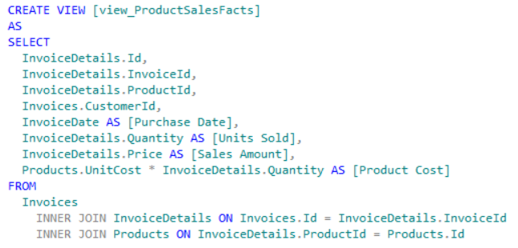
View to Create Fact Table

Slide 13
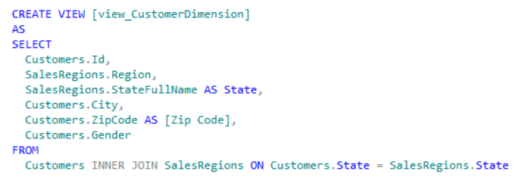
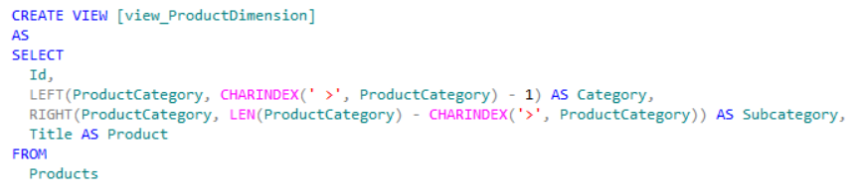
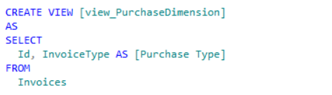
Views to Create Dimension Tables

Slide 14
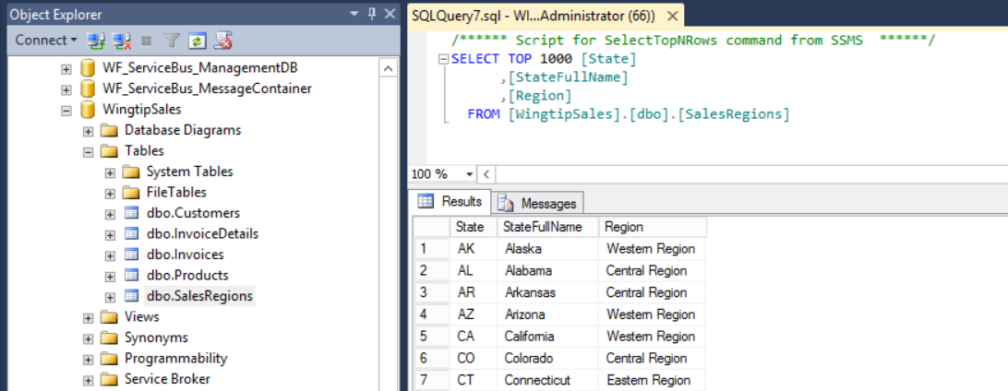
Adding Support Tables

Slide 15
Agenda
Data Warehouse Concepts and Terminology
Tabular Modeling
Data Modeling with the SQL Server Data Tools
Multidimensional Modeling and Cubes
Creating a Cube with the SQL Server Data Tools

Slide 16
Data Source
Connection info for cube and dimension data
Select connection provider
Managed Microsoft .NET provider
Native OLE DB provider
Specify server, database and authentication
Impersonation information required for connections
Impersonation account must have read access to data

Slide 17
Data Source View Tasks
Select tables or views
Rename tables and columns
Replace table with named query
Reduce complexity by eliminating columns
Add expressions to concatenate strings
Add expressions to perform mathematical operations
Set logical primary keys on dimension tables
Create relationships between fact and dimension tables

Slide 18
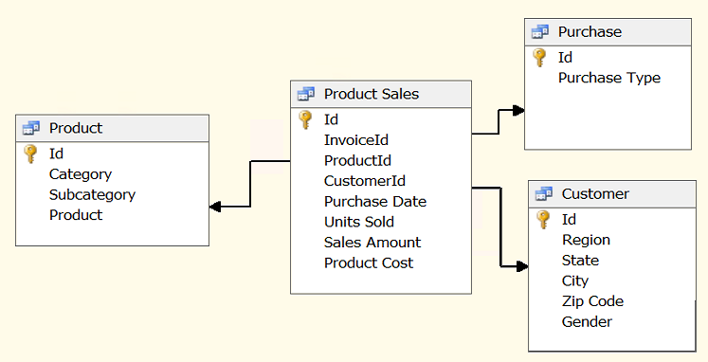
Completed Data Source View

Slide 19
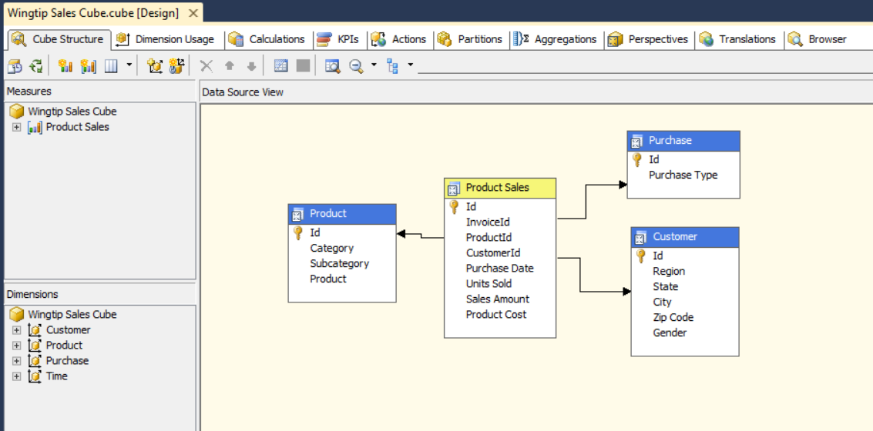
The Cube Designer

Slide 20
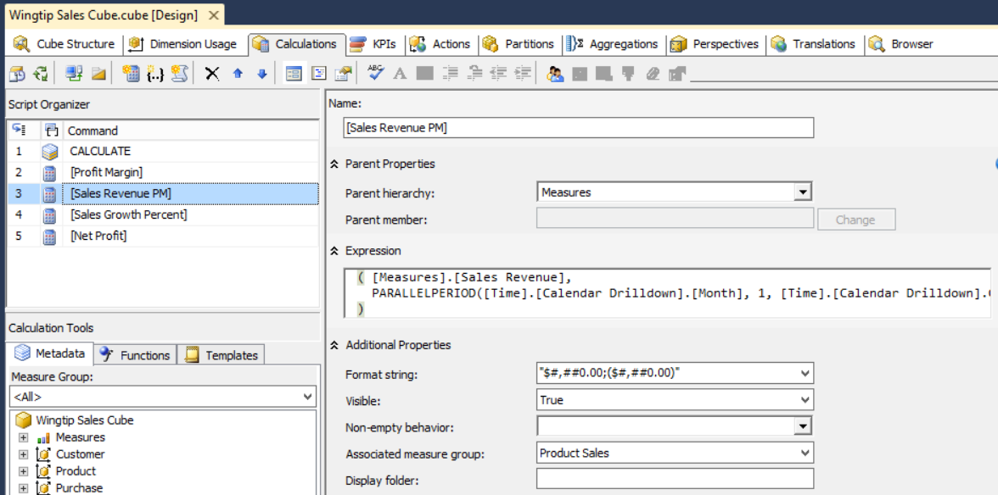
Named Calculations
Pass-through SQL Expressions
Adds named column to table in data source view

Slide 21
Creating a Multidimensional Cube

Slide 22
Summary
Data Warehouse Concepts and Terminology
Tabular Modeling
Data Modeling with the SQL Server Data Tools
Multidimensional Modeling and Cubes
Creating a Cube with the SQL Server Data Tools

