Slide 1
Working with Power Query in Excel 2013
Notes:
This module introduces the core concepts of designing and executing queries with Power Query, Microsoft's new SSBI tool designed for business users to discover and extract data from external sources in order to import it into an Excel worksheet or an Excel data model. You will learn how to use Power Query to import data from a variety of sources including databases, Excel spreadsheets, web pages and SharePoint lists. You will also learn how Power Query can be used to reshape data during the import process by splitting a column with delimited values and combining multiple columns into a single column. You will also learn to perform powerful table operations such as merging columns and appending rows from multiple data sources as well as transposing, pivoting and un-pivoting the rows and columns in a source table.

Slide 2
Agenda
Introduction to Power Query
Working with the Query Editor
Connecting to External Data Sources
Transforming and Reshaping Data
Power BI and the Data Catalog

Slide 3
Understanding ETL
ETL process is essential part of any BI Project
Extract the data from wherever it lives
Transform the shape of the data for better analysis
Load the data into a dataset for analysis and reporting
Power Query is an ETL tool for business users
Power Query can load data into an Excel worksheet
Power Query can load data into the Excel data model
Notes:
Every BI projects work with data of some type. Early in the project, you must discover where this data lives and decide how you are going to import it into a dataset that can be used for reporting and analysis. This is the phase of a BI project that is often called the "ETL" phase because it involves extracting data, transforming data and then loading data.
Power Query is a self-service ETL tool for business users. It has the ability to extract data from a variety of data source and import it into an Excel workbook. When you execute a query from inside an Excel workbook, you have the option to load its output into a worksheet or into the data model. However, the real value of Power Query is that you can perform many types of transforms to better shape the data just before it's loaded.

Slide 4
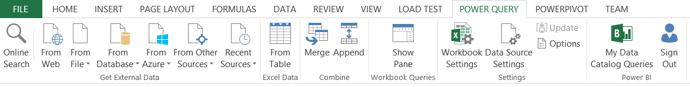
Installing the Excel Power Query Add-In
Power Query is not installed with Excel 2013
Add-in must be downloaded separately from Microsoft
http://www.microsoft.com/en-us/download/details.aspx?id=39379
Once downloaded, it must be installed and activated
Once activated, Power Query adds tab to ribbon
Notes:
Out of the four main SSBI add-ins, Power Query is the only one that is not installed along with Excel 2013. Therefore, the Power Query add-in must be downloaded and installed after you have already installed Excel 2013. The download and user of Power Query is free to any licensed user of Excel 2013. However, the installation of Power Query might require approval and assistance from the IT department.
You can tell whether of not Power Query has been installed and activated by examining the ribbon in Excel 2013. If you see the Power Query tab in the ribbon, you can tell that Power Query has already been installed.

Slide 5
Understanding Query Input and Output
Excel Workbook is container for queries
Queries created and saved within scope of an Excel workbook
Queries can pull data from local table in an Excel worksheet
Queries can pull data from external content sources
Queries can load data into worksheet
Queries can load data into data model
Excel Workbook
External Database
query1
query2
Data Source
col1 | col2 | col3
bob | 23 | 45
mary | 43 | 74
Data Model
worksheet
worksheet
col1 | col2 | col3
bob | 23 | 45
mary | 43 | 74
sue | 32 | 47
fran | 41 | 55
col1 | col2 | col3
bob | 23 | 45
mary | 43 | 74
sue | 32 | 47
fran | 41 | 55
col1 | col2 | col3
bob | 23 | 45
mary | 43 | 74
Notes:
When working with Power Query in Excel 2013, you create and save queries within the scope of an Excel workbook. Each query must have at least one source of data to use as its input. To get started quickly, you can create a new query using a table in a worksheet inside the same workbook. Alternatively, you can create a query from an external data source such as an Access database, a SQL Server database or a SharePoint list.
A query can also be configure to load its output into the Excel workbook. You can configure a query to load its output into a new table in an Excel worksheet or into the data model. If you are creating a query whose sole purpose is to be used as a source for another query, you can disable loading and configure the query as a "connection-only" query.

Slide 6
Query Composition
Query can serve as source for other queries
Allows for creation of reusable base queries & query composition
Complexity can be hidden in base queries
Reference command creates new query based on another query
Excel Workbook
External Database
query1
Data Source
col1 | col2 | col3
bob | 23 | 45
mary | 43 | 74
query2
query3
query4
worksheet
worksheet
worksheet
col1 | col2 | col3
bob | 23 | 45
mary | 43 | 74
sue | 32 | 47
fran | 41 | 55
col1 | col2 | col3
bob | 23 | 45
mary | 43 | 74
sue | 32 | 47
fran | 41 | 55
col1 | col2 | col3
bob | 23 | 45
mary | 43 | 74
sue | 32 | 47
fran | 41 | 55
Notes:
When working with Power Query in Excel 2013, you create and save queries within the scope of an Excel workbook. Each query must have at least one source of data to use as its input. To get started quickly, you can create a new query using a table in a worksheet inside the same workbook. Alternatively, you can create a query from an external data source such as an Access database, a SQL Server database or a SharePoint list.
A query can also be configure to load its output into the Excel workbook. You can configure a query to load its output into a new table in an Excel worksheet or into the data model. If you are creating a query whose sole purpose is to be used as a source for another query, you can disable loading and configure the query as a "connection-only" query.

Slide 7
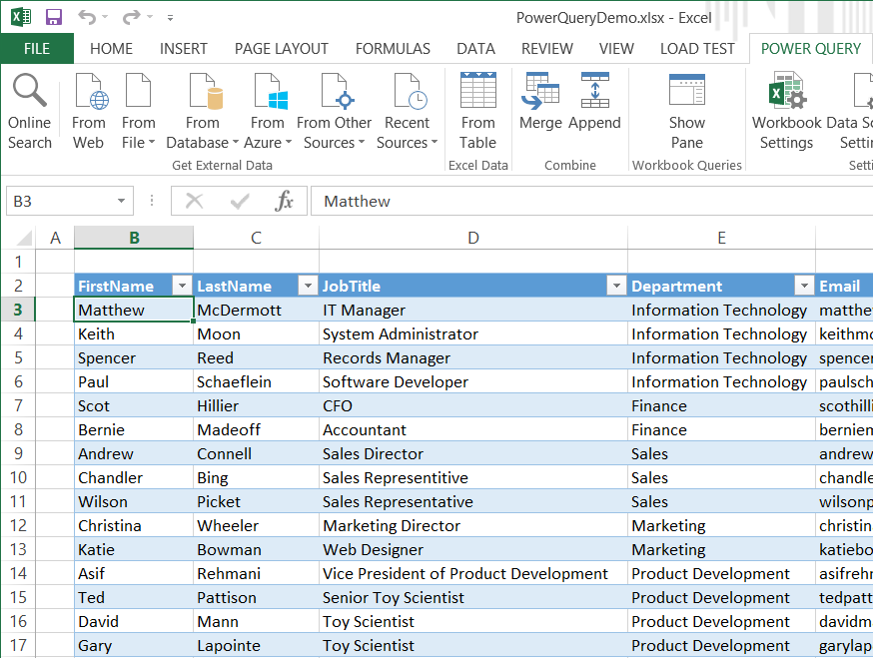
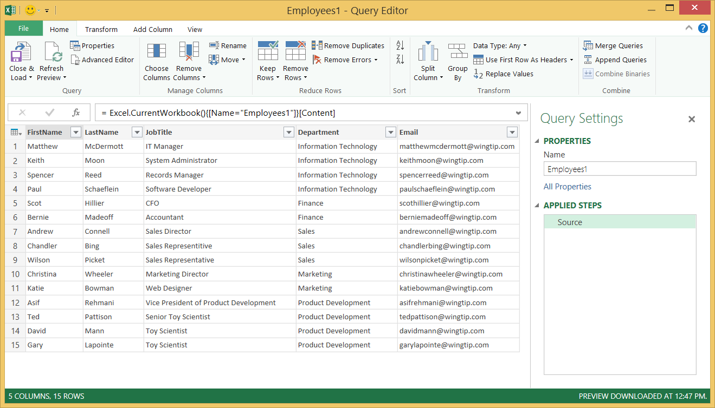
Creating a New Query
New query created using Power Query tab
Power Query tab displays buttons for creating new queries
You can create a new query based on an Excel table
New query is opened in Power Query's Query Editor window
Notes:
To get started creating queries, navigate to the Power Query tab and examine the set of buttons. You will see a set of buttons in the ribbon in the Get External Data group that can be used to create a new query using an external data source as the queries input. It's also pretty easy to create a new query from a table inside an Excel worksheet. You can accomplish this by first selecting a cell in the worksheet that is inside the table. Next, click the From Table button on the ribbon in the Excel Data group.
When you create a new query, Excel 2013 will display a new window which is the Query Editor window. This window is where you will work to design the query's logic for transforming the data as the query executes. The Query Editor window displays several tabs with commands for transform operations. The Query Editor window allow allows you to change the name of the query and configure the load options.

Slide 8
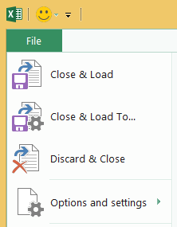
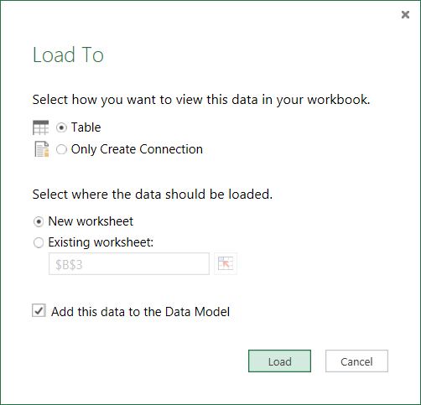
Saving and Loading a Query
Query saved using Close and Load command
By default, new query output loaded into new worksheet
Select Close and Load To… command to configure loading options
Only Create Connection for query which serves as source to other queries
Notes:
When you create a new query, the default behavior with Power Query is to configure the load settings to load the data into a table created in a new worksheet. You can change the configuration to load the data into a table in an existing worksheet and/or into the data model for the current workbook.
You can configure a query's load settings with a setting of Only Create Connection to save a query without loading it's output. This is often done with a query that will only be used as input to other queries for merge and append operations. You also might decide to use this option when you are working with queries that will return large amounts of data.

Slide 9
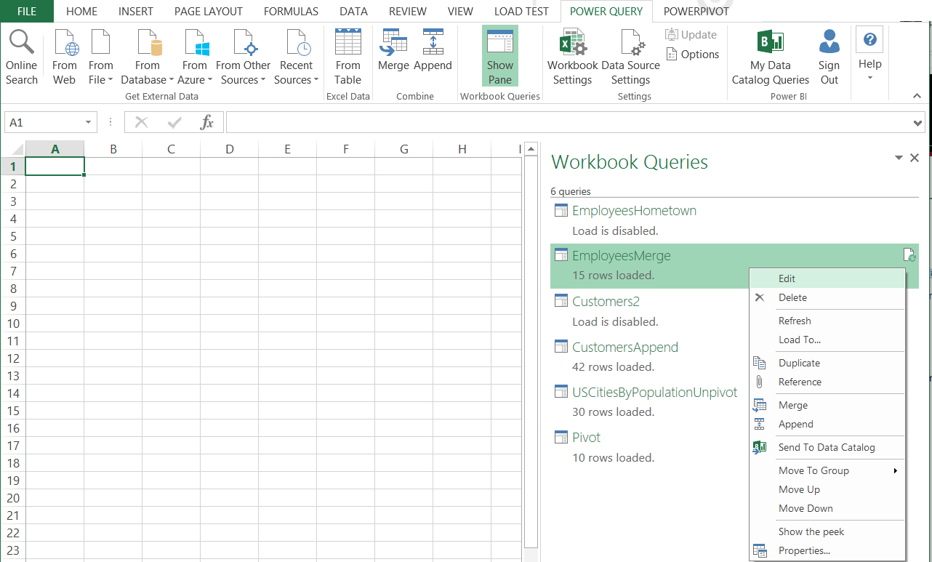
Viewing and Managing Workbook Queries
You view & manage queries with Workbook Queries view
Displays all queries that exist with current Excel workbook
Click Show Pane button in ribbon to toggle view on and off
Right-click on query in Workbook Queries view to see commands
Notes:
The Power Query add-in adds a Workbook Queries view to the task pane in Excel 2013 to show the queries that have been saved to the current workbook. This allows you to see and manage the queries you are working with. If you right-click on a query in the Workbook Queries view, you will see a set of commands to manage queries such as Edit, Delete, Refresh, Load To and Duplicate.
If you do not see the Workbook Queries view in the task pane, you can display it by clicking the Shown Pane button which can be found in the Workbook Queries group of the Power Query tab in the ribbon.

Slide 10
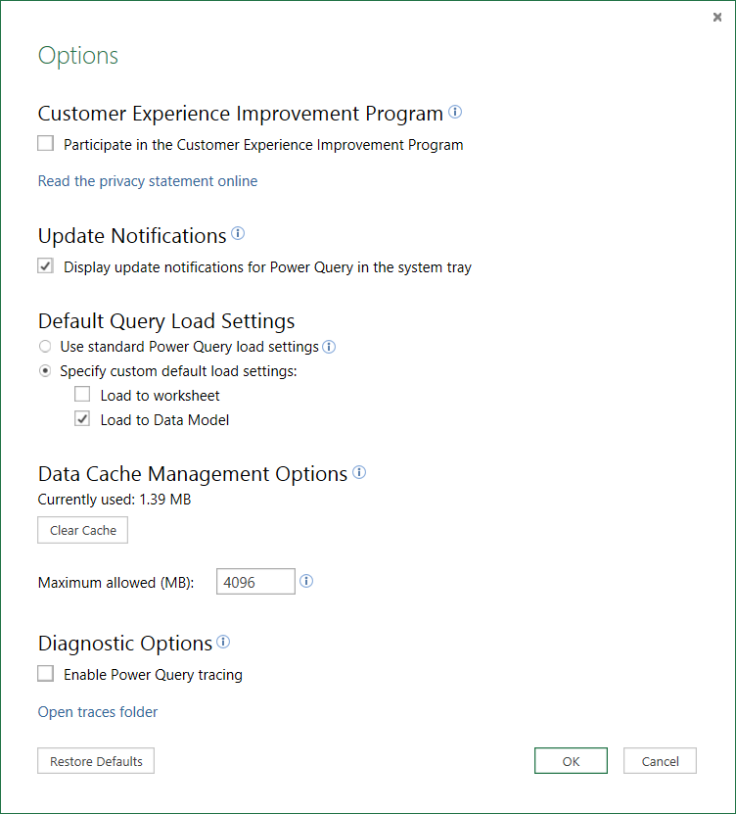
Power Query Settings
Power Query provides Options and Settings dialog
Configure default query load setting (worksheet and/or data model)
Option to clear data cache and set data cache memory size
Option to enabled Power Query tracing for diagnostics and debugging

Slide 11
Creating and Loading a Query in Excel 2013 using Power Query

Slide 12
Agenda
Introduction to Power Query
Working with the Query Editor
Connecting to External Data Sources
Transforming and Reshaping Data
Power BI and the Data Catalog

Slide 13
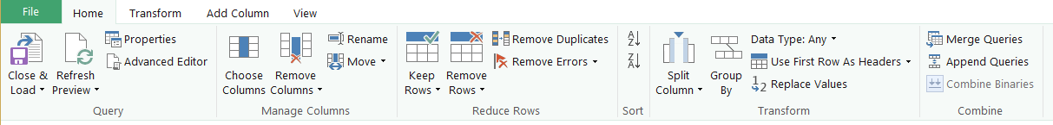
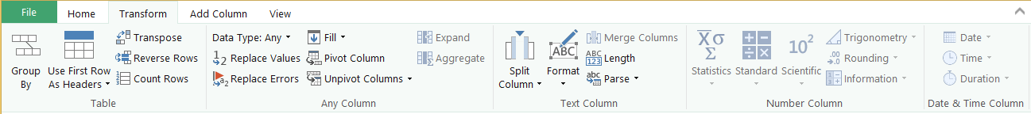
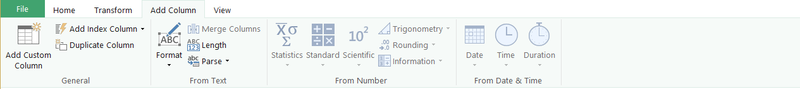
Query Editor Ribbon Tabs
Home tab
Transform tab
Add Columns tab

Slide 14
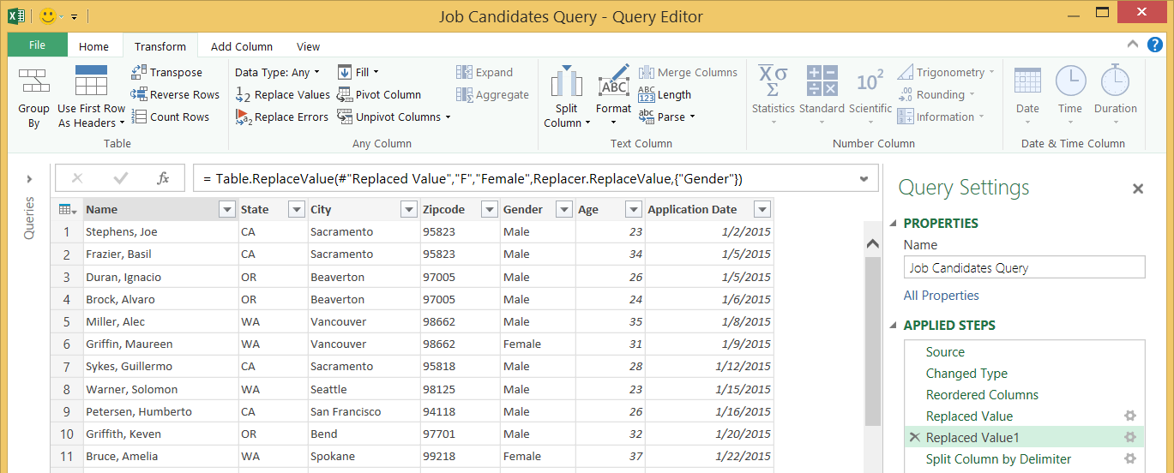
Query Steps
A query is created as a sequence of steps
Each step is a parameterized operation on the data
Each step has formula which can be viewed/edited in formula bar
Query starts with Source step to extract data from a data source
Additional steps added to perform transform operations on data
You can replay query operations one by one by clicking on steps
step formula bar
sequential list of steps for current query

Slide 15
Examples of Basic Steps
Remove column
Rename column
Change column type
Reorder columns
Replace column values across rows
Format column values across rows

Slide 16
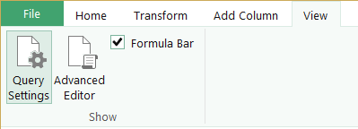
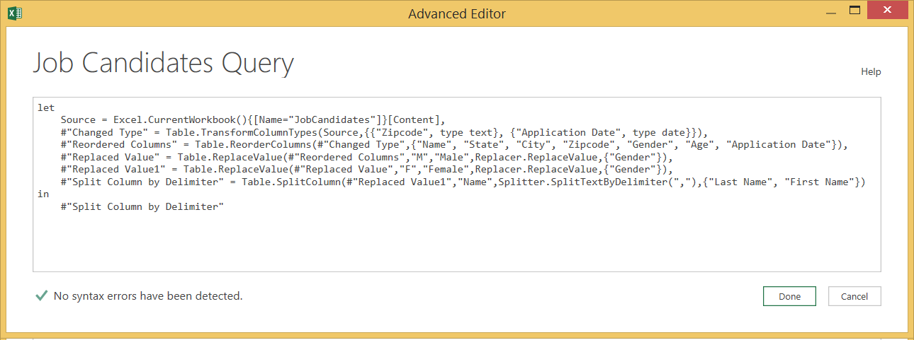
Advanced Editor
Power Query based on "M" functional language
Query in Power Query saved as a set of M statements in code
Query Editor generates code in M behind the scenes
Advanced users can view & modify query code in Advanced Editor

Slide 17
Using the Query Editor Window to Create a Set of Basic Steps

Slide 18
Agenda
Introduction to Power Query
Working with the Query Editor
Connecting to External Data Sources
Transforming and Reshaping Data
Power BI and the Data Catalog

Slide 19
Extracting Data from External Data Sources
Use ribbon to create queries from external data sources
Buttons located in Get External Data group of Power Query tab
Supported external data sources
Data inside HTML tables on web pages
Data inside various types of files
Data inside commonly-used databases
Data in the cloud in Windows Azure
Data from SharePoint lists
Data from an OData data source

Slide 20
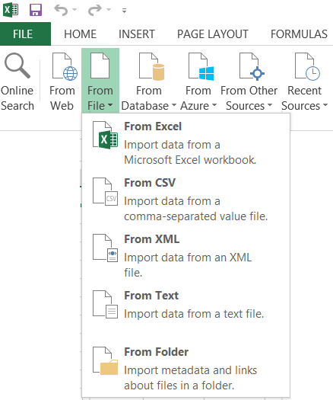
Extracting Data from Files
Power Query supports common file types
Excel workbooks
CSV files
XML files
Text files
Files within folder structure

Slide 21
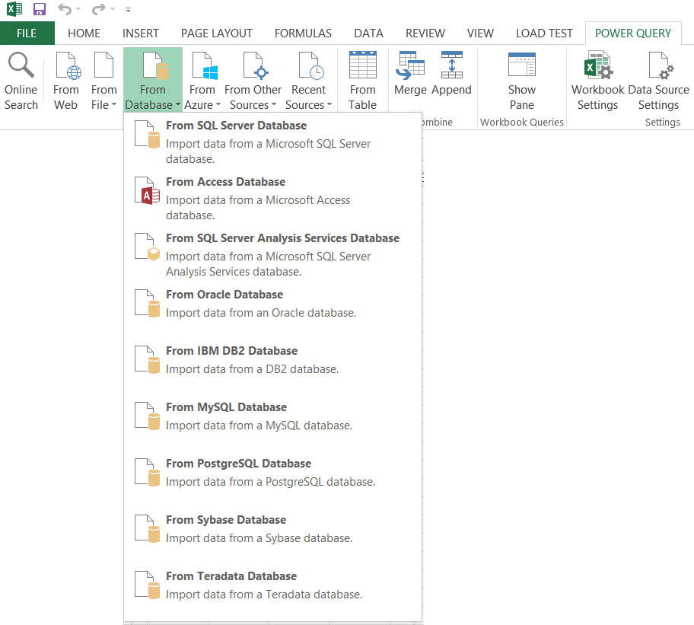
Extracting Data from Databases
Power Query supports many database systems
SQL Server
SQL Server Analysis Services
Access
Oracle
DB2
MySQL
PostgreSQL
Sybase
Teradata
Notes:
Access Databases
SQL Server Databases
Oracle Databases
DB2 Database
MySQL
PostgreSQL
Sybase
Teradata
SQL Server Analysis Services (SSAS)
Tabular Databases
Multidimensional Databases with Cubes

Slide 22
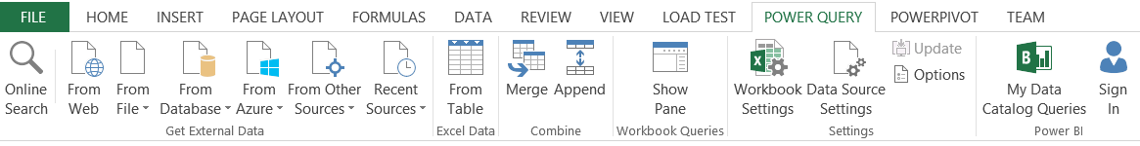
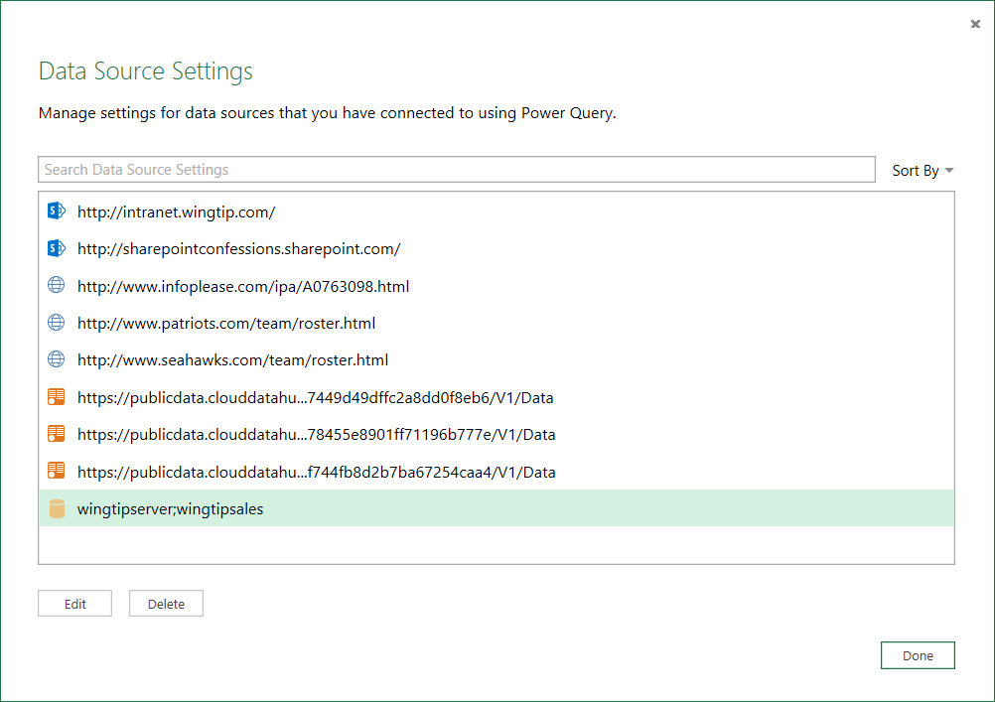
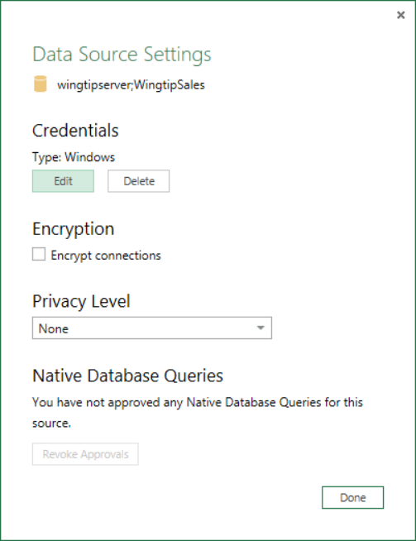
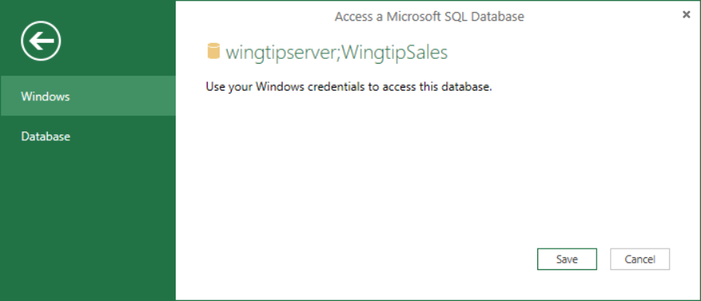
Configuring an External Data Source
Excel workbook contains collection of Data sources
Data sources edited using Data Source Settings dialog

Slide 23
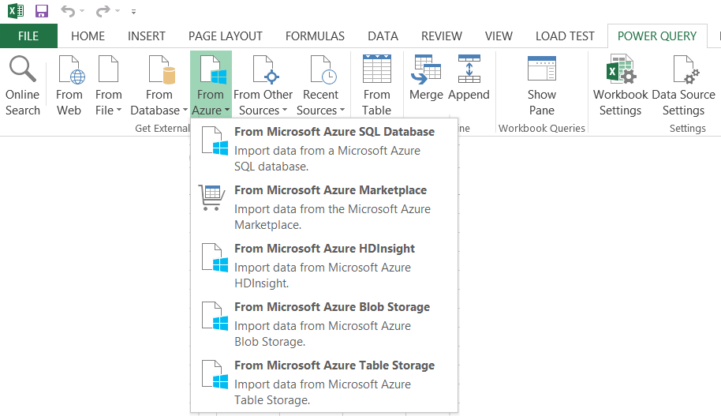
Extracting Data from Azure Data Sources

Slide 24
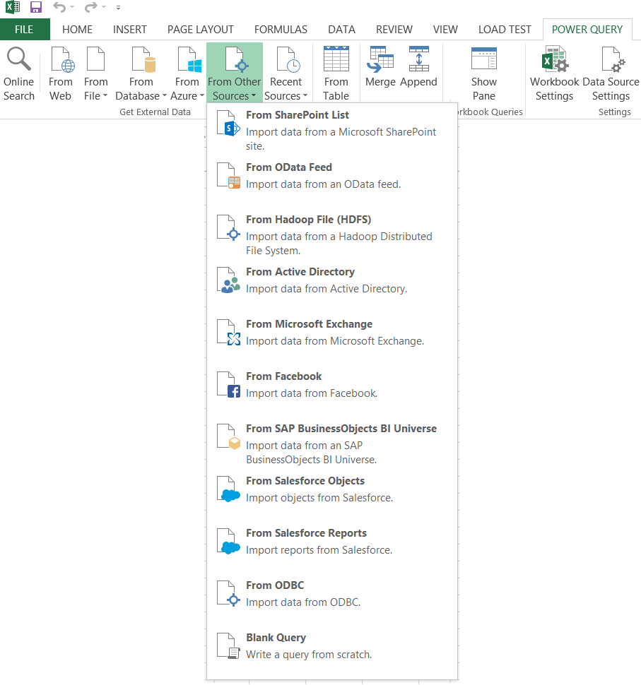
Extracting Data from Other Data Sources
Power Query support other common data sources
SharePoint Lists
OData Feeds
Active Directory
Exchange

Slide 25
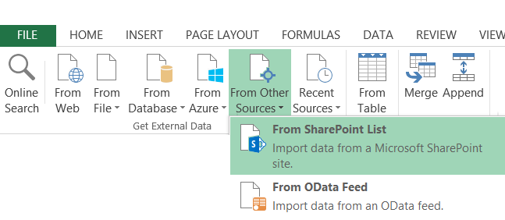
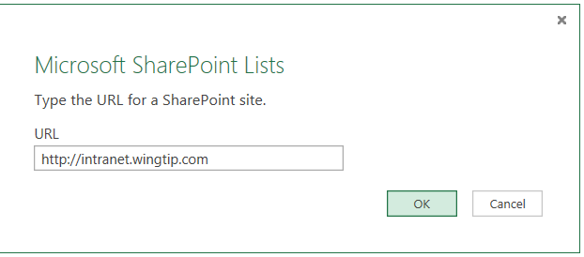
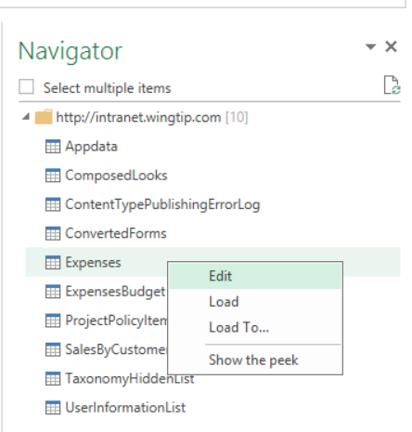
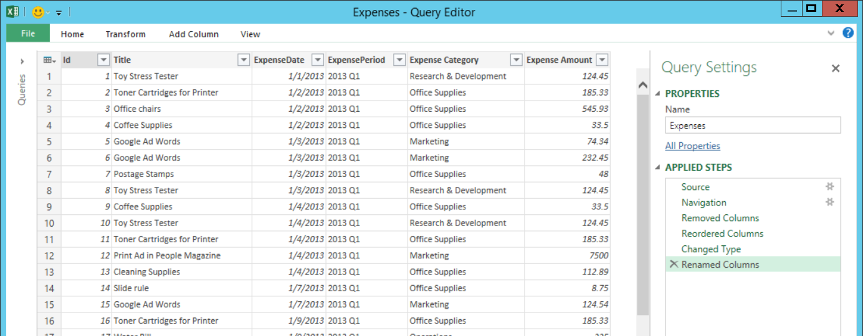
Extracting Data from a SharePoint List

Slide 26
Using Power Query to Load Data from a SharePoint Lists

Slide 27
Agenda
Introduction to Power Query
Working with the Query Editor
Connecting to External Data Sources
Transforming and Reshaping Data
Power BI and the Data Catalog

Slide 28
Combining Queries
Query can be merged or appended with another query
Merge operation allows you combine columns from two tables
Append operation allows you to combine rows from two tables
Two queries are combined into single output for loading
Load settings of main query determines where output is loaded
Secondary query acts as source for main query
Secondary query be can created with connection-only load setting
Data Source
Data Source
Data Source
query2
Data Source
main query
query2
main query
query3
Data Source
query output
query4
Data Source
col1 | col2 | col3
bob | 23 | 45
mary | 43 | 74
sue | 32 | 47
fran | 41 | 55
query output
Notes:
Power Query allows you to combine to queries. Combining queries means that you are combining two data sources into a single table as the queries output. Power Query supports two combine operations which are merge and append. A merge operation is used when you need to combine columns in from two tables into a single table. An append operation is used when you need to combine rows from two tables into a single table.
Consider that combining two queries produces a single output. Yet each of the queries involved has its own Power Query load setting. You configure the load setting of the main query to determine where to load the result of the merge/append operation. However, the secondary query which is only being used as the source in another query doesn't usually need to load its output anywhere in the workbook. When you are creating a query whose sole purpose is to be used as a source for a merge or append operation in another query, you can disable loading by configuring the load setting as a "connection-only" query.
What if you need to append together rows from more than one table? That's not a problem. A main query can include more than one append operation as shown in the diagram above on the right. This means a single query can append together rows from as many source tables as necessary.

Slide 29
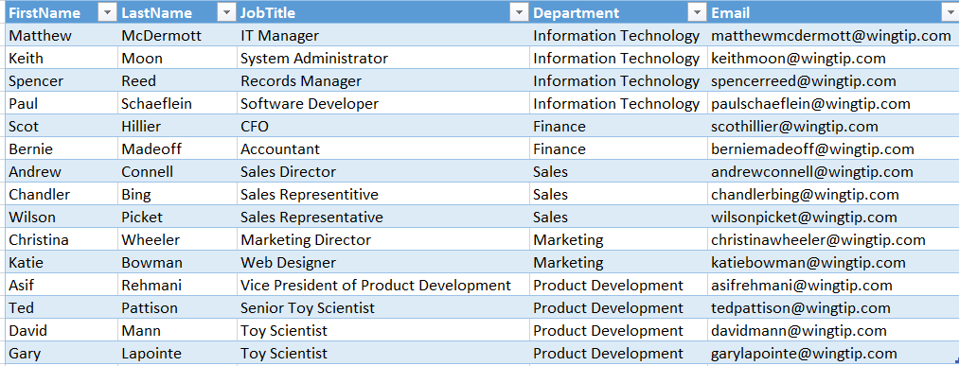

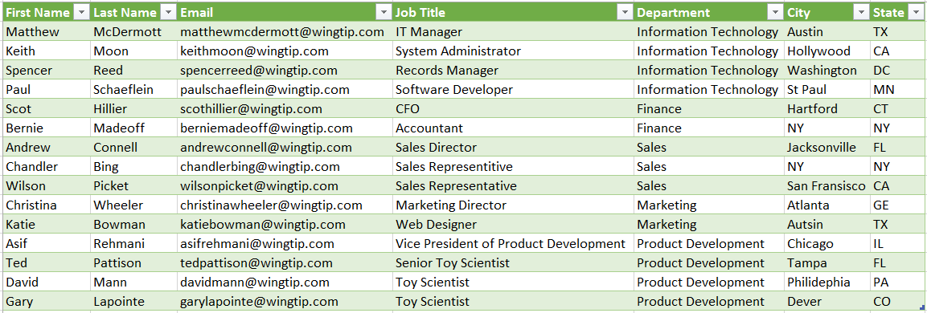
Merging Columns
Main Query Input
Merge Query Input
Join Column
Join Column
Query Output

Slide 30
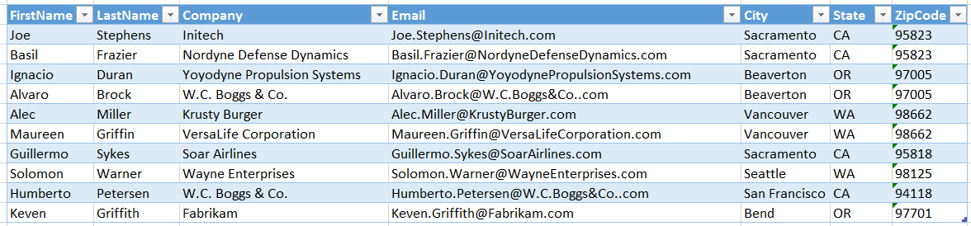
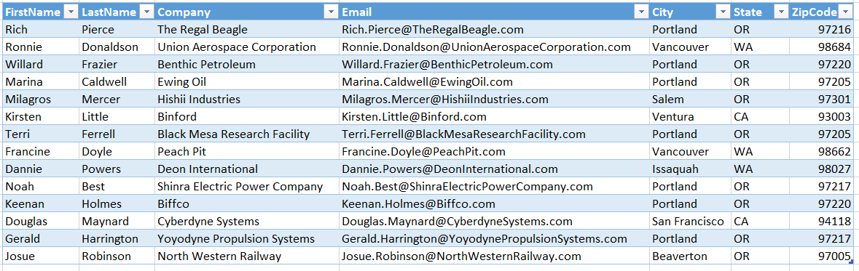
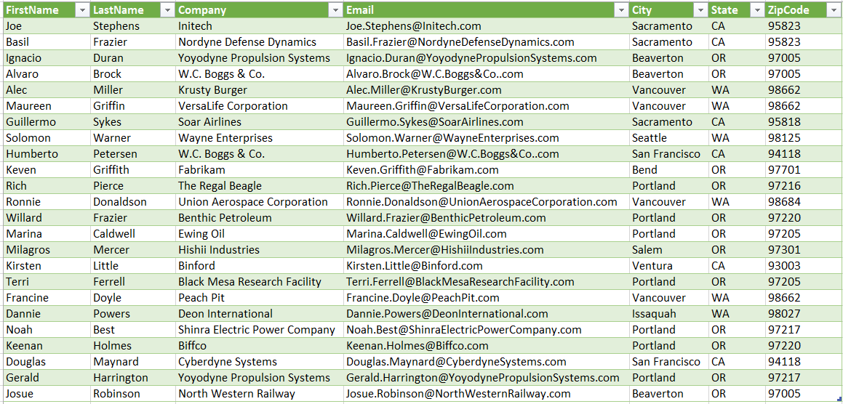
Appending Rows
Main Query Input
Append Query Input
Query Output

Slide 31
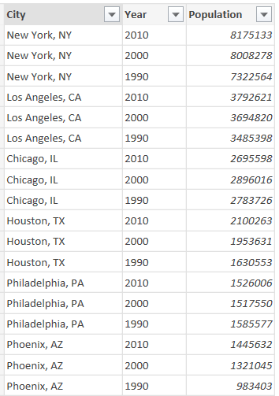
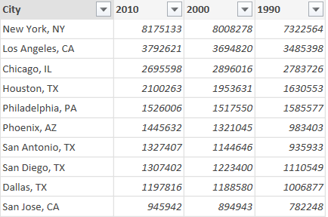
Pivoting Columns
Pivot column adds its values are new columns
Create table layout like PivotTable

Slide 32
Unpivoting Columns
Unpivot columns to collapse them into single column
Removes PivotTable layout
Can be useful to prepare data for charting and analysis

Slide 33
Extracting and Reshaping Data to Create a Data Model

Slide 34
Agenda
Introduction to Power Query
Working with the Query Editor
Connecting to External Data Sources
Transforming and Reshaping Data
Power BI and the Data Catalog

Slide 35
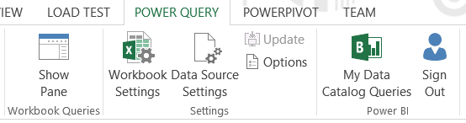
Power BI and the Data Catalog
Power BI has Data Catalog for Office 365 users
Power BI is Microsoft's cloud-based BI Platform
Data Catalog is shared repository of queries
Data Catalog not available in on-premises scenarios

Slide 36
Summary
Introduction to Power Query
Working with the Query Editor
Connecting to External Data Sources
Transforming and Reshaping Data
Power BI and the Data Catalog

