Slide 1
Using Power View in Excel 2013
Notes:
This module begins by explaining the motivation and architecture behind the enhanced Power View support in Microsoft Excel 2013. Students will learn about the BI capabilities of Power View as well as the Power View User Interface for building visualizations from the Data Model. The module demonstrates how to create reports using the Power View Report Designer and to utilize advanced features such as Filtering, Highlighting, and Slicers.

Slide 2
Agenda
Introduction to Power View
Understanding the Power View User Interface
Power View Features in Excel 2013
Charts and Other Visualization Types
Notes:
This module serves to ensure that students are comfortable using BI features in Microsoft Excel 2013. Students will become familiar with the Power View User Interface as well as understand the new features added to Excel 2013. This module also focuses on learning how to use the different chart types and other visualization types available when working with Power View.

Slide 3
Introduction to Power View
What is Power View?
Interactive tool for data exploration, visualization, and presentation
Provides intuitive ad-hoc reporting to create dynamic dashboards
WYSIWYG visual design
Web-based version of Power View introduced first
Supported with SharePoint 2010 and SharePoint 2013
Requires SSRS 2012 in SharePoint mode
Power View Add-in for Excel introduced with Excel 2013
Power View sheets can be added to Excel 2013 workbook
Power View sheets based on internal or external Data Model
Notes:
Power View is a data exploration, visualization, and presentation experience in Excel 2013 used for ad-hoc reporting to create. First introduced with SQL Server 2012 Reporting Services in SharePoint mode, Power View is available in Excel 2013, SharePoint 2010 and SharePoint 2013.
Power View provides the following features for creating intuitive ad-hoc reporting for building dynamic dashboards:
Build dynamic dashboards easy using the WYSIWYG visual designer.
Power View sheets can be added to Excel 2013 workbooks.
The two types of data Power View sheets can be based on are a workbook Data Model or an external tabular Data Model.

Slide 4
Introduction to Power View
Power View has two versions:
Power View in Excel 2013
Sheets are part of the Excel (.xslx) file
Power View in SharePoint Server report
Reports are in SharePoint as .rldx files
Both versions require Silverlight to be installed except with Power BI for Office 365
Power BI for O365 uses HTML5 version of Power View
Notes:
There are two types of versions of Power View:
Power View in Excel 2013. Sheets become a part of the Excel (.xlsx) file.
Power View in SharePoint Server report. Power View reports are stored in SharePoint as .rldx files.
Both versions of Power View do require Silverlight to be installed with the exception of Power BI for Office 365. As part of Power BI for O365 you can view Power View in Excel sheets in your browser which uses the HTML5 version of Power View. Currently, the Power BI for Office 365 is still a work in progress therefore some visualizations may not work as expected however Microsoft is continuing to release updated versions in O365.

Slide 5
Agenda
Introduction to Power View
Understanding the Power View User Interface
Power View Features in Excel 2013
Charts and Other Visualization Types

Slide 6
Power View User Interface
Ribbon
Spans the top of the screen
Holds commands that can be performed for entire report or selected object in report
Tabs
FILE Tab
Holds several key commands such as Save & Print
HOME Tab
Holds basic formatting commands
ADDITIONAL Tabs
Other tabs appear as needed
Often highlighted to make stand out from standard tabs

Slide 7
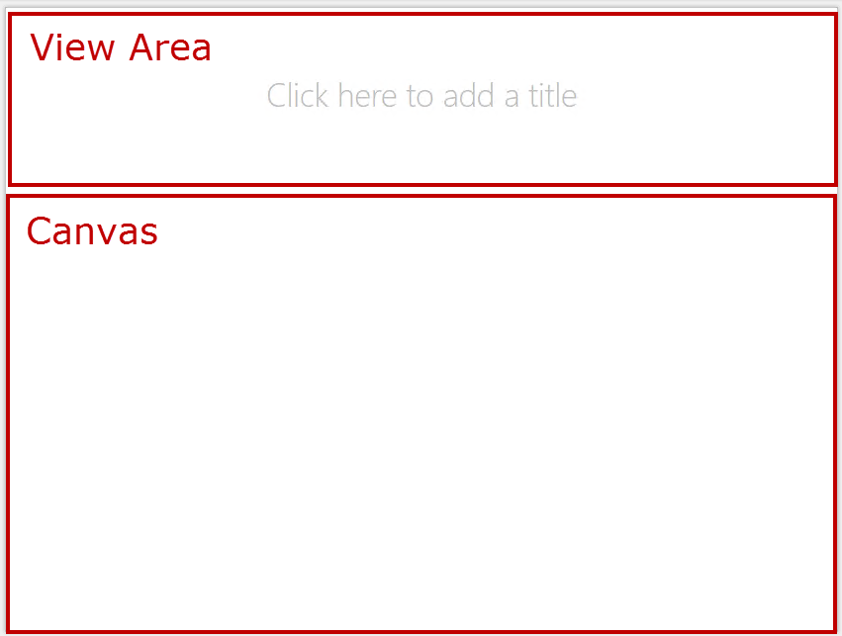
Power View User Interface
Canvas View Area
Used to hold different data visualizations (such as report title) and navigation tools
Can be used to present several states of your data
Canvas
Empty section below the view area
Visualization elements such as tables, charts, and slicers are placed on the canvas

Slide 8
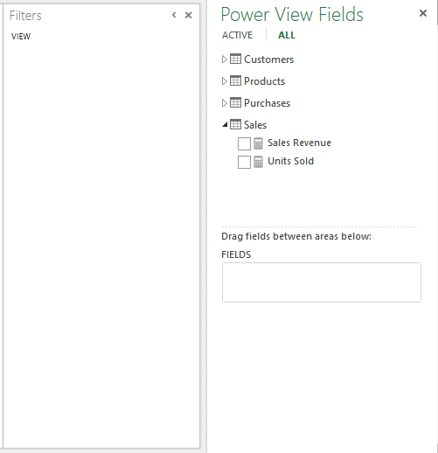
Power View User Interface
Field List
Upper-right side of screen below ribbon
Holds tables in the BI Semantic Model or PowerPivot Workbook, and fields contained within tables
Field Well
Bottom-right corner of screen
Shows fields selected from model to appear on canvas
Provides access to properties/commands for objects
Filters Area
Used to restrict data being displayed in report
Hidden or displayed by clicking the Filters Area button

Slide 9
Power View User Interface

Slide 10
Agenda
Introduction to Power View
Understanding the Power View User Interface
Power View Features in Excel 2013
Charts and Other Visualization Types

Slide 11
Features in Excel 2013
Power View sheets can connect to different data models in one workbook
Every workbook can contain internal Data Model
Modify in Excel, PowerPivot, or in a Power View sheet
Workbook can contain one internal Data Model
Base Power View sheet on Data Model in worksheet or an external data source
Single workbook can contain multiple Power View sheets
Each sheet can be based on a different data model
Notes:
Power View and Data Models
One of the new features in Excel 2013 is that Power View sheets can connect to different data models in one workbook. An Excel workbook:
Can contain only one internal Data Model which you can base a Power View sheet on the Data Model in the workbook or on an external data source.
A single Excel workbook can contain multiple Power View sheets and each sheet can be based on a different data model.
Since each Power View sheet has its own charts, tables, and other visualizations you can copy and paste a chart or other visualization from one sheet to another. However, this only works if both sheets are based on the same data model.

Slide 12
Power View Feature Updates
Power View changes how it handles integers
Excel 2010/SharePoint 2010
Power View aggregated decimals numbers
Treated integers as categories instead of aggregating them
Excel 2013/SharePoint 2013
Power View aggregates both decimal numbers & integers

Slide 13
Backward-and-forward Compatible
Power View backward-and-forward compatible
Power View RDLX files in SharePoint are backward compatible
Power View & SQL Server Analysis Services data models are forward-and-backward compatible
Power View and Excel Services are backward-compatible only
Notes:
Power View RDLX files in SharePoint backwards compatibility
If a Power View file is saved with the SQL Server 2012 Reporting Services add-in the Power View can open and save in Power View in SharePoint 2010 or SharePoint 2013 with the SQL Server 2012 Service Pack 1 (SP 1) Reporting Services add-in. However, you cannot open a newer-version Power View RDLX file in a version of SharePoint with an older SQL Server Reporting Services add-in.
Power View and SSAS data models forward-and-backward compatibility
A Power View file can be based on SharePoint 2010 with the:
SQL Server 2012 Reporting Services add-in on an Excel 2013 data model or on a SQL Server 2012 SP 1 Analysis Services tabular model and vice versa.
However, some features such as hierarchies and KPIs are only available if a Power View report is based on SharePoint with the SQL Server 2012 SP 1 Reporting Services add-in on an Excel 2013 data model or on a SQL Server 2012 SP 1 Analysis Services tabular model.
Power View and Excel Services backward compatibility
Power View and Excel Services are backward compatible but are not forward compatible. SharePoint 2013 is backward-compatible with Excel 2010 Power Pivot workbooks and SharePoint 2010 is not forward-compatible with Excel 2013 workbook Data Models.

Slide 14
Agenda
Introduction to Power View
Understanding the Power View User Interface
Power View Features in Excel 2013
Charts and Other Visualization Types

Slide 15
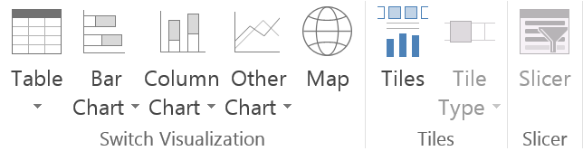
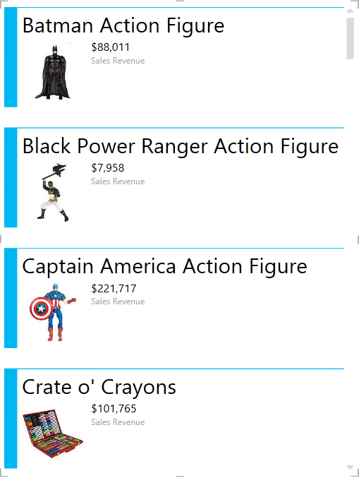
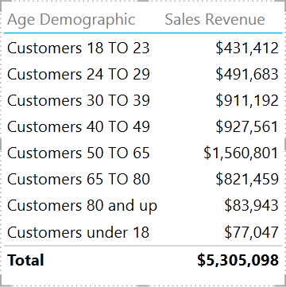
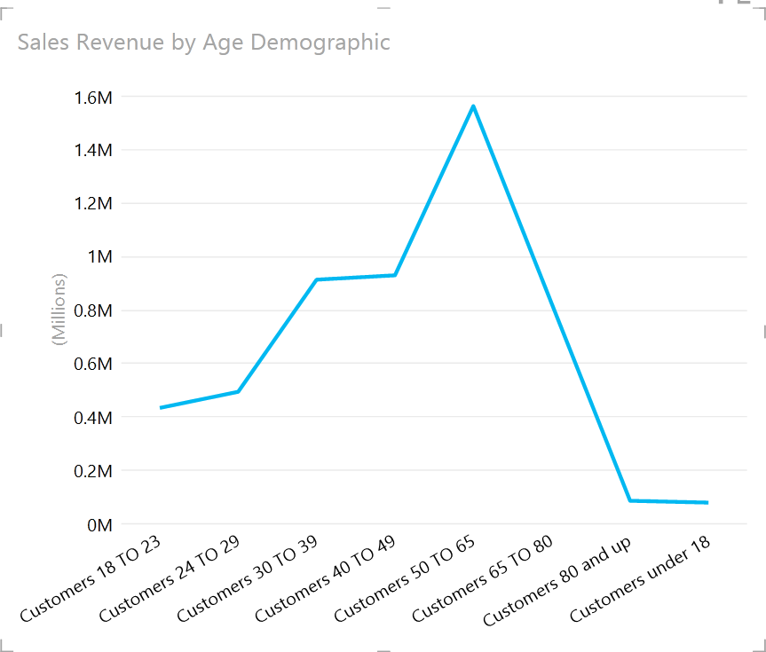
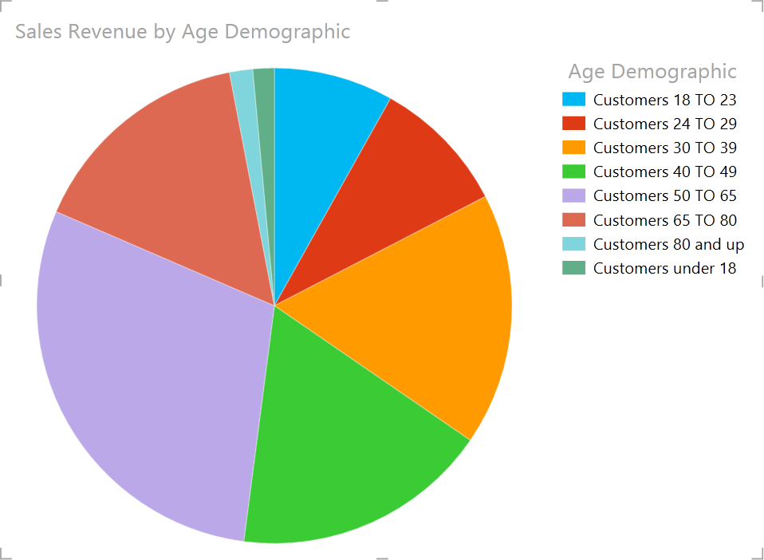
Charts and Other Visualization Types
Power View offers a variety of visualization types
Table
Table, Matrix, Card
Chart
Pie, Column, Bar, Line, Scatter, Bubble
Can have multiple numeric fields and multiple series
Notes:
Power View offers a variety of visualization types for designer ad-hoc reporting dashboards. This includes tables, matrices, card, pie, column, bar, line, scatter, bubble charts, and sets of multiple charts. For every visualization created you start with a table and then covert the table easily to other the other visualization types.
To create a table, you simply click a table or field in the field list or drag a field from the field list to the view. Power View will then draw the table in the view displaying the actual data and automatically adds column headings.
To convert a table to one of the other visualizations, create a table in the view first and then click a different visualization type in the Design tab. When choosing a different visualization type, Power View only enables the charts and other visualizations that work best for the data presented in the table. For example, if Power View doesn’t detect any aggregated numeric values then the chart options will be disabled.

Slide 16
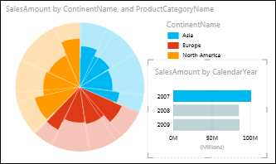
Pie Charts
Create simple or sophisticated pie charts in Power View
Pie Charts can:
Drill down when double-click on a slice
Show sub-slices within the larger color slices
Cross-filter pie chart with another chart
Most usable when:
Fewer than 8 colors
Fewer than 8 slices in each color
Notes:
In Power View, you can create simple or sophisticated pie charts. These pie charts can be drill down when a user double-clicks on a slice or clicks on a sub-slice of a pie chart that is displayed within the larger color slices. You can cross-filter a pie chart with another chart so when a bar in a bar chart is clicked on the part of the pie chart that is applied to the bar is highlighted and the rest of the pie is grayed out.
Pie charts are most usable when the pie chart has fewer than 8 colors and fewer than 8 slices for each color.

Slide 17
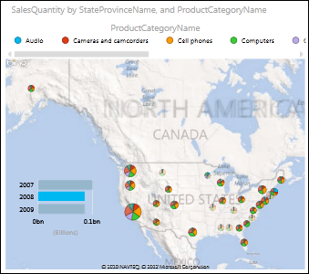
Maps
Display data in the context of geography
Maps in Power View use Bing map tiles
Zoom & Pan as you would any other Bing map
Sends data to Bing through secured web connection for geocoding
Locations and fields are dots on map
Bigger the value, the bigger the dot
When multi-value series are added, you get pie charts on the map
Notes:
Maps in Power View can be used to display data in the context of geography. Maps in Power View use Bing map tiles so the user can zoom and pan as you would with any other Bing map.
In order for maps to work, Power View sends the data to Bing through a secured web connection used for geocoding so it will ask you to enable content. Once the content is enabled, you can add locations and fields which become dots on a map. The larger the value the bigger the dot will be and when multi-value series are added to the map the dots become pie charts with the size of the pie chart showing the size of the total.

Slide 18
Power View Tables & Charts

Slide 19
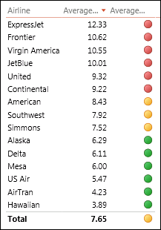
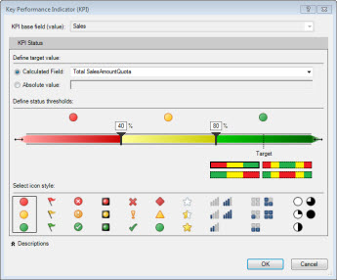
Key Performance Indicators (KPIs)
Add KPIs to Power View report to show progress
KPIs are based on explicit calculated fields in data model
Create KPIs from Power View
In Excel or by managing the Data Model in the Power Pivot window
SQL Server Analysis Services tabular models can also have calculated fields and KPIs
Notes:
Key Performance Indicators (KPIs) can be added to your Power View report to show progress towards goals. KPIs are based on explicit calculated fields in the data model therefore KPIs can only be added if the data model used in the Power View report is based on them.
To create KPIs from Power View, they can be created in Excel or through managing the Data Model in the Power Pivot window. SQL Server Analysis Services tabular models can also have calculated fields and KPIs which you can use the KPIs in Power View in Excel and Power View in SharePoint.

Slide 20
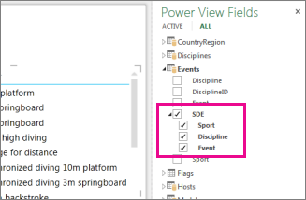
Hierarchies
If the Data Model has a hierarchy you can use it in Power View
Creating a hierarchy
You can create a new hierarchy in Power View
Adding multiple fields to Rows or Columns box for matrix creates a hierarchy for that matrix
Put fields in any order
SQL Server Analysis Services tabular models can also have hierarchies
Notes:
If your Data Model has a hierarchy, you can use it in Power View or you can create a new hierarchy from scratch in Power View. Having the hierarchy in a data model provides the advantage to being able to use the hierarchy in every Power View sheet or report you build on the Data Model.
To create a hierarchy in the Data Model, you must create the hierarchy in Excel through the Power Pivot window. If your Data Model doesn’t have a hierarchy, you can create a new one in Power View.
To create in Power View, add multiple fields to the Rows or Columns of a matrix which creates a hierarchy for that matrix or add multiple fields to the Axis box of a chart which creates a hierarchy for that chart. Once the hierarchy is initially created, you can put the fields in any order in the hierarchy.
Hierarchies can also be a part of SQL Server Analysis Services tabular models.

Slide 21
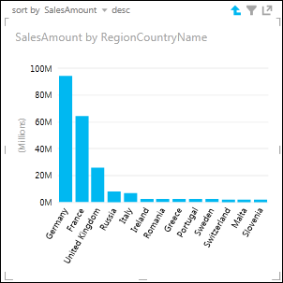
Drilling
Add drill up/drill down to chart or matrix in Power View to show one level at a time
Can be added to matrix, bar, column, and pie charts
Needs a hierarchy for drilling
Either hierarchy in Data Model or hierarchy created in Power View
Report readers
Drill down for details
Drill up for summary data
Drilling down on a chart or matrix acts as a filter
Notes:
Drilling can be added to a chart or matrix in Power View to allow a user to drill up/drill down on a chart or matrix in Power View to show one level at a time. Report readers drill down for details or drill up for summary data.
When a matrix or chart has multiple fields in the rows or columns:
You can set the drilling to show levels which collapses the matrix to show only the top or outermost level. The report viewer double-clicks one value in that level to expand to show the values under that one in the hierarchy and then clicks the up arrow to drill back up.
Drilling bar, column, and pie charts work the same way as the matrices. If a chart has multiple fields in the Axis box, you set it to show levels and so the report viewer will only see one level at a time which will start at the top level. To drill up, the up arrow in the corner when clicked on will take the report view back up to the previous level.

Slide 22
KPIs, Hierarchies, and Drilling

Slide 23

Format Power View Reports
Format Power View reports in various ways
Add background images
Choose background formatting
Choose a theme
Change font size for one visualization
Change font or font size for whole sheet
Format numbers in a table, card, or matrix
Power View has new report themes
When theme is changed, the new theme applies to all Power View views in report or sheets
Notes:
Power View reports can be formatted in various ways using background images, background formatting, themes, font sizing, and formatting numbers in a table, card, or a matrix.
Power View in SharePoint 2010 had themes but they were limited to 8 basic themes however Power View in Excel 2013 and in SharePoint 2013 has and additional 39 themes. These new themes have more varied chart palettes as well as more fonts and background colors. When themes are changed, the new theme applies to all the Power View views in the report or sheets in the workbook.

Slide 24
Hyperlinks and Printing
Hyperlinks
Add a hyperlink to a text box in a sheet or view
If field in data model contains hyperlink add field to sheet or view
Can link to any Internet or email address
Printing
Power View sheets can be printed in Excel and in views in SharePoint
Power View now supports right-to-left languages
Notes:
Hyperlinks
Hyperlinks can be added to a text box in a sheet or view. If a field in your data model contains a hyperlink you can simply add the field to the sheet or view. This hyperlink can link to any Internet or email address. In Power View in Excel and in edit mode for a Power View report in SharePoint, you follow the hyperlink by clicking on it while holding down the Ctrl key.
Printing
Power View sheets can be printed in Excel and in views in SharePoint. In both cases, what gets printed is what is displayed on the sheet or view when you send it to the printer. If the sheet or view contains a region with a scroll bar the printed page will contain the part of the region that is visible on the screen. If a sheet or view contains a region with tiles, the tile that prints is whichever tile is selected.
Support for right-to-left languages
Power View in both Excel and SharePoint now supports right-to-left languages. Power View in Excel takes the setting for default direction from Excel however these settings can be changed. To change the settings in Excel, go to File>Options>Advanced and look for Default direction. In the same dialog box you can also change the direction for a specific sheet without changing the default direction. Power View in SharePoint now has options to set the default direction for new views and the direction for a specific existing view. Unless changed the direction is the same as the direction for SharePoint.

Slide 25
Formatting Power View Report

Slide 26
Summary
Introduction to Power View
Understanding the Power View User Interface
Power View Features in Excel 2013
Charts and Other Visualization Types

