Slide 1
Excel Services and PowerPivot for SharePoint 2013
Notes:
This module introduces students to the architecture and BI capabilities of Excel Services in SharePoint 2013. Students will learn how to use Microsoft Excel 2013 to publish browser-enabled workbooks in a SharePoint document library as well as how to publish individual items from an Excel workbook such as worksheets, charts and tables for scenarios that call for fine-grained control of what the users will see. Students will learn how to add parameters to a workbook’s Browser View Options which makes it possible to interact with the user and accept user input. The module will cover several other fundamental topics such as using the Excel Web Access Web Part, leveraging the Excel Services REST API and configuring a workbook with server-side connections to external data sources. Students will also learn how PowerPivot for SharePoint extends the BI functionality that is provided by Excel Services and SharePoint Server 2013 including publishing an Excel workbook with a data model, scheduling data refreshing, exposing a data model as data source for another workbook.

Slide 2
Agenda
Excel Services Architecture
Publishing Workbooks
Excel Services REST API
PowerPivot for SharePoint

Slide 3
Excel Services Overview
What is Excel Services?
Service application
Enables Excel workbooks to load, calculate, and display in SharePoint through the browser
Excel Services Components
Excel Calculation Services
Excel Web Access
Excel Web Services
Notes:
Excel Services is a shared service used to publish Excel 2013 workbooks which enables the ability to load, calculate, and display Excel workbooks in SharePoint Server 2013. The published workbooks can be managed and secured according to your organization’s needs. They can be shared among SharePoint 2013 users so they can render the workbook through the browser. By using Excel Services, you can reuse and share Excel workbooks on SharePoint 2013 portals and dashboards. Excel Services was first introduced in MOSS 2007 and is only available in the Enterprise edition of SharePoint Server 2013 and the E3 plan for O365.
Excel Services is designed as a web-based, data exploration and reporting system used primarily for Business Intelligence (BI) solutions. Excel workbooks can connect to external data sources, reports are created, and then the workbook is published to a SharePoint document library.
Excel Services includes three core components:
Excel Calculation Services – Main Excel Services component that loads the Excel workbook, calculates the spreadsheet, refreshes external data, and maintains the session state.
Excel Web Access – Web Part that displays the Excel workbooks data and charts.
Excel Web Services – Web Service hosted in SharePoint that provides various methods for developers to calculate, set, extract values from workbooks, and refresh external data connections.

Slide 4
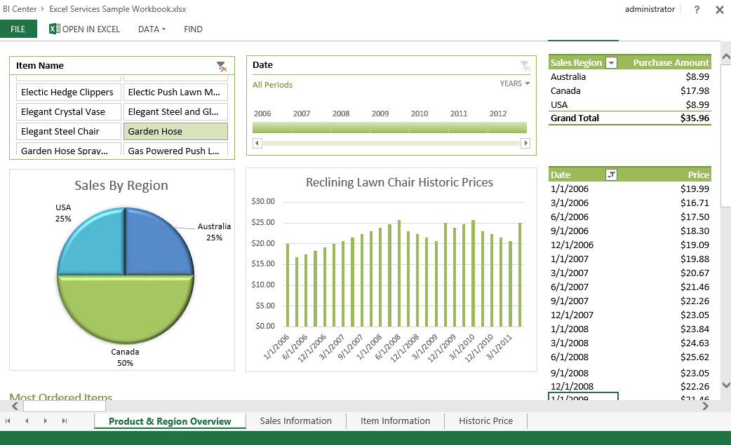
Excel Services Overview

Slide 5
Excel Services Benefits
Secure sharing of workbooks
Share workbooks w/o exposing proprietary business logic
Prevent users from editing workbooks when required
Business Intelligence
Workbooks connected to enterprise data sources
Workbooks can contain dashboards and scorecards
Workbooks can be published to SharePoint
Extensibility
Create reusable logic that is contained inside workbooks
Reliability and availability
Calculations performed on server instead of client machines
Notes:
Offloading calculations to servers frees the users’ computers and takes advantage of the server’s additional computing power.

Slide 6
Excel Services Architecture
External data connections
Support for SQL Server, SQL Server Analysis Services (SSAS), OLE DB, and ODBC
Data models
Supported if SSAS is registered in Excel Services
Reports and scorecards
Reports, dashboards, scorecards, & PivotTable reports supported in Excel Services
Notes:
Excel business intelligence provides the capability to explore and analyze data of any size, and integrate and show interactive solutions of the data. In SharePoint 2013, Excel BI offers the following new features:
External data connections: As mentioned in the previous chapter, most external data connections are supported in Excel Services. This includes SQL Server Analysis Services (SSAS), SQL Server databases, OLE DB, and ODBC data sources.
Data models: Data models are supported as long as an instance of SSAS is registered in Excel Services.
Reports and scorecards: Reports, dashboards, and scorecards created in Excel are supported in Excel Services. PivotTable reports can be viewed, sorted, filtered, and interacted with in the browser through SharePoint. This includes views created by Power View.

Slide 7
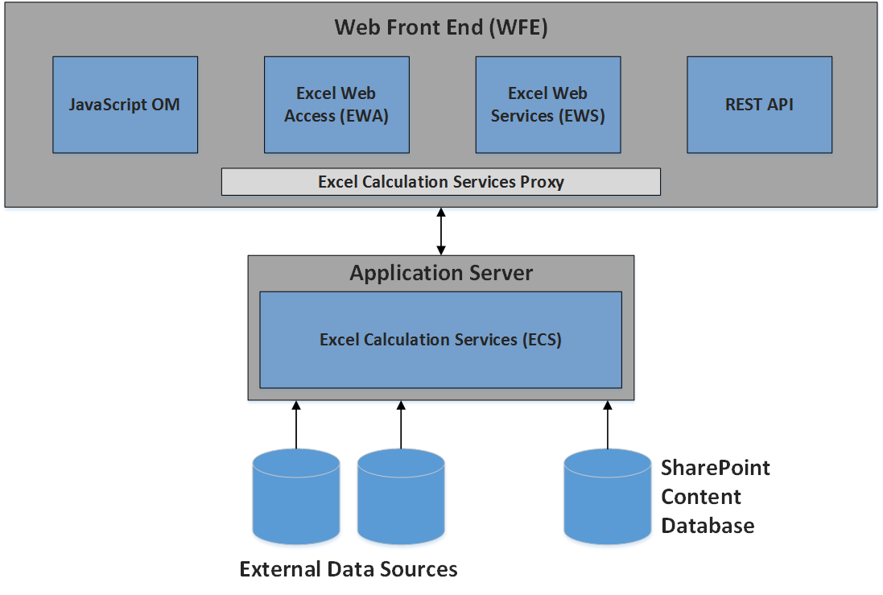
Excel Services Architecture
Notes:
The figure above shows an example of an on-premises SharePoint 2013 Excel Services environment. The Excel Services components can be divided between the Web Front End (WFE) and the Application Server. The WFE includes JavaScript, Excel Web Access, Excel Web Services, and the REST API. Excel Calculation Services component resides on the Application Server along with any UDF assemblies that an administrator has added.
Developers can access the Excel Services REST API on SharePoint Online for O365. The REST API enables developers to access workbook parts manually or programmatically. A subset of .NET SharePoint web services REST API is available and for on-premises all .NET SharePoint web services REST API is available.

Slide 8
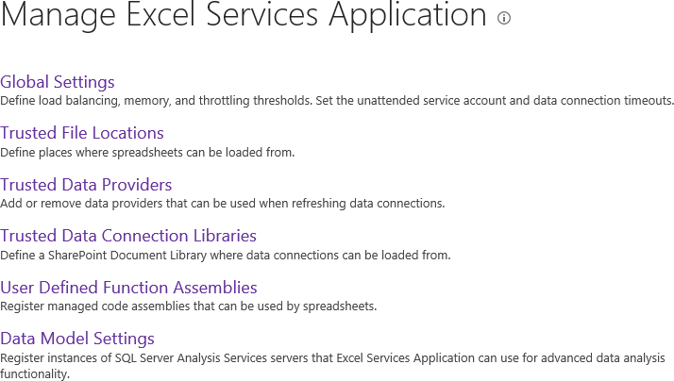
Configuring Excel Services
Notes:
The settings for managing Excel Services include the following:
Global Settings - settings for security, load balancing, session management, memory utilization, workbook, caches, and external data connections.
Trusted File Locations - Allows you to define which document libraries are trusted by Excel Services. Settings also include session management, workbook size, calculation behavior, and external data settings of workbooks stored in the defined locations.
Trusted Data Providers - Contains a predefined list of trust data providers for connecting to your external data. Also provides the ability to add your own trusted data provider.
Trusted Data Connection Libraries - Allows you to define which data connection libraries in your farm are trusted by Excel Services. Data Connection libraries are used to store the shared data connection files.
User-defined Function Assemblies - Provides the ability to add your own custom user-defined assemblies.
Data Model Settings – Registers instances of SSAS for Excel Services.

Slide 9
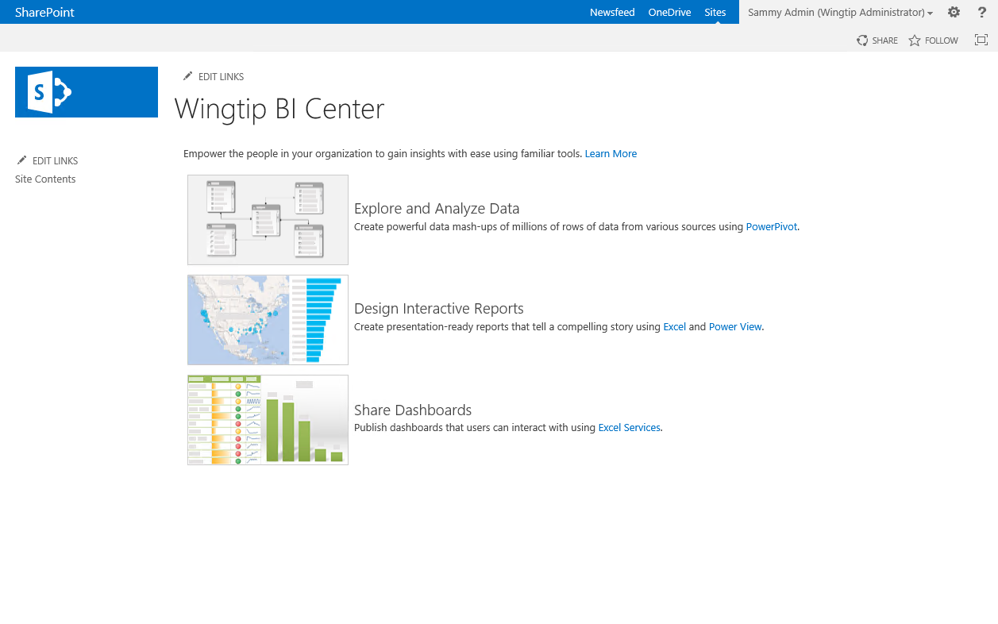
Business Intelligence Center Sites
Business Intelligence Center is Site Template
Used to create sites with BI reports & dashboards
Provides BI support through Excel Services
Provides PowerPivot Gallery to publish data models

Slide 10
Agenda
Excel Services Architecture
Publishing Workbooks
Excel Services REST API
PowerPivot for SharePoint

Slide 11
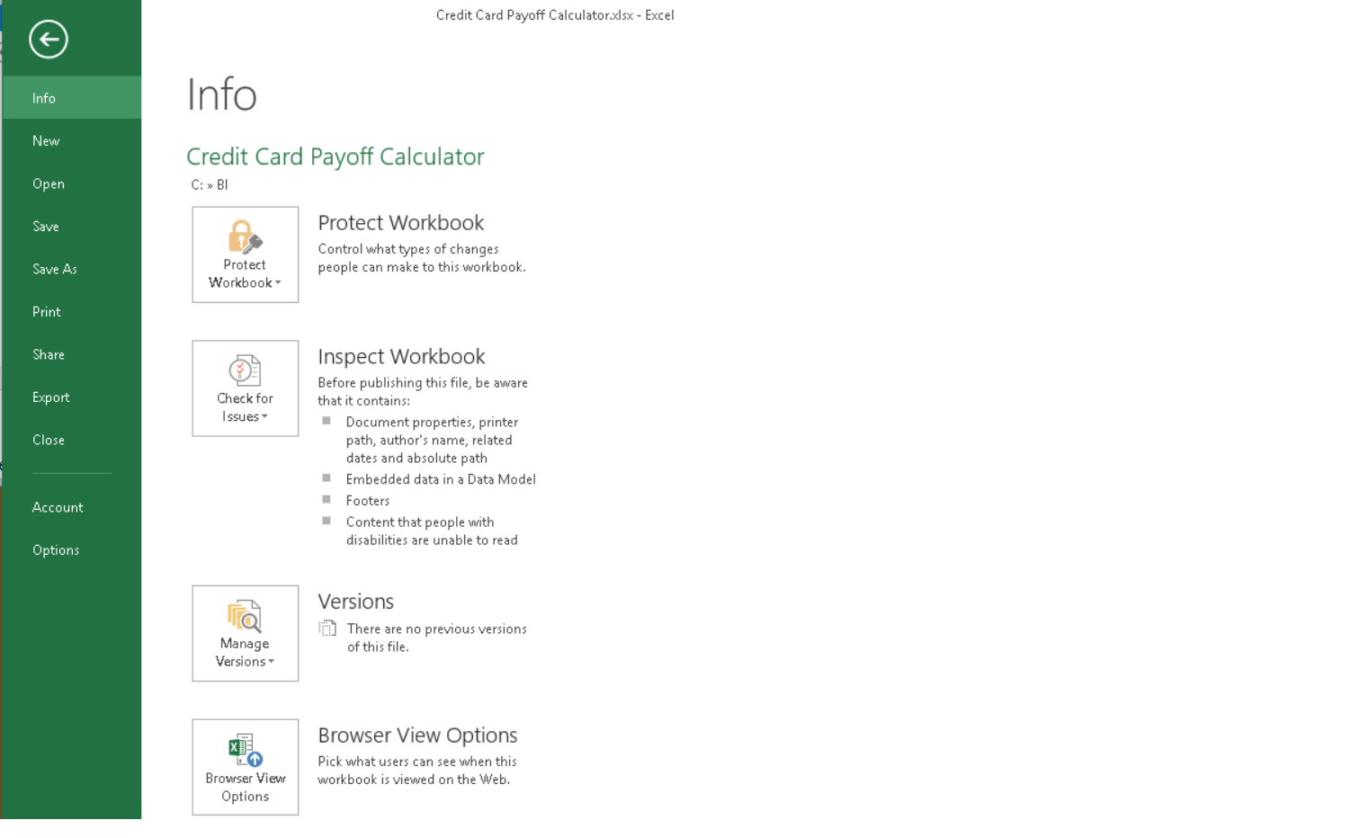
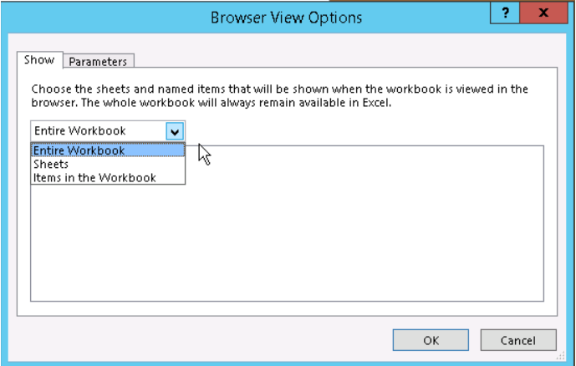
Browser View Options
Used to set granularity of publishing
Default setting is to publishing entire workbook
Publishing can be configured per-worksheet or per-item

Slide 12
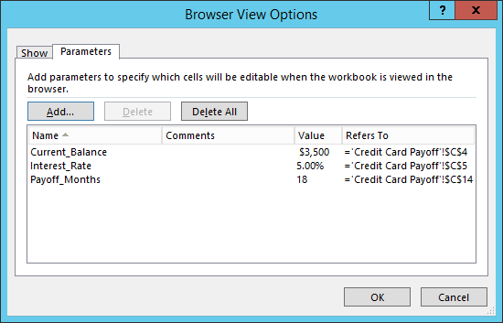
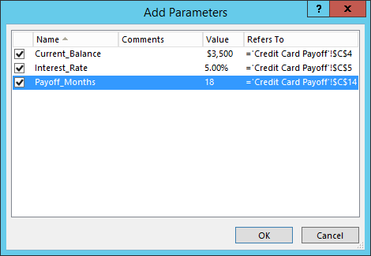
Adding Parameters
Browser options support adding parameters
Based on single-cell named ranges in workbook
Displayed to user via task pane in browser
Allows user to enter custom parameter values

Slide 13
Publishing Workbooks
Simply save workbook to SharePoint document library
Excel services support must be pre-configured in target library
Steps required before publishing a workbook:
Configure contribute permissions on target SharePoint library
Configure trusted data connections and trusted file locations
Extra configuration required in workbook contains data model
Extra configuration required to use Power View in SharePoint
Notes:
Before you can publish Excel 2013 workbooks to your SharePoint Server, the prerequisites must be addressed first based on your requirements.

Slide 14


Publishing Workbooks
An Excel workbook must be created
Workbook must contain at least one item
Chart, table, PivotChart report, PivotTable report, or a range of data
When publishing to document library
Location used must be specified as trusted location for Excel Services
Notes:
In order to publish an Excel workbook, a workbook must be created and contain at least one item such as a chart, table, Pivot chart report, PivotTable report, or a range of data. The document library you are publishing to must have the location added to the trusted location in Excel Services.

Slide 15
Publishing an Excel Workbook to a SharePoint Document Library

Slide 16
Agenda
Excel Services Architecture
Publishing Workbooks
Excel Services REST API
PowerPivot for SharePoint

Slide 17
Excel Services REST API
REST API introduced in SharePoint 2010
Allows access of workbook parts or elements directly through URL
REST Services based on two requirements:
Addressing scheme used to locate networked resources
Methodology for returning representations of resources
REST Sample
http://intranet.wingtip.com/_vti_bin/ExcelRest.aspx/Documents/MyWorkbook.xlsx/Model/Charts('Chart1')
Notes:
The REST API for Excel Services enables operations against Excel workbooks using operations specified in the HTTP standard. This allows for a flexible, secure, and a simple way to access and manipulate Excel Services content. The REST Sample in the slide shows the URL for retrieving a chart named Chart7 from the ExcelFileName.xlsx file on the contoso site which resides in the Documents library. This URL can be placed inside an Image Viewer web part to display the chart through the web part.

Slide 18
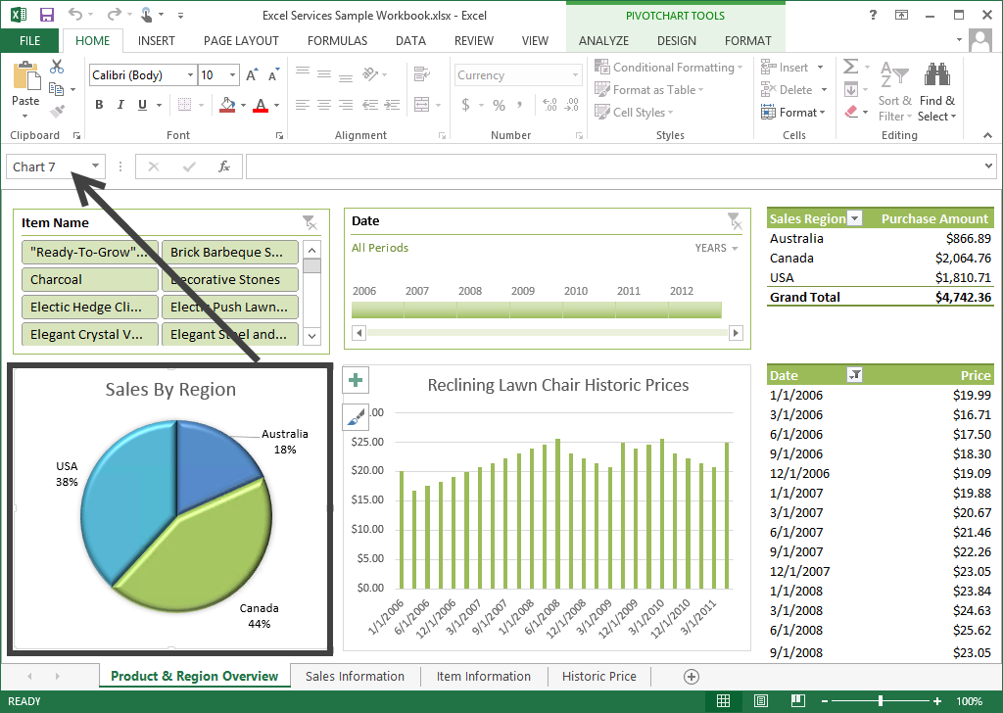
Excel Services REST API

Slide 19
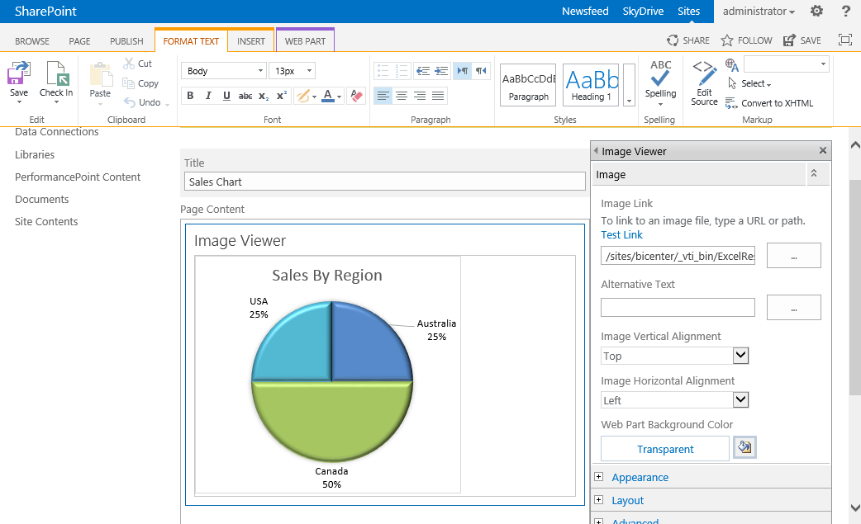
Excel Services REST API

Slide 20
Calling the Excel Services REST API

Slide 21
Agenda
Excel Services Architecture
Publishing Workbooks
Excel Services REST API
PowerPivot for SharePoint

Slide 22
PowerPivot for SharePoint
PowerPivot for SharePoint
You upload workbook with data model uploaded to SharePoint
SharePoint deploys data model to SQL Analysis Services (SSAS)
SQL Analysis Services must be running in SharePoint mode
Provides server hosting of PowerPivot data in SharePoint farm
Queries against data model run server-side in SSAS
No need for running Excel on the desktop
Data is loaded on PowerPivot for SharePoint instances
Data can be refreshed at scheduled intervals

Slide 23
PowerPivot for SharePoint
Excel Services in SharePoint 2013
Includes data model functionality to enable interaction with PowerPivot workbook in browser
PowerPivot for SharePoint 2013 add-in not required
Only need to install SSAS in SharePoint mode & register server in Excel Services Data Model settings
Installing PowerPivot for SharePoint 2013 provides more functionality and features
PowerPivot Gallery
Schedule Data Refresh
PowerPivot Management Dashboard

Slide 24
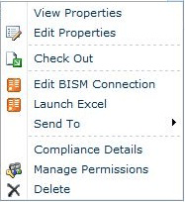
BI Semantic Model Connection
PowerPivot BI Semantic Model Connection (.bism)
Portable connection that connects Excel or Power View reports to SQL Analysis Services tabular model
Similar to Office Data Connection (.odc) files
BI semantic models
Created and accessed via SharePoint
Enables quick launch commands on BI semantic model connection in a library
Quick launch commands open a new Excel workbook or options for editing connection file
Create Power View report command is available if SSRS installed

Slide 25
BI Semantic Model Connection
Connection points to a tabular model data
Two sources for data:
Tabular model database running standalone SSAS instance in tabular mode
Standalone SSAS instance deployment is external to farm
PowerPivot workbooks saved to SharePoint
PowerPivot embedded databases inside Excel workbooks are equivalent to standalone SSAS tabular model databases
Define connection that points to PowerPivot workbooks in a SharePoint library
Build Power View reports using existing PowerPivot data

Slide 26
Connecting from Excel to Tabular Data
All tabular connections made using credentials of user requesting data
Mechanisms of connection very depending on if connection is:
In-farm connection
Single or double-hop connection
Or Kerberos is enabled

Slide 27
Connection Sequence Excel to Tabular
When Excel user specifies BISM connection as data source
Connection information stored in file downloaded to client application
Direct request to SSAS tabular model is issued
To access .bism connection, user must be SharePoint user w/ read permissions to .bism file
Excel
1
PowerPivot .BISM file in SharePoint
SSAS Tabular Model Database
2
3

Slide 28
Connection from Power View to Tabular
When SharePoint user clicks .BISM connection in document library
Power View starts immediately (if installed) and opens connection to tabular model database
Connection between Power View and tabular model database
Double-hop authentication sequence
User identity flowed from client to SharePoint then from SharePoint to back-end SSAS tabular model database

Slide 29
Summary
Excel Services Architecture
Publishing Workbooks
Excel Services REST API
PowerPivot for SharePoint

