Slide 1
Creating Dashboards with PerformancePoint Services
Notes:
This module teaches students what they need to know to build BI solution with PerformancePoint Services. Students will learn to use the Dashboard Designer to create data connections and other types of BI objects such as Reports, Indicators, KPIs and Scorecards. After that the module discusses how to publish these BI objects to a SharePoint site by creating and deploying a Dashboard. Students will also learn how to add filters to a Dashboard to provide the user with controls over filtering and drilling down into greater detail.

Slide 2
Agenda
PerformancePoint Services Overview
Initial Configuration
Working with the Dashboard Designer
Deploying a Dashboard

Slide 3
Context-Driven Dashboards
Provides design environment for BI Producers
Provides browser view for business users
Allows users to navigate and explore analysis
Slice, Dice, and Drill through the data
Apply custom filtering, sorting
Choose Top/Bottom N items
Change displays (ex. Grid to Chart)
Notes:
PerformancePoint Services in SharePoint Server 2013 is a performance management service that can be used to monitor and analyze your business. By providing flexible, easy-to-use tools for building dashboards, scorecards, and key performance indicators (KPIs), PerformancePoint Services can help individuals across an organization make informed business decisions that align with companywide objectives and strategy.
PerformancePoint Services provides a design environment for BI producers as well as provide a browser view for business users.
Users will be able to navigate and explore analysis by:
Slicing, dicing, drill-down the data.
Apply custom filtering and sorting options.
Choose top/bottom number of items.
Change the display such as changing from a grid to a chart.

Slide 4
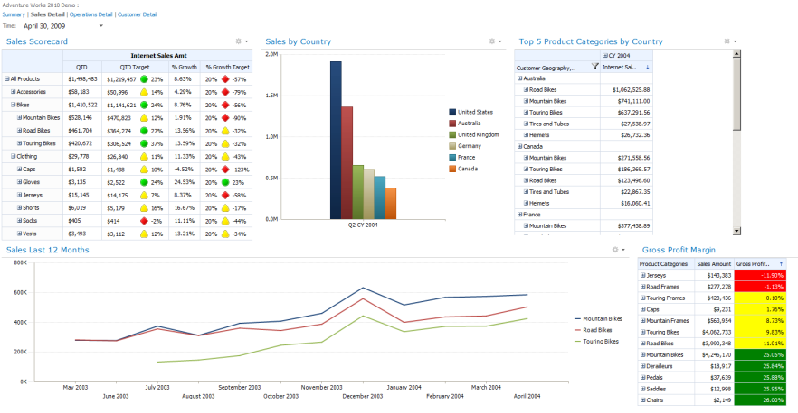
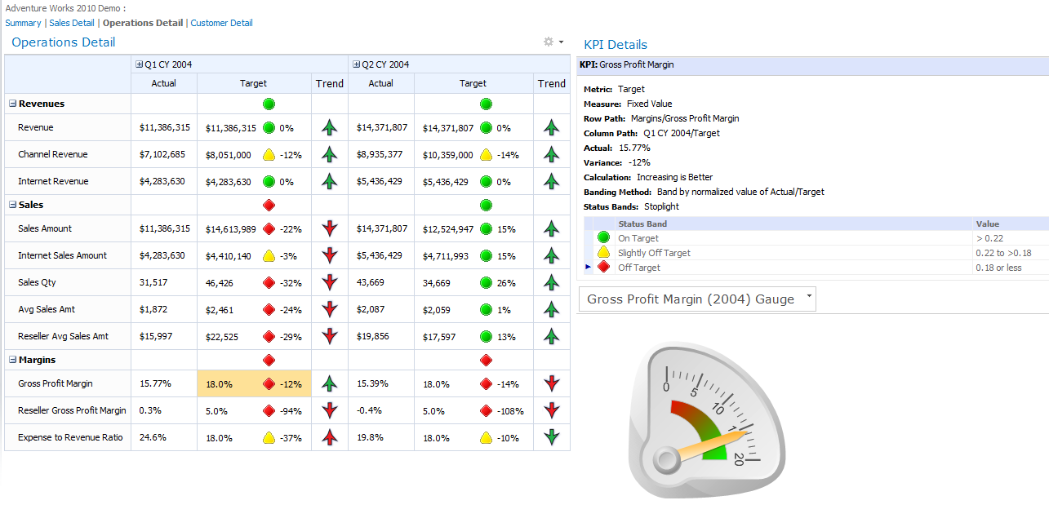
What are Dashboards?
Visual displays of mission critical analysis
Answers fundamental business questions
Single screen display of information
“Real Time” summary of data
Interactive links to details
Notes:
The goal of a dashboard is to provide all the business information a user needs right in front of them while allowing them to quickly and easily explore any aspect as needed.
For example they could see that the projected sales for an region are lower than expected on the main page. They should be able to select that region and see the charts adjust to focus on that region. Then they should be able to drill into the data in one click to see more information and supporting reports.

Slide 5
What are Scorecards?
Provides an overall view of status indicators
Modeled after the business not the data
Manages key performance indicators (KPIs)
Often included as part of a dashboard
Notes:
A scorecard is a special kind of report that provides an overall, high-level snapshot of performance for a group or organization. A scorecard provides a visual representation of performance that can give you a summary of progress at a glance.
Scorecards are dashboard items that show performance for one or more metrics. Scorecards compare actual results to specified goals and express the results by using graphical indicators. The key performance indicators (KPIs) in a scorecard represent specific, measurable elements of performance, such "Sales” for a particular group, or "Number of customer complaints per day."

Slide 6
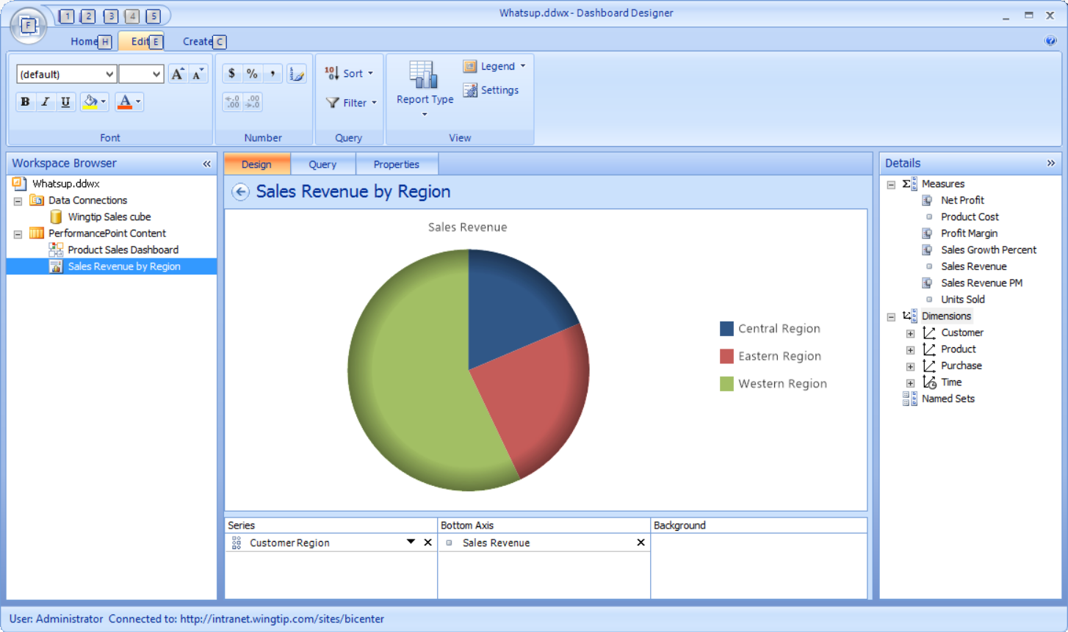
PerformancePoint Dashboard Designer
Dashboard Designer used to create content
ClickOnce application launched from browser
Manages content directly in SharePoint
Lists for content, data sources, dashboards
Notes:
PerformancePoint Dashboard Designer is a tool that you can use to create dashboards, scorecards, and reports and publish them to a SharePoint site. Dashboard Designer is part of PerformancePoint Services in Microsoft SharePoint Server 2013. By using PerformancePoint Dashboard Designer, you can create various scorecards for your dashboards.

Slide 7
Agenda
PerformancePoint Services Overview
Initial Configuration
Working with the Dashboard Designer
Deploying a Dashboard

Slide 8
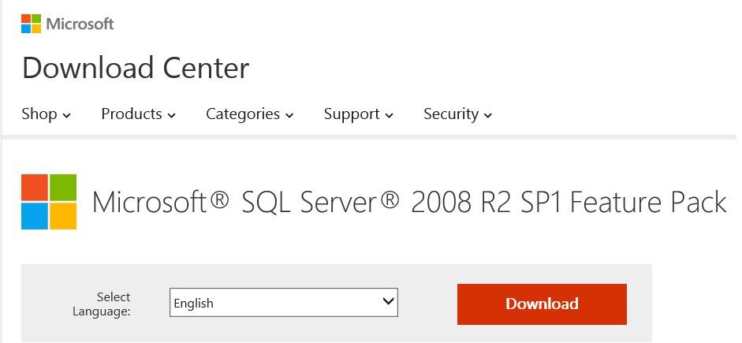
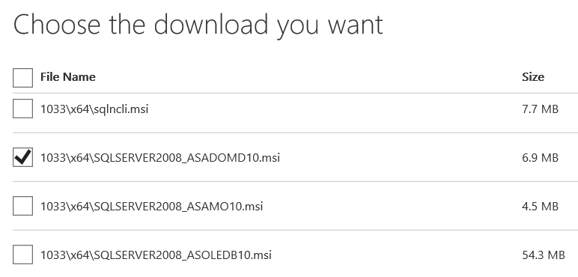
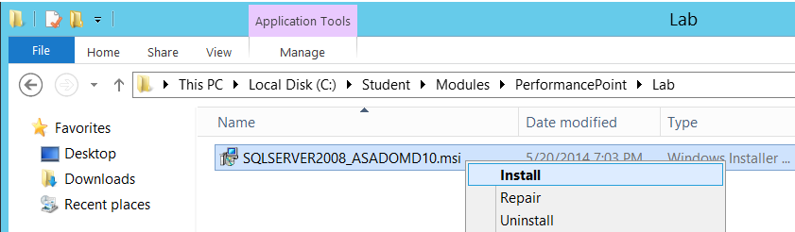
Configuring Dashboard Designer
It requires ADO.NET MD version 10
http://www.microsoft.com/en-us/download/details.aspx?id=26728

Slide 9
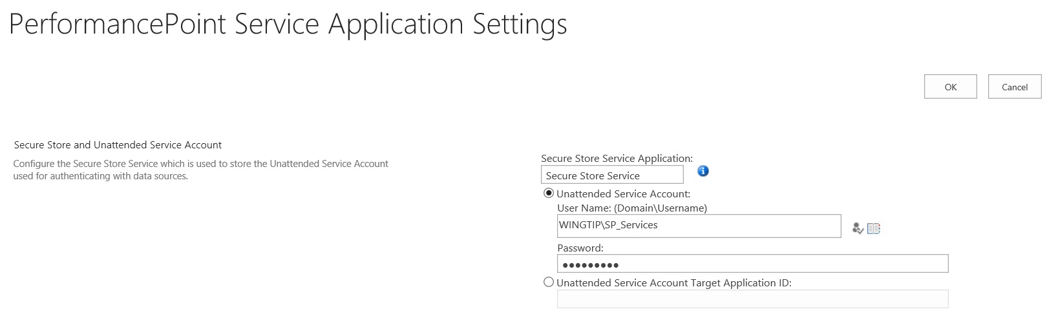
Configuring Unattended Execution

Slide 10
Agenda
PerformancePoint Services Overview
Initial Configuration
Working with the Dashboard Designer
Deploying a Dashboard

Slide 11
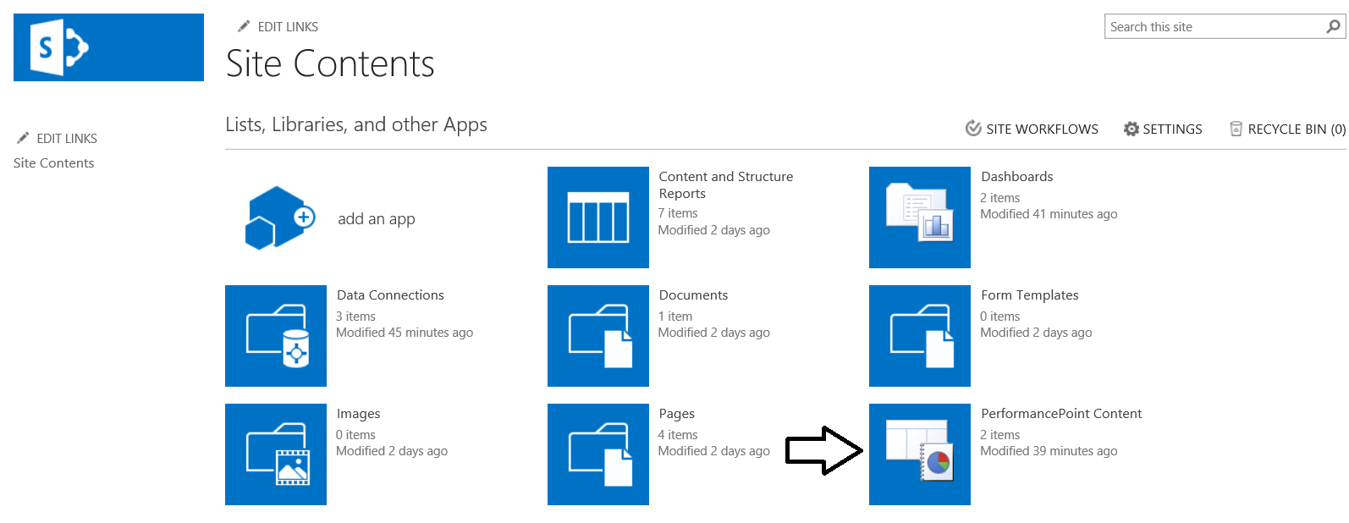
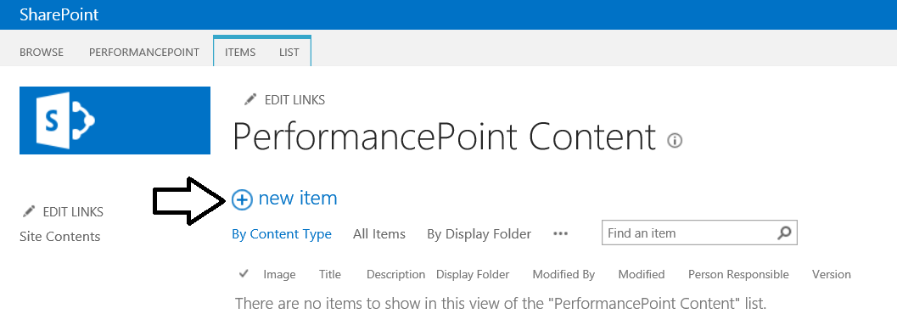
The PerformancePoint Content List

Slide 12
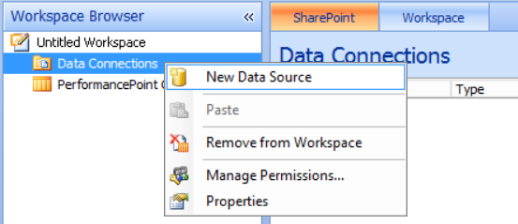
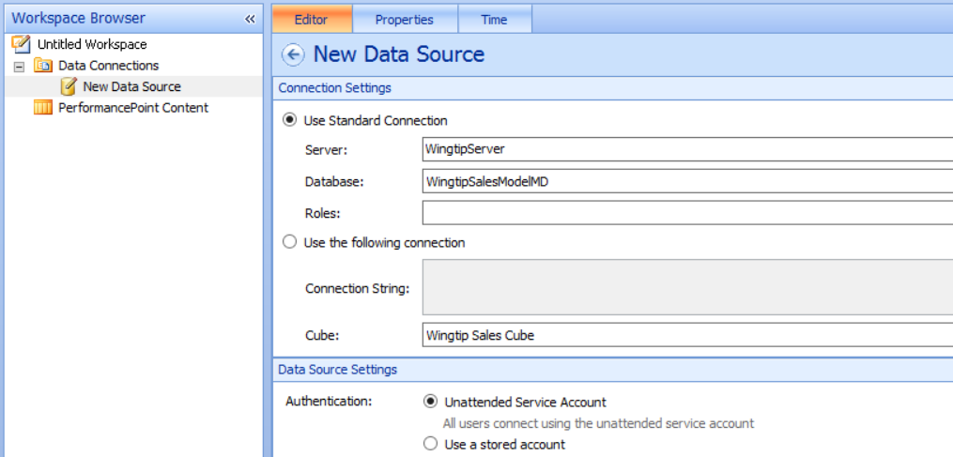
Creating a New Data Source

Slide 13
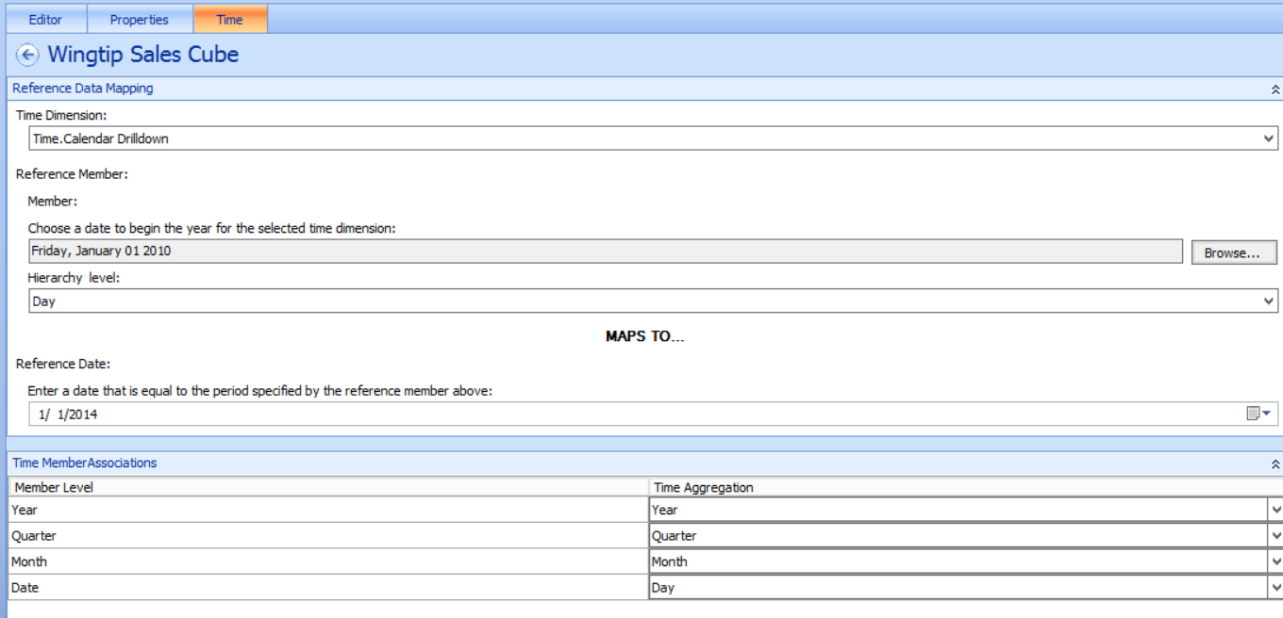
Time Intelligence Configuration

Slide 14
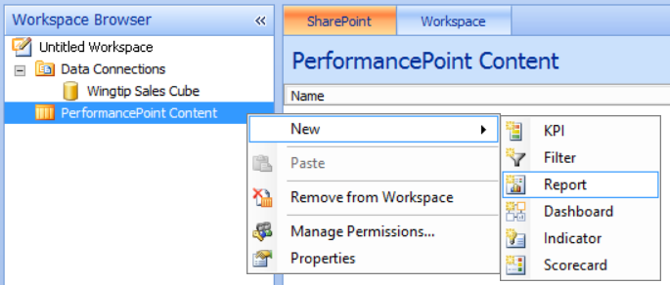
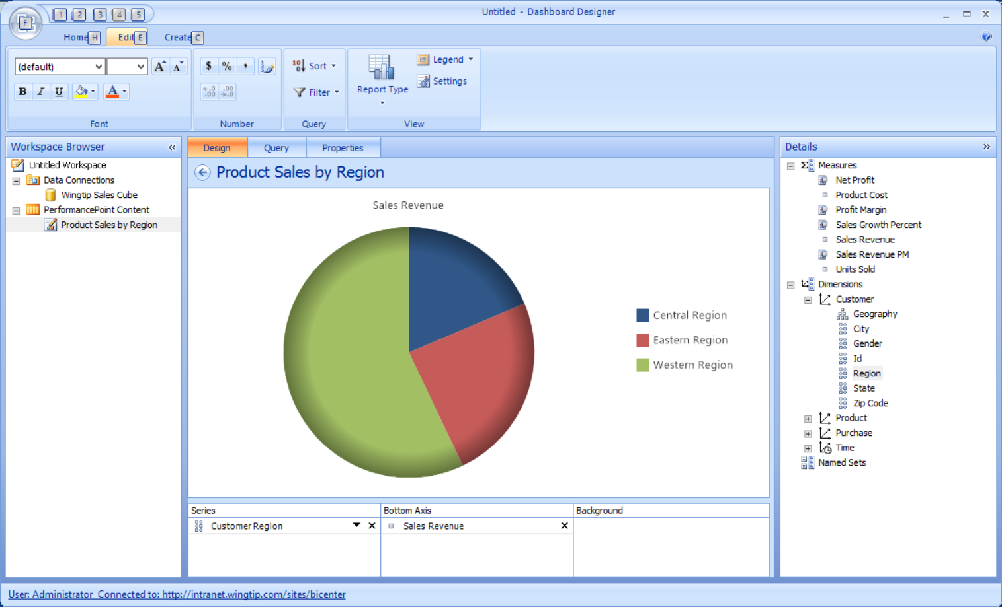

Slide 15
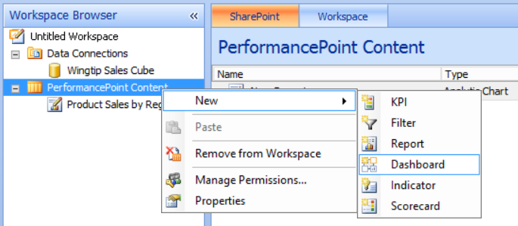
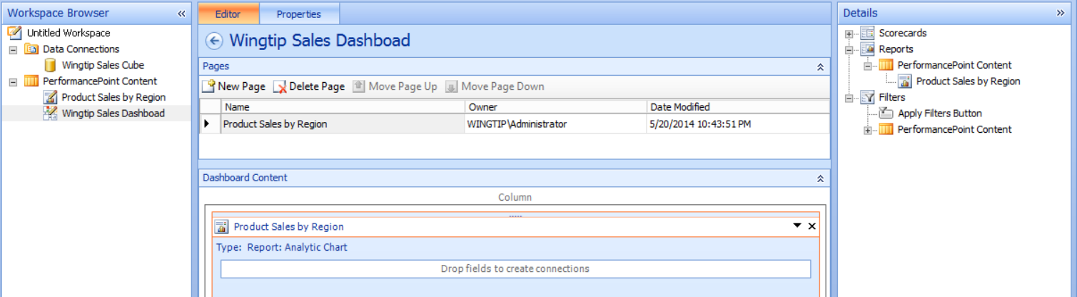
Creating a Dashboard

Slide 16
Agenda
PerformancePoint Services Overview
Initial Configuration
Working with the Dashboard Designer
Deploying a Dashboard

Slide 17
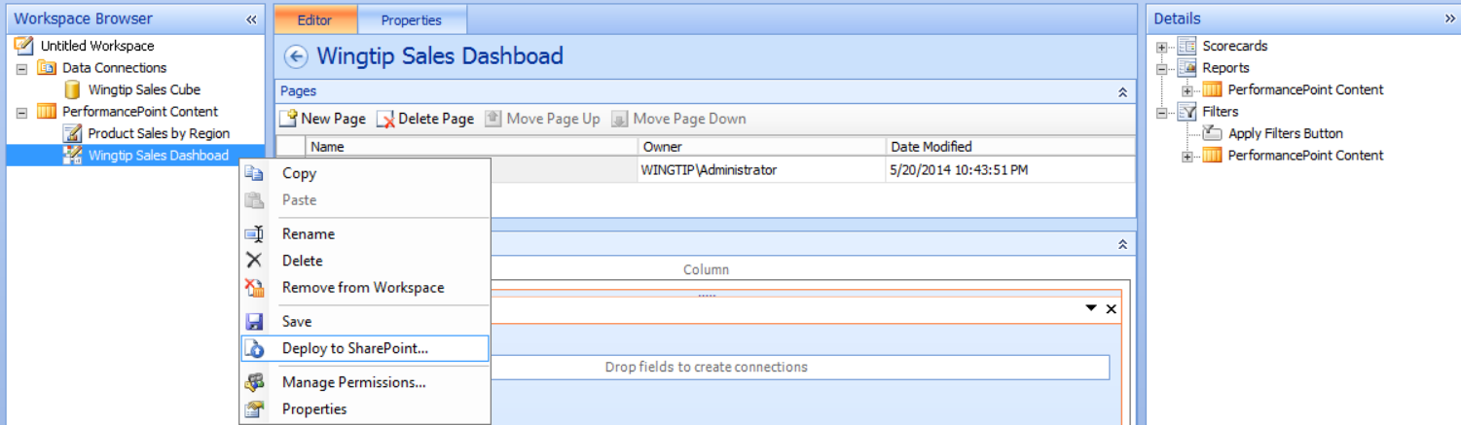
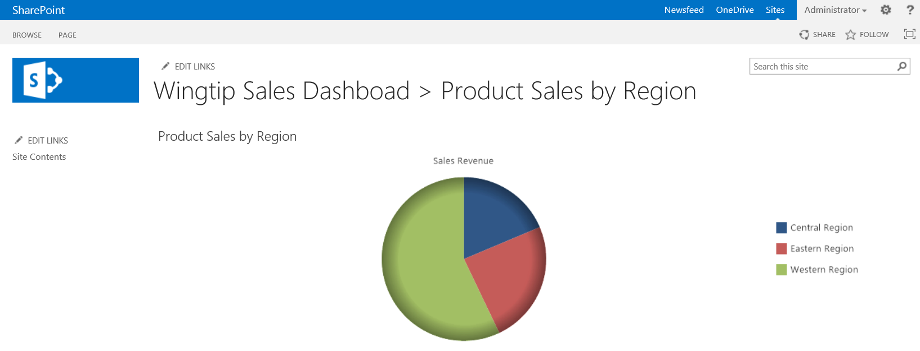
Deploying a Dashboard

Slide 18
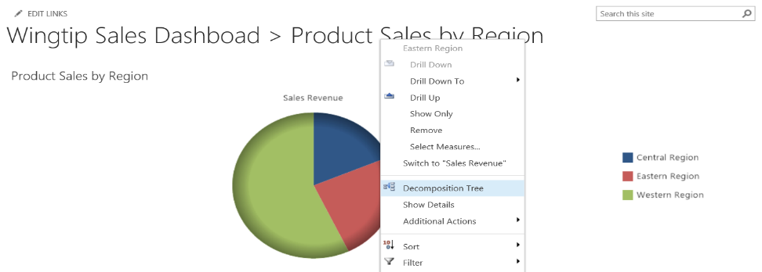
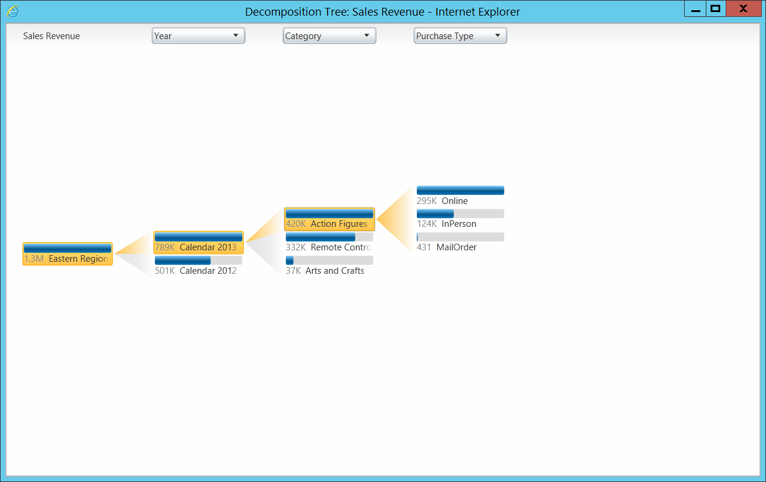
Decomposition Trees

Slide 19
Summary
PerformancePoint Services Overview
Initial Configuration
Working with the Dashboard Designer
Deploying a Dashboard

