Slide 1
Creating a Data Warehouse using SSIS

Slide 2
Agenda
Modeling OLAP Data for a Data Warehouse
Introduction to Integration Services (SSIS)
Developing Packages with Visual Studio
Understanding Slowly Changing Dimensions
Loading Dimension Tables and Fact Tables

Slide 3
Motivation for Data Warehouse
Eliminate contention between OLTP writers and OLAP readers
Too much data from too many places
Track extra types of historical data
Build in a sense of confidence that the data is trusted

Slide 4
OLAP Modeling with Star Schema
Modeling in OLAP often based on star schema
Table are broken down into fact tables and dimension tables.

Slide 5
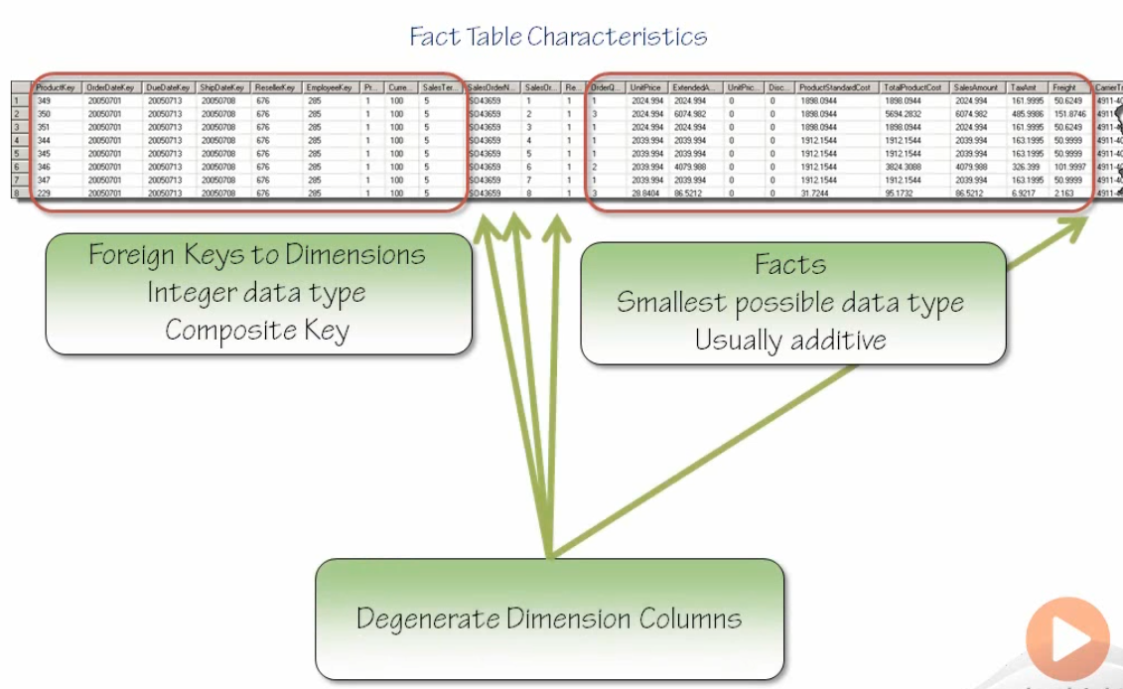

Slide 6
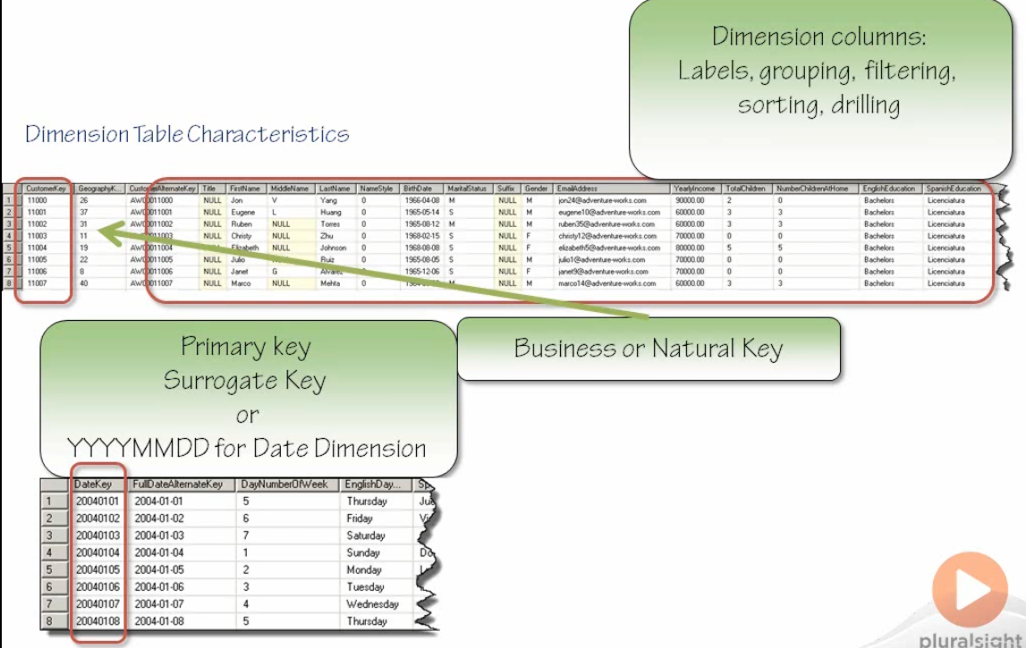

Slide 7
Agenda
Modeling OLAP Data for a Data Warehouse
Introduction to Integration Services (SSIS)
Developing Packages with Visual Studio
Understanding Slowly Changing Dimensions
Loading Dimension Tables and Fact Tables

Slide 8
What is Integration Services For?
ETL for data warehouse population
Cleaning and standardizing data
Merging data from multiple data sources
Automating administrative tasks

Slide 9
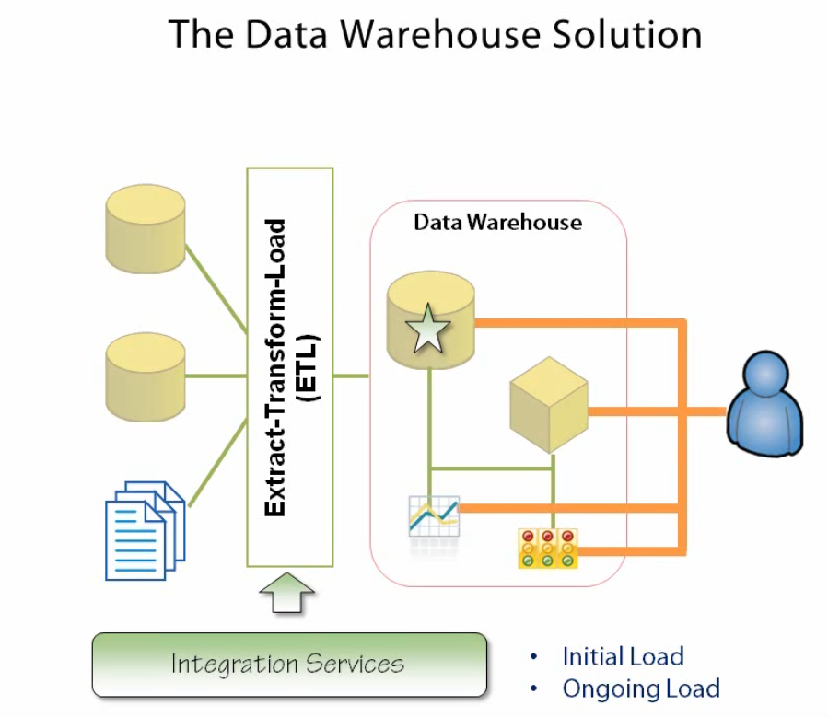
ETL with Data Warehouses

Slide 10
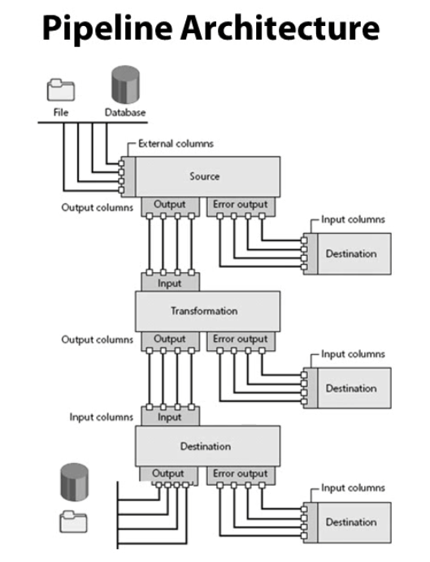

Slide 11
Agenda
Modeling OLAP Data for a Data Warehouse
Introduction to Integration Services (SSIS)
Developing Packages with Visual Studio
Understanding Slowly Changing Dimensions
Loading Dimension Tables and Fact Tables

Slide 12
Packages (*.dtsx)
IIS runtime loads and executes packages
Control of flow engine
Data flow engine
Logging engine
Package
Task
Event handler
Tools for creating packages
Import/Export wizard in SQL Server tools
Package Designer with SSDT Integration Project in VS

Slide 13
Tasks
Components which represent unit of work
Tasks can have precedence constraints
Task has an outcome of success or familiar

Slide 14
Containers
Container types
Sequence container
For loop container
For Each Loop container
Reason to use a container
Set properties once for multiple tasks
Control subsequent flow
Define scope for variables
Combine tasks into a single transaction
Create events handler

Slide 15
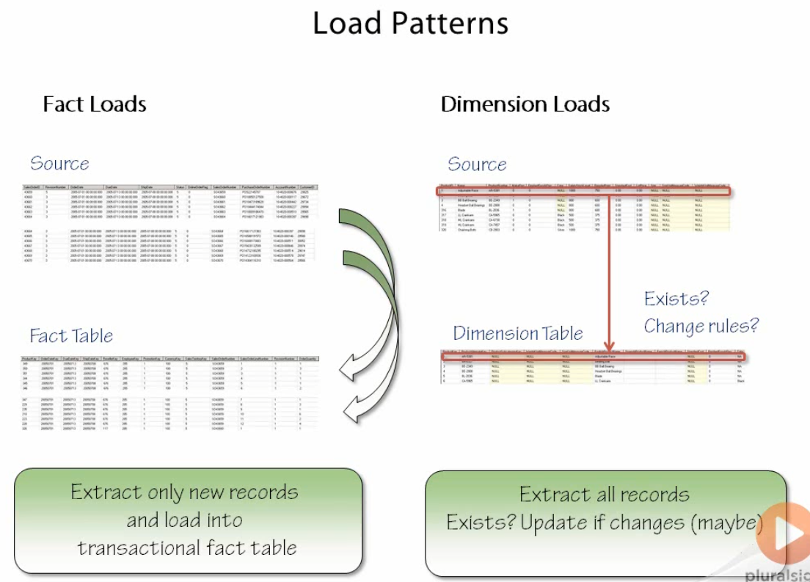

Slide 16
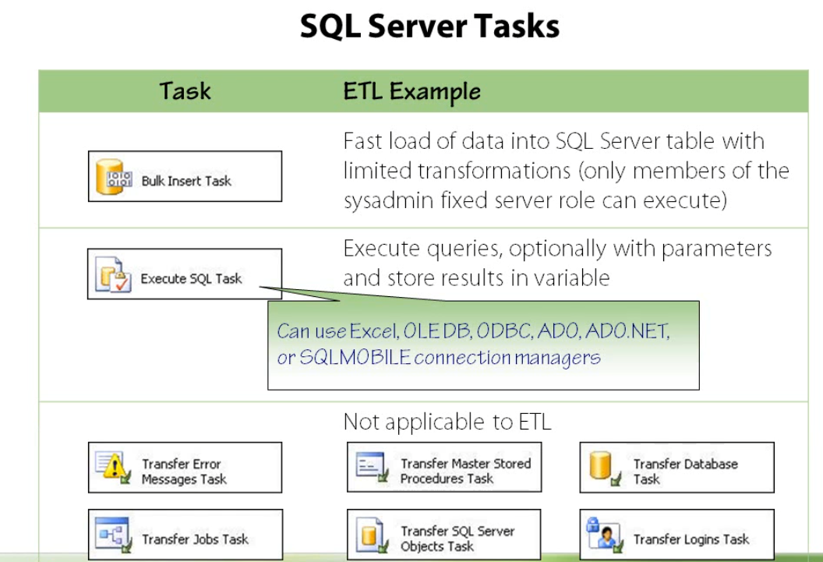

Slide 17
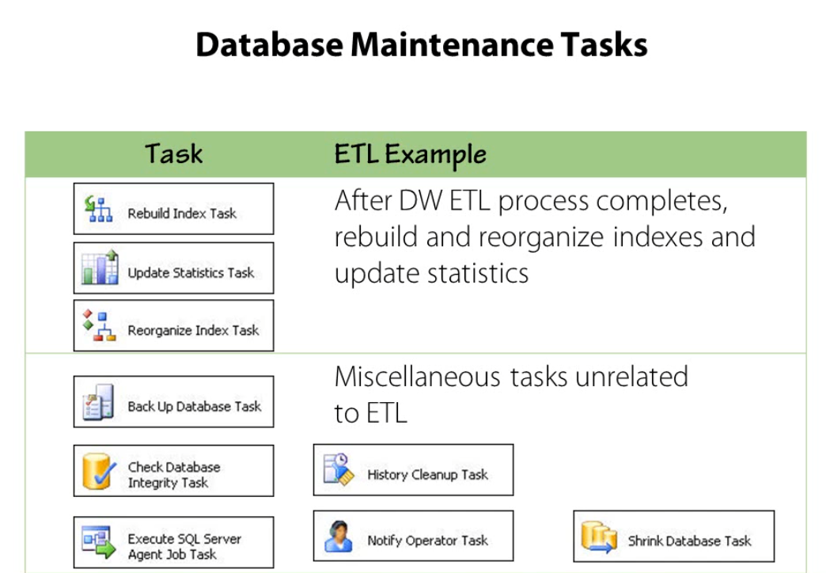

Slide 18
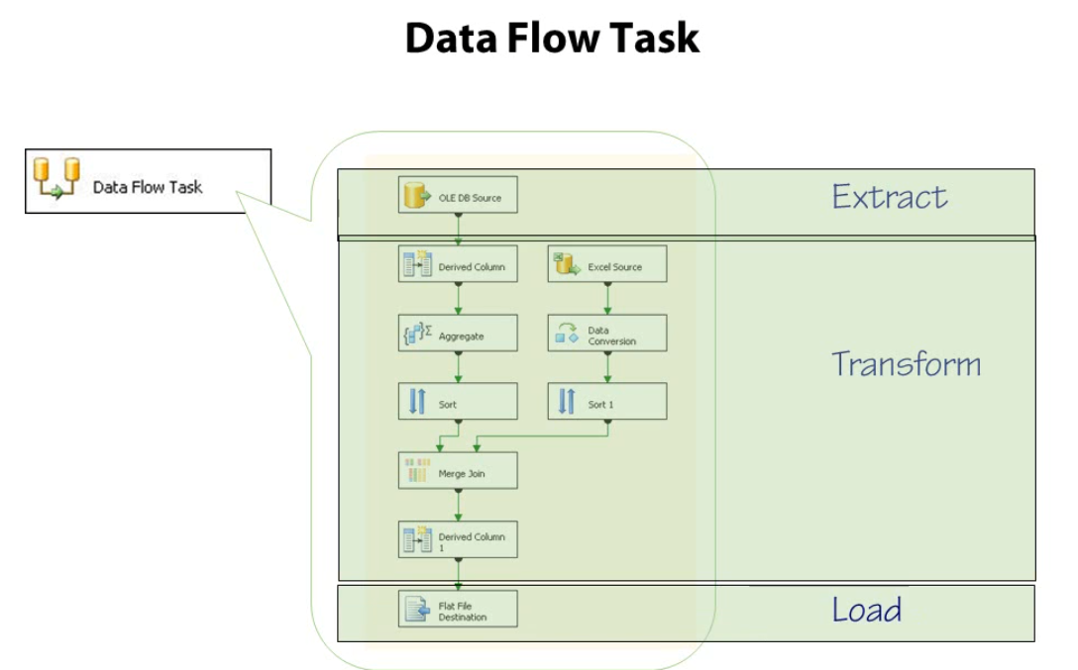

Slide 19
Agenda
Modeling OLAP Data for a Data Warehouse
Introduction to Integration Services (SSIS)
Developing Packages with Visual Studio
Understanding Slowly Changing Dimensions
Loading Dimension Tables and Fact Tables

Slide 20
Agenda
Modeling OLAP Data for a Data Warehouse
Introduction to Integration Services (SSIS)
Developing Packages with Visual Studio
Understanding Slowly Changing Dimensions
Loading Dimension Tables and Fact Tables

Slide 21
Summary
Modeling OLAP Data for a Data Warehouse
Introduction to Integration Services (SSIS)
Developing Packages with Visual Studio
Understanding Slowly Changing Dimensions
Loading Dimension Tables and Fact Tables

