Slide 1
Creating Reports with SQL Server Reporting Services
Notes:
This module discusses how to leverage the integration between SharePoint 2013 and SQL Reporting Services. Students will learn the fundamentals of creating and designing SSRS reports using the Report Builder utility and publishing these reports to a SharePoint site. Students will learn the proper techniques for creating Data Source and Data Sets to be used within an SSRS report. The module discuss how to make SSRS reports interactive allowing the report consumer to drill down into greater detail when necessary. Along the way, students will also learn about on-going responsibilities associated with SSRS which includes deploying and refreshing reports as well as managing snapshot and report history. The module concludes with a discussion of how and when to display an SSRS report using the SQL Server Reporting Services Web Part.

Slide 2
Agenda
SQL Reporting Services Overview
SharePoint Integration
Data Sources
Report Builder

Slide 3
SQL Reporting Services Overview
What is SQL Reporting Services (SSRS)?
Server-based reporting platform
Provides ready-to-use tools to create, prepare, deliver interactive and printed reports
Create interactive, tabular, graphical, free-form reports
Use relational, multidimensional, or XML-based data sources
Publish reports, schedule report processing, access on-demand (ad-hoc) reports
View reports via browser with SharePoint Integration
Notes:
SQL Reporting Services (SSRS) is a comprehensive, highly scalable, server-based platform that empowers real-time reporting. SSRS provides a full range of ready-to-use tools and services that provide the ability to create interactive and print-ready reports for your organization. With SSRS you can create interactive, tabular, graphical, or free-form reports using relational, multidimensional, or XML-based data sources.
You can publish reports, schedule report processing, or access reports on-demand (ad-hoc). Ad-hoc reporting gives users the flexibility to create dynamic reports based on their input. You can select from a variety of viewing formats, export reports to other applications such as Excel or PDF, and subscribe to published reports. The reports can be viewed via the browser in SharePoint with SSRS SharePoint integration.

Slide 4
Agenda
SQL Reporting Services Overview
SharePoint Integration
Data Sources
Report Builder

Slide 5
SharePoint Integration
SharePoint Integrated Mode provides the following features:
Alerts and version control ability on reports
Set permissions on reports and models
Publish or upload reports to SharePoint libraries
Use Report Designer, Model Designer, and Report Builder to create reports and data sources
Use Report View Web Part on SharePoint pages

Slide 6

SSRS & Power View Integration Features
Activated by default after SSRS add-in for SharePoint is installed
Sometimes needs to be manually activated
Report Server integration and Power View integration features only active on root site collection
If SSRS add-in installed after SharePoint installation

Slide 7

Report Server File Sync Feature
Optional SharePoint Site Feature
Synchronizes report server catalog with items in SharePoint document libraries
If deactivated, content will still sync just not as frequently if active
Site settings > Site features

Slide 8
Power View
Interactive data exploration and visualization experience for SSRS
Browser-based Silverlight application launched from SharePoint
Great for ad-hoc reporting
Provides access to data represented by tabular models based on PowerPivot workbooks
Notes:
Power View is an interactive data exploration, visualization, and presentation experience for SQL Reporting Services that was introduced in SQL Server 2012. This Reporting Services Add-on for SharePoint is a browser-based Silverlight application launched from SharePoint. It provides access to data represented by tabular models based on PowerPivot workbooks either published in a PowerPivot Gallery or tabular models deployed to SQL Server 2012 Analysis Services (SSAS) instances.

Slide 9
Agenda
SQL Reporting Services Overview
SharePoint Integration
Data Sources
Report Builder

Slide 10
Data Sources
Before creating reports you must first create a data connection (aka data sources)
Data Sources include:
Data source type, connection information, type of credentials to use
Two types of data sources:
Embedded
Defined in report and used only by the report
Shared
Defined independently
Can be used by multiple reports

Slide 11
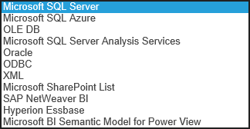

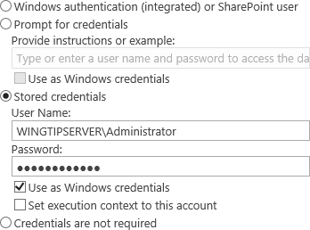
Creating a Data Source
To create a data source you must have the following information:
Data source type
Connection information
Credentials

Slide 12
Creating Data Sources to SQL Server Tables and SharePoint Sites

Slide 13
Agenda
SQL Reporting Services Overview
SharePoint Integration
Data Sources
Report Builder

Slide 14
Report Builder
Reporting authoring tool for business users
Benefits of Report Builder:
Quickly add items to reports, launch table, chart, map wizards, and format report data
Add data using query designers to specify data to include in report
Create/use report parameters and other features
Preview reports that use shared data sources and shared datasets
Preview reports in HTML or print format
Notes:
Report Builder is a reporting authoring tool used for business users to create SSRS reports for SharePoint 2013. This tool enables business users to design reports quickly by adding items to reports, launch table, chart, map wizards, and format data. When a report is being designed, the creator specifies where to get the data, which data to get, and how to display the data. The data is added using query designers to specify the data to use for the report. Parameters and other interactive features can be created/used which will enable the report readers to customize the data and vary report presentation in real-time. When the report reader runs a report the report processor takes all the specified information, retrieves the data, and then combines it with the report layout to generate the report.

Slide 15
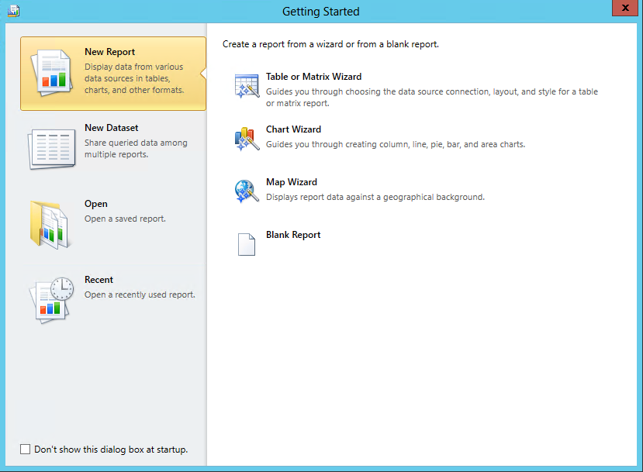
Report Builder

Slide 16
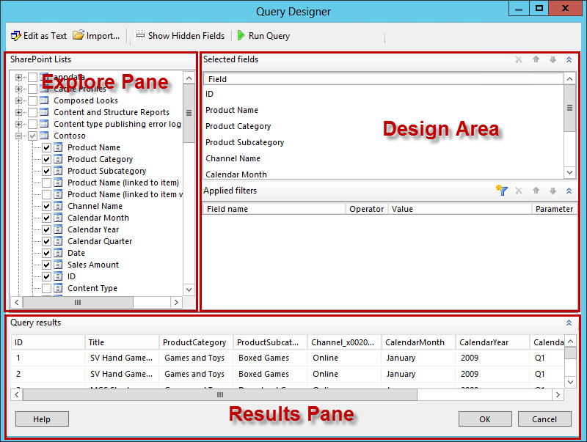
Graphical Design Query

Slide 17
Creating an SSRS Report bade on content from a SQL Server Table

Slide 18
Graphical Design Query
SharePoint Lists
Displays SharePoint lists and fields within each item in the list
Selected Fields
Displays SharePoint field names of items selected in the SharePoint Lists pane
Applied Filters
Displays list of fields and filter criteria for tables or views
Query results
Displays data result set
Notes:
In the graphical query designer, you can explore the SharePoint site and interactively build the command to retrieve SharePoint list data for the dataset. You choose the fields to include in the dataset and specify filters (optional) to limit the data in the dataset. Filters can also be setup to be used as parameters to provide the value of the filter at run-time.

Slide 19
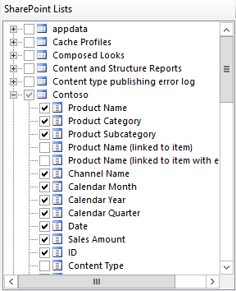
SharePoint Lists Pane
Displays metadata for database objects
Based on permissions to view
Determined by data source connection and credentials
Hierarchical view
Displays database objects organized by database schema
Expand node for each schema to view tables, views, stored procedures, table-valued functions
Expand table or view to display columns
Notes:
The SharePoint Lists pane displays the metadata for database objects that you have the permissions to view. These permissions are determined by the data source connection and credentials that have been provided. The hierarchical view displays database objects organized by database schema. You can expand the node for each schema to view the tables, views, stored procedures, and table-valued functions. To display the columns, you simply expand a table or view.

Slide 20
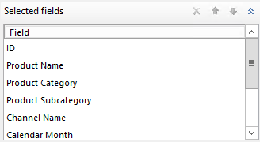
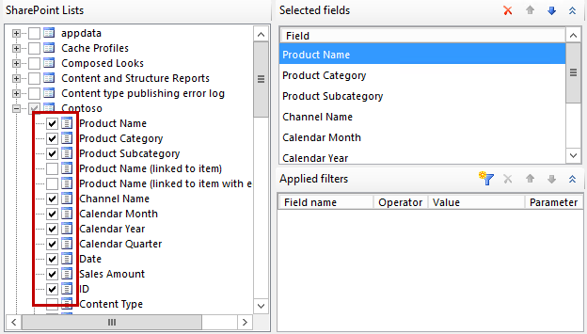
Selected Fields Pane
Displays list item fields of items selected in SharePoint Lists pane
These fields become the field collection for report dataset
To add or remove fields to this pane
Select or clear check boxes for table or view fields in SharePoint Lists pane
Notes:
The Selected Fields pane displays the list item fields based on what is selected for SharePoint list items. The fields that are displayed in this pane become the field collection for the report dataset. After you create a dataset and a query, you can use the Report Data pane to view the field collection for the report dataset. These fields represent the data you can display in tables, charts, and other report items when you view the report.
To add or remove fields to this pane, select or clear check boxes for the table or view fields in the SharePoint Lists pane.

Slide 21
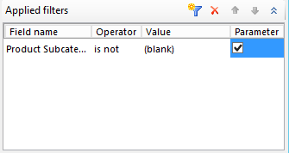
Applied Filters Pane
Use to filter data retrieved at run-time
The following columns are displayed:
Field Name
Displays name of field to apply criteria to
Operator
Displays operation to use in filter expression
Value
Displays value to use in filter expression
Parameter
Displays option to add a query parameter to query
Use Dataset properties to view relationship between query parameter and report parameter
Notes:
The Applied Filters pane displays the criteria that are used to limit the number of rows of data that are retrieved at run-time. Criteria specified in this pane are used to generate a T-SQL WHERE clause. When you select the parameter option, a report parameter is automatically created. Report parameters based on query parameters enable a user to specify values for the query to control the data in the report.
The following columns are displayed:
Field Name - Displays the name of the field to apply the criteria to.
Operator - Displays the operation to use in the filter expression.
Value - Displays the value to use in the filter expression.
Parameter - Displays the option to add a query parameter to the query. Use the Dataset properties to view the relationship between query parameter and report parameter.

Slide 22
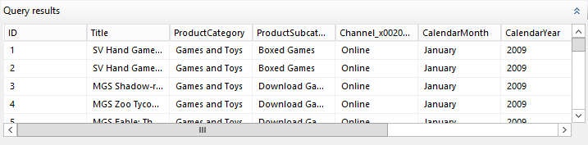
Query Results Pane
Click Run Query to execute query
Query results pane displays results for automatically generated query
Columns in result set:
Are fields specified in Selected Fields pane
Row data limited by filters set in Applied Filters pane
Notes:
The Query results pane displays the results for the automatically generated query that is specified by selections made in the other panes. The columns in the result set are the fields specified in the Selected Fields pane and the row data is limited by the filters specified in the Applied Filters pane.
This data represents values from the data source at the time the query is run and the data is not saved in the report definition. The actual data in the report is retrieved when the report is processed.
Sort order in the result set is determined by the order the data is retrieved from the data source. The sort order can be changed by modifying the query or after the data is retrieved for the report.

Slide 23
Graphical Query Designer Toolbar
Edit As Text
Toggle to text-based query designer
Import
Import existing query from file or report.
Supported file types (.sql & .rdl)
Show Hidden Fields
Toggle to show or hide fields automatically generated by SharePoint (ie. ProgId & Level for link items)
Typically not used in reports
Run Query
Query results pane displays the result set
Notes:
When using the Graphical Query Designer for a SharePoint data source the options you have are the following:
Edit As Text – Toggle to the text-based query designer to view the automatically generated query or to modify the query which is CAML based.
Import - You can import an existing query from a file or report. The files types supported are .sql and .rdl.
Show Hidden Fields - SharePoint lists include a large number of SharePoint specific fields that may not be useful to include in reports therefore these fields are hidden by default from the query designer. You can toggle to show or hide the fields that were automatically generated by SharePoint such as ProgId and Level for SharePoint link items. Other information that can be leveraged is user information and workflow history however this is not common.
Run Query – Same as with other data sources, you can run the query to test the results.

Slide 24
Creating an SSRS Report based on content from a SharePoint List

Slide 25
Report Viewer Web Part
Installed by the Reporting Services Add-in for SharePoint Products
ReportViewer.dwp
Use to view, navigate, print, and export reports
Associated with report definition (.rdl) files
Can only link to a single report
Includes view area, toolbar, collapsible area for setting credentials/parameters, and properties
Notes:
The Report Viewer Web Part can be used to embed a report on a SharePoint page. This is available when the report server is configured to run in SharePoint integrated mode. The Report View Web Part can be linked to a report definition (.rdl) file. You can only link the web part to a single report and set various properties for the web part for how the report is rendered to the page. The URL for the report must be the fully qualified path to a report that is on the current SharePoint site or on a site within the same Web application/farm. The URL must resolve to a document library or to a folder within a document library that contains the report. The report URL must include the .rdl file extension. If the report depends on a model or shared data source files, you do not need to specify those files in the URL because the report contains references to the files which it needs.
To add a Web Part to a Web page, you must have the Add and Customize Pages permission at the site level. If you are using default security settings, this permission is granted to members of the Owners group who have the Full Control level of permission.

Slide 26
Displaying SSRS Reports using the Report Viewer Web Part

Slide 27
Summary
SQL Reporting Services Overview
SharePoint Integration
Data Sources
Report Builder

