Slide 1
Working with Visio 2013 and Visio Services
Notes:
This module provides an overview of the BI features included with Microsoft Visio 2013 and Visio Services. Students will learn how to link a Visio diagram to external data sources as well as how to visualize data that is being linked to. The module explains new Visio 2013 diagram editing features such as Commenting, Coauthoring and Validation. Students will also learn to save Visio diagrams to a SharePoint document library where is can be loaded by Visio services and displayed as web page to make it accessible to any user with a browser. The module concludes with a discussion of common scenarios where it can be valuable to integrate Visio BI support into a larger BI solution.

Slide 2
Agenda
Microsoft Visio 2013
Getting Started with Visio Services 2013
Visio Data Linking
Visio Web Access Web Part
Publish to SharePoint

Slide 3
Visio 2013 Overview
First introduced in 1992
Made by Shapeware corporation
Acquired by Microsoft in 2000
Diagramming and vector graphics desktop application - part of Office Applications
Used for flowcharting, mapping, & creating organizational charts
Document business processes, & draw floor plans
Link diagrams to dynamic data
Notes:
Visio is a diagramming and vector graphics application that was first introduced in 1992 by a company called the Shapeware Corporation. Visio began as a standalone product that was distributed free on a floppy disk. In 1995, the Shapeware Corporation changed their name to Visio Corporation and then was acquired by Microsoft in 2000. When Microsoft acquired Visio, they re-branded it as a Microsoft Office application however it has never been included in any of the Office suites.
Visio 2013 is used for flowcharting, mapping, creating organizational charts, documenting business processes, drawing floor plans, and for linking diagrams to dynamic data.

Slide 4
Visio 2013 File Types
Extensions that comprise Visio 2013 file format:
.vsdx (Visio drawing)
.vsdm (Visio macro-enabled drawing)
.vssx (Visio Stencil)
.vssm (Visio macro-enabled stencil)
.vstx (Visio template)
.vstm (Visio macro-enabled template)
Only macro-enabled files can store VBA macros
Notes:
There are several file types, by extension, that comprise the Visio 2013 file format as listed in the slide above. One thing to note is only macro-enabled files (.vsdm, .vssm, .vstm) can store VBA macros. You cannot store macros in files with a .vsdx, .vssx, or .vstx extension.

Slide 5
Visio 2013 New Features & Improvements
Sync to the cloud
Save to SharePoint or SkyDrive
Change shapes
Replace any shape with another shape while retaining text, data, and connections
Duplicate page
Make a copy of any Visio page with 2 clicks
Use co-authoring
Simultaneously edit Visio diagrams with other users
Create org charts with photos
Easily import photos into Visio org charts

Slide 6
Visio 2013 New Features & Improvements
Improved and expanded themes and effects
Updated diagramming standards are supported
Unified Modeling Language (UML) 2.4
Business Process Model and Notation (BPMN) 2.0
Publish to both SharePoint 2010 and SharePoint 2013 workflows
Expanded set of supported sources for linking shapes to real-time data
Visio 2013
Introduces a new file format (.vsdx files)
Includes a new commenting framework

Slide 7
Visio 2013 New File Format
New File Format (.vsdx)
Replaces Visio binary file format (.vsd) and XML Drawing file format (.vdx)
Based on Open Packaging Conventions (OPC) & XML
Save Visio 2013 diagram directly to SharePoint w/o having to publish Visio Web Diagram (.vdw)
Recalculate formulas in ShapeSheet
Visio Services can refresh all shapes with data and visuals that depend upon data
Most ShapeSheet functions are supported for recalculation
Notes:
Visio 2013 introduces a new file format (.vsdx) for Visio that replaces the Visio binary file format (.vsd) and Visio XML Drawing file format (.vdx). The Visio 2013 file format is based upon Open Packaging Conventions and XML so developers who are familiar with these technologies can quickly learn how to work with Visio 2013 files programmatically.
The Visio 2013 file format is supported on Visio Services in SharePoint 2013 and the diagrams can be saved directly into SharePoint without the need to publish an "intermediary" .vdw file format.

Slide 8
New Commenting Framework
Visio 2013 includes new commenting framework
Comments can now be associated with particular shape or page
Visio Services includes JavaScript APIs to retrieve comments from a diagram
Add/view/edit comments
Using Visio rich client
Using Visio Services
Allows teams to get feedback w/o client being required
Commenting stored as part of Visio file (.vsdx)
Backward compatibility
Old comments converted to new for the new file format
New comments convert to old for old clients

Slide 9
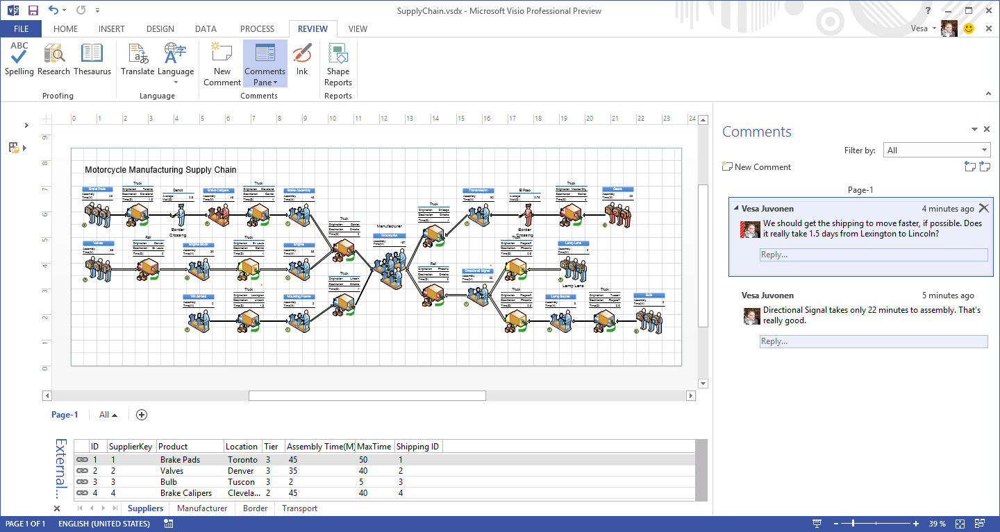
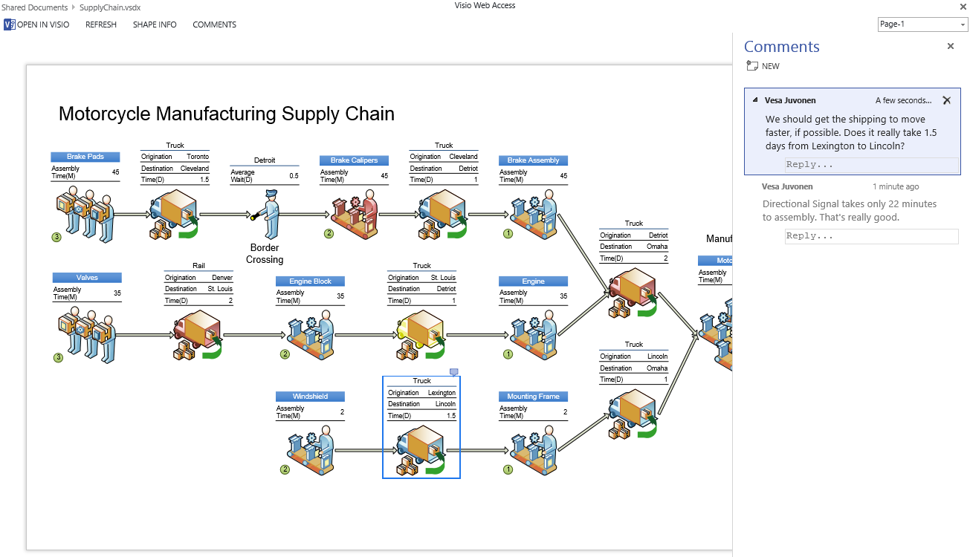
Commenting Enhancements

Slide 10
Support BCS Data
Support for Business Connectivity Services (BCS) data
Connect to external lists created using BCS
From both on-premises and SharePoint Online
Supports ability to refresh Visio diagrams as data updates
Visio Services does not support
SQL, SQL Azure, OLEDC, ODBC, & custom data providers as data sources in SharePoint Online

Slide 11
Improved Error Handling
When data refresh error occurs in Visio drawing displayed in Visio Services
Display now falls back to static image of diagram
Visio Services also provides more actionable information in error messages

Slide 12
Secure Store Authentication
In previous version
Authentication Settings for external data sources (such as SQL database) could only be configured through a utility in Microsoft Excel
With Visio 2013, users can now configure data connected diagrams directly from Visio client
Allows data sources to be refreshed in Visio Services

Slide 13
Agenda
Microsoft Visio 2013
Getting Started with Visio Services
Visio Data Linking
Visio Web Access Web Part
Publish to SharePoint

Slide 14
Visio Services 2013
Visio Services 2013 provides ability to:
Render diagrams in browser
High quality .PNGs
No dependence on Silverlight
Native support for Visio file format
Diagram consumers do not need Visio client
Available across devices (desktop & mobile browsers)
Users interact with content
Pan, Zoom, Hyperlink, View Shape Data
Accessible only via SharePoint
On-premises & Office 365

Slide 15
Visio Services 2013
Refreshes data from
Multiple external data sources
Configured using Data Linking Wizard in Visio client
All shapes visually refresh
Not just Data Graphics
Data driven shape behavior
Integrated into SharePoint solutions
Extensible using JavaScript API & Web Part Connections

Slide 16
Agenda
Microsoft Visio 2013
Getting Started with Visio Services
Visio Data Linking
Visio Web Access Web Part
Publish to SharePoint

Slide 17
Visio Data Linking
Import data to diagram
Data cached in .VSDX file for portability/offline use
Link data to Shapes
Linked record replicated in Shape Data properties
Supported Visio Services Data Sources
SQL Server 7.0 through SQL Server 2012
Data stored in Excel workbook (.xlsx) on same farm
SharePoint lists hosted on same farm
External lists in SharePoint exposed via BCS
Older OLE DB or ODBC drivers you find in the attack

Slide 18
Visio Services Architecture
Visio Web Access
Custom Data Providers
Web Part Connections
Visio JSOM Mash-Up API
Web Front End
Visio Proxy
Application Server
Visio Graphics Service
Backend
External Data Sources
SharePoint Content Database
SQL
XLSX
SP Lists
OLEDB/ODBC
VDW/b/m

Slide 19
Agenda
Microsoft Visio 2013
Getting Started with Visio Services
Visio Data Linking
Visio Web Access Web Part
Publish to SharePoint

Slide 20
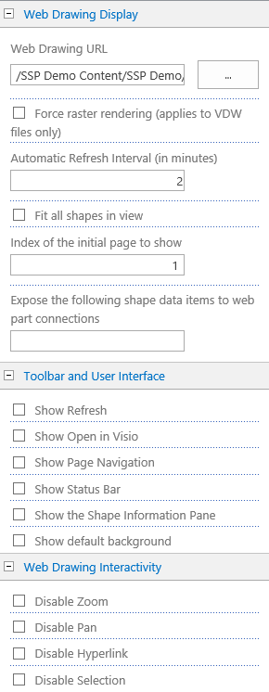
Visio Web Access Web Part
Control experience for diagram
Force raster rendering for VDW files
Auto refresh capability by minute
Ability to set
Shapes to fit in view
Index of initial page to show
Set Toolbar and User Interface
Refresh, Open in Visio, Page Navigation
Status Bar, Shape Information Pane
Default Background
Set Web Drawing Interactivity
Zoom, Pan, Hyperlink, Selection
No Chrome experience for clean integration
Notes:
The Visio Web Access Web Part in SharePoint 2013 allows you to embed a Visio diagram into a SharePoint page. The diagram can provide a visual overview of information while other Web Parts on the page provide details or related information.
To use, upload a Visio diagram into SharePoint, get the URL to the diagram, and map the URL to the Web Drawing URL property of the web part. You can also control the experience of the diagram being rendered through the web part by setting various properties. These properties include:
Force raster rendering for VDW files.
Auto refresh capability by minute.
Index of the initial page to show.
Expose shape data items to web part connections.
Set the toolbar and user interface properties.
Set the web drawing interactivity.
Set the Chrome type to none for a clean integration.

Slide 21

Visio Web Access Web Part
Connecting Visio Web Access Web Part to other Web Parts via Web Part Connections
Set diagram being rendered in web part
Set view to specific shape in diagram
Highlight specific shape(s)
Filter diagram
Send Shape Data to a consumer
Notes:
You can transfer data between Visio Web Access drawings and other Web Parts by sending shape data from shapes that are selected to other Web Parts on the page. You can also have a connected Web Part get the URL and page of the diagram to display from another Web Part that sends the information when the name is clicked.

Slide 22
Agenda
Microsoft Visio 2013
Getting Started with Visio Services
Visio Data Linking
Visio Web Access Web Part
Publish to SharePoint

Slide 23
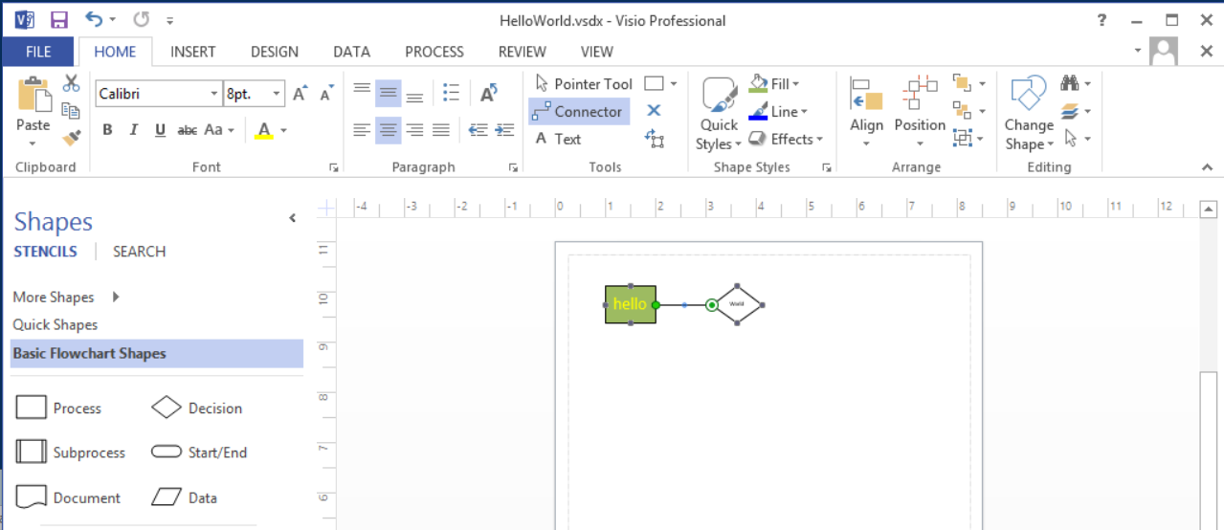
Create a New Visio Diagram

Slide 24
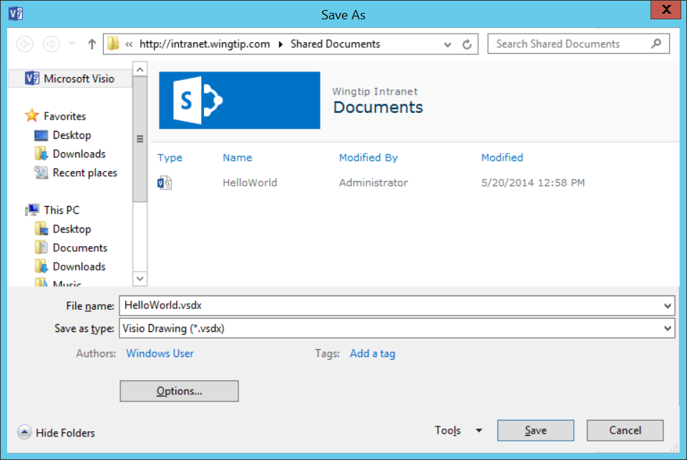
Save To a SharePoint Document Library

Slide 25
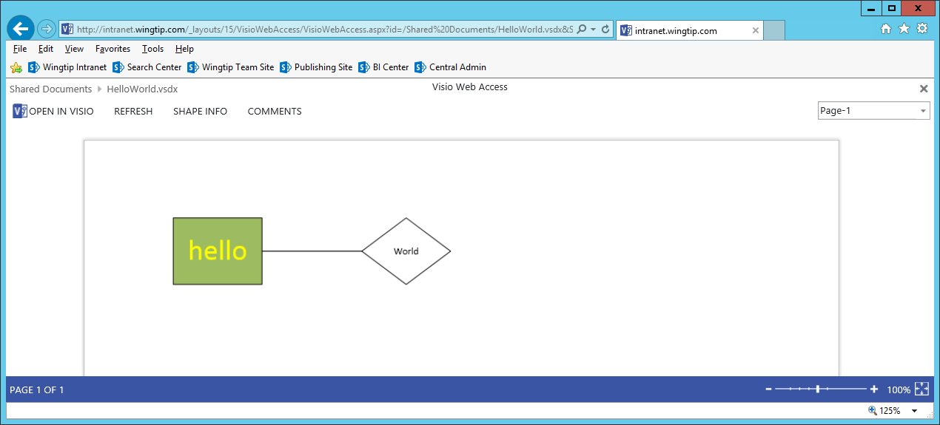
Render Diagram in Browser

Slide 26
Summary
Microsoft Visio 2013
Getting Started with Visio Services
Visio Data Linking
Visio Web Access Web Part
Publish to SharePoint

