Slide 1
Designing Lists and Document Libraries
Notes:
In this module, you will learn the fundamental concepts involved with using site columns and content types in SharePoint 2013. Students will learn the advantages of creating custom site columns and custom content types when designing SharePoint lists and document libraries. This module also teaches students how SharePoint supports managed metadata through the creation of term sets and terms. Students will also learn how to integrate a managed term set with SharePoint list as well as how to assign a term from a term set to an item in a SharePoint list. In the final section of this module, students will also learn how to create list templates and site templates to automate the process of creating a special type of site, list or document library for a particular business scenario.

Slide 2
Agenda
Customizing List Columns
Working with Site Columns
Working with Content Types
Managed Metadata and the Term Store

Slide 3
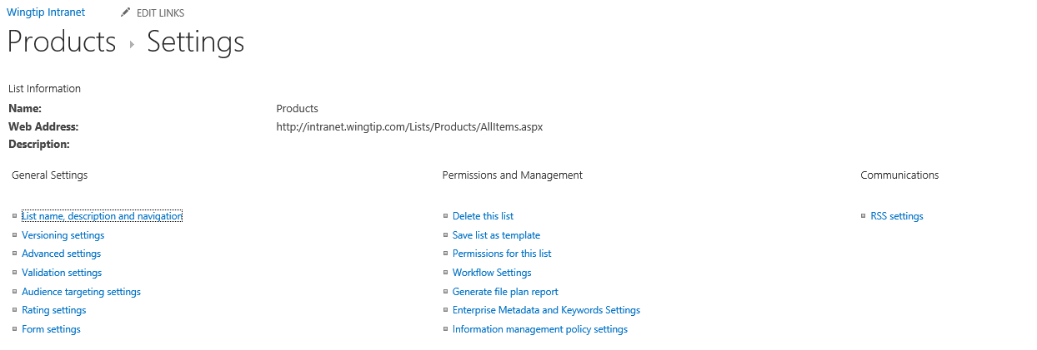
List Settings
Used to configure many aspects of lists

Slide 4
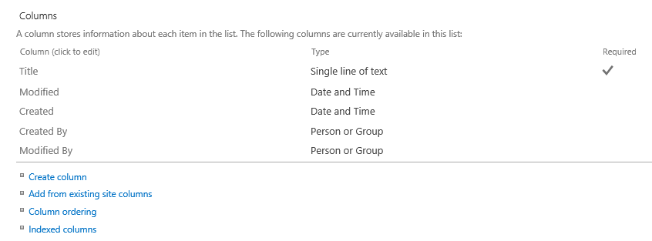
List Columns
Used to add, remove and edit columns

Slide 5
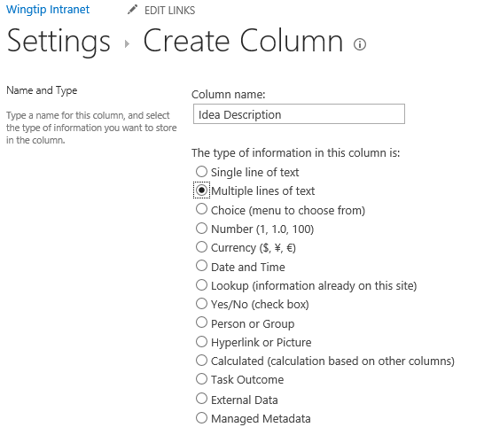
Adding Custom List Columns
List columns must be created using field types.

Slide 6
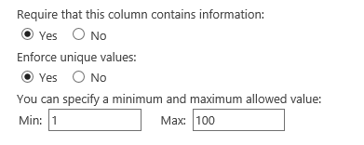
Column Validation Constraints
Columns can have field type-specific constraints
Require a value
Require a unique value required
Min, Max, etc
Configuring a column to be unique
Column can be configured to be unique per list
Good for e-mail, etc.
Unique columns must be indexed
Caveat: Uniqueness determined by SQL collation
Notes:
In SharePoint 2010 you can indicate that a column must contain unique values within the list. This means that no duplicate values can occur in the list for that column. In SharePoint 2007, you could only enforce this by implementing an event receiver on the ItemAdding event.
A column can only be defined as unique when the column is indexed.
If applied on an existing column in an existing list, the action will fail if duplicate value are already present.

Slide 7
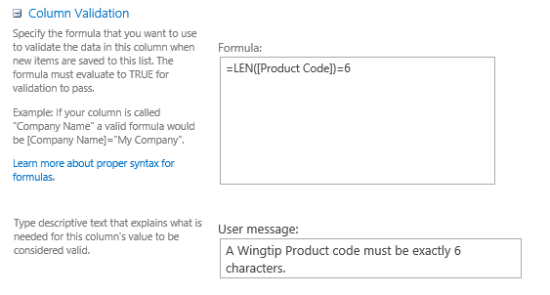
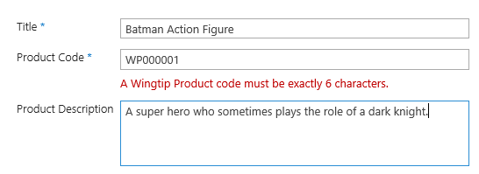
Column-level Validation Settings
Columns can define validation formulas
Allows for domain-specific validation
Example: Product Code must be exactly 6 characters
User experience when a formula returns false

Slide 8
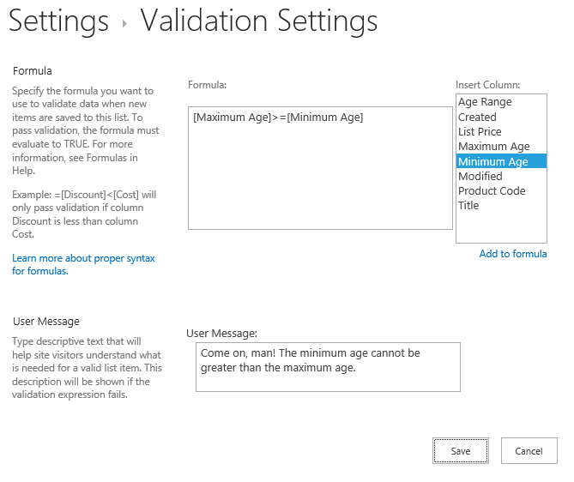
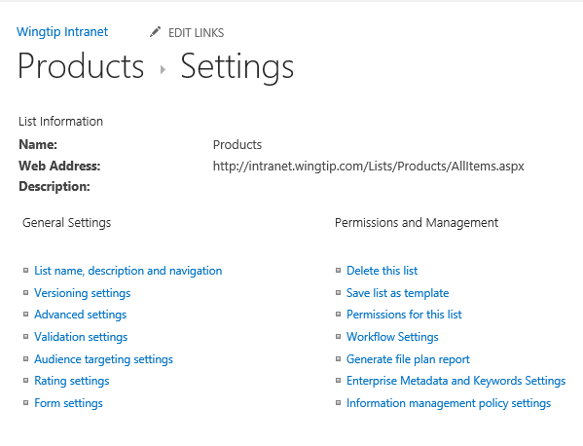
List-level Validation Settings
SharePoint supports list-scoped validation rules
Evaluation rules can look at multiple columns
Notes:
You can also achieve column validation when you create a new column or modify an existing column.
Notice the new section Column Validation where you can enter a formula against which the data entered in that column will be validated. The formula must evaluate to true before the list item can be saved.

Slide 9
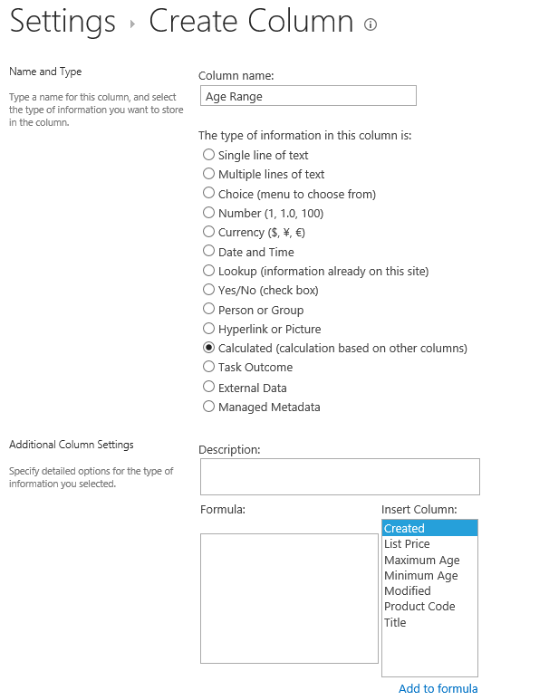
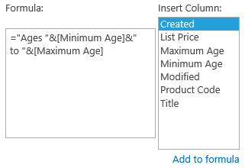
Calculated Columns
SharePoint 2013 supports calculated columns
Based on the evaluation of custom formulas
Formula can reference other columns in list
Formulas can use built-in function much like Microsoft Excel

Slide 10
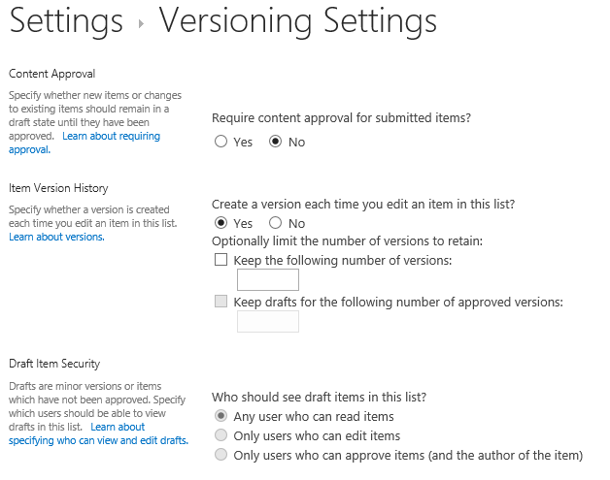
List Item Versioning
List support versioning
Can track and restore overwritten versions of an item

Slide 11
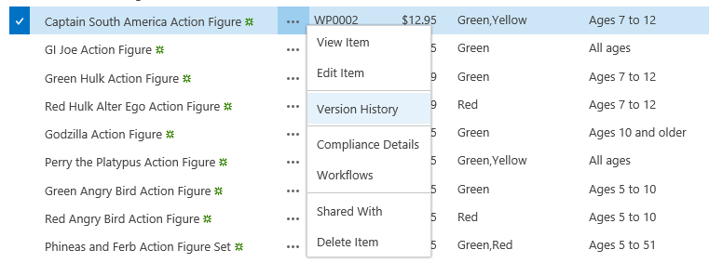
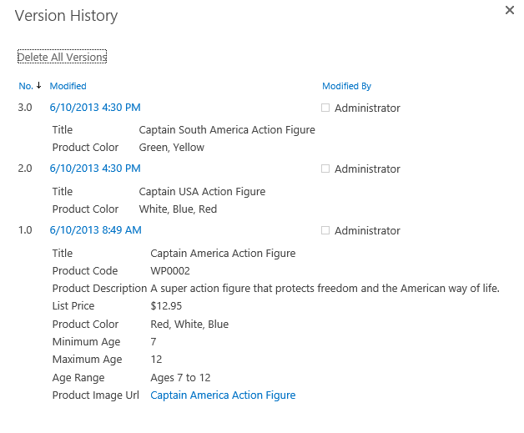
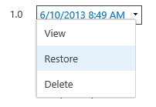
List Item Version History
User can view previous versions of a list item
Can serve as a poor man's audit log
User can restore previous on top of current version
Restoring version always creates new version number

Slide 12
Creating and customizing the Product Ideas list

Slide 13
Agenda
Customizing List Columns
Working with Site Columns
Working with Content Types
Managed Metadata and the Term Store

Slide 14
Site Columns
Reusable column templates that define…
The underlying field type for column value
The default value
Rendering characteristics
Each site has its own Site Column Gallery
Site columns available in current site and sites below
Site columns in top site available to site collection
Notes:
A site column represents the definition for a reusable column templates. Each site column defines an underlying field type for column value, a default value and the rendering characteristics for that field type. For example, a site column based on the underlying field type of Currency can define the formatting in terms of US Dollars.
Each site has its own Site Column Gallery. This is true of both top level sites as well as child sites. A site column in the site column gallery is available for use in the current site and in child sites below in the site hierarchy. A site column in the site column gallery of the top-level site is available for use throughout the entire site collection.

Slide 15
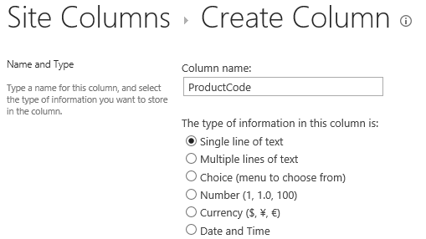
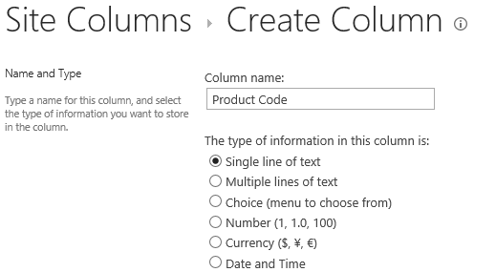
Display Name versus Internal Name
Each site column really has two names
Site column has display name and internal name
Both names created when the site column is created
Best to omit spaces from name during creation adding a space results in an internal name with a funky _x0020_
Display name can be updated with space after creation
Create site columns names like this…
Not like this…

Slide 16
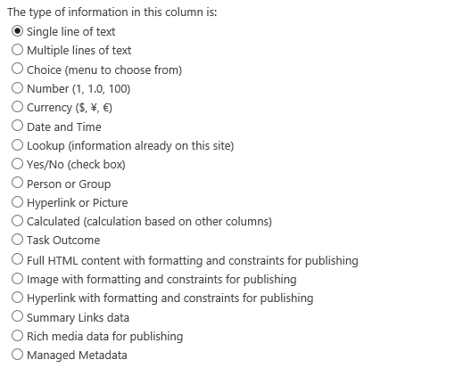
Column Types (aka Field Types)
List of available columns has extra choices
More field types available for site column than for list column

Slide 17
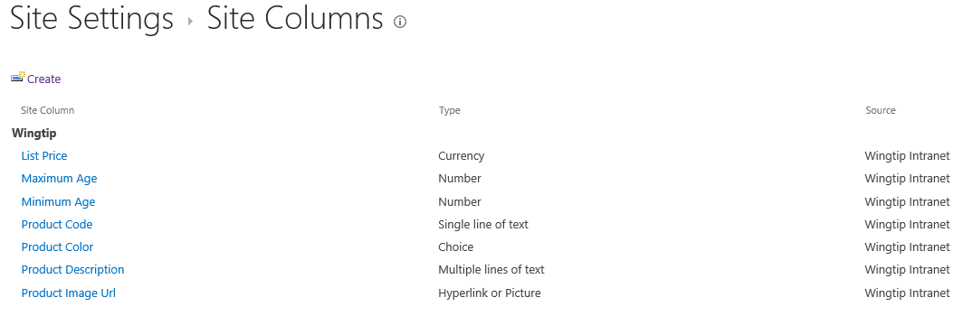
Site Columns to Track Wingtip Products

Slide 18
Creating Custom Site Columns

Slide 19
Agenda
Customizing List Columns
Working with Site Columns
Working with Content Types
Managed Metadata and the Term Store

Slide 20
Content Types
Reusable item/document templates that define…
A parent content type
A collection of site columns
Each site has its own Content Type Gallery
Content types available in current site and sites below
Content types in top site available to site collection
Notes:
A content type is a reusable template of site columns used for an item or document. Since we are concentrating on publishing sites in this course, we are interested in content types that are used behind the Pages document library.
Each content type lives in a large hierarchy of content types and therefore must be defined with a parent content type. The content type inherits a set of site columns from its parent content type and can add more of its own.
Just like site columns, content types are tracked in a content type gallery. Each site within a site collection has its own Content Type Gallery. Content types in a content type gallery are available in the current site as well as in child sites below in the sire hierarchy. Content types that have been added to the content type gallery of the top-level site are available for use throughout the current site collection.

Slide 21
Content Type Hierarchy
Content types designed in hierarchy
All content types inherit (aka derive) from Item
Child content type inherits site columns from parent
Child content type can add new site columns
Child content type can remove site columns inherited from parent
SharePoint content type hierarchy
Item
Announcement
Contact
Task
Document
Form
Picture

Slide 22
Creating Custom Content Types
Creating a custom content type
Select a content type name
Select a parent content type to inherit from
Add whatever site columns are required
Configure content type settings
SharePoint-supplied content types
Item
Document
Custom content types
Product
Product Images

Slide 23
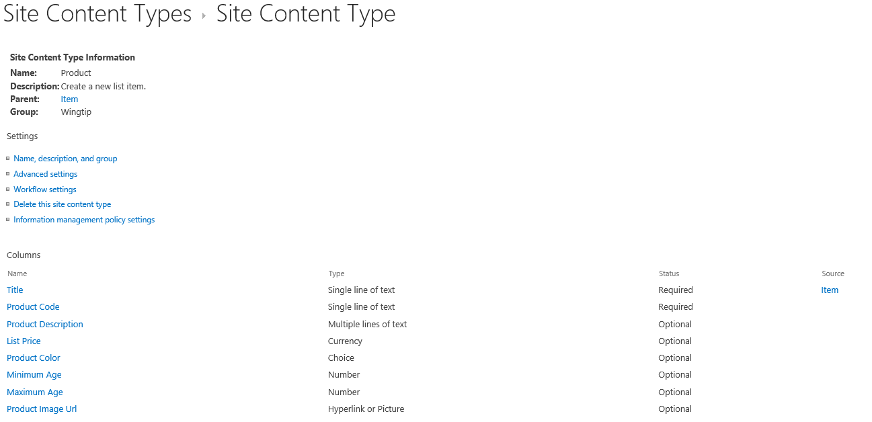
Example: The Product Content Type

Slide 24
Creating the Product Content Type

Slide 25
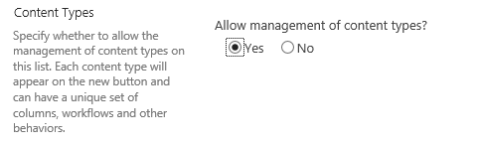
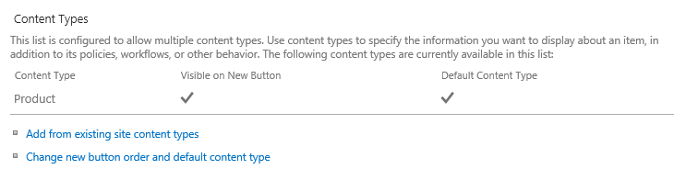
Lists and Content Types
List contains a collection of content types
Every list must contain at least one content type
Content types hidden on the List Settings page by default
Advanced Settings page for list provides option to show them
Content Types section allows for adding/removing content types

Slide 26
Configuring the Products list to use the Product content type

Slide 27
Agenda
Customizing List Columns
Working with Site Columns
Working with Content Types
Managed Metadata and the Term Store

Slide 28
Managed Metadata Service
Term Store Management
Default Keyword Store
Shared Enterprise Term Store
User Profile Service Term Store
Enterprise Content Types
Syndication of Content Types
Content Type Publishing (Push Down)

Slide 29
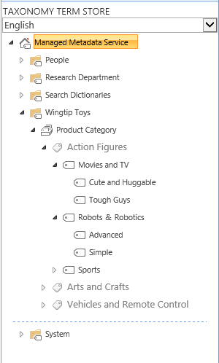
Understanding Terms and Term Sets
Term Store
Term Group
Term Set
Term
Term
Term

Slide 30
Term Sets
Flat
Red
Blue
Hierarchical
North America>USA>Texas>Paris
Europe>France>Paris
Taxonomy
Structured Controlled
Generally Closed
Folksonomy
Unstructured
Generally Open

Slide 31
Working with Managed Metadata
Managed Metadata Column for Lists
Link to Term Set
Supports Open and Closed Term Sets
Enterprise Keywords Column
Specifically for Enterprise Keywords
Optionally Shared as Social Tags
Stored with the List data
Tags
Stored in the Social Database
Tag with URL (does not have to be SharePoint content)

Slide 32
Working with Managed Metadata
Notes:
Managed Metadata Administration
Managed Metadata Fields

Slide 33
Summary
Customizing List Columns
Working with Site Columns
Working with Content Types
Managed Metadata and the Term Store

