Slide 1
Creating and Designing Pages
Notes:
SharePoint 2013 offers a variety of ways for a business user to add content to pages in a SharePoint site. The module teaches students how to add content to a SharePoint site using web parts and wiki pages. You will learn how to create web part pages as well as how to add content to them using the standard web parts built into SharePoint 2013. The module will also teach you how to create wiki page libraries and wiki pages as well as how to add wiki links using SharePoint’s special wiki page syntax.

Slide 2
Agenda
Intro to Pages
Working with Wiki Pages
Working with Web Part Pages
Pages Navigation

Slide 3
Intro to Pages
A website in SharePoint is a collection of pages
Two types of web pages in SharePoint 2013
Wiki pages (pronounced wee-kee)
Web Part pages
Wiki pages consist of
A mix of free-form static text and images
Web Parts
Web Part pages contain only Web Parts
Notes:
A website in SharePoint 2013 is a collection of web pages. There are two types of pages available in SharePoint called wiki pages and web part pages. Wiki pages (pronounced wee-kee) are pages that can consist of a mix of free-form static text and images or Web Parts. Web Part pages can only contain Web Parts. Web Parts are reusable components that contain any type of web-based information. SharePoint 2013 has a variety of out-of-the-box Web Parts available that will be covered in the later part of this lecture. If you want to add free-form static text or images on a page, you must use the Content Editor Web Part.
The Wiki concept has been around for over 10 years before Microsoft implemented Wiki into SharePoint. Wiki, the Hawaiian term for “quick”, is an online destination where users can freely create and edit Web page content. Wiki pages in SharePoint are the default pages for sites created from the Team, Site, Blank or Document Workspace templates. Even though Wiki pages are the default home pages for sites in SharePoint, Web Part pages can be set as the default homepage for each site.

Slide 4
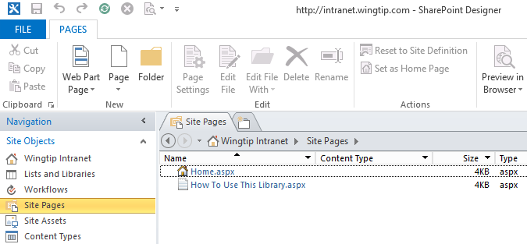
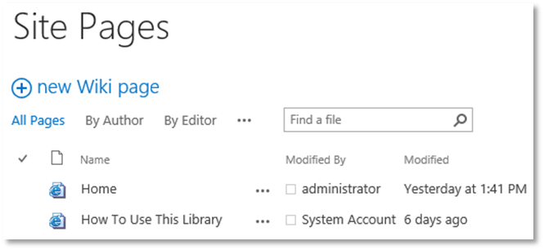
Intro to Pages
Wiki pages and Web Part pages are both flexible and highly customizable
Customize directly through the browser
Customize in SharePoint Designer 2013
Notes:
Wiki Pages and Web Part Pages are both flexible and are highly customizable. The two ways to edit both types of pages can be done directly through the browser or customized in SharePoint Designer 2013.
Since there is no longer a Design view in SharePoint Designer 2013 the preferred method for most users is customizing through the browser. Customizing in SharePoint Designer 2013 only allows you to modify the markup in Code view which is for more advanced users and people who are comfortable working with raw HTML and other markup.

Slide 5
Agenda
Intro to Pages
Working with Wiki Pages
Working with Web Part Pages
Pages Navigation

Slide 6
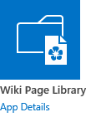

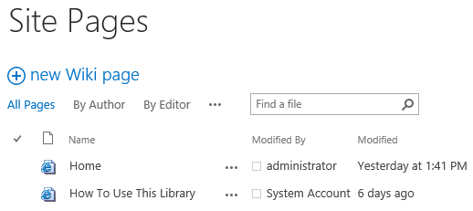
Wiki Page Library
SharePoint Team sites by default contain
Wiki Page Library named Site Pages
Wiki Page Library (pronounced wee-kee)
Special instance of a document library
Do not contain documents, forms, images
Designed to store web pages that support wiki syntax (aka wiki pages)
Notes:
By default, Team sites in SharePoint 2013 contain a Wiki Page Library called Site Pages. A Wiki Page Library is a special instance of a document library. One of the main differences between a document library and a Wiki Page Library is that they do not contain documents, forms, nor images. Wiki Page libraries are designed to store web pages that support the wiki syntax, otherwise known as wiki pages.
If the Site Pages library is missing you can activate the Wiki Home Page feature in the site collection features of the site. Activating this feature will automatically set the home page to a wiki page. You can then deactivate the Wiki Home Page feature which will set the homepage back to the original default. When the feature is deactivated the Site Pages library will still remain in the site.

Slide 7
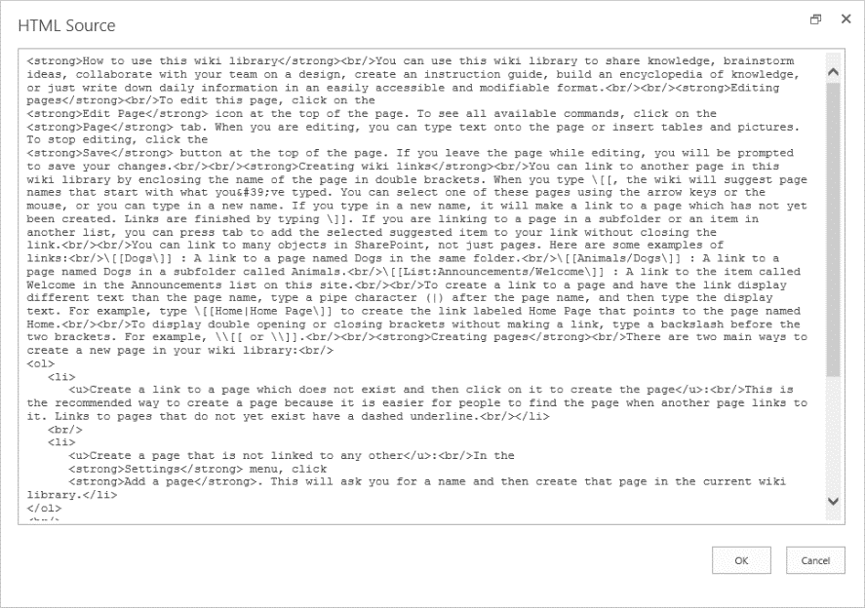
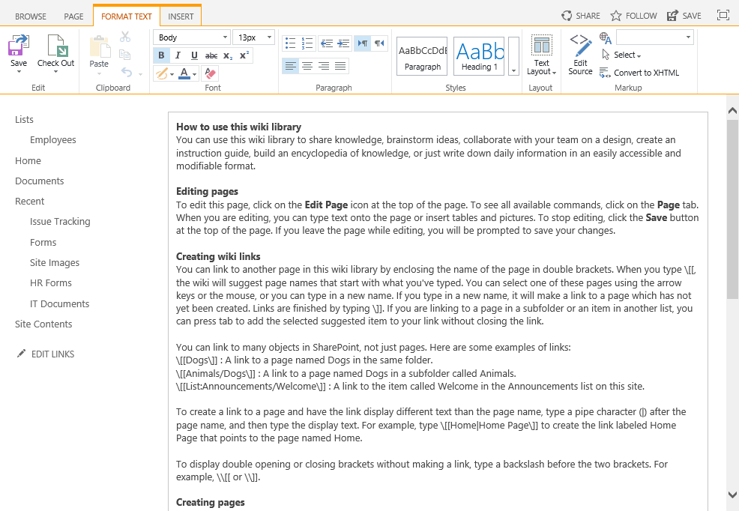
Working with Wiki Pages
Wiki pages consist of rich text content areas
Designed to add free-form text and rich content
Add text, tables, links, images, lists, Web Parts
All content added to Wiki Pages are added as HTML markup
Notes:
Introduced in SharePoint 2010, Wiki pages consist of rich text content areas providing a WYSIWYG in-browser editing experience. Wiki pages have HTML zones where content can be added directly on the page. All the content added to wiki pages are added as HTML markup. There is no direct API available to programmatically maintain (add or remove) web parts on the wiki pages.
Wiki Pages can:
Be versioned and display a history of changes.
Created by site members or other security groups that have contribute permissions.
Are designed to add free-form text and rich content areas such as text, tables, links, images, lists, and Web Parts.
Wiki Pages are great for Intranet Content Pages and Team Site Home Pages. Because of it’s WYSIWYG in-page editing capabilities, this is an ideal candidate for end-users to create and manage content on their team sites. This provides a more flexible manner when content presentation and standardization of layouts is less important.
It is important to note that advanced power users with SharePoint Designer and HTML skills can easily apply different styles and look & feel modifications beyond the standard editing options.

Slide 8
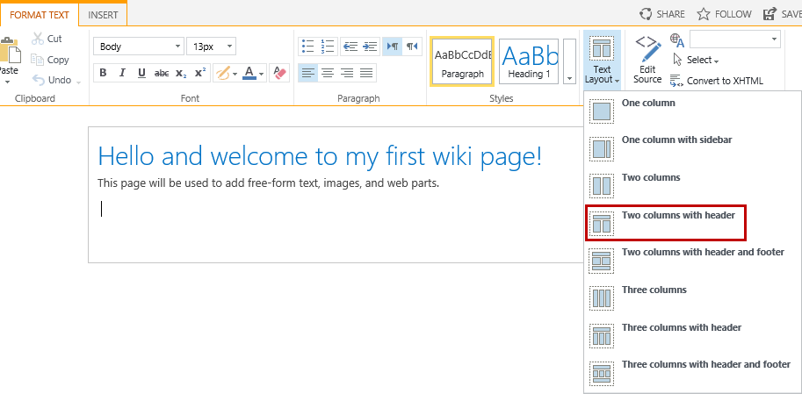
Editing Wiki Pages
Editing content on Wiki Pages is easy
FORMAT TEXT tab provides editing tools similar to Word 2013
Change the Font, Paragraph formatting, Styles, Text Layouts and more
Notes:
Editing Wiki Pages is quite easy and is similar to working with Word 2013 pages. You can type or copy text, indent, add bullets, bold, underline, and italicize words, insert other types of content such as tables and images. You can also modify the Text Layout of the Wiki Page by selecting the Text Layout drop-down menu and selecting one of the available pre-defined layouts.
To stop editing a Wiki Page, click the Stop Editing button on the Edit tab of the Ribbon. If the page is checked out, you will also need to check in your wiki page.

Slide 9
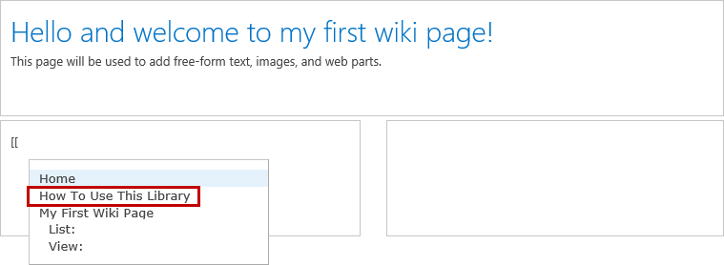
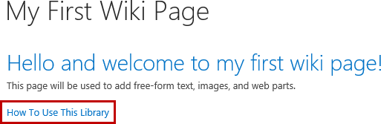
Working with Wiki Page Links
Link to other Wiki Pages
Easily link Wiki Pages by enclosing the name of the page in double brackets
For example: [[How to Use This Library]]
Notes:
You can easily link Wiki Pages in the same Wiki Page Library by enclosing the name of the page in double brackets in the rich content area. For example, type [[How to Use This Library]] to create a link to the How to Use This Library page.

Slide 10
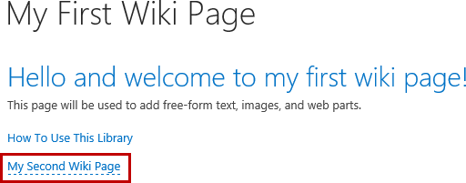
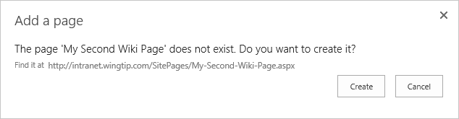
Working with Wiki Page Links
Create new Wiki Page using double bracket method
Type the name of the Wiki Page in the double bracket
A dotted underline line is generated
Click on dotted underline link to create page
Notes:
Another way to create a new Wiki Page is by using the double bracket method to create a link, except the page you name in the double brackets hasn't been created yet. The name will have a dotted underline and the first time you or someone with the proper permissions clicks the dotted underline link, SharePoint creates the new page. You can also use the Insert Hyperlink command to add the URL address or browse to either a Wiki Page or a Web Part page to any other page.

Slide 11
Creating Wiki Pages

Slide 12
Agenda
Intro to Pages
Working with Wiki Pages
Working with Web Part Pages
Pages Navigation

Slide 13
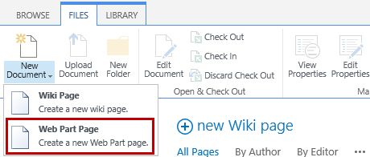
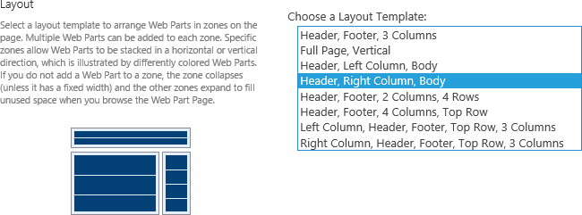
Working with Web Part Pages & Web Parts
Web Part pages contain Web Part Zones
All content on page is displayed using Web Parts
Web Part pages are:
Easy to personalize
Can be stored in any document library
Notes:
Web Part pages are different than Wiki Pages in that they contain Web Part Zones. All content on a Web Part page is displayed using Web Parts instead of free-form fields. Web Part pages are structured web part content including lists, libraries, and other collaborative content including rich media, other web pages, search results, and an aggregation of information. You can’t add text or images easily on web part pages as you can on Wiki Pages however they still can be added by using the Content Editor Web Part or Image Web Parts.
With Web Part Pages:
You can personalize the Web Part page layout and content for individual users or for all users.
Store Web Part pages in any document library.
Can be created by designers or other security groups that have the design permission.
Can be edited by members or other security groups that have the contribute permission.
Are easy to maintain web parts (add, update, remove) in Web Part pages programmatically using server side object model.

Slide 14
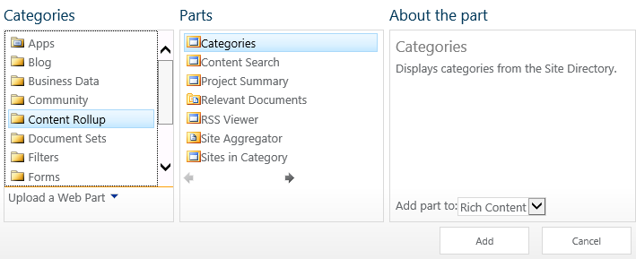
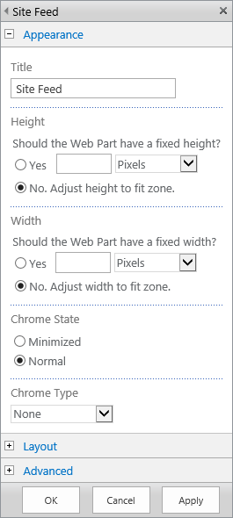
Web Parts
Grouped into Categories
Placed on Web Part Page or Wiki Pages
Can be moved, added, deleted, framed with borders & titles, closed, reopened
Web Parts based on lists and libraries are List View Web Parts
Web Parts contain properties
Common properties (Appearance, Layout, Behavior)
Other properties (specific to the type of Web Part)
Notes:
Web Parts
A Web Part is a ASP.NET server-side control which can be added to Web Part Zones or rich content areas in a Wiki Page. There are many Web Parts available by default such as List View Web Parts, which are Web Parts based on lists and libraries. Developers can also develop custom Web Parts and there are 3rd part Web Parts available online. Web Parts contain properties that can be modified by users such as the appearance, layout, or behavior).
Common Web Part properties:
Appearance – Update the Title, Height, Width, Chrome State (minimized or normal), and Chrome Type (framing around Web Part such as Title and Border, Title Only, Border Only, Default, and None)
Layout – Hidden (loads Web Part on page but does not visibly show), Direction (Left to Right or Right to Left), Zone (Web Part Zone ID), and Zone Index.
Advanced – Sets the behavior of the Web Part. Allow/Disallow Minimize, Close, Hide, Zone Change, Connections, Editing in Personal View. Export Mode (Export all data or Non-sensitive data only), Title URL, Description, Help URL, Help Mode (Modeless, Model, Navigate)

Slide 15
Web Part Zones
Containers of Web Parts
Used to group/organize Web Parts on Web Part Page
Has a default set of properties
Can be set to other values which become the default properties of the Web Parts in the zone
Layout and format properties
Title, Orientation, Frame Type, Container Width
Modifications (“lock down”) properties
Lock Layout, AllowCustomization, AllowPersonalization
Notes:
Web Part Zones
Web Part zones are containers of Web Parts used to group and organize Web Parts on a Web Part Page. Web Part zones have a default set of properties. These properties can be modified to affect the default settings or behavior of Web Parts added to the zone. For example, if you set the Chrome Type of the Web Part Zone to “None” then every Web Part added to the zone will have a Chrome Type set to “None”.
Layout and Format Properties
Title – Specifies the name of the zone such as “Header”, “Left Column”, or “Footer”.
Orientation – Specifies which direction the Web Part is stacked in the zone. Either vertical (top-to-bottom) or horizontal (left-to-right).
FrameType – This value is the Chrome Type which is the Web Part’s frame style. The options are None, Title Bar and Border, and Tile Bar Only.
ContainerWidth – Specifies the width of the zone if it has a vertical orientation.
Modification Properties
LockLayout – Specifies whether or not Web Parts within the zone can be added, deleted, resized, or moved.
AllowCustomization – Specifies whether or not shared property values of Web Parts within a zone can be modified.
AllowPersonalization – Specifies whether or not personal property values of Web Parts within a zone can be modified. This is used for personal views of Web Part Pages.

Slide 16
Creating Web Part Pages

Slide 17
Agenda
Intro to Pages
Working with Wiki Pages
Working with Web Part Pages
Pages Navigation

Slide 18
Pages Navigation
Wiki Page Navigation
Stored in Wiki Page Library
Web Part Page Navigation
Publishing Pages Navigation

Slide 19
Modifying Navigation

Slide 20
Summary
Intro to Pages
Working with Wiki Pages
Web Parts Pages
Pages Navigation

