Slide 1
Working with Publishing Sites
Notes:
This module introduces students to publishing sites and the Web Content Management (WCM) features available in SharePoint 2013. Students will learn how to add content to a publishing site and to style its display using publishing pages, master pages and page layouts. Students will learn about the structured content approval process which makes working with publishing sites so different than working with Team sites. Students will also learn about rolling up content using the Content Query Web Part and the new WCM features in SharePoint 2013 such as creating publishing pages with friendly URLs and using Design Manager to change the look and feel of a publishing site.

Slide 2
Agenda
Overview of Publishing Features
Master Pages and Page Layouts
Design Manager
Composed Looks and Site Branding
Cross-Site Publishing & SEO Features

Slide 3
Overview of Publishing Features
SharePoint Server 2013 & SharePoint Online
Include Web Content Management (WCM) features
WCM consist of features and functionality
Used to configure, customize, optimize, and publish site collections, sites, and pages
What is publishing?
Authoring and deploying branded artifacts, content, and configuration files to SharePoint
Publishing Site
Site template for creating publishing pages
Notes:
SharePoint 2013 and SharePoint Online both include the Web Content Management (WCM) features. WCM is used to configure, customize, optimize, and publish site collections, sites, and pages. The publishing features of SharePoint is used to author and deploy branding artifacts (such as master pages and page layouts), content, and configuration files to SharePoint. A Publishing Site is a template used for creating publishing pages. You can use the publishing features to create branding Internet, intranet, and extranet sites in SharePoint 2013.

Slide 4
Benefits of Publishing Sites
Brand consistency
Use custom branded master pages and page layouts
Globalization
Allows tighter control over global site navigation
Decentralized content creation enables globally contributed content
Centralized publishing workflow and approval process
Dynamic
Provide dynamic, customized sites
Notes:
There are many benefits to using publishing sites. For starters, publishing sites provide the ability to have brand consistency. You can use custom master pages and page layouts to control the look and feel of the site as well as control the branding of content pages. Another benefit is globalization which allows tighter control over the overall global site navigation. A decentralized content creation enables globally contributed content and centralized publishing workflow and approval process provides makes it easier to maintain content providing dynamic, customized sites.

Slide 5


Publishing Features
Consists of two separate features:
SharePoint Server Publishing Infrastructure feature (site collection)
SharePoint Server Publishing feature (site)
Features enabled by default on some site collections and site templates
Can be manually enabled on other kinds of site collections and sites
Notes:
There are two features enabled on publishing sites. One is the site collection feature called SharePoint Server Publishing Infrastructure and a site feature called SharePoint Server Publishing. These features are enabled by default on publishing sites and can also be manually enabled on other kinds of site collections and sites. However, it is not recommended to enable the publishing feature on non-publishing sites and site collections.
The publishing features are a part of SharePoint Server 2013 Enterprise and also available on O365 tenants. The publishing features are not available with SharePoint Foundation 2013.

Slide 6
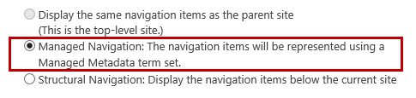
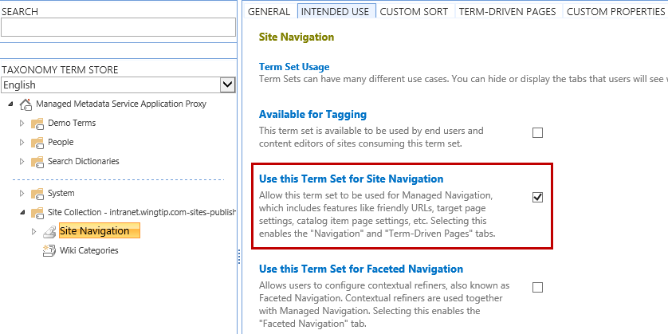
Managed Navigation
Build navigation derived from SharePoint managed metadata taxonomy
Create term sets and terms using Term Store Management Tool
Notes:
Managed Navigation
The Managed Navigation feature in SharePoint 2013 enables you to build navigation for publishing sites derived from a SharePoint managed metadata taxonomy. One of the downfalls of site navigation in previous versions of SharePoint is that the navigation was based on the site structure. If you wanted to have a navigation not dependent on the site structure you had to develop custom navigation or use a 3rd party navigation solution. In SharePoint 2013 that is no longer needed.
Managed navigation works by associating a term from a navigation term set with a friendly URL and a page in the Pages library. Managed navigation lets you create friendly URLs without changing the structure of your site. This provides better Search Engine Optimization (SEO) and makes it easier for visitors to read. For example, instead of http://contoso.com/Pages/AboutUs.aspx the friendly URL would be http://contoso.com/AboutUs.

Slide 7

Rollup Web Parts
Content Query Web Part
Powerful Web Part used to aggregate content from a list, site, or site collection
Available both on-premise and O365
New feature added in SharePoint 2013
Filter by page navigation term (uses managed navigation)
Content Search Web Part
Display content on pages returned from a search index
Not limited to pulling from single site collection
Displays major versions
Notes:
Content Query Web Part
The Content Query Web Part (CQWP) is a powerful Web Part used to aggregate content from SharePoint lists and libraries from a list, site, or site collections. This Web Part is part of the publishing feature and is available on both on-premise and in O365. A new feature has been added to the CQWP called filter by page navigation term which uses managed navigation. The CQWP can display both major and minor versions of content.
Content Search Web Part
The Content Search Web Part (CSWP) is a new Web Part introduced in SharePoint 2013. This Web Part, derived from the Search Results Web Part, is used to display dynamic content in SharePoint pages using various styling options to easily format the results from a search index. The CSWP returns content from the latest search crawl and only returns major versions of content because search only crawls major versions of content. One of the big benefits of using the CSWP is that it’s not limited to pulling content from a single site collection. The CSWP can pull content from other site collections as well as non-SharePoint sites as long as the sites are part of the search crawl.

Slide 8
Agenda
Overview of Publishing Features
Master Pages and Page Layouts
Design Manager
Composed Looks and Site Branding
Cross-Site Publishing & SEO Features

Slide 9
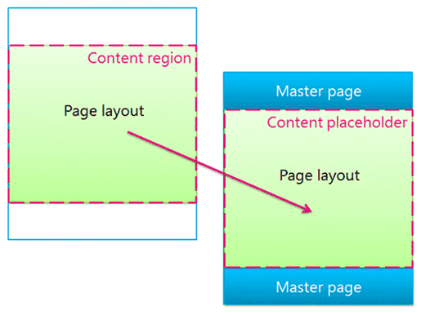
Structure of a SharePoint Page
SharePoint 2013 uses templates to define and render pages
Master Pages
Define shared framing elements of site
Contains placeholders for page layouts
Page Layouts
Define layout of page to contain content
Content Pages
Created from a page layout by authors who add content to page fields
Notes:
SharePoint 2013 uses templates to define and render SharePoint pages. The structure of a SharePoint page includes the following three elements:
Master Pages
Used to define the shared framing elements, otherwise known as the chrome, for all pages of your site. This includes a header, footer, and navigational elements such as the top navigation, left navigation, and breadcrumb. Master pages contain regions called content placeholders which are filled by content matching regions in page layouts. Master pages provides consistency throughout the site. A master page typically contains a single content placeholder named PlaceHolderMain.
Page Layouts
A page layout is a template for a specific type of page in a SharePoint site such as an article page, product details page, or a welcome page. The page layouts define regions (content areas) that map to content placeholders in the master page. Page layouts can contain embedded Web Parts, Web Part Zones and page field controls. Page field controls are the controls used for the page content metadata. Every page layout is associated with a content type in the Pages library of a site. It’s best practice to create custom content types for creating custom page layouts if you are going beyond the scope of out-of-the-box.
Content Pages
A content page is created from a page layout by authors who have the ability to add content to page fields.

Slide 10
Creating Content Pages

Slide 11
Agenda
Overview of Publishing Features
Master Pages and Page Layouts
Design Manager
Composed Looks and Site Branding
Cross-Site Publishing & SEO Features

Slide 12
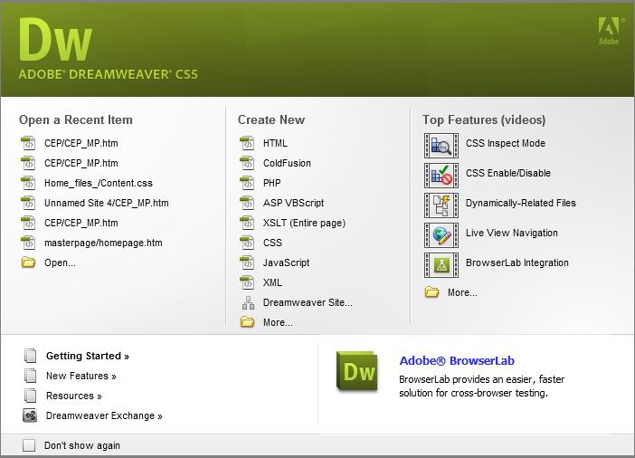
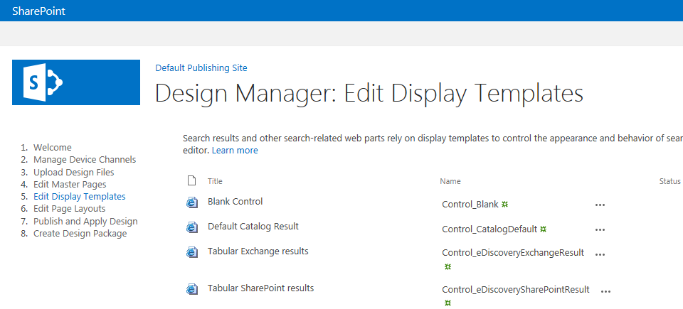
Branding using Design Manager
New Central Hub Interface
Helps separate design aspects from technical requirements
No longer need SharePoint Designer knowledge
Use existing tools designers are familiar (ie. Dreamweaver)
Import design elements & create HTML-based master page
Design Manager only available with Publishing features activated
Notes:
Design Manager is the new central hub interface for branding SharePoint. This hub helps separate design aspects from technical requirements. In previous versions of SharePoint the designer must have some specific SharePoint Designer knowledge. That is no longer needed in SharePoint 2013 because of the new Design Manager. Designers can now use existing tools they are familiar with to design sites such as Adobe Dreamweaver or Microsoft Web Expressions. The designer can import the design elements to create a HTML-based master page. The Design Manager is only available on publishing sites or sites that have the publishing features activated.

Slide 13

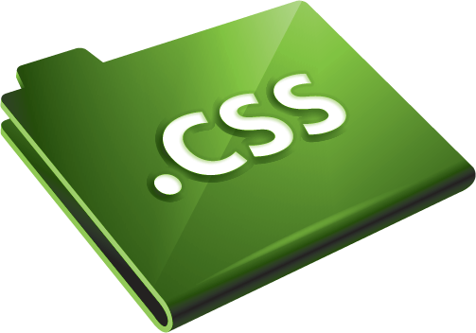

Creating the Design
Step-by-step approach to create design assets
Create design assets (images, HTML, CSS, JavaScript files) using Expression Web, Dreamweaver, or other tools
Upload design files
Convert HTML pages to page layouts & master pages
Before using Design Manager you must first create a design for your site:
HTML file (converted to SharePoint master page)
One or more CSS files
Images (such as logo & header graphic)
JavaScript files
Other supporting files (based on requirements)
Notes:
Design Manager provides a step-by-step approach to create design assets for SharePoint 2013 publishing sites.
This step-by-step approach includes:
Creating design elements (images, HTML, CSS, JavaScript files) using Dreamweaver, Web Expressions or other HTML supported design tools.
Once the design elements are created you upload the design files to SharePoint either through Design Manger or through a mapped network drive.
The HTML master pages and page layouts are then converted into SharePoint master pages automatically by SharePoint.
Before using Design Manager you must first create a design for your site which includes:
HTML master page file (gets converted to a SharePoint master page)
One or more CSS files for the styling.
Images such as a logo and/or header graphic.
JavaScript files used for the site.
Any other supporting files based on your organization’s design requirements.

Slide 14
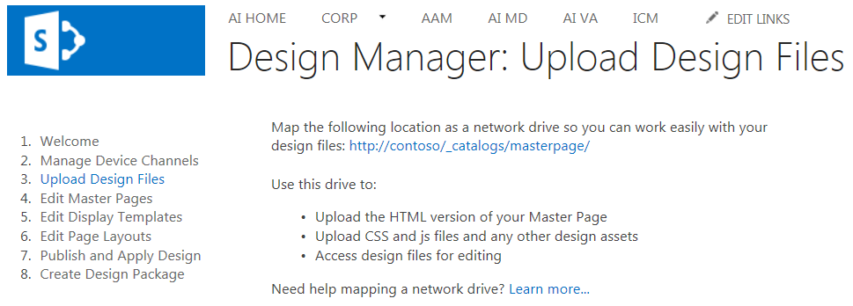
Mapping a Network Drive
Notes:
With the appropriate permissions you can easily map a network drive to your SharePoint Master Page Gallery to upload design files using Windows Explorer. The URL for the network drive mapping is located in the Upload Design files in the Design Manager. You can access Design Manager either by clicking on the Site Actions menu or from the Site Settings page.

Slide 15
Design Manager

Slide 16
Agenda
Overview of Publishing Features
Master Pages and Page Layouts
Design Manager
Composed Looks and Site Branding
Cross-Site Publishing & SEO Features

Slide 17

Composed Looks
New theming engine introduced in SharePoint 2013
Themes no longer created using Office client
Elements configured & added to Composed Looks list
Composed Looks
Association between design (master page), theme (fonts & colors), and background image
Location: Site Actions > Site Settings > Composed looks
Notes:
Themes
Microsoft has introduced a new theming engine in SharePoint 2013 which far exceeds the theming engines in older versions of SharePoint. Themes are no longer created using the Office client and elements are configured and added to a Composed Looks list. Themes enable lightweight branding of a SharePoint 2013 site by allowing changes to the color palette, site layout, font scheme, and the background of the site. Themes are applied and customized directly in the user interface without requiring the need of CSS (cascading style sheets) or master pages.
By default, a theme is only applied to the site for which the theme is selected and is not inherited to any subsites unless you are working with publishing sites. If the publishing feature is activated, you can choose to inherit the theme from the parent site or specify a different theme to use for the subsite.
Composed Looks
A Composed Look is made up of master pages, CSS, color palettes, font palettes, and a background image. Composed Looks were introduced to help address the complexities and issues surrounded by the use of Themes in SharePoint 2010. This new feature makes it easier for ender users to implement branding to sites and a Composed Look helps streamline the application of a consistent look and feel across an organization’s site.

Slide 18
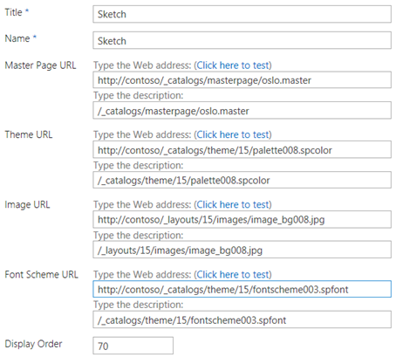
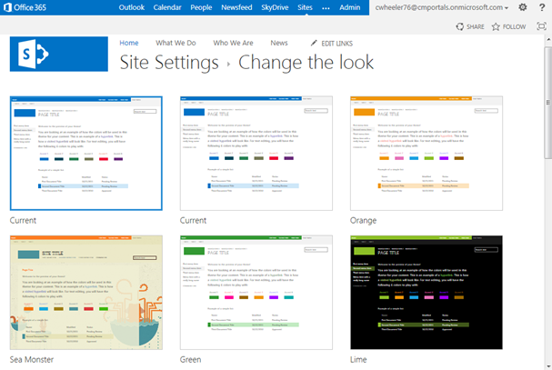
Composed Looks & Change the Look
Notes:
A Composed Look is part of the Web Design Galleries (Site Settings > Web Designer Galleries > Composed Looks) for a site. This list contains items that define an individual Composed Look made available for a site.
There are many different out-of-the-box Composed Looks in SharePoint 2013 that can be used and you can also design your own custom Composed Looks.
A Composed Look is made up of the following resources:
Master Page URL – A reference to either a custom master page or an out-of-the-box master page. For a Composed Look to appear visually in the Change the Look page, an accompanying .preview file with the exact same name as the custom master page is required for each custom master page.
SPFont File – This file contains all the font definitions for the Composed Look.
SPColor File – Similar to SPFont, this file contains all the color variations for the Composed Look.
Background Image – The image that will cover the entire background of the page.

Slide 19
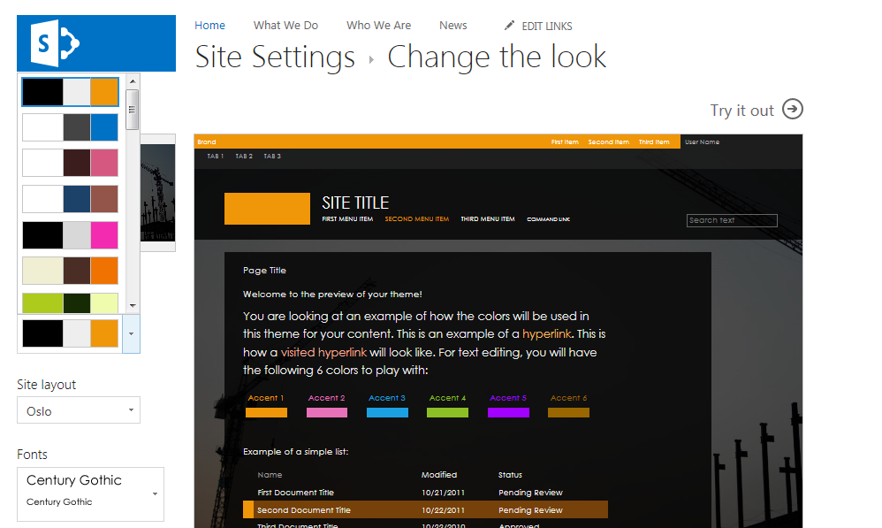
Changing the Look
Notes:
Once you select a Composed Look to start with in the Change a Look page, you can then customize the look by selecting a different color theme, adding or removing a background image, changing the master page, and setting the desired font available form the Fonts drop-down list.
As you update the different options, the preview of the site updates to the right of the available options. Once you have the settings set the way you want it, you can click on Try it out to see a live preview of the site before committing the changes. Once the changes are committed, the Composed Looks list is automatically updated with the “Current” values.

Slide 20
Composed Looks

Slide 21
Agenda
Overview of Publishing Features
Master Pages and Page Layouts
Design Manager
Composed Looks and Site Branding
Cross-Site Publishing & SEO Features

Slide 22
Overview of Cross-Site Publishing
What is Cross-Site Publishing?
New publishing feature introduced in SharePoint 2013
Allows content reuse across site collections
Uses built-in SharePoint search capabilities
Content created in libraries and lists as catalogs in authoring site collection
Search crawls the content & builds search index
User views a page on a publishing site
Triggers queries from Search Web Parts
Results returned from search index and shown in Search Web Parts on the page

Slide 23
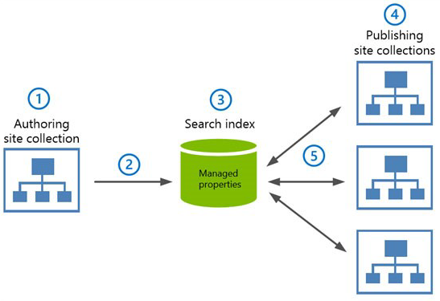
Cross-Site Publishing Diagram

Slide 24
Cross-Site Publishing
Why use cross-site publishing?
Use when you want to store/maintain content in one or more authoring site collections
Display content in one or more publishing site collections
Using cross-site publishing provides the following benefits:
Separates content authoring from branding & rendering
Can be used across site collections, web applications, and across farms
Allows for a mix of authored pages and list content

Slide 25
Content by Search Web Part
Similar to Content by Query Web Part (CQWP)
Exposes results as JSON on page
Customize search results rending
Easier to customize than CQWP styles
Client-side solution using returned results as JSON
Server side via custom Display Templates
Content only editable at source, not in different presentations (presentation = search results)
Notes:
Previous version of SharePoint WCM sites included a powerful web part used for content aggregation and rollup: Content by Query Web Part (CBQ). New in SharePoint 2013 is the Content by Search Web Part (CBS).
The CBS, when placed on a page, allows developers and designers to pull content directly from the search index. The query can be designed to pull content based on values on the page or within the URL, such as terms in a term site. The results are then written to the page in JSON format and a display template is used to render the content in HTML.
When search engines hit the page, SharePoint detects this is not a regular user and instead renders the HTML server side so the engine does not parse through the JSON, rather it parses the standard HTML page. There is also a property on the CBS Web Part that allows developers to force server-side rendering if they choose, as in the case for accessibility reasons.

Slide 26
Working with Catalogs
What is a Catalog?
List or Library used to reuse content across sites
These lists/libraries are shared out to search for using across publishing sites
Catalogs enable content to be published across site collections
Authoring Site to Publishing Site

Slide 27
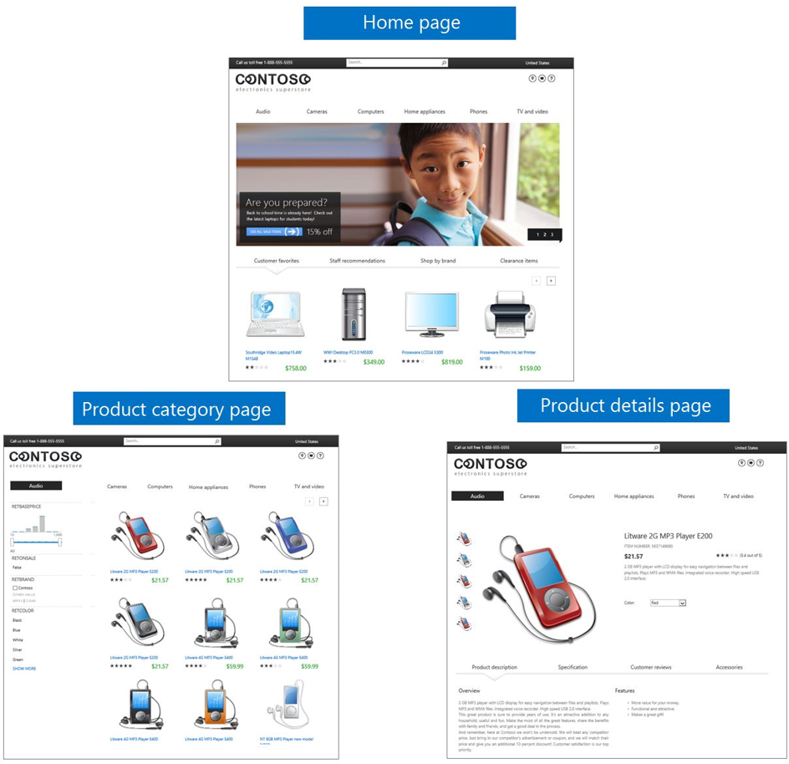
Product Catalog Example

Slide 28
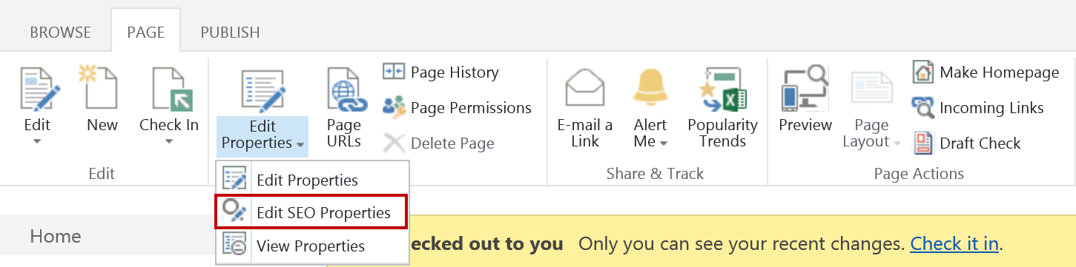
SEO Features
Search Engine Optimization (SEO)
Enabled by default on provisioned public-facing SharePoint publishing sites
SharePoint includes SEO features to provide:
Built-in robots.txt file and auto generate sitemap file
Canonical link filtering and page-level metatagging for title, keyword, and description

Slide 29
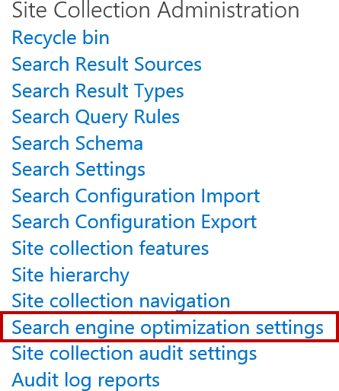
SEO Settings in SharePoint
Settings provided for analyzing/refining search results of SharePoint site
Some search engines offer webmaster tools enabling ability to:
View crawl activity
Upload sitemaps
Research keywords
Aggregate search statistics
Must first verify search engine site is affiliated with and have authority to review search-related data

Slide 30
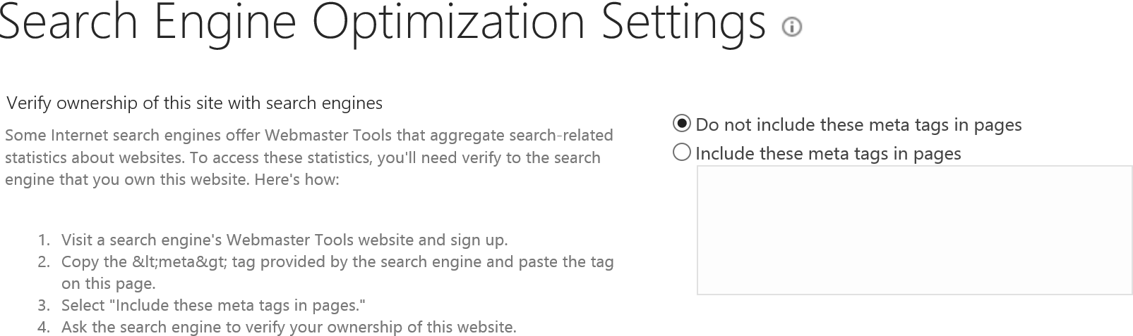
SEO Settings (Site Collection Admin page)

Slide 31
Canonical URL Filtering
Search engines track number of links pointing to pages from external sites
Information used to assign popularity rankings in search results
Multiple links can point to the same content page
Links will vary based on the parameters contained
Links tracked as separate items using canonical URL link parameter filtering SharePoint feature
http://www.mtb.com/branch-locations?city=sortBy=ascending
http://www.mtb.com/branch-locations?city=sortBy=descending

Slide 32

Canonical URL Filtering
Enabling canonical link parameter filtering
Causes SharePoint to strip out all parameters from links unless specified otherwise when reporting URLs to search engines
Can explicitly state when parameters should be included with links and what the parameters should be
Canonical URL
Parameters

Slide 33
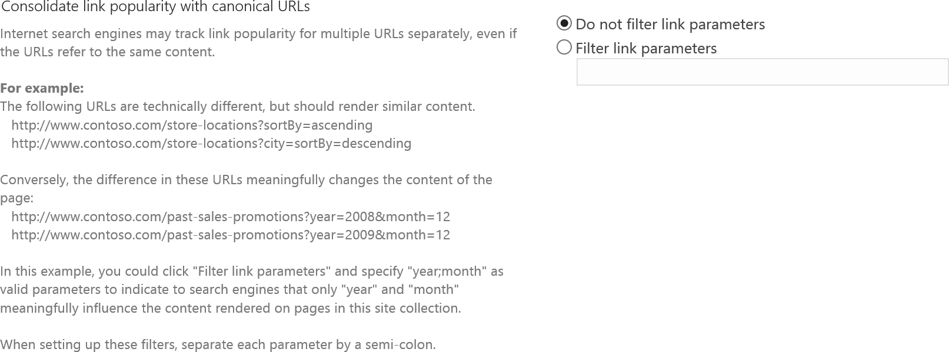
Filter Link Parameters Setting

Slide 34
SEO Meta Tags
SEO Meta Tag | Description
Name | Page name that appears in URL. May or may not match the friendly page title.
Title | Friendly page title. Can display at top of page or hidden from view.
Browser title | Title that appears at top of browser window, browser tabs, and as link text in search results. Is the most important SEO element on a page.
Meta description | Description that accompanies browser title in search results. Descriptions should be brief (150 characters) and precise. A well-crafted description informs users what the page contains and also encourages user to click the link.
Keywords | Terms, phrases, and synonyms that describe content on page. Include words your customers use when searching for the kind of content you feature. Use a comma to separate each word.
Exclude from Internet search engines | Tells search engine crawlers the page should not be indexed or included in search results. The search engine will follow any links embedded in the page.

Slide 35
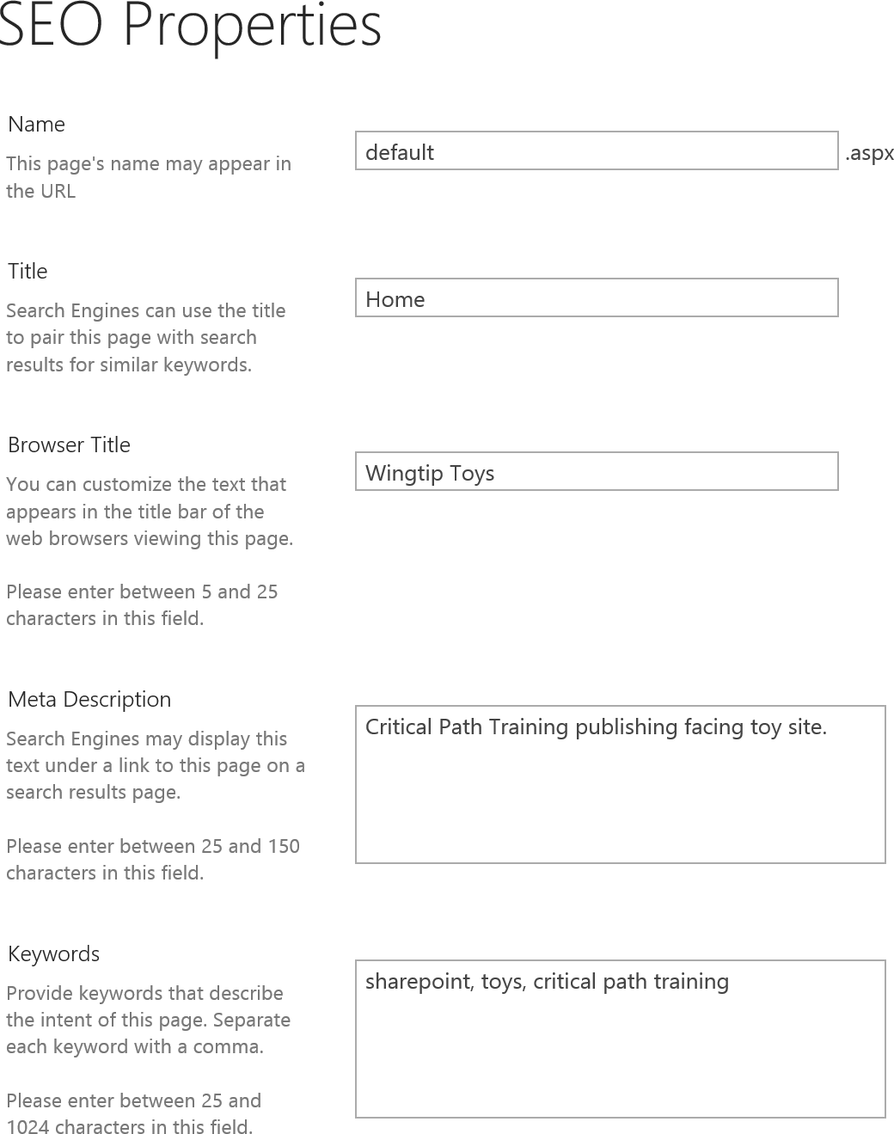
SharePoint SEO Properties

Slide 36
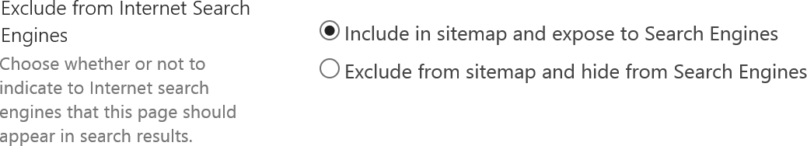
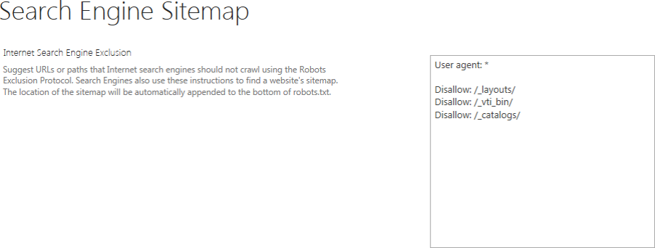
SEO Sitemap Settings in SharePoint
Used to edit robots.txt file to flag which URLs on site should be included/excluded from search
Generates sitemap file automatically

Slide 37
Summary
Overview of Publishing Features
Master Pages and Page Layouts
Design Manager
Composed Looks and Site Branding
Cross-Site Publishing & SEO Features

