Slide 1
SharePoint 2013 Search
Notes:
This module teaches students how to utilize the search features of SharePoint 2013 to discover and navigate through content in a SharePoint environment. Students will learn how to use a Search Center site to execute search queries and to filter search results using the refinement panel. Students will learn advanced query syntax for executing search queries using managed properties. The module also teaches students about what search setting should be configured at the site collection level to achieve the optimal search experience for the site’s user.

Slide 2
Agenda
Intro to SharePoint Search Center
Crawled and Managed Properties
Keyword Query Language (KQL)
Configuring Search Results
Configuring the Refiner Panel

Slide 3
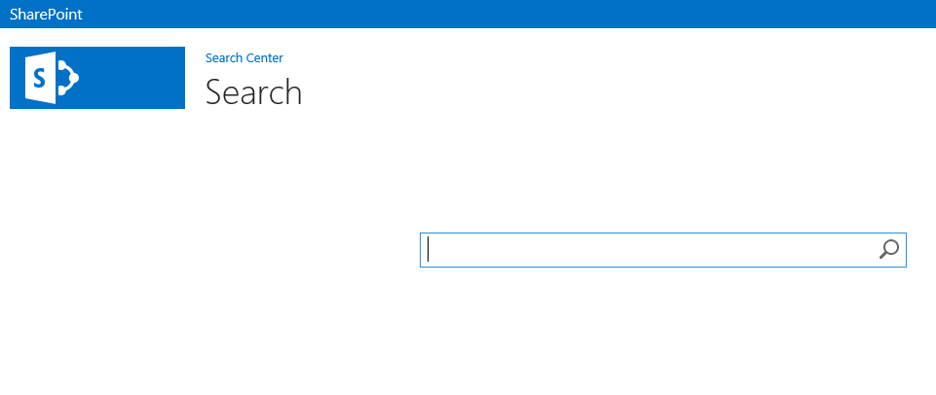
Intro to SharePoint Search Center
SharePoint Search Center
Exists at top-level site collection
Users can submit search queries and view results
Notes:
Search Center is a separate site in the site collection;
Out of the box, has a search box similar to other search engines: Google, Bing, etc.
Use keywords and phrases to search for items in the farm

Slide 4
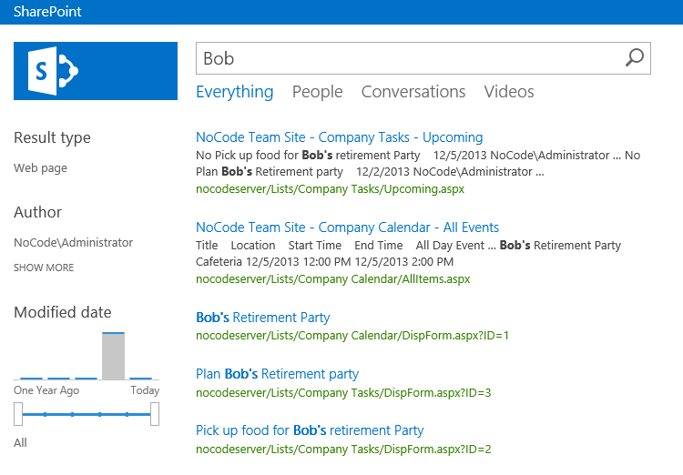
SharePoint Search Center: Results
Notes:
When the user searches an out of the box search center, the results include a standard set of refiners and scopes. These can be customized by adding and removing specific refiners or scopes, or by changing the properties of existing ones.

Slide 5
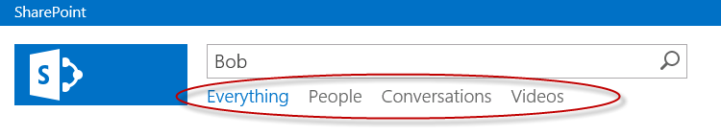
Search Navigation
Search Navigation Links
Each link points to Search Results page that uses pre-defined “Result Source”
Result Source specify:
Search provider or source URL
Protocol to use to get search results (ie OpenSearch)
Query transform (to narrow results)
Result sources, search result pages, and result sources can be added/deleted/modified

Slide 6
Search Navigation: Links
Everything (results.aspx)
View all search results
People (peopleresults.aspx)
View only People in SharePoint
Conversations (conversationsresults.aspx)
View MySite Conversations
Videos (videoresults.aspx)
View only items of video content type

Slide 7
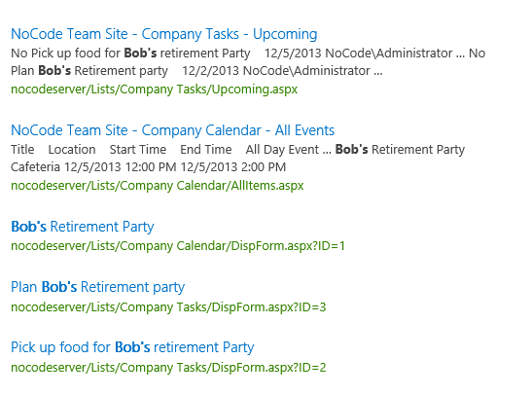
Search Results
Search results appear with useful information so user can make an informed decision about what item to choose
Blue text: link to item, document, or page
Black text: More information about body of returned item
Green text: URL to specific item, document, or page
Information displayed can be customized

Slide 8
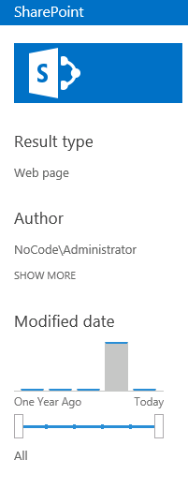
Refinement Panel
Refinement panel used to narrow down search results
Out of the box refiners:
Result Type
Author
Modified Date
Refiners with range can utilize slider bar & graph representation of relevant results

Slide 9
Agenda
Intro to SharePoint Search Center
Crawled and Managed Properties
Keyword Query Language (KQL)
Configuring Search Results
Configuring the Refiner Panel

Slide 10
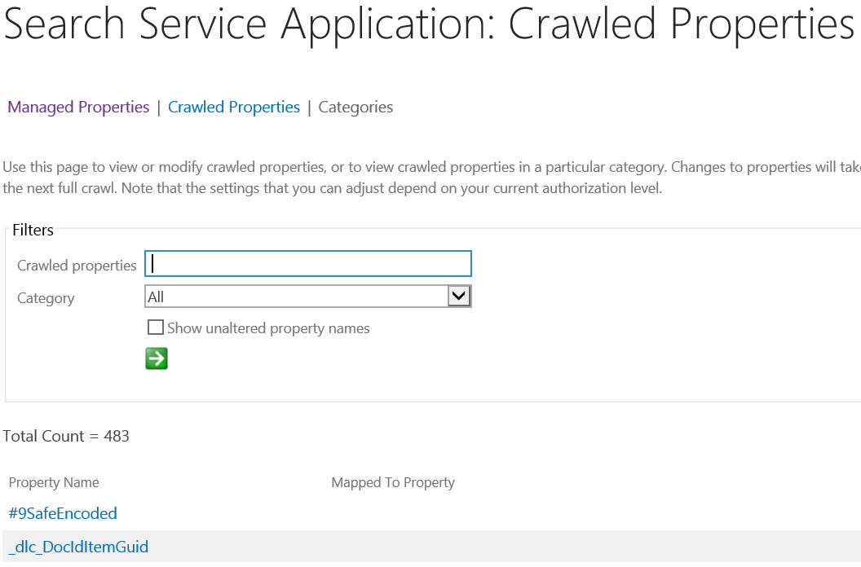
Crawled Properties
Crawled Property
Content and Metadata extracted from an item during a search crawl
Created in Central Administration (Search Service Application)
Created when indexer “crawls” data repositories
Represent fields in data source
Names are often unfriendly, not English readable

Slide 11
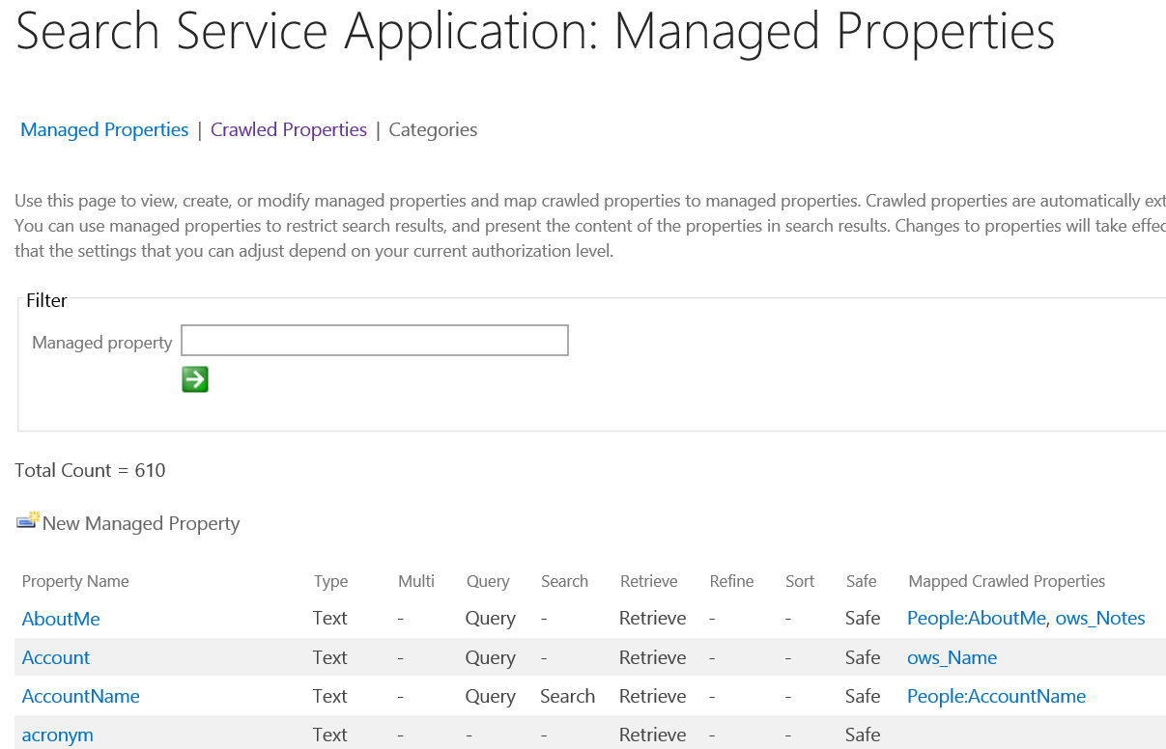
Managed Properties
Managed Properties are defined in SharePoint
Search Service Application level
Site Collection level
Mapped to one or more crawled properties
Provide friendly, English readable names for fields in data sources
Notes:
Managed Properties can be leveraged for more powerful search solutions. They are defined in SharePoint at the Search Service Application level, and at the Site Collection level.
You can define you own managed properties at both levels, but SharePoint does have built in managed properties that you can leverage.
In SharePoint 2013, Site Columns become Managed Properties
New ability to re-index sites and lists means you do not have to go to Central Administration to see changes you make to managed properties in the site collection.

Slide 12

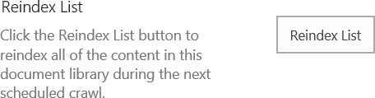
Managed Properties
Leverage existing managed properties or define custom managed properties
Site Columns can become managed properties
Now have ability to reindex sites and lists in site collection

Slide 13
Managed Properties
In SharePoint 2013, managed properties have their own properties
Property | Description
Alias | Friendly names
Multi-valued | Can have multiple values
Queryable | Can be used in property-based searches
Refinable | Can be used as a refiner
Retrievable | Can be returned in the results
Searchable | Includes the value of the managed property in the search index
Sortable | Can be used for sorting results
Type | The data type of the managed property
Notes:
These properties allow us to specify what the managed property can be used for. The ones we use most often are:
Queryable- perform property-based searches, such as “title: dog”
Refinable- use to filter out search results to achieve a tighter set
Retrievable- can be returned in search results as a column
Searchable- not only can I use property based searches, but I can also use free text
Sortable- can be used to sort results. I.e. alphabetical, due-date, etc.

Slide 14
Agenda
Intro to SharePoint Search
Crawled and Managed Properties
Keyword Query Language (KQL)
Configuring Search Results
Configuring the Refiner Panel

Slide 15
Keyword Query Language (KQL)
A query language is the way in which users ask questions of Search
Keyword Query Language
Default language for building search queries
KQL consists of:
Managed Properties
Property Restrictions
Boolean Operators
Free Text Keywords or Phrases
Notes:
A query language is the way in which users ask questions of Search. Asking the right questions yields a more effective search.

Slide 16
Property Restrictions and Boolean Operators
Property Restrictions include:
>
<
=
: (“contains”)
Title : SharePoint
Author = Administrator

Slide 17
Boolean Operators
Boolean Operators are used to combine elements to make more restrictive include:
AND
NOT
OR
Title : SharePoint OR Author = Administrator

Slide 18
Free-Text KQL
Free-Text KQL
Familiar form of Keyword Query Language because it is used in common search engines
IE: Bing, Google
Consists of typing words and phrases into Search Center
Leverages Property Restrictions & Boolean Operators to form more complex queries

Slide 19
Using Managed Properties with KQL
“Property Based KQL”
Form of KQL which leverages managed properties from SharePoint
Returns results based on a specified condition
Uses built-in and custom managed properties for powerful, effective solutions
<property name><property operator><property value>
Author : Smith
Notes:
Using managed properties in KQL is also known as “Property Based KQL”
Specify the name of an existing managed property: can be out of the box, or custom. BUT, must have the property “Queryable”
Use Boolean Operators to create more complex/more restricted queries

Slide 20
Hyperlink Solutions Using Property KQL
Hyperlink solutions are quick, powerful solutions to common user issues
Leverage Property Based KQL
Three easy steps:
Run a KQL Search
Copy Search results URL from the browser
Expose this URL as a hyperlink on a site

Slide 21
Agenda
Intro to SharePoint Search
Crawled and Managed Properties
Keyword Query Language (KQL)
Configuring Search Results
Configuring the Refiner Panel

Slide 22

Customizing Search Using Result Sources
Previous versions of SharePoint
Scopes
SharePoint 2013
Result Sources
Result sources are associated with specific search results page
Link to search results page is added to search navigation
Notes:
In previous versions of SharePoint, the user had access to search scopes which could be added to the search center.
In SharePoint 2013, the concept of “scopes” has been deprecated and replaced with something new, called “result sources.”
There are a few out of the box result sources, and these appear in your results.aspx page as navigation links underneath the search box. These are links such as everything, people, conversations, and videos.
Although the “everything” link brings the user to the results.aspx page, People, conversations, and videos brings the user to search results pages specifically designed for particular result sources.
The user can create their own result sources to link into the search navigation. Result sources can be created at the site collection level. The user then creates a new search results page, associates their result source with that new page, and then adds a link to that page into the search navigation.

Slide 23
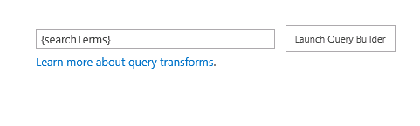
Creating a Custom Result Source
Site Collection level
Select a Source
Local SharePoint Index
Remote SharePoint Index
OpenSearch
Exchange
Build a query to scope the results using the Query Builder
Notes:
A user can create a new result source in central administration, or at the site collection level. When creating one in a site collection, access result sources in site settings using the site actions menu.
Here the user can define the result source and build queries to scope the results.

Slide 24
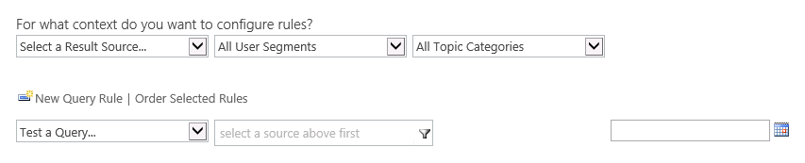
Query Rules
Query Rules
Found in the Site Settings of the Site Collection
Allow for the customization of returned results
Applied to a Result Source
Processed under given conditions
Keyword Query matches
Topic Category

Slide 25
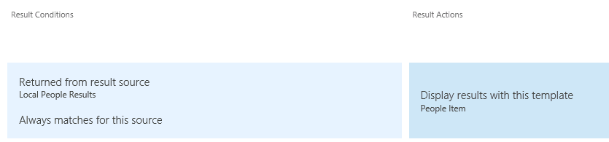
Result Types and Display Templates
Result Types
Determines how to display a set of results
Applied to a Result Source
Defined by a Rule
Associated with a Display Template
Determines how result types appear

Slide 26
Agenda
Intro to SharePoint Search
Crawled and Managed Properties
Keyword Query Language (KQL)
Configuring Search Results
Configuring the Refiner Panel

Slide 27
Configuring the Refiner Panel
Refiners added or removed through the user interface
Out of the box or custom managed properties
Must be “Refinable”
Change settings for each refiner through the user interface
Display name
Display template*
Sort By and Sort Direction
Number of refiner values
Notes:
*more information about the display templates?

Slide 28
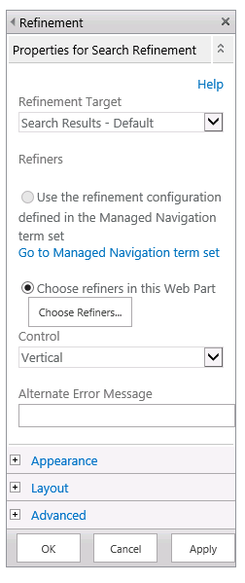
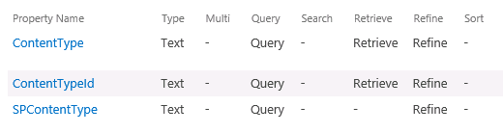
Customizing Search Refiners
To add custom refiners to Search:
Leverage existing site collection managed properties designated as “refinable”
Choose Refiners… in refinement panel

Slide 29
Summary
Intro to SharePoint Search
Crawled and Managed Properties
Keyword Query Language (KQL)
Configuring Search Results
Configuring the Refiner Panel

