Slide 1
User Management and Permissions
Notes:
A complete understanding of user management and permission configuration is essential for a site administrator securing content in SharePoint 2013. This module teaches students about the authorization and security features available in SharePoint 2013 which are used to configure secure access to sites, lists and document libraries. You will learn how to create SharePoint security groups and how to manage site membership. You will also learn the proper way to configure permissions in a hierarchy of securable objects which includes sites, lists, document libraries, items and documents. After completing this module, a student will understand how to manage users and configure the permissions required for secured access in a SharePoint 2013 site collection.

Slide 2
Agenda
Site Security Overview
Configuring Site Permissions
SharePoint Groups
Configuring Fine-grained Permissions
Security Best Practices

Slide 3
SharePoint Security Overview
External Users and Groups
Users and groups defined outside of SharePoint
SharePoint Groups
Group defined within scope of a site collection
Permission Levels
A named set of permissions (e.g. Contribute, Edit)
Permission Assignments
Top site set permissions set default for site collection
Permissions can be configured at more granular level

Slide 4
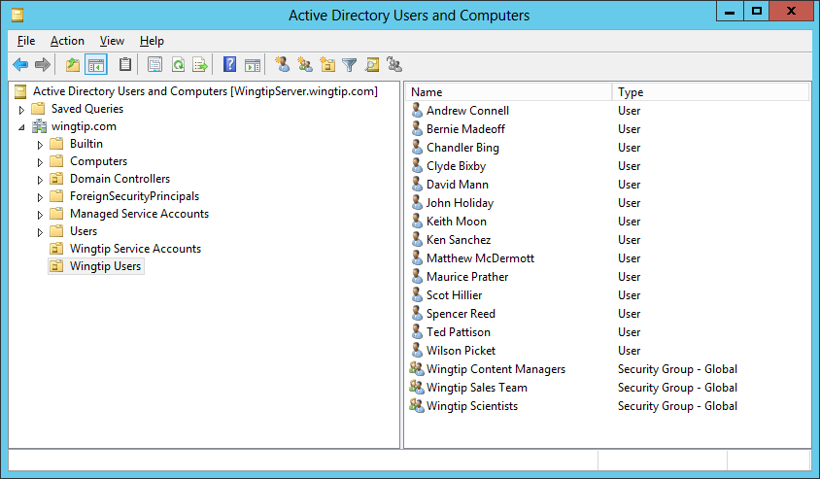



External Users and Groups
Users and groups are external security principals
Users must be authenticated by trusted identity provider
On-premises farms often use Active Directory as identity provider
On-premises farms can also use FBA, Window Live, FaceBook, etc.
Office 365 provides tenancy-scoped user and identity management.

Slide 5
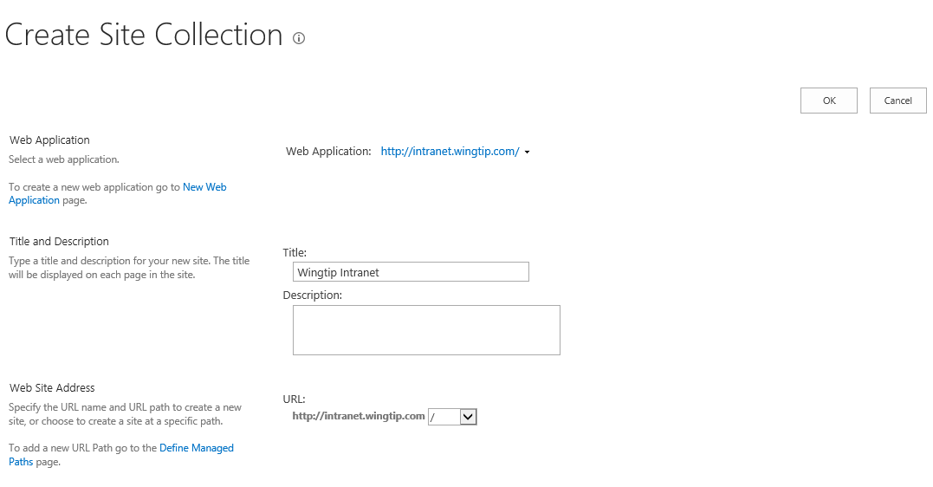
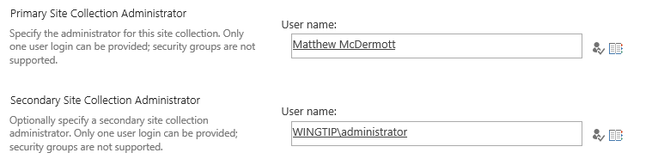
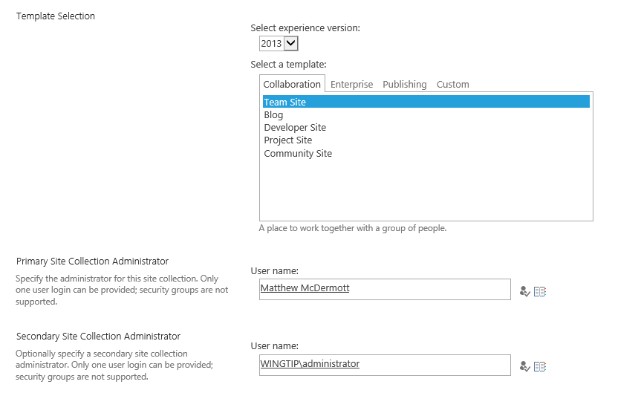
Site Collection Administrator
Granted full administrative permissions
Acts as super user within site collection

Slide 6
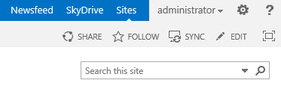
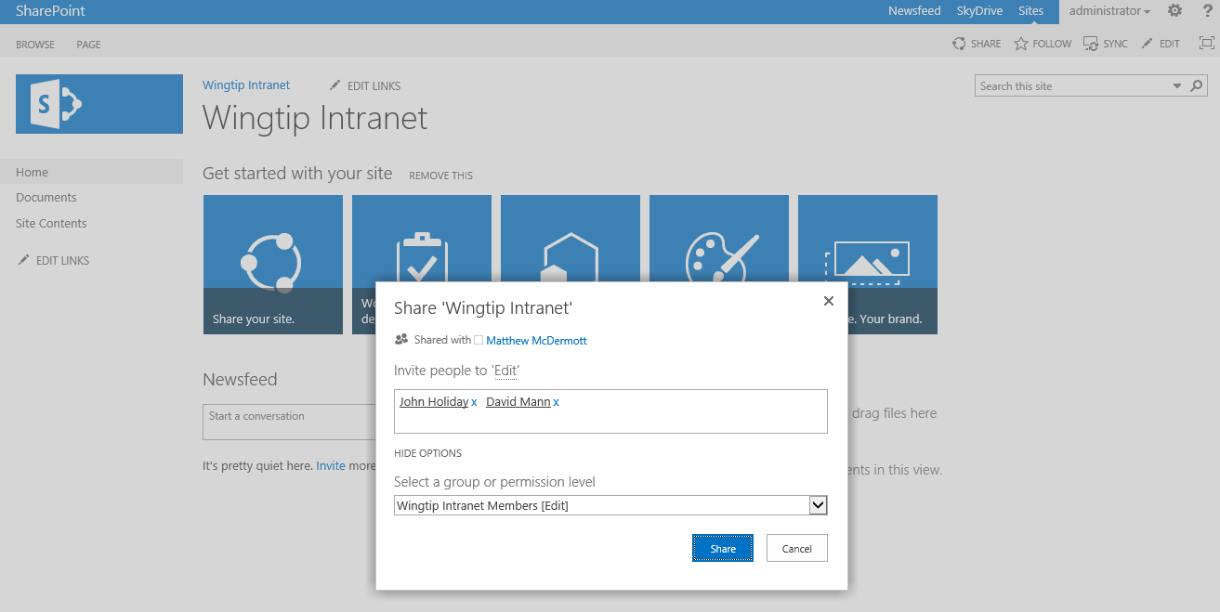
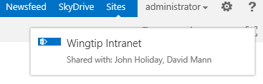
Sharing a Site
1
Click the Share link
2
Configure user access to site using Permission Level or Group
3
Confirm the site is shared

Slide 7
Sharing a Site with Other Users

Slide 8
Agenda
Site Security Overview
Configuring Site Permissions
SharePoint Groups
Configuring Fine-grained Permissions
Security Best Practices

Slide 9
Permissions
SharePoint supports three types of permissions
Site Permissions
Open
View Pages
Browse User Information
Use Remote Interfaces
Use Client Integration Features
Use Self-Service Site Creation
Browse Directories
Edit Personal User Information
Add and Customize Pages
Apply Themes and Borders
Apply Style Sheets
Create Subsites
Create Groups
Enumerate Permissions
Manage Permissions
View Web Analytics Data
Manage Alerts
Manage Web Site
List Permissions
View Items
View Versions
Create Alerts
View Application Pages
Open Items
Add Items
Edit Items
Delete Items
Delete Versions
Approve Items
Manage Lists
Override List Behaviors
Personal Permissions
Manage Personal Views
Add/Remove Personal Web Parts
Update Personal Web Parts

Slide 10
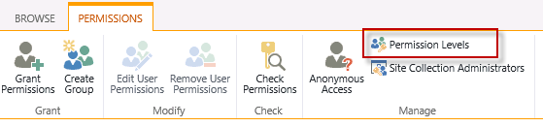
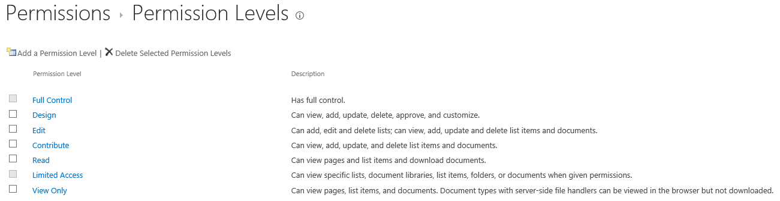
Understanding Permission Levels
Permission level is a named set of permissions
Makes it easier to configure permissions
Named using a verb which implies role (e.g. Contribute)
Several permission levels included automatically
You can create custom permission levels when needed
Permission levels included out-of-the-box with a new Team site

Slide 11
Perm Levels
Standard Permission Levels (created automatically)
View-only (used for Excel Services)
Read
Edit
Contribute
Design
Full Control
Special Permission Level
Limited Access - this is discussed shortly

Slide 12
Site Permissions (default settings)
Site Permissions | View-only | Read | Contribute | Edit | Design | Full Control
Open | x | x | x | x | x | x
View Pages | x | x | x | x | x | x
Browse User Information | x | x | x | x | x | x
Use Remote Interfaces | x | x | x | x | x | x
Use Client Integration Features | x | x | x | x | x | x
Use Self-Service Site Creation | x | x | x | x | x | x
Browse Directories |  |  | x | x | x | x
Edit Personal User Information |  |  | x | x | x | x
Add and Customize Pages |  |  |  |  | x | x
Apply Themes and Borders |  |  |  |  | x | x
Apply Style Sheets |  |  |  |  | x | x
Create Subsites |  |  |  |  |  | x
Create Groups |  |  |  |  |  | x
Enumerate Permissions |  |  |  |  |  | x
Manage Permissions |  |  |  |  |  | x
View Web Analytics Data |  |  |  |  |  | x
Manage Alerts |  |  |  |  |  | x
Manage Web Site |  |  |  |  |  | x

Slide 13
List Permissions and Personal Permissions
List Permissions | View-only | Read | Contribute | Edit | Design | Full Control
View Items | x | x | x | x | x | x
View Versions | x | x | x | x | x | x
Create Alerts | x | x | x | x | x | x
View Application Pages | x | x | x | x | x | x
Open Items |  | x | x | x | x | x
Add Items |  |  | x | x | x | x
Edit Items |  |  | x | x | x | x
Delete Items |  |  | x | x | x | x
Delete Versions |  |  | x | x | x | x
Approve Items |  |  |  | x | x | x
Manage Lists |  |  |  | x | x | x
Override List Behaviors |  |  |  |  | x | x
Personal Permissions | View-only | Read | Contribute | Edit | Design | Full Control
Manage Personal Views |  |  | x | x | x | x
Add/Remove Personal Web Parts |  |  | x | x | x | x
Update Personal Web Parts |  |  | x | x | x | x

Slide 14
The "Limited Access" Permission Level
Limited Access used with fine-grained permissions
Enables user to browse site page to access item
Required when user is granted access to a item but has no permissions to parent list
Limited Access permission level includes minimum set of permissions required for user to access item
You do not assign Limited Access permissions directly
SharePoint automatically assigns permission when required
Occurs when granular permissions assigned at item level or document level

Slide 15
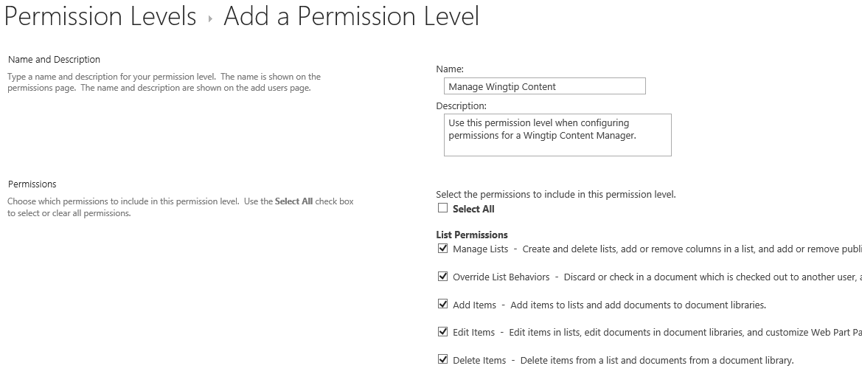
Creating a Custom Permission Level
Create a custom permission level when required
Name permission level using verb (e.g. Manage)
Select the appropriate set of permissions
Once the permission level has been created…
Use it to assign permissions

Slide 16
Creating a Custom Permission Level

Slide 17
Agenda
Site Security Overview
Configuring Site Permissions
SharePoint Groups
Configuring Fine-grained Permissions
Security Best Practices

Slide 18
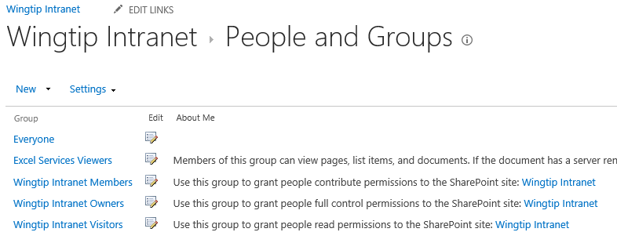
SharePoint Groups
SharePoint provides support for security groups
Created within the scope of a site collection
Eases management of users and permissions
SharePoint often creates standard set of groups
Owners
Members
Visitors
Excel Viewers

Slide 19
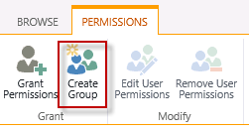
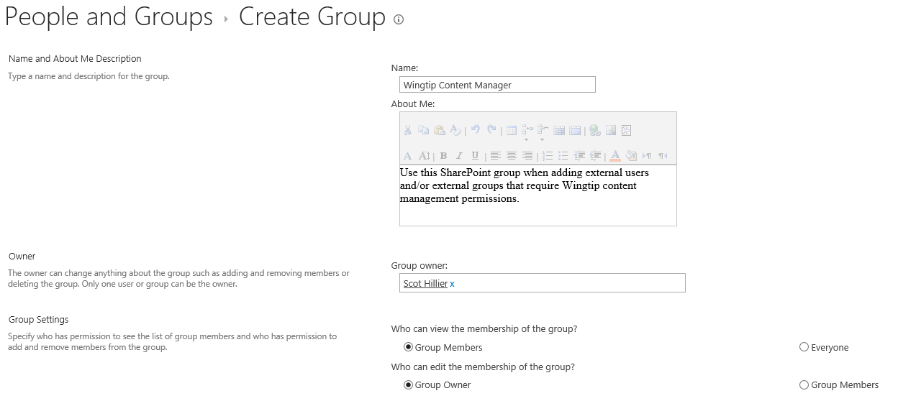
Creating a SharePoint Group (Part 1)

Slide 20
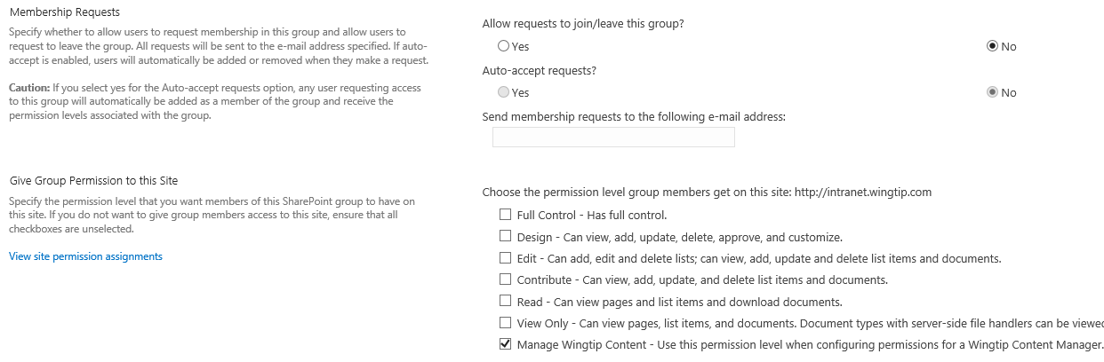
Creating a SharePoint Group (Part 2)

Slide 21
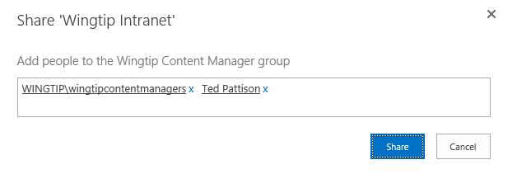
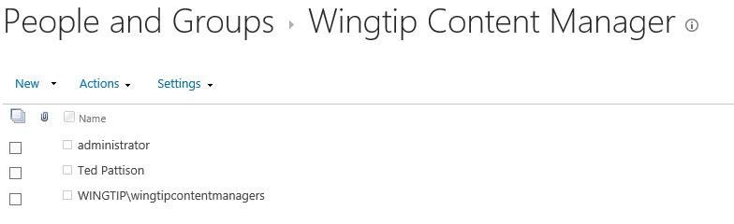
Adding Members to Custom Group
Once you have created a custom group….
Configure permissions on site and other objects
Add external users and external groups

Slide 22
Managing Permissions using SharePoint Groups

Slide 23
Agenda
Site Security Overview
Configuring Site Permissions
SharePoint Groups
Configuring Fine-grained Permissions
Security Best Practices

Slide 24
Securable Objects
Site collection contains securable objects
Top-level site is securable object
Child sites are securable objects
Lists/document libraries are securable objects
Items/documents/folders are securable objects
Securable objects support adding a permissions list
Top-level site always has own permission list
Top-level site permissions list scoped at site collection level
Other securable objects can have unique permissions list
Securable objects without unique permissions inherits permissions

Slide 25
Top-level Site Permissions
Top-level site permissions are required
Unique permissions for Child objects is optional
Child objects without unique permissions inherit from parent
Site Collection
Top-level Site
Perm
List
List
Document Library
Child Site
Item 1
Doc01.docx
Item 2
Doc02.pptx
List
Item 1
Item 2

Slide 26
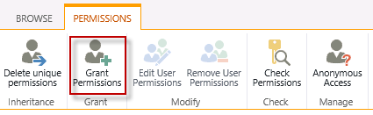
Creating Unique Permissions
When you create unique permissions…
It affects that object and all its children
Site Collection
Top-level Site
Perm
List
List
Document Library
Perm
List
Child Site
Item 1
Doc01.docx
Item 2
Doc02.pptx
List
Item 1
Item 2

Slide 27
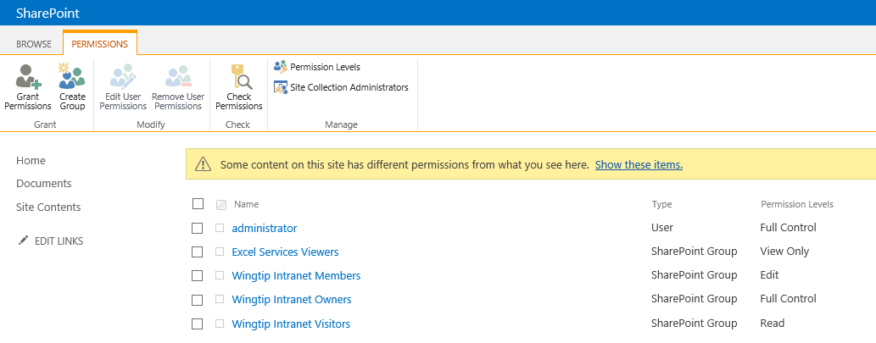
Detecting Unique Permissions

Slide 28
Configuring Fine-grained Permissions

Slide 29
Agenda
Site Security Overview
Configuring Site Permissions
SharePoint Groups
Configuring Fine-grained Permissions
Security Best Practices

Slide 30
Best Practices
Things you want to avoid….
Configuring unique permissions for too many objects
Configuring permissions in terms of external users and groups
Best Practices in Site Security Configuration
Create custom permission levels when necessary
Create a SharePoint Group for each level of access required
Configure permission as often as possible with SharePoint Groups
Break permission inheritance as infrequently as possible

Slide 31
Summary
Site Security Overview
Configuring Site Permissions
SharePoint Groups
Configuring Fine-grained Permissions
Security Best Practices

