Slide 1
Overview of Site Administration
Notes:
In this module, you will learn about the responsibilities and the required skills for a site administrator in the SharePoint 2013 environment. You will learn about the logical architecture of SharePoint 2013 sites and the anatomy of a SharePoint site collection. The module teaches students how to work with the Site Settings page to configure various site collection properties and site properties. Students will also gain an understanding of the features and site templates available in SharePoint 2013 as well as the basic differences between team sites and publishing sites.

Slide 2
Agenda
Anatomy of a SharePoint Site Collection
Site Templates available in SharePoint 2013
Configuring Site Properties
Standard Features and Enterprise Features
Understanding Team Site versus Publishing Site

Slide 3
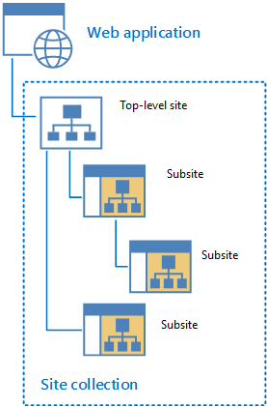
Anatomy of a SharePoint Site Collection
Web Application
Can contain one or more site collections
Site collection
Hierarchical set of sites that can be managed together
Structure made up of one top-level site and sites below
Sites in site collection have common features such as: shared permissions, content types, common navigation
Notes:
Every Web Application in SharePoint contains one or more site collections. The amount of site collections allowed in a single web application depends on the capacity of the server infrastructure. A SharePoint 2013 site belongs to only one site collection and a site collection is made up of one top-level site and all sites below. A site collection is a hierarchical set of sites that can be managed together that share common features such as shared permissions, template galleries, content types, Web Parts, and often a common navigation scheme.
Since site collections and sites exist in a parent-child relationship, there are aspects of control and functionality which can be configured at the site collection level and used at the site level.
Site collection’s galleries and libraries (such as the Master Page Gallery) provides means for creating a unified, branded user experience across all sites in a site collection.
Security policies and features can be managed for an entire site collection to help provide site administrators a unified mechanism and scope for administration.
Shared site columns, content types, Web Parts, and other authoring site collection features provide a consistent authoring environment for site content authors.
A site collection’s unified navigation, branding, and search tools provide a unified experience for site users.

Slide 4
Types of Site Collections
Host-named site collections
Assign a unique DNS name
Path-based site collections
All subsites in site collection share root or parent URL
Site Collection | Name | URL
Site Collection 1 | CourseA | CourseA.wingtip.com
Site Collection 2 | CourseB | CourseB.wingtip.com
Site Collection | Name | URL
Site Collection 1 | CourseA | intranet.wingtip.com/sites/CourseA
Site Collection 2 | CourseB | intranet.wingtip.com/sites/CourseB
Notes:
SharePoint 2013 supports two-types of sites collections: host-named site collections and path-based site collections. The most common type used is using path-based site collections however Microsoft recommends using host-named site collections especially for sites hosted in O365.
Host-named Site Collections
Host-named site collections enable you to assign a unique DNS name to the site collections. This enables you to deploy many sites with unique DNS names in the same web application. For example, CourseA could have an address of http://CourseA.wingtip.com and CourseB could have an address of http://CourseB.wingtip.com.
Path-based Site Collections
In a path-based site collection, all subsites in the site collection will share a root or parent URL (otherwise known as DNS name). For example, CourseA could have a site collection http://intranet.wingtip.com/sites/CourseA and CourseB could have a site collection URL of http://intranet.wingtip.com/sites/CourseB.
When using path-based site collections it is common to setup additional managed paths for the web application. Instead of using /sites as the path you could add a wildcard managed path of /training and then have CourseA be http://intranet.wingtip.com/training/CourseA and CourseB be http://intranet.wingtip.com/training/CourseB.

Slide 5
Web Application & Site Collections

Slide 6
Agenda
Anatomy of a SharePoint Site Collection
Site Templates available in SharePoint 2013
Configuring Site Properties
Standard Features and Enterprise Features
Understanding Team Site versus Publishing Site

Slide 7
Site Templates in SharePoint 2013
Site Templates
Pre-built definitions designed around a particular business need
Use these existing site templates or create your own
Every site’s structure and functionality based on a site template
SharePoint 2013 provides ability to present sites
In the style of SharePoint 2010 or SharePoint 2013
Any SharePoint 2010 site templates deprecated in SharePoint 2013 will not be available for use
Notes:
Since every site collection starts out as a single, top-level site, its structure and functionality are based on a site template. SharePoint 2013 provides many preconfigured site templates available for your use however you can also create your own site templates as needed.
SharePoint 2013 also provides the ability to present sites in the style of SharePoint 2010 or in the style of SharePoint 2013. Depending on the style you select will depend on what site templates become available. Some of the SharePoint 2010 site templates deprecated in SharePoint 2013 are not available as an option such as Document Workspace Site templates. However, existing sites created by using deprecated site templates and then upgraded to SharePoint 2013 will continue to operate.

Slide 8
Collaboration Site Templates
Team Site
Basic site used for working with teams
Blog Site
Full feature blog site - includes libraries such as list for blog posts, library for photos, categories
Developer Site
Used by developers for Apps development
Developers can build, test, publish their custom Apps
Notes:
A site template in SharePoint is what you use to create new SharePoint sites. Each site is based off of a site template. SharePoint 2013 provides various out-of-the-box site templates that can be used for creating new sites.
Team Site
The Team Site template is the most common site template used to enable teams to collaborate, share documents, and stay in sync.
Blog Site
The Blog Site template allows you to create a full-featured blogs which you can customize based on your organization’s needs. Use to write opinions and share information.
Project Site
This site template is used for managing and collaborating on projects. Project sites contain out-of-the-box Web Parts and pages that facilitate Project Managers and teams to work together efficiently by coordinating project statuses and information relevant to a project.
Community Site
A Community Site is an online community and virtual place where users can discuss and share ideas. This site template promotes open communication by fostering discussions among users. Active participation is encouraged through a reward system and community sites can be built as subsites beneath a team site.

Slide 9
Collaboration Site Templates
PowerPivot Site
Site for sharing workbooks in a PowerPivot Gallery
Part of the Business Intelligence features
Project Site
Site for managing projects
Capture and assign tasks, manage project related documents, track project team events
Community Site
An enhanced discussion forum type site
Notes:
PowerPivot Site
This Business Intelligence site template is used for teams to share workbooks that contain PowerPivot data. PowerPivot workbooks are stored in a special type of SharePoint document library called the PowerPivot Gallery. This gallery is specifically designed for working with PowerPivot workbooks and provides special navigation and preview capabilities for PowerPivot workbooks.
Project Site
The Project Site template is used to create a site used for managing and collaborating on a project. This site is provides the ability to capture and assign tasks, manage project related documents, and track project team events using a calendar.
Community Site
The Community Site template is used to create a site where community members can explore, discover content, and discuss common topics.

Slide 10
Enterprise Site Templates
Document Center
Used to centrally manage documents
eDiscovery Center
Provide litigators the ability to discover content in electronic format
Records Center
Use to manage company records
Business Intelligence Center
Use to implement Business Intelligence solutions
Notes:
Enterprise site templates are based on the Enterprise features of SharePoint 2013.
Document Center
Used to centrally manage documents in your enterprise. The library in the document center site is a large-scaled library useful as an enterprise knowledge base or historical archive. This site template includes features that help users easily navigate, search, and manage lots of documents in a deep hierarchy by using a set of specialized Web Parts.
eDiscovery Center
The eDiscovery Center site template is used to create sites used to provide records managers and litigators the ability to discover content in electronic format.
Records Management
A Records Management site template is used to create a site used for providing an alternative way to the traditional processing of copying or moving records to another location and then applying security and retention policies. You can manage records “in place” which means you can leave the document in it’s current location, declare it as a record, and the apply the appropriate security, retention, and disposition properties.
Business Intelligence Center
The Business Intelligence Center site is a pre-built site template used to help working with BI elements. This includes scorecards, dashboards, data connections, status lists, status indicators, and so on. You can use the built-in tools of the site or customize the site.

Slide 11
Enterprise Site Templates
Enterprise Search Center
Provides a more advanced search center site
Includes General search, People search, Conversation search, and Video search
Community Portal
Used to discover community sites
Basic Search Center
Provides a general search center site
Visio Process Repository
Used to share and view Visio process diagrams
Notes:
Enterprise Search Center
This site template is used to deliver an enterprise-wide search experience. This includes a welcome page with a search box that connects users to four different search results page experiences. These four search options include one for general search, one for people search, one for conversation search, and another for video searches.
Community Portal
This site is used to discover new Community Sites (otherwise known as communities) across the enterprise.
Basic Search Center
The Basic Search Center site is used for delivering a basic search experience. This basic site lacks the multiple results pages of the Enterprise Search Center.
Visio Process Repository
The Visio Repository site is used to allow sharing and viewing of Visio process diagrams published n SharePoint 2013.

Slide 12
Publishing Site Templates
Publishing Portal
Used for publishing content using the WCM features
Enterprise Wiki
Used for publishing knowledge you want to share across the enterprise
Technology based on Wiki pages
Product Catalog
Site used for managing product catalogs
Notes:
Publishing Portal
A Publishing Portal is a starter hierarchy typically for Internet-facing sites or for large intranet portals. These type of sites can be customized easily with distinctive branding and the sites typically have more readers than contributors used to publish web pages with approval workflows.
Enterprise Wiki
An Enterprise Wiki site is used for publishing knowledge captured that you want to share across the enterprise. These sites use Wiki technology.
Product Catalog
The Product Catalog site template is used for creating sites used to manage product catalog data that can be published to a Publishing site through search.

Slide 13
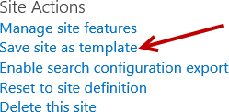
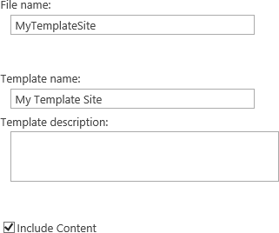
Save Site as Site Template
Turning a customized site into site template
Is extremely useful and powerful
Saving a site as template saves overall framework of site
Lists, libraries, views, forms, and workflows
Ability to include contents of the site in template
Save site as a site template
To quickly recreate the design, structure, or content of a site
Notes:
Turning a customized site into a site template is extremely useful and powerful. When saving a site as a template, the overall framework of the site is saved. This includes lists, libraries, views, forms, and workflows. You can also include the contents of the site in the template if necessary. For example, your customized site may include a Document Library that has some base template Word doc files in the library that you want to include in your site template. When you save the site as a template, you have the ability to select the option to Include Content. By default, this option is not selected on the Save as Template page.
There is a limitation on saving site templates. You cannot save a SharePoint publishing site collection or site as a template. This also means if you create a site using a non-publishing site template but then activate the SharePoint Server Publishing Infrastructure feature, the Save site as template link is removed from the Site Actions section of the Site Settings page.

Slide 14
Site Templates

Slide 15
Agenda
Anatomy of a SharePoint Site Collection
Site Templates available in SharePoint 2013
Configuring Site Properties
Standard Features and Enterprise Features
Understanding Team Site versus Publishing Site

Slide 16
Site Settings Page
Users and Permissions
Links to manage users and permissions of the site
Look and Feel
Administer how the site appears and behaves such as color, title, and landing page
Links available depends on whether Publishing is activated on the site
Web Designer Galleries
Manage building blocks used to create sites and pages such as site columns and site content types
Notes:
The Site Settings page contains links to pages where you can administer different aspects of a site. The links are divided into different sections and the sections and links are security trimmed based on the logged in user’s permissions. A person with site collection administer rights has access to all the sections in the site settings page.
Users and Permissions
Provides links to pages for administering users and permissions of the site. This includes administering peoples and groups, site permissions, site app permissions, and managing the site collection administrators.
Look and Feel
Provides links to pages that affect how the site appears and behaves such as color, title, and the landing page. The links available in this group depends on whether Publishing is activated on the site.
Web Designer Galleries
Provides links to pages where you can manage the building blocks used to create sites and pages. This includes managing site columns, site content types, Web Parts, list templates, master pages, themes, sandboxed solutions, and composed looks.

Slide 17
Site Settings Page
Site Actions
Shortcuts to commands commonly used such as manage site features and save site as template
Site Administration
Modify administrative settings for a site such as workflow settings and term store management
Site Collection Administration
Modify administrative settings for site collection such as the site hierarchy and managing site collection features
Search
Manage search settings such as result sources and query rules
Notes:
Site Actions
Provides links to commands commonly used by administrators, contributors, designers, and hierarchy managers. Link commands include manage site features, save site as template, enable search configuration export, reset to site definition, and delete this site.
Site Administration
Includes links to pages for administering the site’s regional settings, site libraries and lists, user alerts, RSS, sites and workspaces, workflow settings, site closure and deletion, popularity trends, and the term store management.
Site Collection Administrators
Provides links to pages for administering the site collection. This includes links such as to the recycle bin, site collection features, site hierarchy, various policy settings, SharePoint Designer Settings, and links to updates search settings at the site collection level.

Slide 18
Site Settings

Slide 19
Agenda
Anatomy of a SharePoint Site Collection
Site Templates available in SharePoint 2013
Configuring Site Properties
Standard Features and Enterprise Features
Understanding Team Site versus Publishing Site

Slide 20
Standard Features
Sites
Communities
User Profiles
Search
People & expertise search
Visual previews
Visual best bests
Enterprise Content Management (ECM)
Notes:
The standard features in SharePoint 2013 include sites, communities, User Profiles, Basic Search, and Enterprise Content Management (ECM).

Slide 21
Enterprise Features
Search
Standard search features plus entity extraction
Video search
Item recommendations
Business Solutions
InfoPath Forms Services
Access Services
Business Intelligence
Power View
Performance Point Services
Excel Services
Visio Services
Notes:
The enterprise features in SharePoint 2013 provide more functionality intended for organizations that require more advanced search features, InfoPath and Access Services business solutions, and Business Intelligence capabilities. The enterprise features are available in the SharePoint Server 2013 Enterprise edition and the E3 plan in O365.

Slide 22
SharePoint Features

Slide 23
Agenda
Anatomy of a SharePoint Site Collection
Site Templates available in SharePoint 2013
Configuring Site Properties
Standard Features and Enterprise Features
Understanding Team Site versus Publishing Site

Slide 24
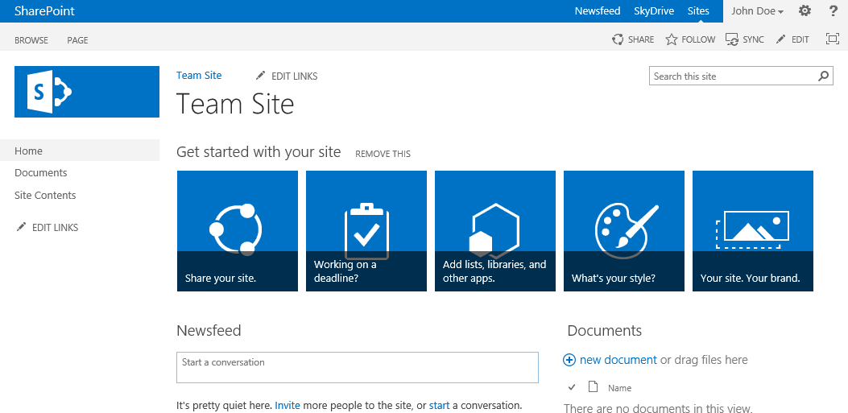
Team Site
Simple and most common site template
Used by teams to collaborate, organize, create, and share information and documents
Includes:
Document library for sharing files
Newsfeed for social interaction
Getting Started tiles
Includes tiles for different actions to help accomplish basic tasks customize your site
Notes:
A Team Site is the most commonly used site by teams to organize, create, and share information and documents. Team site’s include a document library for sharing files, a newsfeed for social interaction and Getting Started tiles. The Getting Started tiles include different actions to help accomplish tasks to customize your site. This Web Part can easily be removed by clicking on the REMOVE THIS link.

Slide 25
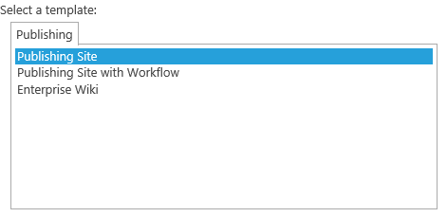
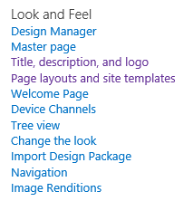
Publishing Site
Widely used for Internet facing sites
Uses Publishing Site templates
Meant for Web Content Management (WCM) sites
Locks down certain page layouts and site templates
Publishing features automatically activated
Provides more look & feel functionality than a team site
Enables Design Manager
Notes:
Publishing Sites differ from Team Sites in such that publishing sites have the publishing features activated. The publishing features are the Web Content Management (WCM) in SharePoint 2013.
Publishing Site
A publishing site is a blank site used for expanding your web site and provide the ability to quickly publish web page content. These sites provide a full authoring experience where content authors (contributors) can work on draft versions of pages and publish them to make them visible to readers. A publishing site includes document and image libraries for storing web publishing assets. Publishing sites provide more look and feel functionality than a team site and enables the Design Manager. More about the Design Manager and Publishing sites will be covered in the Publishing module.

Slide 26
Team Sites and Publishing Sites

Slide 27
Summary
Anatomy of a SharePoint Site Collection
Site Templates available in SharePoint 2013
Configuring Site Properties
Standard Features and Enterprise Features
Understanding Team Site versus Publishing Site

