Slide 1
Social Features in SharePoint 2013
Notes:
SharePoint 2013 provides social networking features and personal sites so that users have a place for social collaboration. The module shows students how to get around within their personal site (aka My Site) in a SharePoint 203 environment. In this module, you will learn how to work with the basic social features in SharePoint 2013 that includes working with your user profile, blogs, newsfeeds, and OneDrive Pro.

Slide 2
Agenda
Intro to Social
My Sites and Your Profile
SharePoint Blogs
Using Newsfeeds
Working with OneDrive Pro

Slide 3



Into to Social
SharePoint 2013 provides the ability to connect enterprises through social features
Get Connected
Engage in conversations to stay informed and make better decisions
Share Knowledge
Use community knowledge to gain insight and find answers
Work Together
Make it easier to work as a team and manage your projects
Notes:
Social media features in SharePoint 2013 have come a long way from previous versions SharePoint. In SharePoint 2013, the social media features are more powerful and more intuitive which provide a nice interface for getting connected, sharing knowledge, and working together. Users can engage in conversations to stay informed to help make better business decisions.
Get Connected
Social isn’t just about a features, it’s about the ability for users to stay up-to-date with information they care about, helping people get to know each other, and sharing information that’s important. SharePoint 2013 provides new features that allow you to get better connected by engaging in conversations to stay informed which can help you make better business decisions.
Share Knowledge
Organizations have large amounts of information spread across repositories and in people’s heads and by using SharePoint organizations can make it easier to share knowledge. From questions and answers in communities, to finding information spread throughout silos in the organization, to determining who can help with a particular problem. Users can use community knowledge to gain insight and find answers.
Work Together
Ultimately few things are as important to organizations than the ability to work as a team and jointly accomplish goals and ‘work together’. The new version of Office has done so much to make it as natural as possible for people to work together. Working together is crucial to ‘getting work done’ which is the primary goal for social in SharePoint.

Slide 4
Agenda
Intro to Social
My Sites and Your Profile
SharePoint Blogs
Using Newsfeeds
Working with OneDrive Pro

Slide 5
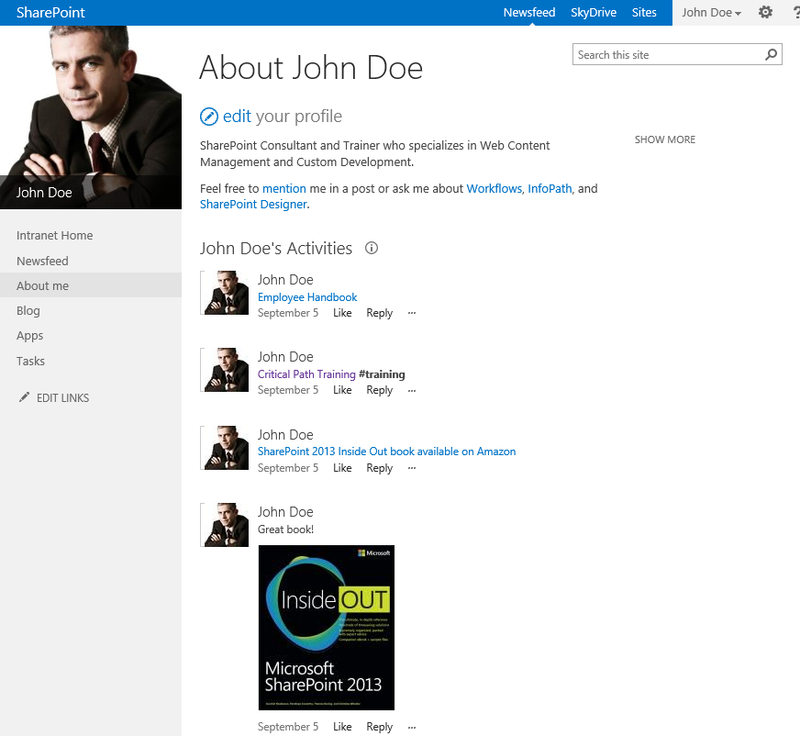
My Sites
Provides users in the organization their own personal site
Use to store personal and shared files
Promote profile and skills within the organization
List recent activities of colleagues
My Site consist of
About Me
OneDrive Pro
Newsfeed
Sites
Notes:
When My Sites are setup, each user in the organization gets their own personal site in SharePoint. This hub is where a list of activities is displayed for yourself and your colleagues. My Sites are also used to store personal and shared files as well as promote profile and skills within the organization. My Sites consists of About Me, OneDrive Pro, interactive newsfeed of activities, and Sites.
About Me
The About Me is includes text describing the person is displayed, links to mention the person in a discussion, and ask about interests with links of the person’s interests. Using these links is similar to mentioning someone on Twitter or writing on someone’s Facebook wall.
OneDrive Pro
Each My Site for a user is a personal site collection that contains a document library called Documents (referred to as OneDrive Pro). More information on OneDrive Pro will be discussed later in this lecture.
Newsfeed
Newsfeed, otherwise known as microblogging, is a new feature in SharePoint 2013 that provides the ability for users to post and interact in conversations similar to Facebook.
Sites
Sites in SharePoint 2013 provides a list of sites the user is following on their profile page. Users have the ability to follow and un-follow sites based on permissions.

Slide 6
Navigating around My Site

Slide 7
Agenda
Intro to Social
My Sites and Your Profile
SharePoint Blogs
Using Newsfeeds
Working with OneDrive Pro

Slide 8
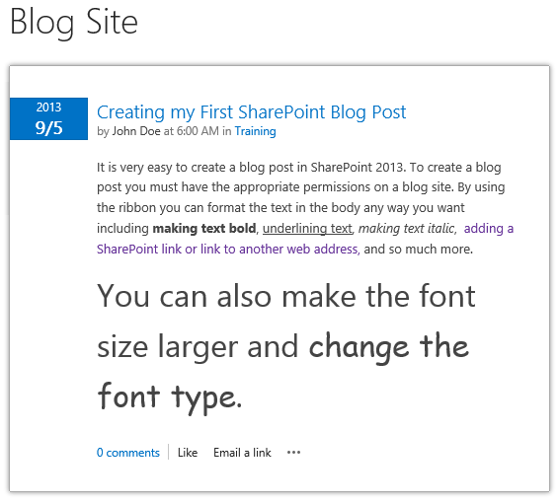
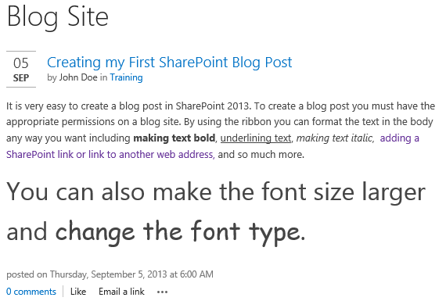
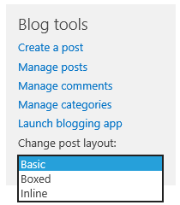
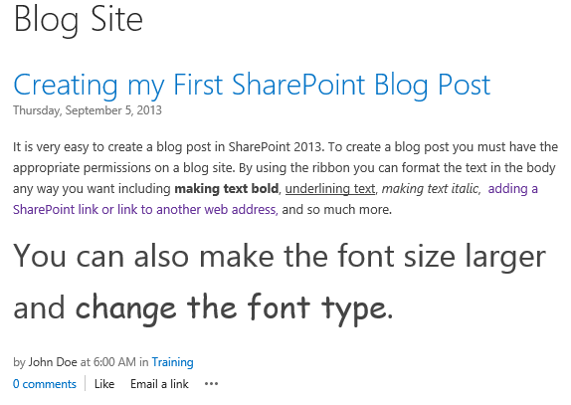
SharePoint Blogs
Improvements made to Blog features
Content approval no longer active by default
3 Blog Layouts Available
Basic
Blocked
Inline
Notes:
Blogs in SharePoint is not a new feature however there have been some improvements and enhancements in SharePoint 2013. Content approval is no longer enabled by default which means posts can be published immediately. If you decide you still want posts to be approved before being published you can enable the feature in the Content Approval Versioning Settings for the Posts library of the blog site.
Layouts in the blog site have also been improved providing three options for layout which are basic, boxed, and inline. This setting is available under the Blog Tools drop-down list for change post layout.
Companies use blogs in SharePoint to share information to the company. For example, the CEO may have a blog site to post announcements to the company. Marketing may also have a blog site to post information about events and news going on within the organization.
Permissions and other settings on blog sites can be configured similar to configuring other types of SharePoint sites. You can configure permissions for blog posts, comments, lists, and libraries associated with your blog.

Slide 9
Blog Posts

Slide 10
Agenda
Intro to Social
My Sites and Your Profile
SharePoint Blogs
Using Newsfeeds
Working with OneDrive Pro

Slide 11
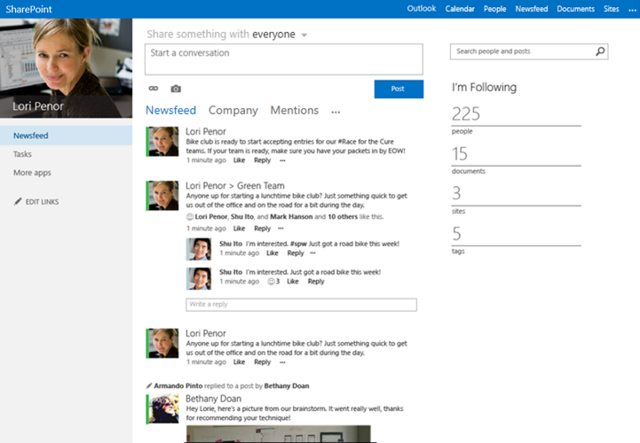
Using Newsfeeds
Newsfeeds (aka microblogging) is similar to Facebook feeds
Conversations
Start new conversations
Reply to existing conversations
“Follow” link
People – follow people to get updates about people you are following
Documents – follow documents to get updates on document changes.
Tags – follow a tag to see all newsfeed posts that contain a tag you’re following.
Notes:
Newsfeeds in SharePoint 2013 are conversations amount colleagues and activities are shown in a feed, similar to Facebook, in SharePoint. Users can follow using the “Following” view of a newsfeed and the “Everyone” view allows a newsfeed to become an organization-wide newsfeed.
New Conversations and Replying to Conversation Posts - Conversations you see in the Following view are started only by people you are currently following. Anyone who sees a conversation thread, whether they are following or not, can post a reply to a conversation post. This means you may see replies in threads created by people you are not following. This provides a way to allow you to start following someone from the conversation thread by clicking on a “Follow” link.
Activity Updates of People you’re Following - You will see updates about people you’re following if their user profiles are setup to share information. For example, when following a person you can see updates when the user starts following a document, site, tag, or other people. You will also updates about events such as birthdays and anniversary dates.
Updates about Documents you’re Following - When a document you’re following is modified, you will see an update in the newsfeed even if you are not following the person who updated the document.
Posts Containing a Tag you’re Following – You will see all newsfeed posts that contain a tag you’re following.

Slide 12
Newsfeeds

Slide 13
Agenda
Intro to Social
My Sites and Your Profile
SharePoint Blogs
Using Newsfeeds
Working with OneDrive Pro

Slide 14

Working with OneDrive Pro
Helps manage work documents and related files
Storage space
O365: each user gets 25GB of space in the cloud for OneDrive Pro
On-premise: organization’s administrators determine storage space limit
All files stored in OneDrive Pro are private unless sharing is configured
OneDrive (short for OneDrive Pro) shortcut is on header at top of SharePoint or O365 page
Notes:
OneDrive Pro is a new feature available in SharePoint 2013 and O365 that provides a place to store and share business-related files. OneDrive Pro synchronizes files to a local computer.
Storage Space
Storage space varies depending on if your organization is using O365 or SharePoint on-premise. In O365, each user gets 25GB of space in the cloud for OneDrive Pro. In SharePoint on-premise, the organization’s administrators determine how much space is available for each user.
Privacy and Sharing
All files stored in OneDrive Pro are private initially and are only viewable by you unless you decide to share the information. Sharing can be easily configured on files and folders in your OneDrive Pro library.
To use your OneDrive Pro library, select the OneDrive link located in the top header of the SharePoint or O365 page.

Slide 15
OneDrive versus OneDrive Pro
OneDrive
Free online personal storage intended for personal use
Use to save documents, photos, other files in the cloud
Share them with friends and collaborate on content
OneDrive Pro
Intended for business purposes
Managed by organization
Let’s you share and collaborate work documents with co-workers
Site collection administrators in organization control what can be done in the library
Notes:
You may be familiar with OneDrive which is another storage service Microsoft offers to store documents and other content in the cloud. The OneDrive service is different from OneDrive Pro.
OneDrive
OneDrive is a free online personal storage intended for personal use that you get from either a Microsoft account or Outlook.com. Use OneDrive to save documents, photos, and other files to the cloud. You can share your files and folders with friends and also collaborate on the content. This service is free and you decide how you want to use it. This service is not integrated with SharePoint.
OneDrive Pro
OneDrive Pro is online storage in the cloud intended for business purposes. Your OneDrive Pro is managed by your organization and allows you to share and collaborate on work documents with co-workers. Site collection administrators within your organization determines what you can do in the library.

Slide 16
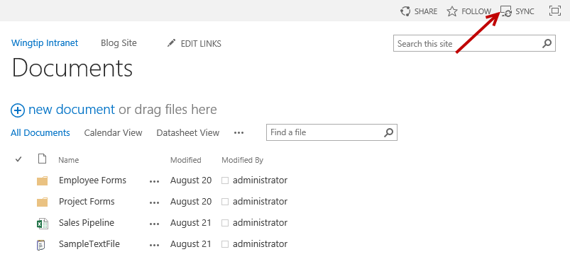
Document Library SYNC
Working with documents offline
SharePoint Workspace is no longer needed
SYNC button introduced in SharePoint 2013
SYNC button available throughout site
Allows you to sync any document library to local drive
Notes:
In the previous version of SharePoint, working with documents offline could be accomplished by using SharePoint Workspace. In SharePoint 2013, SharePoint Workspace is no longer needed nor supported due to a new SYNC feature. The SYNC button allows you to sync any document library to your local computer via OneDrive Pro. The SYNC button is located throughout the site above the search box. You can navigate to the site that contains the library you want to sync and then click on the SYNC button to start the wizard for setting up the synchronization.

Slide 17
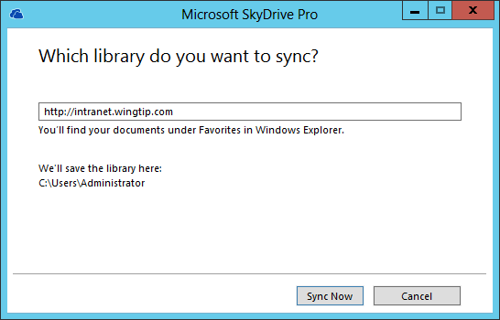
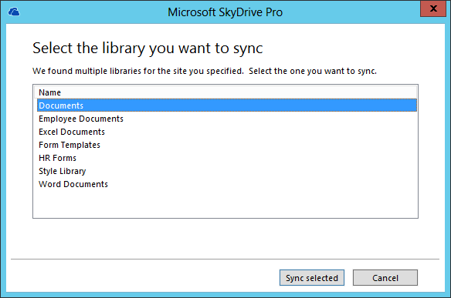
Document Library SYNC
Navigate to library you want to sync and then click on SYNC button
Once clicked, prompted with OneDrive Pro dialog
Notes:
When you want to setup a library to sync to your local computer, navigate to the site library and then click the SYNC button located above the search box. Once clicked, a OneDrive Pro dialog will popup taking you through the steps to setup the library sync. You will be prompted with “What library to you want to sync?” which will contain a pre-filled in text box containing the URL of the site you clicked the SYNC button in. After you click Sync Now, the next dialog allows you to select which library you want to sync. If you clicked on the SYNC button from the document library then the library will already be pre-selected in the list. This option can be changed during this step if there is a different library you prefer to sync.

Slide 18
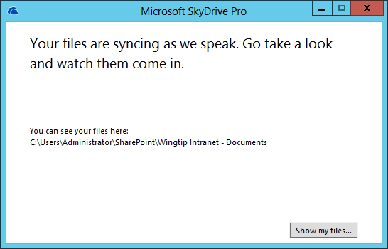
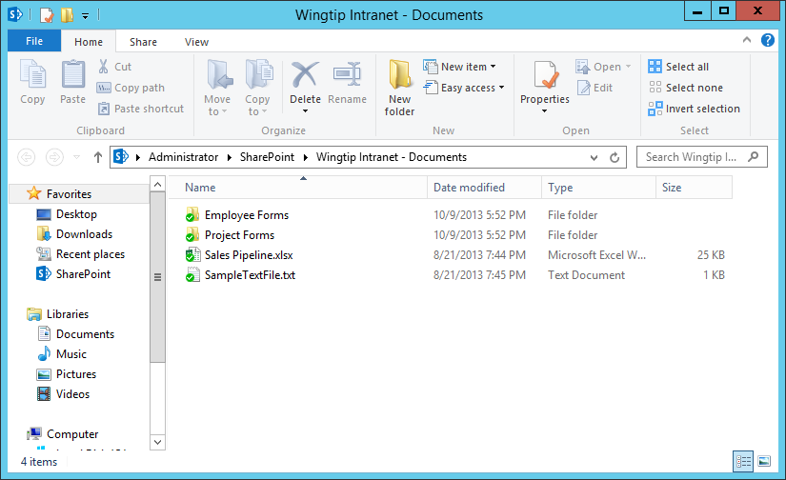

Document Library SYNC
Once the Sync setup is complete you can view your files on your local drive
Notes:
Once the sync setup is complete, the dialog will display a button “Show my files…”. When you click on the button, it will open Windows Explorer displaying the files that have been synced locally. You will notice a green checkmark icon on the files which means the files have been synced. If you make changes to any of the files, the icon will change to a sync icon when the changes are being synced and then the icon will change back to a checkmark once the syncing is complete.

Slide 19
OneDrive Pro and Syncing

Slide 20
Summary
Intro to Social
My Sites and Your Profile
SharePoint Blogs
Using Newsfeeds
Working with OneDrive Pro

