Slide 1
Workflow in SharePoint 2013
Notes:
SharePoint 2013 provides out-of-the-box support for creating workflows to automate various business processes such as document approval. In this module, students will learn about fundamental concepts in SharePoint workflow such as the role of workflow templates, workflow associations and workflow instances. Students will also learn to start workflow instances on items and documents to begin a business process such as document approval. Students will also learn to monitor and manage the lifetime of workflow instances which often involves waiting on and completing workflow tasks.

Slide 2
Agenda
SharePoint Workflows Overview
Workflow Actions, Conditions, and Shapes
Using Workflow Templates
Starting Workflows and Tasks Actions

Slide 3
SharePoint Workflow
A workflow is a series of tasks and actions to produce an outcome
Scenario – Product Approval
Write
Product
Proposal
Submit
Proposal
For
Approval
Approve
Or
Reject
If approved,
Create New
Product Plan
Notes:
Workflows in SharePoint 2013 are powered by Windows Workflow Foundation 4 which has substantially been redesigned from previous versions. Workflows conceptually model structured business models and in a business model a workflow is a process. In other words, a workflow is a series of tasks and actions to produce an outcome. In a business scenario, a workflow is a process. Workflows allow you to model and automate business processes in SharePoint.
The diagram in the slide represents a product approval workflow. In the workflow the submitter writes a product proposal then submits the proposal for approval. The proposal will then get sent to the approver where the approver will either approve or reject the proposal. If the proposal is approved a new project plan will be created.

Slide 4
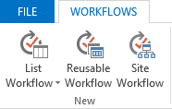
SharePoint Designer Workflow Types
List Workflows
Workflow associated with a single list
Reusable Workflows
Workflow associated to a content type
Reusable for any list or library
Site Workflows
Workflow associated with a site
Notes:
List Workflows
A list workflow is the type of workflow that was first available in SharePoint 2007. A list workflow is associated with the list in which it was created therefore list workflows are not reusable meaning they cannot be made available to other lists or libraries in the site. If you know you will only need the workflows you are designing for a specific list, the list workflow has the advantage of automatically making available the custom fields of the lists.
Reusable Workflow
A reusable workflow is a workflow which may be reused across lists or libraries within a site contained by a site collection. This type of workflow may exist at a subsite or the site collection top-level site. Reusable workflows can only be used at the site in which it was published.
Site Workflow
A site workflow is associated to a site and is not associated to a list, library, or content type. So unlike most workflows, a site workflow is not running on a specific list item. Because of this, many of the actions available for items are not available for site workflows. If you want to create a workflow and don’t need a list, library, or content type for the workflow then a site workflow will probably best meet your needs. For example, you can create a site workflow as a way for users of the site to provide feedback about your site.

Slide 5
SharePoint 2010 vs. 2013 Workflows
SharePoint 2013 support two workflow platforms
SharePoint 2010 workflows (older format)
SharePoint 2013 workflows (newer format)
Benefits to using SharePoint 2010 workflows
Migrate existing workflows from SharePoint 2010
Support out-of-box with no additional configuration
Benefits to using SharePoint 2013
More scalable - especially in SharePoint Online
Improved design experience in SharePoint Designer
Notes:
Customers creating new workflows in SharePoint 2013 are presented with two options in SharePoint Designer 2013:
SharePoint 2010 Workflow: Workflows based on the same SharePoint 2010 model using .NET Framework 3.5 SP1 WF. These execute the same way they did in SharePoint 2010 (they run within the same SharePoint processes) and cannot leverage any of the improvements outlined in the remainder of this module.
SharePoint 2013 Workflow: This option is available when SharePoint 2013 is connected to a configured instance of Workflow Manager. These workflows execute within Workflow Manager and not within the SharePoint process. They can leverage all the improvements outlined in the remainder of this module.
If the SharePoint farm has not been connected to a Workflow Manager farm, SharePoint Designer 2013 will allow the creation of SharePoint Server 2010 style workflows. These workflows will not have any of the new capabilities offered in SharePoint 2013 or Workflow Manager and will be executed within the SharePoint workflow host which was carried forward from SharePoint 2010.
When building workflows with Visual Studio 2012, developers can create SharePoint 2010 style workflows that are coded and must be deployed using farm solutions. These workflows will run within the same workflow host that was included in SharePoint 2010 and are only available for on-prem SharePoint deployments. Visual Studio 2012 also supports creating SharePoint 2013 style workflows which will be covered later in the module.

Slide 6
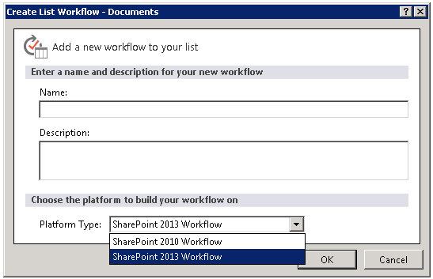
Workflow Manager in SharePoint 2013
Latest workflow technology from Microsoft
Workflow now treated as a service
Workflow Manager
Doesn’t have to run in SharePoint farm
Can still run on SharePoint WFE/App servers
SharePoint deployment drives where the workflow runs
On-Premise: Workflow Manager
Must install and configure Workflow Manager Service
Hosted: Windows Azure Workflow Service
Improves stability, scalability & transparency
Notes:
SharePoint 2013 takes a different approach to workflow. Workflows are now based on Windows Workflow Foundation 4.0 (WF), which has been redesigned from earlier versions. Workflow is now treated as a separate service and leverages Azure Workflow which includes the WF included in .NET Framework 4.0
This new architecture is available both in the on-premise model using the Azure Workflow as well as in a hosted model. This new architecture provides SharePoint benefits from improvements in stability and scalability in the workflow platform. In addition Azure Workflow is much more transparent where developers can use a service-based API to gain insight into metrics and analytics of Workflow Foundation (WF). The workflow service provided by Azure Workflow is decoupled from SharePoint and no longer runs in the content farm but instead runs on it’s own servers. Azure Workflow leverages the latest and greatest advancements in workflow capabilities, performance and scalability from Microsoft.
Existing SharePoint 2010 workflows will still run using the same legacy SharePoint 2010/.NET Framework 3.5 architecture if migrated to SharePoint 2013. Developers and users are also free to continue creating workflows using this approach although it is not recommended.

Slide 7
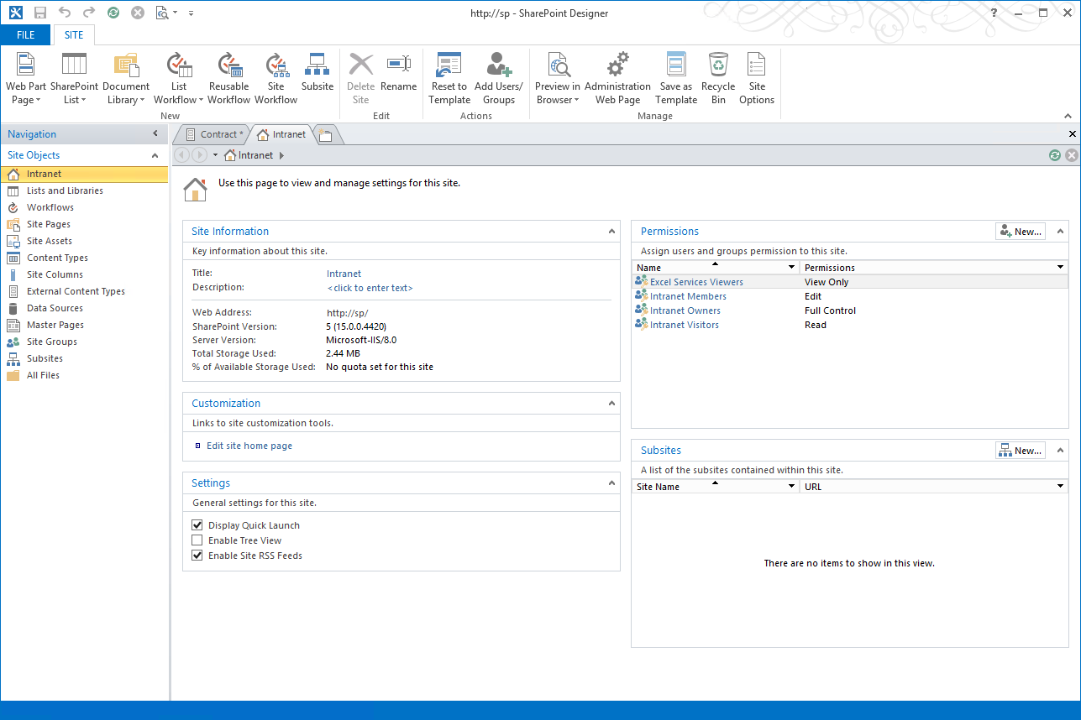
SharePoint Designer 2013
Key investments in workflow management
New workflow configuration
New 2013 workflow model with Workflow Manager
Easy and visual workflow designing
Support added for copy-paste operations
Notes:
SharePoint Designer 2010 has three views for editing HTML and ASPX pages: Code view, Design view, and Split view. In SharePoint Designer 2013, Design view and Split view have been removed. The reason Microsoft decided on this change was because of compared to current versions of Internet Explorer, Design view is an older technology that does not support many new HTML 5 and CSS tags.

Slide 8
SharePoint Designer 2013
Improved visual designer
Integrated the Visio designer into SharePoint Designer
Visio installation required for visual designer
Can switch between visual designer & text-style
Activity properties editable in visual designer
Support for Stages & Loops
Support for calling Web Services
Workflow designer supports Office operations:
cut / copy / paste / undo / redo / select-all
Improved email editor (rich formatting)
Notes:
SharePoint Designer 2013 now provides a visual workflow designer. The previous version, SharePoint Designer 2010, offered integration with Microsoft Visio 2010, so that you could design workflows visually in Visio and then import them into SharePoint Designer. Now, you can visually design your workflows by dragging, dropping, and connecting shapes directly within SharePoint Designer 2013. You can set all the properties of a workflow action in the new visual workflow designer—just select the shape and then click the action tag. Also, if you click Properties on the action tag, the property grids for conditions and actions appear in the visual designer, just as they do in the declarative workflow designer.
Loops: SharePoint Designer 2013 now provides looping. A loop is a container that you can use to group conditions and actions that you want the workflow to process repeatedly.

Slide 9
Agenda
SharePoint Workflows Overview
Workflow Actions, Conditions, and Shapes
Using Workflow Templates
Starting Workflows and Tasks Actions

Slide 10
Core Workflow Actions
Action | Description
Add a Comment | Enables ability to leave informative comments in workflow designer for reference purposes.
Add Time to Date | Adds a specific time in minutes, hours, days, or months to a date (Year not supported), and stores the output value as a variable. The date can be a current data, specific date, or a lookup. The ‘Current Date’ value returns UTC midnight.
Build Dictionary | Builds a Dictionary variable of key/value pairs.
Call HTTP Web Service | Functions as a method call to an HTTP web service and returns data using the JSON format. Basic authentication is supported through the RequestHeader.
Count Items in Dictionary | Returns a count of the number of items in a specified dictionary.
Do Calculation | Performs an arithmetic calculation and stores the output value in a variable.
Get an Item from a Dictionary | Returns a particular item from a dictionary variable.
Log to History List | Writes a message from a list of predefined message items to the workflow history list.
Pause for Duration | Causes a workflow to pause executing for a specified time interval (days, hours, minutes)
Pause Until Date | Causes a workflow to pause executing until a specified date and time.
Send an Email | Automatically sends an email message that contains a predetermined message to a user or group when a specified workflow event occurs.
Set Time Portion of Date/Time Field | Creates a timestamp, and stores the output value in a variable. You can set the time in hours and minutes and add a current date, specific date, or lookup.
Set Workflow Status | Creates a timestamp, and stores the output value in a variable. You can set the time in hours and minutes and add a current date, specific date, or lookup.
Set Workflow Variable | Sets a workflow variable to a value. Also use for workflow to assign data to a variable.
Go to Stage | Specifies the next stage to which flow control should be handed.

Slide 11
Coordination Workflow Actions
Action | Description
Start a List Workflow | Starts a List workflow based on the SharePoint 2010 Workflow platform.
Start a Site Workflow | Starts a Site workflow based on the SharePoint 2010 Workflow platform.
Both workflows have the following issues:
Assignments type field cannot be used as parameter when 2010 workflow has TaskProcess action in it
When multiple calls are made to the same 2010 workflow the result will be multiple data sources in the 2013 workflow lookup functionality
These data sources are all the same
Variable names in 2013 cannot contain special characters such as ‘?’ and ‘#’
If 2010 workflow contains special characters they will be converted to hexadecimal code in the 2013 workflow
Notes:
Coordination actions are used to invoke a workflow based on the SharePoint 2010 Workflow platform.

Slide 12
List Workflow Actions
Action | Description
Check in Item | Checks in an item that is checked out. You can check in items only from a document library. The workflow crashes if you try to check in an item that is not checked out.
Check Out Item | Checks out an item. The workflow verifies if item is checked in before it checks out a document. You can check out items only from a library in your site. The workflow crashes if you try to check out an item that is not checked in.
Copy Document | Copies a document from the current list to a different Document Library list.
Create List Item | Creates a new list item in the list specified. You can supply the fields and values in the new item. You can use this action to create a new item with specific information.
Delete Item | Deletes an item. This action is terminated on the computer running the Workflow Manager workflow engine and throws a System.InvalidOperationException exception. There is no workaround.
Discard Check Out Item | Discards the changes and checks the item back in if an item is checked out and changes have been made to it. The workflow crashes if you try to check in an item that is not checked out.
Set Field in Current Item | Sets a specified field in the current item to a specified value. If you need the workflow to pause until the value of the field has changed, use the Wait for Event in List Item action instead of this action.
Translate Document | Translates a document into a particular language. Requires a preconfigured Machine Translation Service Application.
Update List Item | Updates a list item. You can specify the fields and the new values in those fields.
Wait for Event in List Item | Enhanced version of Office 2010 action. Pauses current instance of workflow to await specified list item event. This action listens for two events: ItemUpdated and ItemAdded.
Wait for Field Change in Current Item | Waits for a field on the current item to equal a particular value.

Slide 13
Project Workflow Actions
Project actions support the integration of Microsoft Project
Used to build Project-based workflows
All Project actions are new in SPD 2013
Action | Description
Create Project from Current Item | Takes the current item and creates a new project in the SharePoint farm PWA site.
Set Project Field | Sets a value for a particular field on Project Server. This action requires the project to be checked in first. If the project is not checked in, the workflow will be terminated and users cannot open that project in Project Web App.
Set Project Stage Status | Sets the status of the Project Stage. An exception occurs when a current project is checked out.
Set status field in idea list | Updates the status on the original list item that is associated to the current project.
Wait for Project Event | Waits for a particular Project Event.

Slide 14
Task Workflow Actions
Task actions provide ability to:
Invoke a workflow based on SharePoint 2010 Workflow platform from within a workflow based on SharePoint 2013 Workflow platform
Action | Description
Assign a Task | Assigns a workflow task to a user and establishes a due date for completion of the task.
Start a Task Process | Creates tasks on multiple users and enables the tasks to be taken through a customized process.

Slide 15
Utility Workflow Actions
Actions that manipulate strings or find the interval between dates
Action | Description
Extract Substring from End of String | Copies specified number of characters starting from end of a string and stores output in a variable.
Extract Substring from Index of String | Copies substring starting at specified index in string and places value in a variable. The index value in Microsoft SharePoint Designer 2013 is zero-based, values in SharePoint Designer 2010 were indexed starting at 1.
Extract Substring from Start of String | Copies specified number of characters beginning at start of string and stores output in a variable.
Extract Substring of String from Index with Length | Copies out a substring comprising a specified number of characters, starting at a specified index in string and places value in a variable. The index value in Microsoft SharePoint Designer 2013 is zero-based, values in SharePoint Designer 2010 were indexed starting at 1.
Find Interval Between Dates | Calculates the time interval in minutes, hours, or days between two dates and stores the output in a variable.
Trim String | Removes white spaces from the beginning and end of a string.
Find Substring in String | Finds a particular substring inside of a string and returns the index of the substrings’s starting position.
Replace Substring in String | Replaces a particular substring with another substring.
Trim String | Removes white spaces from the beginning and end of a string.

Slide 16
Deprecated Actions in SharePoint 2013
Some of the SharePoint workflow actions are deprecated in SharePoint 2013
SharePoint Workflow Interop
Enables SharePoint 2010 workflows to work with the SharePoint 2013 workflow engine
Deprecated actions become available in SharePoint 2013 using the workflow interop bridge
Use workflow Interop in Visual Studio 2012 workflow designer (developer role)
Use if needed to reuse legacy SharePoint 2010 workflows in your SharePoint 2013 environment
Notes:
Workflow Actions deprecated but available through interop bridge:
Add List Item Permissions
Assign a Form to a Group
Assign a To-do Item
Capture a version of the Document Set
Collect Data from a User
Copy List Item
Declare Record
Inherit List Item Parent Permissions
Lookup Manager of a User
Remove List Item Permissions
Replace List Item Permissions
Send Document Set to Repository
Set Content Approval Status
Set Content Approval Status for the Document Set
Set Workflow Status
Start Approval Process
Start Custom Task Process
Start Document Set Approval Process
Start Feedback Process
Undeclare Record
Conditions
If current item field equals value
Check list item permission levels
Check list item permissions
Blocks
Impersonation block

Slide 17
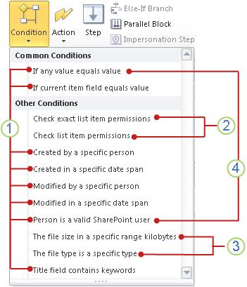
Workflow Conditions
Use workflow conditions when creating SharePoint 2010 workflow in SharePoint 2013
Notes:
Everything marked as item 1 are general conditions in SharePoint Designer 2013.
Check exact list item permissions and Check list item permissions is only available inside an impersonation step.
The file size is a specific range kilobytes and The file type is a specific type are available only in a workflow associated with the Document content type, a child of the Document content type, or a library.
If any value equals value and Person is a valid SharePoint user conditions are only available when you create a site workflow.

Slide 18
SharePoint Designer Workflows

Slide 19
Agenda
SharePoint Workflows Overview
Workflow Actions, Conditions, and Shapes
Using Workflow Templates
Starting Workflows on Items and Documents
Responding to Workflow Tasks

Slide 20
Using Workflow Templates
Workflow templates are available in Visio 2013
Action Shapes
Includes actions such as Assign a Task, Add a Comment, Create List Item, Do Calculation
Condition Shapes
Compare too values, check user memberships, skip project stage
Terminator Shapes
Start/End, Stage, Step, Stage, Loop n Times, Loop with Condition, Start/Stop Parallel Action (Parallel Block)
Notes:
Visio 2013 includes the new Microsoft SharePoint 2013 Workflow template and still includes SharePoint 2010 workflows. When creating a workflow in Visio 2013 instead of a blank canvas, every new workflow starts with an empty container know as a “stage”. Each stage contains all of the actions which make up the logical section of the workflow. Simple workflows might only be single stage while complex workflows could have many stages. Within stages, "step" containers allow you to further organize actions. All actions must be within a stage however decision shapes can determine the flow both within and between stages.

Slide 21
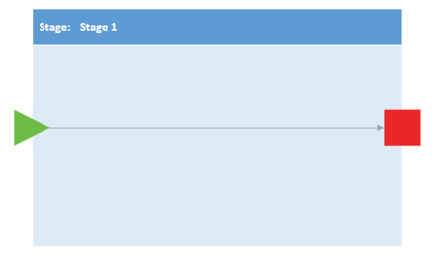
Terminator Shapes - Stage
Container used to contain any number of shapes and actions
SharePoint 2013 Workflow template has a Start, Enter and Exit shape
Notes:
A stage is a container used to contain any number of shapes and actions. The SharePoint 2013 Workflow template has a Start, Enter, and Exit shape.
Stage Rules
Workflow must have at least one stage. Explicit Start shape required outside stage for entire diagram and explicit Terminate shape outside of stage is NOT required.
Stage containers cannot be nested. You can use other containers within stage to nest (such as a step).
Stop Workflow shapes may exist within stage.
At top level, workflow can contain only stages, conditional shapes, and Start and Terminate terminators. All other shapes must be contained within a stage.

Slide 22
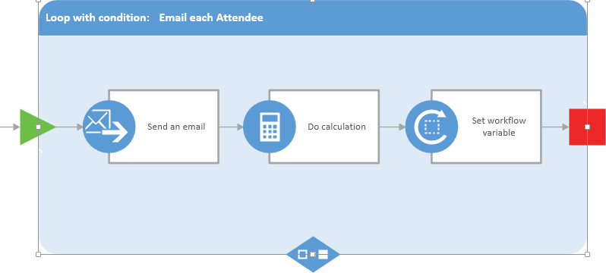
Terminator Shapes - Loop
Series of connected shapes that execute as a single unit within a loop container
Two types supported
Loop n times and loop with condition
Notes:
Loops are a series of connected shapes that will execute as a single unit within a loop container. Like stages, loops are a container shape with an Enter and Exit shape. A loop shape also requires that an Enter and Exit shape be added to the edges of the container to define the paths in and out of the loop. Workflows in SharePoint Server 2013 support two types of loops: loop n times and loop with condition.
Loop Rules
Loops must be within a stage.
Steps may be within a loop.
Loops can only have one entry and one exit point.

Slide 23
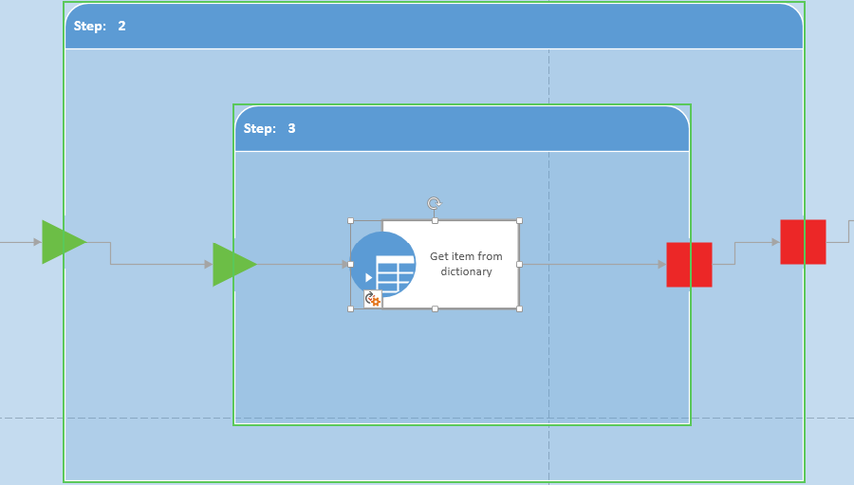
Terminator Shapes - Step
Represent a group of sequential actions to be performed as a single unit
Notes:
A step represents a group of sequential actions to be performed as a single unit.
Step Rules
Steps must be within a stage.
Steps may be within a loop.
Steps can only have one entry and one exit point.
Steps can contain steps.

Slide 24
Workflow Templates

Slide 25
Agenda
SharePoint Workflows Overview
Workflow Actions, Conditions, and Shapes
Using Workflow Templates
Starting Workflows and Tasks Actions

Slide 26
Starting Workflows
Manual Workflows
Can be started on a document or item
Options available depend on how the workflow was designed
Permissions required
Edit permission to start workflow
Some workflows may require Manage List permissions
Auto-start Workflows
Can be configured to start automatically when an item is added or edited
Notes:
After a workflow is added to a list, library, or content type and made available for use, you can manually start the workflow on a document or item. The workflow must be configured to allow it to be started manually. To start a workflow, you select the workflow you want from the list of workflows available for the document or item. If necessary, you may also need to fill out a form with the information the workflow requires. Depending on how the workflow was designed and configured, you may have the option to further customize the workflow when you start it on a document or item. This can include customizing such options as participants, due date, and task instructions.
To manually start a workflow you must at least have the Edit Items permission to start a workflow. Some workflows may require you to also have the Manage Lists permission or another specific permission to start a workflow on a document or item.

Slide 27
Workflow Task Actions
A task in SharePoint Server 2013 is used to assign work to a person or group and then track the progress of that work over time
Two workflow actions in SharePoint Designer 2013 designed for working with tasks
Assign a task
Used to create task and assign it to a single participant
Start a task process
Used to assign task to multiple participants
Task Actions are accessed in Action drop-down menu of SharePoint Designer 2013 ribbon

Slide 28
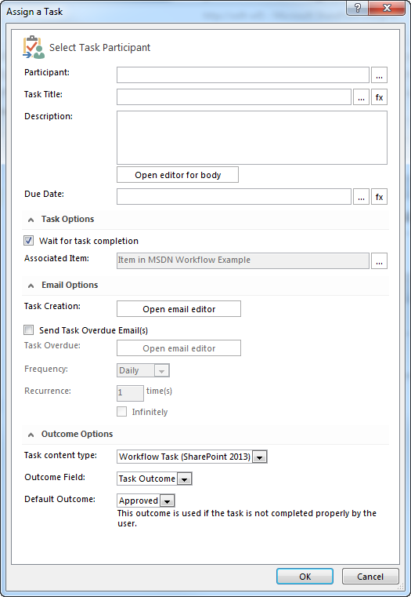
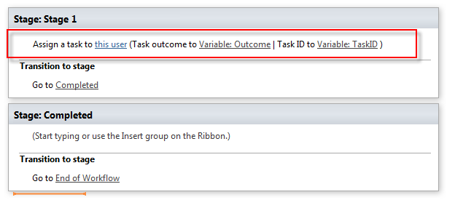
Assign a Task

Slide 29
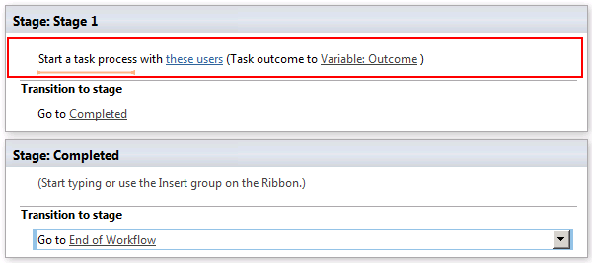
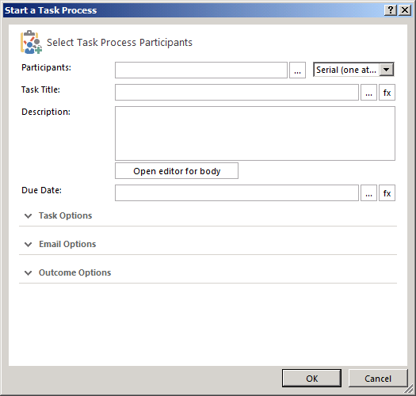
Start a Task

Slide 30
Starting Workflows & Task Actions

Slide 31
Summary
SharePoint Workflows Overview
Workflow Actions, Conditions, and Shapes
Using Workflow Templates
Starting Workflows and Tasks Actions

