Slide 2
SharePoint App best practices using OData and the SharePoint REST API
Ted Pattison
Instructor/Author
Critical Path Training

Slide 3
Agenda
REST and OData Primer
Consuming OData Services
The SharePoint REST API
Querying SharePoint Objects
HTML Slinging with OData Results
Updating SharePoint Objects

Slide 4
REST and OData Primer

Slide 5
Are You Getting Enough REST?
In the beginning there was SOAP
XML-based protocol for executing web service operations
SOAP = Simple Object Access Protocol
SOAP makes simple things more complicated than they could be
Acronym status of SOAP revoked in 2003
REST is simpler and much easier to use
REST = REpresentational State Transfer
Simple approach based on HTTP request/response pairs
HTTP requests target specific resources using unique URIs
Resources move back and forth using representations
Representations of resources defined using Internet Media Types

Slide 6
RESTful Web Services
RESTful Web Service
implemented using the principles of REST
REST URI = [base URI] + [resource path] + [query options]
Calls based on standard HTTP verbs (GET, POST, PUT, DELETE)
Passes data to and from client using representations
Can be designed to implement custom APIs and/or standard APIs
Data passed across network using representations
Representations model resources – but they’re different
Based on common formats: HTML, XML, ATOM and JSON
Based on specific Internet media types

Slide 7

Internet Media Types
Internet media type defines format of representation
Commonly referred to as Content Types
Previous known as MIME types
Examples of common Internet media types
text/html
text/xml
application/xml
application/atom+xml
application/json
HTTP headers used to indicate Internet Media Type
ACCEPT request header indicates what client wants in response
Content-Type header indicates type of request/response body

Slide 8
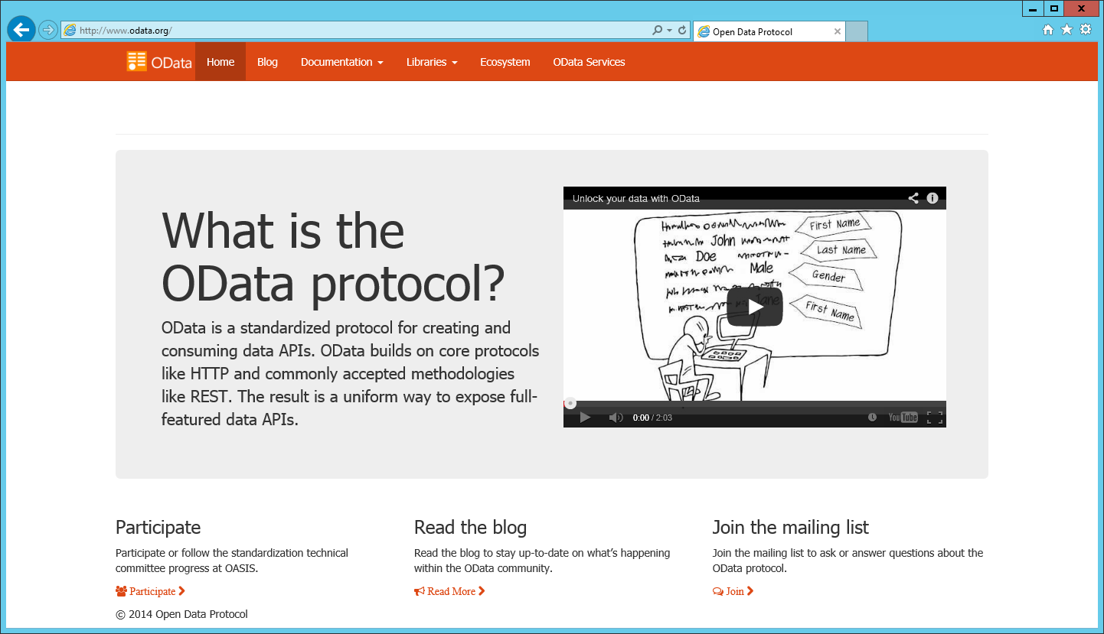
OData Primer
What is OData?
A standardized REST API interface for common CRUD operations
Defined by Open Data Protocol specification
http://www.odata.org/ is a great resource – get to know it!

Slide 9
HTTP Methods used with OData
GET
Returns an items or an array of items
POST
Creates a new item
PUT
Updates an item (delete operation followed by updated)
PATCH or MERGE
Updates an item in-place – existing column values can be retained
DELETE
Deletes an item

Slide 10
OData URIs
URI has three significant parts
Service root URI
Resource path
Query string options
Service Root URI
Resource Path to a SharePoint Object
Query String Options

Slide 11
OData Query Option Parameters
$select
Selecting which columns to retrieve
$filter
Selecting what items to retrieve (i.e. where clause)
$orderby
Selecting the sequence in which items will be returned
$expand
Selecting to retrieve results that are usually deferred
$top
Selecting how many items to return
$skip
Selecting which row to start at

Slide 12
SharePoint REST API Headers
Accept
Tells ODATA service how to format returned results
Content-type
Tells ODATA service what type of content is in request body
X-HTTP-METHOD
Tells ODATA service which operation to perform
X-RequestDigest
Passes encrypted security value to ODATA service required for updates
IF-MATCH
Passes ETag value to ODATA service to control optimistic concurrency

Slide 13
Consuming OData Services

Slide 14
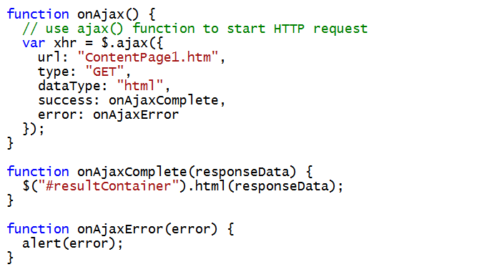
AJAX Calls Across the Network
jQuery provides $.ajax() function
Calls to $.ajax() function are asynchronously
Callback methods can be used to process returned data

Slide 15
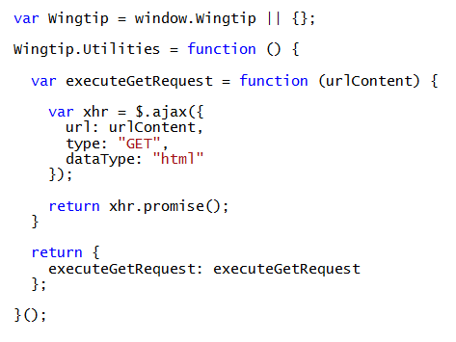
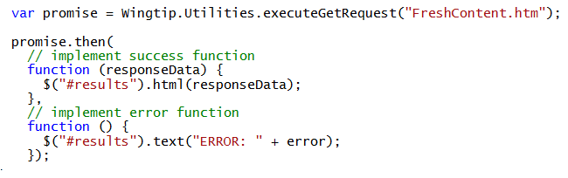
Promises and Deferred Objects
jQuery provides support for async programming
Promise object (e.g. xhr) represents work in progress
When work is done, promise object notifies deferred objects
Promises provide more flexibility than using simple callbacks
Reusable code in Wingtip.Utilities Module
Consumer code in app which uses Wingtip.Utilities module

Slide 16
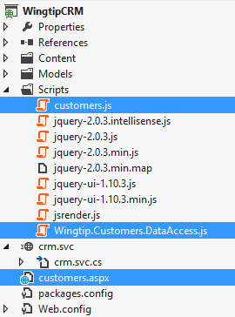
Creating A Reusable Data Access Library
Data access code is kept separate from view
Data access code returns promise to view code
View code encapsulated from details of data access
View code responsible for updating user interface when required
View code
Data access code

Slide 17
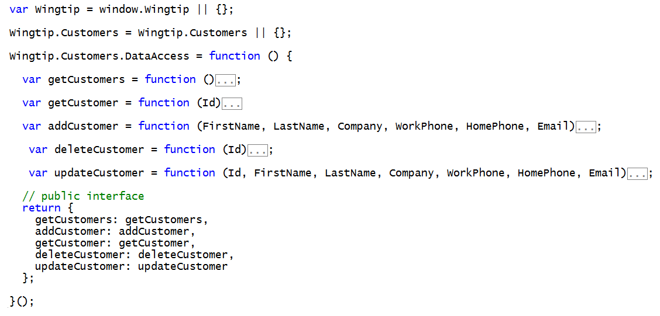
Data Access Library Starting Point
Wingtip.Customers.DataAccess.js

Slide 18
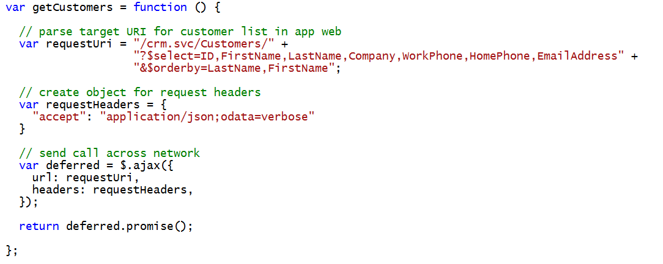
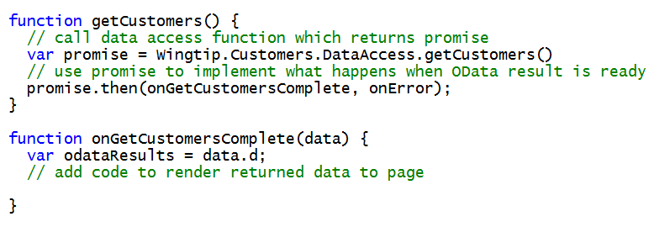
Querying Data from an OData Data Source
Wingtip.Customers.DataAccess.js
customers.js

Slide 19
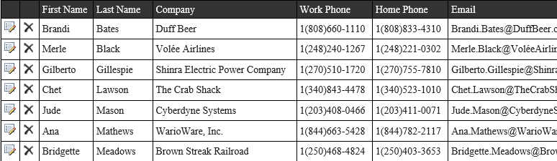
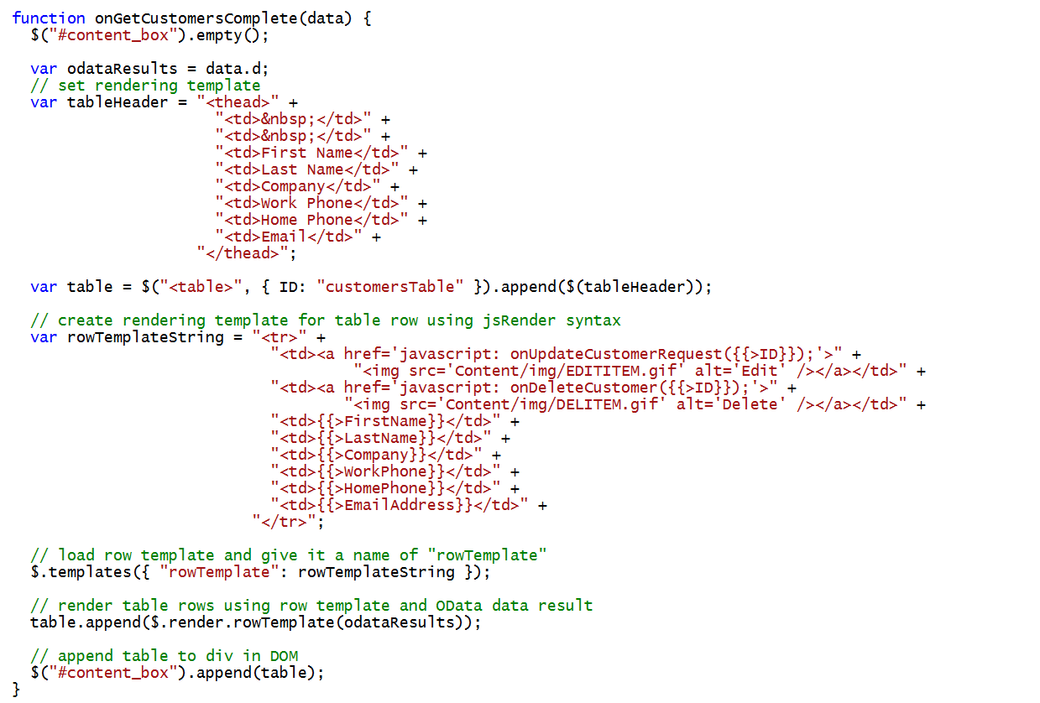
Generating an HTML Table using jsRender
customers.js

Slide 20
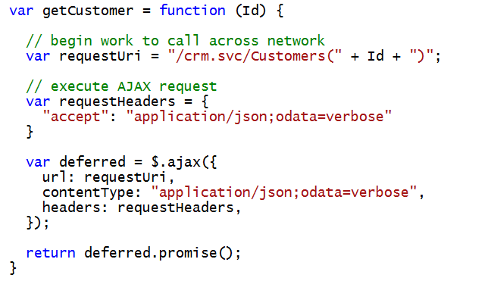
Reading a Single Item
Wingtip.Customers.DataAccess.js

Slide 21
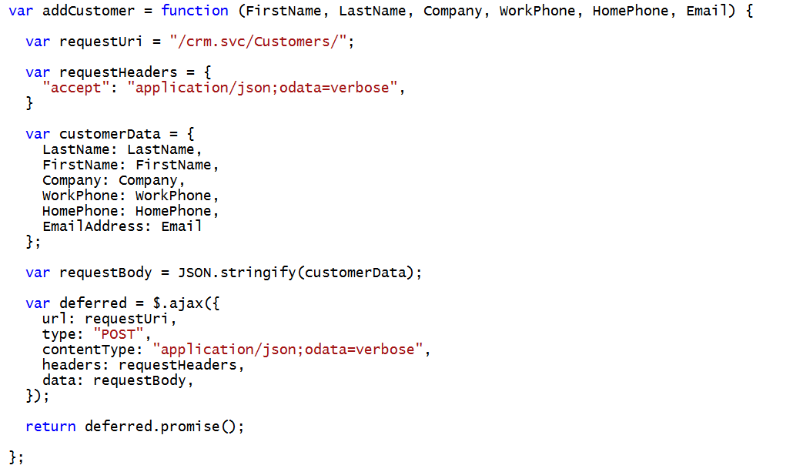
Adding an Item
Wingtip.Customers.DataAccess.js

Slide 22
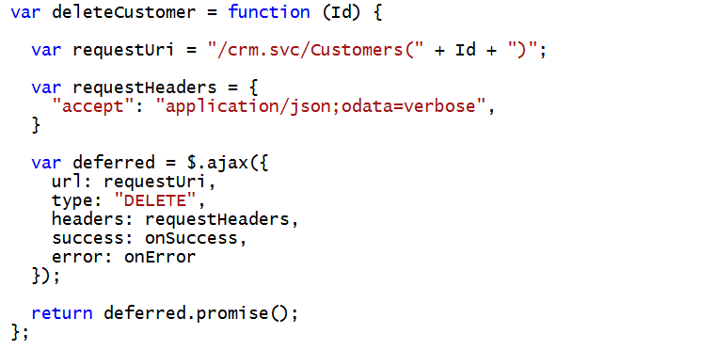
Deleting an Item
Wingtip.Customers.DataAccess.js

Slide 23
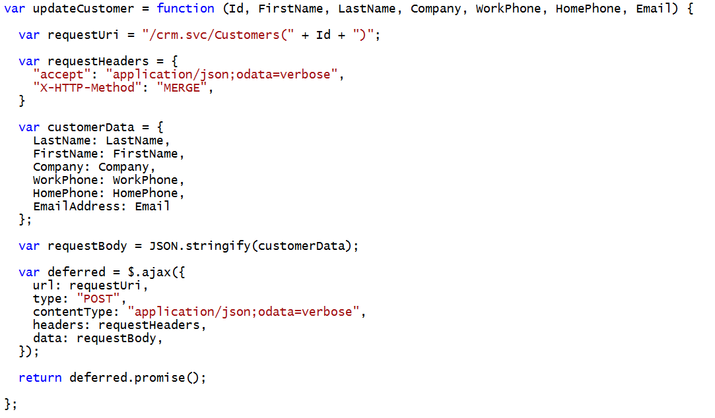
Updating an Item
Wingtip.Customers.DataAccess.js

Slide 24
Exploring the Client-side Code in the WingtipCRM project
Ted Pattison

Slide 25
Implementing an OData Service to Wrap a SQL Server Database
Ted Pattison

Slide 26
The SharePoint REST API

Slide 27
What’s Different About SharePoint OData?
SharePoint 2013 uses OData v2 not OData v3
Arrays returned as data.d.results not data.d
You must include item type metadata for inserts and updates
Sometimes you must pass ETags for updates and deletes
All write operations must pass valid request digest value
SharePoint 2013 rejects any update request that does not have a valid form digest value

Slide 28
Finding the Service Root of the App Web
Easy to create URIs to AppWeb

Slide 29
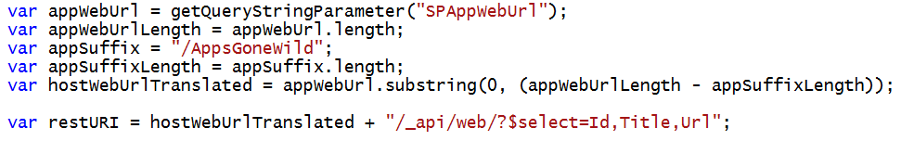
Finding the Service Root of the Host Web
Will it ever work?
Will it work when host web is not at top of domain
Will it ever work when app installed at tenancy scope
No
No
No
Yes
No
No
Yes
Yes
No
Yes
Yes
No
Yes
Yes
Yes

Slide 30
Reliable URIs for the SharePoint REST Calls
For the app web
For the host web

Slide 31
Querying SharePoint Objects

Slide 32
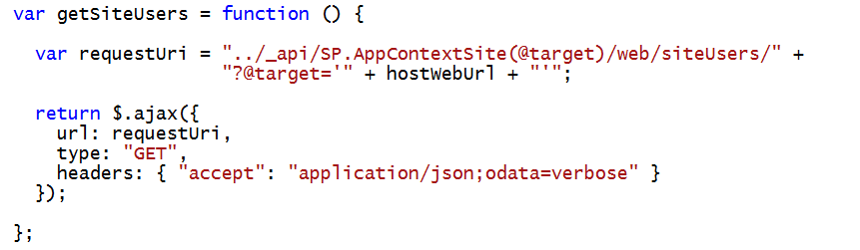
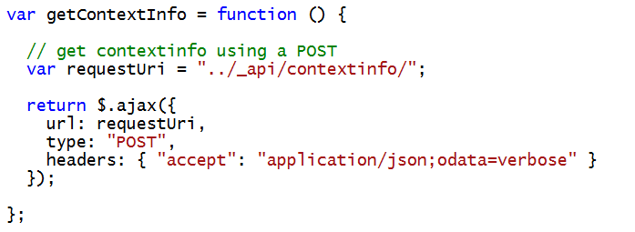
aa
a

Slide 33
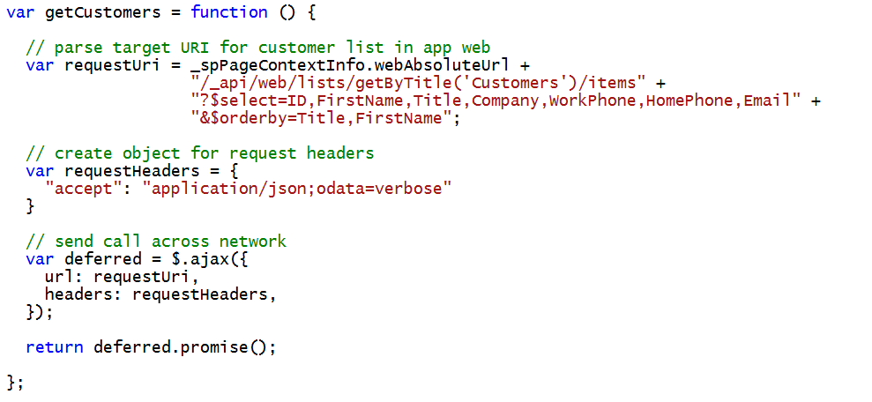
Querying a SharePoint List
You must construct URL to target list items
/_api/web/lists/getByTitle(‘Customers’)/items

Slide 34
Using the $filter Parameter

Slide 35
$filter Parameter String Functions

Slide 36
Other $filter Parameter Functions

Slide 37
HTML Slinging with OData Results

Slide 38
Slingin’ HTML

Slide 39
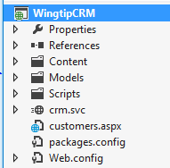
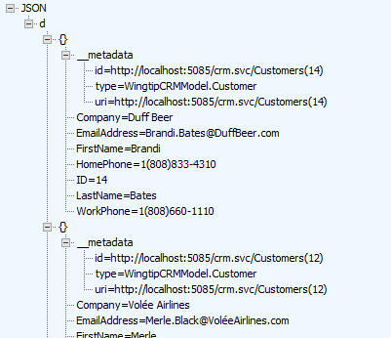
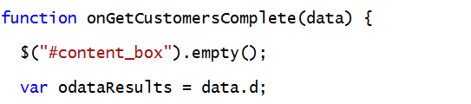
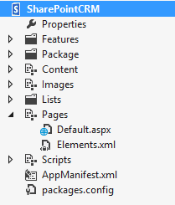
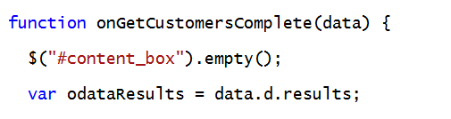
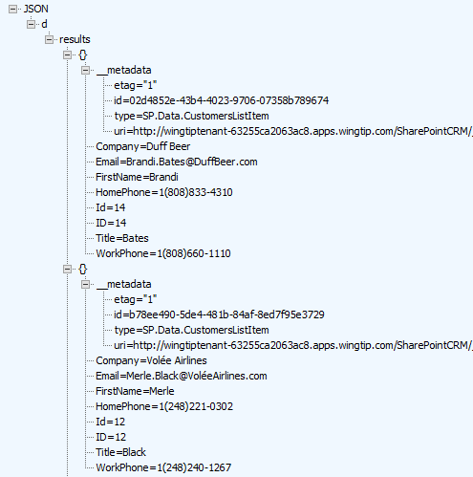
Dealing with OData Results
OData v3 multi-item results returned as data.d
OData v2 multi-item results returned as data.d.results

Slide 40
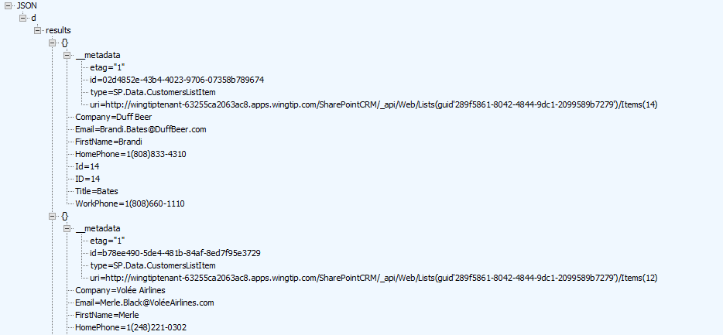
SharePoint-specific OData Results
Standard v3 OData Results
v2 OData Results with SharePoint 2013

Slide 41
Updating SharePoint Objects

Slide 42
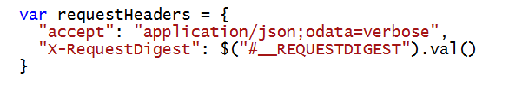
Understanding the Request Digest
All SharePoint write operations require Request Digest
Provides security mechanism to protect again replay attacks
Request digest known to SharePoint old timers as “Form Digest”
SharePoint adds request digest element with ID __REQUESTDIGEST
Request digest value passed using X-RequestDigest header

Slide 43
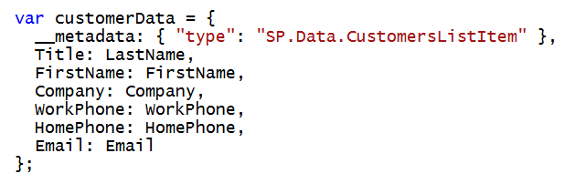
Working with List Item Type Metadata
Each SharePoint list has a unique type for its list items
String-based type value must be passed with all inserts and updates
Type can be discovered using list’s ListItemEntityTypeFullName property

Slide 44
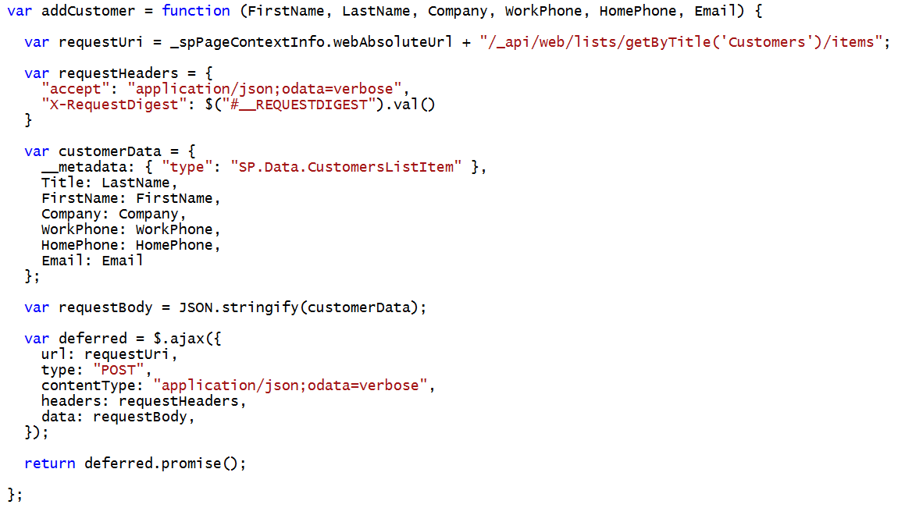
Adding a SharePoint List Item

Slide 45
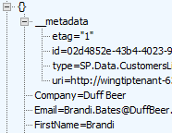

ETags and Optimistic Concurrency
OData v2 requires items to carry ETags
ETag is integer value in that it identities version of item
ETag is automatically incremented with each update
ETag use to support for optimistic concurrency control
ETag works to eliminate the “lost update” scenario
ETag must be tracked in order to post updates in most scenarios

Slide 46
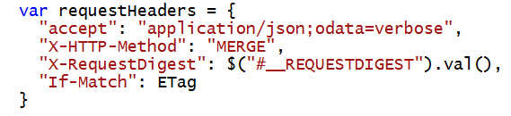
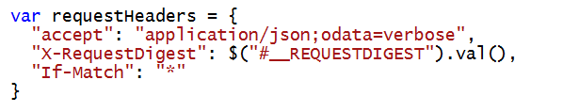
ETags and the If-Match Header
Update and Delete operations require If-Match Header
Allows you to pass ETag value during an update
Update fails if ETag value changed due to update by other user
You can pass wildcard (*) value inside If-Match Header
Done to disable optimistic concurrency control
This is commonly done with delete operations

Slide 47
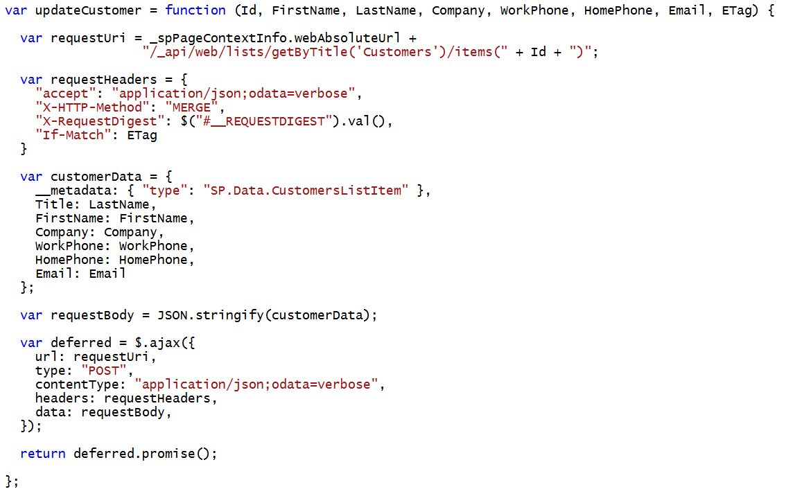
Updating a SharePoint List Item

Slide 48
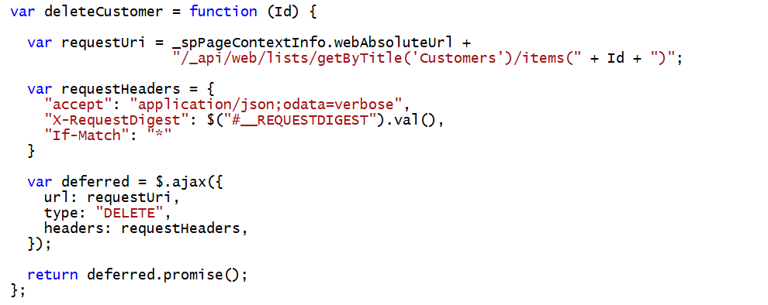
Deleting a SharePoint List Item

Slide 49
Exploring the SharePointCRM App
Ted Pattison

Slide 50
Summary
REST and OData Primer
Consuming OData Services
The SharePoint REST API
Querying SharePoint Objects
HTML Slinging with OData Results
Updating SharePoint Objects

Slide 51

© 2014 Microsoft Corporation. All rights reserved. Microsoft, Windows, and other product names are or may be registered trademarks and/or trademarks in the U.S. and/or other countries.
The information herein is for informational purposes only and represents the current view of Microsoft Corporation as of the date of this presentation. Because Microsoft must respond to changing market conditions, it should not be interpreted to be a commitment on the part of Microsoft, and Microsoft cannot guarantee the accuracy of any information provided after the date of this presentation. MICROSOFT MAKES NO WARRANTIES, EXPRESS, IMPLIED OR STATUTORY, AS TO THE INFORMATION IN THIS PRESENTATION.

