Slide 2
Deep dive: SharePoint and Office App Security Model (OAuth & S2S)
Ted Pattison
Instructor/Author
Critical Path Training

Slide 3
Agenda
App Security Overview
Configuring App Permissions
Understanding App Security Principals
Server-to-Server (S2S) Trust Configuration
Programming with Access Tokens

Slide 4
Let’s start with a basic question
What is a security principal?
An entity that is understood by a security system
An entity for which you can configure authorized access to resources
Examples of security principals
User with an account in Active Directory
User with account in another identity management system (FBA)
Active Directory group or an FBA role
Computer which has been added to an Active Directory domain
SharePoint app (as of SharePoint 2013)

Slide 5
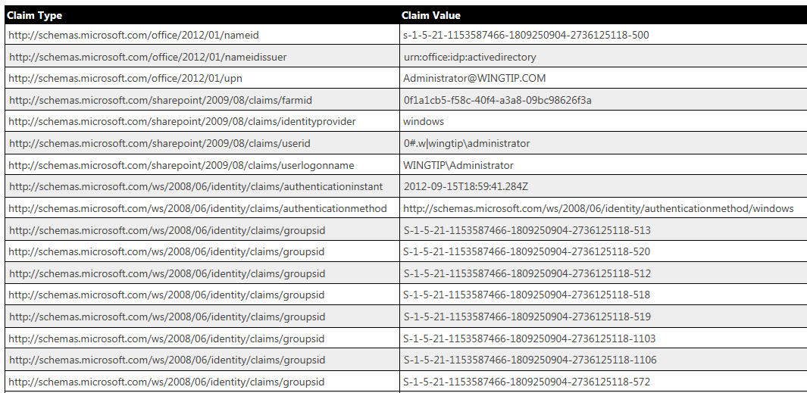
User Authentication in SharePoint 2013
SharePoint user authentication based on claims
Works in SharePoint 2013 just as it does in SharePoint 2010
User authentication results in creation of a claims token
Claims token tracks name value pairs related to token subject
Claims token stored in memory using FEDAUTH token format

Slide 6
Security Problems in SharePoint 2010
Code in farm solutions considered fully-trusted
By default, code runs with permissions of current user
Developer can call SPSecurity.RunWithElevatedPrivledges
Code runs as all-powerful SHAREPOINT\SYSTEM account
Code reverts to Windows identity of host application pool
Sandbox solution code runs as current user
Code always runs with permissions of current user
Activation code runs as site administrator
No ability to elevate permissions if user is visitor

Slide 7
App Authentication in SharePoint 2013
SharePoint 2013 supports App Authentication
Apps promoted to first class security principals
App authentication makes it possible for app authorization
App authentication only supported in CSOM / REST API endpoints
App authentication not supported in custom web services
SharePoint 2013 uses 3 basic types of app authentication
Internal authentication
External authentication using Server-to-Server (S2S) Trusts
External authentication using OAuth

Slide 8
Internal Authentication
Internal authentication is used if the following are true
Incoming call targets a CSOM or REST API endpoint
Incoming call carries claims token with established user identity
Incoming call targets URL of an exiting app web
Important points about using internal authentication
It just works – no need to program in terms of access tokens
It’s always used with client-side calls from pages in the app web
It can be used from remote web pages using cross domain library
It does not support app-only authentication to elevate privledge

Slide 9
External Authentication
In which scenarios does external authentication occur?
When server-side code in the remote web issues CSOM or REST API calls against the SharePoint host
Incoming calls free to target host web and other sites in tenancy
How does it work?
App code must written to create and manage access tokens
Access token carries app identity
Access token can (and usually does) carry user identity as well
App must transmit access token when calling to SharePoint

Slide 10
SharePoint 2013 Authentication Flow

Slide 11
Agenda
App Security Overview
Configuring App Permissions
Understanding App Security Principals
Server-to-Server (S2S) Trust Configuration
Programming with Access Tokens

Slide 12
App Permissions
App are granted permissions
App permissions are different from user permissions
App permissions are granted all-or-nothing
App permissions have no permissions hierarchy this is different than user permissions which have a hierarchy inside a site collection
An app has default permissions
App has full control over app web
App has access to incoming query string parameters
App has no default access to host web
App must include permission request in application manifest
Installer must grant or deny permissions during installation
If installer denies permissions, SharePoint cancels install

Slide 13
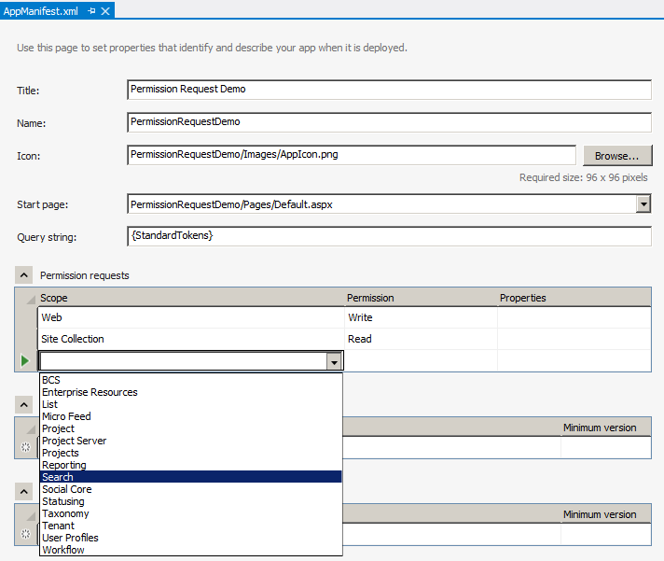
Adding Permission Requests
Permissions requests are added to app manifest
App manifest designer makes this relatively easy
<AppPermissionRequests>
<AppPermissionRequest
Scope="http://sharepoint/content/sitecollection/web"
Right="Write" />
<AppPermissionRequest
Scope="http://sharepoint/content/sitecollection"
Right="Read" />
</AppPermissionRequests>

Slide 14
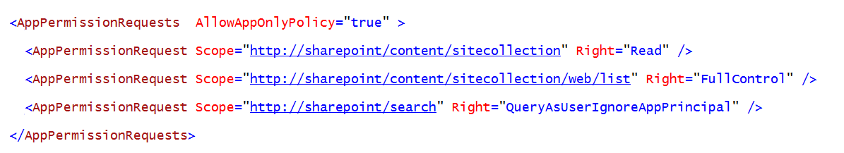
App-Only Permissions
Used for two key scenarios
To call into SharePoint with permissions greater than the current user (elevation)
To call in to SharePoint when there is no current user
Steps to accomplish this
Add AllowAppOnlyPolicy to AppManifest.xml
Write code to acquire an app only access token

Slide 15
Permission Requests
App Permission Scope Defines
Product
Permission Provider
Target object - where grant is requested
<AppPermissionRequest Scope="http://sharepoint/content/sitecollection" Right="Read" />
Product
Permission
Provider
Target
Object
Capability

Slide 16
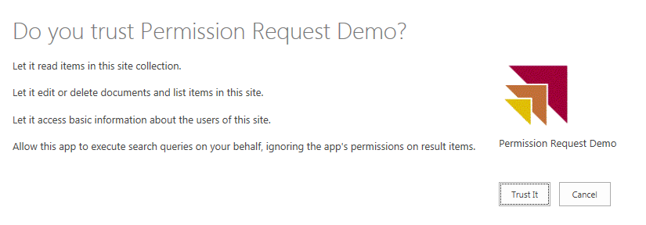
Granting Consent in SharePoint 2013
User prompted to trust the app during installation
Trust It grants requested permissions to app
Cancel prevents app from being installed

Slide 17
Adding Permissions Request to the App Manifest
Ted Pattison

Slide 18
Agenda
App Security Overview
Configuring App Permissions
Understanding App Security Principals
Server-to-Server (S2S) Trust Configuration
Programming with Access Tokens

Slide 19
App Principals
External authentication requires app principals
App principal is a tenancy-scoped account for app identity
App principal identified using a GUID
App principals must be created in SharePoint host
App principal properties
Client ID: GUID-based identifier for app principal
Client Secret: (not used in S2S)
App Host Domain: Base URL of remote web
Redirect URL: URL to a page used to configure on-the-fly security

Slide 20
Managing App Principals in Office 365
Get to know the built-in app management pages
AppRegNew.aspx
AppInv.com
AppPrincipals.aspx
There is also management support using PowerShell
Use PowerShell cmdlets to administer SharePoint apps and app principals

Slide 21
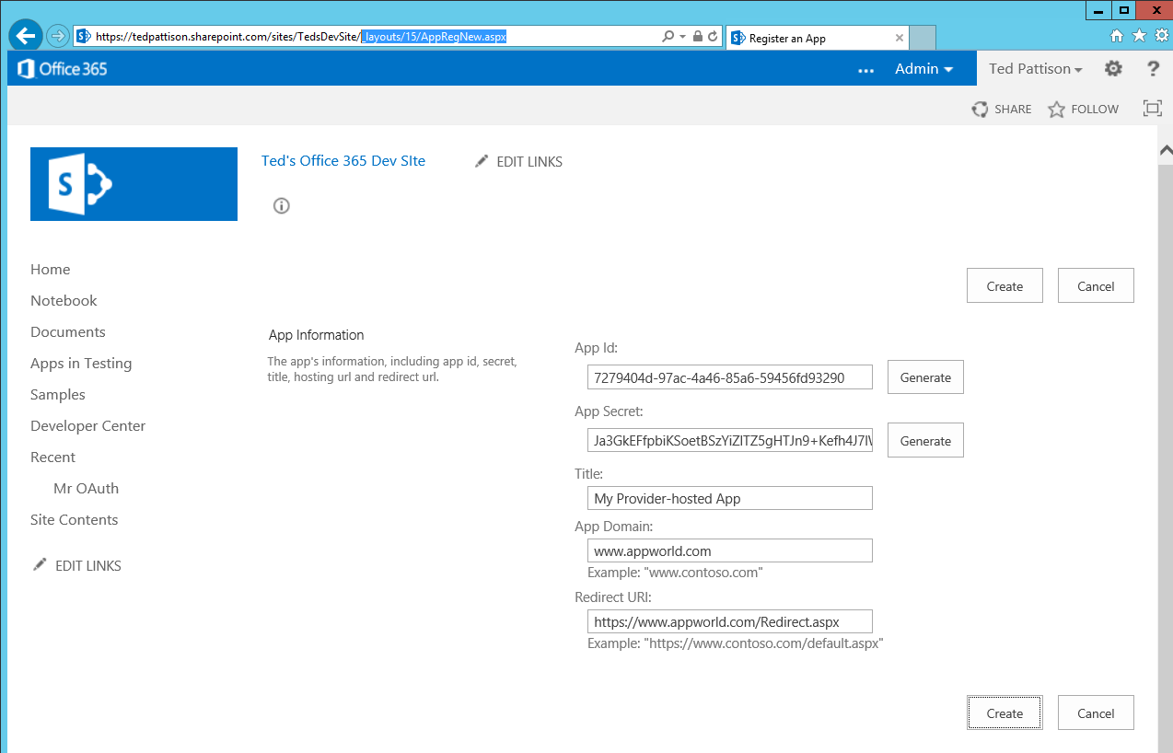
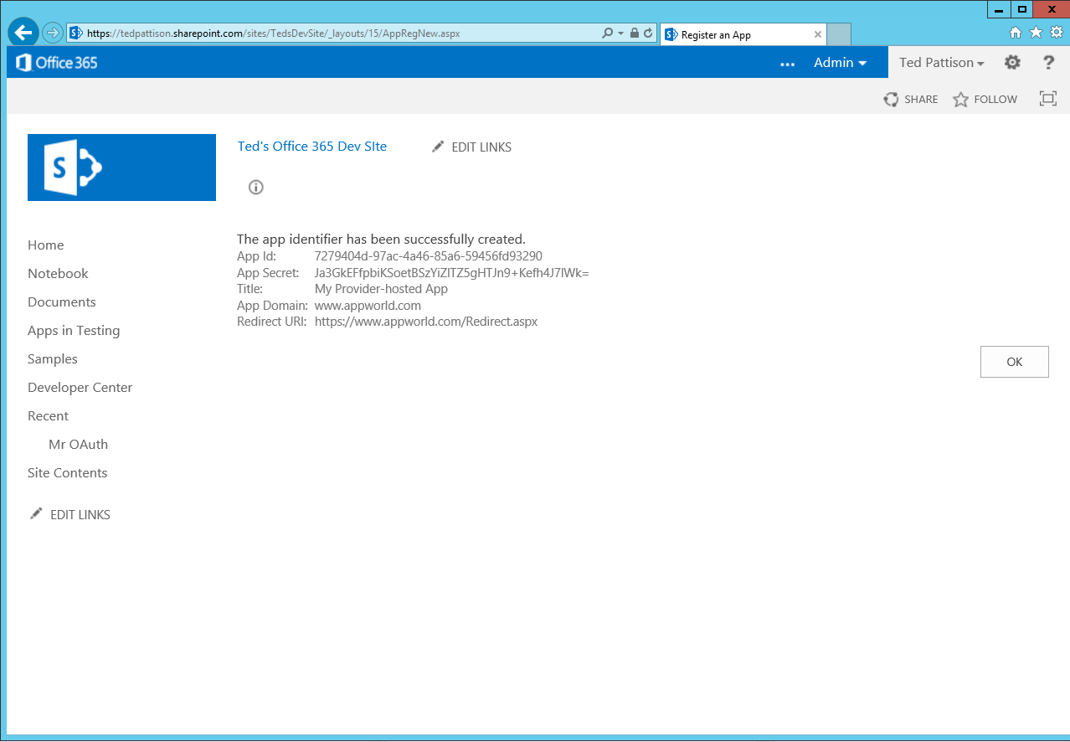
AppRegNew.aspx

Slide 22
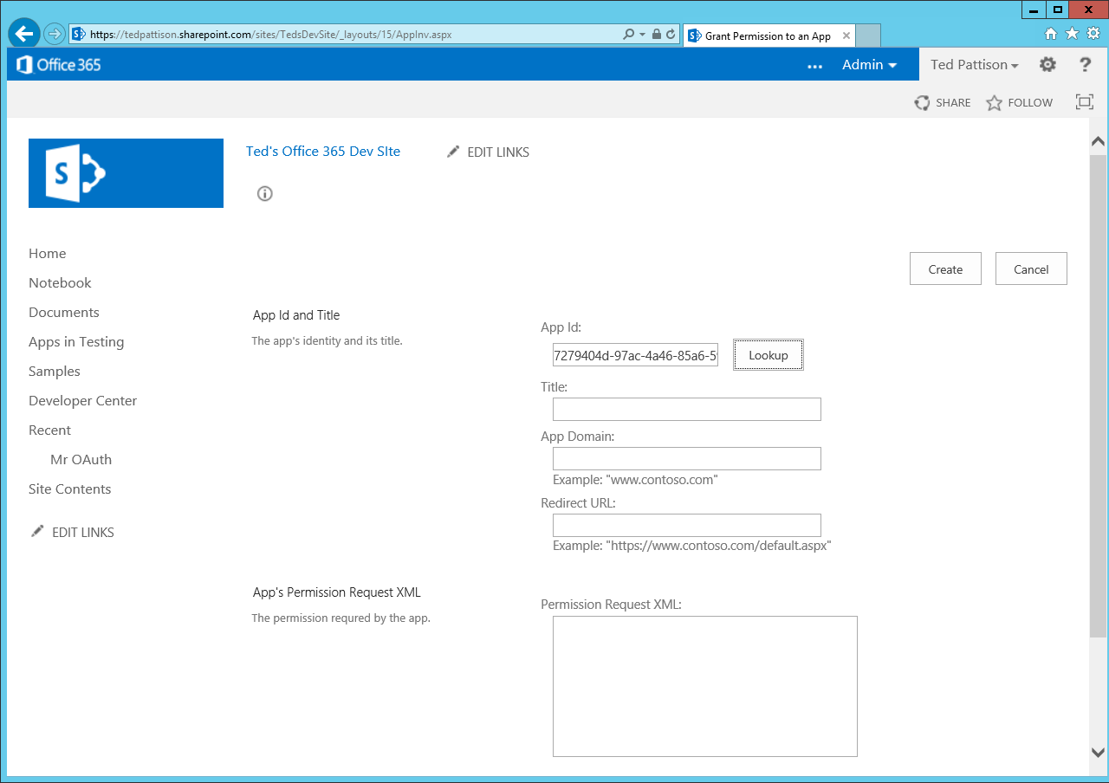
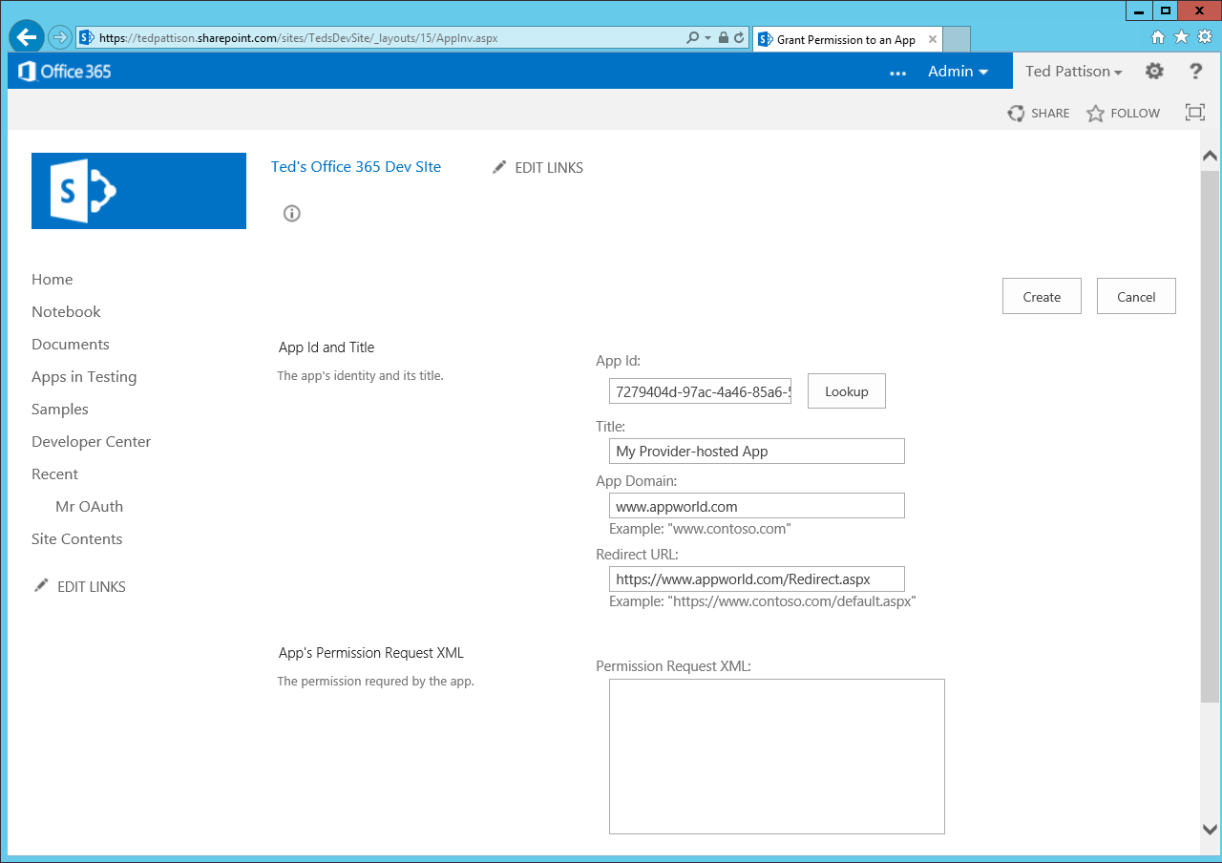
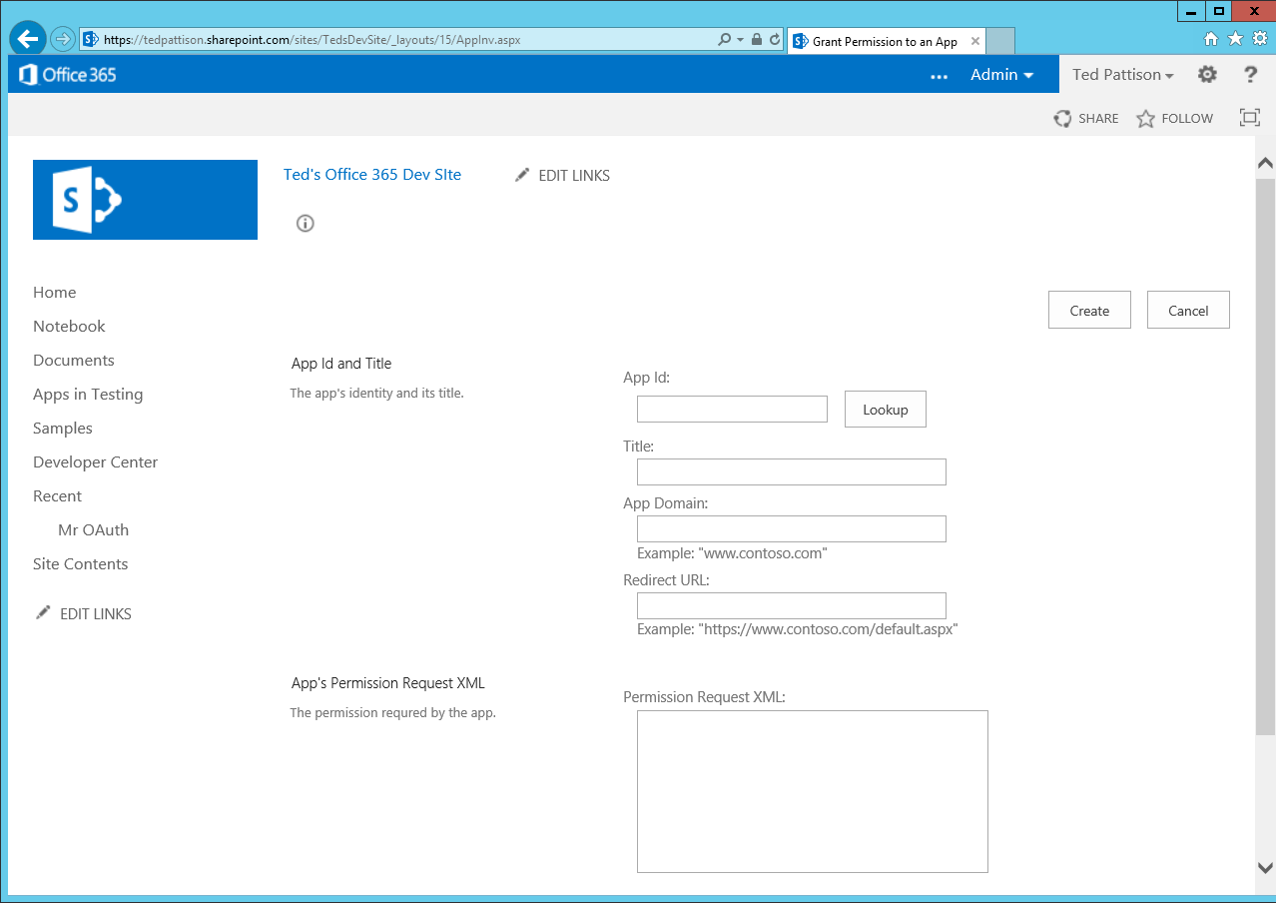
AppInv.aspx

Slide 23
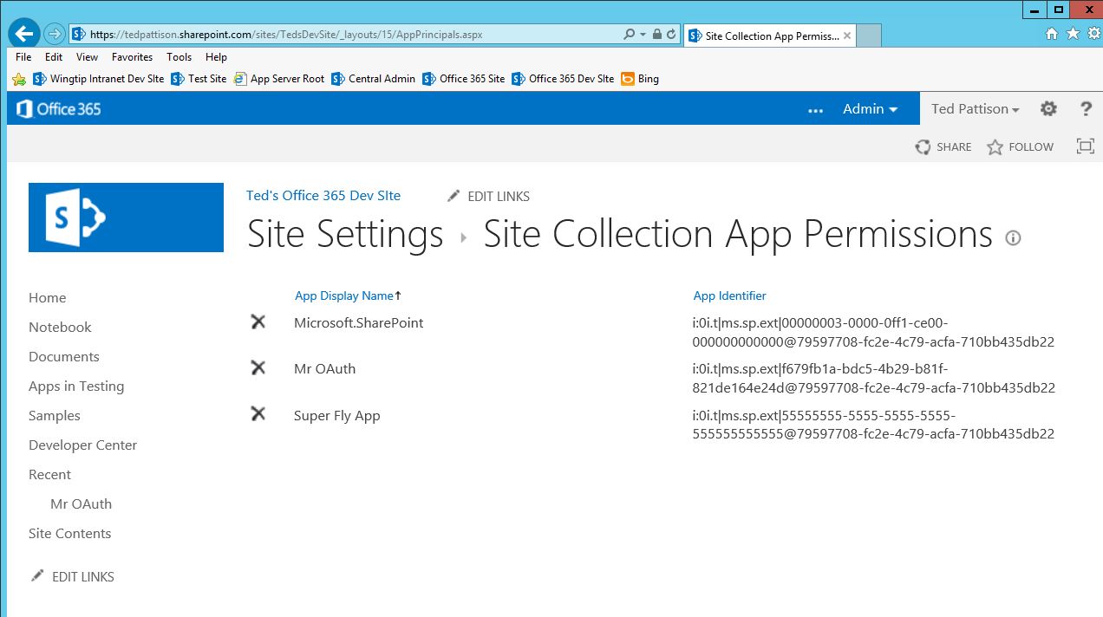
AppPrincipals.aspx

Slide 24
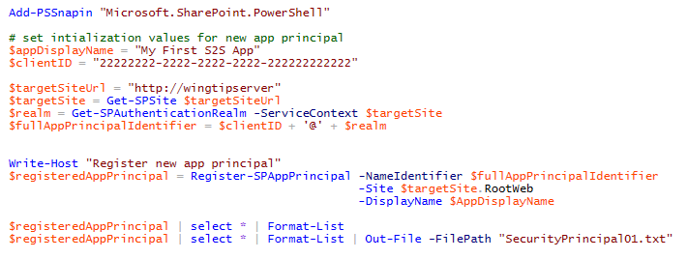
Creating App Principal with PowerShell
Can be done several different ways
Use built-in page named AppRegNew.aspx
Use Register-SPAppPrincipal
Use SPAppPrincipalManager
Let Visual Studio do it for you when developing

Slide 25
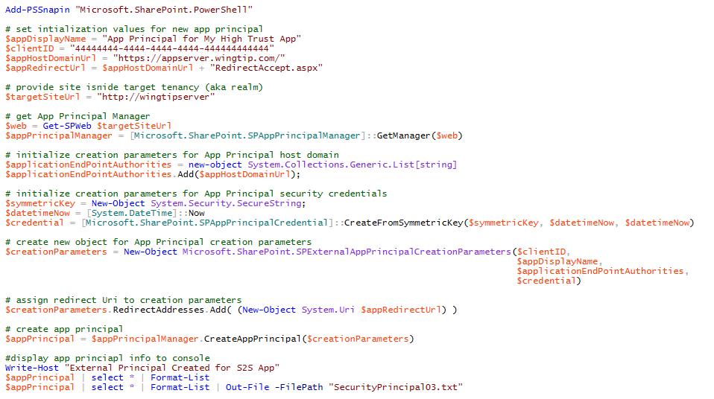
Using SPAppPrincipalManager

Slide 26
Registering an App Principal
Ted Pattison

Slide 27
Agenda
App Security Overview
Configuring App Permissions
Understanding App Security Principals
Server-to-Server (S2S) Trust Configuration
Programming with Access Tokens

Slide 28

What is a Server-to-server (S2S) Trust
Trusted connection between app and SharePoint
Eliminates need for ACS when running apps in on-premises farm
Trust between servers configured using SSL certificates
App code requires access to private key of SSL certificate
Requires creating Security Token Service on SharePoint server(s)
On-premises Farm
SharePoint Web Server
S2S STS
1
User
3
4
2
Client App
SSL Cert
Public/Private key pair (.pfx)

Slide 29
Why Is It Called a “High Trust” App
App must authenticate the user
App passed user identity to SharePoint farm with user identity
SharePoint farm trusts that the app is telling the trust about user identity
“High Trust” is very different from “Full Trust”
Full trust code is not limited by permissions – it can do anything
High trust app has set of permissions that say what it can do

Slide 30
Examples of Applications with S2S Trusts
Exchange 2013
Workflow Manager 1.0
Your custom SharePoint Apps
Your custom Web Applications (non-SharePoint)

Slide 31
Architecture of an S2S Trust
App has x.509 certificate with public/private key pair
Private key used to sign certain aspects in access token
Public key registered with SharePoint farm
This creates a trusted security token issuer
App creates access token to call into SharePoint
App creates access token with a specific client ID and signs it with private key
Trusted security token issuer validates signature
SharePoint establishes app identity
App identity maps to a specific client ID
You can have many client IDs associated with a single x.509 certificate

Slide 32
Configuring a Server-to-Server Trust
Steps to configure an S2S trust
Create an x509 certificate
Make certificate’s public key accessible to SharePoint
Use PowerShell to create a trusted security token issuer based on public key
Develop provider-hosted app which has access to private key file
Create S2S access tokens with the help of TokenHelper class
Pass access token with calling into SharePoint using CSOM or REST API
Two ways to make a certificate available
Pass file path of certificate to SharePoint
Expose certificate from app as metadata endpoint

Slide 33
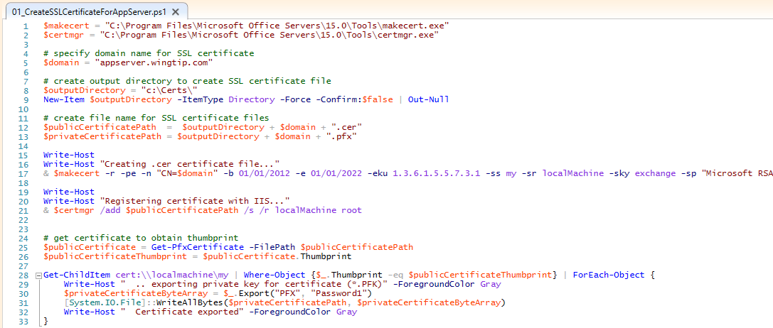
Creating Certificates

Slide 34
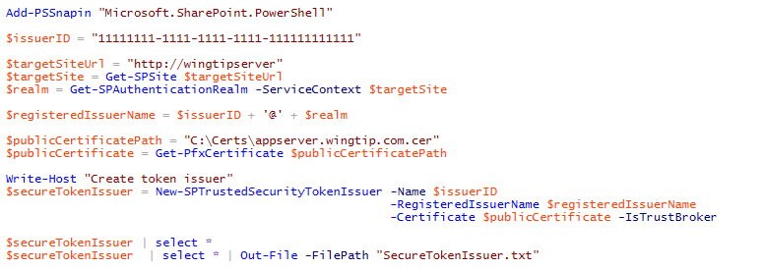
Creating the Secure Token Issuer
Steps to creating security token issuer in SharePoint farm
Get the authentication realm (aka tenancy)
Create realm-qualified app identifier
Create certificate object using .pfx file containing password-protected private key
Call New-SPTrustedSecurityTokenIssuer

Slide 35
Configuring a Secure Token Issuer
Ted Pattison

Slide 36
Agenda
App Security Overview
Configuring App Permissions
Understanding App Security Principals
Server-to-Server (S2S) Trust Configuration
Programming with Access Tokens

Slide 37
Developing Apps that use S2S Trusts
What is developer responsible for with S2S app?
Expose an endpoint to SharePoint to discover service metadata
Authenticate the user (can use Windows Auth, FBA, etc.)
Create security tokens to send to SharePoint server
Details of creating the S2S security token
S2S token like OAuth token but differs from OAuth specification
Security token must contain app identity
Security token can optionally include user identity
Security token must be signed using private key of SSL certificate

Slide 38
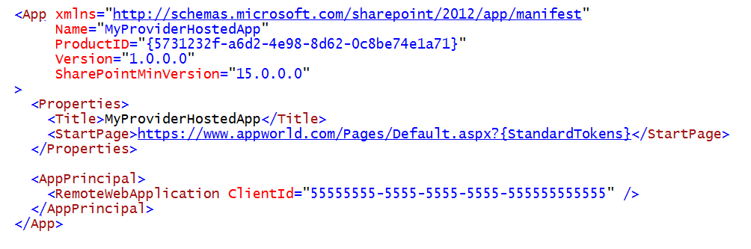
App Manifest for a Provider-hosted App
Notes:
When using OAuth with a developer-hosted app, the app manifest must include the App ID of a registered app principal in the ClientId attribute of the RemoteWebApplication element.

Slide 39
Web.config for a Provider-hosted App
Notes:
When using OAuth with a developer-hosted app, the app manifest must include the App ID of a registered app principal in the ClientId attribute of the RemoteWebApplication element.

Slide 40
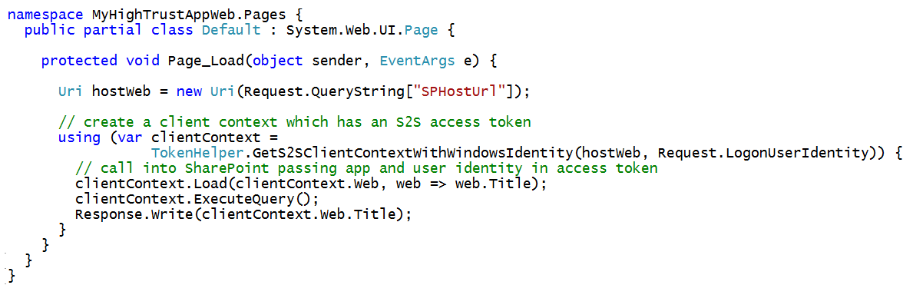
Calling to SharePoint from S2S Apps
TokenHelper class provides methods for S2S Apps
GetS2SClientContextWithWindowsIdentity for CSOM calls
GetS2SAccessTokenWithWindowsIdentity for REST calls
TokenHelper class only supports Windows authentication
You must implement support for other types of authentication

Slide 41
Creating a Provider-hosted App which uses S2S Authentication
Ted Pattison

Slide 42
Summary
App Security Overview
Configuring App Permissions
Understanding App Security Principals
Server-to-Server (S2S) Trust Configuration
Programming with Access Tokens

Slide 43

© 2014 Microsoft Corporation. All rights reserved. Microsoft, Windows, and other product names are or may be registered trademarks and/or trademarks in the U.S. and/or other countries.
The information herein is for informational purposes only and represents the current view of Microsoft Corporation as of the date of this presentation. Because Microsoft must respond to changing market conditions, it should not be interpreted to be a commitment on the part of Microsoft, and Microsoft cannot guarantee the accuracy of any information provided after the date of this presentation. MICROSOFT MAKES NO WARRANTIES, EXPRESS, IMPLIED OR STATUTORY, AS TO THE INFORMATION IN THIS PRESENTATION.

Slide 44
OAuth Is Used for External Authentication
In which scenarios is OAuth used?
Calls to SharePoint from server-side code running in remote web
How does it work?
Incoming calls requires access token with app identity
Access token can optionally carry a user identity as well
Call does not need to target URL inside app web
Call can target any CSOM or REST endpoint in any site
Your app code is required to create and manage security tokens

Slide 45
Security Tokens used in OAuth
Context Token
Contextual information passed to app
Refresh Token
Used by client app to acquire an access token
Access Token
Token passed to SharePoint to app when using external authentication
Authorization Code
Used to register an app with on the fly permissions

Slide 46
OAuth Protocol Flow in SharePoint 2013
1
SharePoint authenticates user using claims
Content Server
SharePoint 2013
Web Server
2
SharePoint requests context token for user
2
3
ACS returns context token
1
4
SharePoint pass context token to User
User
desktop computer
laptop computer
mobile device
tablet or iPad
4
3
Authentication Server
Trusted ACS server that authenticates applications and creates OAuth tokens
5
User POSTS to app passing context token
6
Client app is able to pull refresh token out
of context token. Client app then passes
refresh token to ACS to request OAuth token
8
9
7
ACS returns OAuth token to client app
5
Client App
Web Server running remote app code
6
8
Client App makes CSOM/REST calls to SharePoint site passing OAuth token
10
7
9
SharePoint returns site content to app
10
Client App returns HTML to user device
Notes:
The slides shows a walkthrough of the typical authentication flow used by SharePoint 2013 when an app is authenticated using OAuth and calls into a SharePoint site.
User connects to the SharePoint site. SharePoint authenticates the user and creates a SAML token which contains information about the user identity.
SharePoint queries its Application Management database using the App ID and determines whether the app is external of not. If the app is external and has a registered app principal, SharePoint calls to ACS to create a context token passing information about the app and also about the current user.
ACS creates a context token which contains information about the app principal and about the user. The context token also contains a refresh token which is used by the client app. Also note that certain aspects of the context token are signed by ACS using the App Secret and can only be ready by the client app which also has a copy of the app secret.
SharePoint returns a page to the browser which contains a launcher (e.g. a clickable tile) allowing the user to redirect from the SharePoint site to the client app.
When the user clicks on the launcher, JavaScript behind the launcher issues an HTTP POST request to redirect the user to the client app. The body of this HTTP POST request contains the context token as named form parameter.
The client app reads the context token and exacts the refresh token from inside. The client app passes the refresh token to ACS in a request to create an OAuth token. Part of the message to ACS is signed with the App Secret.
ACS uses the App Secret to authenticate the client app request. If authentication succeeds, ACS creates and OAuth token and returns it back to the client app.
The client app uses the OAuth token to make CSOM calls and REST calls into SharePoint.
SharePoint Authenticates the client app and makes sure it has the proper permissions to ensure it is authorized to do whatever it is attempting to do. If the call is authenticated and authorized, SharePoint performs whatever work is requested by the CSOM and/or REST calls and returns any information requested back to the client app.
The client app returns a page back to the user which contains HTML generated from data returned by CSOM and REST calls into SharePoint.

Slide 47
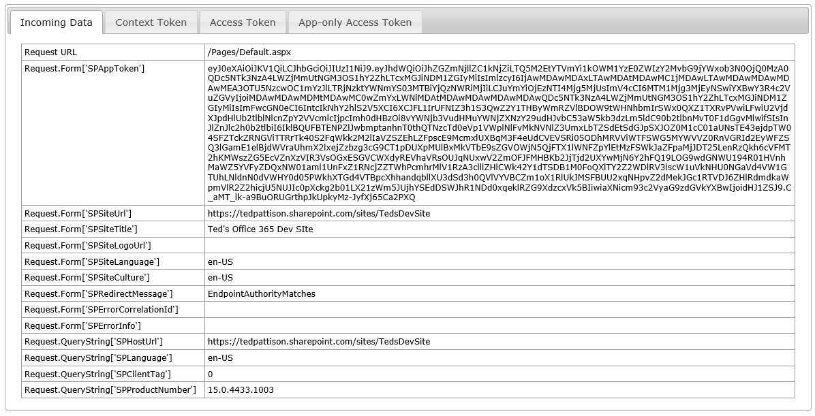
POST Data Sent to Start Page

Slide 48
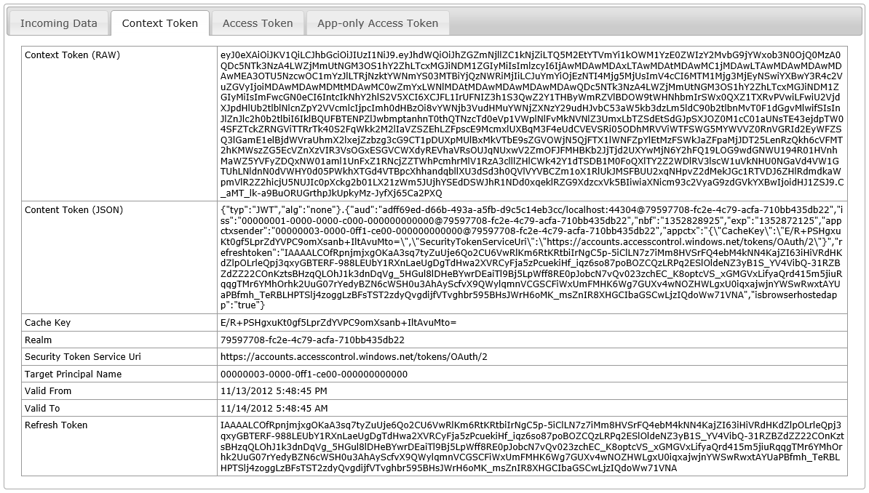
Context Token

Slide 49
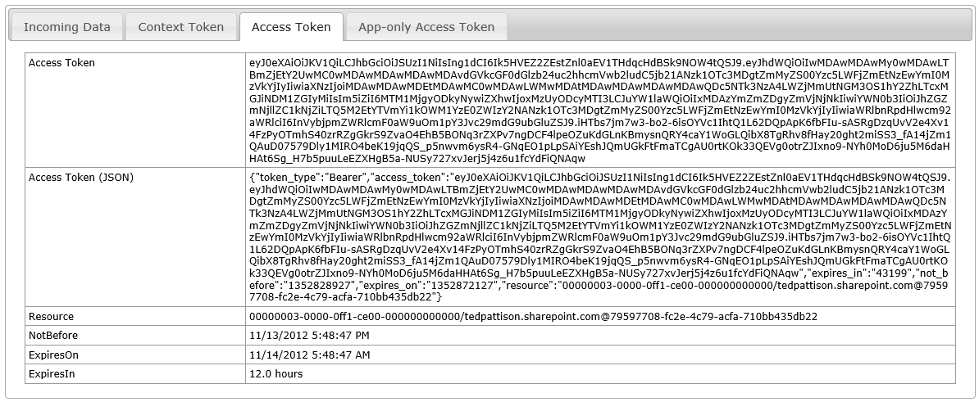
Access Token

Slide 50
Steps to using OAuth in Office 365
Create a new cloud-hosted app project
Can be either provider-hosted or autohosted
SharePoint-hosted Apps will never use OAuth
Register an App Principal
Registration handled automatically in autohosted apps
Registration requires explicit steps for provider-hosted apps
Registration requires extra steps for apps published to Office Store
Add code in remote web to manage tokens
Code required to retrieve access tokens from ACS
Explicit code required to create and manage access tokens

Slide 51
App Principals
External authentication requires app principals
App principal provides tenancy-scoped app identity
App principals must be registered with SharePoint
Account for App Principal is created in ACS
App principal properties
Client ID: GUID-based identifier (aka App ID)
Client Secret: Signs tokens sent between app and ACS
App Host Domain: Base URL of remote web
Redirect URL: URL to a page used to configure on-the-fly security

Slide 52
Managing App Principals in Office 365
Get to know the built-in app management pages
AppRegNew.aspx
AppInv.com
AppPrincipals.aspx
There is also management support using PowerShell
Download and install Windows PowerShell for SharePoint Online
Use PowerShell cmdlets to connect to Office 365 tenancy
Use PowerShell cmdlets to administer SharePoint app principals

Slide 53
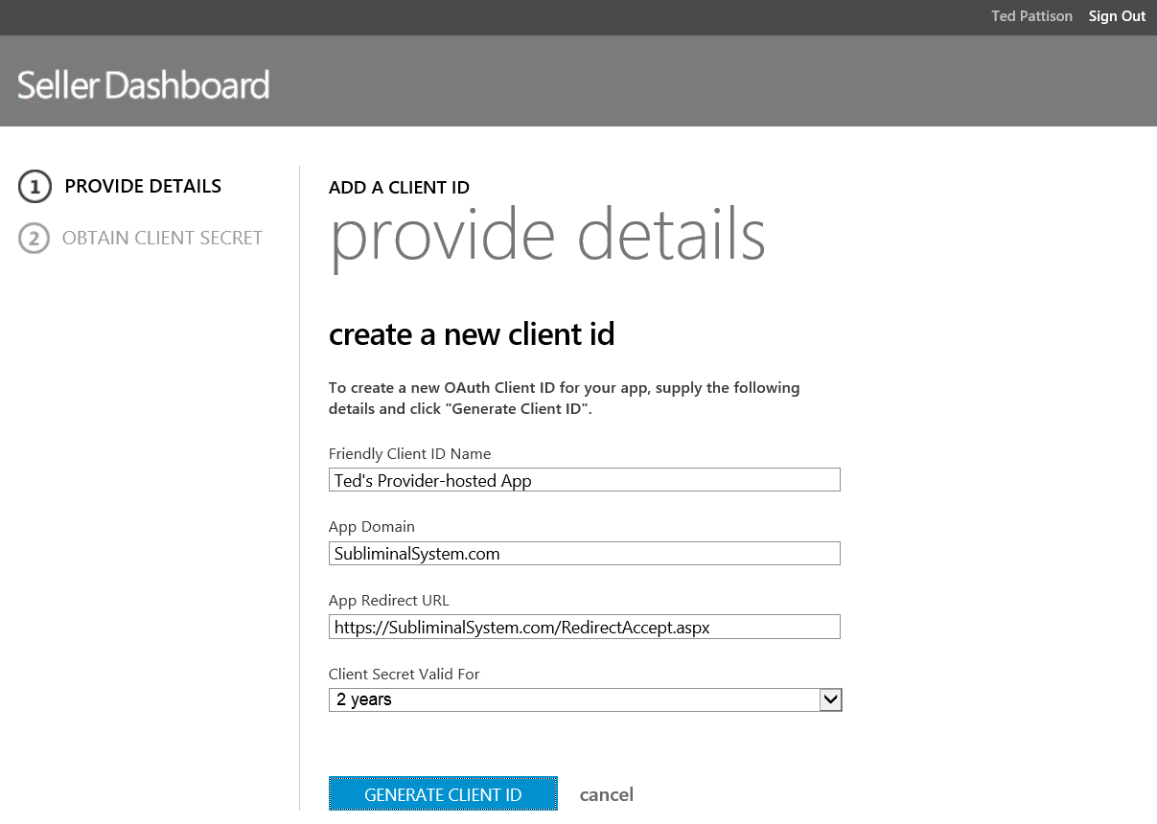
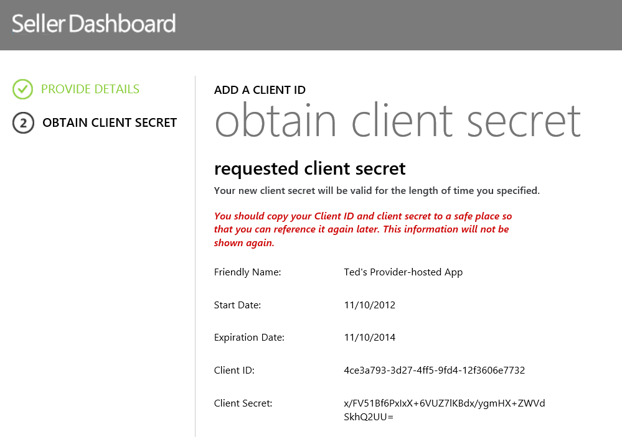
Getting Client ID from Seller Dashboard
Required when publishing apps to Office Store
Create a new reseller account
Create client ID with required information
Seller Dashboard generates Client Secret for you

Slide 54
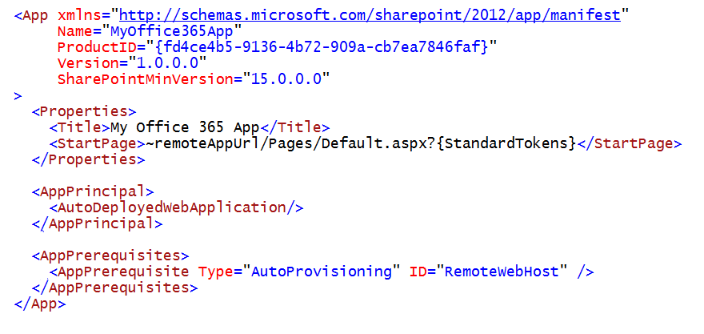
App Manifest for an Autohosted App

Slide 55
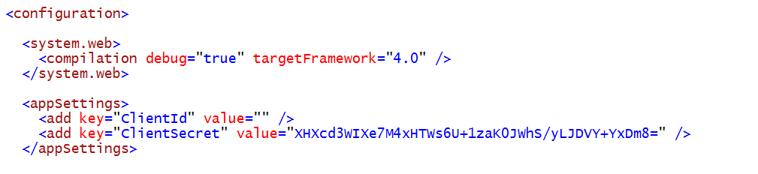
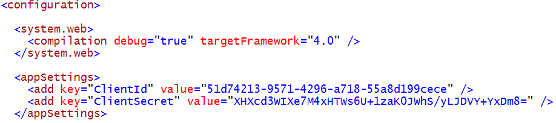
Web.config for an Autohosted App

Slide 56
App Manifest for a Provider-hosted App
Notes:
When using OAuth with a developer-hosted app, the app manifest must include the App ID of a registered app principal in the ClientId attribute of the RemoteWebApplication element.

Slide 57
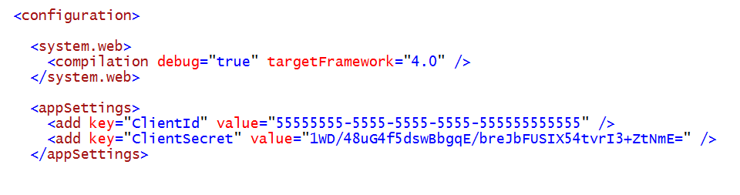
Web.config for a Provider-hosted App
Notes:
When using OAuth with a developer-hosted app, the app manifest must include the App ID of a registered app principal in the ClientId attribute of the RemoteWebApplication element.

Slide 58
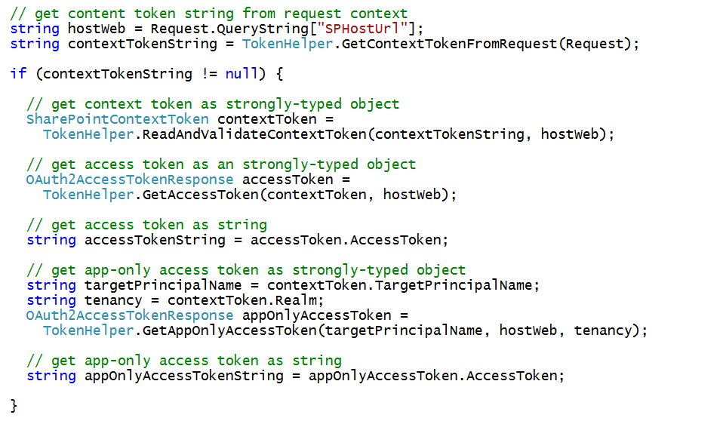
Programming with OAuth Access Tokens

Slide 59
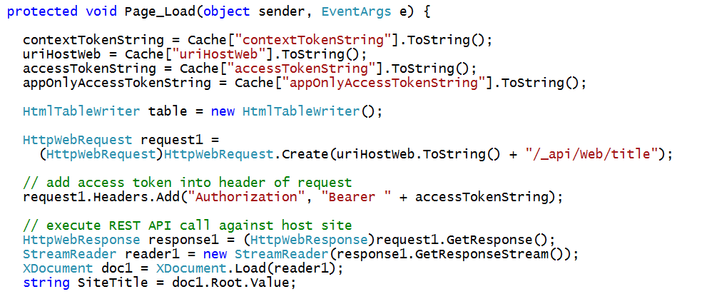
Making REST Calls with OAuth

Slide 60
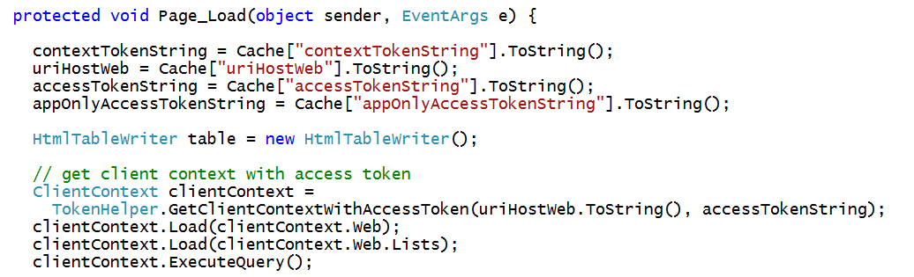
Making CSOM Calls with OAuth

Slide 61
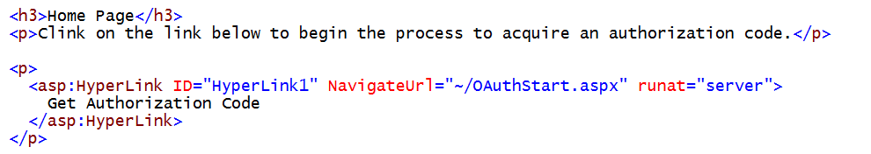
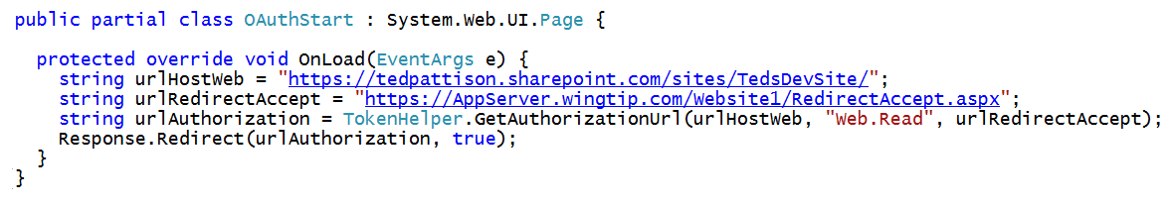
Requesting Permissions on the Fly
Request permission without installing an app
Navigate to page to begin request for authorization code
Call GetAuthorizationUrl redirect user using Response.Redirect

Slide 62
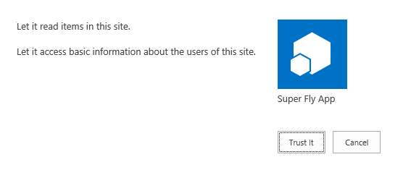
Authorization by a Privileged User

Slide 63
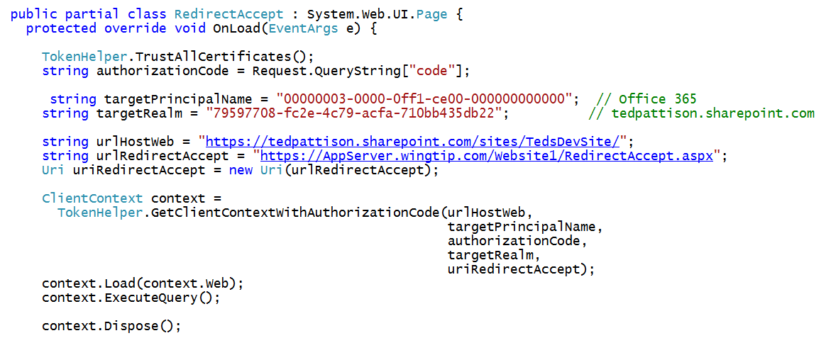
Using the Authorization Code

