Slide 1
Developing SharePoint Apps
Notes:
SharePoint 2013 introduces a new way to extend SharePoint sites: the SharePoint App Model. This module will cover everything students need to know about the SharePoint App Model including how to deploy them to the Marketplace to monetize your projects.

Slide 2
Agenda
Introduction to SharePoint Apps
Developing SharePoint Apps
Distribution and Deployment
App Lifecycle Events

Slide 3
Pain Points with SharePoint Solutions
Custom code runs inside SharePoint environment
This poses risks and compromises scalability
Custom code has dependencies on DLLs
Makes it hard to migrate to new versions of SharePoint
Permissions model based entirely on user identity
You cannot configure permissions for the solution itself
Impersonation solves the too-little-permissions problem
Impersonation causes too-many-permissions problem
SharePoint solutions are hard to manage
They lack effective support and easily understood semantics for distribution, installation and upgrade
Notes:
The first problem with SharePoint solutions is that much of the code you write runs inside the SharePoint environment. For example, managed code deployed in a farm solution runs inside the main SharePoint worker process (w3wp.exe). Managed code deployed using a sandboxed solution runs inside the SharePoint sandbox worker process (SPUCWorkerProcess.exe). However, The SharePoint app model mandates that code from an app cannot run inside any process that is launched or managed by SharePoint.
There are a few simple reasons why Microsoft wants to get rid of custom code that runs inside the SharePoint environment. The first reason has to do with increasing the stability of SharePoint farms. The one is pretty obvious. Getting rid of any type of custom code running inside the SharePoint environment results in lower risk, fewer problems and greater stability for the hosting farm.
The second reason has to do with a company’s ability to upgrade to newer versions of SharePoint. The underlying problem is that SharePoint solutions which contain code that programs against the SharePoint server-side object model have been notorious at creating migration problems when a company is upgrading from one version of SharePoint to the next. More to the point, Microsoft has witnessed many of their biggest SharePoint customers postponing the upgrade of their production farm for months and sometimes years until they have had time to update and test all their SharePoint solutions on the new version of SharePoint. Since this problem negatively affects SharePoint sales revenue, you can bet it was pretty high on the fix-it priority list when Microsoft began to design SharePoint 2013.
Security causes problems with impersonation. The problem is that solution code is always recognized as a specific user and that compromises your options.

Slide 4
SharePoint App Model Overview
SharePoint app model based on these assumptions:
Apps supported in Office 365 and in on-premises farms
App code never runs in SharePoint host environment
Apps talk to SharePoint using Web service entry points
App code is authenticated and has established identity
App has permissions independent of user permissions
Apps deployed to catalogs using a publishing scheme
Published apps are easier to find, install and upgrade
Notes:
Unlike solutions, apps are supported and will work in both on-premises deployments and in Office 365. The business logic within an app does not run within the SharePoint server or host environment; rather it runs external to SharePoint on another server or in the client. There is also a notion of app identities in the sense that apps can be assigned permissions, similar to users.

Slide 5
SharePoint Tenancies
A tenancy is a set of site collections
Configured and administrated as a unit
Created with administrative site collection
A scope for provisioning new site collection
Central concept to site management in Office 365
A requirement for installing SharePoint apps
What about tenancies in on-premises farms?
Most farms do not have explicitly created tenancies
To add support for SharePoint apps, on-premises farm can be configured with a farm-wide default tenancy
Notes:
SharePoint 2010 introduced the subject of a multi-tenant deployment in the sense where multiple customers (tenants) use the same SharePoint installation and hardware yet all their data, users, rights and site collections are applicable only to their resources. SharePoint 2013 has added additional capabilities in managing multi-tenant deployments.
Office 365 is a multi-tenant SharePoint deployment… you can think of it as simply your own mini-farm or just a collection of your site collections and provisioned service applications.
For on-premises deployments, you generally don’t stand up a multi-tenant deployment. Instead what you usually do is have a single default tenant that services the entire farm.

Slide 6
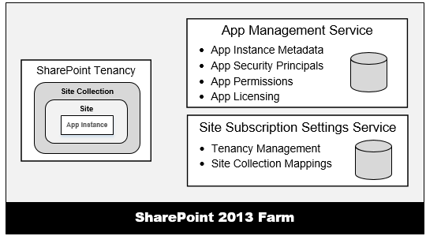
Service Application Support for Apps
App support requires two service applications
App Management Service
Site Subscription Management Service
These two services must be created in on-premises farms to support apps

Slide 7
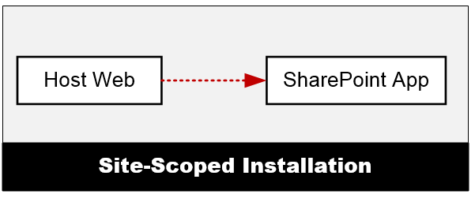
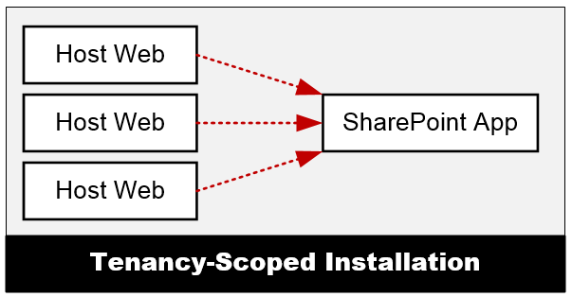
App Installation Scopes
Site-Scoped Installation
App is installed in a specific site
App is launched from same site
This site is known as host web
Tenancy-Scoped Installation
App installed > app catalog site
App available many host webs
Host webs access one app instance
Centralizes app management
Notes:
There are two scoping options for installing apps. Site-scoped apps are installed within a SharePoint site (SPWeb) and are available to all users of that site. If the same app is installed in multiple sites or multiple times in the same site, each installation is isolated and does not share resources with each other. Think of this as somewhat similar to the sandboxed solution deployments.
A tenant-scoped app installation is different in the sense that it is installed within the App Catalog site. The administrator can then make the app installation available to all sites within one or more site collections or to specific sites. Users of the sites will then be sharing the same app installation.

Slide 8
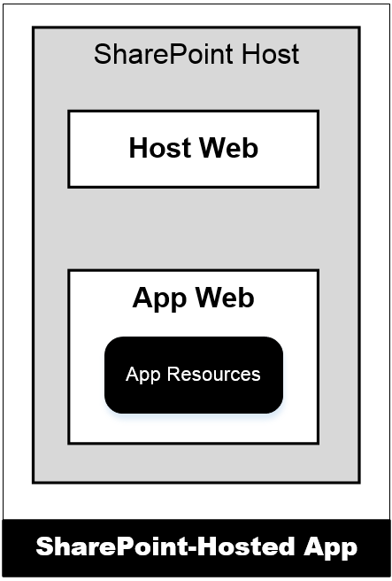
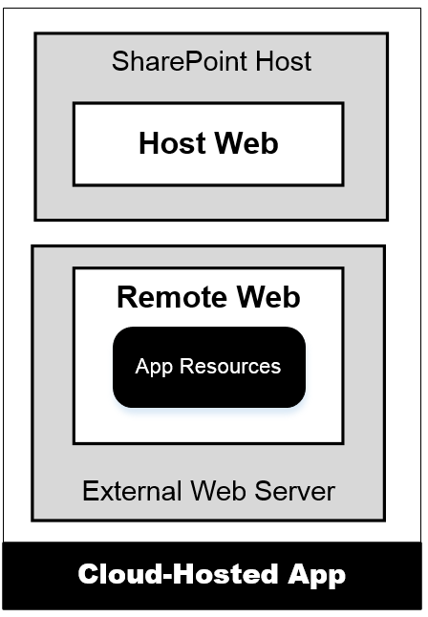
SharePoint App Architecture
SharePoint-Hosted Apps
App resources added to SharePoint host
Stored in child site known as app web
App can have client-side code
App cannot have server-side code
Cloud-Hosted Apps
App resources deployed on remote server
Remote site known as remote web
App can have client-side code
App can have server-side code
Notes:
There are two different types of apps and a few terms you should be aware of. First, apps are typically either hosted within SharePoint or they are hosted outside of SharePoint. The first type, SharePoint-Hosted apps are those types of apps where all their resources (images, style sheets, JavaScript, pages) are all provisioned to SharePoint. The business logic within SharePoint-Hosted apps runs within the client (browser). These differ from Cloud-Hosted apps in the sense that the bulk of these apps reside outside of SharePoint, for instance as an ASP.NET MVC site on another Windows Server, in Azure, as a PHP site in Amazon Web Services or any number of other options.
The site in which an app is installed from is called the host web. When an app is installed, if the app contains SharePoint artifacts, SharePoint will create a subsite (SPWeb) called the app web. For cloud hosted apps, the remote site is called a remote web.

Slide 9
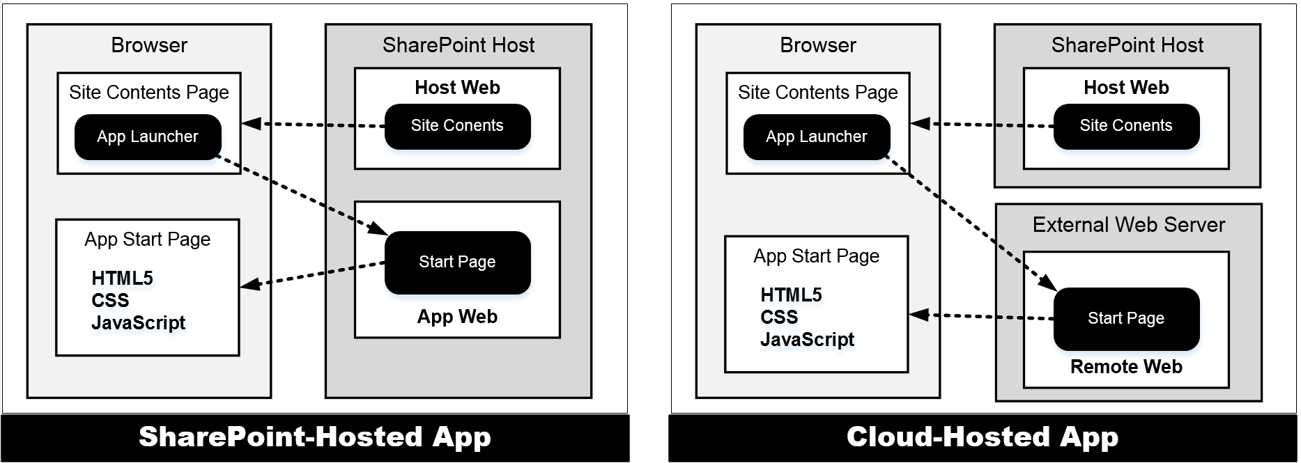
App Start Page
Every app requires a start page
Start page provides entry point into app
SharePoint adds app launcher to Site Contents in host web
SharePoint-Hosted app start page hosted by SharePoint
Cloud-Hosted app start page hosted in remote web
Notes:
As you will learn in a later module, there are a few different ways an app can be surfaced in SharePoint. At minimum, every app must contain a start page. This start page is where the user is taken when they click on the app from the Site Contents page. This page contains an app launcher that redirects the user to the start page of the app which may reside in an app web (if SharePoint-Hosted) or a remote web (if Cloud-Hosted).

Slide 10
Creating a SharePoint-Hosted App

Slide 11
App Hosting Models
SharePoint-Hosted App
App deployed to app web created under child site
Provider-Hosted App
App deployed to remote web on remote web server
Developer deploys remote web prior to app installation
Autohosted App
App deployed to remote web in Office 365 environment
Office 365 deploys remote web during app installation
Notes:
So far two types of apps have been covered: SharePoint-Hosted and Cloud-Hosted. Cloud-Hosted apps can be further broken down into two more types: Provider-Hosted & Autohosted.

Slide 12
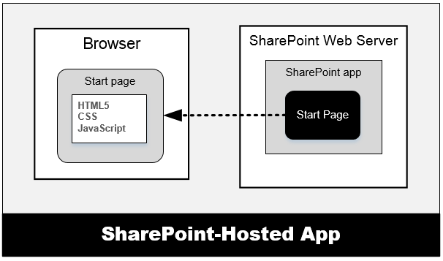
Provider-Hosted App
Developer responsible for deploying remote web
App deployed to remote web on remote web server
Developer deploys remote web prior to app installation
Developer often required to deploy database as well
Notes:
Provider-Hosted apps create a remote web and reside external to SharePoint. This doesn’t mean they cannot interact with SharePoint artifacts like lists and libraries, it just means that they primarily live outside of SharePoint like other Cloud-Hosted apps. In this scenario, the developer (or provider of the app) is responsible for deploying, installing & configuring all resources that are external to SharePoint.
For instance, if a Provider Hosted app references an ASP.NET MVC application deployed to Windows Azure that leverages Azure services like Service Bus, Access Control Services and SQL Azure, the developer is responsible for standing up and configuring all the non-SharePoint pieces of the application.

Slide 13
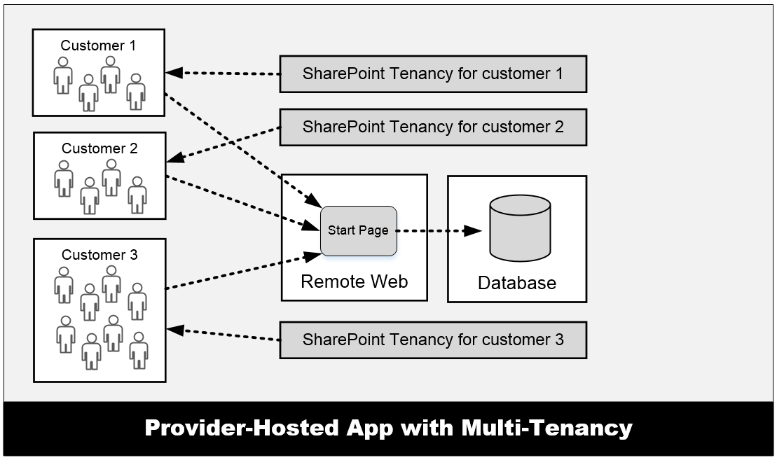
Provider-Hosted App with Multi-tenancy
Many customers access the same remote web
Remote web must be able to scale as needed
App design must isolate data on per-customer basis
Complexity increases time and cost of development
Notes:
One characteristic of Provider-Hosted apps is that you can have the same app installed multiple times in a SharePoint farm, but they can all connect to the same shared remote deployment.

Slide 14
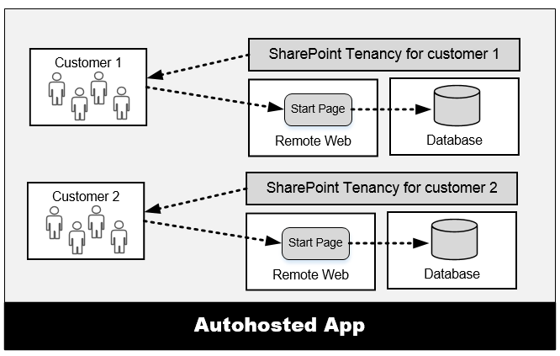
Autohosted App
Office 365 responsible for deploying remote web
Office 365 deploys remote web during app installation
Office 365 can also deploy SQL Azure database
Developer doesn't worry about scaling or multi-tenancy
Notes:
Another type of Cloud-Hosted application is the Autohosted app. In this scenario, the developer has created a ASP.NET based website and optionally a SQL Azure database that the app uses. These things are included in an app package with the SharePoint pieces to the app. When a user installs the app, SharePoint handles the provisioning and deployment of the Windows Azure Website & SQL Azure database.
Unlike the Provider-Hosted app model, these app deployments do not share remote web or database resources… each installation gets its own provisioned resources.
These types of deployments are only available to Office 365 deployments, not on-premises SharePoint deployments.

Slide 15
Creating a Provider-Hosted App

Slide 16
Agenda
Introduction to SharePoint Apps
Developing SharePoint Apps
Distribution and Deployment
App Lifecycle Events

Slide 17
App Manifest
All apps require app manifest (AppManifest.xml)
SharePoint reads manifest metadata during app install
Metadata used to configure installed app instances
Visual Studio 2012 provides app manifest designer
Some things must be modified in markup view
<?xml version="1.0" encoding="utf-8" ?>
<App xmlns="http://schemas.microsoft.com/sharepoint/2012/app/manifest"
Name="MyFirstCloudHostedApp"
ProductID="{0e3db7a6-35af-490b-87ab-93e446582a44}"
Version="1.0.0.0"
SharePointMinVersion="15.0.0.0">
<Properties>
<Title>My First Cloud Hosted App</Title>
<StartPage>~remoteAppUrl/Pages/Default.aspx?{StandardTokens}</StartPage>
</Properties>
<AppPrincipal>
<Internal />
</AppPrincipal>
</App>
Notes:
Every app must have an app manifest file that tells SharePoint the basic information about the app (name & ID) as well as the version number and all app permissions specified by the developer.

Slide 18
Start Page URL
Dynamic tokens used in start page URL
SharePoint-Hosted apps use ~appWebUrl token
~appWebUrl/Pages/Default.aspx
Cloud-Hosted apps use ~remoteAppUrl token
~remoteAppUrl/Pages/Default.aspx
All apps should use {StandardTokens} token
~appWebUrl/Pages/Default.aspx?{StandardTokens}
~remoteAppUrl/Pages/Default.aspx?{StandardTokens}
Notes:
There are two types of tokens that can be used in projects: those found at the start of a URL and those that can be used within a URL. The ones that can be used at the start of a URL start with a ~ character while those used within a URL are wrapped in curly brackets {}. A complete token list follows and additional details can be found here: http://msdn.microsoft.com/en-us/library/jj163816(v=office.15).
Tokens that can be used at the beginning of a URL in an app:
~appWebUrl: URL of the app web of an app.
~controlTemplates: URL of the ControlTemplates virtual folder in current site.
~layouts: URL of Layouts folder in current site.
~remoteAppUrl: URL of a remote web app in an app.
~site: URL of current website.
~sitecollection: URL of the parent site collection of current site.
Tokens that can be used within a URL:
{AppWebUrl}: URL of the app web in an app for SharePoint.
{HostLogoUrl}: logo for the host web of an app for SharePoint.
{HostTitle}: title of the host web of an app for SharePoint.
{HostUrl}: URL of the host web of an app for SharePoint.
{ItemId}: ID of a item in a list or library (an integer).
{ItemUrl}: URL of the item being acted upon.
{Language}: current language/culture of the host web of an app for SharePoint.
{ListId}: ID of the current list (a GUID).
{RecurrenceId}: recurrence index of a recurring event.
{Site}: URL of the current website.
{SiteCollection}: URL of the parent site of the current website.
{SiteUrl}: URL of the current website
{StandardTokens}: includes {HostUrl}, {AppWebUrl} & {Language} (with “SP” prefix for each key in query string)

Slide 19
Available URL Tokens
Tokens available at beginning of SharePoint App URLs
Token | Resolves To
~appWebUrl | URL of the app web of an app for SharePoint
~remoteAppUrl | URL of a remote web application in an app for SharePoint
~controlTemplates | URL of the ControlTemplates virtual folder for the current website
~layouts | URL of the Layouts virtual folder for the current website
~sitecollection | URL of the parent site collection of the current website
~site | URL of the current website
Notes:
This slide shows all the tokens that are available at the start of the app URL.

Slide 20
Available URL Tokens
Tokens available within a URL
Token | Resolves To | Use in StartPage?
{AppWebUrl} | URL of the app web in an app for SharePoint
{HostLogoUrl} | Logo for the host web of an app for SharePoint
{HostTitle} | Title of the host web of an app for SharePoint
{HostUrl} | URL of the host web of an app for SharePoint
{ItemId} | ID of a item in a list or library (an integer)
{ItemUrl} | URL of the item being acted upon
{Language} | current language/culture of the host web of an app for SharePoint
{ListId} | ID of the current list (a GUID).
{RecurrenceId} | Recurrence index of a recurring event
{Site} | URL of the current website
{SiteCollection} | URL of the parent site of the current website
{SiteUrl} | URL of the current website
{StandardTokens} | SPHostUrl={HostUrl}&SPAppWebUrl={AppWebUrl}&SPLanguage={Language}
Notes:
This slide shows all the tokens available for use within the URL.

Slide 21
App Web
App web is created during app installation
App web created as child to site where app is installed
SharePoint-Hosted apps must create app web
App must add start page and related resources
App can add other SharePoint elements (e.g. lists)
Cloud-Hosted apps can create app web
Most cloud-hosted apps will not create an app web
Cloud-hosted app can create app web if needed
Notes:
As previously covered, an app web is where the app is installed. This is only created when an app package contains a WSP. Therefore cloud-hosted apps don’t necessarily create an app web unless they contain something that gets provisioned in SharePoint and is deployed with a WSP.

Slide 22
App Web Hosting Domain
App web pages served out of isolated domain
Isolates JavaScript code on app web pages
Allows SharePoint to authenticate callbacks from app
URL to app web made up of 4 parts
Tenancy name: wingtiptenant
APPUID: ee060af276f95a
App web hosting domain: apps.wingtip.com
App name: MyFirstApp
https://wingtiptenant-ee060af276f95a.apps.wingtip.com/MyFirstApp
Notes:
When app webs are created, they are given their own top-level domain name. The reason for this is to block cross-site-scripting attacks. The parts of this URL are specified on this slide.

Slide 23
Host Web Features
SharePoint apps can extend UI three ways
Start page (required)
App parts
UI custom actions
App parts and UI custom actions added host web
Added to host web using a host web feature
Users add app parts just like adding Web Parts
UI custom actions used to extend ribbon & ECB menu
Details of developing these covered in a later module
Notes:
A host web Feature, just a standard SharePoint Feature, is something that is deployed to the host web by an app. The only things that can be included in a host web Feature are the start page, app parts and custom UI actions.

Slide 24
Adding a List to the App Web

Slide 25
Agenda
Introduction to SharePoint Apps
Developing SharePoint Apps
Distribution and Deployment
App Lifecycle Events

Slide 26
App Distribution Overview
App Packaging
Packaging app resources for distribution
App Publication
Making app available for installation and upgrade
App Installation
Make app available for use
App Upgrade
Replace current version of app with newer version

Slide 27
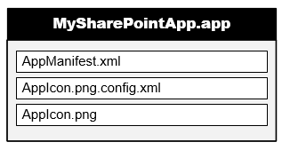
App Package
SharePoint apps distributed using app packages
App package is ZIP archive file with *.app extension
Built according to Open Package Convention (OPC)
Same packaging format used in Apps for Office
App package must contain AppManifest.xml
App package will often contain file for app icon
Notes:
The app package is just a ZIP file that conforms to the Open Package Conventoin (OPC) the same thing used for OpenXML Office files. Within the package you will find the app manifest and likely the app icon.

Slide 28
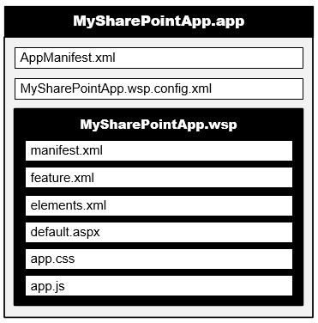
App Web Solution Package
App package contains inner WSP for app web
Elements deployed to app web using solution package
Solution package built into app package as inner WSP
All SharePoint-hosted apps will have an inner WSP in their app package
Cloud-hosted apps will not have an inner WSP in their app package unless they have been implemented to create an app web
Notes:
For SharePoint-Hosted apps, the artifacts that were traditionally deployed with a solution are still included within a WSP that is included within the APP file.

Slide 29
Packaging Host Web Features
Host web feature elements added at top level
elements.xml file added for each app part
elements.xml file added for each UI custom action
features.xml file added for host web feature
Visual Studio adds GUID to file names
Notes:
Host web features are not packaged within a WPS and instead live at the root of the APP package.

Slide 30
Packaging for Autohosted Apps
Autohosted apps packaged with extra resources
Office 365 requires resources to deploy remote web built into app package as web deploy package (*.web.zip)
Office 365 requires resources to create SQL Azure DB built into app package as Data Tier Application Package (*.dacpac)
Notes:
Autohosted apps contain the website to deploy to Windows Azure Websites (as a web deploy package) and the SQL Azure Database (as a SQL DACPAC).

Slide 31
Publishing Apps
App distributed based on publishing scheme
Publishing involves uploading app package to catalog
Provides better app discovery, installation and upgrade
SharePoint Store is catalog available to public
Developers publish apps to SharePoint Store
Anyone can discover apps and purchase/install them
App catalog site for publishing at private scope
Implemented as a SharePoint site collection
Used in Office 365 tenancies and in on-premise farms
Must be explicitly created in on-premises farm
Notes:
Apps can be deployed to a marketplace, either a public “SharePoint Marketplace” where other people can purchase and install your app, just like other marketplaces for smart phones, or using the App Catalog which acts like a private tenant-specific marketplace where apps aren’t bought and sold, rather they are just deployed by corporate developers or when administrators buy licenses and deploy the purchased app to the catalog.

Slide 32
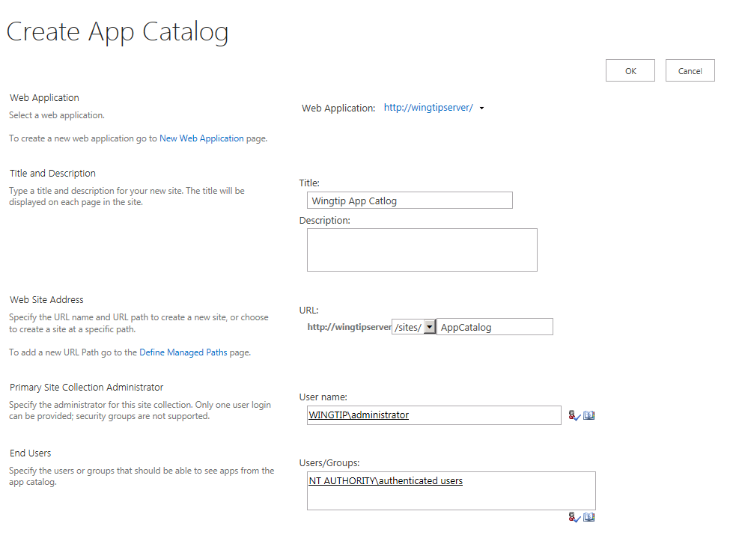
Creating an App Catalog Site
App catalog site created in Central Administration
App catalog site is created at web application scope

Slide 33
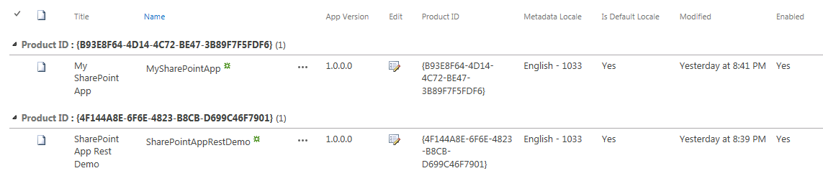
Apps for SharePoint Document Library
App catalog site contains support for...
Publishing SharePoint apps
Publishing Apps for Office
Managing user request for apps
Apps for SharePoint is special document library
It's the place where you publish SharePoint apps
You upload app package and add related metadata

Slide 34
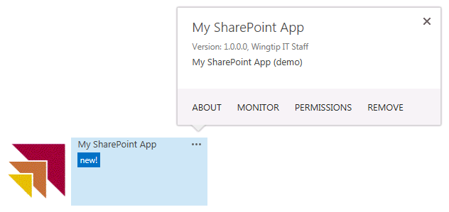
Installing Apps
Must be an administrator of site to install an app
Click add an app link on Site Contents page - this takes you to app discovery page (addanapp.aspx)
Click on app tile to install it
After installation, app tile added to Site Contents page - app tile provides fly-out menu to assist with app management
Notes:
Once an app is installed you can see a few things in the action bar about the app.

Slide 35
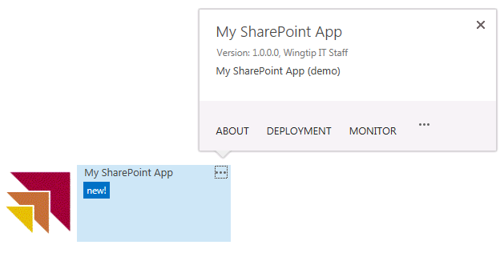
Installing Apps at Tenancy Scope
App catalog site used for tenancy-scoped install
Step 1: Publish app to app catalog site
Step 2: Install app in same app catalog site
Step 3: Configure app to make it available in other sites
Deployment action only appears for apps installed in app catalog sites
Notes:
Apps that are installed at a tenancy scope have an extra “Deployment” link which is used to push the installed app to sites.

Slide 36
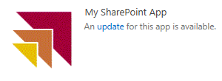
Upgrading Apps
Overview of SharePoint app upgrade process
App catalog tracks current version number of app
SharePoint host records app version at install time
Updated version of app can be uploaded to app catalog
SharePoint host notifies user when there's new version
User makes choice whether upgrade or not
User is never forced to upgrade
If user decides to upgrade, it involves clicking a button
Provider-hosted apps must support multiple versions
Notes:
App updates are not automatically pushed out to every place it is installed. Just like a smart phone user sees alerts indicating an app update is available, SharePoint app users are notified when an update available. This means that even though developers may publish a new version, they could have many previous versions of the app running at any given time.

Slide 37
Creating an App Catalog Site

Slide 38
Agenda
Introduction to SharePoint Apps
Developing SharePoint Apps
Distribution and Deployment
App Lifecycle Events

Slide 39
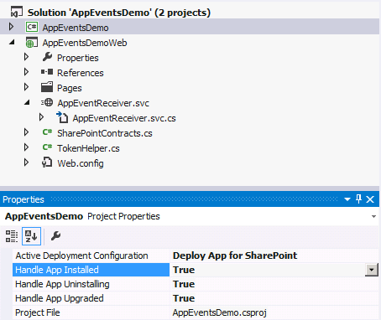
App Lifecycle Events
SharePoint app models support app events
App events for installation, upgrade and uninstall
SharePoint host calls to entry point in remote web
Not support in SharePoint-hosted apps
Added to app project using property sheet
Implemented as a remote event receiver
Notes:
The installation, upgrade and uninstallation of an app raises events that developers can trap. These are surfaced as remote event receivers where the app calls out to a well known endpoint where the developer can do something upon these events.

Slide 40
Summary
Introduction to SharePoint Apps
Developing SharePoint Apps
Distribution and Deployment
App Lifecycle Events

