Slide 1
Client-Side SharePoint Development
Notes:
In this module students will learn how to leverage each of the three client object model (CSOM) implementations in SharePoint projects. In addition students will also learn how to use the OData/REST APIs to access SharePoint data from off the server.

Slide 2
Agenda
Overview of CSOM and REST
Programming CSOM with C# and JavaScript
REST and ODATA Fundamentals
Making REST calls with C# and JavaScript

Slide 3
CSOM in SharePoint 2010
CSOM made accessible through client.svc
Direct access to client.svc not supported
Calls to client.svc must go through supported entry points
Supported entry points:
.NET
Silverlight
JavaScript
Notes:
The SharePoint client-side object model (CSOM) debuted in SharePoint 2010 where it was made available as a WFC entry point named client.svc. However, SharePoint 2010 did not support developers accessing client.svc directly. Instead, the developer uses client-side proxy objects exposed by either a .NET assembly or a JavaScript library.
It is fair to say that the CSOM is easier to program against from managed code (i.e. C# and VB.NET) than from JavaScript. That’s because managed code programs against a strongly-typed object model, and you experience compile-time type checking and much higher levels of IntelliSense. While you can also write CSOM code using JavaScript behind pages in a SharePoint 2010 site, the code is harder to write and debug because there is not compile-time type checking and IntelliSense is nowhere near as rich.

Slide 4
Changes in SharePoint 2013
client.svc extended with REST capabilities
client.svc now supports direct access from REST clients
client.svc accepts HTTP GET, PUT, POST requests
Implemented in accordance with OData protocol
CSOM extended with new APIs
New APIs for SharePoint Server functionality
New API for Windows Phone Applications
Notes:
One of the most significant changes in SharePoint 2013 is that the Web service entry point of client.svc service has been extended to allow for direct access via REST-based Web service calls. This is a big change because it makes the SharePoint platform accessible to just about any other platform and any type of device.
A significant portion of the REST-based access in SharePoint 2010 has been designed and implemented in accordance with the OData protocol. This means developers can access SharePoint content from across the Internet using one of today's most popular standards. If you do not already know about OData concepts and how to program against it, this is something you want to get up to speed on for the 2013 SharePoint product lifecycle.

Slide 5
What is covered in the new CSOM?
New APIs with SharePoint Server functionality
User Profiles
Search
Taxonomy
Feeds
Publishing
Sharing
Workflow
E-Discovery
IRM
Analytics
Business Data
Notes:
This slide above lists new areas in the SharePoint 2013 remote API that are accessible through both CSOM and REST. This is a welcome change because most of this functionality is only available through server-side APIs in a SharePoint 2010 farm. You can also see that adding this remote access is very important to the new app model where developers can no longer run code in a SharePoint environment.

Slide 6
SharePoint 2013 Remote API Architecture
_api is new alias for _vti_bin/client.svc
Server
Execute Query
Client
OData
JavaScript Library
Silverlight Library
.Net CLR Library
Custom Client Code
Notes:
This architectural diagram shows how things have changed in SharePoint 2013. Client-side code uses the CSOM in SharePoint 2010. The major changes include:
You can substitute the alias _api in order to reference _vti_bin/client.svc
Client code can access client.svc directly using REST-based HTTP requests.
Much of the REST-based API is based on the OData protocol.
Code which uses the CSOM in SharePoint 2010 should migrate to SharePoint 2013 without any problems.
It is important to note that the CSOM is not the same as the REST/OData interface. Microsoft has focused primarily on the CSOM while added REST/OData endpoints in many cases, but in many cases you will find there is no REST/OData where there is CSOM coverage.

Slide 7
What About ListData.svc?
ListData.svc added REST support for reading & writing to SharePoint lists in SharePoint 2010
Still present in SharePoint 2013, but primarily only for backwards capability
Existing code won’t break
New development recommendation: use new SharePoint 2013 REST/OData API
Notes:
In SharePoint 2010, the product provided OData support through the Web server entry point ListData.svc. The ListData.svc Web service is available in SharePoint 2013. However, you should understand that it is mainly provided for backwards compatibility for older clients that are migrating to SharePoint 2013. When creating new projects for SharePoint 2013 and later, you should not be using ListData.svc. Instead, you should be using the newer remote APIs with OData support that are discussed later in this module.

Slide 8
Agenda
Overview of CSOM and REST
Programming CSOM with C# and JavaScript
REST and ODATA Fundamentals
Making REST calls with C# and JavaScript

Slide 9
Programming using CSOM
Your JavaScript Code
Browser
JSON Response
Client.svc
Server OM
JavaScript OM
Proxy
XML Request
Proxy
XML Request
Content database
Managed OM
JSON Response
Managed Client
Your C# and VB.NET Code
SharePoint Web Server
Notes:
There are three different entry points you can use to program against the CSOM:
.NET Applications
Silverlight Applications
JavaScript code
.NET applications and Silverlight applications program against class in an assembly while JavaScript code programs against JavaScript objects made accessible through sp.js. In all three cases the programmer is shielded from having to send and receive WCF messages as they are sent to the Web server.

Slide 10
Changes to CSOM in SharePoint 2013
SharePoint Foundation 2013
No significant changes to CSOM beyond REST support
Primary investment was adding REST to existing API
SharePoint Server 2013
New APIs added with CSOM and REST support
Notes:
The primary enhancement to the CSOM for SharePoint Foundation is that the majority of its functionality has now also been exposed to Web service clients making REST calls across the network. This makes it easier to program JavaScript behind Web pages and it opens doors to client applications that do not run using the .NET framework.
While SharePoint foundation does not expand its CSOM functionality, many of the SharePoint server services that did not expose Web service entry points in SharePoint 2010 now do in SharePoint 2013. Some examples are Web services exposed for document management, WCM, terms and term sets and user profiles. You should also note that most (but not all) new CSOM functionality introduced in SharePoint Server 2013 is also mirrored with REST-based entry points as well.

Slide 11
CSOM using Managed Code
ClientContext cc = new ClientContext("http://clientside.wingtip.com");
cc.Credentials = CredentialCache.DefaultCredentials;
Web site = cc.Web;
ListCollection lists = site.Lists;
// load site info
cc.Load(site, s => s.Title);
cc.ExecuteQuery();
Console.WriteLine("Site Title: " + site.Title);
// create list
ListCreationInformation newList = new ListCreationInformation();
newList.Title = "Customers CSOM";
newList.Url = "Lists/Customers_CSOM";
newList.QuickLaunchOption = QuickLaunchOptions.On;
newList.TemplateType = (int)ListTemplateType.Contacts;
site.Lists.Add(newList);
// refresh lists collection
cc.Load(lists);
// make round trip to Web server to do all the work
cc.ExecuteQuery();
foreach (List list in lists) {
Console.WriteLine(list.Title);
}
Notes:
This slide shows an example of CSOM code which accomplishes the following:
Establishes a connection to the SharePoint farm using default credentials
Retrieves information about the current site
Creates a new Contacts list
Retrieves and displays information about the lists in the current site

Slide 12
CSOM using JavaScript
var ctx;
var web;
var lists;
$(onPageLoad);
function onPageLoad() {
ExecuteOrDelayUntilScriptLoaded(initCSOM, "sp.js");
}
function initCSOM() {
ctx = SP.ClientContext.get_current();
web = ctx.get_web();
ctx.load(web);
ctx.load(web.get_currentUser());
lists = web.get_lists();
ctx.load(lists);
ctx.executeQueryAsync(onDisplaySiteInfo, onError);
}
function onDisplaySiteInfo() {
var siteTitle = web.get_title();
var siteId = web.get_id().toString();
var siteUrl = web.get_url();
var currentUser = web.get_currentUser().get_loginName();
// do something with these values
}
function onError(sender, args) { alert(JSON.stringify(args)); }
Notes:
This slide shows a typical example using the CSOM from JavaScript behind a page in a SharePoint 2013 site. This code also leverages jQuery and in particular the document ready function to execute the onPageLoad function when the DOM is ready to access. Note how this code calls ExecuteOrDelayUntilScriptLoaded to force the download of sp.js before executing the initializeCSOM function. This is a common practice to ensure that that CSOM is available for use before you begin to program against it.

Slide 13
Programming CSOM with C#
Notes:
Show code from demo 1 that creates a list via CSOM

Slide 14
Agenda
Overview of CSOM and REST
Programming CSOM with C# and JavaScript
REST and ODATA Fundamentals
Making REST calls with C# and JavaScript

Slide 15
REST URLs in SharePoint 2013
CSOM URLS can go through /_api/ folder
Simplifies URLs that need to be built
Removes client.svc file name from URL
You can replace this URL:
http://wingtipserver/_vti_bin/client.svc/web
With this URL:
http://wingtipserver/_api/web
Notes:
In SharePoint 2013 the Service root URI contains the URI to the target SharePoint site and then the relative path to the client.svc entry point inside the _vti_bin virtual directory. After that you add the resource path to specify an object such as a site or list. Here's an example of a resource path for the current site.
http://wingtipserver/_vti_bin/client.svc/web
SharePoint 2013 allows REST URLs can go through the _api folder which cleans up the look of the URLs that need to be built and removes client.svc file name from URL. The URL below is equivalent to the one above and should be preferred.
http://wingtipserver/_api/web

Slide 16
Mapping Objects to Resources
Example REST URLs targeting SharePoint sites
http://[..]/_api/web/lists
http://[..]/_api/web/lists/getByTitle(‘Contacts')
http://[..]/_api/web/getAvailableWebTemplates(lcid=1033)
Notes:
The collection of lists for the current site: /_api/web/lists
Get a specific list by its title: /_api/web/lists/getByTitle('Announcements')
Get all the Web templates within the current site which is based on US English: /_api/web/getAvailableWebTemplates(lcid=1033)
Refer to the following article on MSDN, specifically figure 9, to see how SharePoint constructs REST URLs:
http://msdn.microsoft.com/en-us/library/office/apps/fp142385(v=office.15).aspx
A fantastic resource for the detailed documentation for all REST APIs can be found in the protocol documents:
Web Versions:
http://msdn.microsoft.com/en-us/library/cc339475(v=office.12).aspx
ZIP of all protocol docs as PDFs:
http://download.microsoft.com/download/8/5/8/858F2155-D48D-4C68-9205-29460FD7698F/SharePointProtocols.zip

Slide 17
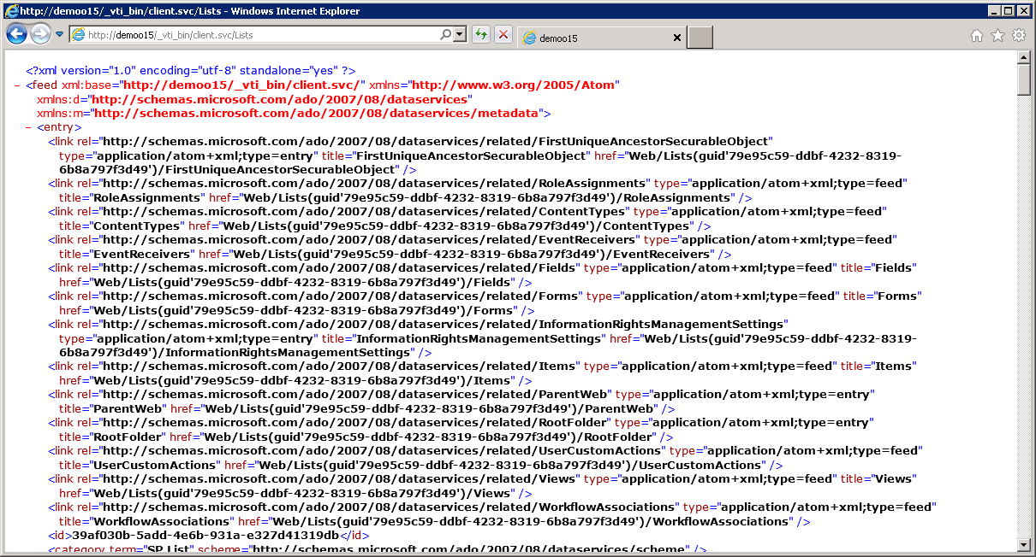
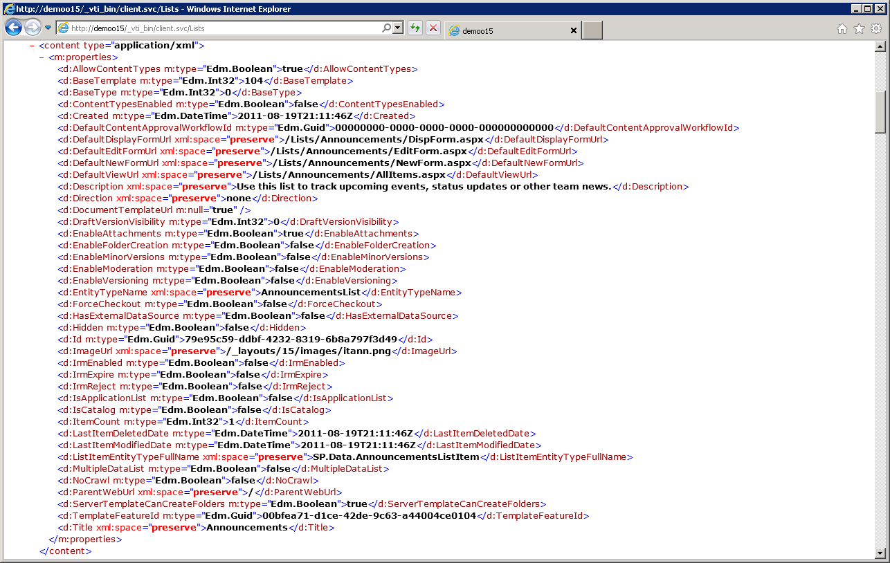
Testing REST Calls Through the Browser
Notes:
One of the best parts of REST is that it simplifies calling Web service operations. All you need is a browser that can authenticate against a SharePoint 2013 site and you can simply run queries by typing the REST-based URIs for HTTP GET operations. This becomes a fast and easy way for you to learn how to put together URIs that query, filter and sort content from SharePoint sites.

Slide 18
Executing REST Queries Through The Browser
Notes:
Manually enter some queries in the browser
http://clientside.wingtip.com/_api/web
http://clientside.wingtip.com/_api/web/lists
http://clientside.wingtip.com/_api/web/lists?$select=Title,Url
http://clientside.wingtip.com/_api/web/lists?$select=Title,Url&$filter=Hidden eq $false
http://clientside.wingtip.com/_api/web/lists/GetByTitle('Customers')/Items?$select=Title,Url

Slide 19
Agenda
Overview of CSOM and REST
Programming CSOM with C# and JavaScript
REST and ODATA Fundamentals
Making REST calls with C# and JavaScript

Slide 20
Returning ATOM XML vs. JSON
<entry xml:base="http://intranet.wingtip.com/_api/" xmlns="http://www.w3.org/2005/Atom" xmlns:d="http://schemas.microsoft.com/ado/2007/08/dataservices" xmlns:m="http://schemas.microsoft.com/ado/2007/08/dataservices/metadata" m:etag="&quot;0&quot;">
<id>http://intranet.wingtip.com/_api/Web/Lists(guid'0c165f0c-fc82-44e6-ae8c-3d0405d2cbb2')</id>
<category term="SP.List" scheme="http://schemas.microsoft.com/ado/2007/08/dataservices/scheme" />
<link rel="edit" href="Web/Lists(guid'0c165f0c-fc82-44e6-ae8c-3d0405d2cbb2')" />
<title />
<updated>2012-10-05T20:53:47Z</updated>
<author>
<name />
</author>
<content type="application/xml">
<m:properties>
<d:Title>Documents</d:Title>
</m:properties>
</content>
</entry>
Control data format response with ACCEPT header
ATOM-PUB (XML)
Verbose
Easier to read
ACCEPT = application/atom+xml
JSON
Condensed notation
Smaller payload
ACCEPT = application/json;odata=verbose
{
"d":{
"__metadata":{
"id":"F05C411B-943E-42A0-A5DF-205F5C75E673",
"uri":"http://intranet.wingtip.com/_api/Web/Lists(guid'0c165f0c-fc82-44e6-ae8c-3d0405d2cbb2')",
"etag":"\"0\"",
"type":"SP.List"
},
"Id":"0c165f0c-fc82-44e6-ae8c-3d0405d2cbb2",
"Title":"Documents"
}
}
Notes:
When you run REST-based queries against SharePoint 2013 sites, you have the option of having the data returned as either XML in the ATOM format or JSON (JavaScript Object Notation). The default behavior is to return XML but you can change this default behavior to return JSON by including the ACCEPT header with a value of "application/json“ or the more preferred “application/json;odata=verbose”. If you include the ACCEPT header with an explicit value of "application/atom+xml", this has the same result as the default behavior in that the results are returned as ATOM-based XML.
Both XML and JSON can be consumed client-side and server-side:
Both can be serialized and deserialized into strongly typed objects in managed code
ATOM-PUB: using standard XML serialization objects & techniques
JSON: using the JavaScriptSerializer object
In client-side code, XML is a bit more cumbersome to work with
ATOM-PUB: manual parsing of XML
JSON: community libraries, such as datajs (covered later), make it easier to consume

Slide 21
REST Query from Managed Code
Tips for making REST calls from managed code
Use HttpWebRequest & HttpWebResponse
Query XML using XDocument.Descendants
Or use JSON & JavascriptSeralizer / JSON.NET
// build request
Uri uri = new Uri(siteUrl + "/_api/web/lists/getByTitle('Documents')/?&select=Title");
HttpWebRequest request = WebRequest.Create(uri) as HttpWebRequest;
request.Credentials = CredentialCache.DefaultCredentials;
request.Accept = "application/atom+xml";
// send request
HttpWebResponse response = request.GetResponse() as HttpWebResponse;
// use LINQ to XML to get data
XDocument doc = XDocument.Load(response.GetResponseStream());
XNamespace nsDataService = "http://schemas.microsoft.com/ado/2007/08/dataservices";
string title = doc.Descendants(nsDataService + "Title").First().Value;
Notes:
If you are making REST calls into SharePoint 2013 using C# or VB.NET, there are a few tips to make things easier. First, .NET 4.0 added a two new classes named HttpWebRequest and HttpWebResponse which provide a few conveniences not offered by their base classes WebRequest and WebResponse. For example, there is a strongly-typed Accept property on the HttpWebRequest object that allows you to set the ACCEPT header.
When it's time to retrieve data values from elements within an XML document, it's time to abandon older XML APIs such as XMLReader in favor of LINQ to XML and the XDocument class. Retrieving data from an XML document using the Descendants property of an XDocument object as shown above makes dealing with nested elements and XML namespaces so much easier.

Slide 22
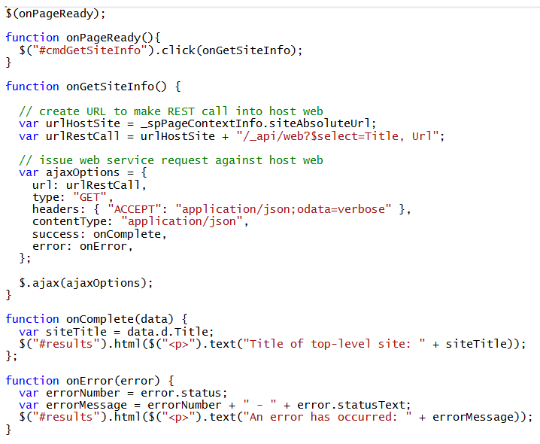
REST Query Using JavaScript & jQuery
Notes:
If you are executing REST-based queries against SharePoint 2013 sites using JavaScript, the first piece of advice is to use jQuery because it simples returning and processing JSON result sets. The code above uses the jQuery function $.ajax and explicitly sets the ACCEPT header to return a JSON result set. When jQuery calls the callback method (onComplete in this example) it passes a data parameter which represents that JSON results set which has already been converted from a string into JavaScript objects.

Slide 23
Updates and the Form Digest
Updates using REST require Form Digest
Digest is special value created using cryptography
Used to protect against replay attack
SharePoint master pages include Form Digest control
Web service client must acquire Form Digest
Form Digest can be acquired with POST to http://site/_api/contextinfo
POST request requires header Content-Length:0
Once acquired, Form Digest is valid for 30 minutes
Notes:
One thing that can be tricky is understanding the purpose of the Form Digest control. The purpose of this control is that it protects SharePoint against replay attacks. The Form Digest control does this by using cryptography to create a special value that is passed to the client browser. This value must be passed back to SharePoint and validated on requests that update objects or content within a SharePoint site. In many scenarios everything is transparent because the Form Digest control is added to master pages and does all the required work behind the scenes. However, when making updates with CSOM and REST there is no page postback so the form digest cannot do all that is required by itself.
When writing JavaScript behind pages in a SharePoint 2013 site, you often will be required to query the value of the Form Digest control and pass it back in a named header. Web service clients often do not have a page associated with it so they have to obtain a Form Digest value by making an explicit call into SharePoint before making updates. Note that a Form Digest value can be acquired through the older SOAP Web service entry point _vti_bin/sites.asmx. However, the recommended way to get the Form Digest is by sending a POST request to the REST web service entry point at /_api/context.

Slide 24
Creating Lists with Managed Code & REST
Parse together URL to point to lists collection
Add X-RequestDigest header with form digest value
Set HTTP method to POST
Create body content with new list info
// build request
Uri uri = new Uri(siteUrl + "/_api/web/lists";
HttpWebRequest request = WebRequest.Create(uri) as HttpWebRequest;
request.Accept = "application/atom+xml";
request.Headers["X-RequestDigest"] = FormDigest;
request.Method = "POST";
string body = Properties.Resources.CreateList_atom;
body = body.Replace("@Title", listTitle);
request.ContentLength = body.Length;
StreamWriter writer = new StreamWriter(request.GetRequestStream());
writer.Write(body);
writer.Flush();
// send request
HttpWebResponse response = request.GetResponse() as HttpWebResponse;
Notes:
This slide shows the code which demonstrates creating a new list using client-side C# code which uses the new REST entry point. The first task is to parse together a URL to point to a list collection which is _api/web/lists. The next task is to add the X-RequestDigest header which includes the value of the form digest. This example also sets the ContentType header to a value of application/atom+xml to tell SharePoint it is passing XML as opposed to JSON. Next, you must create an XML document that contains an Entry as defined by ATOM and conforms to the structure used by SharePoint 2013. The last task is to execute the request using an HTTP POST operation.

Slide 25
Creating Lists with JavaScript and REST
function onCreateList() {
var newList = {
"__metadata":{ "type":"SP.List" },
"BaseTemplate":105,
"TemplateFeatureId":"4AE88D99-DBBC-4B9E-95CC-CA3C320A2345",
"Title":"NewListName"
}
var requestHeaders = {
"ACCEPT":"application/json",
"X-RequestDigest":$("#__REQUESTDIGEST").val()
}
$.ajax({
url: _spPageContextInfo.webAbsoluteUrl + "/_api/web/lists",
type: "POST",
contentType: "application/json",
data: JSON.stringify(newList),
headers: requestHeaders,
success: onSuccess,
error: onError
});
}
Create appropriate JavaScript object and convert to JSON format for request body
Create request headers for HTTP Request
Get form digest value from control on page
Send request to Web server using jQuery $.ajax function
Convert request body data to string-based JSON object
Notes:
This code demonstrates how to create a new list using JavaScript and the jQuery library. Note that this is different from the previous example using C# because the entry is created using JSON instead of XML. Note that the code queries the value of the form digest control with the standard name of __REQUESTDIGEST and adds the value to the X-RequestDigest header. Also note that the $.ajax function can be used to execute the required HTTP POST operation which creates the list.

Slide 26
Querying and Updating Content Using REST
Notes:
Run setup for demo 3a to create a list
Show demo 3b to see how to execute queries via REST API

Slide 27
Summary
Overview of CSOM and REST
Programming CSOM with C# and JavaScript
REST and ODATA Fundamentals
Making REST calls with C# and JavaScript

