Slide 1
SharePoint Development Practices and Techniques
Notes:
With a solid understanding of the high-level structure of SharePoint 2013, students will then learn about the development options and tools available to them for creating custom solutions in this module. Not only are the tools and approaches covered, but an overview of the different APIs available for both server-side and client-side development are discussed in this module. Finally, some practices and techniques are demonstrated along with some useful tools (both those included with SharePoint as well as publically available free tools) for debugging & testing customizations.

Slide 2
Agenda
Extensibility & Development Options
Packaging Extensibility & Development Artifacts
SharePoint 2013 APIs
SharePoint Development Environment
SharePoint Development Tools & Utilities
Community Development Tools & Utilities
Client-Side Development Tools & Libraries
Windows PowerShell & SharePoint

Slide 3
Extensibility & Development Options
Audience: Power User
Browser
SharePoint Designer
Rich-client for SharePoint (sites, lists, libraries, etc.)
Workflow & External Content Type Designer
Audience: Developer
Solutions
Introduced in SharePoint 2007, updated in SharePoint 2010
SharePoint Apps
Introduced in SharePoint 2013
Marketplace distribution model
Ideal for Office 365
Notes:
SharePoint by its nature is a very customizable and extensible platform. For Power Users, you can customize and extend SharePoint using just the browser or by using the SharePoint Designer client. For Developers, you can customize and extend SharePoint either using SharePoint solutions (*.wsp) or using SharePoint Apps. Both of which will be covered throughout the course.

Slide 4
Extensibility & Development Options
Some options available in both deployment types
Sandboxed solutions: on-prem & hosted
SharePoint-hosted apps: on-prem & hosted
Provider-hosted apps: on-prem & hosted
Others available only in specific deployments
Farm solutions: on-prem
Autohosted apps: hosted
Notes:
As previously mentioned, there are two different types of extensibility options for SharePoint developers: apps and solutions. This slide shows that some of these are available in certain deployment scenarios while others are not.

Slide 5
Agenda
Extensibility & Development Options
Packaging Extensibility & Development Artifacts
SharePoint 2013 APIs
SharePoint Development Environment
SharePoint Development Tools & Utilities
Community Development Tools & Utilities
Client-Side Development Tools & Libraries
Windows PowerShell & SharePoint

Slide 6
Extensibility & Development Artifacts
Features
Used to deploy artifacts
List templates & instances, workflows, UI customizations, Web Parts
Solutions
Used to deploy code & files to SharePoint servers & sites
Usually includes Feature(s)
Package of files (*.wsp)
Apps
New in SharePoint 2013
Used to deploy solutions & other things that makeup app
Package of files (*.app)
Notes:
All types of extensibility models include one or more of the different artifacts depicted on the slide here. Some contain each other. For instance a Feature is an atomic unit of reuse to deploy certain artifacts to SharePoint. In order for these to get on the server, they are grouped together within a Solution which is used to deploy things to the server. While an App may not deploy anything to SharePoint, when it does (as in the case of a SharePoint-hosted app), it does so using a Solution that may or may not include one or more Features.

Slide 7
SharePoint Server-Side Object Model
Oldest & most mature API for SharePoint
Only available for custom code running on a SharePoint server
Farm solutions
Full access to complete server-side API
Sandbox solutions
Access to subset of server-side API
Apps
Not available – no server-side code on SharePoint box
Notes:
The oldest and most mature way to program against SharePoint is to use the server-side object model. This is available in solutions and is accessible from custom code running on the SharePoint server. However this model is being deprecated by Microsoft in favor of more client-friendly APIs.

Slide 8
SharePoint Client-Side Object Model (CSOM)
Introduced in SharePoint 2010
Multiple implementations:
Managed: .NET Framework & Silverlight
JavaScript
Expanded significantly increased coverage from CSOM in SharePoint 2010, including:
and many many more!
Business Data | Search | User Profile & Feeds
Publishing | Taxonomy | Workflow
Notes:
SharePoint 2010 introduced the client-side object model, also known as the CSOM. This enables developers to use .NET, Silverlight or JavaScript to interact with SharePoint from the SharePoint server. In SharePoint 2013 Microsoft greatly expanded the area and API enabling many more types of solutions to be built with the CSOM.

Slide 9
REST, OData & [..]/_API
SharePoint 2010 had one REST endpoint:
http://[..]/_vti_bin/ListData.svc
This has been deprecated in favor of new endpoints
All requests map to http://[..]/_vti_bin/client.svc
This is also the primary CSOM endpoint
New endpoint /_api/ maps to /_vti_bin/client.svc
Enables basic CRUD operations using REST interface & OData syntax
Queries crafted using OData syntax
Supports OAuth security
Notes:
In SharePoint 2013 the Service root URI contains the URI to the target SharePoint site and then the relative path to the client.svc entry point inside the _vti_bin virtual directory. After that you add the resource path to specify an object such as a site or list. Here's an example of a resource path for the current site.
http://intranet.wingtip.com/_vti_bin/client.svc/web
SharePoint 2013 allows REST URLs to go through _api folder which cleans up the look of the URLs that need to be built and removes client.svc file name from URL. The URL below is equivalent to the one above and should be preferred.
http://intranet.wingtip.com/_api/web

Slide 10
OData Primer
“THE” Data Access API for HTTP-based Clients
Based on open specification growing in popularity
Standardizes Data Access APIs for CRUD operations
OData services emerging on Internet (NetFlix, Azure)
OData clients also becoming popular (Excel 2010)
http://www.odata.org
Notes:
OData is quickly becoming the industry’s new data access API. Its popularity is based on the fact that it is the first mainstream data access API for HTTP-based clients. OData serves to standardize performing CRUD (Create, Read, Update, Delete) operations from across the network using HTTP verbs such as GET, PUT and POST.
OData services are becoming more popular on the Internet. Examples of OData services include NetFlix, Dallas, and the Azure Data Mart. Client application such as Excel 2010 and Excel 2013 are examples of applications that can consume data from any OData-based data source.

Slide 11
OData Implementation Details
OData maps CRUD operations to HTTP verbs
Read operations mapped to HTTP GET
Insert operations mapped to HTTP POST
Update operations mapped to HTTP PUT or MERGE
Delete operations mapped to HTTP DELETE
Methods will be mapped into either…
Navigator operations (e.g., lists.getByTitle) via GET
Modifcations via POST, PUT, MERGE or DELETE
Notes:
The primary purpose of OData is to map CRUD operations to HTTP verbs. For example, you can query data using an HTTP GET. You can add new entries (e.g. list items, database records) using an HTP POST. Updates are performed using either an HTTP PUT or an HTTP MERGE. You can delete entries using an HTTP DELETE.
The advantage of the HTTP Merge over the HTTP PUT for updates is that you can update some columns while leaving others with their original value. Updating an entry with the HTTP PUT operation will reset any column not explicitly assigned a value back to the default value.

Slide 12
OData URIs
URI has three significant parts
Service root URI
Resource path
Query string options
Notes:
To understand how to use OData as a developer, you must understand how OData URIs are constructed. Each URI has three significant parts: The first part of the URI is the Service root URI which points to a site on the Internet and a path to an entry point such as a .svc file. The next part of the URI is the Resource path which identifies a specific object such as a site, a collection (e.g list) or an entry (e.g. item). The final part of the URI is the optional query string parameters that allow you to request special processing instructions such as filtering and sorting.

Slide 13
Why is REST Important?
Significant Industry Momentum
Simpler and Easier to Use
Much easier to use than SOAP-based Web service
Higher productivity when using JavaScript and jQuery
Results can be returned in JSON or ATOM format
Each query is submitted with a unique URL
Results can be cached by proxy servers
Notes:
Over the last few years REST-based Web services have become increasing popular through the IT industry and particularly within Microsoft. REST-based Web services are much easier to use than SOAP-based Web service and therefore lower the barrier of entry to different types of potential clients. REST-based Web services are also much easier to call from JavaScript code especially when using the jQuery library.

Slide 14
Returning ATOM XML vs. JSON
<entry xml:base="http://intranet.wingtip.com/_api/" xmlns="http://www.w3.org/2005/Atom" xmlns:d="http://schemas.microsoft.com/ado/2007/08/dataservices" xmlns:m="http://schemas.microsoft.com/ado/2007/08/dataservices/metadata" m:etag="&quot;0&quot;">
<id>http://intranet.wingtip.com/_api/Web/Lists(guid'0c165f0c-fc82-44e6-ae8c-3d0405d2cbb2')</id>
<category term="SP.List" scheme="http://schemas.microsoft.com/ado/2007/08/dataservices/scheme" />
<link rel="edit" href="Web/Lists(guid'0c165f0c-fc82-44e6-ae8c-3d0405d2cbb2')" />
<title />
<updated>2012-10-05T20:53:47Z</updated>
<author>
<name />
</author>
<content type="application/xml">
<m:properties>
<d:Title>Documents</d:Title>
</m:properties>
</content>
</entry>
Control data format response with ACCEPT header
ATOM-PUB (XML)
Verbose
Easier to read
ACCEPT = application/atom+xml
JSON
Condensed notation
Smaller payload
ACCEPT = application/json;odata=verbose
{
"d":{
"__metadata":{
"id":"F05C411B-943E-42A0-A5DF-205F5C75E673",
"uri":"http://intranet.wingtip.com/_api/Web/Lists(guid'0c165f0c-fc82-44e6-ae8c-3d0405d2cbb2')",
"etag":"\"0\"",
"type":"SP.List"
},
"Id":"0c165f0c-fc82-44e6-ae8c-3d0405d2cbb2",
"Title":"Documents"
}
}
Notes:
When you run REST-based queries against SharePoint 2013 sites, you have the option of having the data returned as either XML in the ATOM format or JSON (JavaScript Object Notation). The default behavior is to return XML but you can change this default behavior to return JSON by including the ACCEPT header with a value of application/json or the more preferred “application/json;odata=verbose”. If you include the ACCEPT header with an explicit value of "application/atom+xml", this has the same result as the default behavior in that the results are returned as ATOM-based XML.
Both XML and JSON can be consumed client-side and server-side:
Both can be serialized and deserialized into strongly typed objects in managed code
ATOM-PUB: using standard XML serialization objects & techniques
JSON: using the JavaScriptSerializer object
In client-side code, XML is a bit more cumbersome to work with
ATOM-PUB: manual parsing of XML
JSON: community libraries, such as datajs (covered later), make it easier to consume

Slide 15
Deployment Types: Available Languages
Depending on the deployment type of your customizations, different languages are available
 | Farm Solution | Sandbox Solution | App (SP-Hosted) | App (Provider/Auto-Hosted)
C# / VB.NET
Managed code on SharePoint server
JavaScript

Slide 16
Agenda
Extensibility & Development Options
Packaging Extensibility & Development Artifacts
SharePoint 2013 APIs
SharePoint Development Environment
SharePoint Development Tools & Utilities
Community Development Tools & Utilities
Client-Side Development Tools & Libraries
Windows PowerShell & SharePoint

Slide 17
Development Environment Options
What types of things are you building?
SharePoint-hosted apps
Solutions apps
What you are building dictates the type of local development environment you need
SharePoint-Hosted Apps
Office 365 Napa App
What you need: Office 365 Developer Site & browser
Solutions, Provider-Hosted / Autohosted Apps
Visual Studio 2012 + Office & SharePoint Tools
What you need: Complete local development environment
Notes:
The type of development environment required is going to be dependent on the types of solutions you’ll be building. For instance, if you are only building apps, you might be able to get by with Visual Studio 2012, the SharePoint 2013 developer tools, an internet connection & a Office 365 account. However, if you are building solutions or more advanced apps, you might need a completely built out SharePoint developer environment.

Slide 18
Complete Development Environment
Local on-premises deployment of:
Prerequisites: SQL Server, Workflow Manager, etc.
SharePoint 2013 Server
Tools: Visual Studio, Office, SharePoint Designer
Recommended hardware
Host machine has 16GB+
Allocate 12GB+ to SharePoint VM
Complete environment setup guide available at www.CriticalPathTraining.com/Members
Notes:
Creating a SharePoint developer environment can be a tedious and complicated task. You can use a setup guide we’ve provided with detailed walk-through steps. We offer tis guide free of charge to the SharePoint community and distrubute it through the Members section of our website: www.criticalpathtraining.com.

Slide 19
Agenda
Extensibility & Development Options
Packaging Extensibility & Development Artifacts
SharePoint 2013 APIs
SharePoint Development Environment
SharePoint Development Tools & Utilities
Community Development Tools & Utilities
Client-Side Development Tools & Libraries
Windows PowerShell & SharePoint

Slide 20
“Napa” Office 365 Development Tools
All Office 365 Developer Sites have an unlimited license to the “Napa” app
Available in online SharePoint Store for free
Essentially a simplified and webified version of Visual Studio 2012
Client-side code only
Markup view for ASPX pages
Code-behind not allowed
Ideal for creating SharePoint-hosted apps
Can create many SharePoint 2013 or Office 2013 Apps
Can open the app in a local instance of Visual Studio 2012 to take it to the next level
Notes:
The NAPA tools for building apps is essentially a stripped down version of Visual Studio 2012 that runs in the browser. It cannot handle code-behind files, but it is useful in building custom solutions that are HTML, ASPX and JavaScript-based.

Slide 21
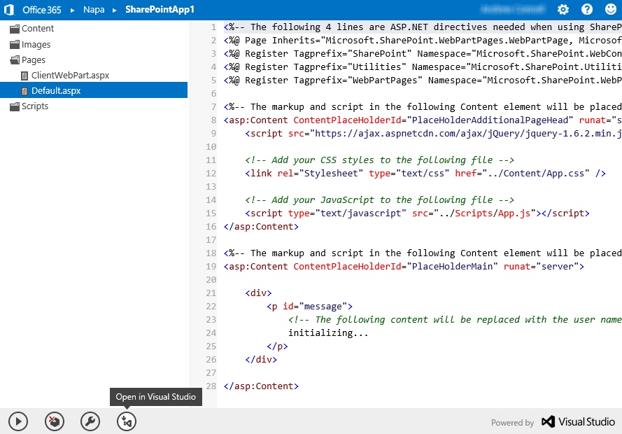
“Napa” Office 365 Development Tools

Slide 22
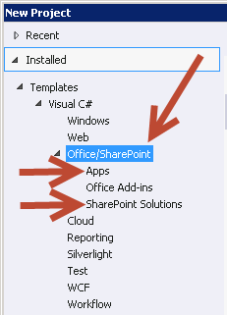
SharePoint Development Tools
Visual Studio 2012
Microsoft Office Developer Tools for Visual Studio 2012
Distributed via Microsoft’s Web Platform Installer
Developer tools include:
Project templates
Item templates
Designers & tool windows
Deployment & debugging steps
Notes:
Visual Studio 2012 has an extra addin you can download and install using the Web Platform Installer that adds support for developing SharePoint solutions apps and adds a bunch of useful tool windows to Visual Studio.

Slide 23
Exploring Development Tools: “Napa” & Visual Studio 2012
Notes:
Demo 1:
INTENRET CONNECTION REQUIRED
Add Napa app to Office 365 developer site
Create a new app
Write markup & JavaScript to show lists in site and site name
Open app in Visual Studio 2012
Demo 2:
Do same thing as above, except do it with Visual Studio 2012
Use local environment

Slide 24
Developer Dashboard Details
Introduced in SharePoint 2010
Showed only information about current request
SharePoint 2013 improvements
Shows requests from start of dashboard session
Surfaced as a popup window
Diagnostic data shown (per request):
Server Information | Service Calls
Scopes | ULS Entries (new)
SQL Queries from SharePoint API | Cache Calls (new)
SPRequests | Animation details (new)
Asserts | MDS details (new)
Notes:
The developer dashboard was introduced in SharePoint 2010 in an effort to assist developers with finding performance issues with custom components on a page. In SharePoint 2013 it has been improved to be surfaced as a popup window and track all requests for the current logged-in user (note: not all users, just the currently logged-in user).

Slide 25
Enabling & Using Developer Dashboard
Must be enabled via API:
Display mode OnDemand deprecated
Default: Off
Requires Usage & Health Data Collection Service Application instance, otherwise shows no data
$contentService = [Microsoft.SharePoint.Administration.SPWebService]::ContentService
$devDashboardSettings = $contentService.DeveloperDashboardSettings
if ($devDashboardSettings.DisplayLevel -eq "On"){
$devDashboardSettings.DisplayLevel = "Off"
} else {
$devDashboardSettings.DisplayLevel = "On"
}
$devDashboardSettings.Update()
Notes:
The dashboard must be enabled through the server-side SharePoint API such as with PowerShell as shown on the slide. This means that it is not available in Office 365. It is only available in SharePoint on-premises installations.

Slide 26
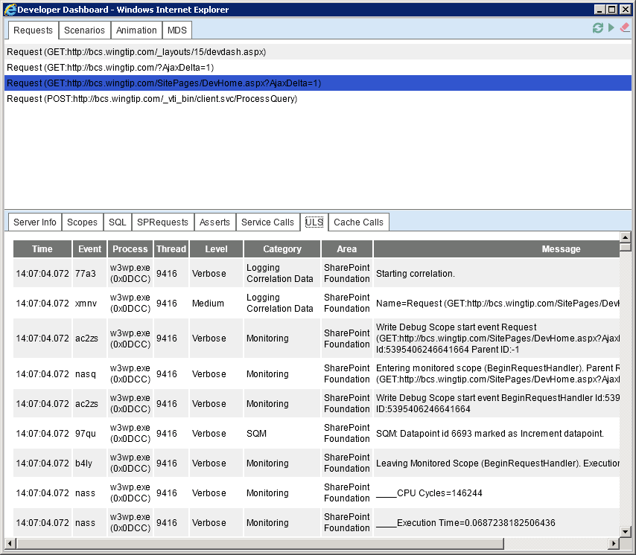
Developer Dashboard

Slide 27
Unified Logging Service
SharePoint’s log files
Located on each SharePoint server:
[..]\15\LOGS
Configure level of logging for different categories:
Central Administration → Monitoring → Configure Diagnostic Logging
Collecting logging data:
PowerShell: Merge-SPLogFile
Collects data from ULS into a new text file for analysis
Filter by category, message contents, time, correlation ID, event ID, etc.
Notes:
The SharePoint logging system is called the Unified Logging Service, or ULS for short. You can configure the level of logging through Central Administration for on-premises deployments only. In addition, when something occurs you can use the Merge-SPLogFile cmdlet to search across all servers in the farm and find all entries matching the message provided.

Slide 28
Writing to the Logging Information
Only possible from full trust farm solutions
Each scope is listed in dashboard
Wrap code in SPMonitoredScope
New constructor supports conditional scope: Microsoft.SharePoint.Administration.TraceSeverity
TraceSeverity set in the SharePoint Foundation → Monitoring category in ULS’ Diagnostic Logging confg.
Determine if dashboard is on within scope: SPMonitoredScope.IsDeveloperDashboardEnabled
Notes:
Developers can write to the ULS in custom solutions provided they are deployed in fully trusted farm solutions (this means you can’t do this in Office 365).

Slide 29
Developer Dashboard & Unified Logging Service
Notes:
Demo 1:
Show Usage & Health Data Collection service app
Enable dashboard
Open dashboard on the page & tour
Demo 2:
Write a farm solution with a web part
Include SPMonitoredScope, add a nested one too, use trace severity
Deploy & add to page
Open dashboard & navigate to page
See data from scope

Slide 30
Agenda
Extensibility & Development Options
Packaging Extensibility & Development Artifacts
SharePoint 2013 APIs
SharePoint Development Environment
SharePoint Development Tools & Utilities
Community Development Tools & Utilities
Client-Side Development Tools & Libraries
Windows PowerShell & SharePoint

Slide 31
Community Development Tools & Utilities
Web Essentials 2012
Visual Studio 2012 Extension in Online Gallery
Additional IntelliSense for CSS3
Warnings & helpers for browser compatibility issues
Selector IntelliSense for HTML elements, classes, IDs
Fiddler
HTTP debugging proxy
See everything in a request & associated response
Useful in debugging SharePoint ←→ Workflow
Useful in debugging JavaScript / client-side & REST based development
Notes:
With SharePoint moving to a more client-side or “off the SharePoint box” development model, there are many common web development tools that will be useful for developers.
The Web Essentials 2012 Visual Studio 2012 free add on is by a senior person on the Microsoft ASP.NET web development team and includes a TON of cross browser tools to make your life easier.
http://visualstudiogallery.msdn.microsoft.com/07d54d12-7133-4e15-becb-6f451ea3bea6
Fiddler is an HTTP debugging proxy that enables you to see the raw requests & responses coming form the currently logged in user:
http://www.fiddler2.com/fiddler2/

Slide 32
Using Fiddler: 101
Notes:
Open Fiddler
Explain the UI
Browse to a page
Inspect the request
Run process trigger OData with XML & JSON
Examine responses

Slide 33
Agenda
Extensibility & Development Options
Packaging Extensibility & Development Artifacts
SharePoint 2013 APIs
SharePoint Development Environment
SharePoint Development Tools & Utilities
Community Development Tools & Utilities
Client-Side Development Tools & Libraries
Windows PowerShell & SharePoint

Slide 34
Client-Side Development: Browsers
Browser-based development tools
View HTML
View & modify CSS
View & debug JavaScript
Internet Explorer
Developer Tools: included
FireFox
FireBug: extra download
Google Chrome
FireBug: extra download
Notes:
All popular browsers include developer tools for debugging JavaScript, understanding how a page is constructed client-side and inspecting CSS styles.

Slide 35
Client-Side Development: Tools
JSLint
JavaScript code quality tool
Originated as lint, a tool used to scan C programs
Necessary before compilers got better at warnings
Rigid code formatting rules
JSHint
Many JavaScript developers frustrated by JSLint rigidity
Forked version of JSLint
Detects errors & potential problems in JavaScript code
Rules are community driven
Included & supported in Web Essentials 2012
Notes:
http://www.jslint.com/lint.html
http://anton.kovalyov.net/2011/02/20/why-i-forked-jslint-to-jshint/
http://www.jshint.com/about/

Slide 36
Client-Side Development: Libraries
jQuery
http://www.jquery.com
Simplifies work of interacting with browser DOM
Cross-browser
Helps with selection, handling events
Library size: 32kb minified
<ol id="states">
<li>Florida</li>
<li>Washington</li>
</ol>
<script>
$(document).ready(function () {
$("#states li").hover(function () {
$(this).addClass("yellowHighlight");
}, function () {
$(this).removeClass("yellowHighlight");
});
});
</script>
Notes:
“jQuery is a fast and concise JavaScript Library that simplifies HTML document traversing, event handling, animating, and Ajax interactions for rapid web development. jQuery is designed to change the way that you write JavaScript.” – http://www.jquery.com

Slide 37
Client-Side Development: Libraries
DataJS
http://datajs.codeplex.com/
Cross-browser library for data-driven web applications
Simplifies working with OData & JSON responses
Library size: 58kb minified
<script>
OData.read("http://../Northwind/Northwind.svc/Categories", function (data) {
var html = "";
$.each(data.results, function (item) {
html += "<div>" + item.CategoryName + "</div>";
});
$(html).appendTo($("#target-element-id"));
});
</script>
Notes:
“datajs is a new cross-browser JavaScript library that enables data-centric web applications by leveraging modern protocols such as JSON and OData and HTML5-enabled browser features. It's designed to be small, fast and easy to use.” – http://datajs.codeplex.com

Slide 38
Client-Side Development: Libraries
jsRender
https://github.com/BorisMoore/jsrender
Templated rendering
Works very well in combination with JSON collections
$.template - create a template
$.render - generate output from JSON collections
<script>
var oDataResults = data.d.results;
renderingTemplate = "<li>{{=Title}}</li>";
$.template("templateLists", renderingTemplate);
var ol = $("<ol>");
ol.append($.render(oDataResults, "templateLists"));
$("#resultsDiv").append(ol);
</script>
Notes:
When dealing with JSON result sets, it is a common practice to parse together HTML elements to update the current page. The jsRender library is a very useful utility library because it allows you to construct complex HTML elements using a special syntax for creating templates. More information on this library can be found at the following URL:
https://github.com/BorisMoore/jsrender
You can also ready about using jsRender in these two MSDN articles:
http://msdn.microsoft.com/en-us/magazine/hh882454.aspx
http://msdn.microsoft.com/en-us/magazine/hh975379.aspx

Slide 39
Client-Side Development: Libraries
Knockout
http://www.knockoutjs.com
JavaScript implementation of MVVM pattern
Declarative bindings
Automatic UI refresh
Dependency checking
Templating
Library size: 40kb minified
Choose a ticket class:
<select data-bind="options: tickets, optionsText: 'name', value: chosenTicket"></select>
<p data-bind="with: chosenTicket">
You have chosen <b data-bind="text: name"></b>
($<span data-bind="text: price"></span>)
</p>
<script type="text/javascript">
function TicketsViewModel() {
this.tickets = [
{ name: "Economy", price: 199.95 },
{ name: "Business", price: 449.22 },
{ name: "First Class", price: 1199.99 }
];
this.chosenTicket = ko.observable();
this.resetTicket = function () { this.chosenTicket(null) }
}
ko.applyBindings(new TicketsViewModel());
</script>
Notes:
“Knockout is a JavaScript library that helps you to create rich, responsive display and editor user interfaces with a clean underlying data model. Any time you have sections of UI that update dynamically (e.g., changing depending on the user’s actions or when an external data source changes), KO can help you implement it more simply and maintainably.” - http://knockoutjs.com

Slide 40
JavaScript: Browsers & Libraries
Notes:
Demo 1:
Open IE & show developer dashboard
Show how to view CSS & Script
Add WINDOW to watch window & explore global variables
Demo 2:
Open FireFox & show developer dashboard
Show how to view CSS & Script
Add WINDOW to watch window & explore global variables
Demo 3:
Show sample web project using DataJS
Demo 4:
Show sample web project using KnockoutJS

Slide 41
Agenda
Extensibility & Development Options
Packaging Extensibility & Development Artifacts
SharePoint 2013 APIs
SharePoint Development Environment
SharePoint Development Tools & Utilities
Community Development Tools & Utilities
Client-Side Development Tools & Libraries
Windows PowerShell & SharePoint

Slide 42
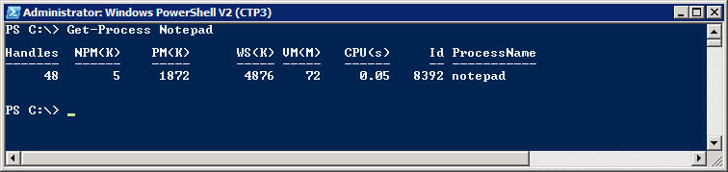
Windows PowerShell Primer for Beginners
What is Windows PowerShell?
Modern replacement for the CMD (command) shell
Powerful scripting environment for administration
Windows PowerShell fundamentals
Cmdlets (e.g. Get-Process and Stop-Process)
Pipelining and formatting features
Provider-based model for accessing resources
Notes:
Over the last few years, Windows PowerShell scripting has begun to replace older DOS-style batch files and VBScript files as the preferred way to manage and automate administrative tasks
Cmdlets are callable functions.
Pipelining allows one Cmdlet to return an object as input to another.
Windows PowerShell includes formatting features to display output using lists or tables.
Windows PowerShell is based on a provider-based model based on Snap-ins.

Slide 43
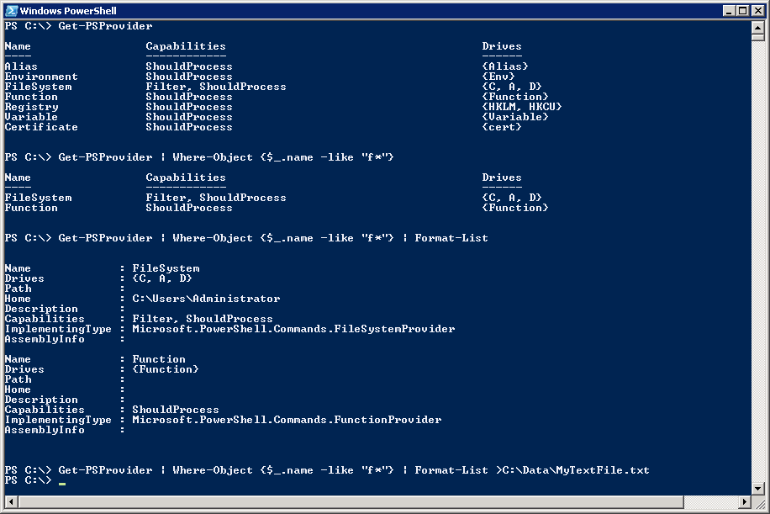
Getting Started with Windows PowerShell
(1) Execute a Cmdlet
(2) Filter results using where clause
(3) Add formatting instructions
(4) Redirect output to new text file
Notes:
The first example shows calling a Cmdlet that takes no parameters.
The second example adds filtering by adding a Where-Object cmdlet:
Where-Object {$_.name –eq "F*"}
The syntax $_ refers to the object in question
$_.name refers to the object's name property
-eq is the operator for equals
The third example adds in formatting instructions.
The last example redirects output so it is stored in a new text file.

Slide 44
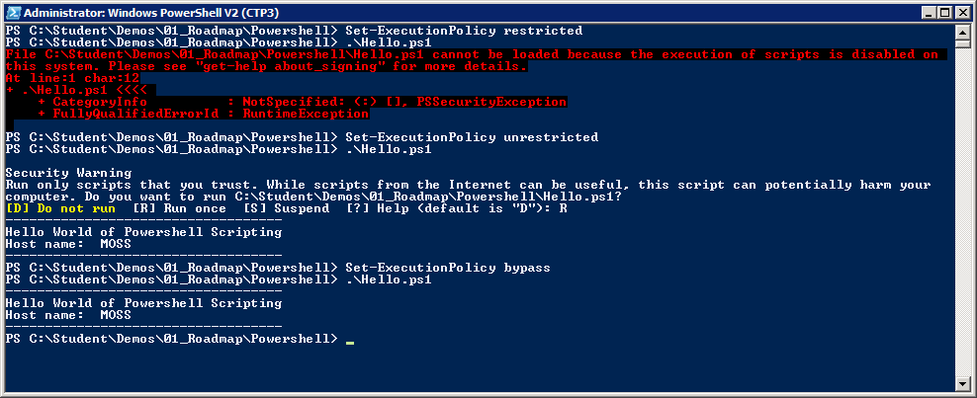
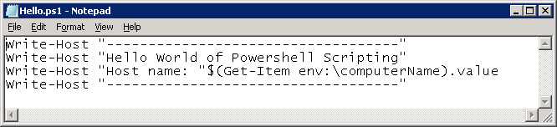
Scripts and Execution Policy
You can author Windows PowerShell scripts
Scripts have *.ps1 extension
Local execution policy must be configured
Scripts will not execute under default execution policy of restricted
Scripts can execute under execution policy of unrestricted. Scripts that are not signed result in prompting user for permission to execute.
Scripts can execute under execution policy of bypass. This mode suppresses prompting user for permission to execute.
Notes:
By default, Windows PowerShell does not allow scripts to run. The SharePoint Administrator must change execution policy to enable script execution.
There are a number of settings that you can apply to Execution Policy:
restricted (default) – Scripts prohibited from executing.
unrestricted - Scripts can execute. Scripts that are signed can run with user interaction. Scripts that are not signed result in prompting user for permission to execute.
bypass (developer mode) – Scripts can execute and user interaction is suppressed.

Slide 45
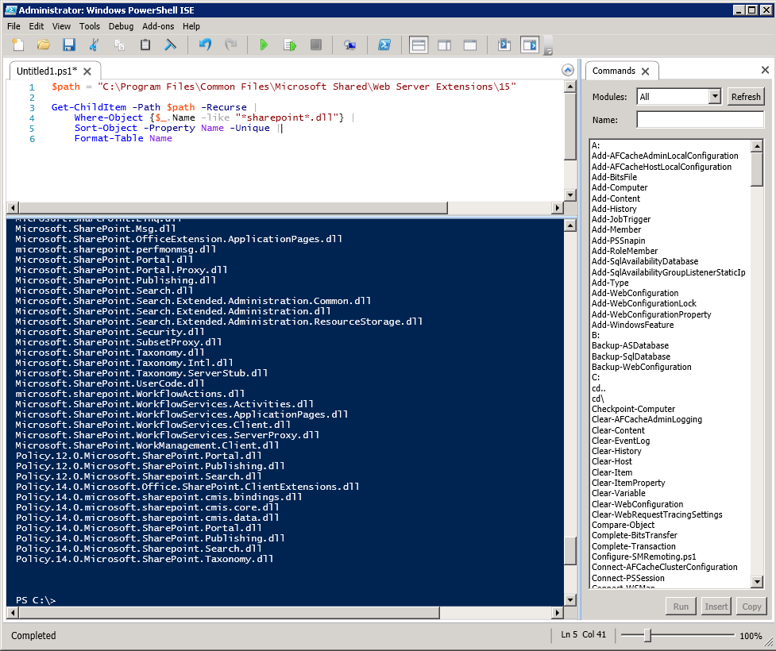
Windows PowerShell ISE
Supports color-coding, IntelliSense and debugging
Notes:
With the initial release of Windows Powershell, administrators and developers usually resorted to writing scripts with NotePad. Windows PowerShell 2 provides a nice development environment for writing Windows PowerShell scripts named the Windows PowerShell Integrated Scripting Environment (ISE).
When it comes to writing complex scripts with control of flow logic, it is really nice to be able to debug and single step through your code.

Slide 46
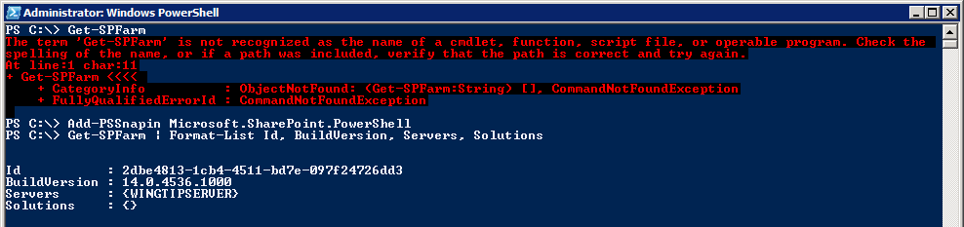
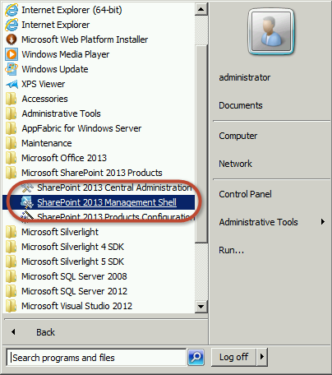
SharePoint Windows Powershell Snapin
Explicitly load SharePoint Windows PowerShell snap-in from console or script
Implicitly load snap-in by using link in Windows Start menu
Begin using SharePoint Cmdlets
Notes:
SharePoint Server 2013 adds many cmdlets for SharePoint administration through a Snap-in provider named Microsoft.SharePoint.PowerShell. The SharePoint cmdlets cannot be called until the SharePoint snap-in has been loaded.
There are two common ways to load the SharePoint snap-in:
Call the Add-PSSnapin cmdlet and pass a parameter with the snap-in name
Launch the Windows PowerShell console using SharePoint 2013 Management Console. This link points to an XML file that loads the SharePoint snap-in in a declarative fashion.

Slide 47
Windows PowerShell & SharePoint
Notes:
Use PowerShell Console
Show simple OOB Windows PowerShell stuff
Get-ChildItem
Pipeline
Show how to ask PowerShell for help
Get-Help
Get-Command
Get-Member
Show working with scripts
Execution policy
Show how possible to run remote commands on servers
Mention this is how some scripts in the course work
Show Integrated Scripting Environment
Show how to work with SharePoint PowerShell provider
Load snapin from OOB
Show how to launch the SharePoint Management Shell

Slide 48
Summary
Extensibility & Development Options
Packaging Extensibility & Development Artifacts
SharePoint 2013 APIs
SharePoint Development Environment
SharePoint Development Tools & Utilities
Community Development Tools & Utilities
Client-Side Development Tools & Libraries
Windows PowerShell & SharePoint

