Slide 1
Server-Side SharePoint Development
Notes:
This module covers everything students need to know about building solutions that run on the server and use the SharePoint Server-Side API. In this module you will learn how to setup LINQ for SharePoint and query lists as well as use the more traditional methods of working with SharePoint data using CAML, SPQuery and SPSiteDataQuery.

Slide 2
Agenda
Server-Side API Overview
Server-Side Data Access
CAML, SPQuery & SPSiteDataQuery
LINQ Primer
LINQ for SharePoint

Slide 3
Server-Side API Overview
Programming against the SharePoint server-side API is only possible in farm & sandboxed solutions
Not permitted in SharePoint Apps
Improvements / Additions in SharePoint 2013
App management
Most API investments are in client-side technologies
Data Access Options:
SPQuery & SPSiteDataQuery: CAML
LINQ: abstraction of CAML queries

Slide 4
Agenda
Server-Side API Overview
Server-Side Data Access
CAML, SPQuery & SPSiteDataQuery
LINQ Primer
LINQ for SharePoint

Slide 5
SharePoint CAML Overview
CAML: Collaborative Application Markup Language
Used as the “all-up” term for the various XML schemas defined in SharePoint
Usually references data access method
Similar to creating T-SQL statement but with XML
Still used in SharePoint 2013 in server-side solutions & client object model queries
Full SDK reference on MSDN:
http://msdn.microsoft.com/en-us/library/ms462365.aspx
Notes:
Collaborative Application Markup Language (CAML) is the schema defined and used by SharePoint. Introduced in SharePoint 2003, it is used to define things like lists, Features, workflows and also to query SharePoint lists.
It is similar to T-SQL in that developers use it to express the fields to SELECT, the WHERE cause for filtering data and how to sort the result set using ORDERBY. It is still the fastest way to access data stored within SharePoint lists, even with the introduction of LINQ for SharePoint.

Slide 6
Server-Side Data Access Overview
Multiple ways to get data out of SharePoint
Most common ways when server-side:
SPQuery
SPSiteDataQuery
Considerations for large data sets
If querying large data sets or cross site-collection data sets, consider using the search API
Search queries can be executed via server-side code or via new CSOM & REST support

Slide 7
SPQuery
Executes query against a single list
Developer must parse together CAML fragments
Access to columns is not strongly typed
SPList contacts = SPContext.Current.Web.Lists.TryGetList("Contacts");
if (contacts == null) return;
SPQuery query = new SPQuery();
// select LastName (Title), FirstName & Email
query.ViewFields = @"<FieldRef Name='Title' />
<FieldRef Name='FirstName' />
<FieldRef Name='Email' />";
// filter for only name starts with B and sort asc by name
query.Query = @"<Where>
<BeginsWith>
<FieldRef Name='FirstName'/><Value Type='Text'>B</Value>
</BeginsWith>
</Where>
<OrderBy>
<FieldRef Name='Title' /><FieldRef Name='FirstName' />
</OrderBy>";
SPListItemCollection results = contacts.GetItems(query);
foreach (SPListItem item in results){
string fullname = string.Format("{0} {1}", item["FirstName"].ToString(), item["Title"].ToString());
}
Notes:
Querying a list for specific items that meet a certain criteria can be done using the Microsoft.SharePoint.SPQuery object. The SPQuery.Query property accepts a CAML fragment, which defines the query to be performed. The SPQuery.ViewFields property defines the fields to return.
The SPQuery.ViewFields property accepts a CAML fragment containing a series of FieldRef XML elements. Each FieldRef XML element has a Name attribute that specifies the name of the list field to return from the query. Note that the Name attribute must contain the name of the field as it is defined in the schema.xml file for the list definition and not simply the display name of the field.
To create a query, you must construct a CAML fragment properly, defining the items to return from the list. At the highest level, the CAML fragment may contain Where, OrderBy, and GroupBy XML elements. Inside each of these elements, you can use additional CAML elements to specify conditions.

Slide 8
SPSiteDataQuery
Similar to SPQuery with respect to CAML parsing and no strongly typed access
Can execute query against multiple lists and aggregate results
Queries scoped to level of the site collection
SPSiteDataQuery query = new SPSiteDataQuery();
query.Webs = "<Webs scope='SiteCollection' />";
query.ViewFields = @"<FieldRef Name='Title' />
<FieldRef Name='FirstName' />
<FieldRef Name='Email' />";
query.Query = @"<Where>
<FieldRef Name='ContentType'/>
<Value Type='Computed'>Contact</Value>
</Where>";
DataTable results = SPContext.Current.Web.GetSiteData(query);
foreach(DataRow item in results.Rows){
string fullname = string.Format("{0} {1}", item["FirstName"].ToString(), item["Title"].ToString());
}
Notes:
If you want to query multiple lists within a site collection simultaneously, then you can make use of the Microsoft.SharePoint.SPSiteDataQuery object. Like the SPQuery object, the SPSiteDataQuery object has SPSiteDataQuery.Query and SPSiteDataQuery.ViewFields properties. In addition to these fields, the SPSiteDataQuery object also has SPSiteDataQuery.Lists and SPSiteDataQuery.Webs properties. The SPSiteDataQuery.Lists property is used to specify the lists within the site collection that should be included in the query. The SPSiteDataQuery.Webs property is used to determine the scope of the query.
The Lists property is a CAML fragment that can take several forms to specify the lists to include in the query. Setting the property to <Lists ServerTemplate=“[value]” /> limits the query to lists of a certain server template. For example, type 106 is a calendar. Setting the property to <Lists BaseType=“[value]”/> limits the query to lists of a certain BaseType. Setting the property to <Lists Hidden=“true”/> includes hidden lists in the query. Setting the property to <Lists MaxListLimit=“[value]” /> limits the query to considering no more than the specified number of lists.
The SPSiteDataQuery.Webs property is a CAML fragment that must either be <Webs Scope=“SiteCollection” /> or <Webs Scope=“Recursive”/>. SiteCollection includes all lists in the site collection while Recursive includes only those lists in the current site or subsites beneath the current site.

Slide 9
CAML, SPQuery & SPSiteDataQuery

Slide 10
Agenda
Server-Side API Overview
Server-Side Data Access
CAML, SPQuery & SPSiteDataQuery
LINQ Primer
LINQ for SharePoint

Slide 11
Generic Collection Classes
.NET 1.0 introduced IEnumerable collections
Allows for enumeration using foreach syntax
Collection item based on System.Object which is not type safe
.NET 2.0 introduced generic collections and type safety
Generics types in System.Collection.Generics namespace
Collection classes such as List<T> allow you to specify type
Allows you to create collections with type safety enforced
ArrayList list = new ArrayList();
list.AddRange(new string[] { "John", "Paul", "George", "Ringo" });
foreach (string item in list){
Console.WriteLine(item);
}
List<string> list = new List<string>();
list.AddRange(new string[] { "John", "Paul", "George", "Ringo" });
foreach (string item in list){
Console.WriteLine(item);
}
Notes:
.NET 1.0 introduced the IEnumerable collections that allowed for enumerating collections using the foreach syntax.
.NET 2.0 introduced generic collections and type safety. By defining collections of type List<T> your can create strongly typed lists of objects that can be accessed by index. It provides methods to search, sort, and manipulate lists.
The foreach statement of the C# language (For Each in Visual Basic) hides the complexity of the enumerators. Therefore, using foreach is recommended, instead of directly manipulating the enumerator.

Slide 12
The IEnumerable<T> Interface
Provides the foundation for all of LINQ
Guarantees capability for type safe enumeration
Automatically implemented by .NET Framework arrays
Implemented by all generics collection classes
Implemented by any and all LINQ-friendly collections
private static void CollectionsOfFun()
{
// string array
string[] list1 = new string[] { "John", "Paul", "George", "Ringo" };
// list collection
List<string> list2 = new List<string>() { "John", "Paul", "George", "Ringo" };
// queue collection
Queue<string> list3 = new Queue<string>();
list3.Enqueue("John"); list3.Enqueue("Paul");
list3.Enqueue("George"); list3.Enqueue("Ringo");
// all collections implement IEnumerable<T>
PrintToConsole(list1);
PrintToConsole(list2);
PrintToConsole(list3);
}
private static void PrintToConsole(IEnumerable<string> collection) { }
Notes:
The IEnumerable<T> interface is the foundation of LINQ to Objects.The IEnumerable<T>offers collections of strongly typed objects and is automatically implemented by .NET generic collection classes.
All of the collections in the System.Collections.Generic namespace support the IEnumerable<T> interface. This makes it possible to query them using LINQ to Objects.
In addition, LINQ queries offer two main advantages over traditional foreach loops:
They are more concise and readable, especially when filtering multiple conditions.
They provide powerful filtering, ordering, and grouping capabilities with a minimum of application code.

Slide 13
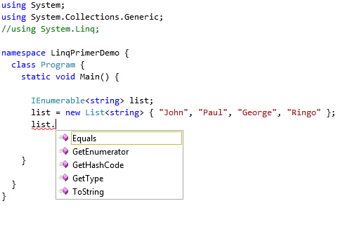
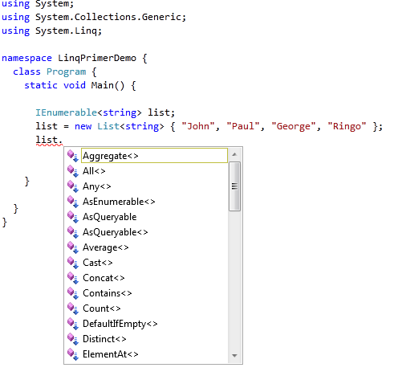
LINQ Extension Methods
Extension methods feature added to .NET 3.0
Allows developers to extend existing types
LINQ adds extension methods to IEnumerable<T>
Make sure to import System.Linq namespace
standard IEnumerable<T> methods
Extension methods added by LINQ
Notes:
.NET 3.0 came with a number of new features, extension methods being one of them. Extension methods enable you to "add" methods to existing types without creating a new derived type, recompiling, or otherwise modifying the original type.
The most common extension methods are the LINQ standard query operators that add query functionality to the existing IEnumerable<T> types. To use the standard query operators, first bring them into scope with a using System.Linqdirective. Then any type that implements IEnumerable<T> appears to have instance methods such as GroupBy, OrderBy, Average, and so on. You can see these additional methods in IntelliSense statement completion when you type "dot" after an instance of an IEnumerable<T> type such as List<T> or Array.

Slide 14
Using LINQ Extension Methods
LINQ extension methods add functionality
Provides common list-based operations
Can be used on any IEnumerable<T> collection
IEnumerable<string> list1, list2, list3;
list1 = new List<string>() { "John", "Paul", "George", "Ringo" };
list2 = new List<string>() { "Mick", "Keith", "Brian", "Charlie"};
int listSize = list1.Count();
bool isKeithInList = list2.Contains("Keith");
list3 = list1.Concat(list2);
Notes:
In short, LINQ extension methods add functionality to any type that implements IEnumerable<T> . It provides common list-based operations like Contains, Count, Distinct, GroupBy, OrderBy, Average, and so on.

Slide 15
Filtering with the Where Extension Method
Call to Where uses one of three techniques
Explicit delegate
Anonymous Delegate
Lambda expression
private static void WhereIsTheFun() {
IEnumerable<string> list1, list2, list3, list4;
list1 = new List<string>() { "John", "Paul", "George", "Ringo" };
// technique 1: named delegate & WHERE method
Func<string, bool> delegateFilterMethod = StringHasFourCharacters;
list2 = list1.Where(delegateFilterMethod);
// technique 2: anonymous delegate
list3 = list1.Where(delegate(string value){ return (value.Length == 4); });
// technique 3: lambda
list4 = list1.Where(value => value.Length == 4);
}
private static bool StringHasFourCharacters(string value){
return (value.Length == 4);
}
Notes:
LINQ to Objects represents a different approach to working over collections. In the old way, you had to write complex foreach loops that specified how to retrieve data from a collection. In the LINQ approach, you write declarative code that describes what you want to retrieve.
With LINQ you can filter collections using the Where extension method. A first technique is to create a delegate and pass that delegate to the Where method. This technique requires a method to exist in the code. Many of these methods will only get used in a single call.
To avoid having to develop numerous filter methods, you can use a second technique, which is the technique of using an anonymous delegate. The filtering code delegate is written inline in the Where clause using the delegate keyword.
A shorter notation for anonymous delegates is the use of lambda expressions. A lambda expression is a very concise way to construct the expression tree. The lambdas allow the Where calls to look similar, although in fact the type of object created from the lambda is different.

Slide 16
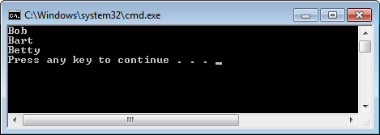
Lambda Expressions
Important to understand when using LINQ
Name "lambda" makes them seem harder then they are
Concise syntax to inline (1) parameter list and (2) statement body
IEnumerable<string> list1, list2, list3, list4, list5;
list1 = new List<string>() { "John", "Paul", "George", "Ringo" };
// find all names that start with G
list2 = list1.Where(value => value.StartsWith("B"));
// sort by the name length
list3 = list1.OrderBy(value => value.Length);
// switch the order
list4 = list1.Reverse();
// only get the first two items in the list
list5 = list1.Take(2);
Input Parameter(s)
Lambda Operator
Statement Block
read as "value goes into value starts with B"
Notes:
All lambda expressions use the lambda operator =>, which is read as "goes into". The left side of the lambda operator specifies the input parameters (if any) and the right side holds the expression or statement block.

Slide 17

LINQ Query Expressions
LINQ provides syntax for writing queries
Designed to seem natural, intuitive and readable
IEnumerable<string> list = new List<string>() { "John", "Paul", "George", "Ringo" };
IEnumerable<string> query = from item in list
where item.StartsWith("B")
orderby item.Length
select item;
foreach (string s in query) {
Console.WriteLine(s);
}
computation
range variable
data source
query clauses
projection
Notes:
The type IEnumerable<T> plays two key roles in this code.
The query expression has a data source called list which implements IEnumerable<T>.
The query expression returns an instance of IEnumberable<T>.
Every LINQ to Objects query expression, including the one shown above, will begin with a line of this type:from item in list.
In each case, the data source represented by the variable list must support the IEnumerable<T> interface. The list of strings shown in this example supports that interface.

Slide 18
LINQ Support for Custom .NET Objects
new C# 3.0 syntax for automatic properties
public class WingtipCustomer {
public string FirstName { get; set; }
public string LastName { get; set; }
public string Company { get; set; }
public string BusinessPhone { get; set; }
public string HomePhone { get; set; }
public string EMail { get; set; }
}
new C# syntax for creating and initializing object
designed to replace this old-school syntax
WingtipCustomer c1 = new WingtipCustomer {
FirstName = "Bobby",
LastName = "Simpson",
Company = "Mega Corp",
BusinessPhone = "1(425)345-6789",
HomePhone = "1(425)987-6543",
EMail = "Bobby.Simpson@MegaCorp.com"
};
WingtipCustomer c2 = new WingtipCustomer();
c2.FirstName = "Homer";
c2.LastName= "Jones";
c2.Company = "Acme Corp";
c2.BusinessPhone = "1(425)123-4567";
c2.HomePhone = "1(425)765-4321";
c2.EMail = "Homer.Jones@AcmeCorp.com";
Here is a sample method that returns a LINQ-friendly collection of custom objects
public static IEnumerable<WingtipCustomer> GetCustomerList() {
return new List<WingtipCustomer>() {
// create first customer
new WingtipCustomer{ FirstName="Homer", LastName="Jones", Company="Acme Corp",
BusinessPhone="1(425)123-4567", HomePhone="1(425)765-4321",
EMail="Homer.Jones@AcmeCorp.com" },
// create second customer
new WingtipCustomer{ FirstName="Bobby", LastName="Simpson", Company="Mega Corp",
BusinessPhone="1(425)345-6789", HomePhone="1(425)987-6543",
EMail="Bobby.Simpson@MegaCorp.com" }
};
}
Notes:
LINQ to Objects refers to the use of LINQ queries with any IEnumerable or IEnumerable<T> collection directly.

Slide 19
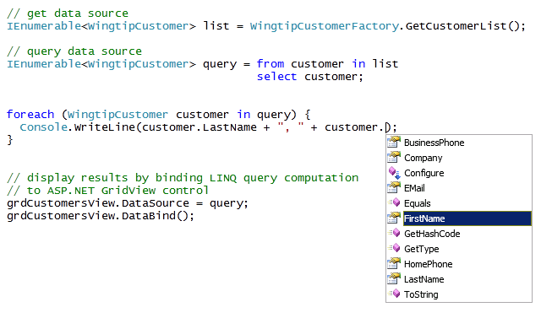

Querying Custom .NET Objects
Custom objects can be queried
You still benefit from strong typing and IntelliSense
ASP.NET GridView supports simple binding
Notes:
As collections of type IEnumerable<T> allow for collecting strongly typed objects, you can query and work with custom .NET objects using LINQ. The objects retrieved from the collection are still strongly typed and IntelliSense is available.

Slide 20

Type Inference and the var Keyword
var keyword allows you to use type inference
Compiler determines type being used by your code
You still get strong typing and IntelliSense
this code can be rewritten using var keyword
IEnumerable<WingtipCustomer> list = WingtipCustomerFactory.GetCustomerList();
IEnumerable<WingtipCustomer> query = from rv in list select rv;
foreach (WingtipCustomer customer in query) {
Console.WriteLine(customer.LastName + ", " + customer.FirstName);
}
using var can make code more concise, more adaptable and more readable
var list = WingtipCustomerFactory.GetCustomerList();
var query = from rv in list select rv;
foreach (var customer in query) {
Console.WriteLine(customer.LastName + ", " + customer.FirstName);
}
hover mouse over var keyword to see type
Notes:
Another useful feature of LINQ is the use of Type Inference. Type Inference allows the compiler to decide the data type of a variable at run time. This can be useful when using variables of which you don't know the data type. In order to use Type Inference in C#, we are required to use the new keyword var.
The var keyword allows you to defer typing until you know the type of the object you are working with.

Slide 21
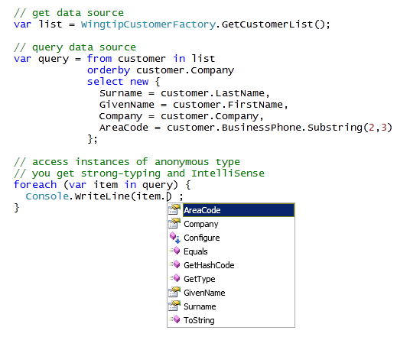


Projections using Anonymous Types
select clause can project an anonymous type
Rename columns and create calculated columns
No loss in type safety or IntelliSense
this anonymous class defines four properties
Notes:
Projection is the technique of taking a collection of one type, filtering it and/or sorting it, and then projecting a collection of a new type. The select extension method is what you use to implement projection on a collection. The new type is called an anonymous type.
Anonymous types provide a convenient way to encapsulate a set of read-only properties into a single object without having to first explicitly define a type. The type name is generated by the compiler and is not available at the source code level. Anonymous types are typically used in the select clause of a query expression to return a subset of the properties from each object in the source collection.
The select clause offers the ability to rename columns and to create calculated columns. The anonymous type declaration starts with the new keyword.

Slide 22

Query Composition
Queries can execute against output others
Allows for composition of queries
var query1 = from customer in list
select new {
Surname = customer.LastName,
GivenName = customer.FirstName,
Company = customer.Company,
AreaCode = customer.BusinessPhone.Substring(2, 3)
};
// run second query on computational output of first query
var query2 = from customer in query1
orderby customer.AreaCode
select customer;
Notes:
Executing a LINQ query results in a new set of objects. This set can be used as the source for a second LINQ query.

Slide 23
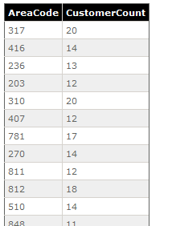
Grouping and Aggregation
LINQ support group by syntax
Allows for aggregate operations (e.g. Count and Sum)
Grouping create using into keyword
var query1 = from customer in list
select new { AreaCode = customer.BusinessPhone.Substring(2, 3) };
// create query with group-by-into to perform aggregation
var query2 = from customer in query1
group customer by customer.AreaCode into AreaCodeGrouping
select new {
AreaCode = AreaCodeGrouping.Key,
CustomerCount = AreaCodeGrouping.Count()
};
Notes:
Another extension method in LINQ is group by. Essentially, the clause is group the objects by a list of fields by which to group the records, then into followed by a list of aggregate expressions to calculate. In addition to aggregate expressions, the into clause can also contain the keyword new to create a new type of object.

Slide 24
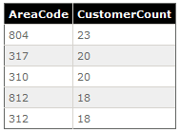
Putting it all Together
Find the top 5 area codes by customer count
// calculate area code for each customer
var query1 = from customer in list
select new { AreaCode = customer.BusinessPhone.Substring(2, 3) };
// group customers by area code
var query2 = from customer in query1
group customer by customer.AreaCode into AreaCodeGrouping
select new {
AreaCode = AreaCodeGrouping.Key,
CustomerCount = AreaCodeGrouping.Count()
};
// sort area codes by customer count descending
var query3 = from AreaCode in query2
orderby AreaCode.CustomerCount descending
select AreaCode;
// take first 5 items from collection
var query4 = query3.Take(5);
Notes:
This sample code executes a number of queries, each time returning a collection of objects of anonymous type, and serving as the source for the new query.

Slide 25
Agenda
Server-Side API Overview
Server-Side Data Access
CAML, SPQuery & SPSiteDataQuery
LINQ Primer
LINQ for SharePoint

Slide 26
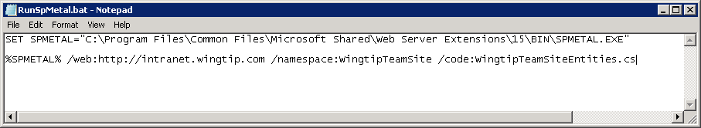
Creating Entity Classes with SPMETAL
SPMetal.exe essential to LINQ to SharePoint
Command-line utility which is part of SharePoint install
Used to generate strongly-typed entity classes
Each entity class represents a SharePoint list
SPMetal.exe also generates DataContext class
How do you use SPMetal.exe?
Call it from a batch file and pass URL to site
Take generated source file and add it to your project
Notes:
SharePoint comes with a LINQ provider for SharePoint called LINQ to SharePoint. You can use the SPMetal tool, which is a command line tool, to generate entity classes that provide an object oriented interface to the SharePoint content. Each entity class represents a SharePoint list.
SPMetal also generates a DataContext class.
The tool is included with SharePoint Foundation and is located in the [..]\15\BIN folder. SPMetal accepts arguments like:
/web: specifies the URL to SharePoint site for which you want to generate entity classes.
/namespace: the namespace in which the entity classes will reside.
/code: the name of the class that will be generated.
You can copy the generated source file to your project folder and add it to your Visual Studio project. SPMetal generates partial classes, so that you can easily add methods and properties in separate code files, and do not have to modify the generated code.

Slide 27
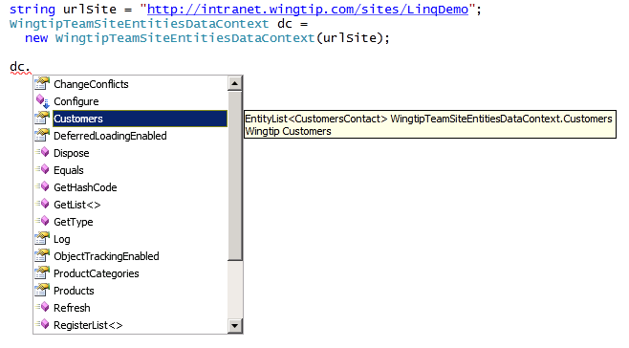
DataContext Object
DataContext represents connection to site
Provides strongly-typed access to list as EntityList<T>
Notes:
The heart of the LINQ to SharePoint experience is the DataContext object. The DataContext object is retrieved from the SPWeb and allows access to the lists in the SPWeb.
Once entity classes are created, they may be used in LINQ queries. These classes are primarily used in LINQ to SharePoint queries, but they can also be used to add, delete, and change list items.

Slide 28
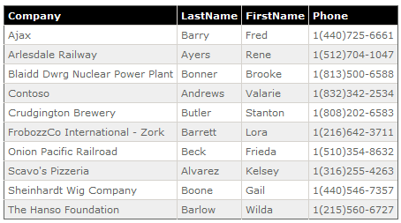
Querying Items in a List
Query list items using LINQ query expressions
const string urlSite = "http://intranet.wingtip.com";
WingtipTeamSiteEntitiesDataContext dc = new WingtipTeamSiteEntitiesDataContext(urlSite);
var query = from customer in dc.Customers
where customer.LastName.StartsWith("A") |
customer.LastName.StartsWith("B")
orderby customer.Company
select new
{
Company = customer.Company,
LastName = customer.LastName,
FirstName = customer.FirstName,
Phone = customer.BusinessPhone
};
Notes:
You can query the SharePoint content using LINQ queries. The sample code retrieves all customers having a last name starting with A or B. The orderby clause sorts the customers by company. The resulting objects will be of a trimmed version of the customer class, only containing the columns Company, LastName, FirstName and BusinessPhone.

Slide 29
Adding Items to a List
Entity classes provide InsertOnSubmit method
Method accepts strongly-typed entity class instance
You must explicit save changes through DataContext
CustomersContact newCustomer =
new CustomersContact {
FirstName = txtFirstName.Text,
Title = txtLastName.Text,
Company = txtCompany.Text,
BusinessPhone = txtWorkPhone.Text,
HomePhone = txtHomePhone.Text,
EMail = txtEMail.Text
};
dc.Customers.InsertOnSubmit(newCustomer);
dc.SubmitChanges();
Notes:
Entity classes provide an InsertOnSubmit method. This method accepts a strongly-typed entity class instance that represents the list item that needs to be created. You must call the SubmitChanges method to save the changes through the DataContext.

Slide 30
LINQ for SharePoint

Slide 31
Summary
Server-Side API Overview
Server-Side Data Access
CAML, SPQuery & SPSiteDataQuery
LINQ Primer
LINQ for SharePoint

