Slide 1
Understanding SharePoint 2013
Notes:
In this module students will get up to speed on SharePoint 2013 both from a SKU/license perspective as well as from a capability & architectural perspective. The different deployment models will also be covered in depth (on-premises / hosted [Office 365] / hybrid) and an overview on the different development and extensibility options.

Slide 2
Agenda
SharePoint History
Significant Changes from SharePoint 2010
SharePoint 2013 Topology & Architecture
SharePoint 2013 Deployment Options
Extensibility Options
Course Introduction

Slide 3
SharePoint 2007
Windows SharePoint Services (WSS) 3.0
At its core, a site and list provisioning engine
Recognized by SharePoint Developers as a "platform"
Microsoft Office SharePoint Server (MOSS) 2007
Built on top of WSS 3.0
Provides extra components and services Enterprise Search, Forms Services, WCM, ECM, BDC, etc…
The Old World
Browser Clients
Microsoft Office SharePoint Server 2007 (MOSS)
MS Word Clients
Windows SharePoint Services 3.0 (WSS v3)
MS Outlook Clients
.NET Framework 3.0
Internet Information Services 6.0 or 7.0
Windows Server 2003 or 2008 (32-bit or x64)

Slide 4
SharePoint 2010
Microsoft SharePoint Foundation (SPF) 2010
Renamed from Windows SharePoint Services (WSS)
Microsoft SharePoint Server (SPS) 2010
Browser Clients
Microsoft SharePoint Server 2010
MS Word Clients
Microsoft SharePoint Foundation 2010
MS Outlook Clients
.NET Framework and ASP.NET 3.5 SP1
Internet Information Services 7.0
Windows Server 2008 (x64 only) for Production Environments
Windows 7 or Vista (x64 only) for Development Environments only
requires a 64-bit OS
built On .NET 3.5 SP1
development now supported on client OS
Notes:
SharePoint Foundation 2010 is the next version of Windows SharePoint Services 3.0.
SharePoint Server 2010 is the next version of the SharePoint technology stack. There different SKUs for SharePoint Server 2010:
SharePoint Foundation 2010
SharePoint Server 2010 Standard
SharePoint Server 2010 Enterprise
SharePoint Server 2010 for Internet Sites, Standard
SharePoint Server 2010 for Internet Sites, Enterprise
SharePoint 2010 only runs on 64-bit operating systems. This is different from MOSS 2007 and WSS 3.0 which ran on either a 32-bit OS or a 64-bit OS.
SharePoint 2010 is the first version of the product that supports installation on a client operating system for development. The supported client operating systems include 64-bit version of Windows 7 and Windows Vista.

Slide 5
SharePoint 2013
Microsoft SharePoint Foundation (SPF) 2013
Platform provides core collaboration capabilities
Microsoft SharePoint Server (SPS) 2013
Built on top of SPF 2013
Browser Clients
Microsoft SharePoint Server 2013
MS Word Clients
Microsoft SharePoint Foundation 2013
MS Outlook Clients
.NET Framework 4.5
Internet Information Services 7.0
Windows Server 2008 R2 SP1 (x64 only)
Windows Server 2012 (x64 only)
Notes:
SharePoint Foundation 2013 is the free version of SharePoint that provides the core collaboration capabilities. SharePoint Server 2013 is the next version of the SharePoint technology stack.
Like SharePoint 2010, SharePoint 2013 only runs on 64-bit operating systems. It is supported on both Windows Server 2008 R2 w/ Service Pack 1 or on the latest release of Windows Server: Windows Server 2012.
However unlike SharePoint 2010, SharePoint 2013 cannot be installed on a client operating system such as Windows 7 or Windows 8. However there are some developer extensibility opportunities for SharePoint 2013 where all you need is a browser, Internet connection and a developer instance of Office 365. Others only require Visual Studio 2012.

Slide 6
Agenda
SharePoint History
Significant Changes from SharePoint 2010
SharePoint 2013 Topology & Architecture
SharePoint 2013 Deployment Options
Extensibility Options
Course Introduction

Slide 7
Significant Changes in SharePoint 2013
New Development Model
App Marketplace
Minimal Download Strategy (MDS) UX
Architectural Changes
Workflow
Search
Web Content Management
Deprecated / Removed Capabilities
SharePoint Designer’s Design View
Meeting & Document Workspaces
BI: Chart Web Part, Status Indicators & Status Lists
Web Apps = Claimed Based Authentication by default
Notes:
More information on Minimal Download Strategy (MDS):
http://www.wictorwilen.se/sharepoint-2013---introduction-to-the-minimal-download-strategy-mds

Slide 8
Agenda
SharePoint History
Significant Changes from SharePoint 2010
SharePoint 2013 Topology & Architecture
SharePoint 2013 Deployment Options
Extensibility Options
Course Introduction

Slide 9
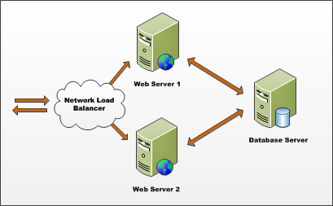
Farms
SharePoint deployment based on farms
Farm requires Web server(s) and database server
Farm can be single server or multi-server
Each farm has exactly one configuration database
Single-server farm used for development environments
Notes:
A SharePoint Farm is simply a collection of servers that have SharePoint installed on them and are all connected to the same configuration database (aka: the config DB).

Slide 10
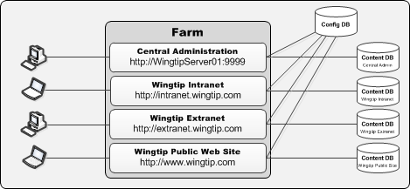
Web Applications
Web Applications provide HTTP entry points
Web Applications based on IIS Web sites
Web Application defines one or more URL spaces
Web Application security configured independently
Notes:
SharePoint sites and content live within SQL Server databases called “content databases”. SharePoint is primarily a Web-based application. Microsoft uses Web applications, also referred to as Web Sites in Internet Information Services (IIS), as the HTTP/HTTP entry point into SharePoint site collections.

Slide 11
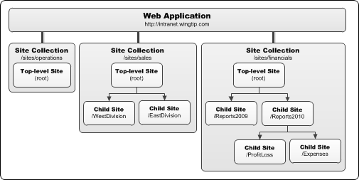
Site Collections and Sites
Sites are partitioned into Site Collections
Site collection is scope for administrative privileges
Site collection always contains top-level site
Site collection may contain hierarchy of child sites
Web application can support 1000s of site collections
Notes:
All content resides in SharePoint sites. These sites contain lists, document libraries and other subsites.
Sites are grouped into site collections. Each site collection must have exactly one site referred to as the “top-level” or “root” site. This site has all the same characteristics of other SharePoint sites.

Slide 12
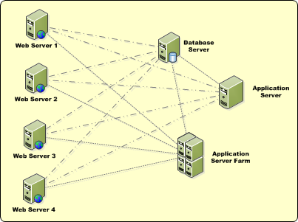
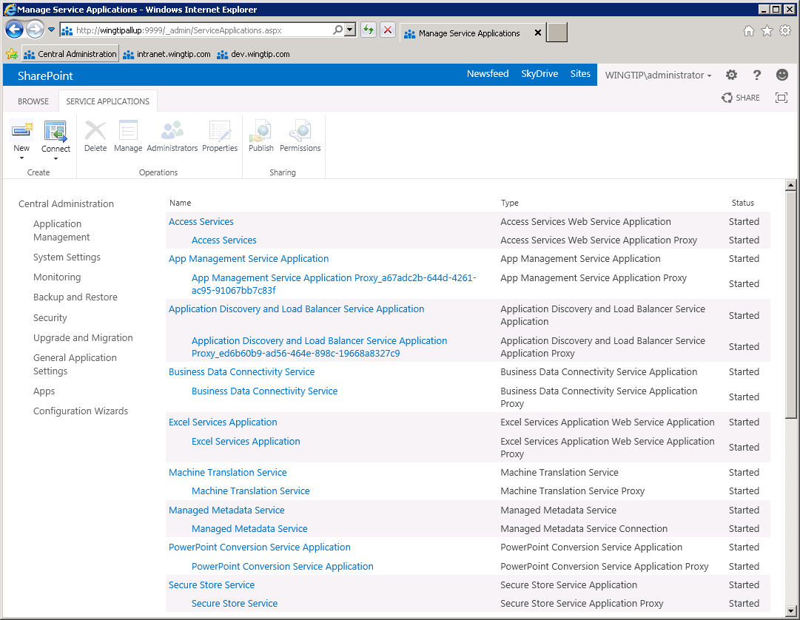
Service Applications
Services applications facilitate resource sharing
Service apps can run on WFE or Application Servers
Service apps can be used across farms
administrated through Central Admin
Notes:
Microsoft broke up the Shared Service Provider (SSP) framework in SharePoint 2007 into a new model called Service Applications. This new model facilitates a multitenant deployment of SharePoint 2010 as much more flexible SharePoint farm topologies.
Web applications are no longer tied to a collection of configured service offerings such as in the SSP model. Now Web applications can be associated with different service offerings (service applications) on a more a la carte model.

Slide 13
Managing SharePoint
Central Administration
Available in On-Premises deployments
Manage servers, services, jobs, etc.
Create Web Applications, site collections
Site Settings
Available in On-Premises & Hosted deployments
Manage site features, lists, users, permissions, etc.
Dual-purpose management site for sites & site collections
Manage site collection from top-level site’s site settings page
When in a non-top-level site, only managing current site
Notes:
SharePoint offers a few different surface areas for management. For administrators, they can use the Central Administration website that provides all farm-wide management capabilities. They can also use the command-line PowerShell interface known as the SharePoint 2013 Management Shell. Both of these are only available for on-premises deployments. Every site in SharePoint also contains a Site Settings site that allows for management by site collection and site administrators of site collections and sites. It is security and context trimmed so only certain things can be managed depending on who is logged in and what has been enabled/installed on the site collection/site.

Slide 14
Exploring SharePoint 2013
Notes:
Show Team Site
Show new Developer Site
Show ribbon
Show Site Settings page for SPWeb (non-RootWeb) & SPSite (RootWeb)
Show Central Administration
Show Service Applications page
Jump into one Service App and show

Slide 15
Agenda
SharePoint History
Significant Changes from SharePoint 2010
SharePoint 2013 Topology & Architecture
SharePoint 2013 Deployment Options
Extensibility Options
Course Introduction

Slide 16
SharePoint 2013 Deployment Options
On-Premises (aka: on-prem / behind firewall)
Installed 100% on company servers
Access to 100% of SharePoint’s features & capabilities
Hosted (aka: Office 365 / SharePoint Online)
Installed 100% and managed in the cloud
Most common context: Office 365 / SharePoint Online
Some features not available in the cloud
Hybrid (aka: mix of On-Prem & Hosted)
Mix of the two deployments
Very scenario driven on customer-by-customer basis
Notes:
SharePoint can be deployed in three ways. An On-Premises deployment is historically the most common. This is where SharePoint is installed on company servers behind the firewall and administrators manage the performance, storage and business continuity story. A Hosted deployment is one in which SharePoint is installed and managed by a third party. The most common and popular instance of this is Office 365. In some scenarios, either as companies migrate from an On-Premises deployment to Hosted or where a permanent co-existence is desired, SharePoint can also be deployed in a hybrid model where a local On-Premises installation is aware of a Hosted SharePoint tenant.

Slide 17
Agenda
SharePoint History
Significant Changes from SharePoint 2010
SharePoint 2013 Topology & Architecture
SharePoint 2013 Deployment Options
Extensibility Options
Course Introduction

Slide 18
Extensibility & Development Options
Audience: Power User
Browser
SharePoint Designer
Rich-client for SharePoint (sites, lists, libraries, etc.)
Workflow & External Content Type Designer
Audience: Developer
Solutions
Introduced in SharePoint 2007, updated in SharePoint 2010
SharePoint Apps
Introduced in SharePoint 2013
Marketplace distribution model
Ideal for Office 365
Notes:
SharePoint by nature is a very customizable and extensible platform. For Power Users, you can customize and extend SharePoint using just the browser or by using the SharePoint Designer client. For Developers, you can customize and extend SharePoint either using SharePoint solutions (*.wsp) or using SharePoint Apps, both of which will be covered throughout the course.

Slide 19
Agenda
SharePoint History
Significant Changes from SharePoint 2010
SharePoint 2013 Topology & Architecture
SharePoint 2013 Deployment Options
Extensibility Options
Course Introduction

Slide 20
Course Lectures, Demos & Labs
Modules consist of:
Lecture + Demos
Hands-On Lab
Student.zip
Provided by instructor
Includes:
All demo scripts, projects, code, etc.
Any files / code needed for lab exercises

Slide 21
Lab Virtual Environment
Each student has their own environment
Consists of one virtual machines:
All installed & configured with trial installs
They will expire / time-bomb < 180 days
Created using the Critical Path Training SharePoint 2013 Setup Guide, freely available at: www.CriticalPathTraining.com/Members

Slide 22
Summary
SharePoint History
Significant Changes from SharePoint 2010
SharePoint 2013 Topology & Architecture
SharePoint 2013 Deployment Options
Extensibility Options
Course Introduction

