Slide 1
Office Services
Notes:
This module includes any of the additional services that are not covered in various other places in the course. In this module students will learn how to programmatically work with the social and Excel Services APIs as well as how to do document assembly with Word Automation Services and PowerPoint Services. In addition students will learn about the dramatic changes with Access Services in SharePoint 2013 and how they can leverage the new Translation Service Application.

Slide 2
Agenda
Social
Newsfeed
Excel Services
Word Automation Services
PowerPoint Automation Services
Translation Service

Slide 3
Social Features
Newsfeed, Sites, and SkyDrive (aka My Site)
My Likes
My Tasks
SkyDrive Pro
Microblogging
Following
Mentions
Likes
Communities

Slide 4
Architecture
Personal Site
App Fabric Cache
Social Feed
Social
SkyDrive Pro
Profile DB
System
User
Sites
Docs
People
Tags
Notes:
The data sources used for the social features are:
Social Feed: Contains all the activity around a user. Activities may be user generated (post) or system generated (profile change)
Social List: contains the list of all things that a person is following (i. e., documents, people, sites, tags)
Profile Database: contains profile information, followed people, and tags
App Fabric Cache: Used to store the latest activities so they may be displayed quickly on the What’s New page.
SkyDrive Pro: personal document library
This means that you need a My Site to participate in many social capabilities.
Sites have both Social quota and Content quota. Some social activity counts as content, some content counts against social.

Slide 5
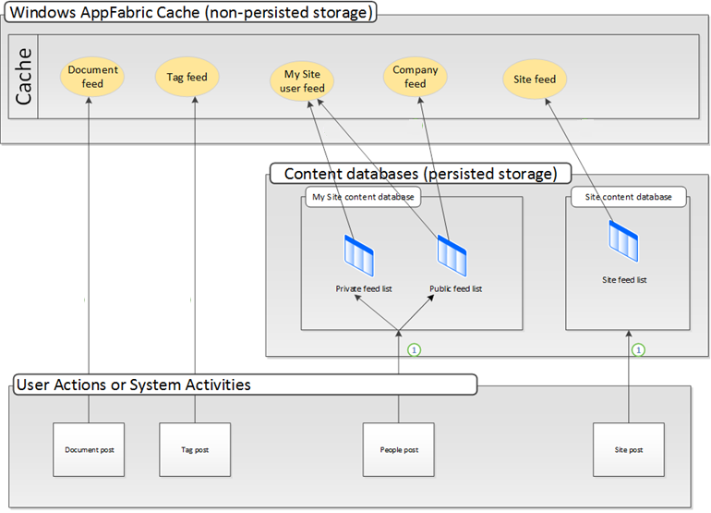
App Fabric Cache
Notes:
App Fabric Cache - Used to store the latest activities so they may be displayed quickly on the What’s New page.
Document and Tag Activities are written only to the cache
People and Site activities are written to persistent storage, then the cache
The App Fabric Cache is load balanced across all WFEs so it doesn’t matter what WFE the user lands on.

Slide 6
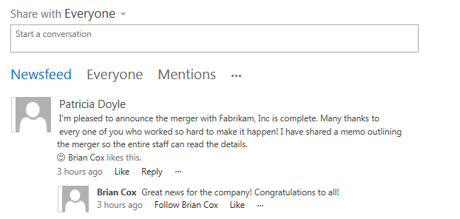
Social Feed
Private view
Updates on things you follow
New Posts from Others
Profile changes
Changes to followed documents
Things tagged with followed tags
Mentions
My Activities
My Likes

Slide 7
My Tasks
Single view of tasks across SharePoint, Project, and Exchange
Enterprise Search gathers SharePoint tasks
Connects to Project and Exchange for other tasks
New “Work Management” Service Application performs aggregation
Hidden List caches data
New items can also be added
Updates are reflected back to original task
Notes:
My Tasks is a single view of all tasks assigned to you across SharePoint, Project & Exchange. A new Work Management service application aggregates content from across all three sources and stores the data in a hidden list.

Slide 8
SkyDrive Pro
Single personal library
All: provides an overall view of documents in the library
Personal: shows documents in the library that have not be shared with anyone
Recent: provides a view of the library grouped by dates
Shared by me: provides the ability to show who can access to what in the library
Shared with me: provides the ability to show all documents that have been shared with you across people’s libraries
Notes:
Shared with me view
It looks like a form view but, in reality, it uses Search underneath to aggregate content
there’s a lag time (default 15 minutes) before the document appears in the view.
The query is smart in gathering the information: it looks for all documents that contain “IsMyDocuments” managed property.
This essentially returns all documents in Skydrive Pro.
Search does security trimming, so it only returns documents which the querying user has permission to view

Slide 9
Folder Sync
Provides access to your SkyDrive Pro documents in the Windows Explorer.
Makes your documents accessible online, offline or in-between and your changes are automatically synced
Overlays on files and folders so you can easily tell if your content is in sync.
Based on SharePoint Workspace which, has been redesigned to use Skydrive Pro library only
Notes:
Folder sync works with SharePoint Workspace which has been redesigned to sync with the Skydrive Pro folders.

Slide 10
Social Features & Communities
Notes:
This is an optional demo… no developer opportunities in this demo, just showing some of the new social features in SharePoint 2013
Demo 1 – Sharing Content, Following People, Sites and Documents
Login as UserA
Create new content, DocumentA
Share DocumentA with UserB
Go to UserA’s Newsfeed enter a message to share with everyone
Login as UserB
Go to UserB’s Newsfeed
Follow UserA’s Newsfeed
When you see UserA’s conversation, LIKE it
Reply to UserA’s message
Click UserA & look at their Docuemnts
Follow DocumentA
View all the documents you’re following
Login as UserA
Edit the document
Login as UserB
Notice UserB’s newsfeed shows the document was updated
Demo 2 – Communities
Create a new subsite of type Communities
Name the site about some support topic (SharePoint End User Support)
Add some categories to the community
On the Community site homepage, go to Reputation Settings
On the Manage the List of Gifted Badges page, add a Moderator
On the Community site homepage, go to the Assign Badges to Members
In the members list, give UserA the Moderator badge
On the Community site homepage, go to the Community Settings
Enable reporting of offensive content
Login to the site as UserB
Create a new discussion
Login to the site as UserA
Go to the Manage discussions page
Edit the discussion from UserB and change the category

Slide 11
Agenda
Social
Social Feed
Excel Services
Word Automation Services
PowerPoint Automation Services
Translation Service

Slide 12
Social Feed Overview
Social Feed List
Stores all activity related to the user
Activities can be user or system generated
Admins control what system-generated activities appear
System-generated activities are security trimmed
App Fabric Cache
Activities are generally added to the cache as well
CSOM and REST APIs

Slide 13
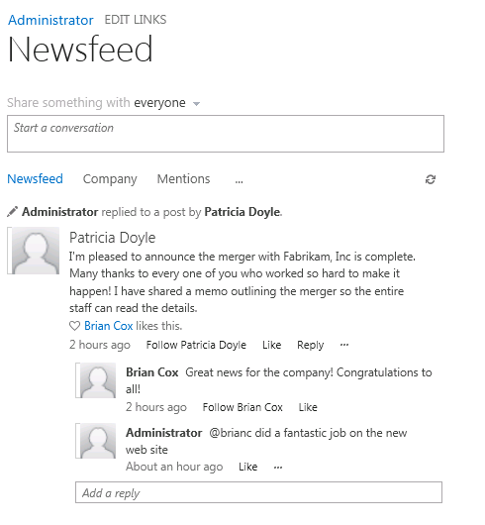
Social Feed: Following
People
Sites
Documents
Tags
Notes:
Things are followed based on a GUID, so the following things will not affect following:
-Name changes
-Placing a document on hold (stops all changes)
-Declaring the document as a record (stops all changes)
When following documents, theses changes may result in a stoppage of the “follow”
-Restoring from the Recycle Bin

Slide 14
Social Feed
@me: Mentioning a Person
Updates user’s social feed
Updates the mentioned person’s social feed
My Likes: “Liking” a Post
Updates user’s social feed
Updates the post author’s social feed
Updates App Fabric cache

Slide 15
Programming the Social Feed
Server-Side API
Object Model
Microsoft.Office. Server.UserProfiles.dll
Key Classes
SPMicrofeedManager
PeopleManager
Client-Side API
Managed CSOM
Microsoft.SharePoint. Client.UserProfiles.dll
JavaScript CSOM
SP.UserProfiles.js
Key Objects
MicrofeedManager
PeopleManager
FollowedContent
Notes:
Server Side Social Feed Development
SPMicrofeedManager allows you to work with feeds
PeopleManager works with profiles and following
Client-Side Social Feed Development
The My Site Social CSOM is built on the SharePoint 2013 CSOM. Therefore, client code first accesses the SharePoint 2013 CSOM and then accesses the My Site Social CSOM, as follows:
For the .NET Framework client-side object model, get a ClientContext instance and then use the object model in the Microfeed namespace and UserProfiles namespace in the Microsoft.SharePoint.Client.UserProfiles assembly.
For the JavaScript object model, get an SP.ClientContext instance and then use the object model in the SP.UserProfiles.js file.
The My Site Social client-side object model provides the following objects that you can use to access the My Site Social API:
Use the MicrofeedManager object to get feeds, to post to threads, to like and unlike entities, and to perform other feed-related tasks.
Use the PeopleManager object to retrieve user properties, to start or stop following people, to retrieve list of followed people, and to perform other "following people" tasks.
Use the FollowedContent to follow things
Use the FollowedContent object to start or stop following content, to get followed content, and to perform other following content tasks. Use the MicrofeedPostDefinitionManager object to create custom post types and to retrieve, update, and delete post types. Client code uses the CSOM first to set up requests that retrieve or change objects and then to run the requests on the server.

Slide 16
Programming the Microfeed
Notes:
Show code for FeedDeck solution.

Slide 17
Agenda
Social
Newsfeed
Excel Services
Word Automation Services
PowerPoint Automation Services
Translation Service

Slide 18
Excel Services: Key Areas
SOAP Web Service
Same as SharePoint 2010
http://[..]/_vti_bin/ExcelService.asmx
JavaScript Object Model
Improved from SharePoint 2010
REST
Improved from SharePoint 2010
Notes:
SOAP Web Service:
No changes from SharePoint 2010
Excel Forms:
Allow for the creation of forms that have fields bound to cells in the workbook. The form may be sent out to many people. When filled out, populates the spreadsheet
Apps for Office support:
Cross reference to the Apps for Office modules, which are separate modules in the Developer Kit.
Excel Everywhere:
Code snippet to drop on a web page above a table. When clicked, the table lights up and becomes a spreadsheet. Sort of like linking and embedding for a web page.

Slide 19
Excel JavaScript Object Model
Allows scripting against spreadsheets in the Excel Services web part
New Methods, New Events
SharePoint Online Support
JavaScript User-Defined Functions
Support for Hidden Sheets
Ability to Specify a Callback function after reload
New events to detect user changes
Notes:
JavaScript Object Model
Lots of improvements to support Excel as a component of solutions
New APIs that allow for web developers to overlay elements on top of the Excel Web App that’s embedded or web-parted into pages. A developer could choose to use jQuery for such elements, just like they could choose to use a different web library or technology.
Works with spreadsheets in Office 365 and SkyDrive
User-defined functions (UDF) can be written in JavaScript in the page that hosts the spreadsheet
New Events:
Sheet.DataEntered()
Workbook.DataEntered()
Workbook.BeforeTyping()
New Method:
Workbook.Reload(callback)

Slide 20
Excel Services: JavaScript Object Model
Allows scripting on a page against the Excel Web App Web Part surfacing a spreadsheet also on the page
var ewa;
function ewaStart(){
Ewa.EwaControl.add_applicationReady(ewaConnect);
}
function ewaConnect() {
ewa = Ewa.EwaControl.getInstances().getItem(0);
if (ewa) {ewa.add_activeCellChanged(ewaCellChanged);}
}
function ewaCellChanged(rangeArgs) {
var sheetName = rangeArgs.getRange().getSheet().getName();
var col = rangeArgs.getRange().getColumn();
var row = rangeArgs.getRange().getRow();
var value = rangeArgs.getFormattedValues();
alert('Active Cell is now at Row' + (row + 1) +
', Column' + (col + 1) + ', with Value of ' + value);
}
ewaStart();

Slide 21
Excel REST
Exists in SharePoint 2010
New ability to expose tables as OData
Regions named as tables within the spreadsheet
Works in Office 365
http://[..]/_vti_bin/ExcelRest.aspx/Documents/Sales.xlsx/OData/Table1
Notes:
REST
A few improvements
Ability to expose tables as OData
Works with spreadsheets in Office 365 and SkyDrive
Service Root:
http://[..]/_vti_bin/ExcelRest.aspx/Documents/Winter%20Olympics%20Medals.xlsx/OData/
Metadata:
http://[..]/_vti_bin/ExcelRest.aspx/Documents/Winter%20Olympics%20Medals.xlsx/OData/$metadata
Table Data Feed:
http://[..]/_vti_bin/ExcelRest.aspx/Documents/Winter%20Olympics%20Medals.xlsx/OData/Table1

Slide 22
Excel JSON API & OData
Notes:
Demo 1 – JSON API
Upload spreadsheet to site
Add Excel Web Access Web Part to page & map to the spreadsheet uploaded
Add Script Editor Web Part to the page
Add JS to show contents of the spreadsheet
Demo 2 – Excel OData
VS2012, new farm solution & create sandboxed Web Part
Add jQuery to project
Add JS to the sandboxed Web Part
Update location of spreadsheet & jQuery library

Slide 23
Agenda
Social
Newsfeed
Excel Services
Word Automation Services
PowerPoint Automation Services
Translation Service

Slide 24
Word Automation Services
Exists in SharePoint 2010
New support for sync conversions
New support for streaming files into service
Conversion Process:
Create a Conversion job
Provide Settings for the job
Add files to the job
Submit the job

Slide 25
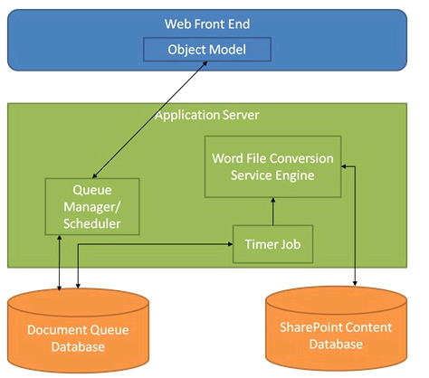
Word Automation Services Architecture
Notes:
Word Automation Service Application – contains all of the components
Document Queue Database – stores requested, completed, and current conversions
Queue Manager – moves requests into the Queue Database and schedules them for conversion
Timer Job – runs periodically to convert scheduled documents in the queue
Conversion Engine – converts documents and moves them into libraries
Object Model – API to the system

Slide 26
Word Automation Services: Asynchronous conversion
// Set up the job
ConversionJobSettings jobSettings = new ConversionJobSettings();
// job settings
jobSettings.OutputFormat = SaveFormat.PDF;
ConversionJob job =
new ConversionJob("Word Automation Services", jobSettings);
// add files
string wordFile = web.Url + "/" + item.Url;
pdfFile = wordFile.Replace(".docx", ".pdf");
job.AddFile(wordFile, pdfFile);
//Start Job
job.Start();

Slide 27
Word Automation Services

Slide 28
Agenda
Social
Newsfeed
Excel Services
Word Automation Services
PowerPoint Automation Services
Translation Service

Slide 29
PowerPoint Automation Services
New for SharePoint 2013
Based on Word Automation Service model
Supports
Sync Processing
Async Processing
Streaming Processing
Supported Formats
Source
PPT
PPTX
Destination
PPTX
PDF
XPS
JPG
PNG
Notes:
Using PowerPoint Automation Services, you can convert from the PowerPoint binary file format (.ppt) and the PowerPoint Open XML file format (.pptx) to other formats. For example, you may want to upgrade a batch of PowerPoint 97-2003 files to Open XML presentation files. You could also create a custom action in the Edit menu to allow users to create a PDF version of presentations on demand.

Slide 30
PowerPoint Automation Services
//Get file content to convert
byte[] buffer = file.OpenBinary();
MemoryStream inStream = new MemoryStream(buffer);
MemoryStream outStream = new MemoryStream();
// Create the presentation conversion request.
PresentationRequest request = new PresentationRequest(inStream, ".ppt", outStream);
// Synchronous Request
IAsyncResult result =
request.BeginConvert(SPServiceContext.GetContext(site), null, null);
request.EndConvert(result);
// Add the converted file to the document library
web.AllowUnsafeUpdates = true;
web.Files.Add(site.Url + libUrl + fileName, outStream.ToArray(), true);
web.AllowUnsafeUpdates = false;

Slide 31
PowerPoint Automation Services

Slide 32
Agenda
Social
Newsfeed
Excel Services
Word Automation Services
PowerPoint Automation Services
Translation Service

Slide 33
Translation Services
New for SharePoint 2013
Cloud-based (Bing) translation services
Based on Word Automation Service model
Supports
Sync Processing
Async Processing
Streaming Processing
Can translate documents and sites
Notes:
Translation Services is a new service application in Microsoft SharePoint 2013 that provides automatic machine translation of files and sites. When the Translation Services application processes a translation request, it forwards the request to a cloud-hosted machine translation service, where the actual translation work is performed.
The Translation Services application processes translation requests asynchronously and synchronously. Asynchronous translation requests are processed when the translation timer job executes. The default interval of the translation timer job is 15 minutes; you can manage this setting in Central Administration or by using Windows PowerShell. You can also set the timer to execute immediately.
Using the object model, you can submit requests to the Translation Services application asynchronously or synchronously (for instant translation). The Translation Services application has two working queues for storing translation requests: the asynchronous queue and the synchronous queue. Requests in the synchronous queue are treated as higher priority and are translated before requests in the asynchronous queue. The requests are routed to one of these queues based on the class that you use.

Slide 34
Translation Services: Architecture and Process
Same basic architecture as WAS
Queue
Manager
Timer Job
Same basic steps as WAS
Create job
Job Settings
Add Files
Run

Slide 35
Translation Services
// Set up Job
SPServiceContext sc = SPServiceContext.GetContext(site);
byte[] inputByte = file.OpenBinary();
byte[] outputByte;
// Execute job synchronously
SyncTranslator job = new SyncTranslator(sc, CultureInfo.GetCultureInfo(2058));
TranslationItemInfo itemInfo = job.Translate(inputByte, out outputByte, extension);
//Upload translated file
web.AllowUnsafeUpdates = true;
web.Files.Add(fileOut, outputByte, true);
web.AllowUnsafeUpdates = false;

Slide 36
Translation Services

Slide 37
Summary
Social
Newsfeed
Excel Services
Word Automation Services
PowerPoint Automation Services
Translation Service

