Slide 1
Pages, Navigation & User Interface
Notes:
In this module you will learn how to create custom application pages as well as content pages and the details around customizing pages. In addition this module will also dive into the aspects of customizing the SharePoint user interface for custom branding experiences as well as customizing and extending the SharePoint Ribbon.

Slide 2
Agenda
Master Pages in SharePoint 2013
Site Pages and Modules
User Interface Design for Apps
Application Pages

Slide 3
SharePoint Sites are Collections of Pages
All pages share the same look and feel
HTML page layout defined by common Master Page
Page formatting defined by common CSS files
Client-side behaviors defined by JavaScript files
Pages within site can be split into two categories
Site Pages exist within the content DB for a site
Application Pages only exist on file system of WFE
Notes:
All pages within a SharePoint site have the same look and feel. The pages are based on a common Master page and implement the same CSS files.
Site pages live within a content database and can be customized by the user.
Application pages live on the file system and cannot be customized by the user.

Slide 4
Site Pages vs. Application Pages
Site Pages exist within virtual file system of site
They support customization via Web Parts and/or SPD
Site pages can be rendered using underlying template
Page using template is said to be a ghosted page
Page can be customized (unghosted) by user
Application Pages are deployed once per farm
They are accessible through _layouts virtual directory
They are parsed / compiled in classic ASP.NET mode
They do not support any form of user customization
The can only be added using farm solutions
Notes:
Site Pages:
By default site pages are ghosted, which means that the page template is stored on the WFE file system, while the content is stored in the content database. Site pages can be customized. At that time they become unghosted and both the template and the content are stored in the content database. Customizing pages can make it hard to migrate content to a new version of SharePoint. Customizing pages can impact the performance in large farms due to excessive memory usage.
Application Pages:
Application pages are deployed in the _layouts folder of the SharePoint root on the file system. There is one version of an application page scoped at the farm level. It is compiled into a single DLL and loaded into memory once for each Web application.

Slide 5
SharePoint Integration with Master Pages
Master Page integration with SharePoint 2010
Master Pages stored in Master Page Gallery (MPG)
MPG created automatically on per site basis
All pages in site link to v4.master in MPG
Changes in SharePoint 2013
v4.master serves as master page for 2010 UI mode
seattle.master serves as default master page in 2013
Site has new UseV15Rendering property
MPG includes others (e.g. belltown.master)
New options for user to change site master page
Notes:
In SharePoint 2010:
When a site is created, a Master Page Gallery is created and SharePoint provisions an instance of the v4.master within the site.
In SharePoint 2013:
v4.master is still there for backward compatibility. New site pages created in SharePoint 2010 link to the v4.master.
Also application pages link to the v4.master. A minimal.master is provided out of the box, which wasn’t the case in SharePoint 2007.

Slide 6
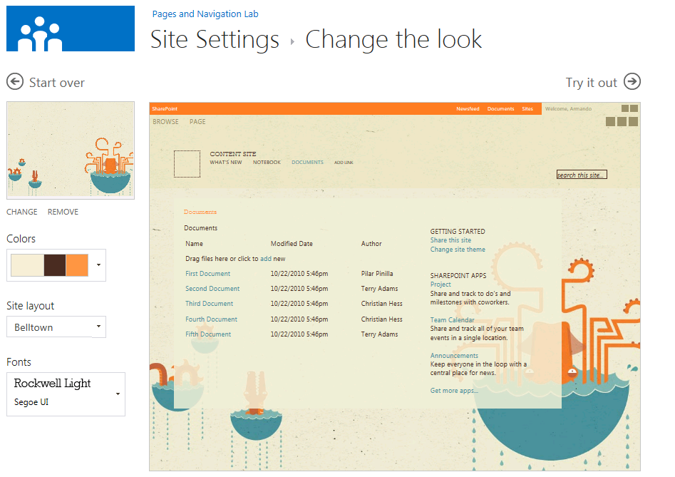
Changing the Look of a Site
Notes:
SharePoint 2013 introduces a new way to theme sites called Composed looks. These consist of a color pallet and fonts you can use to change the way a site looks.

Slide 7
Agenda
Master Pages in SharePoint 2013
Site Pages and Modules
User Interface Design for Apps
Application Pages

Slide 8
Site Pages Overview
Site pages can be added by a developer
Works in SharePoint solutions and in SharePoint apps
Sites pages and related resources added with Modules
Site pages cannot contain any server-side code
Developers create site pages using templates
You create a Module and add one of more templates
Feature activation create instances from the templates
Sites pages initially in uncustomized state (ghosted)
Sites pages can be customized (unghosted) by users
Notes:
Uncustomized pages are called ghosted pages. Only the difference between the page and the template is stored in the content database. Customized pages are stored completely in the content database and are called unghosted pages.
Site pages can be customized using SharePoint Designer.
Customized site pages don’t support inline code. You can only add controls that are registered as Safe Controls in the web.config.

Slide 9
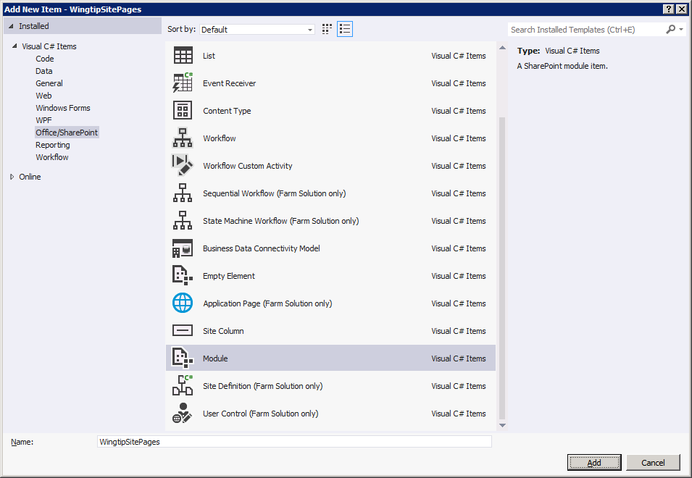
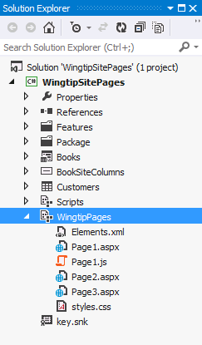
Creating Site Pages from Page Templates
Site pages created using a Module
Module must be associated with a feature
Visual Studio adds project folder with elements.xml file
Inside is a <Module> element with <File> elements
Notes:
You can create site pages using the Visual Studio SharePoint Development Tools. The SPI template to use is Module. The elements.xml is the manifest that specifies a <Module> element, which in its turn contains a set of <File> elements . Each <File> element provisions on instance of a page from the custom page template you created in the project.

Slide 10
Modules & Elements.xml File
Visual Studio updates Module element.xml for you
You just create / add files to Module folder
Some scenarios requires manual edits to elements.xml
<?xml version="1.0" encoding="utf-8"?>
<Elements xmlns="http://schemas.microsoft.com/sharepoint/">
<Module Name="WingtipPages">
<File Path="WingtipPages\Page1.aspx" Url="WingtipPages/Page1.aspx" />
<File Path="WingtipPages\Page2.aspx" Url="WingtipPages/Page2.aspx" />
<File Path="WingtipPages\Page3.aspx" Url="WingtipPages/Page3.aspx" />
<File Path="WingtipPages\styles.css" Url="WingtipPages/styles.css" />
</Module>
</Elements>
Notes:
With the Visual Studio SharePoint Development Tools you only have to create the Module SPI and add the site pages. The element.xml will be generated automatically by the tools.

Slide 11
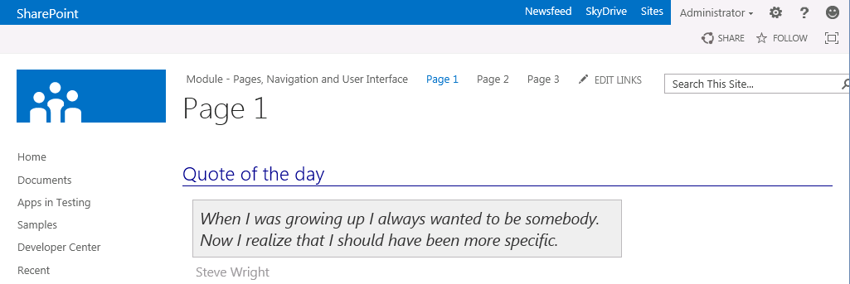
'Hello World' Page Template for Site Page
<%@ Page MasterPageFile="~masterurl/default.master" %>
<asp:Content ContentPlaceHolderId="PlaceHolderAdditionalPageHead" runat="server">
<link href="styles.css" rel="stylesheet" type="text/css" />
<script src="Page1.js" type="text/javascript"></script>
</asp:Content>
<asp:Content ContentPlaceHolderId="PlaceHolderPageTitle" runat="server">
Page 1 – This shows up at the top of the browser window
</asp:Content>
<asp:Content ContentPlaceHolderId="PlaceHolderPageTitleInTitleArea" runat="server">
Page 1
</asp:Content>
<asp:Content ContentPlaceHolderId="PlaceHolderMain" runat="server">
<h3>Quote of the day</h3>
<p id="quote">When I was growing up I always wanted to be somebody.
Now I realize that I should have been more specific.</p>
<p id="quote_author">Steve Wright</p>
</asp:Content>
Notes:
This is a sample of a provisioned site page based on the HelloWorld.aspx page template you created in the Visual Studio project.

Slide 12
Designing Web Part Pages
Changes from previous page templates
Inherit from WebPartPage class
Add controls for web part zones and web parts
<%@ Assembly Name="Microsoft.SharePoint, Version=15.0.0.0, Culture=neutral, PublicKeyToken=71e9bce111e9429c" %>
<%@ Page MasterPageFile="~masterurl/default.master" Inherits="Microsoft.SharePoint.WebPartPages.WebPartPage" %>
<%@ Register TagPrefix="WebPartPages"
Namespace="Microsoft.SharePoint.WebPartPages"
Assembly="Microsoft.SharePoint, Version=15.0.0.0, Culture=neutral, PublicKeyToken=71e9bce111e9429c" %>
<asp:Content ContentPlaceHolderID="PlaceHolderMain" runat="server">
<WebPartPages:WebPartZone ID="Main" Title="Main Web Part Zone" FrameType="TitleBarOnly" runat="server">
<ZoneTemplate>
<WebPartPages:XsltListViewWebPart
runat="server" ID="CsutomersWebPart"
Title="Customers" ListUrl="Lists/Customers"
ChromeType="None">
</WebPartPages:XsltListViewWebPart>
</ZoneTemplate>
</WebPartPages:WebPartZone>
</asp:Content>
Notes:
Web Parts make it possible for a site owner to customize a site page with changes that are seen by all users. Web Parts go even further to allow individual users to add personalization changes that are seen only by them. On top of that, customizing and personalizing Web Parts does not require customizing the Web Part pages that host them.
You can also design Web Part pages as a site page template. In that case the .aspx page inherits from Microsoft.SharePoint.WebPartPages.WebPartPage.
Add WebPartZone controls to the site page template because Web Parts reside in WebPartZones. You have to specify the WebPartZones but not the Web Parts that go inside that zone. Instead, all of the data for tracking Web Part instances and their customization and personalization data are kept in separate tables inside the content database. This means that a Web Part page can remain in a ghosted state, even when users customize them.

Slide 13
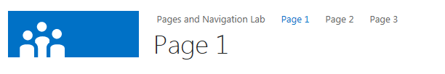
Adding Navigation Nodes to Top Nav Bar
Simple navigation technique for teams sites
Done using server-side code or client-side code
Not a technique to use in publishing sites
public class MainSiteEventReceiver : SPFeatureReceiver
{
public override void FeatureActivated(SPFeatureReceiverProperties properties)
{
SPSite siteCollection = properties.Feature.Parent as SPSite;
if (siteCollection != null)
{
SPWeb site = siteCollection.RootWeb;
// create menu items on top link bar for custom site pages
SPNavigationNodeCollection topNav = site.Navigation.TopNavigationBar;
topNav.AddAsLast(new SPNavigationNode("Page 1", "WingtipPages/Page1.aspx"));
topNav.AddAsLast(new SPNavigationNode("Page 2", "WingtipPages/Page2.aspx"));
topNav.AddAsLast(new SPNavigationNode("Page 3", "WingtipPages/Page3.aspx"));
}
} }
Notes:
When your site page instances are created, they must be made accessible to the users. An option is to add navigation nodes to the top navigation bar when the feature containing the site pages gets activated.
In the FeatureActivated event handler of the FeatureReceiver class you can retrieve the top navigation bar from the site using site.Navigation.TopNavigationBar. This returns a collection of type SPNavigationNodeCollection. Write code that adds instances of type SPNavigationNode to that collection.

Slide 14
Provisioning Site Pages using Page Templates

Slide 15
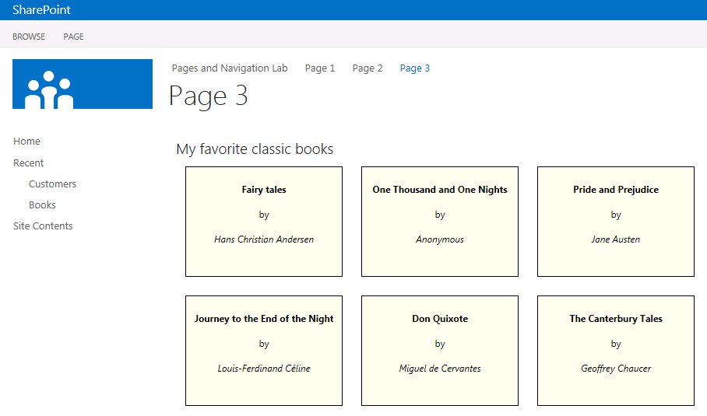
Custom View Rending with JSLink
List view can have custom rendering logic
Done by referencing JavaScript template in list view
Requires adding JSLink element to schema.xml
(function () {
// create and initialize object to override context
var overrideCtx = {};
overrideCtx.BaseViewID = 2;
overrideCtx.ListTemplateType = 10000;
// initialize template
overrideCtx.Templates = {};
overrideCtx.Templates.Header = "<h2>My favorite classic books</h2>";
overrideCtx.Templates.Item = customItem;
// register with page template manager
SPClientTemplates.TemplateManager.RegisterTemplateOverrides(overrideCtx);
})();
function customItem(ctx) {
// create item style
var itemStyle = "display:inline-block;width:200px;height:120px;border:black 1px solid;";
// create and return HTML for each item
return "<div style='" + itemStyle + "'>" +
ctx.CurrentItem.Title + "<br/>by<br/>" + ctx.CurrentItem.BookAuthor +
"</div>";
}
Notes:
SharePoint versions prior to 2013 required developers to use XSLT to create custom views for SharePoint lists and libraries. SharePoint 2013 introduces a new client side rendering (CSR) capability where JavaScript is used to render list data in a view in a simpler way than using XSLT and CAML. This is done by registering a JavaScript file using a new JSLink element on a list view element.

Slide 16
Creating Custom List Views with JavaScript

Slide 17
Agenda
Master Pages in SharePoint 2013
Site Pages and Modules
User Interface Design for Apps
Application Pages

Slide 18
User Interface Extensions for Apps
SharePoint App model defines 3 UI entry points
Start Page (required for every app)
App Part
UI Custom Action
All three entry points require pages behind them
Pages added to app web with SharePoint-Hosted apps
Pages added to remote web with Cloud-Hosted apps

Slide 19
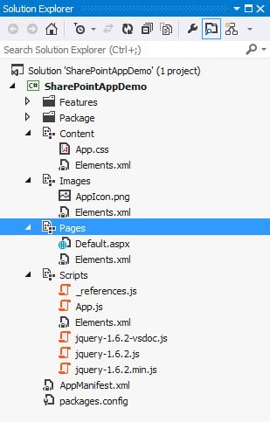
Modules in a SharePoint-Hosted App
Visual Studio adds Modules to each new project
Content
Images
Pages
Scripts
Notes:
Visual Studio adds a few SharePoint modules to a project when creating a SharePoint-Hosted App. These are used to provision style sheets, scripts, pages and images used by the application.

Slide 20
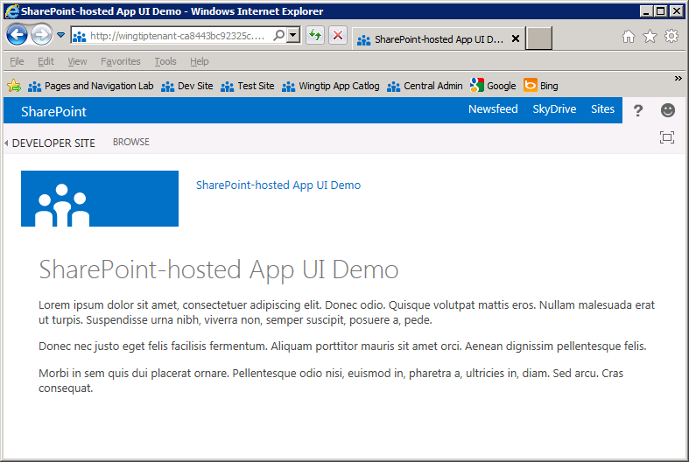
App.master
App web uses app.master by default
Gives app SharePoint look and feel
Provides app with required link back to host web
Does not have Site Actions menu or top link bar
Notes:
SharePoint-Hosted apps, by default, use a specific master page (app.master) that SharePoint provides. One thing you’ll notice is that many things from a typical SharePoint page are missing such as the Quick Launch, the top navigation bar, the site actions menu, etc.

Slide 21
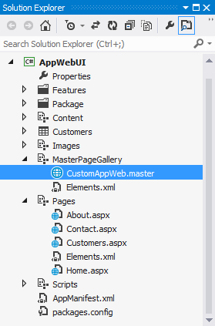
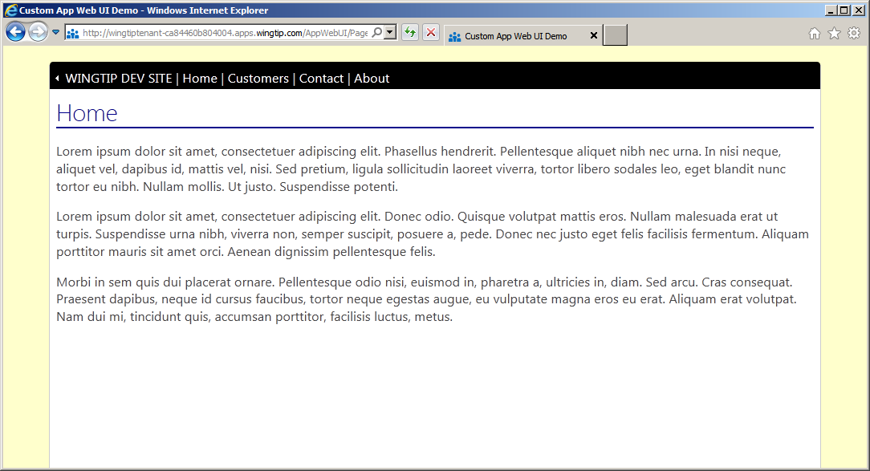
Custom Master Pages in the App Web
Custom master page added to MPG with Module
Master page should have ReturnToParentLink control
Pages in app web can link to custom master page
Notes:
Developers are free to create custom master pages used by the pages within a SharePoint-Hosted app. Things work the same way they work in traditional ASP.NET sites in the sense that the developer is responsible for wiring things up manually.

Slide 22
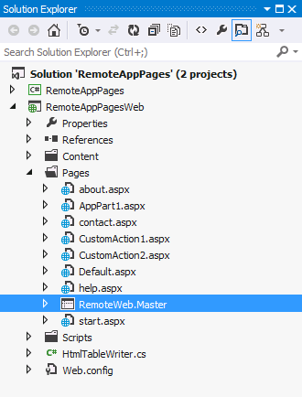
UI Design for Cloud-Hosted Apps
Cloud-hosted app pages live outside SharePoint
You have responsibility and freedom to build entire UI
Often makes sense to create remote web master page
<%@Master language="C#" %>
<!DOCTYPE html PUBLIC "-//W3C//DTD XHTML 1.0 Strict//EN" "http://www.w3.org/TR/xhtml1/DTD/xhtml1-strict.dtd">
<html>
<head>
<title>Remote App Pages</title>
<link href="/Contents/app.css" type="text/css" rel="stylesheet" />
<asp:ContentPlaceHolder ID="PlaceholderAdditionalPageHead" runat="server" />
</head>
<body>
<form id="form1" runat="server">
<div id="pageWidth">
<div id="chrome_ctrl_container"></div>
<div id="contentBody">
<asp:ContentPlaceHolder ID="PlaceholderMain" runat="server" />
</div>
</div>
</form>
</body>
</html>
Notes:
MSDN: Apps for SharePoint UX design guidelines
http://msdn.microsoft.com/en-us/library/office/apps/jj220046(v=office.15)

Slide 23
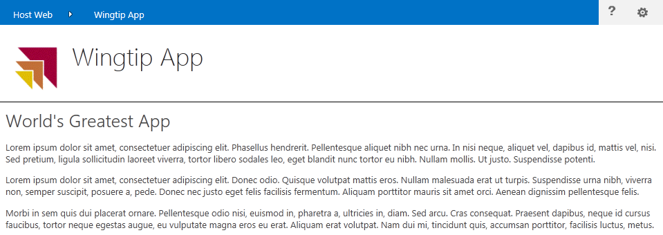
Leveraging the Chrome Control
JavaScript Component used in Remote Web
Provides SharePoint look and feel to remote web page
Provides link to host web and configurable navigation
function renderChromeControl() {
hostWebUrl = decodeURIComponent(getQueryStringParameter("SPHostUrl"));
var options = {
siteUrl: hostWebUrl,
siteTitle: "Host Web",
appHelpPageUrl: "help.aspx?SPHostUrl=" + hostWebUrl,
appIconUrl: "/Contents/AppIcon.png",
appTitle: "Wingtip App",
settingsLinks: [
{ linkUrl: "start.aspx?SPHostUrl=" + hostWebUrl, displayName: "Home" },
{ linkUrl: "about.aspx?SPHostUrl=" + hostWebUrl, displayName: "About" },
{ linkUrl: "contact.aspx?SPHostUrl=" + hostWebUrl, displayName: "Contact" }
]
};
var nav =
new SP.UI.Controls.Navigation("chrome_ctrl_container",
options);
nav.setVisible(true);
}
Notes:
Pages in the remote web of Cloud-Hosted Apps do not have access to the app.master and thus don’t have the same look & feel of their hosted SharePoint sites. To address this Microsoft provides something called the chrome control which is a JavaScript library that writes the HTML that includes the header of the hosting SharePoint site as well as a reference to an ASP.NET HTTP Handler that pulls all the CSS from the parent site so the pages in the remote web can look the same as the host web.

Slide 24
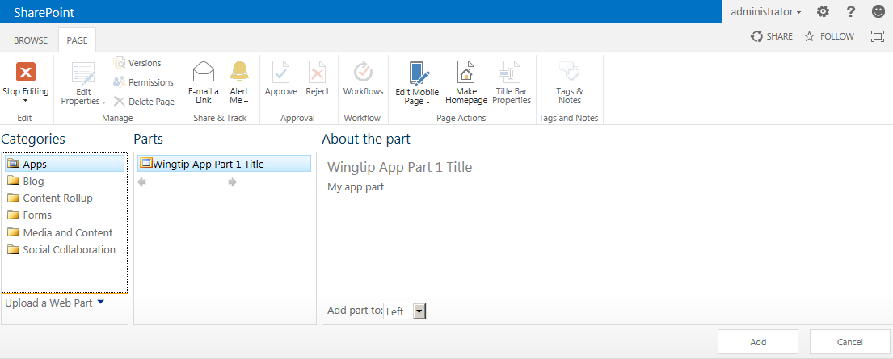
Creating App Parts Using Client Web Parts
App parts are implemented using client Web Part
App parts added to host web pages as Web Parts
<?xml version="1.0" encoding="utf-8"?>
<Elements xmlns="http://schemas.microsoft.com/sharepoint/">
<ClientWebPart Name="AppPart1"
Title="Wingtip App Part Title"
Description="My app part"
DefaultWidth="600"
DefaultHeight="360">
<Content Type="html" Src="~remoteAppUrl/Pages/AppPart.aspx?{StandardTokens}" />
</ClientWebPart>
</Elements>
Notes:
SharePoint 2013 introduces a new artifact to supplement the server-side nature of the Web Part and Visual Web Part. The Client Web Part is meant to provide Web Part like functionality but without the server-side code and thus, to make apps more useful. Effectively what happens is the Client Web Part renders an HTML IFrame that loads another page but looks and acts like a regular Web Part. This other page can come from a page hosted in the app web or in the remote web.

Slide 25
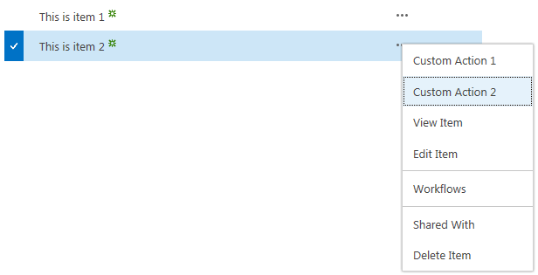
Creating UI Custom Actions
UI custom actions used to extend host web UI
Used to create ECB menu items and ribbon buttons
Cannot use JavaScript or other types of custom actions
Supports many dynamic tokens related to host page, item and list
<?xml version="1.0" encoding="utf-8"?>
<Elements xmlns="http://schemas.microsoft.com/sharepoint/">
<CustomAction Id="CustomAction1"
RegistrationType="List"
RegistrationId="100"
Location="EditControlBlock"
Sequence="10"
Title="Custom Action">
<UrlAction Url="~remoteAppUrl/Pages/CustomAction.aspx?Source={Source}
&amp;ListURLDir={ListUrlDir}&amp;ListID={ListId}
&amp;ItemURL={ItemUrl}&amp;ItemID={ItemId}
&amp;{StandardTokens}"/>
</CustomAction>
</Elements>
Notes:
Like previous versions of SharePoint, SharePoint 2013 includes Custom Actions which allows developers to add navigation elements to various places in SharePoint. New in SharePoint 2013 is the ability to make these custom actions launch a dialog and not just redirect to another page.

Slide 26
Creating Pages in the Remote Web

Slide 27
Agenda
Master Pages in SharePoint 2013
Site Pages and Modules
User Interface Design for Apps
Application Pages

Slide 28
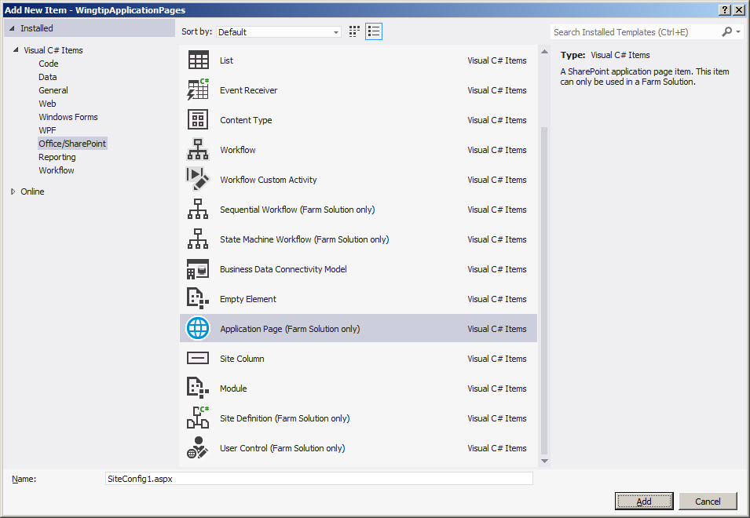
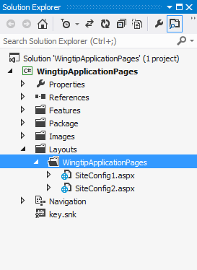
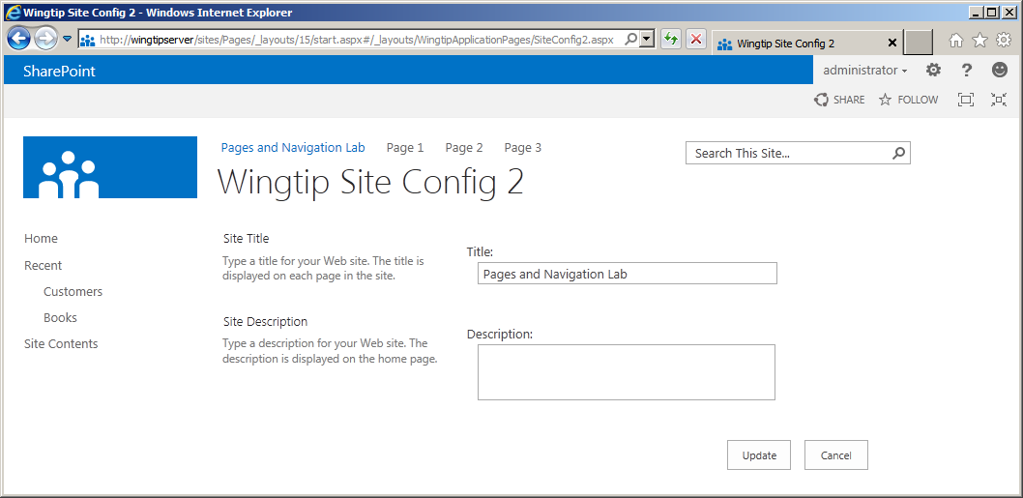
Creating Application Pages
Creating custom application pages
Visual Studio provides project item template
Only supported in farm solutions
Only type of page that supports server-side code
Notes:
Using Visual Studio SharePoint Development Tools, you can create custom application pages:
Create a project using the Visual Studio SharePoint Development Tools.
Add a new Application Page project item.
Override the PlaceholderMain to add your own HTML, ASP.NET controls and SharePoint controls.

Slide 29
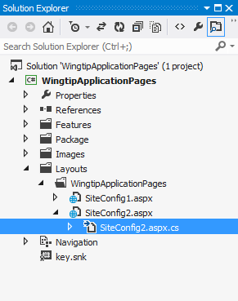
Adding Code to An Application Page
public partial class SiteConfig2 : LayoutsPageBase {
protected override void OnInit(EventArgs e) {
base.OnInit(e);
cmdUpdate.Click += new EventHandler(cmdUpdate_Click);
}
void cmdUpdate_Click(object sender, EventArgs e) {
SPWeb site = this.Web;
site.Title = txtSiteTitle.Text;
site.Description = txtSiteDescription.Text;
site.Update();
SPUtility.Redirect("settings.aspx",
SPRedirectFlags.RelativeToLayoutsPage,
this.Context);
}
protected override void OnPreRender(EventArgs e) {
base.OnPreRender(e);
SPWeb site = this.Web;
txtSiteTitle.Text = site.Title;
txtSiteDescription.Text = site.Description;
}
}
Notes:
You can also add code to custom application pages:
Create a class that inherits from LayoutsPageBase, which resides in the Microsoft.SharePoint.WebControls namespace of the Microsoft.SharePoint.dll
In the .aspx page, add a directive that specifies that the page inherits from your custom class. <@Page Language=“C#” MasterPageFile=“~masterurl/default.master” Inherits=”WingtipUI.Layouts.WingtipUI.SiteConfig2” >
Implement the functionality and handle events that are fired by the controls on the application page

Slide 30
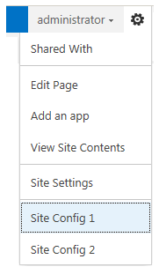
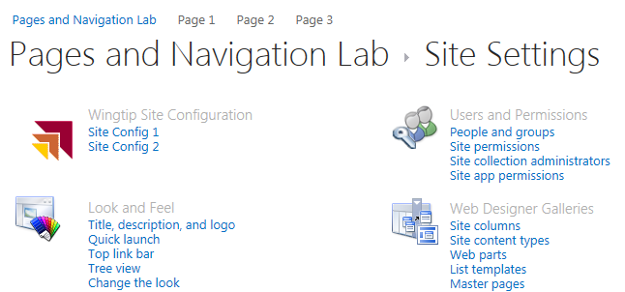
Navigating with CustomActions
CustomAction elements provide navigation
Add Site Settings links and Site Actions menu items
<CustomAction
Id="WingtipSiteActionsConfig1"
GroupId="SiteActions"
Location="Microsoft.SharePoint.StandardMenu"
Rights="ManageWeb"
Sequence="1"
Title="Site Config 1"
Description="Use this page to configure the current site" >
<UrlAction Url="~site/_layouts/WingtipApplicationPages/SiteConfig1.aspx" />
</CustomAction>
<CustomAction
Id="WingtipSiteActionsConfig2"
GroupId="SiteActions"
Location="Microsoft.SharePoint.StandardMenu"
Rights="ManageWeb"
Sequence="2"
Title="Site Config 2"
Description="Use this fancier page to configure the current site" >
<UrlAction Url="~site/_layouts/WingtipApplicationPages/SiteConfig2.aspx" />
</CustomAction>
<CustomActionGroup
Id="WingtipSiteConfiguration"
Location="Microsoft.SharePoint.SiteSettings"
Title="Wingtip Site Configuration"
Sequence="1"
Description="Wingtip application pages"
ImageUrl="/_layouts/15/images/WingtipApplicationPages/WingtipIcon.gif" />
<CustomAction
Id="WingtipSiteSettingsConfig1"
GroupId="WingtipSiteConfiguration"
Location="Microsoft.SharePoint.SiteSettings"
Rights="ManageWeb"
Sequence="1"
Title="Site Config 1"
Description="Use this page to configure the current site" >
<UrlAction Url="~site/_layouts/WingtipApplicationPages/SiteConfig1.aspx" />
</CustomAction>
<CustomAction
Id="WingtipSiteSettingsConfig2"
GroupId="WingtipSiteConfiguration"
Location="Microsoft.SharePoint.SiteSettings"
Rights="ManageWeb"
Sequence="2"
Title="Site Config 2"
Description="Use this page to configure the current site" >
<UrlAction Url="~site/_layouts/WingtipApplicationPages/SiteConfig2.aspx" />
</CustomAction>
Notes:
To be able to navigate to the custom application page, add a CustomAction element. CustomActions can be used to add links to the Site Settings, page, to the Site Actions menu, to toolbars, to the Edit Control Block, and so on.

Slide 31
Application Pages & Extending Site Settings

Slide 32
Summary
Master Pages in SharePoint 2013
Site Pages and Modules
User Interface Design for Apps
Application Pages

