Slide 1
Reusable Type Definitions and Templates
Notes:
In this module you’ll learn how to create custom field types, field controls, site columns and content types as well as how to leverage them in custom solutions. In addition, you’ll also learn how to implement them in a repeatable fashion with the SharePoint tools in Visual Studio 2012. Finally this module will also cover creating site definitions and Web Templates

Slide 2
Agenda
Site Columns & Content Types
List Definitions & Templates
Site Definitions
Web Templates

Slide 3
Site Columns
Reusable column template for use within lists and content types
Specify:
Name & description
Data type
Site column group
Scoped at the site level
Available to child sites
Adding to a list / content type creates a copy
To manage, must have Web designer rights
Notes:
Lists store data in columns, also referred to as fields. You can create the fields in the context of your list, but you can also create site columns that can be reused in multiple lists.
Site columns are created at the level of the site collection and are available to all the sub sites. When creating a site column you have to specify a name, a data type and the name of a group.

Slide 4
Creating & Managing Site Columns
Create / manage many ways:
Browser-based user interface
SharePoint Designer 2013
SharePoint object model (server-side / CSOM)
Feature XML <Field>
Features & object model provide most control
Easy to version in virtually all source control systems
Highest level of reuse
Notes:
You can create site columns in many different ways:
Create them in the user interface: navigate to the Site Settings page of the root site and click the Site Columns hyperlink under the Galleries group.
Use SharePoint Designer.
Use the SharePoint object model to create a site column programmatically.
Use CAML to create a site column declaratively using the <Field> element.

Slide 5
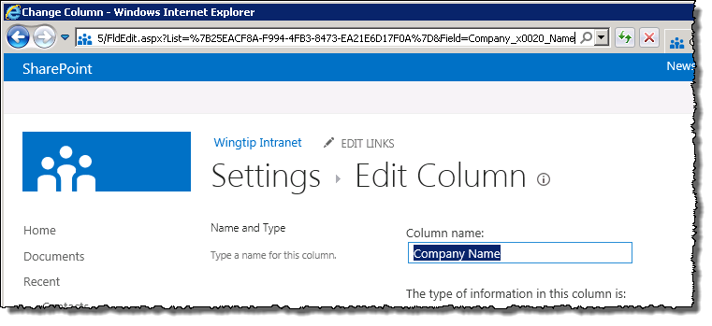
The Feared & Dreaded _x0020_ !!!
When creating columns with spaces in the names, the internal name (ID) converts spaces to encoded spaces (x0020)
To avoid this, explicitly set the internal name within a the XML definition
URL Encoded version of Company_x0020_Name
Notes:
You can create columns in the user interface of SharePoint. To have a user friendly name, in general you enter a name with spaces. When saving your column, SharePoint translates this column name to a name with encoded spaces.
For example: Company Name will be translated to an internal name of Company_x0020_Name. To avoid this, you can explicitly set the internal name within an XML definition:
<Field ID=“{C2A8588A-F8A2-4324-BE39-4962E2E75895}” Name=“CompanyName“ DisplayName=“Company Name” Type="Text">

Slide 6
Creating Site Columns with Features
<?xml version="1.0" encoding="utf-8"?>
<Elements xmlns="http://schemas.microsoft.com/sharepoint/">
<Field ID="{41f2138d-f9d7-4bd8-a369-54054b016c22}"
Name="ReferringCompany"
DisplayName="Referring Company"
Group="Wingtip Site Columns"
Type="Text"
Hidden="FALSE"
Required="FALSE"
ReadOnly="FALSE"
Sealed="FALSE"
DisplaceOnUpgrade="TRUE">
</Field>
</Elements>
Notes:
This code sample demonstrates how to create a custom field in XML. Important properties are:
ID: must be a unique GUID.
DisplayName: is the user friendly name that will be displayed in the user interface.
Name: is the internal name.
Type: the data type of the column.
Required: indicates whether the column is required or optional.
Group: the group is which the custom column will be shown.
Hidden: indicates whether the column is hidden to the user or not.
ReadOnly: can only be updated through the API or definition (XML).
Sealed: can only be updated through the definition (XML).

Slide 7
Content Types
Used to define a type of data
Enable storage of different types of content in same list or library
Specify:
Name & description
Site columns, workflows, event receivers, policies, etc.
Content type group
Scoped at the site level
Available to child sites
Adding to a list creates a copy
To manage, must have Web designer rights
Notes:
Content types are designed to help users organize their SharePoint content in a more meaningful way. A content type is a reusable collection of columns, a data structure, that can be applied to several lists or document libraries in the site collection.
You can also apply more than one content type to the same list or library, enabling users to store multiple different types of content in the same list or library.
Each content type can include different columns for gathering and storing item metadata, and can have different workflows assigned to them.
Content types are defined at site collection level but are available to all sites and sub sites in the site collection.

Slide 8
Creating & Managing Content Types
Create / manage many ways:
Browser-based user interface
SharePoint Designer 2013
SharePoint object model (server-side / CSOM)
Feature XML <ContentType>
Features & object model provide most control
Easy to version in virtually all systems
Highest level of reuse
Notes:
As with site columns, you can create site columns in many different ways:
Createthem in the user interface: navigate to the Site Settings page of the root site and click the Content Types hyperlink under the Galleries group.
Use SharePoint Designer.
Use the SharePoint object model to create a content type programmatically.
Use CAML to create a content type declaratively using the <ContentType> element.

Slide 9
Inheriting Content Types
Allows base definition reuse across multiple types
Core properties can be defined in base content types
The Base content type is inherited by more specific content types
Base Document
Wingtip Document
Wingtip Proposal
Wingtip Presentation
Notes:
You can define a content type with several columns and use it as a base for other content types. More specific content types can inherit the base content type and add more specific columns to it.

Slide 10
Creating Content Types with Features
<?xml version="1.0" encoding="utf-8"?>
<Elements xmlns="http://schemas.microsoft.com/sharepoint/">
<!-- Parent ContentType: Contact (0x0106) -->
<ContentType ID="0x010600ADFF3A525118400BA1271AAAAB3A7F4B"
Name="SalesLead" Group="Custom Content Types"
Description="My Content Type"
Inherits="TRUE"
Version="0">
<FieldRefs>
<FieldRef ID="{41f2138d-f9d7-4bd8-a369-54054b016c22}"
Name="ReferringCompany"
DisplayName="Referring Company"
Required="FALSE" />
</FieldRefs>
</ContentType>
</Elements>

Slide 11
Upgrading Content Types
Upgrading content types has always been hard
New <UpgradeActions> element in Feature schema
One of the action is <AddContentTypeField>
Enables developers to easily upgrade content types
<?xml version="1.0" encoding="utf-8" ?>
<Feature xmlns="http://schemas.microsoft.com/sharepoint/">
<UpgradeActions>
<VersionRange BeginVersion="1.0.0.0" EndVersion="2.0.0.0">
<AddContentTypeField
ContentTypeId="0x010600ADFF3A525118400BA1271AAAAB3A7F4B"
FieldId="{41f2138d-f9d7-4bd8-a369-54054b016c22}"
PushDown="TRUE"/>
</VersionRange>
</UpgradeActions>
</Feature>
Notes:
In SharePoint 2007 it is not easy to upgrade the definition of existing content types.
SharePoint 2010 added new elements to the CAML schema that allows for a better upgrade scenario. You can use the <UpgradeActions> element within the <Feature> element to indicate that you want to upgrade a feature. Within the <UpgradeActions> element you can place elements like <AddContentTypeField> to add a new field to a provisioned content type and to propagate the change to child lists and content types.

Slide 12
Upgrading Content Types – Special Note
Upgrading content types should be thoroughly tested in each scenario
Strongly recommended to read the following resources:
Patterns & Practices: SharePoint Guidance http://msdn.microsoft.com/en-us/library/ff770300.aspx
P&P: SharePoint Guidance: Columns, Lists & Content Types http://msdn.microsoft.com/en-us/library/ff798404.aspx
MSDN Documentation: Updating Content Types http://msdn.microsoft.com/en-us/library/aa543504.aspx
Notes:
The process of upgrading existing content types has been a dynamic challenge since they were introduced in SharePoint 2007. While the improvements in upgrade actions added in SharePoint 2013 are quite helpful and updating content types through the browser is straightforward and reliable, it is strongly recommended that developers review the documentation links in this slide. There are so many different scenarios and conditions that could happen that it is best for developers to get a solid understand of what options are available, what are the advantages and disadvantages of each and come up with their own process.

Slide 13
Site Columns & Content Types
Notes:
Using VS2012 create a site column & content type in a SharePoint hosted app.
Make sure to add title to the content type, but rename it.
Make one site column use the custom field type from demo 1
Scenario: columns for sales leads, content type can be based on contacts CT, or a new one.

Slide 14
Agenda
Site Columns & Content Types
List Definitions & Templates
Site Definitions
Web Templates

Slide 15
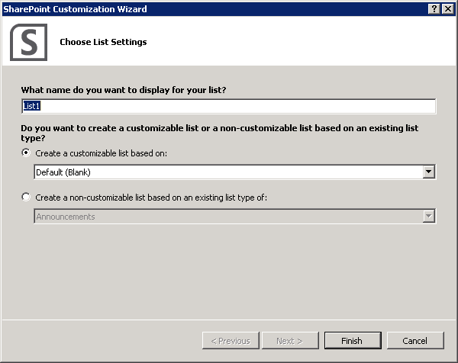
List Definitions & Visual Studio
Visual Studio 2010:
Included 3 project template types:
List Definition
List Definition with Content Type
List Instance
Visual Studio 2012:
Includes one project template type with a wizard
Notes:
In Visual Studio 2012, Microsoft changed the available templates and created a single project template and added a wizard. The wizard isn’t terribly intuitive, so here’s a translation of what it means:
Customizable List
This option will create a new list definition with an associated instance of the new definition. You can then customize the definition using the new list designer.
Non-Customizable List
This option will simply create an instance of a list using an existing list definition but because it is an instance, it is not customizeable.

Slide 16
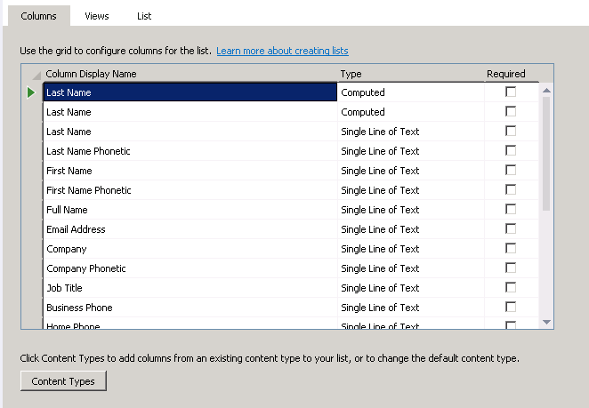
List Definition Designer
Visual Studio 2012 introduces a new list designer
Add columns to the list
Add columns to views
Create views
Modify list settings

Slide 17
List Definitions
Notes:
Using VS2012, create a list definition using the project you created earlier that contained the site column & content type:
Scenario: List type: blank

Slide 18
Agenda
Site Columns & Content Types
List Definitions & Templates
Site Definitions
Web Templates

Slide 19
Site Definition
Top-level component for site provisioning
Used to create site templates
Aggregates smaller, more modular definitions
Every site is provisioned from a site definition
The association remains in place for lifetime of site
Each site definition has one or more configurations
Each configuration can serve as creatable site template
Notes:
A site definition is the top-level component that aggregates smaller, more modular definitions to create a complete site template that can be used to provision sites. For example, a site definition usually includes a custom page template for the site’s home page and can additionally reference external features to add support for custom lists, secondary pages, web parts, and so on.
Every site is provisioned from a specific site definition. Once a site is provisioned from a particular site definition, it picks up a dependency on that site definition that remains in effect for the lifetime of the site.
A site definition contains one or more configurations. These configurations are what appear to users as creatable site templates.

Slide 20
Site Definition Contents
ONET.XML
Acts as manifest for site definition
WEBTEMP.XML
Language-specific file used to activate site definition
Page template files
Used to provision home page and secondary pages
Notes:
A Site Definition consists of diferent parts:
ONET.XML: the ONET.XML file serves as the manifest for the site definition and references the components that are to be used, like the features that define list types that need to be available to users to create new lists.
WEBTEMP.XML: This file references configurations in the ONET.XML file. Each WEBTEMP.XML contains a set of <Template> elements and each <Template> element contains a set of <Configuration> elements. These files list the different site definitions.
Page template files: these files are used to provision the home page and the secondary pages.

Slide 21
Create A Site From A Site Definition
Create a new site from Team Site template
Using default configuration for STS site definition
Create a new site from Blank Site template
Using explicit configuration from STS site definition
$newSite = New-SPSite -Url "http://intranet.wingtip.com/sites/sitename"
-OwnerAlias "wingtip\administrator"
-Template "STS"
-Name "Site Title"
$newSite = New-SPSite -Url "http://intranet.wingtip.com/sites/sitename"
-OwnerAlias "wingtip\administrator"
-Template "STS#1"
-Name "Site Title"
Notes:
You can create a new site from a site template using the Windows PowerShell cmdlet New-SPSite. You have to specify the following arguments:
URL: this is the URL where you want to create the newsite.
OwnerAlias: the owner of the new site.
Template: the name of the template you want to base your new site on. If you only specify the name of the template, the default configuration will be used to create the site. You can explicitly specify the configuration by adding a # sign to the template name and the number of the configuration you want to use.
Name: the name of the new site.

Slide 22
Global Site Definition
Contains global provisioning instructions
What's inside affects provisioning for every site in farm
Eliminates redundant markup required in all templates
Global Site Definition defines and provisions
Master Page Gallery and default.master
Web Part Gallery
List Template Gallery
Site Template Gallery
Solution Gallery
User Information Profile list
Notes:
The Global site definition contains global provisioning instructions that are required by every site definition. The Global site definition contains more than 2600 lines of required common components, like base types and galleries. This way redendant markup is eliminated from the different site definition.
The Global site definition is located in the [..]\15\TEMPLATES\GLOBAL folder and its subfolders. It contains a number of master page templates like default.master, v4.master, v15.master and minimal.master.

Slide 23
Agenda
Site Columns & Content Types
List Definitions & Templates
Site Definitions
Web Templates

Slide 24
Web Template
Introduced in SharePoint 2010
Provides a way to define a site template without using farm solutions
Web Templates can be deployed in sandbox solutions
Doesn’t require the webtemp.xml that is required with site definitions
Can be included in SharePoint Apps

Slide 25
Creating Custom Web Templates
Must derive & reference an existing base template
Registered using WebTemplate in a Feature’s element manifest file
Include onet.xml to define template

Slide 26
Web Templates

Slide 27
Summary
Site Columns & Content Types
List Definitions & Templates
Site Definitions
Web Templates

