Slide 1
SharePoint Search​
Notes:
Previous versions of SharePoint included various search implementations between SharePoint search & FAST search. In SharePoint 2013 Microsoft merged their search implementations into a single, unified search architecture with a powerful and robust search API that is accessible both in server-side and client-side solutions. In this module students will learn about the search architecture as well as how to leverage it in custom solutions.

Slide 2
Agenda
Search Overview
Search Architecture & APIs
Executing Queries
Search Verticals
Parsers
Custom Entity Extraction
Web Service Callout

Slide 3
Search Landscape in SharePoint 2010
 | SharePoint Search | FAST Search
Focus | Enterprise search | Search application platform
Strengths | Ease of deployment, low TCO | Scale, Extensibility
Limitations | Limited extensibility | Complex deployment, maintenance
Products | SharePoint Foundation SharePoint Server Search Server | FAST Search for SharePoint FAST Search for Internet Sites
Notes:
Just a reminder of what products we had in SharePoint 2010.

Slide 4
Search in SharePoint 2013
Single Extensible Platform
FAST Engine
SharePoint Crawler
Best of both!
Resulting search product used as the search solution for both SharePoint 2013 & Exchange 2013
Notes:
The point here is that the search products are all unified under a single search product.

Slide 5
Search Architecture
Notes:
FAST really didn't crawl. It allowed push into index (Content API), while SharePoint crawled.
In SharePoint 2013, the Content API is out. Now the crawler runs continuously. Continuous focuses on a small number of things to be efficient.
Continuous crawl is for the SharePoint index only and makes use of the change log to pick up changes.
Continuous crawls run in parallel and do not wait for previous threads to complete so it updates quickly
Continuous crawls do not retry errors from previous crawls, incremental is used for that
Security changes are included
Full and Incremental crawls still exist, they would be used:
Full is still required under the same conditions as SharePoint 2010: http://technet.microsoft.com/en-us/library/cc262794(office.12).aspx
Continuous for changes noticeable by end users
You don't really need a dedicated server for continuous, but you could. This depends on resource usage.
Managed Properties – still exist. You can create site columns and have a managed property created, and administer at the Site Collection level. Online you can do it at the tenant admin level.
Architecture
Crawl and Connectors - .NET Assembly Connectors and Parsers. Allows for connection to a system and crawling a system
Content Pipeline – just the functionality of bringing content in through crawl.
Web Service Callout – Synchronous call to a web service for additional content processing.
CTS Runtime – processes contents. No real extensibility story.
Analyzer - Process user behavior (click analysis). Supports things like recommendations based on behavior. There is an extensibility story for that.
Indexing Engine – Indexes content.
Query Engine – Executes queries.
Query Pipeline – Just the functionality for processing queries.
IMS Runtime – Processes queries. No real extensibility story.
REST Service – Execute queries through REST.
Client Framework – Execute queries through CSOM.

Slide 6
Export and Import Search Settings
CSOM API
Allows targeting export and import of search settings
Handles rules, sources, managed properties, etc.
Does not handle master pages, templates, and web parts
Supports migrations, DEV→QA→PROD scenarios

Slide 7
Agenda
Search Overview
Search Architecture & APIs
Executing Queries
Search Verticals
Parsers
Custom Entity Extraction
Web Service Callout

Slide 8
Executing Queries: Query Languages
Keyword Query Syntax
Preferred method
Added support for proximity queries (ie: “NEAR”)
FAST Query Language
Still available
SQL Query
Removed from SharePoint 2013
Notes:
KQL – All the basics. Simpler syntax. Now supports proximity queries like “NEAR”. The point here is that KQL is really the language to use.

Slide 9
Executing Queries: Keyword Query Language
 | Keyword | Example | Description
General | Text | Training | Search for items containing “Training”
 | Wildcard | Train* | Search for items like “Training” and “Trainer”
 | Phrase | “Training Room” | Search for the exact phrase
Documents | IsDocument | Training IsDocument:1 | Returns documents containing “Training”
 | FileExtension | Training FileExtension:docx | Returns Word documents containing “Training”
 | Author | Author:Cox IsDocument:1 | Returns documents authored by “Cox”
 | Title | Title:Training IsDocument:1 | Returns documents with “Training” in the title
People | Lastname | Lastname:C | Returns all people whose last name starts with “C”
Tasks | contentClass | contentClass:STS_ListItem_Tasks | Returns all task items
Events | contentClass | contentClass:STS_ListItem_Events | Returns all calendar events
Notes:
KQL – All the basics. Simpler syntax. Now supports proximity queries like “NEAR”. The point is that KQL is really the language to use.

Slide 10
Executing Queries: CSOM
ClientContext clientContext = new ClientContext(siteUrl);
var query = new KeywordQuery(clientContext);
query.QueryText = "Search terms";
SearchExecutor searchExecutor = new SearchExecutor(clientContext);
var resultCollection = searchExecutor.ExecuteQuery(query);
// process results
clientContext.ExecuteQuery();

Slide 11
Executing Queries: REST
Keywords:
http://[..]/_api/search/query?querytext='{KQL Query}'
Selecting Properties:
http://[..]/_api/search/query?querytext='test'&selectproperties='Title,Rank'
Sorting:
http://[..]/_api/search/query?querytext='test'&sortlist='LastModifiedTime:descending'
http://[..]/_api/search/query?querytext='test'&sortlist='LastModifiedTime:descending,Rank:ascending'
Notes:
REST interface allows for querying
App Permissions required:
Scope: http://sharepoint/search
Right: QueryAsUserIgnoreAppPrincipal

Slide 12
Executing Queries: JavaScript & REST
Results = {
element: '', url: '',
init: function (element) {
Results.element = element;
Results.url = _spPageContextInfo.webAbsoluteUrl + "/_api/search/query?querytext='" + queryTerms + "'";
},
load: function () {
$.ajax({
url: Results.url,
method: "GET", headers: { "ACCEPT": "application/json;odata=verbose" },
success: Results.onSuccess, error: Results.onError
});
},
onSuccess: function (data) {
var results = data.d.query.PrimaryQueryResult.RelevantResults.Table.Rows.results;
var html = "<table>";
for (var i = 0; i < results.length; i++) {
html += "<tr><td>" + results[i].Cells.results[3].Value + "</td>;
html += "<td>" + results[i].Cells.results[6].Value + "</td></tr>";
}
html += "</table>";
Results.element.html(html);
},
onError: function (err) { alert(JSON.stringify(err)); }
}
Results.init($('#resultsDiv'));
Results.load();

Slide 13
Executing Queries: Query Throttling
Client Types
Search Center P1
Unspecified P3
Throttling Based on Query Latencies
“System too busy”
OOB Configuration
Enabled for SharePoint Online
Disable for On-Prem
Notes:
Note: Out-of-the-box (OOB) in on-prem scenarios query throttling is turned off. In SharePoint Online the plan is to have it turned on so that tenants cannot impact each other’s query performance.
Client Types are a mechanism for us to throttle incoming queries. SharePoint enumerates all of the OOB sources where queries are issued, and assigned a Client Type + a priority. E.g., a query from a search center would be P1; a query to refresh the site map might be P3.
Primary development scenario: you’ll want to create a new Client Type for your app and pass that in at query time…otherwise it will default to P3 and you may get throttled (ie error returned as “system is too busy…try again later”). A very useful tool for segmenting traffic and degrading “gracefully” in SharePoint Online where query loads could be spiky.
OOB every client that issues a query specifies a ClientType and we have added those have been added to the OOB list. Every other app needs to specify this in the Query object that they create so that they can configure which tier they belong to – this happens using this UI. If query latencies in a higher tier are worse than a threshold (configurable on-prem) SharePoint starts throttling queries from lower tiers (and potentially higher tiers as well) so as to give more processing throughput to the higher tiers.

Slide 14
Creating a Search App
Notes:
Show solution from HOL ex3

Slide 15
Agenda
Search Overview
Search Architecture & APIs
Executing Queries
Search Verticals
Parsers
Custom Entity Extraction
Web Service Callout

Slide 16
Search Verticals: No-Code Customization
Result Sources
Analogous to a Federated location in SharePoint 2010
Query Rules
Allow for the customization of returned results
Result Types
Determines how to display a set of results
SPNavigation Provider
Replaces the tabs in previous versions of Search Center
Notes:
Result Sources:
With search result sources, you can give users the ability to simultaneously search content in the search index of the local search service, as well as in other sources, such as Internet search engines. In SharePoint Server 2010, these were known as federated locations.
Query Rules:
Query rules let you customize the search experience for the kinds of queries that are important to your users, without any custom coding. For example, if your users frequently search for PowerPoint slides, you can use query rules to recognize these queries by tracking keywords such as "slides" or "ppt", or by learning the queries where users commonly click on PowerPoint files in the results. Then, when the user performs these queries, you can do any of the following:
Return a special result linking to a search vertical customized for displaying PowerPoint files.
Show a block of results with only PowerPoint files.
Change the search results so that PowerPoint files are ranked higher in the results.
Result Types:
Result types define how to display a set of search results based on a collection of the following:
Rules: Determines when to apply a result type, based on the specified conditions. Rule conditions can be joined together by using equality, comparison, and logical operators.
Properties: Determines the list of managed properties for the result. You must add managed properties to the list before you map it to a display template.
Display templates: Defines the visual layout of the result type.

Slide 17
Search Verticals: Result Sources
Select a Source
Local SharePoint Index
Remote SharePoint Index
OpenSearch
Exchange
Apply a Query Transformation
{searchTerms} contentclass:sts_listItem_genericlist
path:http://[..]/Lists/Glossary
Notes:
Result Sources allow you to use Federated Locations as a source, but utilize a Query Transformation to narrow the search against the source. You can search something very narrow, like a list, or broad like a site collection.

Slide 18
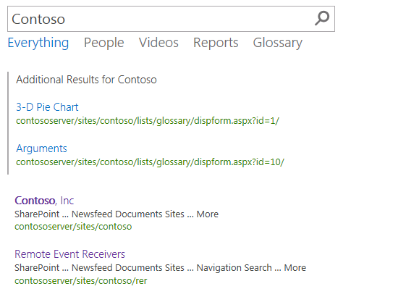
Search Verticals: Query Rules
Applied to a Result Source
Processed under given conditions
Keyword Query matches
Topic Category
Result Types
Result Blocks

Slide 19
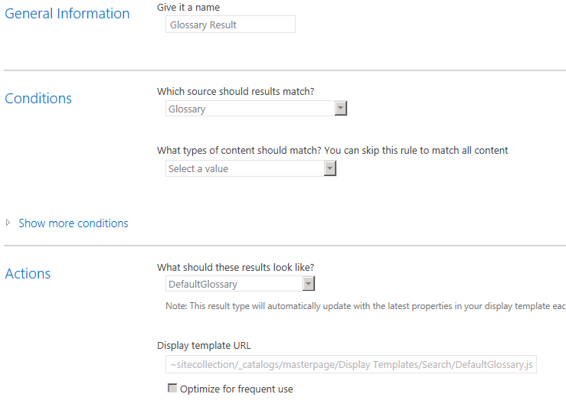
Search Verticals: Result Types
Bound to a Result Source
Defined by a Rule
Associated with a Template

Slide 20
Search Verticals: Display Templates
Determines how Result Types appear
Created as an HTML file with special references to the Managed Metadata properties
<div id="Header">
_#= ctx.CurrentItem.owsqTXTTextProduct =#_
</div>

Slide 21
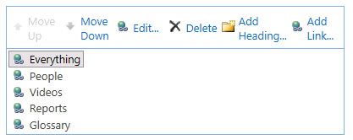
Search Verticals: Search Navigation
Utilizes the SPNavigation Provider
Replaces the SharePoint 2010 tabs model
Search Center → Site Settings → Search Settings

Slide 22
Search Verticals
Notes:
Manually do same steps from HOL ex2

Slide 23
Agenda
Search Overview
Search Architecture & APIs
Executing Queries
Search Verticals
Parsers
Custom Entity Extraction
Web Service Callout

Slide 24
Parsers
Parser Engine detects document format
Many formats supported OOB
Calls appropriate Format Handler
Format Handlers perform actual parsing
Custom Format Handlers implement IFormatHandler
Notes:
The indexer needs a way to access a system and parse the contents it finds there.
Accessing systems is accomplished by .NET Assembly Connectors.
Parsing the contents is handled by “Parsers” and “Format Handlers”. Parsers detect the document format (and do not rely on the document extension). They then call the appropriate Format Handler to parse the document.

Slide 25
Parsers
New parsing features
Automatic file format detection
Deep link extraction for Word and PowerPoint formats
Visual meta-data extraction: titles, authors and dates
High-performance format handlers for HTML, DOCX, PPTX, TXT, Image; XML and PDF formats
IFilter API still supported
Allows support for file formats that do not have format handlers
New Montage, Visio and OneNote IFilters
Notes:
Automatic File Format Detection:
OOB, Parsers can actually detect more formats than are supported by the available format handlers. For this reason, the IFilter API is still supported. The IFilter can call a generic Format Handler to plug into the parsing architecture.
Deep Link Extraction:
Deep Link extraction means that anything in the document formatted as a header (or slide title) is pulled out and displayed as a link in the hover panel. This allows you to preview the paragraph (or slide) that is most relevant to your search.
Visual Metadata Extraction:
Extracts the title, author, and date based on the document and not the metadata because the metadata is often wrong.

Slide 26
Parsers
Format Handlers and IFilters
Notes:
This shows how the parsers can detect formats that have a format handler and ones that do not. IFilters are used where there is no specific format handler.

Slide 27
Agenda
Search Overview
Search Architecture & APIs
Executing Queries
Search Verticals
Parsers
Custom Entity Extraction
Web Service Callout

Slide 28
Custom Entity Extraction
Activate refiners based on custom dictionaries
12 custom extractor “slots” you can use:
 | Case insensitive | Case sensitive
Word matching | 5 word extractors | 1 word exact extractor
Substring matching | 5 word part extractors | 1 word part exact extractor
Notes:
The Custom Entity Extraction feature in SharePoint 2013 is a powerful extensibility point for the customers. You can use Custom Entity Extraction when you want to refine results by something that doesn’t have a managed property defined. For example, say you have a corpus of medical documents and you want to refine by the commercial name of various medicines. However, no one included a metadata property for that. So you want to extract that information from the document itself. You could then define a dictionary like this:
MedicalDictionary
Advil
Lipitor
Ambien
The main idea behind Custom Entity Extraction is that you can plug your own dictionary into the SharePoint's content processing pipeline. You create a dictionary as a simple text file with an extension of .csv and then you add the dictionary content. This can be done with Notepad.exe or with Microsoft Excel. When creating the dictionary file, the first line is title. Next you add a list of terms. You can have a comma after the term to normalize the term. Once you have created the dictionary file, you then import the dictionary into the SharePoint environment using a PowerShell cmdlet. Remember, you will always need to crawl content after configuring a custom dictionary before it has any effect.

Slide 29
Custom Entity Extraction: Setup
Import your dictionary using the PowerShell cmdlet
Import-SPCustomExtractionDictionary
Enable a custom extractor for certain managed properties on the Search Schema UI
Initiate full re-crawl
Edit the refinement web part to display your custom extractor
Notes:
Once the dictionary is defined, you must use PowerShell to import it into one of the 12 available “slots”. The slots are defined using magic words like:
Microsoft.UserDictionaries.EntityExtraction.Custom.Word.1
The only way to find these magic words is to type in nonsense into the cmdlet. Then the error message spits out the possible values.
Once the dictionary is loaded into a slot, you must enable entity extraction for the managed property. This is done using a simple check box on the property. Usually you will enable it on the body of the document.
Finally, you must add the custom refiner to the refiner web part on the search page.

Slide 30
Agenda
Search Overview
Search Architecture & APIs
Executing Queries
Search Verticals
Parsers
Custom Entity Extraction
Web Service Callout

Slide 31
Web Service Call-Out
Transform managed properties using a custom web service
Data cleansing
Entity extraction
Classification and tagging
SOAP web service
Reads a set of managed properties and returns new or modified properties
Content Processing web service client
Trigger conditition controls when to do (synchronous) call-out
New or modified managed property values get indexed
Configurable error handling: Warn or Fail document
Notes:
Content Pipeline is the one place where you have access to all of the searched items before the index gets created.
Web service allows you to modify managed property values or add new properties.
Example: You can add additional information like a rating from a web service that’s not part of the metadata information normally.
Data Cleansing: You can use this to normalize data like making «MSFT» or «Microsoft» into «Microsoft Corporation» by changing the value of a managed property.
Entity Extraction: Allows for adding managed properties to a document that didn’t exist before based on values in the body of the document.
Classification and Tagging: Allows for adding managed properties to a document that didn’t exist before based on classification rules.
The web service client is configured with:
SOAP RPC endpoint
Implements a well-defined interface
Optional SSL transport security
Trigger condition: checks existence/values of managed properties before doing call-out (allows for rules that determine when the callout happens)
Input managed properties: set of managed properties to send to web service, includes read-only managed properties
Output managed properties: set of managed properties returned from web service, can not include read-only properties
Failure mode: if web service generates error, either log warning and index document OR fail document and return error code to crawler
There are size limits for each property returned from the web service + a total size for the message

Slide 32


Web Service Call-Out
Data Flow
SOAP RPC Web Sevice
Input MPs
Output MPs
Content Processing
Crawler
TriggerCondition = True
Index
Crawler Flow
Indexing behavior
Farm Admin
 | No errors | Errors
Failure Mode = Error | New MP values get indexed | Item not indexed (see crawl log for errors)
Failure mode = Warning | New MP values get indexed | Item gets indexed without new MP values
1. Configure schema
2. Configure web service client
3. Start Crawl
Trigger expression
Input MPs
Output MPs
Failure Mode
Admin
Database
Notes:
Farm Admin sets up the rules for triggering and the endpoint to call.
Remember, managed properties must exist before the crawl starts or the callout will return errors.
You can only have a single callout in the engine. The web service must implement the IContentProcessingEnrichmentService interface.

Slide 33
Summary
Search Overview
Search Architecture & APIs
Executing Queries
Search Verticals
Parsers
Custom Entity Extraction
Web Service Callout

