Slide 1
Developing Workflows
Notes:
SharePoint 2013 dramatically changes the workflow architecture in the latest release. Workflow is now handled by Workflow Managers, both in on-premises and hosted deployments. In this module students will learn how to create custom workflows using SharePoint Designer 2013 and Visual Studio 2012 as well as some of the new capabilities introduced in SharePoint 2013 workflows: dynamic values, stages and remote web service calls.

Slide 2
Agenda
Workflow in SharePoint 2010
Workflow in SharePoint 2013
SharePoint 2013 Workflow Improvements
Creating Custom Workflows
Tooling: Visio 2013 & SharePoint Designer 2013
Tooling: Visual Studio 2012
Working with Web Services
Advanced Workflow Debugging

Slide 3
Workflow in SharePoint 2010
SharePoint 2010 hosted the Workflow Foundation (WF) workflow runtime
Tightly coupled workflow to SharePoint 2010
Workflow data kept in SharePoint content databases
Tied to .NET Framework 3.5 Service Pack 1 version of WF
Notes:
SharePoint 2010 leveraged Workflow Foundation (WF) found in the .NET Framework 3.5 SP1. There wasn’t much difference in SharePoint 2010’s workflow story from SharePoint 2007 from an architectural perspective as SharePoint 2007 introduced workflow to the SharePoint platform via .NET Framework 3.0. The biggest improvements around workflow in SharePoint 2010 included:
Site-based workflows: Workflows that run within the context of an SPWeb (previously they could only run within the context of an SPListItem)
Power User Tooling Improvements:
Workflows could be modeled using Visio 2010 and exported/imported to SharePoint Designer 2010.
Ability to create “Reusable Workflows” or those that are tied to content types.
Ability to import reusable workflows into Visual Studio 2010 coded workflows.
Workflow Events: Overrideable events developers can handle to run custom processes.

Slide 4
SharePoint 2010 Workflow Challenges
Designed for on-premises deployments
Didn’t scale well in the cloud (Office 365)
In SharePoint, extending WF meant you had to be a box admin
Only possible via farm solutions
Analytics on current / previous workflow instances hard to acquire
Buried within the SharePoint content databases
Workflows were executed in the context of SharePoint as super user
Notes:
Workflows built for SharePoint were tightly coupled with SharePoint ran at a very low level and were designed primarily for on-premise deployments.
This meant that coded workflows could not run within the sandbox or in a hosted environment.
All workflow data was also retained within the site collection’s content database where the workflow ran.

Slide 5
Agenda
Workflow in SharePoint 2010
Workflow in SharePoint 2013
SharePoint 2013 Workflow Improvements
Creating Custom Workflows
Tooling: Visio 2013 & SharePoint Designer 2013
Tooling: Visual Studio 2012
Working with Web Services
Advanced Workflow Debugging

Slide 6
Workflow in SharePoint 2013
Workflow processing moved to Workflow Manager (WM)
No longer runs in the SharePoint content farm / servers
SharePoint farm & WM farm can be on same / different servers
Improves stability, scalability & transparency
SharePoint 2013 leverages WM
WM hosts Workflow Foundation v4 (WF4)
Notes:
SharePoint 2013 takes a very different approach to workflow. Existing SharePoint 2010 workflows will still run using the same legacy SharePoint 2010 / .NET Framework 3.5 architecture and developers/users are free to continue creating workflows using this approach although it is not recommended.
SharePoint 2013 workflows are based on Windows Workflow Foundation 4.0 (WF), which has been substantially redesigned from earlier versions. WF, in turn, is built on the messaging functionality provided by WCF. The workflow story in SharePoint 2013 now treats workflow as a separate service and leverages Workflow Manager which includes the WF included in .NET Framework 4.0. The workflow service provided by Workflow Manager is decoupled from SharePoint and no longer runs in the content farm; rather it runs on its own servers. Workflow Manager also leverages the latest and greatest advancements in workflow capabilities, performance and scalability from Microsoft.
Workflow Manager is very much a customer and leverages the new SharePoint App Model architecture in that workflows (like apps) are treated as a “service”. SharePoint instructs Workflow Manager to execute a workflow and the two products communicate with each other over a service model infrastructure (WCF).

Slide 7
SharePoint 2013 Workflow Changes
Ability to call Web Services
Workflows on WF4 are fully declarative
No more custom code within workflows
When you would have needed custom code, now build a Web Service & call it from the workflow
Full parity between deployment types
SharePoint 2013–style workflows based on WM will work the same way regardless of the deployment type
Tooling improvements:
SharePoint Designer 2013
Visual Studio 2012
Notes:
You can now call web services from within declarative workflows. Data returned by those Web services is stored in workflow variables and can then be used by the workflow in any number of scenarios. These actions provide tremendous flexibility in integrating data external to SharePoint into your workflows. The recommended approach to embedding custom logic implemented with custom code in SharePoint 2013 workflows is to create a custom service and use the new service actions so all can consume these from your declarative workflow.
In addition, all workflows now in SharePoint 2013, executed by Workflow Manager, are fully declarative. This means custom managed code within a workflow project is no longer possible. When you would have written custom code, the guidance is now to build a custom web service, ideally an OData service with WCF Data Services (Microsoft’s implementation of the OData protocol) and call these services using the new activities provided.
Both SharePoint Designer 2013 and Visual Studio 2012 have also received significant improvements as covered later in this module. Finally, Microsoft also included quite a few new actions and activities for use in creating workflows.

Slide 8
SharePoint 2010 vs. 2013 Workflows
SharePoint 2013 includes the workflow host included in SharePoint 2010
Based on Workflow Foundation in .NET 3.5 SP1
Ensures all legacy workflows will continue to run
Types of workflows in SharePoint 2013
SharePoint 2010 Workflow:
Workflow Foundation v3.5 hosted by SharePoint
SharePoint 2013 Workflow:
Workflow Manager: Hosted / On-Premises WF v4
Notes:
Customers creating new workflows in SharePoint 2013 are presented with two options in SharePoint Designer 2013:
SharePoint 2010 Workflow: Workflows based on the same SharePoint 2010 model using .NET Framework 3.5 SP1 WF. These execute the same way they did in SharePoint 2010 (they run within the same SharePoint processes) and cannot leverage any of the improvements outlined in the remainder of this module.
SharePoint 2013 Workflow: This option is available when SharePoint 2013 is connected to a configured instance of Workflow Manager. These workflows execute within Workflow Manager and not within the SharePoint process. They can leverage all the improvements outlined in the remainder of this module.
If the SharePoint farm has not been connected to a Workflow Manager farm, SharePoint Designer 2013 will allow the creation of SharePoint Server 2010 style workflows. These workflows will not have any of the new capabilities offered in SharePoint 2013 or Workflow Manager and will be executed within the SharePoint workflow host which was carried forward from SharePoint 2010.
When building workflows with Visual Studio 2012, developers can create SharePoint 2010 style workflows that are coded and must be deployed using farm solutions. These workflows will run within the same workflow host that was included in SharePoint 2010 and are only available for on-prem SharePoint deployments. Visual Studio 2012 also supports creating SharePoint 2013 style workflows which will be covered later in the module.

Slide 9
SharePoint Deployments & Workflow
Office 365 / SharePoint Online
Workflow Manager hosted version already deployed & managed by Microsoft
No custom setup / configuration actions necessary
SharePoint On-Prem Deployment
Customer must install a Workflow Manager farm
After Workflow Manager farm installed, must connect SharePoint 2013 farm to Workflow Manager farm
Notes:
This new architecture is available both in the on-premises model using Workflow Manager as well as in a hosted model. By moving to this new architecture, SharePoint benefits from improvements in stability and scalability in the workflow platform. In addition Workflow Manager is much more transparent where developers can use a service-based API to gain insight into metrics and analytics of WF.
Regardless of how you are using SharePoint, either in a hosted deployment such as SharePoint Online in Office 365, or on-prem (where you install SharePoint on your own corporate servers), workflows are created and are processed the same way.
Microsoft has already installed & configured Workflow Manager and connected it to SharePoint Online in Office 365 so there is no extra work for you to do; you can create and deploy workflows right away in this scenario.
If you are running SharePoint on-premises, as in the case where you install it on your own servers, you need to install and configure a Workflow Manager farm. After installing and configuring it, you will need to then connect your on-prem SharePoint farm to the Workflow Manager farm. Once this is done you’ll be in the same state as SharePoint Online and can then create and deploy workflows on-prem.

Slide 10
Installing Workflow Manager 1.0
Distributed via Web Platform Installer (WebPI)
WM & SB Service Account:
Must be installed with it’s service account
Service account must be in local admins group
After installing WM, connect SharePoint farm to the WM farm via Windows PowerShell
Register-SPWorkflowService -SPSite "http://intranet.wingtip.com" -WorkflowHostUri "http://wingtipallup:12291" -AllowOAuthHttp
Notes:
Workflow Manager is distributed via the Microsoft Web Platform Installer (http://www.microsoft.com/web/downloads/platform.aspx). There are a few important things to keep in mind when installing and configuring Workflow Manager:
Service Account
Workflow Manager runs under a special service account, just like SharePoint. This account must be added to the local Administrators group on the server where Workflow Manager is being installed. Because of this, Workflow Manager cannot be installed on a domain controller (something you’d never do in production, but maybe in a test or developer environment). Further, you should be logged into the server with the account that will act as the Workflow Manager service account when you run the Workflow Manager installer and configuration wizard.
SharePoint Configuration
When you install and configure Workflow Manager, you are simply creating a new Workflow Manager farm. For SharePoint to be able to use this farm, you need to go to one of the servers in your SharePoint farm and run a Windows PowerShell cmdlet (Register-SPWorkflowService) to connect the SharePoint farm to the Workflow Manager farm.

Slide 11
SharePoint 2013 & Workflow Manager
WM talks to SharePoint via CSOM
WM calls are authenticated with OAuth token that includes:
App ID: let’s SharePoint know the call is from WM
User Context: user who initiated workflow
Notes:
SharePoint 2013 also has new CSOM and REST APIs exposing running workflows without having to go directly to the Workflow Manager instances. SharePoint communicates with Workflow Manager via standard protocols (WCF Services HTTP / HTTPS depending how it was configured at installation). These workflows are declarative.

Slide 12
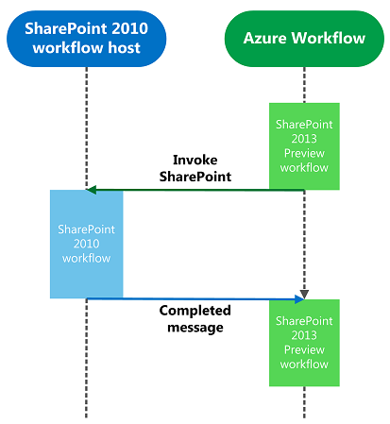
Workflow Interop Bridge
Enables SharePoint 2010 workflows to work in 2013
Execution engine hosted in SharePoint 2013
Negotiates between the two execution engines
WF in SharePoint 2010
WM in SharePoint 2013
InvokeSharePointWorkflow activity sends a start message to SharePoint’s workflow web service control endpoint
Notes:
Existing SharePoint 2010 workflows will continue to run within the context of SharePoint within SharePoint 2013 and cannot leverage new additions to the workflow story in SharePoint 2013. However at times a SharePoint 2010 workflow may need to communicate with a SharePoint 2013 workflow. The Workflow Interop Bridge is a tool to connect SharePoint Workflow to Workflow Manager workflow. The bridge exists to allow customers to reuse existing workflow assets available in SharePoint and provide a smooth transition path to Workflow Manager. It allows Workflow Manager workflows to delegate part of the process to SharePoint, enabling reuse of existing workflow assets that may not be available in Workflow Manager. It removes the complexity of creating workflows that span the SharePoint workflow host and the Workflow Manager workflow host. Customers will not have to write any service gateways, solve distributed security models, and cross-product integration challenges.
Essentially, the Interop Bridge allows SharePoint workflows based on Workflow Foundation 3 to run. Workflow Manager simply calls back into SharePoint which hosts the Workflow Foundation 3 runtime and receives a message when the process has completed.
The message flow documented on this slide is kicked off when the Workflow Manager workflow encounters a branch of the workflow that calls the interop bridge by invoking the activity InvokeSharePointWorkflow. From there, the following happens:
The InvokeSharePointWorkflow activity tells the Workflow 3 engine in SharePoint to start (by calling a Web service). This message includes the workflow instance ID which acts as a correlation ID when SharePoint sends a completed message back to Workflow Manager (#4).
The SharePoint workflow Web service authorizes the request and then starts the workflow.
When finished, workflow events are used to publish a message through the SharePoint event publisher. This message includes the workflow instance ID.
The SharePoint event publisher notifies Workflow Manager using the same pipeline that is used to notify Workflow Manager of list events (for instance: item updated/added).
Workflow Manager dispatches a Completed message to the instance within Workflow Manager using the instance ID as the correlation ID.

Slide 13
Agenda
Workflow in SharePoint 2010
Workflow in SharePoint 2013
SharePoint 2013 Workflow Improvements
Creating Custom Workflows
Tooling: Visio 2013 & SharePoint Designer 2013
Tooling: Visual Studio 2012
Working with Web Services
Advanced Workflow Debugging

Slide 14
New Workflow Activities & Actions
New Actions & Activities |  | Microsoft Project Specific Actions
Assign a Task | Get Property from [Dictionary/DynamicValue] | Create a Project from Current Item
Start a Task Process | Count Items in [Dictionary/DynamicValue] | Set the current project stage status to this value
Go to This Stage | Trim String | Set the status field in the idea list item to this value
Call HTTP Web Service | Find Substring in String | Wait for Project Event
Start a List Workflow | Replace Substring in String | Set this field in the project to this value
Start a Site Workflow | Translate Document
Build [Dictionary/DynamicValue] | Set Workflow Status
Notes:
SharePoint 2013 workflows are built using a series of activities that are arranged in stages and steps as well as conditions and loops. There are multiple types of activities:
Core Actions: Actions for adding comments, adding time to date, calling services, performing calculations, sending emails, etc.
List Actions: Check In/Out items, copy items, updating items, etc.
Conditional Actions: If statements, checking if something was created or modified by a specific person or in a time span, etc.
Utility Actions: String manipulation functions.
Task Actions: Assigning tasks or starting a task process.
In SharePoint 2013, Microsoft added a series of new activities, including:
Assign a Task: Assigns a single workflow task to a user or group.
Start a Task Process: Initiates execution of a task process.
Go to This Stage: Specifies the next stage in a workflow to which flow control should be handed.
Call HTTP Web Service: Functions as a method call to a Representational State Transfer (REST) endpoint.
Start a List Workflow: Starts a list-scoped workflow.
Start a Site Workflow: Starts a site-scoped workflow.
Build [Dictionary/DynamicValue]: Creates a new variable of type [Dictionary/DynamicValue].
Get Property from [Dictionary/DynamicValue]: Retrieves a property value from a specified variable of type [Dictionary/DynamicValue].
Count Items in [Dictionary/DynamicValue]: Returns the number of rows in a variable of type [Dictionary/DynamicValue].
Trim String: Removes all leading and trailing white-space characters from the current string.
Find Substring in String: Returns 1-based index of the first occurrence of one or more characters, or the first occurrence of a string, within a string.
Replace Substring in String: Returns a new string in which all occurrences of a specified character or string are replaced with another specified character or string.
Translate Document: Functions as a wrapper around the HTTP activity that calls the synchronous translation API. You must configure a Machine Translation Service Application for the SharePoint site on which you run the workflow.
Set Workflow Status: Updates workflow status as specified in message string.
The activities that contain Dictionary / Dynamic Value are handled differently depending on the tool. For instance, only Visual Studio understands the new DynamicValue types and therefore, SharePoint Designer only uses a Dictionary type.
Some new activities are specific to Microsoft Project:
Create a Project from Current Item: Creates a Project Server project based on the current item.
Set the current project stage status to this value: Sets the two status fields within the current stage of the project.
Set the status field in the idea list item to this value: Updates the status field of the original SharePoint list item.
Wait for Project Event: Pauses the current instance of the workflow to await a specified Project event: Project checked in, Project committed, Project submitted.
Set this field in the project to this value: Sets the value

Slide 15
SharePoint Designer Workflow Stages
Each stage has an entry point & gate
Gate: conditional transition point where workflow exits
Underlying core in WF4 flow step in a flowchart
Can contain multiple steps
Mitigates SharePoint Designer loop limitations
Notes:
Microsoft has introduced the concept of stages to workflows in SharePoint 2013. Stages, founded on the flowchart workflow type in WF 4.0, mitigate a lot of the challenges people had creating workflows with SharePoint Designer in previous versions of SharePoint, specifically the loop limitations. Each stage has an entry point and gate. All workflows start by entering the first stage. At the end of a stage the workflow author dictates the next stage (optionally using a conditional IF statement) the workflow should proceed to. Further, each workflow stage can contain multiple steps and actions within it.
Stages: In the past, declarative workflows have been strictly serial: They start at the beginning and progress to the end. Now, SharePoint Designer 2013 introduces an important new building block—the stage. Stages are a top-level container that you use to group together conditions, actions, or steps. The conditions, actions, or steps in one stage are processed in the listed order before the workflow transitions to the next specified stage. But here’s the important part: The transition means that the next stage can be any stage in the workflow—not necessarily the next stage serially.
Stages, not steps, are the new top-level containers.
Stages cannot be nested in any other building block; a stage must be at the top level.
Only stages can have Go To actions, and the target of a Go To action must be another stage.
Steps can be nested in stages and other steps.
A stage can be connected only to another stage. (In the visual workflow designer only, a stage can also be connected to a condition shape.)

Slide 16
Agenda
Workflow in SharePoint 2010
Workflow in SharePoint 2013
SharePoint 2013 Workflow Improvements
Creating Custom Workflows
Tooling: Visio 2013 & SharePoint Designer 2013
Tooling: Visual Studio 2012
Working with Web Services
Advanced Workflow Debugging

Slide 17
Creating Custom Workflows
Possible to create SharePoint 2010 style workflows in both current tools
SharePoint farm must be connected to Workflow Manager farm to create SharePoint 2013 style workflows
All SharePoint 2013 workflows are declarative
Visio 2013
Used for modeling process & sharing with disconnected customers
SharePoint Designer 2013
Text-based & new visual designer
Audience: end users, power users & developers
Visual Studio 2012
Visual designer for modeling workflows
Audience: developers
Notes:
SharePoint 2013 supports creating workflows based on both Workflow Foundation (WF) v3.5 and WF v4.0. The recommended approach is to create WF for SharePoint 2013 using WF v4. In order to do this SharePoint must be connected to an installed and configured Workflow Manager. If this step has not been completed you will only be able to create workflows using the WF v3.5 engine which is hosted by SharePoint.
You can leverage your existing workflow investments such as workflows created in the previous version of SharePoint that are based on WF v3.5 in your SharePoint 2013 deployment as well as in new WF v4 based workflows. This is done via the new Workflow Interop Bridge (covered later in this module).
The focus in SharePoint 2013 workflows is to build workflows declaratively. This is different from previous versions of SharePoint where one tool (SharePoint Designer) was used to create declarative workflows while Visual Studio could only create programmatic workflows. Programmatic workflows are still possible, but they are not SharePoint workflows, they are workflows that run within the context of Workflow Manager and can call SharePoint using the REST and CSOM APIs provided they have been granted access via OAuth2.

Slide 18
Workflow Authoring Tools Compared
 | SharePoint Designer 2013 | Visual Studio 2012
Declarative
Custom Code
Reusability | Reusable / Content Type based workflows | Workflow templates, include workflows in apps
Include in Apps
Visio Integration
Custom Actions | Consume, not create | Create & consume
Debugging
Supported Versions | 2010 & 2013 | 2010 & 2013
Target Audiences | Power Users, End Users, Developers | Developers
Notes:
The two primary tools – SharePoint Designer 2013 and Visual Studio 2012 – used to create custom workflows in SharePoint 2013 are similar but have some distinct differences from their previous versions:
Declarative vs. Custom Code: Both SharePoint Designer & Visual Studio can create declarative workflows. In fact, Visual Studio can *only* create declarative workflows for SharePoint 2013… a significant change from previous versions. Custom code is only possible when creating SharePoint 2010 workflows using farm solutions which is still supported but not recommended as you cannot leverage any of the new capabilities in Workflow Manager or SharePoint 2013.
Reusability: Similar to previous versions, SharePoint Designer can create reusable workflows that can be used multiple times within the same site or exported for deployment to other sites. Visual Studio workflows are created as templates which can be deployed and associated with any list or library.
Include in Apps: One benefit Visual Studio has over SharePoint Designer is that developers can include workflows within SharePoint Apps; SharePoint Designer has no support for apps.
Visio Integration: Only SharePoint Designer supports Visio integration in that workflows can be modeled using Visio and imported into SharePoint Designer. Only SharePoint Designer authored workflows will have a user-friendly visualization for executing workflows.
Custom Actions: Both SharePoint Designer and Visual Studio can consume and use custom actions in authored workflows. However Visual Studio will use the underlying action’s activity and not the action in its workflow. Further custom activities/actions can be created using Visual Studio.

Slide 19
Agenda
Workflow in SharePoint 2010
Workflow in SharePoint 2013
SharePoint 2013 Workflow Improvements
Creating Custom Workflows
Tooling: Visio 2013 & SharePoint Designer 2013
Tooling: Visual Studio 2012
Working with Web Services
Advanced Workflow Debugging

Slide 20
SharePoint Designer 2013
Improved visual designer
Integrated the Visio designer into SharePoint Designer
Visio installation required for visual designer
Can switch between visual designer & text-style
Activity properties editable in visual designer
Support for Stages & Loops
Support for calling Web Services
Workflow designer supports Office operations:
cut / copy / paste / undo / redo / select-all
Improved email editor (rich formatting)
Notes:
SharePoint Designer 2013 now provides a visual workflow designer. The previous version, SharePoint Designer 2010, offered integration with Microsoft Visio 2010 so that you could design workflows visually in Visio and then import them into SharePoint Designer. Now you can visually design your workflows by dragging, dropping, and connecting shapes directly within SharePoint Designer 2013. You can set all the properties of a workflow action in the new visual workflow designer—just select the shape and then click the action tag. Also, if you click Properties on the action tag, the property grids for conditions and actions appear in the visual designer, just as they do in the declarative workflow designer.
Loops: SharePoint Designer 2013 now provides looping. A loop is a container that you can use to group conditions and actions that you want the workflow to process repeatedly.

Slide 21
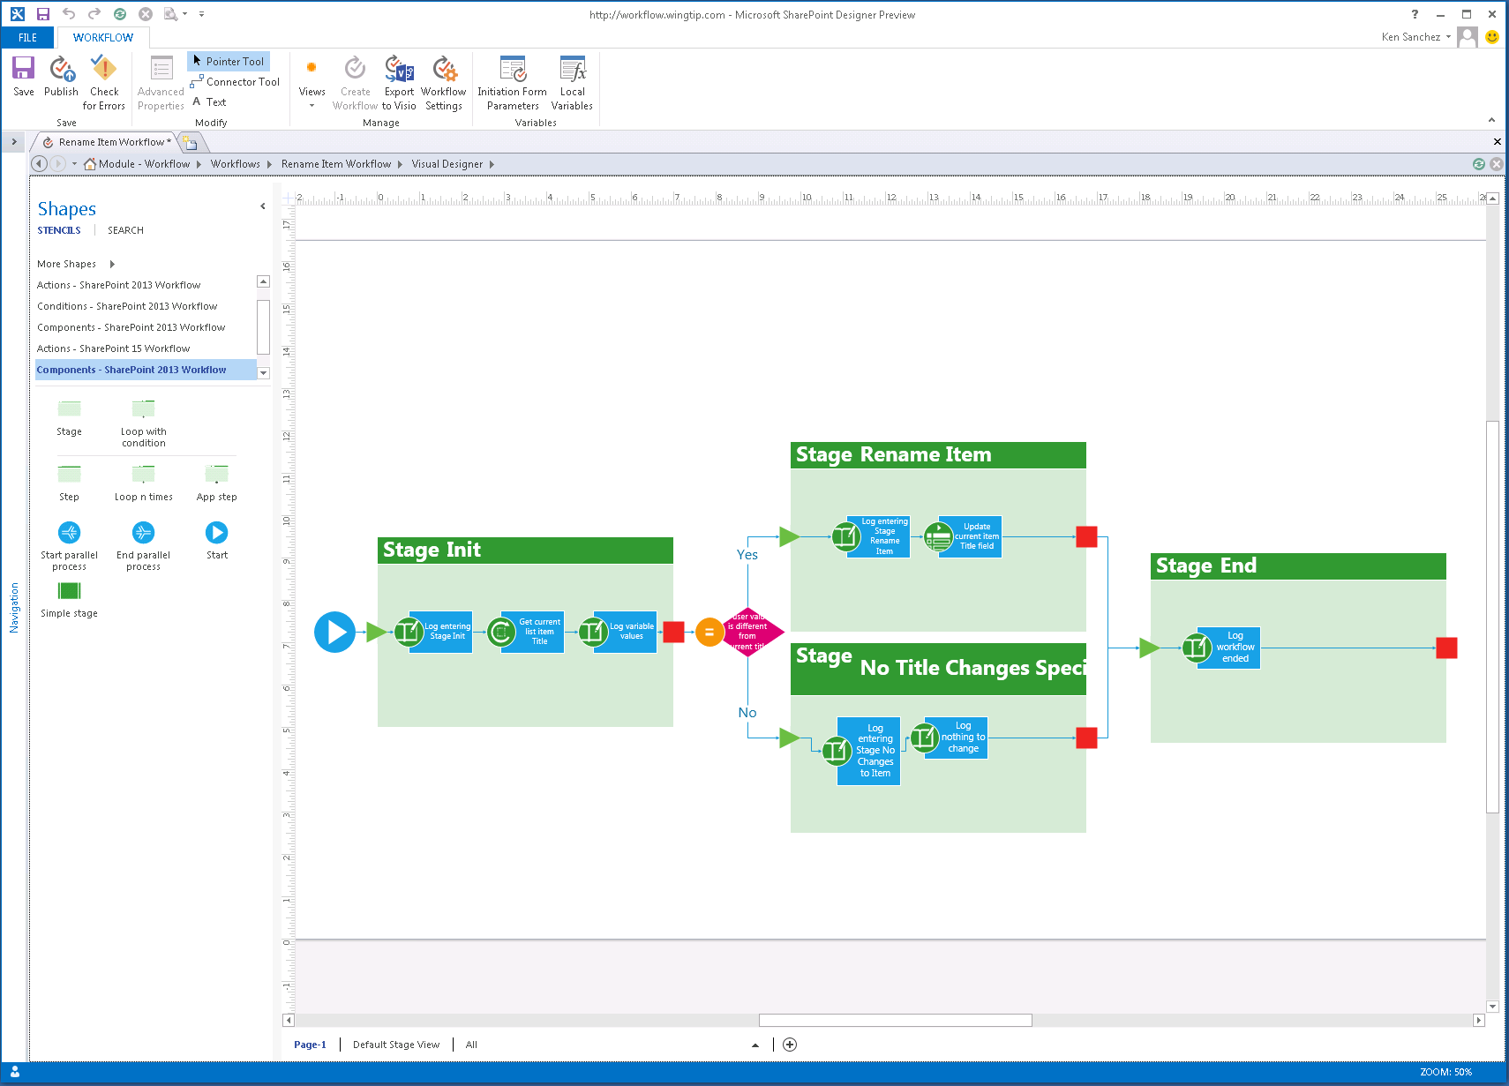
SharePoint Designer – Visual Designer
Notes:
In addition to the existing Test-Based Designer, SharePoint Designer has been improved to include a visual designer for authoring and customizing workflow, similar to how Visio allowed you to create workflows in previous versions of SharePoint. This new designer in SharePoint Designer, available when Visio is installed, allows you to not only customize the workflow actions and stages but you can modify the properties of the actions directly in the Visual Designer.

Slide 22
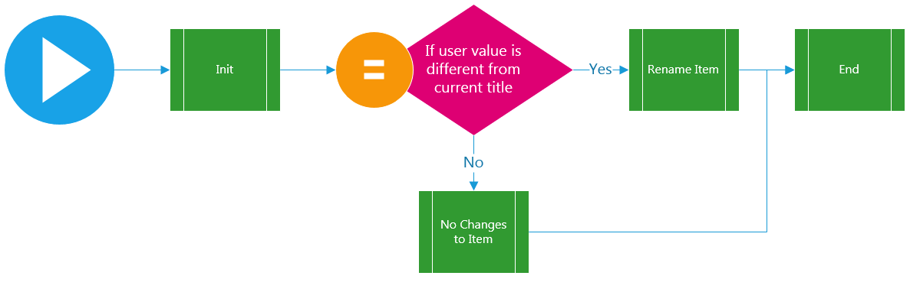
SharePoint Designer – Stage View

Slide 23
Creating Workflows with Visio 2013 SharePoint Designer 2013
Notes:
Steps:
In Visio, create list workflow on announcement list that does following:
Stage 1
Log stage message
Get title of current announcement & stuff in variable “originalTitle”
Log message collected
Log original announcement title
Transition: If newTitle = “” then >Stage2 else >Stage3
Stage 2
Log stage message
Update item title to new title
Log
Transition: >StageEnd
Stage 3
Log stage message
Log “title didn’t change, so do nothing”
Transition: >StageEnd
Stage End
Log stage message
Transition: End
Export from Visio
Import to SPD
Add init form parameter “newTitle”
Add additional logic
Show Text & designer view
Save, publish
Browser: test

Slide 24
Agenda
Workflow in SharePoint 2010
Workflow in SharePoint 2013
SharePoint 2013 Workflow Improvements
Creating Custom Workflows
Tooling: Visio 2013 & SharePoint Designer 2013
Tooling: Visual Studio 2012
Working with Web Services
Advanced Workflow Debugging

Slide 25
Visual Studio 2012
New project item templates
Workflow (SharePoint 2013 / Workflow Manager style)
Workflow Custom Activity
Custom Activities
Reusable grouping of activities w/ action file
Can be consumed in Visual Studio or SharePoint Designer authored workflows
New activities for working with Web Services
Rich Debugging Capabilities
Notes:
Microsoft has improved the workflow tooling in Visual Studio for SharePoint 2013. A new SharePoint project item (SPI) template is now included to assist in creating custom activities and actions for declarative workflows.

Slide 26
Creating Workflows with Visual Studio 2012
Notes:
Goal – Very brief demo showing new tool improvements, new activities, and how workflows can be included in apps.
Create a workflow that simply updates the item submitted.

Slide 27
Agenda
Workflow in SharePoint 2010
Workflow in SharePoint 2013
SharePoint 2013 Workflow Improvements
Creating Custom Workflows
Tooling: Visio 2013 & SharePoint Designer 2013
Tooling: Visual Studio 2012
Working with Web Services
Advanced Workflow Debugging

Slide 28
Workflows & Web Services
Move custom code in workflows to web services
SharePoint 2013 & Workflow Manager only support declarative workflow
Recommendation: move code to OData web service
New activities added to authoring tools to call & process web service responses
Web service
Must support JSON format
Can support authentication / anon
Can access SharePoint via CSOM / REST & OAuth
Support for HTTP GET, PUT, POST, DELETE & MERGE
Notes:
The recommended approach to creating workflows in SharePoint 2013 is to create declarative workflows. Both Visual Studio and SharePoint Designer support creating declarative workflows. This approach means workflow authors do not have to have an in-depth understanding and familiarity with the WF, or SharePoint API, to create workflows.
In the cases where custom code is required for business logic, developers should wrap this code within a custom web service and host it somewhere (Azure, IIS, etc.). The workflow activities for calling web services can then be used to interact with these Web services.

Slide 29
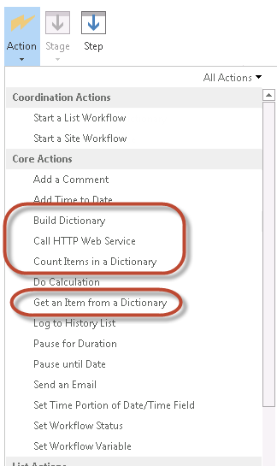
SharePoint Designer 2013 & Web Services
Uses Dictionary to submit name-value pairs to service
Converts name-value response to Dictionary
Process:
Optionally build dictionary
Call service & store response in local Dictionary variable
Retrieve named items from response

Slide 30
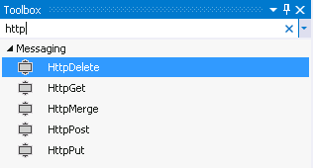
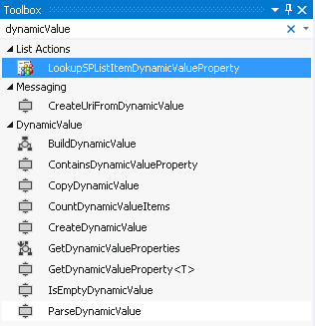
Visual Studio 2012 & Web Services
Uses new data type DynamicValue to submit & receive service responses
DynamicValue supports hierarchical data (JSON)
Same general process as SharePoint Designer 2013 except DynamicValue vs. Dictionary

Slide 31
DynamicValue Type
Enable creating, storing and consuming hierarchical data structures within workflows declaratively
Workflow Manager include special activities for working with the DynamicValue type:
DynamicValue Activities Included in Visual Studio 2012
BuildDynamicValue | CreateDynamicValue | IsEmptyDynamcValue
ContainsDynamicValueProperty | CreateUriFromDynamicValue | ParseDynamicValue
CopyDynamicValue | GetDynamicValueProperties
CountDynamicValueItems | GetDynamicValueProperty<T>
Notes:
A new DynamicValue type enables workflow authors to work with structured data within workflows in a declarative way. DynamicValue data can be recursive and thus, supports JSON responses from OData and REST services. Workflow Manager includes new workflow activities for working with DynamicValues within workflows without having to write any code:
BuildDynamicValue: Builds a DynamicValue instance. It receives a dictionary of paths and values as input and returns the resulting DynamicValue. It uses a multi-assign approach to build the DynamicValue (it accepts multiple paths and values).
ContainsDynamicValueProperty: Returns true if a DynamicValue contains a property represented by the specified path.
CopyDynamicValue: Copies properties from one DynamicValue to another DynamicValue.
CountDynamicValueItems: Returns the count of children in a DynamicValue path.
CreateDynamicValue: Creates an instance of a DynamicValue passing only one path and one value (no multi-assign semantics).
GetDynamicValueProperties: Gets several properties of an existing DynamicValue. Given a DynamicValue a user can query multiple properties (passing multiple paths) using a single activity.
GetDynamicValueProperty<T>: Gets one property of a DynamicValue, where T is one of the types in previously given list.
IsEmptyDynamicValue: Returns a Boolean value depending if the JSON response had no results.
ParseDynamicValue: Parses a JSON string into a DynamicValue.

Slide 32
DynamicValue Example
OData Service Request:
URI: http://foo.com/odata/v2/Products/Titles?$Top=2
HTTP Header: ACCEPT: application/json;odata=verbose
OData Service Response:
GetDynamicValueProperty<string>:
PropertyName: d/results(1)/Name
Result: ProductName
ProductName: “Laptop”
{“d”:
{“results”:
{"ID":"123", "Name":"Phone", "Price":"74.99"},
{"ID":"456", "Name":"Laptop", "Price":"1999.99"}
}
}
Notes:
In this example a request is made to a fake OData service that returns a list of products. By passing in a valid OData URL and including the HTTP Header “accept: application/json;odata=verbose”, the service will respond with the top two products in the company catalog in JSON format.
Using the activities provided in SharePoint 2013 and Workflow Manager, a developer could author a workflow with Visual Studio that does the following:
Issue an HTTP GET (activity=HttpGet) to obtain a JSON result and store the result in a local field jsonResponse
Extract a value from the JSON result jsonResponse (activity=GetDynamicValueProperty<T>) and use the path d/results(1)/Name to get the name of the second product returned (Laptop), storing it in a local field productName
Use the productName field elsewhere in the workflow

Slide 33
Creating Workflows & Interacting with Web Services
Notes:
Steps:
SharePoint Designer
Create new contact list
Workflow
Stage Init
Log entering stage
Check that they entered a email address
Route to web service stage
Stage Query AW Odata
Log entering stage
Build dictionary for filter
Call web service
Get result
If return code = 200, go to update item
Else if return code = something else, go to error
Stage Update Item
Log entering stage
Update user’s address info
Go to end
Stage End workflow
Log entering stage
Visual Studio
Create Product Request List
Title = ProductId (string)
Product Name (string)
Quantity (int)
Est Cost Per Unit (int)
Est Total Cost (int)
Create workflow
Retrieve variables title & quantity
Log web service URL
Query product Odata & get product name & cost
Log response
Log Web Service URL
Query math Odata & get total cost multiplying the cost & quantity
Log response
Update list item
Log finished

Slide 34
Agenda
Workflow in SharePoint 2010
Workflow in SharePoint 2013
SharePoint 2013 Workflow Improvements
Creating Custom Workflows
Tooling: Visio 2013 & SharePoint Designer 2013
Tooling: Visual Studio 2012
Working with Web Services
Advanced Workflow Debugging

Slide 35
Advanced Debugging
Use Fiddler to inspect & debug traffic between SharePoint & Workflow Manager
Must configure Fiddler to:
Intercept secure traffic & decrypt for inspection
Re-encode traffic and pass to intended recipient
Must configure SharePoint to:
Trust Fiddler certificate
Must run Fiddler as SharePoint & Workflow Manager service account
After starting Fiddler, recycle Web & Workflow Manager services (restart services when finished)
Setup Steps: http://bit.ly/SP2013WkflwDebugSetup

Slide 36
Advanced Workflow Debugging
Notes:
Run one of the workflows from the previous web service demo but watch interaction with Fiddler and explain what is going on.

Slide 37
Summary
Workflow in SharePoint 2010
Workflow in SharePoint 2013
SharePoint 2013 Workflow Improvements
Creating Custom Workflows
Tooling: Visio 2013 & SharePoint Designer 2013
Tooling: Visual Studio 2012
Working with Web Services
Advanced Workflow Debugging

