Slide 1
Business Connectivity Services​
Notes:
In this module you will learn about the architecture of Business Data Connectivity Services (BCS) which allows you to configure read/write connections to backend data sources such as SQL Server databases and line of business systems (e.g. SAP, PeopleSoft). You will learn how to create external content types using SharePoint Designer 2013. You will also learn several different ways to surface backend data from an external content type using external lists, the Business Data Web Parts and external data columns. The module also discusses the new BCS support for creating external content types based on external data sources that expose their data using the OData protocol.

Slide 2
Agenda
BCS Overview
Creating Secure Store Service Applications
Creating External Content Types
Consuming External Content Types
External Content Types with SharePoint Add-ins

Slide 3
Business Data Connectivity Services (BCS)
Integrates SharePoint with external data sources
External data can be surfaced through SharePoint sites
Supports write back to external data source
External data can also be surfaced in Office clients
Notes:
Systems such as customer relationship management (CRM) and enterprise resource planning (ERP) have special roles that are not replaced easily by Microsoft SharePoint. As a result, strategies must be adopted to provide interoperability between SharePoint and these systems. In the absence of a strategy for integrating systems with SharePoint, many organizations duplicate information in SharePoint lists. Customer contact information, for example, may exist in a CRM system and also be entered into a contact list in SharePoint. Worse still, the data may be duplicated many times in different team sites by different groups. This kind of duplication leads to significant data maintenance issues because updates must be performed in many lists.
Along with these existing systems, custom applications, databases, and Web services are common within organizations. When a separate database is required, developers have historically created ASP.NET applications or custom Web Parts that act as front ends for the database to have the data appear in the SharePoint environment. However, these types of solutions generally offer little integration with SharePoint capabilities; they are largely limited to presenting data within a SharePoint Web page.
Business Connectivity Services (BCS) changes all the rules for integrating systems, databases, and Web services with SharePoint. Beyond simply bringing data into SharePoint for display, BCS allows for capabilities that simply can’t exist in an ASP.NET application or custom Web Part without a significant investment. These capabilities include enterprise search, External Data columns, user profile integration, client synchronization, offline support, and Microsoft Word integration. BCS is a set of out-of-box features, services and tools that streamlines the creation of SharePoint Solutions with deep integration of External Data and Services. Power users, IT, Devs can create no code solutions using BCS.The basics of ECT store and BDC runtime are baked into SharePoint Foundation 2013.
Why BCS?
Integrate other Line of Business application systems with SharePoint sites.
Search for data in other systems via the SharePoint Search service.
Save the time, cost, and monotony of writing yet another data layer!

Slide 4
Essential BCS Terms and Concepts
External Data Source
Data source accessible to BCS through SQL, web services, etc.
External Content Type (ECT)
Metadata for accessing data in external data source
External List
Used to surface the data for an ECT in a specific SharePoint site
External Data Column
Used to surface ECT data in a specific SharePoint list column
Business Data Web Parts
Used to surface ECT data on web part pages and wiki pages
Profile Page
Automatically-generated page which displays single ECT instance
Notes:
There are many features that support External Content Types and understanding the jargon can be very helpful. Through the demos and lab you will use many of the items presented here.

Slide 5
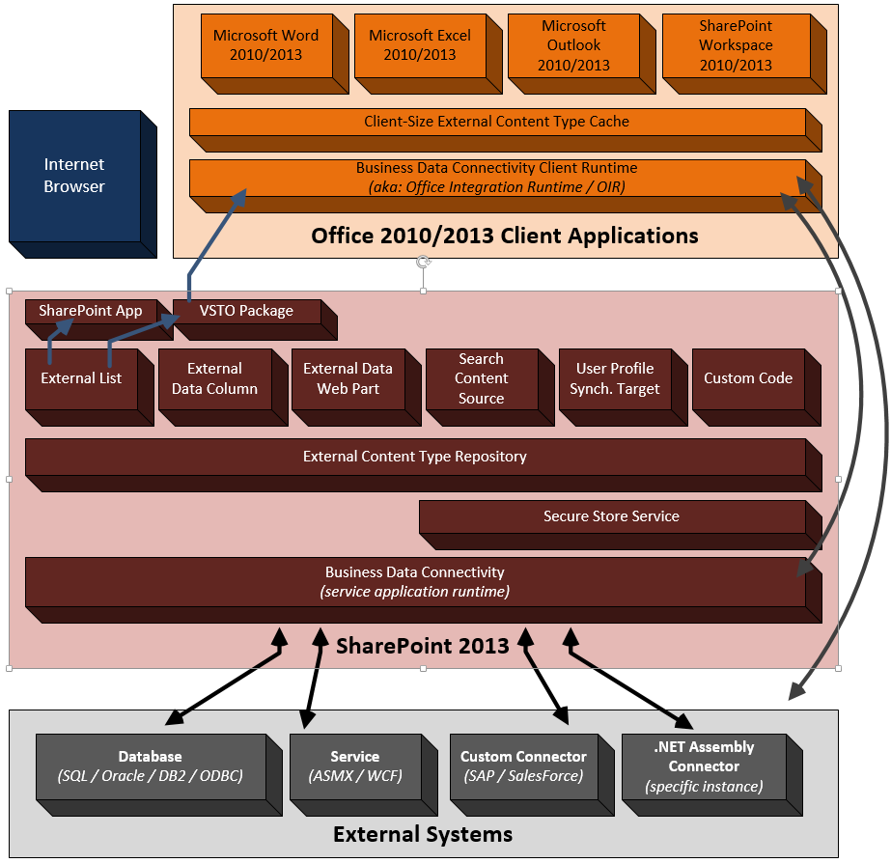
BCS Architecture
Notes:
BCS (and the BDC runtime) is a full end to end connectivity solution. The process begins by defining data sources and describing them in a model file that is stored in the External Content Type repository. Data connections can utilize the Secure Store Service. Once created the data in the External Content Type can be used in SharePoint Lists as Columns, in web parts and Search. BCS data can be used to augment the User Profile. You can also use the BCS data in Office Solutions, making the BCS data available Offline for Outlook solutions.

Slide 6
External Content Types
Describe the schema of external data source
Describes operators / operations on external data
Creating External Content Types:
SharePoint Designer 2013
Visual Studio 2013
Can export/import external content types via the Business Data Connectivity service application
Notes:
ECTs define fields, operations, and filters to be used with the External Data and are the heart of the BCS infrastructure. As an example, consider a manufacturing database that contains product information.
An ECT named Product can be created that defines ProductID, ProductName, and ProductDescription fields. Furthermore, it might define operations for retrieving data based on a keyword query or exact product identifier. Defining ECTs is one of the primary activities involved in creating a BCS solution and may be performed in either Microsoft SharePoint Designer 2013 (SPD) or Microsoft Visual Studio 2013 (VS2013). ECTs are stored in a metadata catalog, which is part of the BDC Service Application and is available throughout the SharePoint farm.

Slide 7
Surfacing External Data
External Data Columns
Add data from external content types to standard SharePoint lists
Can be made available as Content Controls in Word
Provided Web Parts
External Data Item
External Data List & External Data Related List
External Data Item Builder
Chart Web Part
Profile Page
External Data Search
Integrate External Data into search results
Inclusion in SharePoint Apps
Notes:
External Data Columns:
Along with using an ECT as the basis for a list, you can use an ECT as the source for a column in another list. This capability is known as an External Data Column. When you create an External Data Column for a list, you select the ECT to use as the basis for the column. You may then select one or more of the fields available in the ECT to display alongside the column you are creating. These additional fields are known as projected fields because they project data from the ECT into the parent list.
BCS Web Parts:
Another way you can use ECTs is through a set of Web Parts that ship with SharePoint Server 2013 known as External Data Web Parts (also called Business Data Web Parts). External Data Web Parts are designed specifically to display ECT data and relationships. The available parts include the Business Data List, Business Data Related List, and Business Data Item. These Web Parts display a list based on an ECT, a list based on an ECT association, or a single item, respectively.
Business Data Item: Displays details for a single external item
Business Data List: Displays list of external items
Business Data Related List: Displays a list of external items related to an item passed as input (typically selected in the Item or List web part)
Business Data Actions: Displays a list of actions for the selected external item
Business Data Item Builder: Retrieves input parameters from the URL/query string and passes them to parts on the page. This Web Part is not visible when the page is not in edit mode
Profile Page:
When SharePoint surfaces ECT data in lists and Web Parts, it does not necessarily show all the available fields and associations. For example, when an ECT is used as the source for an external column, only a single field is required for display. When users see partial ECT data, however, they are quite often interested in being able to see the data behind it. This is where profile pages enter the picture. A profile page is a dedicated page that shows all the ECT data for a specific record. This way, users can jump from partial ECT data to a complete view of the record.
External Data Search:
ECTs created with SPD already support indexing by SharePoint Search with no additional work. However, External Systems will be indexed only if you explicitly set up a content source that includes the ECT. Content sources can be created within the Search service application, where you will have the option to create a content source associated with an External System.
SharePoint Site/App – Sites and Apps can use external data. The primary way that users interact with external data is through an external list. External lists look and feel like standard lists, but they are backed by an ECT instead of a standard content type. Apps can also have ECTs defined within the app through a BDCM file. This file allows for app-level ECTs (discussed in detail later), which supports the isolation model of Apps. Exernal lists may be synchronized with Outlook through the automatic creation of a VSTO click-once package, which is downloaded to the client.

Slide 8
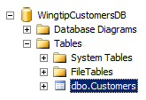
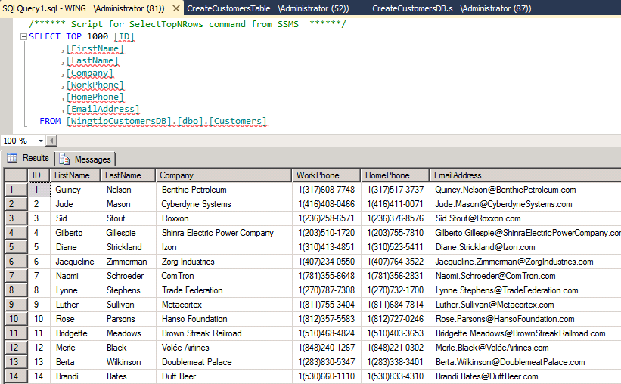
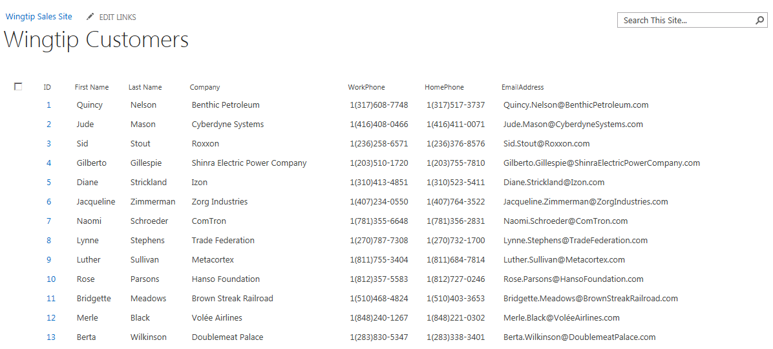
Connecting to Database Tables and Views
Easy to create ECT to database table
Model database tables as external content type (ECT)
Surface ECT in specific site as an external list
External Content Type
External List
Notes:
The process of creating an External Content Type involves constructing queries that return the data you wish to present to the users. Then you decide how you want to interact with the data in SharePoint. Don’t worry though, SharePoint Designer makes creating the query pretty easy.

Slide 9
Agenda
BCS Overview
Creating Secure Store Service Applications
Creating External Content Types
Consuming External Content Types
External Content Types with SharePoint Add-ins

Slide 10


BCS Authentication & Authorization
Secure Store Service
Authentication
BDC Service Application
External Content Type Repository
Authorization
External List
Notes:
BCS security can be though of as breaking down into two different categories: authorization & authentication.
Authorization:
After creating an external content type, even if the user has rights to the underlying external data in the external system, the BDC service application runtime will deny access to the data. The reason for this is that each ECT in the External Content Type Repository has four types of permissions that can be applied to it. At a minimum the user requesting the data must have the Execute permission to execute methods defined in the ECT. Users can be granted access either by their specific account, membership to a group or even using claims.
Authentication:
Assuming the user requesting the external data is given access to the external data, they then need to be authenticated against the external system. There are three options for authentication covered later in the module.

Slide 11
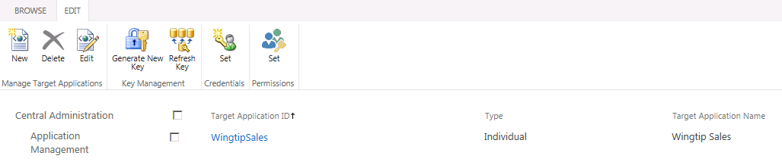
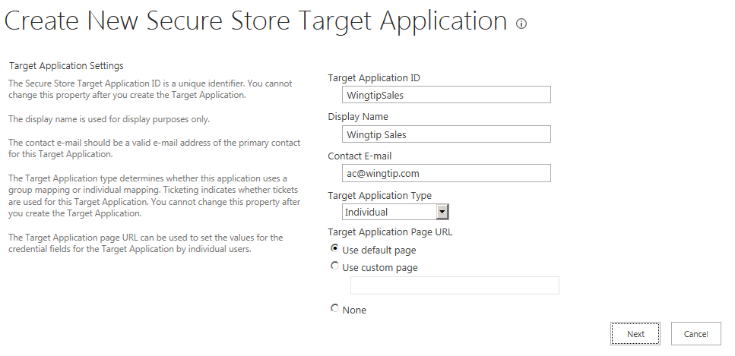
Secure Store Service (SSS) Applications
Provide infrastructure for credential caching
Two primary types of SSS applications
Individual: credentials cached separately for each user
Group: One set of credentials used across many users
Notes:
The Secure Store Service is a SharePoint Service Application that “brokers” the authorization between the User, SharePoint and the External Data. There are many options, but the most common is Individual and group authentication.
Individual – Each user’s credentials are cached and presented to the external data source when the data is requested.
Group – After the Secure Store Service authenticates the user a different credential is presented on behalf of the group of users. (This is sometimes referred to as impersonation.)

Slide 12
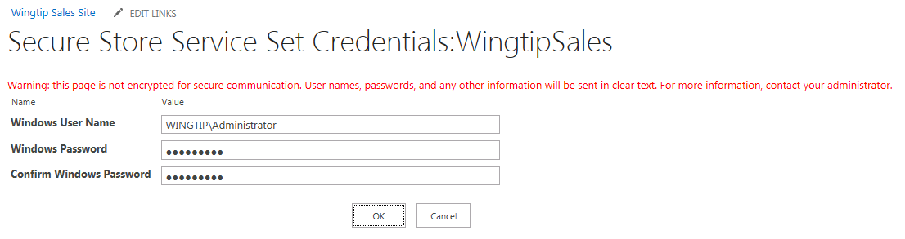
The Default Target Application Page
What happens if user has no valid credentials?
User redirected to Target Application page
Allows users to enter credentials in just-in-time fashion
Credentials cached in SSS DB in encrypted format
Notes:
The Secure Store Service uses “Applications” to control access to credentials. When you set up an application you are actually creating a template for others to use when they want to request credential access to an external system. All credentials are stored in an encrypted format in the database.

Slide 13
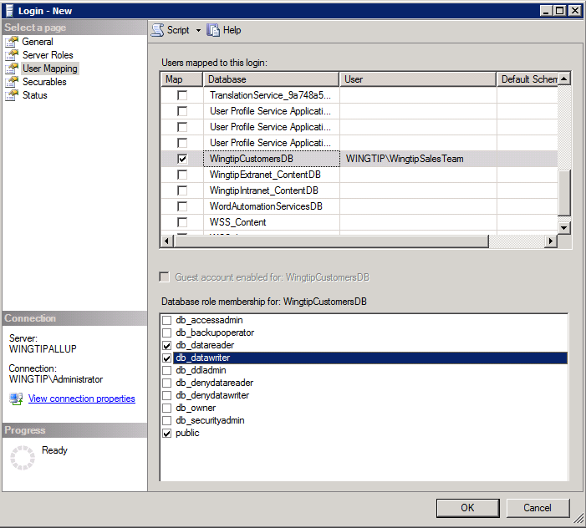
Assigning Data Source Permissions
External data source must be configured
Permissions required for accounts accessing data
Could be user accounts, daemon accounts, AD groups
Notes:
None of this configuration will “get around” or “by-pass” the External data source’s built in security. It helps to have a DBA who can help you set up the access to the data you seek. Generally, if end users already have access, you will use an Individual target application, passing the users credentials to the Database. Ultimately it is up to the DBA to decide how they want users to access the data.

Slide 14
Creating a Secure Store Service Application

Slide 15
Agenda
BCS Overview
Creating Secure Store Service Applications
Creating External Content Types
Consuming External Content Types
External Content Types with SharePoint Add-ins

Slide 16
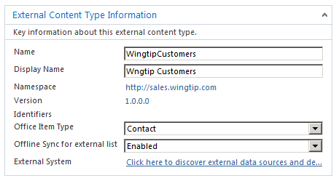
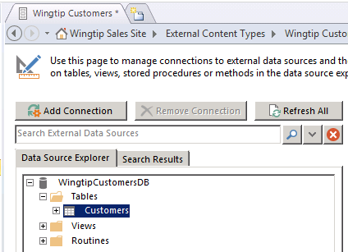
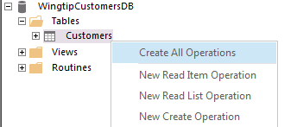
Create an External Content Type in SPD
Give ECT a name
Connect to data source
Create ECT operations
Notes:
In SharePoint Designer creating the new external content type uses the following process:
Give the External Content Type a name.
Connect to a Data Source, this can be SQL, a Web service or custom .Net assembly.
Define the operations that you want to support. This means that if you wish to create read-only content type you can.

Slide 17
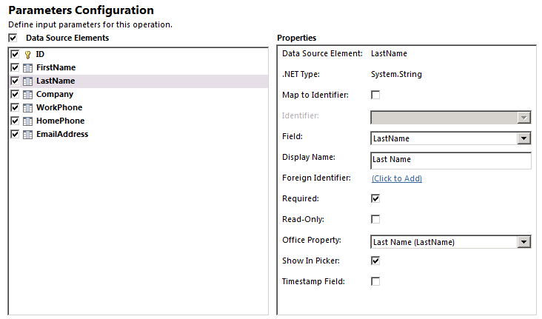
Creating Parameters for an ECT
Essential to define parameters when creating ECT
They define WHERE clause parameters and row limits
They provide users with search capabilities
Notes:
The Parameters configuration helps you to map the incoming external data fields to known data types for office if you desire. This is also where default values and “picker columns” are defined for the presentation of the content.

Slide 18
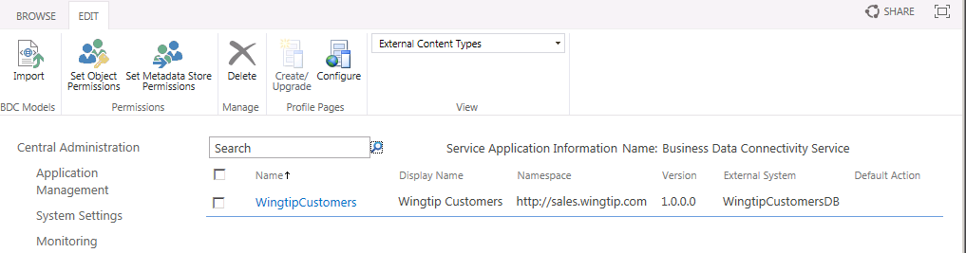
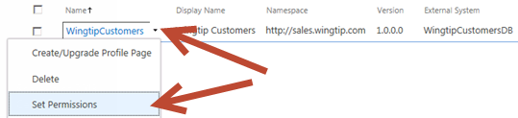
Assigning ECT permissions
New ECT is not accessible to anyone
ECT provides no default permissions - even to the creator
Once ECT has been created, you must assign permissions
Notes:
By default new External Content Types are not available to anyone. Once created you have to grant at least Execute for users to perform the queries contained in the model. This is a granular permission, so you can decide who has permissions to run the model.

Slide 19
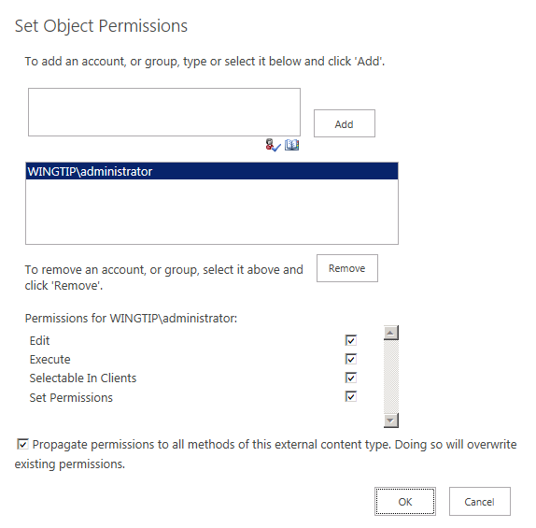
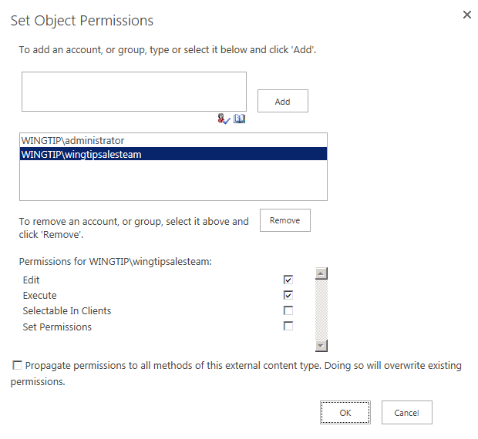
Granting BCS Permissions
Configurable BCS Permissions:
Edit: create, delete, update metadata objects
Execute: call external system (read)
Set Permissions: give permissions to other users
Selectable In Clients: accessible to clients applications like entity picker
Notes:
BCS Permission level enable Administrators to control who can do what with the BCS Service Application and the Models and External Content Types contained within:
Edit – Create and Change items in the BCS like Models. (This is NOT edit permissions of the data in the model, just the model file itself!)
Execute – User can execute (or run) the model. In other words if you create a model for financial data, the finance folks need to execute it.
Set Permissions – User can allow other folks to access the models and objects in the BCS.
Selectable in Clients – This permission enables users to see the model to make connections to it. Usually this permission is for designers and solution builders.

Slide 20
Creating An External Content Type using SharePoint Designer 2013
Notes:
Demo1

Slide 21
Creating ECTs with OData Data Sources
OData is very popular protocol for services
OData not supported by BCS in SharePoint 2010
OData now supported by BCS in SharePoint 2010
OData also supported with ECTs in SharePoint Online
Creating ECTs based on OData data sources
Visual Studio provides support for automatically generating ECT and external list from an OData source
No support in SharePoint Designer 2013 for OData
Notes:
The key message here is that OData is now a first-class source for BCS models with support in Visual Studio 2013.

Slide 22
OData Sources
Creating External Content Types
<?xml version="1.0" encoding="utf-8"?>
<LobSystem Name="ODataWebNorthwindModel" Type="OData">
<Properties>
<Property Name="ODataServiceMetadataUrl" Type="System.String">
http://services.odata.org/Northwind/Northwind.svc/$metadata
</Property>
<Property Name="ODataMetadataAuthenticationMode" Type="System.String">PassThrough</Property>
<Property Name="ODataServicesVersion" Type="System.String">2.0</Property>
</Properties>
<LobSystemInstances>
<LobSystemInstance Name="http://services.odata.org/Northwind/Northwind.svc">
<Properties>
<Property Name="ODataServiceUrl" Type="System.String">
http://services.odata.org/Northwind/Northwind.svc
</Property>
<Property Name="ODataServiceAuthenticationMode" Type="System.String">PassThrough</Property>
<Property Name="ODataFormat" Type="System.String">application/atom+xml</Property>
</Properties>
</LobSystemInstance>
</LobSystemInstances>
</LobSystem>
Notes:
This is a portion of a BDC Metadata Model showing how an OData source can be accessed:
Type - This attribute must be set to ODATA when working with OData datasources
ODataServiceMetadataUrl- Provides the end point of the metadata service
ODataAuthenticationMode - The authentication mode used by the datasource to allow access and what type of access to the calling API
ODataServicesVersion - The version of OData
ODataServiceUrl- The endpoint for the service
ODataFormat- The format for the returned data

Slide 23
Agenda
BCS Overview
Creating Secure Store Service Applications
Creating External Content Types
Consuming External Content Types
External Content Types with SharePoint Add-ins

Slide 24
External Lists
Expose external data as a native SharePoint list
Full CRUD-Q capability w/ familiar UI & navigation
Forms can be converted to InfoPath forms
Profile page available for each item in the list
Access via SharePoint object model (SPList)
New support for alerts (notifications)
Requires implementation of new operators
Some differences from traditional SP lists
Because SharePoint doesn’t “own” the data, some standard list functionality is not available with external lists
Notes:
External Lists can be created directly in SPD or in the browser using the Create menu in SharePoint. Once the new External List is created, it may be viewed in the browser. Because all the CRUD operations were created, the resulting list supports editing, adding, and deleting items. The appearance of the External List closely resembles a standard SharePoint list. The Ribbon is functional, as well as the edit control block (ECB) associated with individual items. Any changes to items in the list will be reflected immediately in the External System. Just like “regular“ lists, External Lists may be taken offline through both the SharePoint Workspace 2013 and Outlook 2013.
While External Lists appear similar visually to standard SharePoint lists and are supported by a SPList object, they do have significant limitations that must be considered in any design. These limitations include lack of workflow support and several standard list features. The following lists some of the major limitations of External Lists.
Approval: Approval of items is not supported
Attachments: Attachments are not supported directly, but must be implemented using a StreamAccessor operation in a custom solution
Check-in/Check-out: Check-in and checkout of items are not supported
Content Types: Using standard site content types in External Lists is not supported
Drafts: Drafts of items are not supported
ECB: Send-To operations are not supported
Ribbon: Datasheet View is not supported
SPLINQ: Querying through LINQ to SharePoint is not supported
Templates: Document templates are not supported
Versioning: Versioning of items is not supported
Workflow: Starting workflows from items is not supported, but workflows can read or write to External Lists through the SPList object
Validation: Validation formulas are not supported

Slide 25
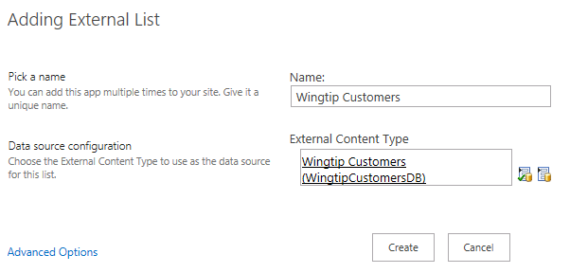
Creating an External List
External list used as simplest way to surface ECT
External list created using pre-existing ECT
External list can be created through SPD or browser
Notes:
An external list uses an external content type and displays it as a SharePoint list. If the viewer of the External List has the permissions they can use SharePoint list functions to Add, Edit, and Delete. The actions performed on the list will be communicated back to the source of the data.

Slide 26
Creating an External List and an External Data Column

Slide 27
Using the Business Data Web Parts

Slide 28
Agenda
BCS Overview
Creating Secure Store Service Applications
Creating External Content Types
Consuming External Content Types
External Content Types with SharePoint Add-ins

Slide 29
App-Level ECTs
Ability to define ECT within an app
ECT is isolated to the app only
Can be used to create External List
Can be access using API
Allows for accessing variety of External Systems
CRUD operations performed using standard list APIs
Notes:
In SharePoint 2010, External Content Types could only be installed and used at the farm level. This caused a problem for developers because, even for simple applications, an administrator had to be involved because of the access rights needed to install at the farm level.
In SharePoint 2013, a new paradigm is introduced that more or less isolates applications into more autonomous units, more simply, Apps. They generally will contain all the resources they need within the App itself and will be insulated from other Apps.
The benefit of this architecture are:
Developers can create Apps that are aligned with the new Apps model of SharePoint 2013
Developers can create Apps that access external data from SAP, Netflix, proprietary and other types of data without involving the tenant administrator A
Access to external applications is maintained through BCS, which provides a consistent and uniform interface that can be used by other SharePoint Apps .

Slide 30
Architecture
External Content Type
FileBackedMetadataCatalog (BDC Runtime Components)
OData Source
External List
Notes:
BDC Metadata Models will be saved in a library named BusinessDataMetadataCatalog. This means you can upload a BDC Metadata Model to the site, or include it within the definition of an App.
External List will have new property named MetadataCatalogFileName that refers to the BDCM model file located in the library. The FileBackedMetadataCatalog class will load the BDC Metadata Model and then the External List will render. Support for OData, WCF, and SQL only. No support for .NET Assembly Connectors or Custom Connectors.

Slide 31
External List Definitions
<?xml version="1.0" encoding="utf-8"?>
<Elements xmlns="http://schemas.microsoft.com/sharepoint/">
<ListInstance Url="Lists/Employees" Description="Employees"
OnQuickLaunch="TRUE" Title="Employees">
<DataSource>
<Property Name="LobSystemInstance" Value="Northwind" />
<Property Name="EntityNamespace" Value="NorthwindModel" />
<Property Name="Entity" Value="Employees" />
<Property Name="SpecificFinder" Value="ReadSpecificEmployee" />
<Property Name="MetadataCatalogFileName" Value="BDCMetadata.bdcm" />
</DataSource>
</ListInstance>
</Elements>

Slide 32
SharePoint REST API Against External List
AppLevelECT.Grid.prototype = {
init: function () {
var query = siteUrl + "_api/lists/getbytitle('Person')/items?$select=FirstName,LastName"
$.ajax({
url: query,
headers: { "ACCEPT": "application/json",
"X-RequestDigest": $("#__REQUESTDIGEST").val()
},
success: this.showItems
});
},
showItems: function (data) {
var resultString = "";
$.each(data.d.results, function (key, val) {
resultString += val.FirstName + " " + val.LastName + "\n";
});
alert(resultString);
}
}

Slide 33
CSOM Against External List
using (var clientContext = spContext.CreateUserClientContextForSPAppWeb()) {
List list = clientContext.Web.Lists.GetByTitle("Employees");
CamlQuery camlQuery = new CamlQuery();
camlQuery.ViewXml = @"<View>...";
ListItemCollection listItems = list.GetItems(camlQuery);
clientContext.Load(
listItems,
items => items
.Include(
item => item["EmployeeID"],
item => item["LastName"],
item => item["FirstName"],
item => item["HireDate"],
item => item["HomePhone"]));
clientContext.ExecuteQuery();
foreach (ListItem listItem in listItems) {
…
}

Slide 34
Summary
BCS Overview
Creating Secure Store Service Applications
Creating External Content Types
Consuming External Content Types
External Content Types with SharePoint Add-ins

