Slide 1
Developing SharePoint Solutions
Notes:
SharePoint extensibility has traditionally been done using solution packages (*.wsp’s). The two types of solutions, farm & sandbox, are covered in depth in this module. Students will learn when they are available depending on the deployments, what you can and can’t do with them as scenarios when they are applicable.

Slide 2
Agenda
Understanding SharePoint Solutions
Features and Feature Receivers
Creating Web Parts
Creating Site Pages and Application Pages

Slide 3
SharePoint Solutions
SharePoint development based on solutions
Solution is a CAB file with a *.wsp extension
Solution is a container of files distributed as a unit
Solution contain manifest with instructions for installer
Solutions can be deployed at two different scopes
At farm scope as a farm solution (aka Full Trust Solution)
At site collection scope as a sandboxed solution
Notes:
A SharePoint solution (*.WSP) is a Microsoft cabinet file (*.CAB) that contains files to deploy to SharePoint servers. Files that can be deployed include anything that would go in the SharePointRoot folder or assemblies that would go in a Web application’s \BIN folder or the server’s global assembly cache.
Solutions deployed to the farm (the only type of solutions deployed in SharePoint 2007) are available across the farm. SharePoint 2010 introduced a new type of solution, the “sandbox solution” allows site collection administrators to deploy custom code solutions to SharePoint.

Slide 4
Sandbox Solutions in SharePoint 2013
A short-lived strategy for safer developer extensibility
Introduced in SharePoint 2010
Solutions with “User Code” are deprecated in SharePoint 2013
SharePoint App Model designed to replace Sandbox Solutions
Avoid using Sandboxed solutions on any new projects
No-code sandboxed solutions (NCSS) are not deprecated
NCSS created using features and declarative XML elements
NCSS can be deployed at either farm level or site collection level
NCSS can be used to create lists, site columns and content types
NCSS can be used to add content

Slide 5
SharePointRoot Directory
SharePoint Foundation relies on set of template files
Stored in special directory known as SharePointRoot
SharePointRoot located on file system of each WFE at this path
C:\Program Files\Common Files\Microsoft Shared\Web Server Extensions\15
Farm solutions deploy their files into child directories
Path relative to SharePoint Root | Template file types
/ISAPI | Web Services (*.svc, *.ashx and *.asmx)
/Resources | Resource files (*.resx)
/TEMPLATE/ADMIN | Application pages used exclusively in Central Administration
/TEMPLATE/CONTROLTEMPLATES | ASP.NET User Controls (*.ascx)
/TEMPLATE/FEATURES | Feature definition files (*.xml)
/TEMPLATE/IMAGES | Images (*.gif, *.jpg and *.png)
/TEMPLATE/LAYOUTS | Application pages (*.aspx)
/TEMPLATE/LAYOUTS/1033/STYLES | CSS Files (*.css)
/TEMPLATE/LAYOUTS/ClientBin | Silverlight components (*.xap)
/TEMPLATE/SiteTemplates | Site Definition files (onet.xml)
/TEMPLATE/XML | Custom field type definition files (fdltype*.xml)
Notes:
The SharePoint system directory ([..]/14 or [..]/15) was been given an official name in SharePoint 2010: the SharePointRoot.

Slide 6
Deployment Using Solution Packages
What is a solution package?
Deployment mechanism
Atomic unit of reuse, deployment and versioning
A set of files and manifest with installation instructions
A CAB file with *.wsp extension
What can be deployed via a solution package
Feature definitions
Images
Assemblies
And much more…
Notes:
Features can be deployed to SharePoint using solution packages. A solution package is a *.cab file with extension *.wsp and contains the files that make up the different features in the solution package.

Slide 7
The manifest.xml file
Each Solution Package requires manifest.xml file
Mainly serves as instructions to installer on WFE
<?xml version="1.0" encoding="utf-8"?>
<Solution xmlns="http://schemas.microsoft.com/sharepoint/"
SolutionId="07752644-45b2-41c3-9eaa-2d58a1ac31b9"
SharePointProductVersion="15.0"
DeploymentServerType="WebFrontEnd"
ResetWebServer="TRUE">
<FeatureManifests>
<FeatureManifest Location="LeadTracker\Feature.xml" />
</FeatureManifests>
<TemplateFiles>
<TemplateFile Location="IMAGES\WingtipDevProject\FeatureIcon.gif" />
<TemplateFile Location="IMAGES\WingtipDevProject\SiteIcon.gif" />
</TemplateFiles>
<Assemblies>
<Assembly Location="WingtipDevProject.dll"
DeploymentTarget="GlobalAssemblyCache" />
</Assemblies>
</Solution>
Notes:
A solution package also contains a manifest.xml. This file defines the list of features, site definitions, resource files, Web Part files, and assemblies to process.

Slide 8
Farm Solution Deployment
Done using Windows PowerShell scripts
Add-SPSolution – uploads solution package
Install-SPSolution – deploy solution package
Add-PSSnapin Microsoft.SharePoint.Powershell -ErrorAction SilentlyContinue
$SolutionPackageName = "WingtipDevProject1.wsp"
$SolutionPackagePath = "WingtipDevProject1_v1000\WingtipDevProject1.wsp"
$solution = Get-SPSolution | where-object {$_.Name -eq $SolutionPackageName}
if ($solution -ne $null) {
if($solution.Deployed -eq $true){
Uninstall-SPSolution -Identity $SolutionPackageName -Local -Confirm:$false
}
Remove-SPSolution -Identity $SolutionPackageName -Confirm:$false
}
Write-Host "Installing Solution..."
Add-SPSolution -LiteralPath $SolutionPackagePath
Install-SPSolution -Identity $SolutionPackageName -Local -GACDeployment
Write-Host "Deployment Complete"
Notes:
The script in the screenshot on this slide demonstrates adding and deploying a farm solution to the farm. However before deploying the solution it first checks to see if the solution is already present and/or deployed. If so, it retracts (uninstalls) the solution and then removes it from the solution store.
The process of adding/updating/removing a sandbox solution is very different as it will be uploaded to a special gallery the same way documents are uploaded to document libraries.

Slide 9
Updating a Farm Solution
Used to push out new files to WFE
Used to replace images or DLLs with new version
Used in feature upgrade
Watch out…
Solution update doesn’t automatically upgrade features
$SolutionPackageName = "WingtipDevProject1.wsp"
$SolutionPackagePath = "WingtipDevProject1_v2000\WingtipDevProject1.wsp"
Update-SPSolution -Identity $SolutionPackageName -LiteralPath $SolutionPackagePath -Local -GACDeployment
Notes:
The script in the screenshot on this slide demonstrates how to update a farm solution. This is a preferred way to updating previous deployed solutions. When the upgrade/update process runs, it overwrites the existing *.WSP in the farm solution store and then redeploys it to all Web applications it was previously deployed to.

Slide 10
Creating Farm Solutions

Slide 11
Agenda
Understanding SharePoint Solutions
Features and Feature Receivers
Creating Web Parts
Creating Site Pages and Application Pages

Slide 12
Designing and Implementing Features
What is a SharePoint Feature?
Formally known as a “feature definition”
A unit of design and implementation
A building block for creating SharePoint solutions
Features can contain elements
e.g. menu items, links, list types and list instances
Many other element types possible
Features can contain event handlers
Implemented using a feature receiver class
Event handler code can program using SharePoint OM
Notes:
Features can be used to deploy any type of customization:
Web Parts
Application pages
Event handlers
Custom actions
Site columns
Content types
List definitions and list instances
Master pages

Slide 13
The feature.xml file
feature.xml serves as feature manifest file
Defines attributes for feature definition
Can reference one or more element manifests
Can reference a feature receiver
<Feature xmlns="http://schemas.microsoft.com/sharepoint/"
Id="86689158-7048-4421-AD21-E0DEF0D67C81"
Title="Wingtip Lead Tracker"
Description="A sample feature deployed using WingtipDevProject1.wsp"
Version="1.0.0.0"
Scope="Web"
Hidden="FALSE"
ReceiverAssembly="WingtipDevProject1, Version=1.0.0.0, Culture=neutral, PublicKeyToken=56170dd0494afccc"
ReceiverClass="WingtipDevProject1.FeatureReceiver"
ImageUrl="WingtipDevProject1/FeatureIcon.gif">
<ElementManifests>
<ElementManifest Location="elements.xml" />
</ElementManifests>
</Feature>
Notes:
The Feature definition file (feature.xml) provides metadata information to SharePoint as well as registers the actions the Feature should perform when activated (element manifests) and files related to the Feature (element files).

Slide 14
Element Manifest Files
Element manifest contain declarative elements
ListInstance elements creates list during activation
Many other element types available
Element manifest can contain many elements
feature.xml file can reference many element manifests
<Elements xmlns="http://schemas.microsoft.com/sharepoint/">
<ListInstance Id="SalesLeads"
FeatureId="00BFEA71-7E6D-4186-9BA8-C047AC750105"
TemplateType="105“
Title="Sales Leads"
Url="SalesLeads"
OnQuickLaunch="TRUE" />
</Elements>
Notes:
The element manifest files in Features is the way you will do declarative work when a Feature is activated.

Slide 15
Feature Element Types
Element Type | Description
BdcModel (new in 2013) | Used to include ECTs with SharePoint Apps
ClientWebPart (new in 2013) | Used to create a client web part in the host web
ContentType | Used to create a content type
ContentTypeBinding | Used to add a content type to a list
Control | Used to create a delegate control
CustomAction | Used to create a new link or menu command
CustomActionGroup | Used to create a new section for links
HideCustomAction | Used to hide a built-in or custom link or menu command
FeatureSiteTemplateAssociation | Used to staple a feature to a site definition
Field | Used to create a site column
ListInstance | Used to create a list instance
ListTemplate | Used to create a custom list type
Module | Used to provision a file from a template file
PropertyBag | Used to add name-value properties to feature
Workflow | Used to create a workflow template
WorkflowActions | Used to broadcast actions in pre v4.0 workflows
WorkflowActions4 (new in 2013) | Used to broadcast actions in v4.0 workflows
WorkflowAssociation | Used to associate a workflow template with a list
Notes:
The table on this slide includes most of the things you can do with a Feature. You’ll notice a few new additions. Some things are not available in certain deployments (on-prem / hosted).

Slide 16
Feature Receivers
Feature receiver used to add event handlers
Must derive from SPFeatureReceiver
Not available with Features included in Apps
public class FeatureReceiver : SPFeatureReceiver {
public override void FeatureActivated(SPFeatureReceiverProperties props) {
SPWeb site = props.Feature.Parent as SPWeb;
if (site != null) {
site.Title = "Feature Activated";
site.SiteLogoUrl = @"_layouts/images/WingtipDevProject1/SiteIcon.gif";
site.Update();
} }
public override void FeatureDeactivating(SPFeatureReceiverProperties props) {
SPWeb site = props.Feature.Parent as SPWeb;
if (site != null) {
site.Title = "Feature Deactivated";
site.SiteLogoUrl = "";
site.Update();
SPList list = site.Lists.TryGetList("Sales Leads");
if (list != null) { list.Delete(); }
} } }
Notes:
When the element manifest files can’t provide the necessary functionality desired when activating a Feature, developers can implement one of the four events exposed in the lifetime of a Feature. SharePoint will execute this code at specific times during the Feature’s life cycle.
The events available include :
FeatureInstalled– runs after the Feature has been installed.
FeatureActivated– runs after the Feature has been activated.
FeatureDeactivating– runs before the Feature is deactivated.
FeatureUninstalling– runs before the Feature is uninstalled.

Slide 17
Working with SharePoint Features

Slide 18
Agenda
Understanding SharePoint Solutions
Features and Feature Receivers
Creating Web Parts
Creating Site Pages and Application Pages

Slide 19
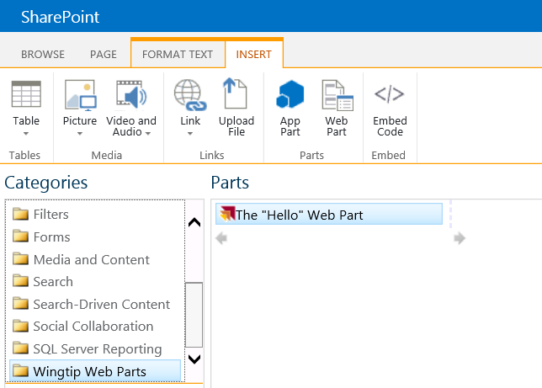
Web Parts
Web Parts add content and functionality
Content is modular, consistent and easy to navigate
Configurable chrome: border and title bar
Added and configured by users inside browser
Notes:
Web Parts are fundamental building blocks for the SharePoint user interface. A Web Part encapsulate a well defined functionality and can be placed on several pages within the SharePoint sites to which they are deployed.
Users can easily customize the border and title, and they can hide the Web Part on the page.

Slide 20
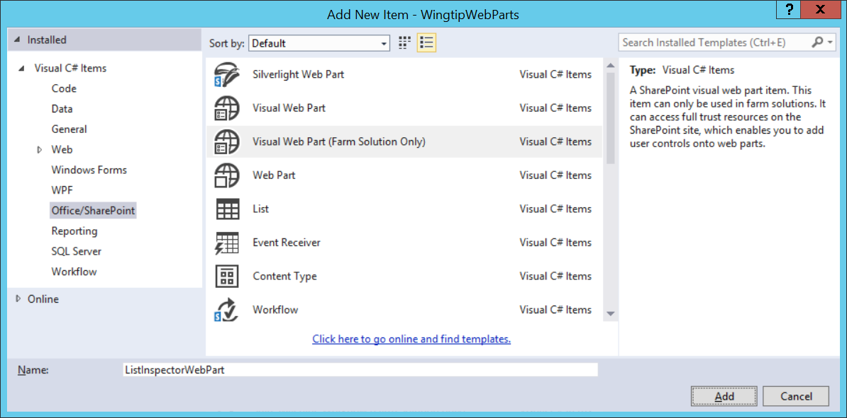
Overview of Developing Web Parts
SharePoint Developer Tools supports two types
Web Part: ASP.NET server control style
Visual Web Part: ASP.NET user control style (*.ASCX)
Notes:
In SharePoint 2007 you can develop custom Web Parts, but the user interface must be built up with server controls.
In SharePoint 2010 you have also Visual Web Parts where you can define the user interface in a *.ascx user control. The user control is loaded into the Web Part when the Web Part is loaded.
You can develop Web Parts using the Visual Studio 2010 Tools for SharePoint. You have 2 SPIs: one for a classic Web Part and one for a Visual Web Part.

Slide 21
Creating the Custom Web Part Object
Build a typical ASP.NET 2.0 server control:
Create a new class that inherits from: System.Web.UI.WebControls.WebParts.WebPart
Override CreateChildControls()
Used to add any child controls to the page such as buttons, textboxes, labels, etc.
Override RenderContents()
Renders the contents of the Web Part, inside the outer tags and Web Part chrome
Never override Render()!!!!
SharePoint overrides Render() to include the Web Part chrome and outer tags
Notes:
A Web Part inherits from the WebPart class residing in the System.Web.UI.WebControls.WebParts namespace of the System.Web.dll.
Instantiate the controls that make up the user interface in the CreateChildControls() method.

Slide 22
Creating a Custom Web Part

Slide 23
Agenda
Understanding SharePoint Solutions
Features and Feature Receivers
Creating Web Parts
Creating Site Pages and Application Pages

Slide 24
SharePoint Sites are Collections of Pages
All pages share the same look and feel
HTML page layout defined by common Master Page
Page formatting defined by common CSS files
Client-side behaviors defined by JavaScript files
Pages within site can be split into two categories
Site Pages exist within the content DB for a site
Application Pages only exist on file system of WFE
Notes:
All pages within a SharePoint site have the same look and feel. The pages are based on a common Master page and implement the same CSS files.
Site pages live within a content database and can be customized by the user.
Application pages live on the file system and cannot be customized by the user.

Slide 25
Site Pages vs. Application Pages
Site Pages exist within virtual file system of site
They support customization via Web Parts and/or SPD
Site pages can be rendered using underlying template
Page using template is said to be a ghosted page
Page can be customized (unghosted) by user
Application Pages are deployed once per farm
They are accessible through _layouts virtual directory
They are parsed / compiled in classic ASP.NET mode
They do not support any form of user customization
The can only be added using farm solutions
Notes:
Site Pages:
By default site pages are ghosted, which means that the page template is stored on the WFE file system, while the content is stored in the content database. Site pages can be customized. At that time they become unghosted and both the template and the content are stored in the content database. Customizing pages can make it hard to migrate content to a new version of SharePoint. Customizing pages can impact the performance in large farms due to excessive memory usage.
Application Pages:
Application pages are deployed in the _layouts folder of the SharePoint root on the file system. There is one version of an application page scoped at the farm level. It is compiled into a single DLL and loaded into memory once for each Web application.

Slide 26
SharePoint Integration with Master Pages
Master Page integration with SharePoint 2010
Master Pages stored in Master Page Gallery (MPG)
MPG created automatically on per site basis
All pages in site link to v4.master in MPG
Changes in SharePoint 2013
v4.master serves as master page for 2010 UI mode
seattle.master serves as default master page in 2013
Site has new UseV15Rendering property
MPG includes others (e.g. belltown.master)
New options for user to change site master page
Notes:
In SharePoint 2010:
When a site is created, a Master Page Gallery is created and SharePoint provisions an instance of the v4.master within the site.
In SharePoint 2013:
v4.master is still there for backward compatibility. New site pages created in SharePoint 2010 link to the v4.master.
Also application pages link to the v4.master. A minimal.master is provided out of the box, which wasn’t the case in SharePoint 2007.

Slide 27
Site Pages Overview
Site pages can be added by a developer
Works in SharePoint solutions and in SharePoint apps
Sites pages and related resources added with Modules
Site pages cannot contain any server-side code
Developers create site pages using templates
You create a Module and add one of more templates
Feature activation create instances from the templates
Sites pages initially in uncustomized state (ghosted)
Sites pages can be customized (unghosted) by users
Notes:
Uncustomized pages are called ghosted pages. Only the difference between the page and the template is stored in the content database. Customized pages are stored completely in the content database and are called unghosted pages.
Site pages can be customized using SharePoint Designer.
Customized site pages don’t support inline code. You can only add controls that are registered as Safe Controls in the web.config.

Slide 28
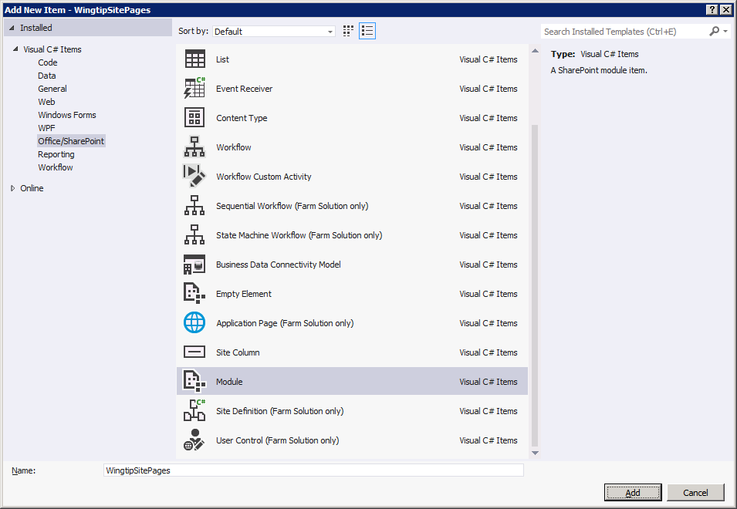
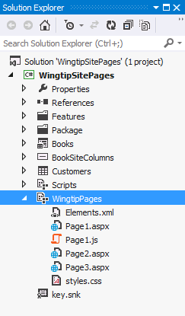
Creating Site Pages from Page Templates
Site pages created using a Module
Module must be associated with a feature
Visual Studio adds project folder with elements.xml file
Inside is a <Module> element with <File> elements
Notes:
You can create site pages using the Visual Studio SharePoint Development Tools. The SPI template to use is Module. The elements.xml is the manifest that specifies a <Module> element, which in its turn contains a set of <File> elements . Each <File> element provisions on instance of a page from the custom page template you created in the project.

Slide 29
Modules & Elements.xml File
Visual Studio updates Module element.xml for you
You just create / add files to Module folder
Some scenarios requires manual edits to elements.xml
<?xml version="1.0" encoding="utf-8"?>
<Elements xmlns="http://schemas.microsoft.com/sharepoint/">
<Module Name="WingtipPages">
<File Path="WingtipPages\Page1.aspx" Url="WingtipPages/Page1.aspx" />
<File Path="WingtipPages\Page2.aspx" Url="WingtipPages/Page2.aspx" />
<File Path="WingtipPages\Page3.aspx" Url="WingtipPages/Page3.aspx" />
<File Path="WingtipPages\styles.css" Url="WingtipPages/styles.css" />
</Module>
</Elements>
Notes:
With the Visual Studio SharePoint Development Tools you only have to create the Module SPI and add the site pages. The element.xml will be generated automatically by the tools.

Slide 30
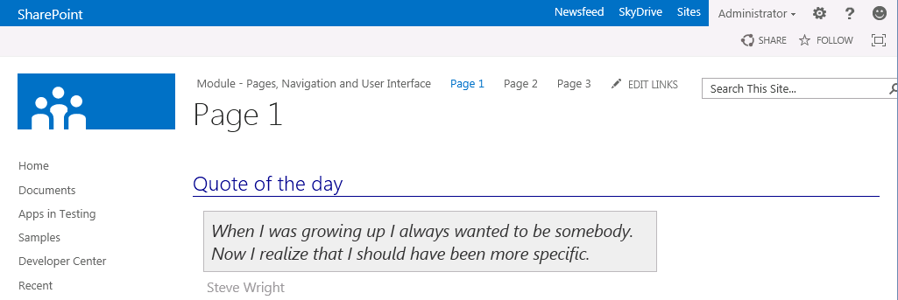
'Hello World' Page Template for Site Page
<%@ Page MasterPageFile="~masterurl/default.master" %>
<asp:Content ContentPlaceHolderId="PlaceHolderAdditionalPageHead" runat="server">
<link href="styles.css" rel="stylesheet" type="text/css" />
<script src="Page1.js" type="text/javascript"></script>
</asp:Content>
<asp:Content ContentPlaceHolderId="PlaceHolderPageTitle" runat="server">
Page 1 – This shows up at the top of the browser window
</asp:Content>
<asp:Content ContentPlaceHolderId="PlaceHolderPageTitleInTitleArea" runat="server">
Page 1
</asp:Content>
<asp:Content ContentPlaceHolderId="PlaceHolderMain" runat="server">
<h3>Quote of the day</h3>
<p id="quote">When I was growing up I always wanted to be somebody.
Now I realize that I should have been more specific.</p>
<p id="quote_author">Steve Wright</p>
</asp:Content>
Notes:
This is a sample of a provisioned site page based on the HelloWorld.aspx page template you created in the Visual Studio project.

Slide 31
Designing Web Part Pages
Changes from previous page templates
Inherit from WebPartPage class
Add controls for web part zones and web parts
<%@ Assembly Name="Microsoft.SharePoint, Version=15.0.0.0, Culture=neutral, PublicKeyToken=71e9bce111e9429c" %>
<%@ Page MasterPageFile="~masterurl/default.master" Inherits="Microsoft.SharePoint.WebPartPages.WebPartPage" %>
<%@ Register TagPrefix="WebPartPages"
Namespace="Microsoft.SharePoint.WebPartPages"
Assembly="Microsoft.SharePoint, Version=15.0.0.0, Culture=neutral, PublicKeyToken=71e9bce111e9429c" %>
<asp:Content ContentPlaceHolderID="PlaceHolderMain" runat="server">
<WebPartPages:WebPartZone ID="Main" Title="Main Web Part Zone" FrameType="TitleBarOnly" runat="server">
<ZoneTemplate>
<WebPartPages:XsltListViewWebPart
runat="server" ID="CsutomersWebPart"
Title="Customers" ListUrl="Lists/Customers"
ChromeType="None">
</WebPartPages:XsltListViewWebPart>
</ZoneTemplate>
</WebPartPages:WebPartZone>
</asp:Content>
Notes:
Web Parts make it possible for a site owner to customize a site page with changes that are seen by all users. Web Parts go even further to allow individual users to add personalization changes that are seen only by them. On top of that, customizing and personalizing Web Parts does not require customizing the Web Part pages that host them.
You can also design Web Part pages as a site page template. In that case the .aspx page inherits from Microsoft.SharePoint.WebPartPages.WebPartPage.
Add WebPartZone controls to the site page template because Web Parts reside in WebPartZones. You have to specify the WebPartZones but not the Web Parts that go inside that zone. Instead, all of the data for tracking Web Part instances and their customization and personalization data are kept in separate tables inside the content database. This means that a Web Part page can remain in a ghosted state, even when users customize them.

Slide 32
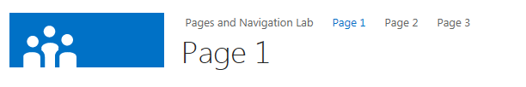
Adding Navigation Nodes to Top Nav Bar
Simple navigation technique for teams sites
Done using server-side code or client-side code
Not a technique to use in publishing sites
public class MainSiteEventReceiver : SPFeatureReceiver
{
public override void FeatureActivated(SPFeatureReceiverProperties properties)
{
SPSite siteCollection = properties.Feature.Parent as SPSite;
if (siteCollection != null)
{
SPWeb site = siteCollection.RootWeb;
// create menu items on top link bar for custom site pages
SPNavigationNodeCollection topNav = site.Navigation.TopNavigationBar;
topNav.AddAsLast(new SPNavigationNode("Page 1", "WingtipPages/Page1.aspx"));
topNav.AddAsLast(new SPNavigationNode("Page 2", "WingtipPages/Page2.aspx"));
topNav.AddAsLast(new SPNavigationNode("Page 3", "WingtipPages/Page3.aspx"));
}
} }
Notes:
When your site page instances are created, they must be made accessible to the users. An option is to add navigation nodes to the top navigation bar when the feature containing the site pages gets activated.
In the FeatureActivated event handler of the FeatureReceiver class you can retrieve the top navigation bar from the site using site.Navigation.TopNavigationBar. This returns a collection of type SPNavigationNodeCollection. Write code that adds instances of type SPNavigationNode to that collection.

Slide 33
Provisioning Site Pages using Page Templates

Slide 34
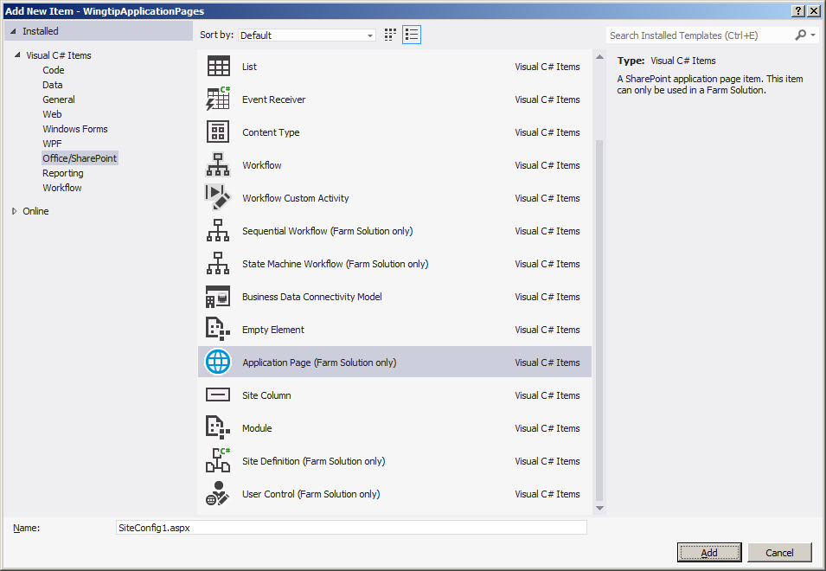
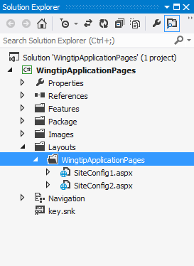
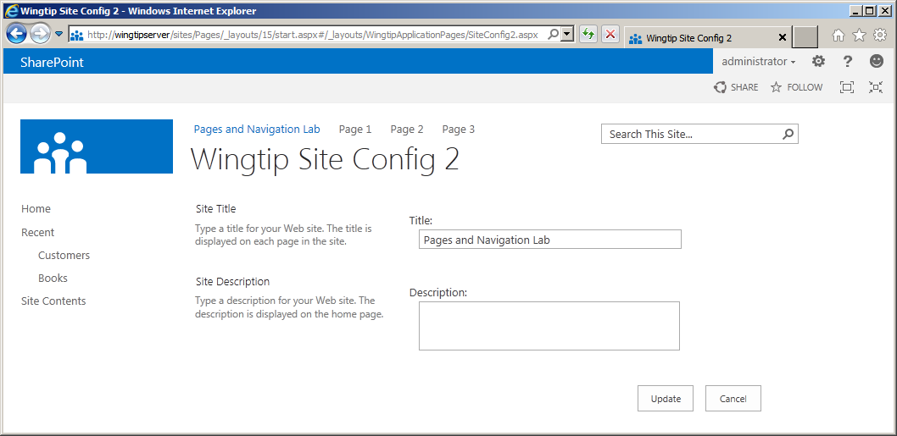
Creating Application Pages
Creating custom application pages
Visual Studio provides project item template
Only supported in farm solutions
Only type of page that supports server-side code
Notes:
Using Visual Studio SharePoint Development Tools, you can create custom application pages:
Create a project using the Visual Studio SharePoint Development Tools.
Add a new Application Page project item.
Override the PlaceholderMain to add your own HTML, ASP.NET controls and SharePoint controls.

Slide 35
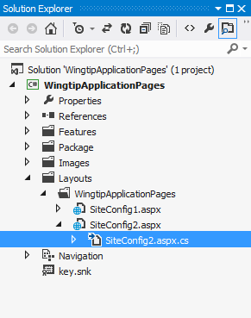
Adding Code to An Application Page
public partial class SiteConfig2 : LayoutsPageBase {
protected override void OnInit(EventArgs e) {
base.OnInit(e);
cmdUpdate.Click += new EventHandler(cmdUpdate_Click);
}
void cmdUpdate_Click(object sender, EventArgs e) {
SPWeb site = this.Web;
site.Title = txtSiteTitle.Text;
site.Description = txtSiteDescription.Text;
site.Update();
SPUtility.Redirect("settings.aspx",
SPRedirectFlags.RelativeToLayoutsPage,
this.Context);
}
protected override void OnPreRender(EventArgs e) {
base.OnPreRender(e);
SPWeb site = this.Web;
txtSiteTitle.Text = site.Title;
txtSiteDescription.Text = site.Description;
}
}
Notes:
You can also add code to custom application pages:
Create a class that inherits from LayoutsPageBase, which resides in the Microsoft.SharePoint.WebControls namespace of the Microsoft.SharePoint.dll
In the .aspx page, add a directive that specifies that the page inherits from your custom class. <@Page Language=“C#” MasterPageFile=“~masterurl/default.master” Inherits=”WingtipUI.Layouts.WingtipUI.SiteConfig2” >
Implement the functionality and handle events that are fired by the controls on the application page

Slide 36
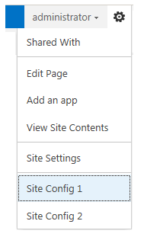
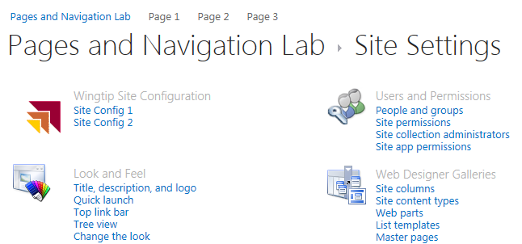
Navigating with CustomActions
CustomAction elements provide navigation
Add Site Settings links and Site Actions menu items
<CustomAction
Id="WingtipSiteActionsConfig1"
GroupId="SiteActions"
Location="Microsoft.SharePoint.StandardMenu"
Rights="ManageWeb"
Sequence="1"
Title="Site Config 1"
Description="Use this page to configure the current site" >
<UrlAction Url="~site/_layouts/WingtipApplicationPages/SiteConfig1.aspx" />
</CustomAction>
<CustomAction
Id="WingtipSiteActionsConfig2"
GroupId="SiteActions"
Location="Microsoft.SharePoint.StandardMenu"
Rights="ManageWeb"
Sequence="2"
Title="Site Config 2"
Description="Use this fancier page to configure the current site" >
<UrlAction Url="~site/_layouts/WingtipApplicationPages/SiteConfig2.aspx" />
</CustomAction>
<CustomActionGroup
Id="WingtipSiteConfiguration"
Location="Microsoft.SharePoint.SiteSettings"
Title="Wingtip Site Configuration"
Sequence="1"
Description="Wingtip application pages"
ImageUrl="/_layouts/15/images/WingtipApplicationPages/WingtipIcon.gif" />
<CustomAction
Id="WingtipSiteSettingsConfig1"
GroupId="WingtipSiteConfiguration"
Location="Microsoft.SharePoint.SiteSettings"
Rights="ManageWeb"
Sequence="1"
Title="Site Config 1"
Description="Use this page to configure the current site" >
<UrlAction Url="~site/_layouts/WingtipApplicationPages/SiteConfig1.aspx" />
</CustomAction>
<CustomAction
Id="WingtipSiteSettingsConfig2"
GroupId="WingtipSiteConfiguration"
Location="Microsoft.SharePoint.SiteSettings"
Rights="ManageWeb"
Sequence="2"
Title="Site Config 2"
Description="Use this page to configure the current site" >
<UrlAction Url="~site/_layouts/WingtipApplicationPages/SiteConfig2.aspx" />
</CustomAction>
Notes:
To be able to navigate to the custom application page, add a CustomAction element. CustomActions can be used to add links to the Site Settings, page, to the Site Actions menu, to toolbars, to the Edit Control Block, and so on.

Slide 37
Summary
Understanding SharePoint Solutions
Features and Feature Receivers
Creating Web Parts
Creating Site Pages and Application Pages

