Slide 1
Getting Started with SharePoint 2013
Notes:
In this module students will introduce students to the big picture of SharePoint development. You will learn about the architecture and topology of a SharePoint on-premises farm. You will learn about the two main SharePoint development strategies which include full trust solutions and SharePoint apps. You will also be introduced to a set of tools that are often used during SharePoint development.

Slide 2
Student Introductions
Basic Info
What’s your name?
Where do you work? (optional)
How long have you been a developer?
Have you used SharePoint? Which versions?
List the skills with which you already feel comfortable
.NET programming in Visual Studio with C# or VB.NET
Development with ASP.NET and ASP.NET MVC
SharePoint solution development
JavaScript and jQuery
REST and OData

Slide 3
Agenda
SharePoint Architecture and Topology
SharePoint Development Strategies
SharePoint Developer Tools and Utilities
Creating a SharePoint Development Environment

Slide 4
SharePoint 2013
Microsoft SharePoint Foundation (SPF) 2013
Platform provides core collaboration capabilities
Microsoft SharePoint Server (SPS) 2013
Built on top of SPF 2013
Browser Clients
Microsoft SharePoint Server 2013
MS Word Clients
Microsoft SharePoint Foundation 2013
MS Outlook Clients
.NET Framework 4.5
Internet Information Services 7.0
Windows Server 2008 R2 SP1 (x64 only)
Windows Server 2012 (x64 only)
Notes:
SharePoint Foundation 2013 is the free version of SharePoint that provides the core collaboration capabilities. SharePoint Server 2013 is the next version of the SharePoint technology stack.
Like SharePoint 2010, SharePoint 2013 only runs on 64-bit operating systems. It is supported on both Windows Server 2008 R2 w/ Service Pack 1 or on the latest release of Windows Server: Windows Server 2012 R2.
However unlike SharePoint 2010, SharePoint 2013 cannot be installed on a client operating system such as Windows 7 or Windows 8. However there are some developer extensibility opportunities for SharePoint 2013 where all you need is a browser, Internet connection and a developer instance of Office 365. Others only require Visual Studio 2013.

Slide 5
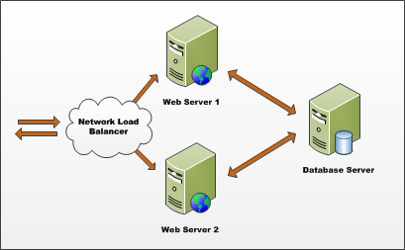
SharePoint Farms
SharePoint farms created for on-premises deployments
Farm requires Web server(s) and database server
Farm can be single server or multi-server
Each farm has exactly one configuration database
Single-server farm used for development environments
Notes:
A SharePoint Farm is simply a collection of servers that have SharePoint installed on them and are all connected to the same configuration database (aka: the config DB).

Slide 6
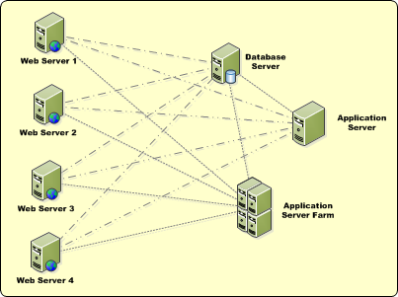
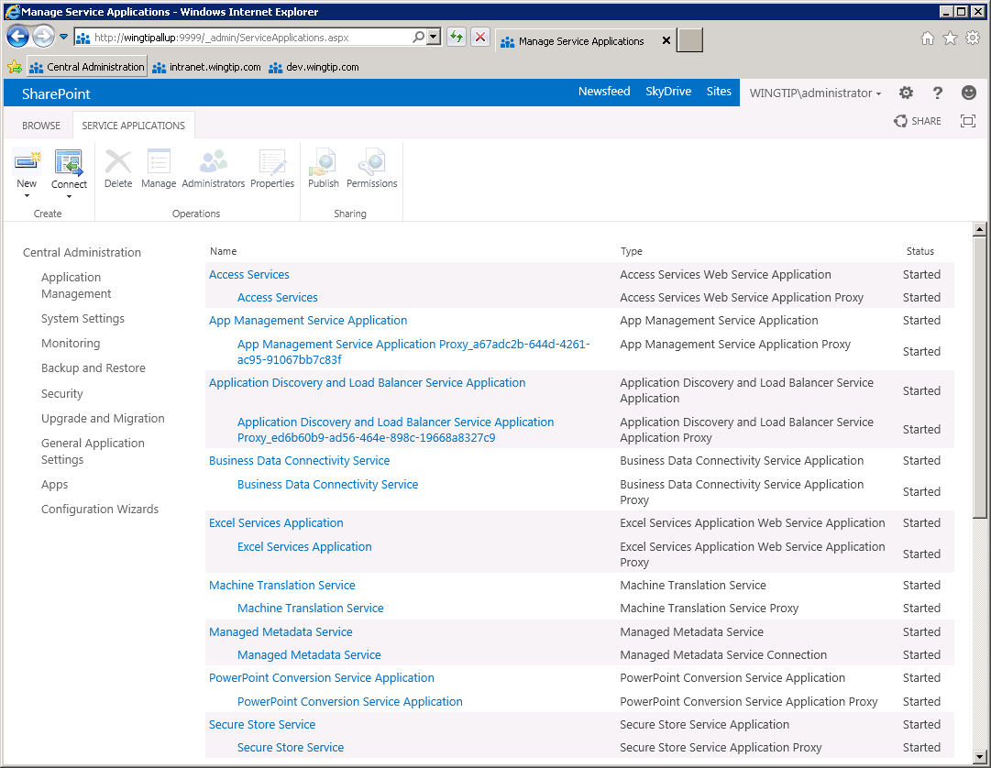
Service Applications
Services applications facilitate resource sharing
Service apps can run on WFE or Application Servers
Service apps can be used across farms
administrated through Central Admin
Notes:
Microsoft broke up the Shared Service Provider (SSP) framework in SharePoint 2007 into a new model called Service Applications. This new model facilitates a multitenant deployment of SharePoint 2010 as much more flexible SharePoint farm topologies.
Web applications are no longer tied to a collection of configured service offerings such as in the SSP model. Now Web applications can be associated with different service offerings (service applications) on a more a la carte model.

Slide 7
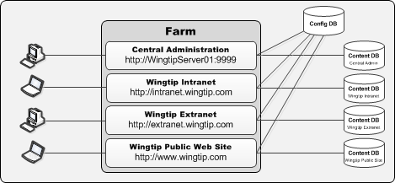
Web Applications
Web Applications provide HTTP entry points
Web Applications based on IIS Web sites
Web Application defines one or more URL spaces
Web Application security configured independently
Notes:
SharePoint sites and content live within SQL Server databases called “content databases”. SharePoint is primarily a Web-based application. Microsoft uses Web applications, also referred to as Web Sites in Internet Information Services (IIS), as the HTTP/HTTP entry point into SharePoint site collections.

Slide 8
Site Collections and Sites
Sites always created in scope of a site collection
Site collections created at web application scope in on-prem farm
Site collections created at tenancy scope in SharePoint on-line
User can be configured to be site collection administrator
SharePoint Web Application Host Header Path: http://intranet.wingtip.com
site collection (root)
site collection /sites/operations
site collection /sites/sales
site collection /sites/finance
top-level site
(root)
top-level site
(root)
top-level site
(root)
top-level site
(root)
child site
/WestDivision
child site
/EastDivision
child site
/FY2012
child site
/FY2013
child site
/Reports
child site
/Dashboards
Notes:
All user-generated content resides in SharePoint sites. The primary types of content include items within lists and documents inside document libraries. However, there are other forms of user-generated content as well such as customization data and personalization data tracked by server-side web parts as well.
Sites are grouped into site collections. Whenever a site is created, it is always created within a scope of a specific site collection. Furthermore, each site collection is associated with exactly one content database which is used to store the content of all the sites inside.
Each site collection must have exactly one site referred to as the “top-level” or “root” site. The URL of the top-level site is always the same as the URL of the site collection. A site collection may additionally contain child sites below the root site. Child sites can be nested within other child sites within a site collection resulting in the creation of a site hierarchy. While SharePoint supports nested child sites more than 10 levels in depth, experience has taught the SharePoint community that creating deep site hierarchies can be very hard to manage and to scale.
A key reason why the SharePoint architecture requires that sites are always partitioned into site collections has to do with security. More specifically, site collections provide a scope for administrative privileges. If you are configured as the site collection administrator (aka site collection owner), you are guaranteed to have full administrative control over all the sites inside.

Slide 9
Managing SharePoint
Central Administration
Available in On-Premises deployments
Manage servers, services, jobs, etc.
Create Web Applications, site collections
Site Settings
Available in On-Premises & Hosted deployments
Manage site features, lists, users, permissions, etc.
Dual-purpose management site for sites & site collections
Manage site collection from top-level site’s site settings page
When in a non-top-level site, only managing current site
Notes:
SharePoint offers a few different surface areas for management. For administrators, they can use the Central Administration website that provides all farm-wide management capabilities. They can also use the command-line PowerShell interface known as the SharePoint 2013 Management Shell. Both of these are only available for on-premises deployments. Every site in SharePoint also contains a Site Settings site that allows for management by site collection and site administrators of site collections and sites. It is security and context trimmed so only certain things can be managed depending on who is logged in and what has been enabled/installed on the site collection/site.

Slide 10
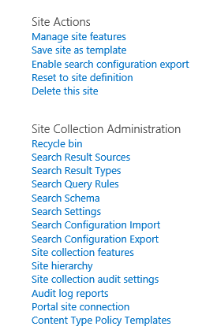
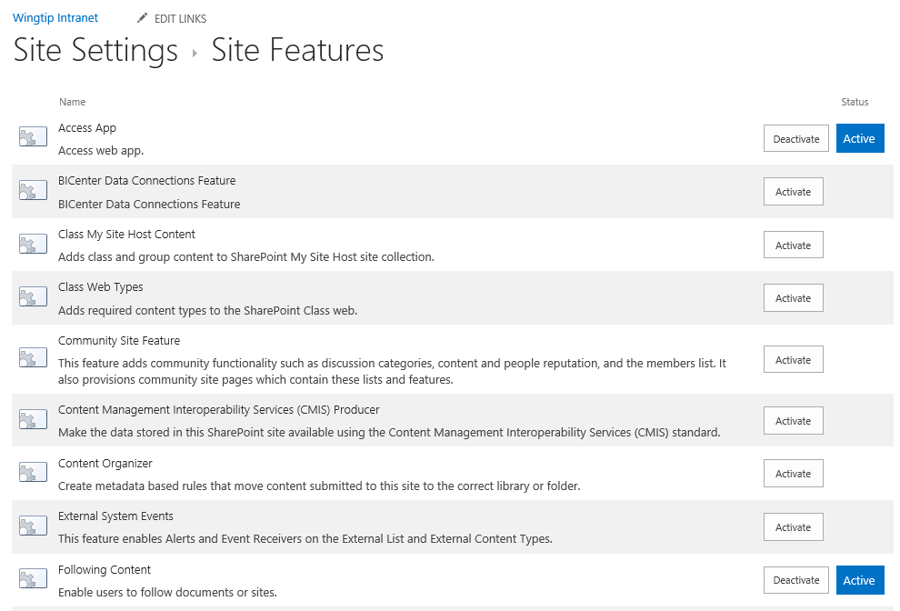
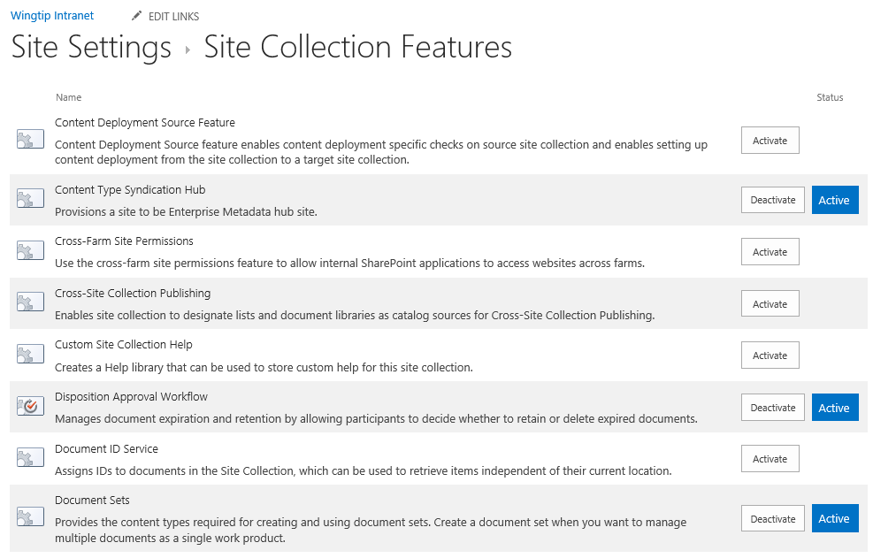
Managing Features
Site collection administrator can activate features
Some features activate at site (aka web) level
Other features activate at site collection level

Slide 11
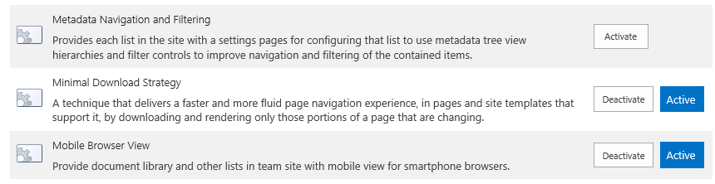
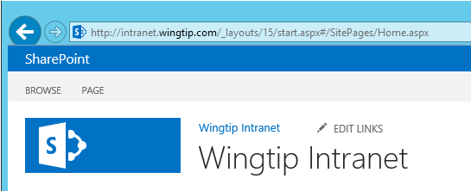
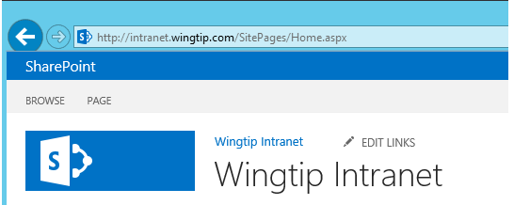
Minimal Download Strategy (MDS) Feature
MDS features used to smooth page transitions
Implemented with site-scoped feature
MDS features is activated in Team Site by default
MDS feature is disabled (and not supported) in Publishing Sites
URL structure to site page with MDS feature activated
URL structure to site page with MDS feature deactivated

Slide 12
Creating a Team Site using Central Administration

Slide 13
Agenda
SharePoint Architecture and Topology
SharePoint Development Strategies
SharePoint Developer Tools and Utilities
Creating a SharePoint Development Environment

Slide 14
SharePoint 2013 Environments
On-Premises Farms
SharePoint installed and managed by company
Access to 100% of SharePoint’s features & capabilities
Office 365 and SharePoint On-line
SharePoint installed and managed by Microsoft in cloud
Some on-premises features not available in the cloud
Hybrid Environments
Mix of the two other environments
Very scenario driven on customer-by-customer basis
Notes:
SharePoint can be deployed in three ways. An On-Premises deployment is historically the most common. This is where SharePoint is installed on company servers behind the firewall and administrators manage the performance, storage and business continuity story. A Hosted deployment is one in which SharePoint is installed and managed by a third party. The most common and popular instance of this is Office 365. In some scenarios, either as companies migrate from an On-Premises deployment to Hosted or where a permanent co-existence is desired, SharePoint can also be deployed in a hybrid model where a local On-Premises installation is aware of a Hosted SharePoint tenant.

Slide 15
SharePoint Development Strategies
Farm Solutions (aka Full Trust Solutions)
Packaged and deployed using farm solution packages
Deployment requires farm administrator
Works in on-premises farms but not Office 365
Heavily used since SharePoint 2013
Sandboxed Solutions
Introduced in SharePoint 2010 with very limited adoption
Deprecated by Microsoft in SharePoint 2013
SharePoint Apps Add-ins
Introduced with SharePoint 2013
Designed for Office 365 and on-premises farms
Does not allow server-side code to run in SharePoint
Requires breadth of client-side development skills
Notes:
As previously mentioned, there are two different types of extensibility options for SharePoint developers: solutions and add-ins (formerly known as apps) . This slide shows that some of these are available in certain deployment scenarios while others are not.

Slide 16
SharePoint Server-Side Object Model
Accessible through Microsoft.SharePoint.dll
In-process Assembly DLL for ..NET clients
Oldest & most mature API for SharePoint
Available in solution packages but not SharePoint apps
Farm solutions have full access to server-side API
Sandbox solutions can access only a subset
Notes:
The oldest and most mature way to program against SharePoint is to use the server-side object model. This is available in solutions and is accessible from custom code running on the SharePoint server. However this model is being deprecated by Microsoft in favor of more client-friendly APIs.

Slide 17
Client-Side Object Model (CSOM)
CSOM provides client-side API for SharePoint
Introduced in SharePoint 2010
Accessible using .NET, Silverlight and JavaScript
CSOM expanded in SharePoint 2013
Search
Managed Metadata
User Profiles and Social Feeds
Business Connectivity Service (BCS)
Workflow
Publishing
Notes:
SharePoint 2010 introduced the client-side object model, also known as the CSOM. This enables developers to use .NET, Silverlight or JavaScript to interact with SharePoint from the SharePoint server. In SharePoint 2013 Microsoft greatly expanded the area and API enabling many more types of solutions to be built with the CSOM.

Slide 18
SharePoint REST API
SharePoint 2013 introduces new REST API
Great alternative to CSOM when coding in JavaScript
Can also be called from server-side .NET code
Accessible from non-Windows platforms as well
Unlike CSOM, SharePoint REST API accessible to all
Creating URIs for the SharePoint REST API
URIs created based on principles of REST and ODATA
[Target Site URL] + _api + [Target SharePoint object]
http://intranet.wingtip.com/_api/web/lists/getByTitle('Customers')
Notes:
In SharePoint 2013 the Service root URI contains the URI to the target SharePoint site and then the relative path to the client.svc entry point inside the _vti_bin virtual directory. After that you add the resource path to specify an object such as a site or list. Here's an example of a resource path for the current site.
http://intranet.wingtip.com/_vti_bin/client.svc/web
SharePoint 2013 allows REST URLs to go through _api folder which cleans up the look of the URLs that need to be built and removes client.svc file name from URL. The URL below is equivalent to the one above and should be preferred.
http://intranet.wingtip.com/_api/web

Slide 19
Agenda
SharePoint Architecture and Topology
SharePoint Development Strategies
SharePoint Developer Tools and Utilities
Creating a SharePoint Development Environment

Slide 20
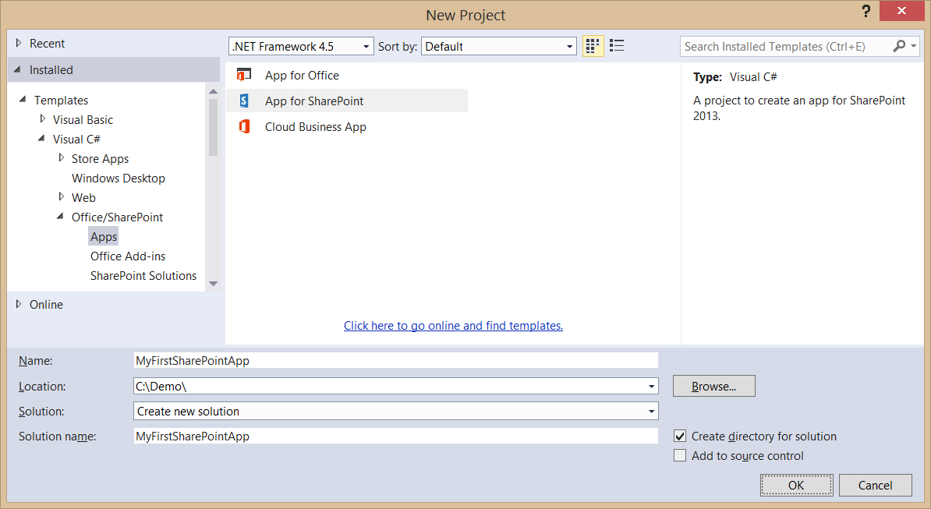
Visual Studio 2013
Visual Studio supports SharePoint development
Project templates for SharePoint solutions and apps
Make sure to get latest updates for SharePoint tools
Use Visual Studio 2013 with Update 3 or later

Slide 21
Web Essentials
Web Essentials 2013
Visual Studio 2013 Extension in Online Gallery
Additional IntelliSense for CSS3
Warnings & helpers for browser compatibility issues
Selector IntelliSense for HTML elements, classes, IDs
Web Essentials includes JSHint
Includes JSHint which detects problems in JavaScript
Notes:
With SharePoint moving to a more client-side or “off the SharePoint box” development model, there are many common web development tools that will be useful for developers.
The Web Essentials extension to Visual Studio 2003 is a free add-on was authored by a senior person on the Microsoft ASP.NET web development team and includes a TON of cross browser tools to make your life easier.
http://visualstudiogallery.msdn.microsoft.com/07d54d12-7133-4e15-becb-6f451ea3bea6

Slide 22
Developer Tools provided by the Browser
Browser-based development tools
View HTML
View & modify CSS
View & debug JavaScript
Internet Explorer
Developer Tools: included
FireFox
FireBug: extra download
Google Chrome
Developer Tools: included
Notes:
All popular browsers include developer tools for debugging JavaScript, understanding how a page is constructed client-side and inspecting CSS styles.

Slide 23
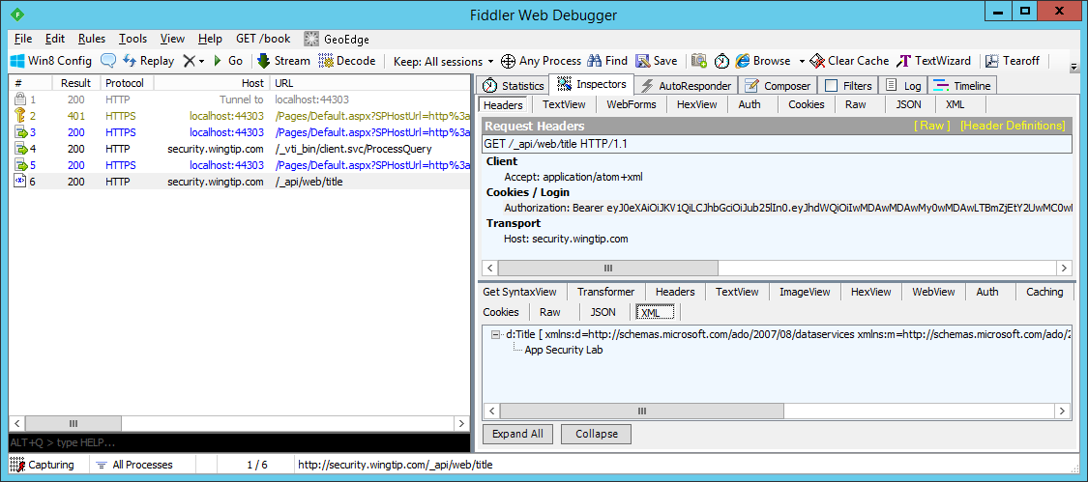
Debugging HTTP request with Fiddler
Fiddler is a HTTP debugging proxy
It helps you inspect HTTP request & response
Useful in debugging client-side JavaScript code
Useful in debugging SharePoint Workflows
Notes:
With SharePoint moving to a more client-side or “off the SharePoint box” development model, there are many common web development tools that will be useful for developers.
The Web Essentials 2013 for Visual Studio 2013 free add on is by a senior person on the Microsoft ASP.NET web development team and includes a TON of cross browser tools to make your life easier.
http://visualstudiogallery.msdn.microsoft.com/07d54d12-7133-4e15-becb-6f451ea3bea6
Fiddler is an HTTP debugging proxy that enables you to see the raw requests & responses coming form the currently logged in user:
http://www.fiddler2.com/fiddler2/

Slide 24
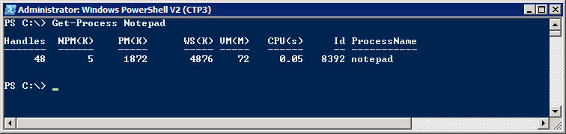
Working with Windows PowerShell
SharePoint developers should learn PowerShell
Scripting environment for SharePoint administration
Used to create and manage test sites
Used to configure SharePoint environment
Windows PowerShell fundamentals
Cmdlets (e.g. Get-Process and Stop-Process)
Pipelining and formatting features
Provider-based model for accessing resources
Notes:
Over the last few years, Windows PowerShell scripting has begun to replace older DOS-style batch files and VBScript files as the preferred way to manage and automate administrative tasks
Cmdlets are callable functions.
Pipelining allows one Cmdlet to return an object as input to another.
Windows PowerShell includes formatting features to display output using lists or tables.
Windows PowerShell is based on a provider-based model based on Snap-ins.

Slide 25
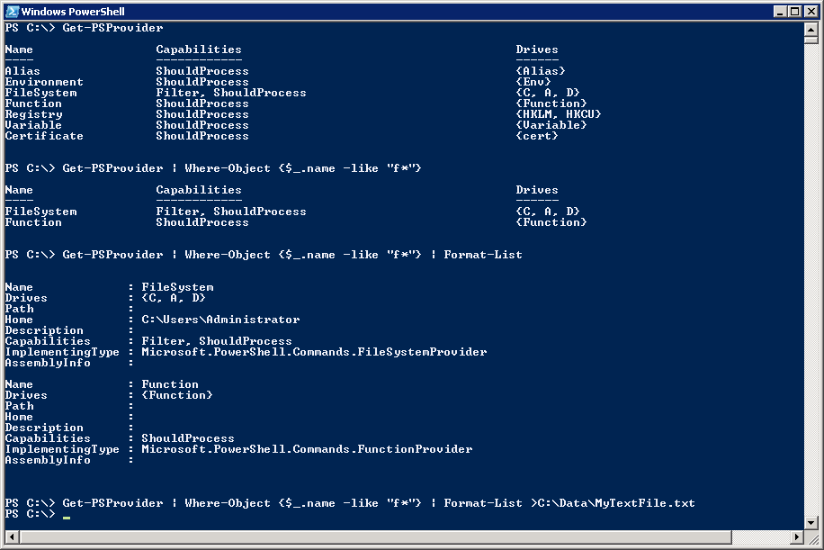
Getting Started with Windows PowerShell
(1) Execute a Cmdlet
(2) Filter results using where clause
(3) Add formatting instructions
(4) Redirect output to new text file
Notes:
The first example shows calling a Cmdlet that takes no parameters.
The second example adds filtering by adding a Where-Object cmdlet:
Where-Object {$_.name –eq "F*"}
The syntax $_ refers to the object in question
$_.name refers to the object's name property
-eq is the operator for equals
The third example adds in formatting instructions.
The last example redirects output so it is stored in a new text file.

Slide 26
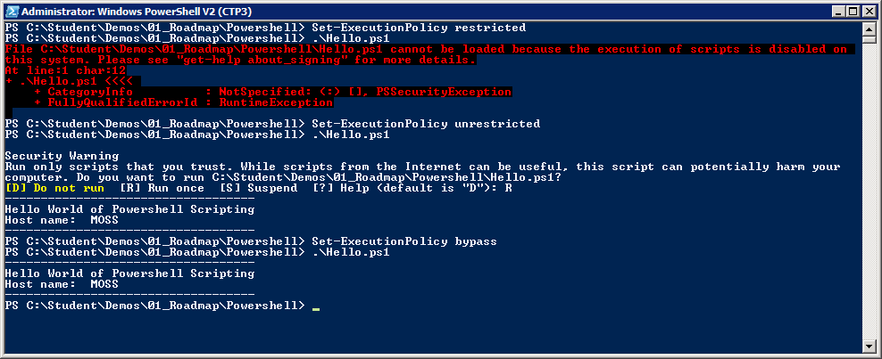
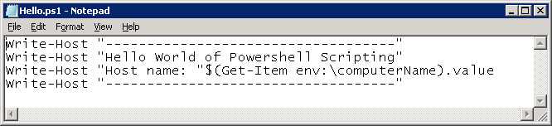
Scripts and Execution Policy
You can author Windows PowerShell scripts
Scripts have *.ps1 extension
Local execution policy must be configured
Scripts will not execute under default execution policy of restricted
Scripts can execute under execution policy of unrestricted. Scripts that are not signed result in prompting user for permission to execute.
Scripts can execute under execution policy of bypass. This mode suppresses prompting user for permission to execute.
Notes:
By default, Windows PowerShell does not allow scripts to run. The SharePoint Administrator must change execution policy to enable script execution.
There are a number of settings that you can apply to Execution Policy:
restricted (default) – Scripts prohibited from executing.
unrestricted - Scripts can execute. Scripts that are signed can run with user interaction. Scripts that are not signed result in prompting user for permission to execute.
bypass (developer mode) – Scripts can execute and user interaction is suppressed.

Slide 27
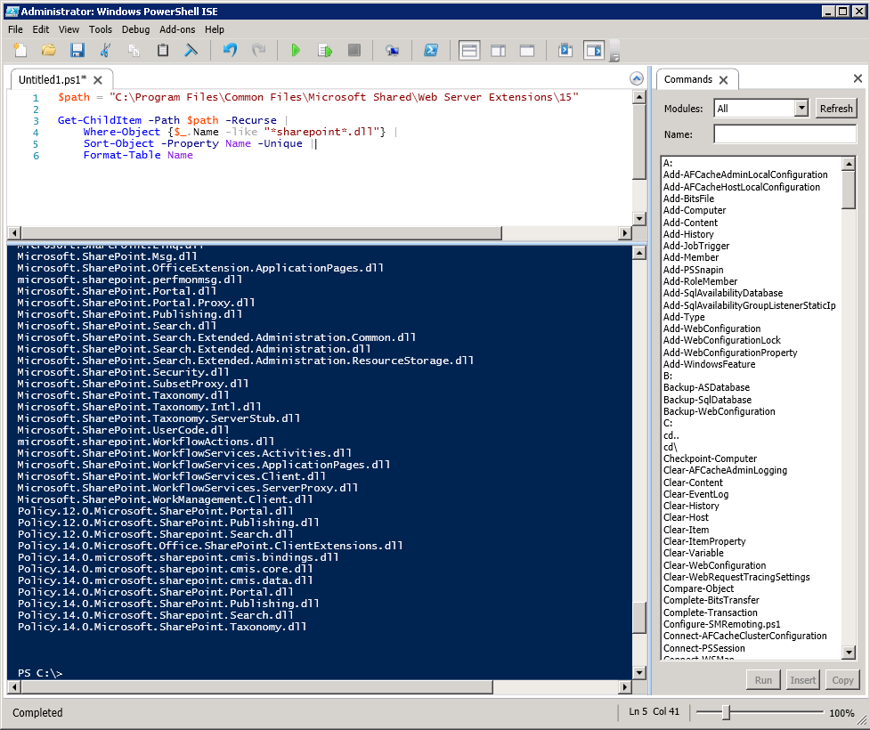
Windows PowerShell ISE
Supports color-coding, IntelliSense and debugging
Notes:
With the initial release of Windows Powershell, administrators and developers usually resorted to writing scripts with NotePad. Windows PowerShell 2 provides a nice development environment for writing Windows PowerShell scripts named the Windows PowerShell Integrated Scripting Environment (ISE).
When it comes to writing complex scripts with control of flow logic, it is really nice to be able to debug and single step through your code.

Slide 28
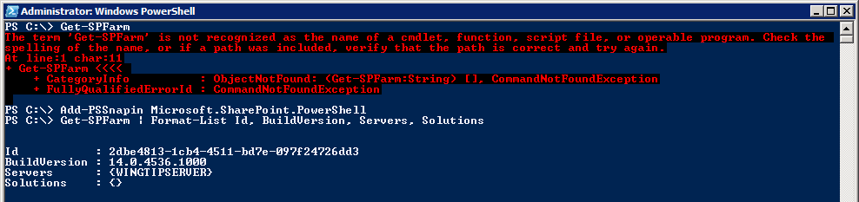
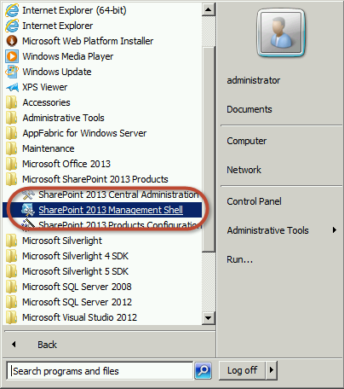
The Microsoft.SharePoint.Powershell Snapin
Explicitly load SharePoint Windows PowerShell snap-in from console or script
Implicitly load snap-in by using link in Windows Start menu
Begin using SharePoint Cmdlets
Notes:
SharePoint Server 2013 adds many cmdlets for SharePoint administration through a Snap-in provider named Microsoft.SharePoint.PowerShell. The SharePoint cmdlets cannot be called until the SharePoint snap-in has been loaded.
There are two common ways to load the SharePoint snap-in:
Call the Add-PSSnapin cmdlet and pass a parameter with the snap-in name
Launch the Windows PowerShell console using SharePoint 2013 Management Console. This link points to an XML file that loads the SharePoint snap-in in a declarative fashion.

Slide 29
Troubleshooting Errors with ULS
ULS is Unified Logging Service
SharePoint’s log files located at ..\15\LOGS
Configure level of logging for different categories:
Central Administration → Monitoring → Configure Diagnostic Logging
Developer Tools for inspecting ULS logs
Merge-SPLogFile cmdlet in PowerShell
ULS Log Reader Utility (ULSViewer.exe)
Developer Dashboard
Notes:
The SharePoint logging system is called the Unified Logging Service, or ULS for short. You can configure the level of logging through Central Administration for on-premises deployments only. In addition, when something occurs you can use the Merge-SPLogFile cmdlet to search across all servers in the farm and find all entries matching the message provided.

Slide 30
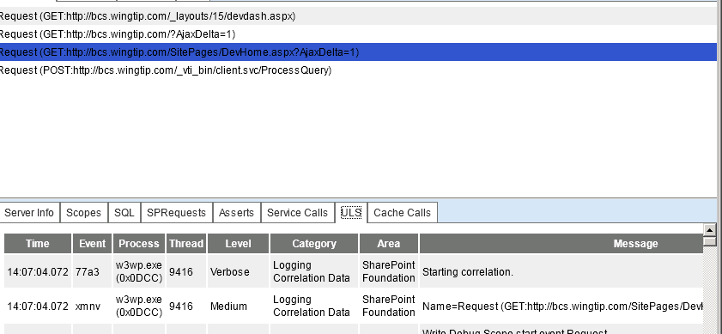
Developer Dashboard
A utility for inspecting per-request diagnostics
Introduced in SharePoint 2010
Much improved in SharePoint 2013
Shows requests from start of dashboard session
Notes:
The developer dashboard was introduced in SharePoint 2010 in an effort to assist developers with finding performance issues with custom components on a page. In SharePoint 2013 it has been improved to be surfaced as a popup window and track all requests for the current logged-in user (note: not all users, just the currently logged-in user).

Slide 31
Enabling & Using Developer Dashboard
Developer Dashboard must be enabled
Typically done using PowerShell script
Developer Dashboard requires Usage & Health Data Collection Service Application instance
$contentService = [Microsoft.SharePoint.Administration.SPWebService]::ContentService
$devDashboardSettings = $contentService.DeveloperDashboardSettings
if ($devDashboardSettings.DisplayLevel -eq "On"){
$devDashboardSettings.DisplayLevel = "Off"
} else {
$devDashboardSettings.DisplayLevel = "On"
}
$devDashboardSettings.Update()
Notes:
The dashboard must be enabled through the server-side SharePoint API such as with PowerShell as shown on the slide. This means that it is not available in Office 365. It is only available in SharePoint on-premises installations.

Slide 32
Agenda
SharePoint Architecture and Topology
SharePoint Development Strategies
SharePoint Developer Tools and Utilities
Creating a SharePoint Development Environment

Slide 33
Complete Development Environment
Local on-premises deployment of:
Prerequisites: SQL Server, Workflow Manager, etc.
SharePoint 2013 Server
Tools: Visual Studio, Office, SharePoint Designer
Recommended hardware
Host machine has 16GB+
Allocate 12GB+ to SharePoint VM
Complete environment setup guide available at www.CriticalPathTraining.com/Members
Notes:
Creating a SharePoint developer environment can be a tedious and complicated task. You can use a setup guide we’ve provided with detailed walk-through steps. We offer tis guide free of charge to the SharePoint community and distrubute it through the Members section of our website: www.criticalpathtraining.com.

Slide 34
Student VM for this Class
Here is what is installed in the CPT student VMy
Windows Server 2012 R2 (server name is WINGTIPSERVER)
Active Directory Domain Services (domain is WINGTIP.COM)
SQL Server 2012 with SP1
SharePoint Server 2013 with SP1
Workflow Manager 1.0 (includes updates from 2014)
SharePoint Designer 2013 with SP1
Visual Studio 2013 with Update 3
Microsoft Office 2013 Professional with SP1
Microsoft Visio 2013 Professional SP1

Slide 35
Summary
SharePoint Architecture and Topology
SharePoint Development Strategies
SharePoint Developer Tools and Utilities
Creating a SharePoint Development Environment

