Slide 1
SharePoint Lists and Events
Notes:
In this module you will learn how to create lists and document libraries using the SharePoint development tools in Visual Studio 2013. Students will also learn about the various events in SharePoint 2013 including the new remote event receiver capability.

Slide 2
Agenda
Site Columns and Content Types
Creating Lists and Document Libraries
Updating Columns, Content Types and Lists
Creating Event Receivers
Creating Remote Event Receivers

Slide 3
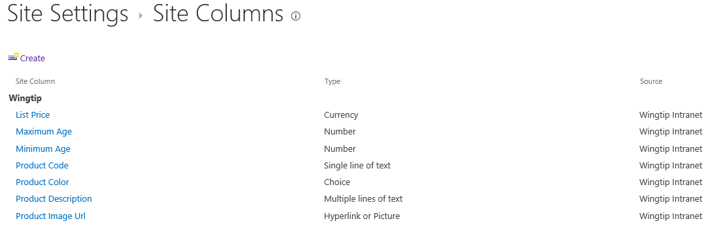
Site Columns
Reusable column templates that define…
The underlying field type for column value
The default value
Rendering characteristics
Each site has its own Site Column Gallery
Site columns available in current site and sites below
Site columns in top site available to site collection
Notes:
A site column represents the definition for a reusable column templates. Each site column defines an underlying field type for column value, a default value and the rendering characteristics for that field type. For example, a site column based on the underlying field type of Currency can define the formatting in terms of US Dollars.
Each site has its own Site Column Gallery. This is true of both top level sites as well as child sites. A site column in the site column gallery is available for use in the current site and in child sites below in the site hierarchy. A site column in the site column gallery of the top-level site is available for use throughout the entire site collection.

Slide 4
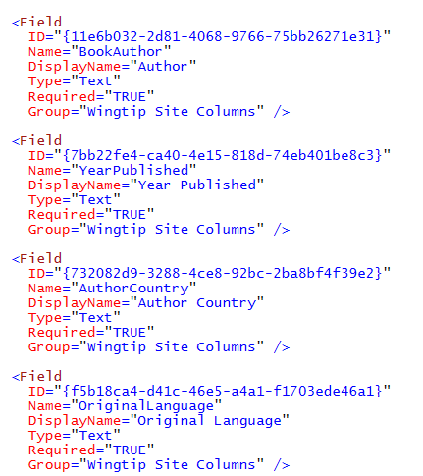
Creating Site Columns using XML
Site columns can be created declaratively
Declarative XML element activated using feature

Slide 5
Content Types
Reusable item/document templates that define…
A parent content type
A collection of site columns
Each site has its own Content Type Gallery
Content types available in current site and sites below
Content types in top site available to site collection
Notes:
A content type is a reusable template of site columns used for an item or document. Since we are concentrating on publishing sites in this course, we are interested in content types that are used behind the Pages document library.
Each content type lives in a large hierarchy of content types and therefore must be defined with a parent content type. The content type inherits a set of site columns from its parent content type and can add more of its own.
Just like site columns, content types are tracked in a content type gallery. Each site within a site collection has its own Content Type Gallery. Content types in a content type gallery are available in the current site as well as in child sites below in the sire hierarchy. Content types that have been added to the content type gallery of the top-level site are available for use throughout the current site collection.

Slide 6
Content Type Hierarchy
Content types designed in hierarchy
All content types inherit (aka derive) from Item
Child content type inherits site columns from parent
Child content type can add new site columns
Child content type can remove site columns inherited from parent
SharePoint content type hierarchy
Item
Announcement
Contact
Task
Document
Form
Picture

Slide 7
Creating Custom Content Types
Creating a custom content type
Select a content type name
Select a parent content type to inherit from
Add whatever site columns are required
Configure content type settings
SharePoint-supplied content types
Item
Document
Custom content types
Book
Book Cover Image

Slide 8
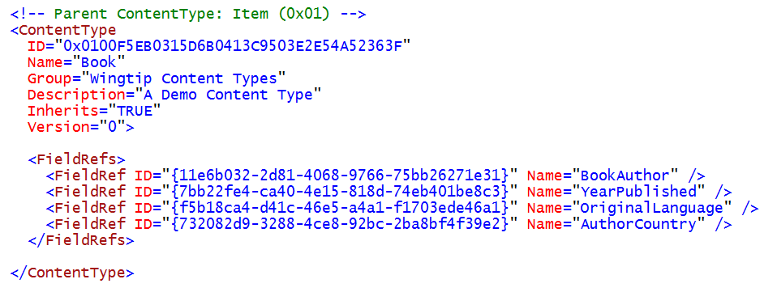
Creating Content Types using XML
This example shows a custom content type
Designed for use custom Books list type

Slide 9
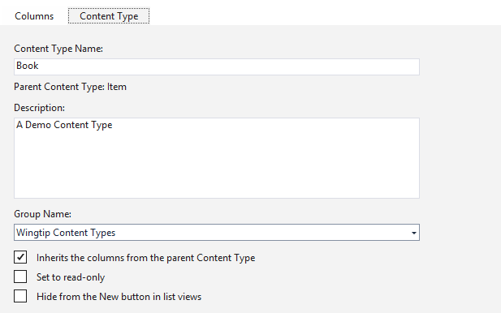
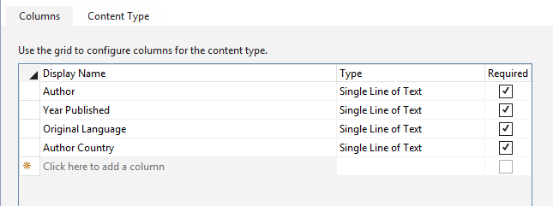
Visual Studio Content Type Designer
Makes it easier to work with content types
You don't need to work directly with XML elements
Site columns added to content type from dropdown list

Slide 10
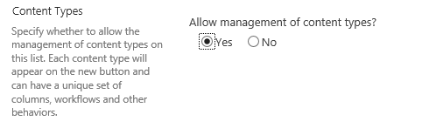
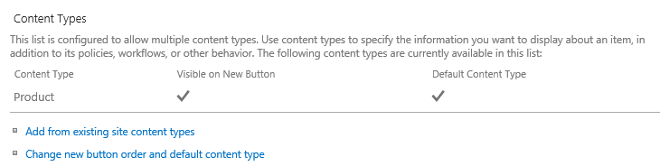
Lists and Content Types
List contains a collection of content types
Every list must contain at least one content type
Content types hidden on the List Settings page by default
Advanced Settings page for list provides option to show them
Content Types section allows for adding/removing content types

Slide 11
Agenda
Site Columns and Content Types
Creating Lists and Document Libraries
Updating Columns, Content Types and Lists
Creating Event Receivers
Creating Remote Event Receivers

Slide 12
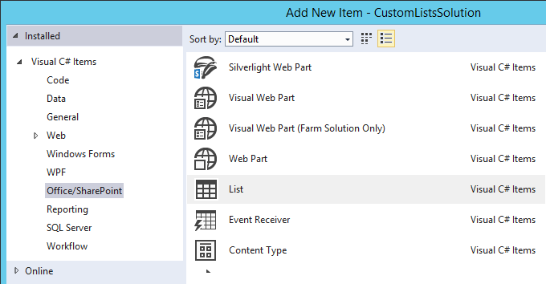
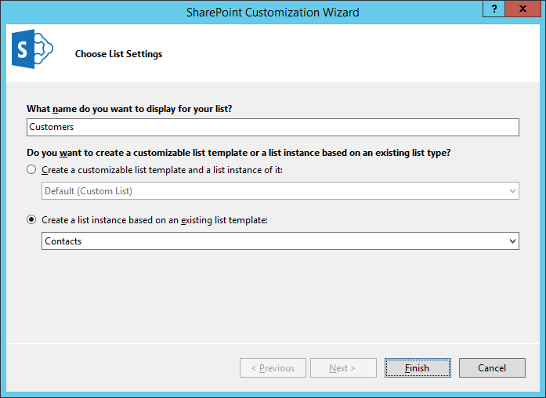
Creating Lists with Visual Studio
Visual Studio provides support for creating SharePoint lists
SharePoint list added to Visual Studio projects using List item template
SharePoint lists supported in SharePoint solutions and SharePoint apps
Options when creating list
list instance based on existing list type
customizable list template with instance
create customizable list template
create standard list

Slide 13
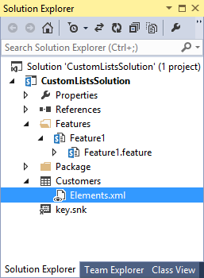
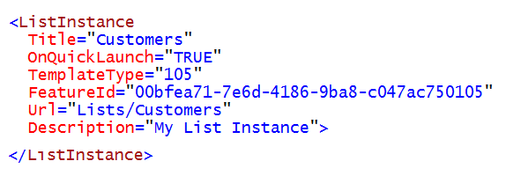
Creating a Standard List Instance
Creating using ListInstance element
Title: acts as list display name
URL: URL offset from root of site
TemplateType: ID of standard SharePoint list type
FeatureId: ID of SharePoint feature which provide list type

Slide 14
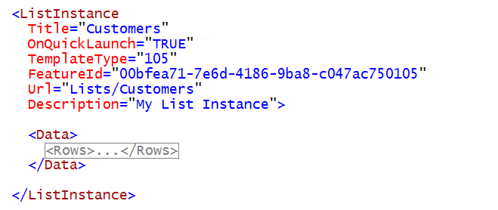
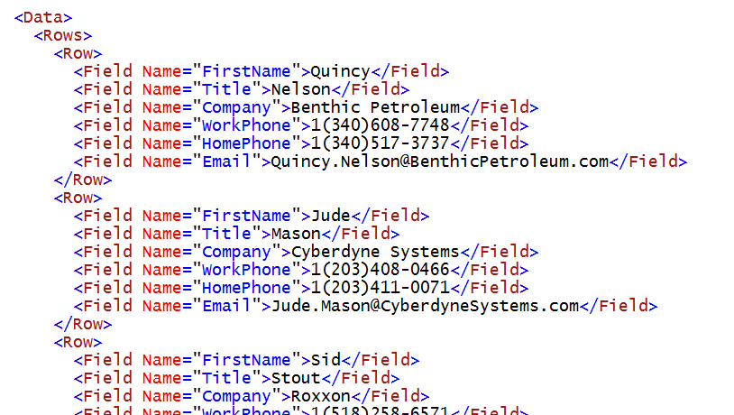
Populating a New List with Items
List can be created with pre-populated items
Item data added in Rows and Row elements
Item column values assigned using site column names

Slide 15
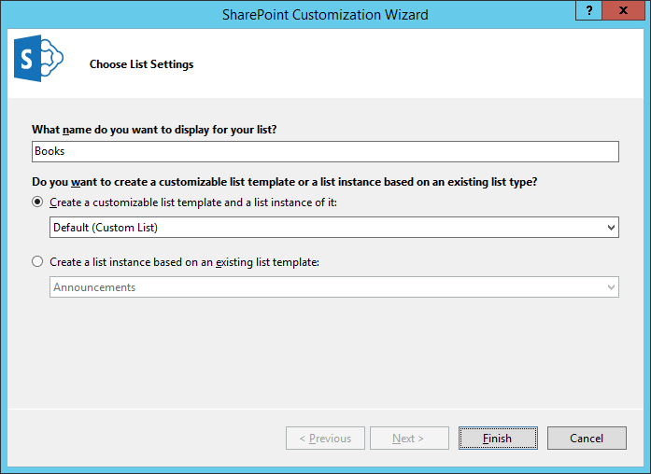
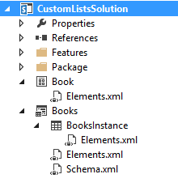
Creating Customizable List Templates
Select standard List type when creating template
Affects initial set of list columns and list content type
Schema.xml contains SharePoint list definition
First Elements.xml file added with ListTemplate element
Second Elements.xml file added with ListInstance element
List Instance Element
List Template Element
List Template Definition

Slide 16
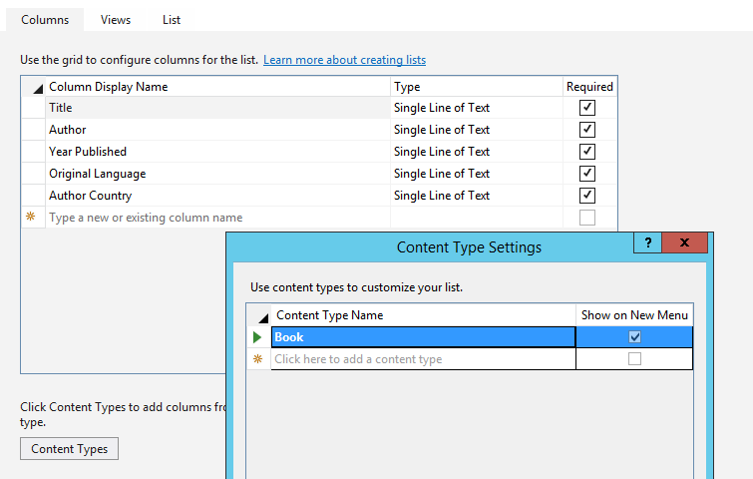
Visual Studio List Designer
List Designer abstracts away XML in Schema.xml
Used to add columns and content type support
Used configure list properties and add/modify views

Slide 17
Provisioning Document Libraries
<?xml version="1.0" encoding="utf-8"?>
<ListInstance Id="Proposals"
TemplateType="101"
Title="Proposals"
Description="Document Library for proposals"
OnQuickLaunch="True"
Url="Proposals">
</ListInstance>
<Module Name="TestData" List="101" Path="TestData" Url="Proposals" >
<File Url="Adventure Works Proposal.docx" Type="GhostableInLibrary" />
<File Url="Contoso Proposal.docx" Type="GhostableInLibrary" />
<File Url="Wingtip Toys Proposal.docx" Type="GhostableInLibrary" />
</Module>
<Module Name="WordTemplate" List="101" Url="Proposals/Forms">
<File Url="ProposalTemplate.dotx" Type="Ghostable" />
</Module>
Notes:
When working with features, you can provision a document library on feature activation.
The <ListInstance> element creates the list. The TemplateType indicates that a document library will be created.
The first <Module> element populates the document library with a number of Word documents.
The second <Module> element uploads a Word template that will be used when the user chooses the New button to create a new document.

Slide 18
Creating Lists

Slide 19
Agenda
Site Columns and Content Types
Creating Lists and Document Libraries
Updating Columns, Content Types and Lists
Creating Event Receivers
Creating Remote Event Receivers

Slide 20
Feature Upgrade
Used to version feature instances in production
Supported in SharePoint 2010 and SharePoint 2013
How does it work?
Feature definition is modified with Upgrade Actions
New feature definition pushed out using solution update
Feature instances queried and explicitly upgraded
Notes:
Previously SharePoint did not have a way to upgrade deployed Features. Developers were left to write custom code to handle these scenarios on their own.
SharePoint 2010 introduced the ability to write custom upgrade actions. There is a declarative option but when that doesn’t satisfy the requirements, developers are given a way to wire up custom code.

Slide 21
UpgradeActions
Instructions for what to do during feature upgrade
ApplyElementManifest – used to process element manifest
CustomUpgradeAction – used to execute event handler
MapFile – used to remap existing file URL to new physical file
AddContentTypeField – used to add new column to existing content type
<Feature xmlns="http://schemas.microsoft.com/sharepoint/"
Id="86689158-7048-4421-AD21-E0DEF0D67C81"
Title="Wingtip Lead Tracker"
Version="2.0.0.0" Scope="Web">
<ElementManifests>
<ElementManifest Location="elements.xml" />
<ElementManifest Location="elements_v2.xml" />
</ElementManifests>
<UpgradeActions>
<VersionRange BeginVersion="1.0.0.0" EndVersion="2.0.0.0">
<ApplyElementManifests>
<ElementManifest Location="elements_v2.xml"/>
</ApplyElementManifests>
</VersionRange>
</UpgradeActions>
</Feature>
<Elements xmlns="http://schemas.microsoft.com/sharepoint/">
<ListInstance Id="SalesLeads"
TemplateType="105"
Title="Sales Leads"
Url="SalesLeads"
OnQuickLaunch="TRUE" />
</Elements>
Notes:
With SharePoint 2007 you already had some upgrade scenarios but they were far from complete.
SharePoint 2010 addressed this problem by adding upgrade actions to the schema. These actions allow for declarative upgrades and code-based upgrades. Define declarative upgrades using elements like <ApplyElementManifests>, <AddContentTypeField>, <MapFile>, <CustomUpgradeAction>. Code-based upgrades are defined using the <CustomUpgradeAction> element.
There is also a FeatureUpgrading event added to the FeatureReceiver class. This event is triggered when a feature is upgraded.

Slide 22
Upgrading Content Types
Use Upgrade Action named <AddContentTypeField>
Enables developers to easily upgrade content types
<?xml version="1.0" encoding="utf-8" ?>
<Feature xmlns="http://schemas.microsoft.com/sharepoint/">
<UpgradeActions>
<VersionRange BeginVersion="1.0.0.0" EndVersion="2.0.0.0">
<AddContentTypeField
ContentTypeId="0x010600ADFF3A525118400BA1271AAAAB3A7F4B"
FieldId="{41f2138d-f9d7-4bd8-a369-54054b016c22}"
PushDown="TRUE"/>
</VersionRange>
</UpgradeActions>
</Feature>
Notes:
In SharePoint 2007 it is not easy to upgrade the definition of existing content types.
SharePoint 2010 added new elements to the CAML schema that allows for a better upgrade scenario. You can use the <UpgradeActions> element within the <Feature> element to indicate that you want to upgrade a feature. Within the <UpgradeActions> element you can place elements like <AddContentTypeField> to add a new field to a provisioned content type and to propagate the change to child lists and content types.

Slide 23
Triggering Feature Upgrade
Updating solution do not trigger feature upgrade
Feature instances must be queried and upgraded
Typically done using a Windows PowerShell script
Add-PSSnapin Microsoft.SharePoint.Powershell -ErrorAction SilentlyContinue
$WebAppUrl = "http://intranet.wingtip.com"
$featureId = New-Object System.Guid -ArgumentList "86689158-7048-4421-AD21-E0DEF0D67C81"
$webApp = [Microsoft.SharePoint.Administration.SPWebApplication]::Lookup($WebAppUrl)
$features = $webApp.QueryFeatures($FeatureId, $true)
foreach($feature in $features){
Write-Host "Updating feature in "$feature.Parent.Url
$feature.Upgrade($true)
}
Notes:
The process of upgrading a Feature is not an automation action. This is something a developer or administrator must perform at the console of the server.
The snippet in the screenshot in this slide demonstrates a process of getting a list where a specific Feature has been activated. It then walks through all these instances it found and upgrades each one.

Slide 24
Upgrading Content Types – Special Note
Upgrading content types should be thoroughly tested in each scenario
Strongly recommended to read the following resources:
Patterns & Practices: SharePoint Guidance http://msdn.microsoft.com/en-us/library/ff770300.aspx
P&P: SharePoint Guidance: Columns, Lists & Content Types http://msdn.microsoft.com/en-us/library/ff798404.aspx
MSDN Documentation: Updating Content Types http://msdn.microsoft.com/en-us/library/aa543504.aspx
Notes:
The process of upgrading existing content types has been a dynamic challenge since they were introduced in SharePoint 2007. While the improvements in upgrade actions added in SharePoint 2013 are quite helpful and updating content types through the browser is straightforward and reliable, it is strongly recommended that developers review the documentation links in this slide. There are so many different scenarios and conditions that could happen that it is best for developers to get a solid understand of what options are available, what are the advantages and disadvantages of each and come up with their own process.

Slide 25
Agenda
Site Columns and Content Types
Creating Lists and Document Libraries
Updating Columns, Content Types and Lists
Creating Event Receivers
Creating Remote Event Receivers

Slide 26
SharePoint Support for Events
Server-Side Events
Supports Pre-Action & Post-Action Events
Event receivers created using Farm Solutions
Custom .NET code in DLL runs inside SharePoint
Not supported by new SharePoint App model
Remote Events
Designed to give event-capabilities to SharePoint apps
Requires provider-hosted app
Not support with SharePoint-hosted app
Supports subset of events in server-side event model
Provides app lifecycle events as well

Slide 27
Server-Side Events
Many events have a pre & post side to them
Many pre-events cancellable with message / error page
Site
Create
Move
Delete
Feature
Create
Delete
List / Library Schema
Create
List Item
Create
Update
Delete
Move
CheckIn
Attachment Added
File Moved
Workflow
Start
Postpone
Complete
Update
Delete
UnCheckIn
CheckOut
Attachment Removed
File Converted
Install
Uninstall
Activate
Deactivate
List / Library
Notes:
This slide shows all the events that the server-side events support by only farm and sandboxed solutions.

Slide 28
Server-Side Events

Slide 29
Agenda
Site Columns and Content Types
Creating Lists and Document Libraries
Updating Columns, Content Types and Lists
Creating Event Receivers
Creating Remote Event Receivers

Slide 30
Event Handling Support in SharePoint 2013
Classic server-side events for SharePoint solutions
Supported as early as SharePoint 2003
Based on ‘before’ events and ‘after’ events
Event handlers implemented using event receiver class in C#
Event handler assembly loads into SharePoint worker process
New remote event infrastructure introduced for app model
Event handler code runs in remote web not in SharePoint host
SharePoint calls web service in remote web to trigger event
Set of supported remote events is subset of server-side events
Remote “before” events implemented as two-way events
Remote after events implemented as one-way events

Slide 31
Supported Remote Events
Site
Create
Move
Delete
Create
Delete
List / Library Schema
Create
List Item
Create
Update
Delete
Move
CheckIn
Attachment Added
File Moved
SharePoint App
Install
Uninstall
Update
Delete
UnCheckIn
CheckOut
Attachment Removed
File Converted
List / Library
Update
Notes:
The goal is to make the remote event receivers equivalent to the standard event receivers in SharePoint.
In cases where latency is high, remote synchronous events could cause significant delays in the operations that the event is responding to. Synchronous events are available today, though, and they’re important, especially for complex data validation rules.

Slide 32
Remote “Before” Events
Remote before events modeled as two-way events
Execution flow goes to remote web and then back to SharePoint
Client is blocked while event processing occurs in remote web
Sample execution flow for two-way event
Client attempts action which triggers an event (e.g. update item)
SharePoint host calls to web service in remote web
SharePoint host blocks until call returns from remote web the key point is that two-way events block the SharePoint host and delay response back to user
SharePoint host commits action and returns to Client
Two Way Event (aka before event)
Client
1
SharePoint Host
Remote Web
2
3
4

Slide 33
Remote “After” Events
Remote after events modeled as one-way events
Execution flow goes to remote web but does not return
Unlike before events, after events do not block client response
Sample execution flow for one-way event
Client attempts action which triggers an event (e.g. update item)
SharePoint host commits action and returns to Client
SharePoint host executes one-way WCF call on remote web the key point is that one-way events do not block the SharePoint host nor delay response back to user
One Way Event (aka after event)
Client
1
SharePoint Host
Remote Web
2
3

Slide 34
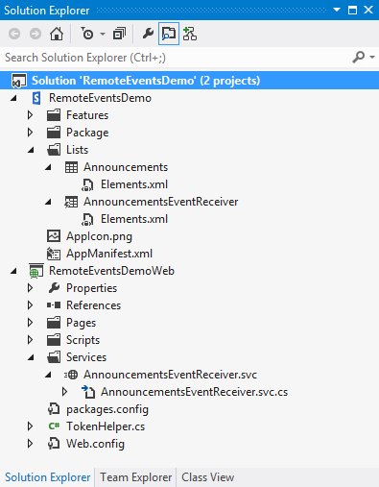
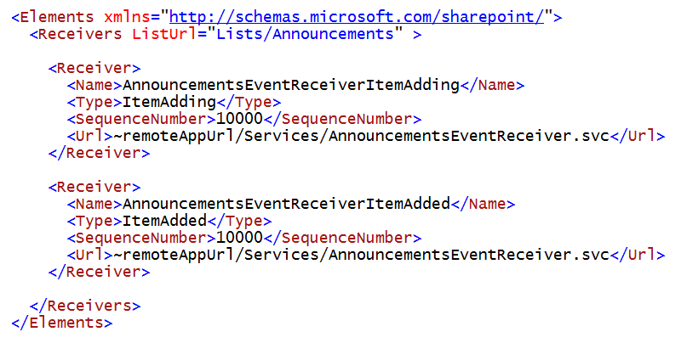
Registering Remote Events Receivers
Event receivers must be registered with SharePoint host
Registration can be declaratively for events occurring in app web
Registration for events occurring in host web requires code

Slide 35
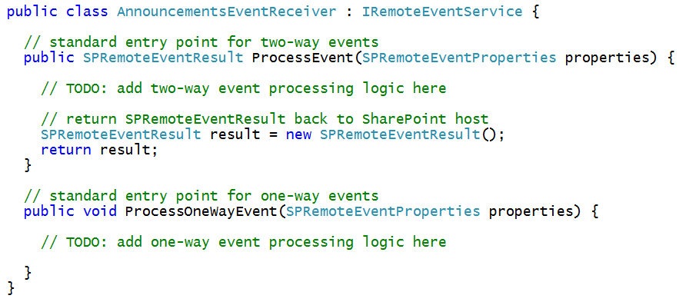
The Remote Event Receiver Entry Point
Remote event receiver implemented with .svc file
Event receiver code written as C# code code-behind .svc file
Event receiver is class that implements IRemoteEventService
ProcessEvent method executes when two-way event is triggered
ProcessOneWayEvent method executes when one-way event is triggered

Slide 36
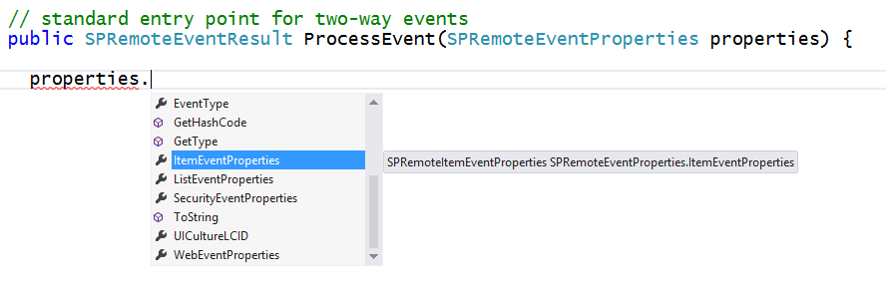
SPRemoteEventProperties
SPRemoteEventProperties parameter passed to event handlers
Provides you with contextual information about the current event
Allows you to read and update user input during before event
Makes it possible to perform validation in before events

Slide 37
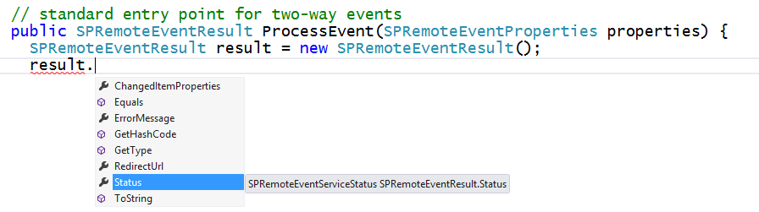
SPRemoteEventResult
Two-way event handlers return SPRemoteEventResult object
SPRemoteEventResult object makes it possible to cancel action

Slide 38
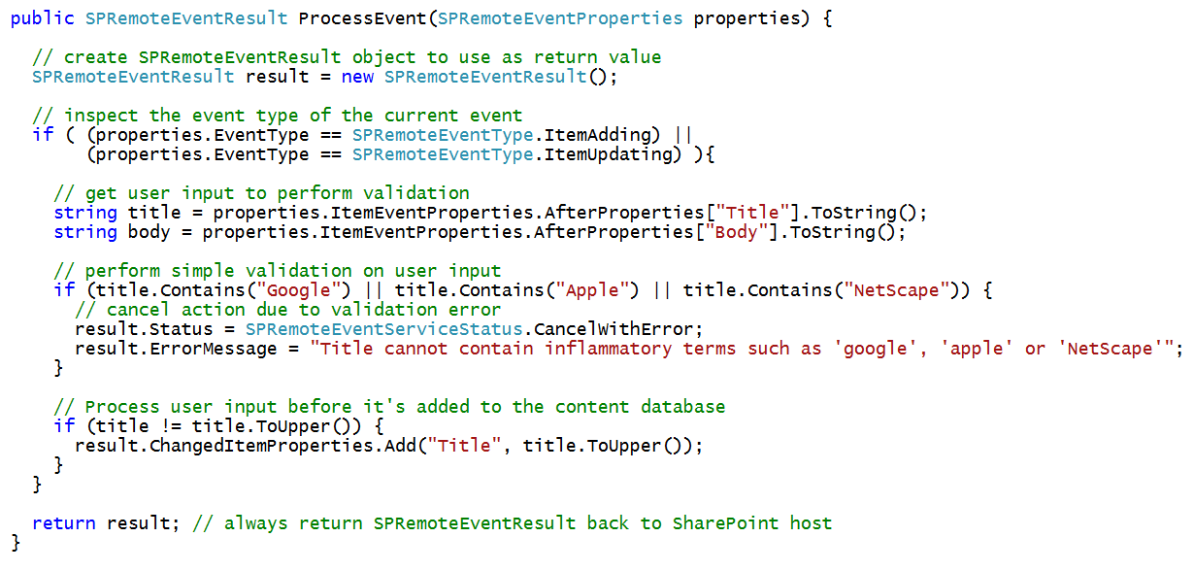
Example Before Event with a List Item

Slide 39
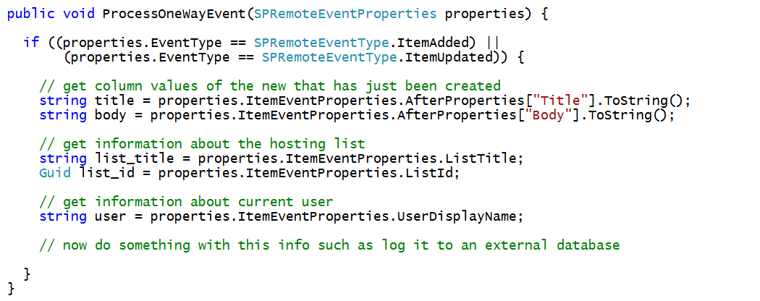
Example After Event with a List Item

Slide 40
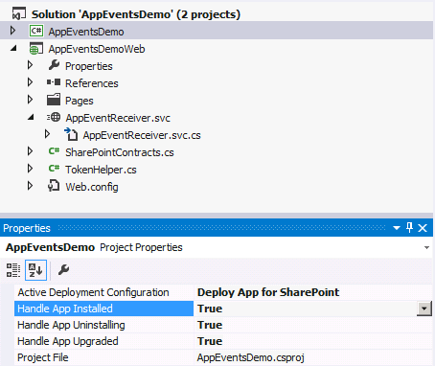
App Lifecycle Events
SharePoint app models support app events
App events for installation, upgrade and uninstall
Added to app project using property sheet
Implemented as a remote event receiver
Notes:
The installation, upgrade and uninstallation of an app raises events that developers can trap. These are surfaced as remote event receivers where the app calls out to a well known endpoint where the developer can do something upon these events.

Slide 41
App Lifecycle Event Registration
Declaratively register remote event receivers
Definitions found in AppManifest.xml
<Properties>
<Title>App Lifecycle Event</Title>
<StartPage>~appWebUrl/Pages/Default.aspx?{StandardTokens}</StartPage>
<InstalledEventEndpoint>~remoteAppUrl/AppEventReceiver.svc</InstalledEventEndpoint>
<UninstallingEventEndpoint>~remoteAppUrl/AppEventReceiver.svc</UninstallingEventEndpoint>
<UpgradedEventEndpoint>~remoteAppUrl/AppEventReceiver.svc</UpgradedEventEndpoint>
</Properties>
Notes:
Remote Event Receivers can also be set up for Installed, Uninstalling, and Upgrading events in the App lifecycle.
To handle a SharePoint app event, set its event value to True in Visual Studio. The default value for the events is False. When you set the value of an app event to True, Visual Studio creates an app event receiver. To disable an app event receiver, set its value to False

Slide 42
Remote Event Receivers

Slide 43
Summary
Site Columns and Content Types
Creating Lists and Document Libraries
Updating Columns, Content Types and Lists
Creating Event Receivers
Creating Remote Event Receivers

