Slide 1
Developing Provider-hosted Add-ins
Notes:
The module begins with an in-depth examination of the architecture of a provider-hosted app. Student will learn how to create a user interface experience in the pages of the remote web using a customer master page and the SharePoint 2013 Chrome Control. The module discusses how to write and test server-side code which leverages ASP.NET and the libraries of the .NET Framework. Student will learn how to create remote event receivers as well as how to implement the remote web of a provider-hosted app in Visual Studio 2013 using an ASP.NET MVC5 project.

Slide 2
Agenda
Getting Started with Provider-hosted Apps
User Interface Design for the Remote Web
Working with ASP.NET MVC
Creating Provider-hosted Apps using MVC5

Slide 3
Provider-Hosted App
Developer responsible for deploying remote web
App deployed to remote web on remote web server
Developer deploys remote web prior to app installation
Developer often required to deploy database as well
Notes:
Provider-Hosted apps create a remote web and reside external to SharePoint. This doesn’t mean they cannot interact with SharePoint artifacts like lists and libraries, it just means that they primarily live outside of SharePoint like other Cloud-Hosted apps. In this scenario, the developer (or provider of the app) is responsible for deploying, installing & configuring all resources that are external to SharePoint.
For instance, if a Provider Hosted app references an ASP.NET MVC application deployed to Windows Azure that leverages Azure services like Service Bus, Access Control Services and SQL Azure, the developer is responsible for standing up and configuring all the non-SharePoint pieces of the application.

Slide 4
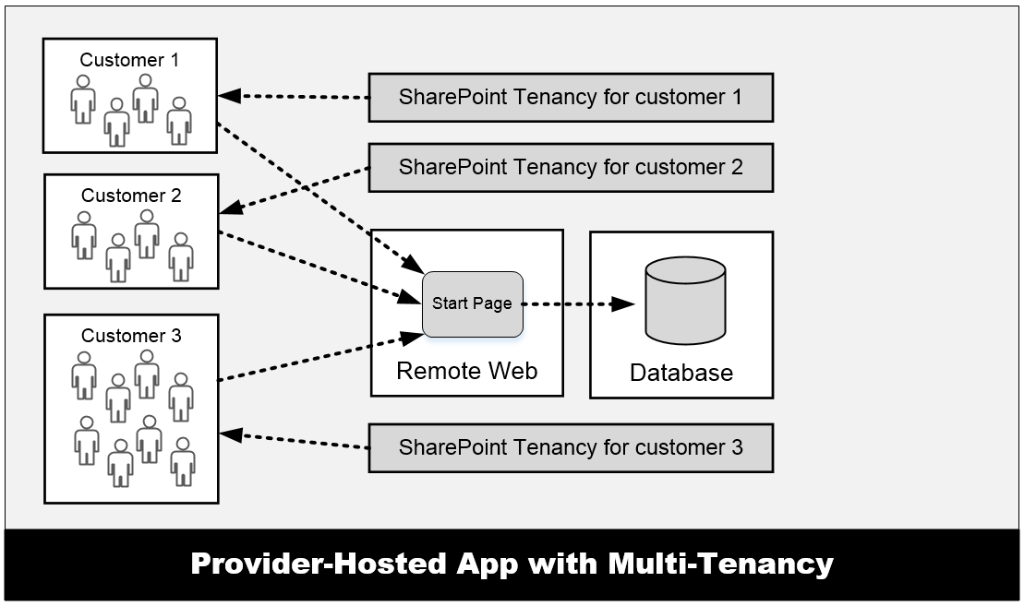
Provider-Hosted App with Multi-tenancy
Many customers access the same remote web
Remote web must be able to scale as needed
App design must isolate data on per-customer basis
Complexity increases time and cost of development
Notes:
One important aspect of provider-hosted apps is that you can have the same app installed multiple times across multiple SharePoint farms and/or SharePoint tenancies. However, all users that access the remote web of the app all connect through the same entry points as shown in the graphic in the slide. This can pose design issues when you are designing and developing a provider-hosted app for a multi-tenant environment and you are storing data for customers in a custom database. The database design often becomes more complex because you are usually required to isolate the data from different customers in separate tables and possibly separate database as well.

Slide 5
Pros and Cons of Provider-hosted Apps
Benefits of provider-hosted over SharePoint-hosted apps
You can write server-side .NET code using C# or VB.NET ([wahoo!])
Your server-side code can access data in a custom database
You can leverage the support for remote event receivers
You can make CSOM/REST API calls using App-only permissions
Negatives when compared to SharePoint-hosted apps
You must deploy and manage the remote web
Requires extra code to acquire and manage security tokens
Multi-tenant aware app design can introduce significant complexity

Slide 6
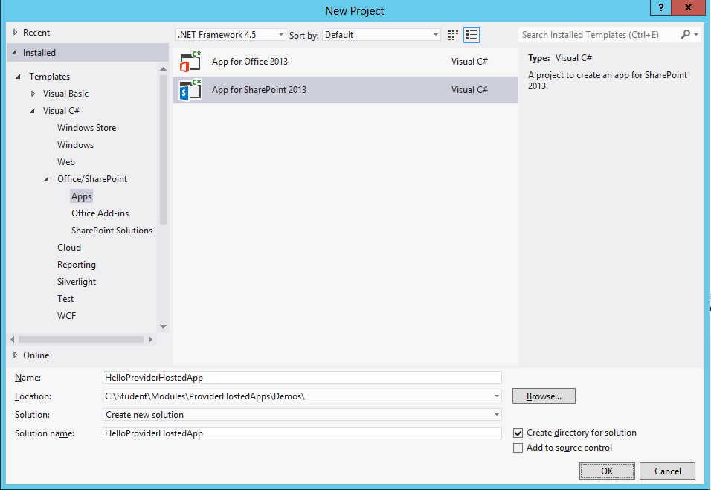
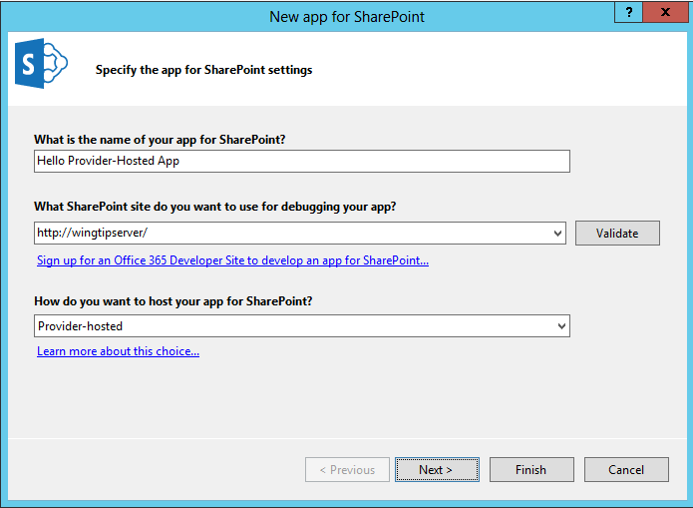
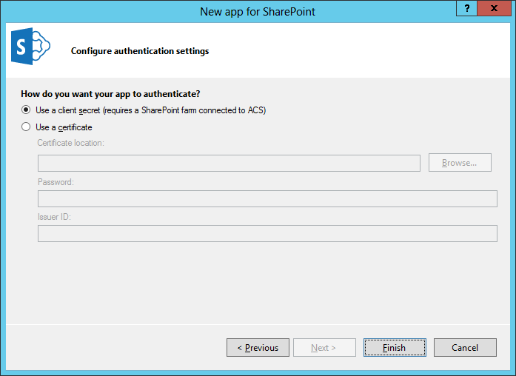
Creating a Provider-hosted App Project

Slide 7
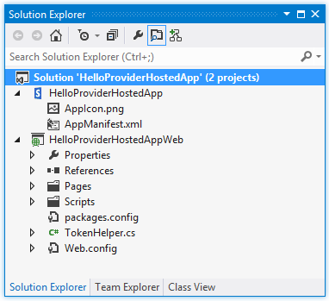
Provider-hosted App Projects
Visual Studio create solution with two projects
SharePoint app project
ASP.NET Website project for remote web this project is known as the “web project”

Slide 8
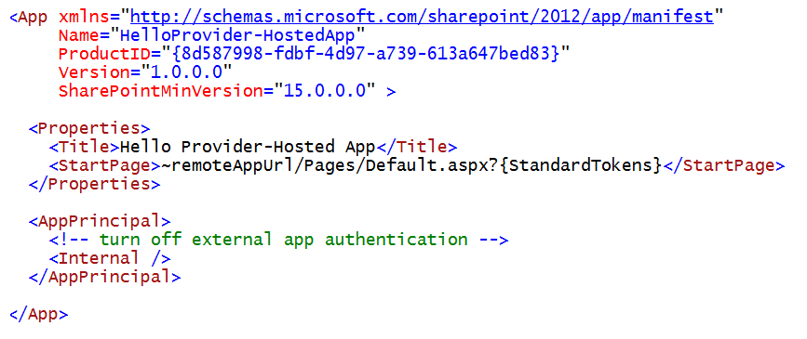
AppManifest.xml
Provider-hosted app adds requirements to App Manifest
StartPage must point to page in remote web
AppPrincipal requires app authentication settings
External app authentication can be disabled using Internal setting

Slide 9
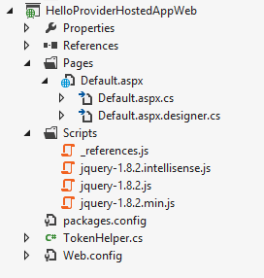
Implementing the Remote Web
Web project provides start point for remote web
web.config for site configuration of remote web
Default.aspx for start page with HTML layout
Default.aspx.cs for server-side C# code behind start page
Scripts folder with jQuery library already added
TokenHelper class for security-related programming

Slide 10
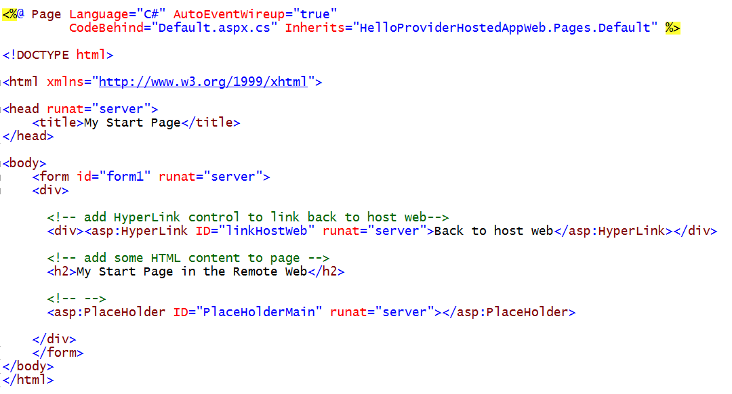
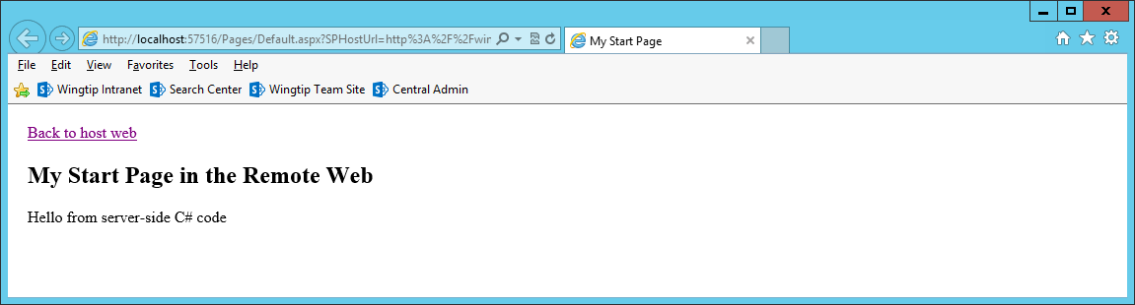
A Sample Start Page

Slide 11
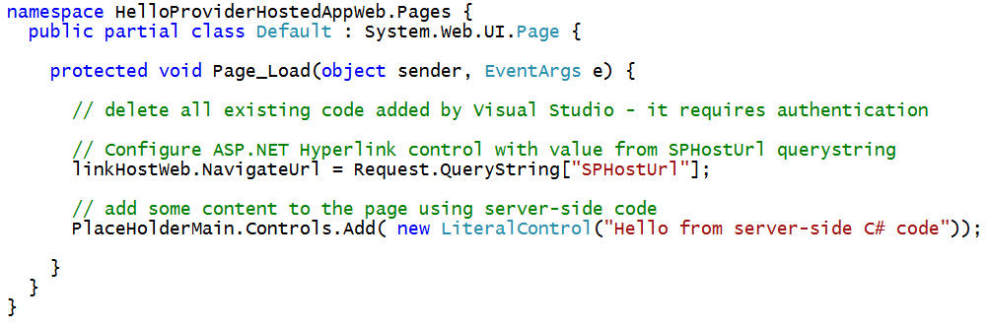
C# Code Behind Sample Start Page

Slide 12
Debugging the Remote Web in IIS Express
Visual Studio debugging involves IIS Express
URL created in localhost domain (e.g. https://localhost:57516)
Port number for Remote Web project selected automatically behind scenes
IIS Express debugging support allows you to debug…
Server-side C# code behind pages in the remote web
Web service calls from browser to remote web
Web service calls from SharePoint to remote web
SharePoint
Worker Process
Browser
Client-side JavaScript
Remote Web running locally in IIS Express
attach
Visual Studio .NET Debugger

Slide 13
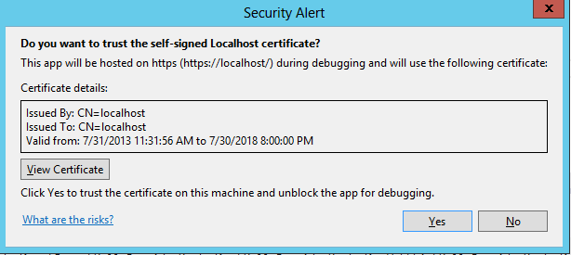
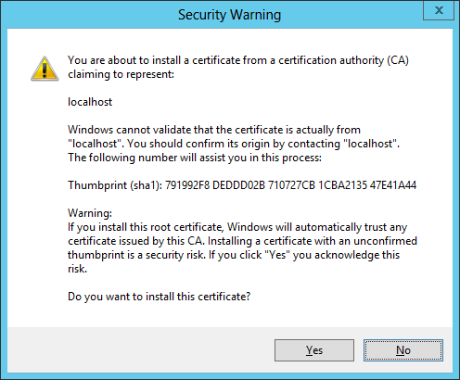
Debugging Code in the Remote Web
Remote Web can optionally use SSL
Pages can be served using HTTPS or HTTP
Use of SSL is usually preferred
IIS Express can configure SSL through https://localhost
Visual Studio registers self-signed certificate on first use

Slide 14
Creating the ‘Hello World’ Provider-Hosted App

Slide 15
Agenda
Getting Started with Provider-hosted Apps
User Interface Design for the Remote Web
Working with ASP.NET MVC
Creating Provider-hosted Apps using MVC5

Slide 16
Designing the Remote Web User Interface
Create user interface using single page app pattern
Start page serves as exclusive user entry point into remote web
Start page designed with HTML markup and ASP.NET controls
Start page can be written with server-side C# code
Start page can also include client-side JavaScript code
JavaScript code can call to custom web services in remote web
Create user interface as a multi-page app
Users can navigate from start page to other pages in remote web
ASP.NET master page can create consistent UI across pages
Master page can leverage SharePoint Chrome control
Multi-page app loses major benefits of single-page app pattern
Extra work required to track start page POST data across requests

Slide 17
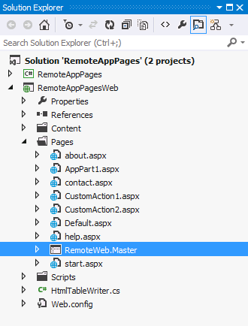
Using Master Pages in the Remote Web
Pages in remote web live outside SharePoint
You have responsibility and freedom to build entire UI
Often makes sense to create remote web master page
<%@Master language="C#" %>
<!DOCTYPE html PUBLIC "-//W3C//DTD XHTML 1.0 Strict//EN" "http://www.w3.org/TR/xhtml1/DTD/xhtml1-strict.dtd">
<html>
<head>
<title>Remote App Pages</title>
<link href="/Contents/app.css" type="text/css" rel="stylesheet" />
<asp:ContentPlaceHolder ID="PlaceholderAdditionalPageHead" runat="server" />
</head>
<body>
<form id="form1" runat="server">
<div id="pageWidth">
<div id="chrome_ctrl_container"></div>
<div id="contentBody">
<asp:ContentPlaceHolder ID="PlaceholderMain" runat="server" />
</div>
</div>
</form>
</body>
</html>
Notes:
MSDN: Apps for SharePoint UX design guidelines
http://msdn.microsoft.com/en-us/library/office/apps/jj220046(v=office.15)

Slide 18
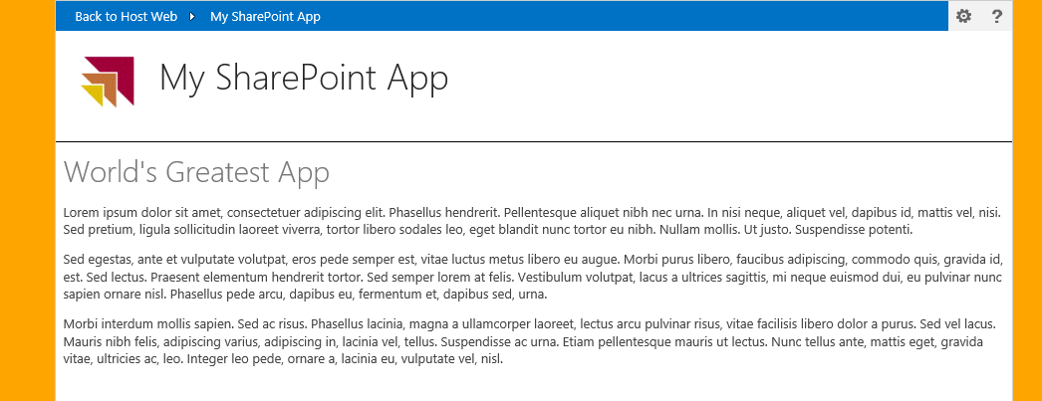
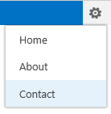
Leveraging the Chrome Control
Optional JavaScript component for use in Remote Web
Used to create top banner of page with SharePoint look and feel
Provides link to host web, configurable navigation and help link
Can pull custom styles used in host web
Notes:
Pages in the remote web of Cloud-Hosted Apps do not have access to the app.master and thus don’t have the same look & feel of their hosted SharePoint sites. To address this Microsoft provides something called the chrome control which is a JavaScript library that writes the HTML that includes the header of the hosting SharePoint site as well as a reference to an ASP.NET HTTP Handler that pulls all the CSS from the parent site so the pages in the remote web can look the same as the host web.

Slide 19
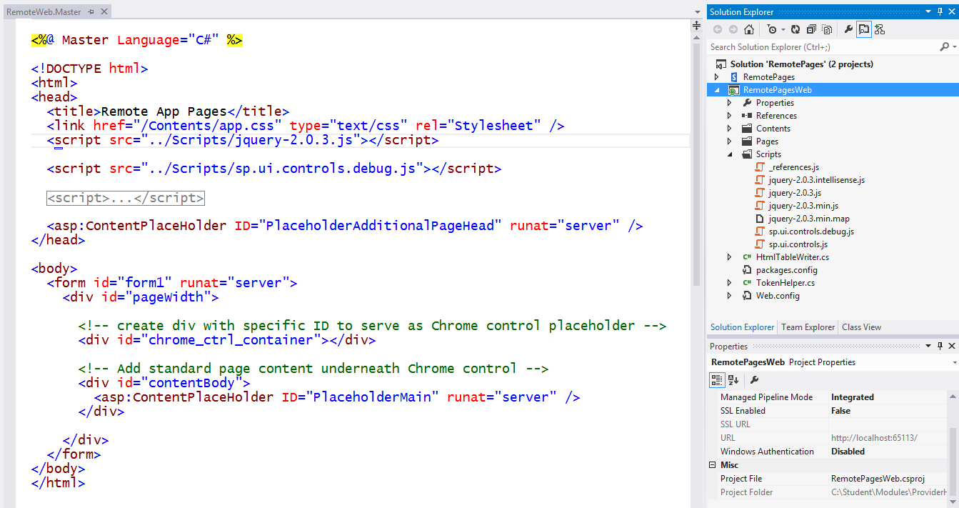
Using the Chrome control

Slide 20
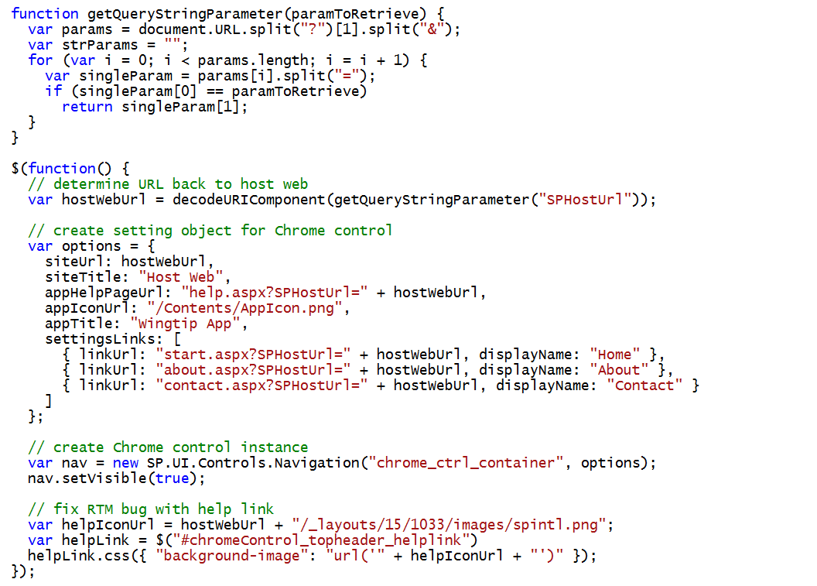
Initializing the Chrome Control

Slide 21
Creating Pages in the Remote Web using the Chrome Control

Slide 22
Agenda
Getting Started with Provider-hosted Apps
User Interface Design for the Remote Web
Working with ASP.NET MVC
Creating Provider-hosted Apps using MVC5

Slide 23
Web Forms Versus MVC
ASP.NET provides two different platforms
ASP.NET Web Forms (e.g. ASPX files)
ASP.NET MVC
MVC provides better platform for the web
More flexible routing
Lighter-weight
Richer templating
Better C# integration
Unit testing

Slide 24
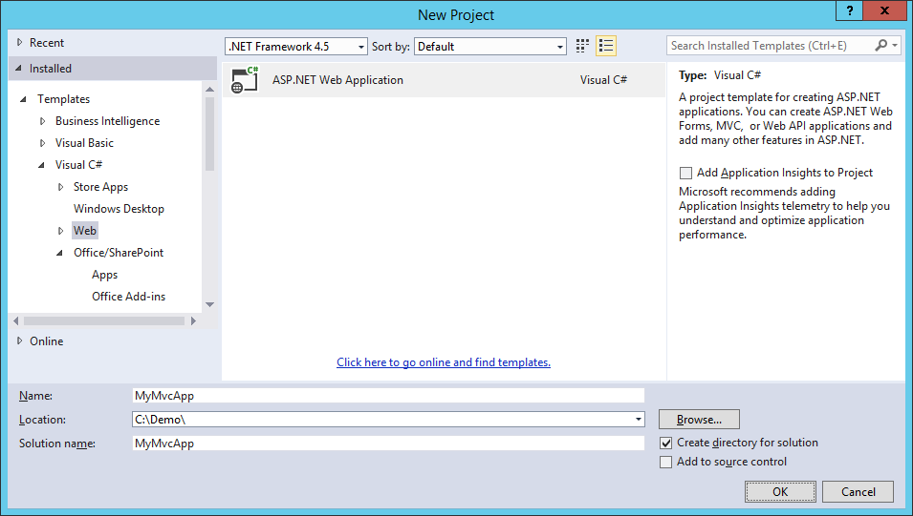
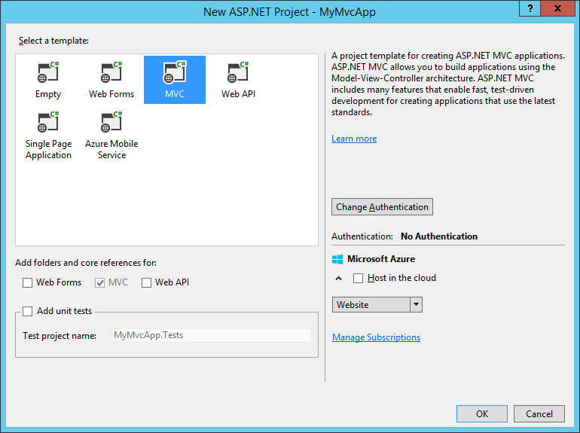
Creating an MVC Project

Slide 25

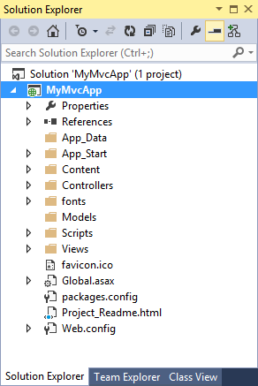


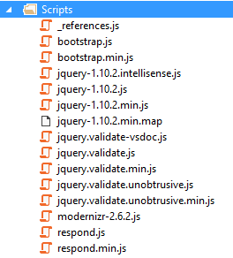
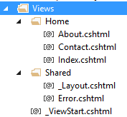
MVC App Project Files

Slide 26
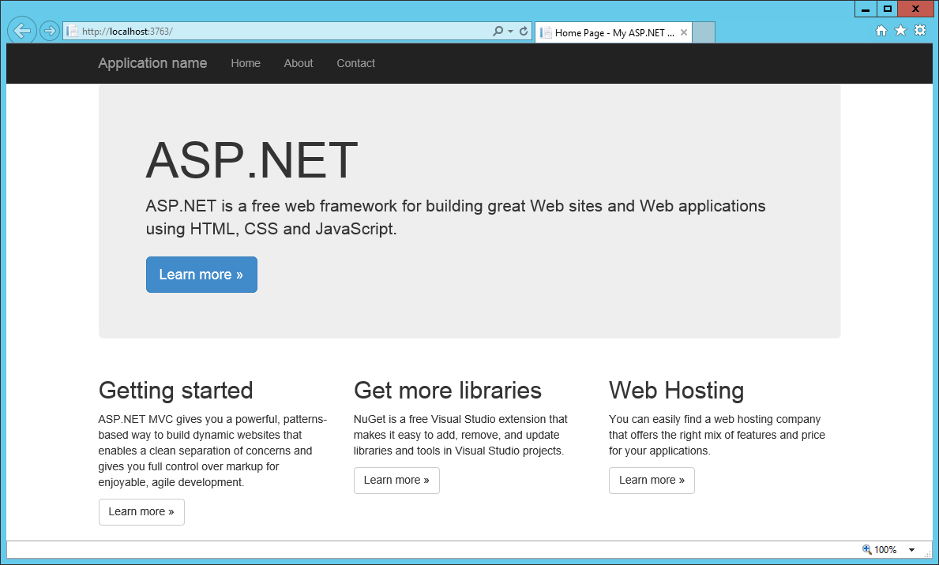
Running an MVC Project

Slide 27
Creating a Simple App with ASP.NET MVC

Slide 28
Understanding Controllers
A set of classes that manage…
processing incoming HTTP requests
communication to and from user
overall application flow and application-specific logic
Every controller has one or more Actions
It’s critical to understand the role of Actions in MVC

Slide 29
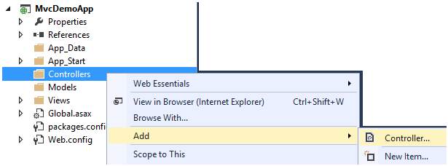
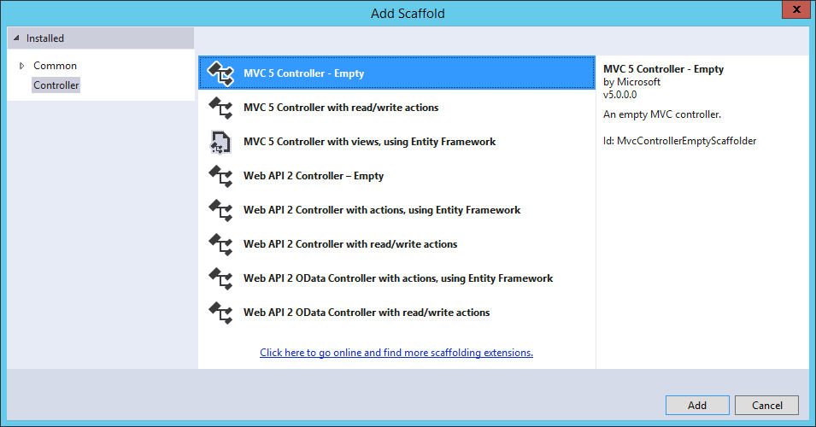
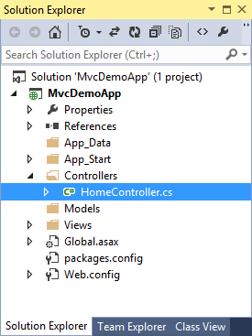
Adding a Controller

Slide 30
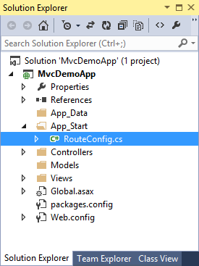
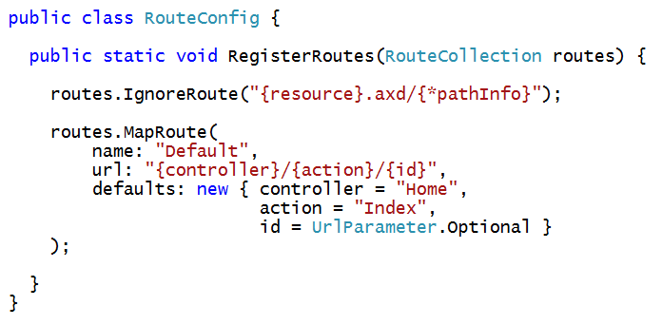
Wiring Up a Controller
When you ad a controller…
Visual Studio updates RouteConfig class
Routing scheme defined using standard format
{controller}/{action}/{id}

Slide 31
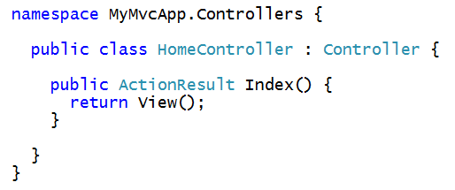
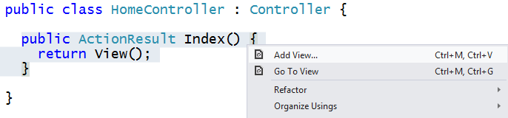
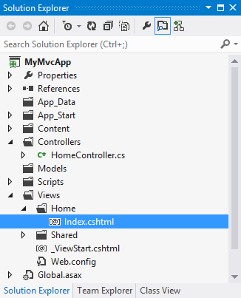
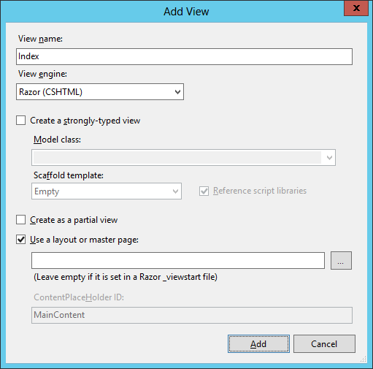
Creating a View from a Controller Action
Controller method often return ActionResult
Right-click on Controller method to generate its view

Slide 32
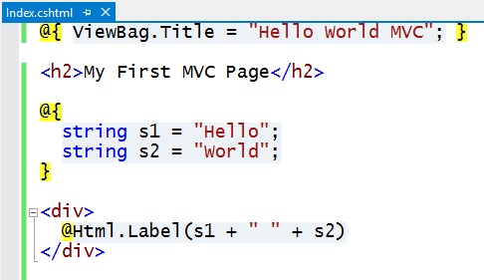
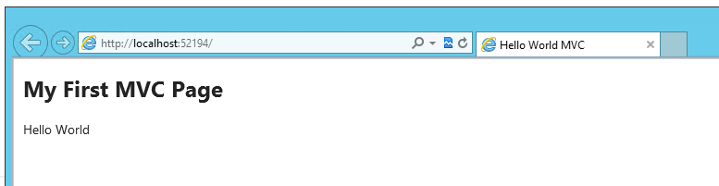
Customizing the View
Views are creating using the Razor engine
Provides a lean and elegant way to create HTML pages
Use data passed from controller
Write in-line C# code
Construct pages using HTML Helpers

Slide 33
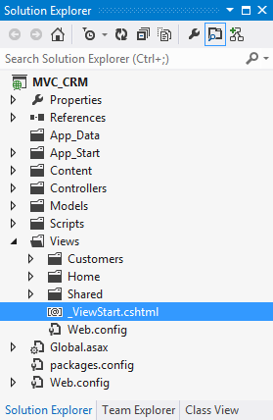
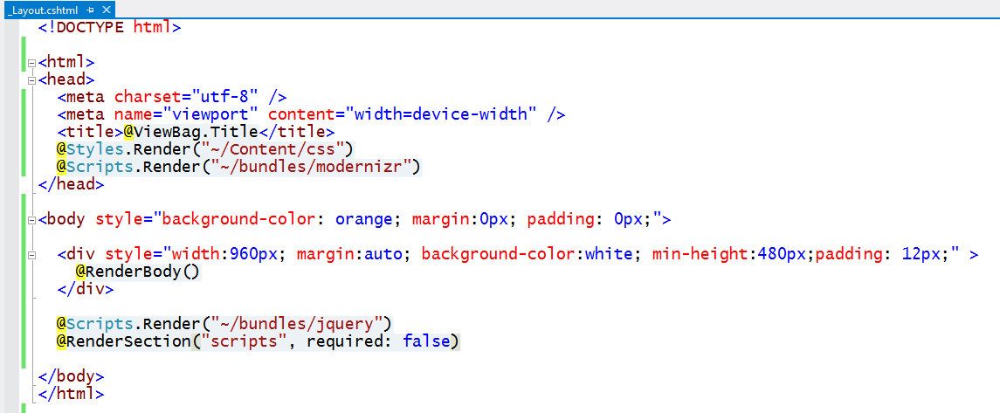
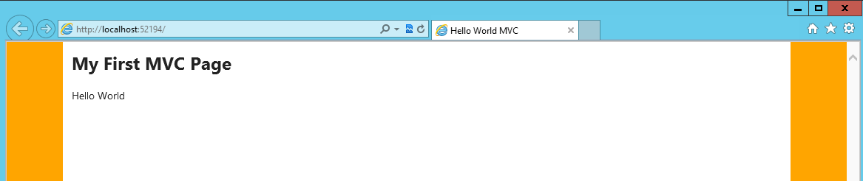
Customizing the Shared View
MVC provides Shared Views
Provides same purpose as master pages in ASP.NET web forms
Default MVC shared view is named _ViewStart.cshtml

Slide 34
Working with Controllers and Views

Slide 35
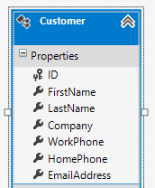
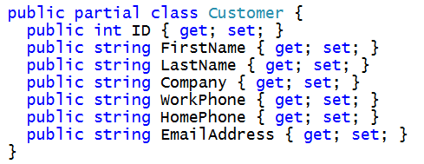
Motivation for Strongly-typed Models
MVC designed based on strongly-typed models
Controller creates model object and passes it to view
Razor view engine supplies IntelliSense for model behind view
HTML helpers make it easy to create views and forms
HTTP Request
Controller
Model
HTTP Response
View

Slide 36
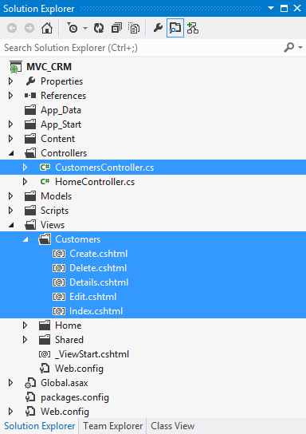
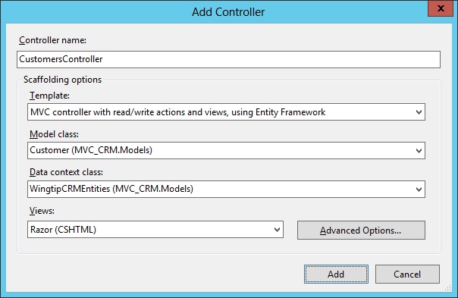
Creating a Strongly-typed Controller Class

Slide 37
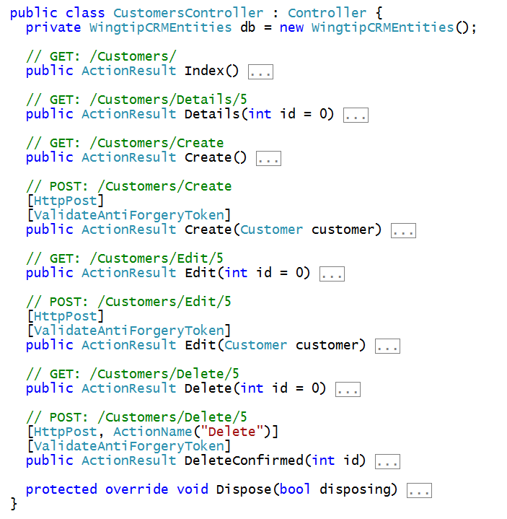
Customers Controller Class

Slide 38
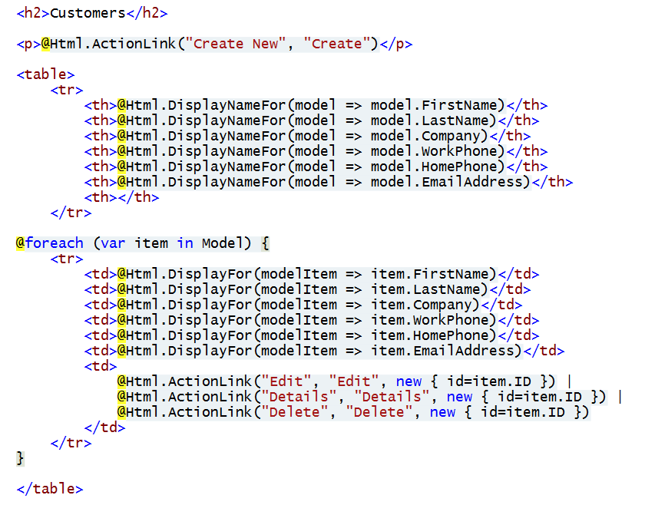
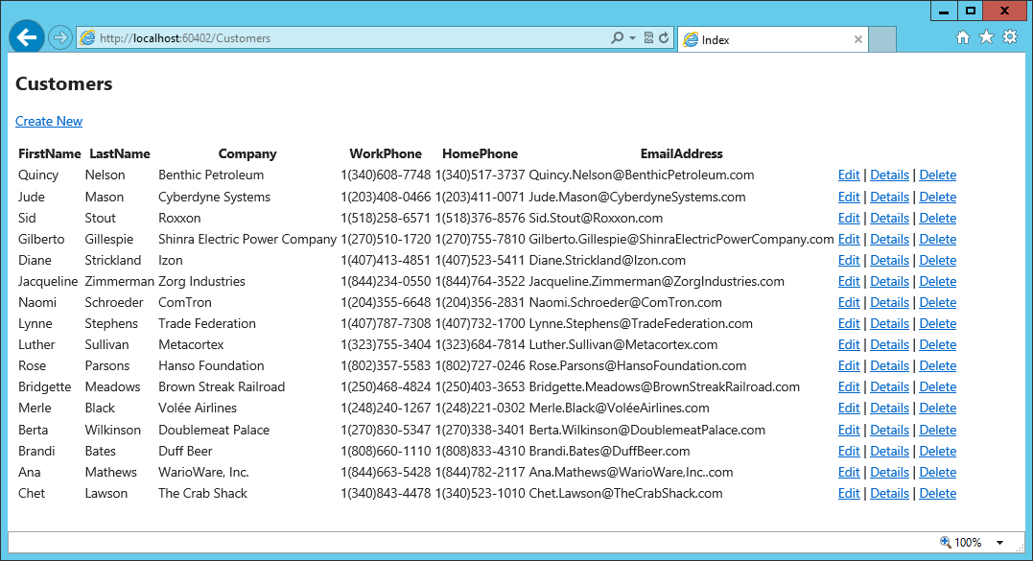
Customers Controller – Index View

Slide 39
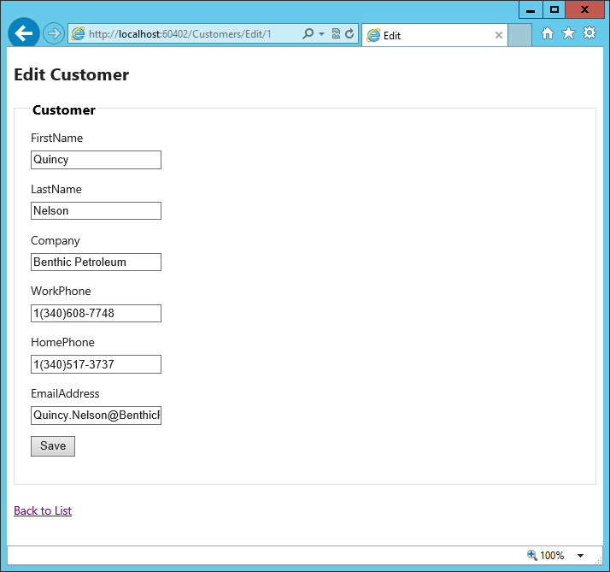
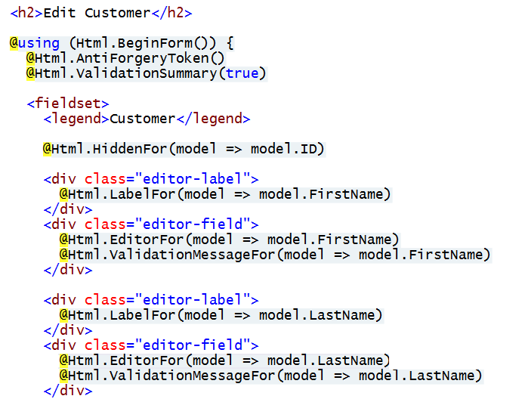
Customers Controller – Edit View

Slide 40
Using a Strongly-typed Model

Slide 41
Agenda
Getting Started with Provider-hosted Apps
User Interface Design for the Remote Web
Working with ASP.NET MVC
Creating Provider-hosted Apps using MVC5

Slide 42
Integrating MVC with SharePoint Apps
Visual Studio 2012 poses two noteworthy limitations
One VS project cannot contain both Web Forms and MVC4
None of the SharePoint App project templates integrate with MVC4
Steps to create SharePoint app using MVC4
Create new VS solution for provider-hosted SharePoint App
Delete with original Web project which is based on Web Forms
Add a new MVC4 project into the same VS solution
Configure the MVC4 project to be the new Web Project
Visual Studio 2013 provides much better experience
VS2013 can mix Web Form items and MVC5 in single VS project
SharePoint app projects integrated with MVC5

Slide 43
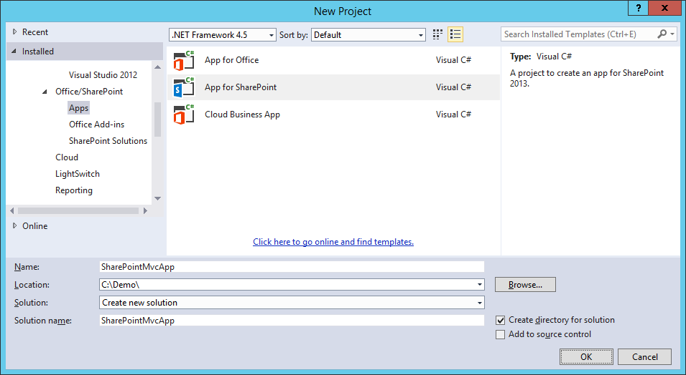
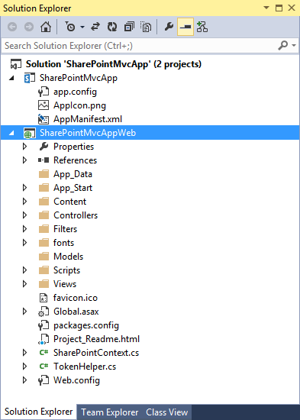
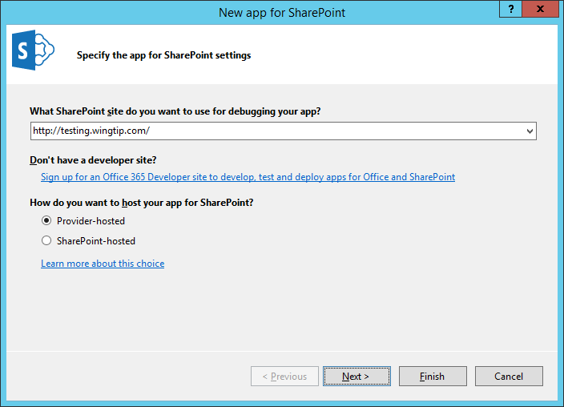
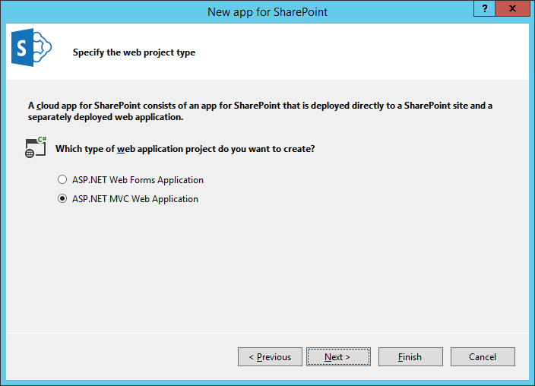
Creating a Provider-hosted App with MVC

Slide 44


SharePoint-specific Files
TokenHelper.cs and SharePointContext.cs
Same as discussed earlier in course
SharePointContextFilterAttribute.cs
Provides OAuth redirect logic for when context token is missing
Filter has no purpose when using app authentication based on S2S trust
spcontext.js
Client-side JavaScript code to propagate SPHostUrl query string parameter

Slide 45
Creating a Provider-hosted SharePoint App Using MVC5

Slide 46
Summary
Getting Started with Provider-hosted Apps
User Interface Design for the Remote Web
Working with ASP.NET MVC
Creating Provider-hosted Apps using MVC5

