Slide 1
SharePoint Search​
Notes:
Previous versions of SharePoint included various search implementations between SharePoint search & FAST search. In SharePoint 2013 Microsoft merged their search implementations into a single, unified search architecture with a powerful and robust search API that is accessible both in server-side and client-side solutions. In this module students will learn about the search architecture as well as how to leverage it in custom solutions.

Slide 2
Agenda
SharePoint 2013 Search Architecture
Managed Properties
Query Execution using KQL
Result Sources and Query Rules
Result Types and Custom Display Templates
Executing Searches Programmatically

Slide 3
SharePoint 2013 Search Architecture
Public API
Unit of scale/role boundary
Content Processing
Search Index
Crawl
Index
Query Processing
WFE
API
Content
UX
Analytics
Processing
Search
Admin
Notes:
The crawl component crawls content sources to collect crawled properties and metadata from crawled items. It sends this information to the content processing component. The content processing component transforms the crawled items so that they can be included in the search index. The component also maps crawled properties to managed properties. In addition, the content processing component interacts with the analytics processing component. The analytics processing component analyzes the crawled items and how users interact with their search results. The information is used to improve the search relevance, and to create search reports and recommendations. The index component receives the processed items from the content processing component and writes them to the search index. The component also handles incoming queries, retrieves information from the search index and sends the results back to the query processing component.
The query processing component analyzes incoming queries to help optimize precision, recall (which items are returned in the results) and ranking (the order of those items). The query is then sent to the index component which returns a set of search results for the query. The results can then be further processed before they are presented to the user as the search results for his/her query. The search administration component runs the required search processes and adds and initializes new instances of search components.
The crawl database contains detailed tracking and historical information about crawled items such as documents and links. The database holds information such as the last crawl time, the last crawl ID and the type of update during the last crawl (add, update, delete). The link database stores the information extracted by the content processing component and click-through information. The analytics reporting database stores the results of search and usage analysis, such as the number of times an item has been viewed. The search administration database stores settings for the Search service application, such as the topology, crawl rules, query rules and the mappings between crawled and managed properties.

Slide 4
Building Blocks for Extending Search
Managed Properties
Result Sources
Query Rules
Result Types
Search Navigation

Slide 5
Configuring the SharePoint Search Service
Central Administration (SSA)
Content Sources
Result Sources
Query Rules
New Managed Properties
Site Collection and Site
Result Sources
Result Types
Query Rules
Reassign Managed Properties
Notes:
Search can be configured at the Farm level for all major areas of Search Configuration. A subset of configuration items are available now in the Site Collection and the Site.

Slide 6
Search Administration
Notes:
Search Administration
Contrast with Site Administration

Slide 7
Agenda
SharePoint 2013 Search Architecture
Managed Properties
Query Execution using KQL
Result Sources and Query Rules
Result Types and Custom Display Templates
Executing Searches Programmatically

Slide 8
Managed Properties
Mapped to Crawled Properties
Tenancy level
Site Collection level
Site Columns Become Managed Properties
Publishing and Multiple Lines prefixed with ows_r_<four-letter-code>
Managed Metadata prefixed with ows_taxId
All others prefixed with ows_q_<four-letter-code>

Slide 9
Managed Properties
Property | Description
Queryable | Managed Property can be used in property-based searches
Refinable | Managed Property can be used as a refiner
Retrievable | Managed Property can be returned in the results
Searchable | Includes the value of the Managed Property in the Search Index
Sortable | Managed Property can be used for sorting results
Type | The data type of the Managed Property
Safe | Can be returned to anonymous users
Alias | Friendly names
Multi-valued | Managed Property can have multiple values
Notes:
Tenant
SSA
Site Collection level

Slide 10
Managed Properties
Notes:
Create and Map Managed Properties
Discuss Managed Property Attributes

Slide 11
Agenda
SharePoint 2013 Search Architecture
Managed Properties
Query Execution using KQL
Result Sources and Query Rules
Result Types and Custom Display Templates
Executing Searches Programmatically

Slide 12
Query Language Options
Keyword Query Language (KQL)
Default query language
FAST Query Language (FQL)
Available, though disabled by default
SQL Query Language
Removed from SharePoint 2013
Notes:
SharePoint uses Keyword Query Language for requesting search results. You can also use the predecessor, FAST Query Language if you need to, but the SQL Query Language is no longer available.
More info: http://msdn.microsoft.com/en-us/library/jj163973.aspx

Slide 13
KQL
Free text
SharePoint
Wildcard
Share*
Managed Property
Author:McD*, ContentType:Image
NEAR, ONEAR
SharePoint NEAR Social
Notes:
Keyword Query Language is pretty easy to understand. At it’s core is just a word or phrase that you are looking for, but it can be so much more. You can request a value of a specific property, like author, or content type. You can also use special operators like NEAR and ONEAR to find words in relation to one another.

Slide 14
Search Queries
Notes:
Free text Queries
Managed Property Queries
People Queries (Phonetic Name Search)
MacDermot
Theodore
Kenneth

Slide 15
Agenda
SharePoint 2013 Search Architecture
Managed Properties
Query Execution using KQL
Result Sources and Query Rules
Result Types and Custom Display Templates
Executing Searches Programmatically

Slide 16
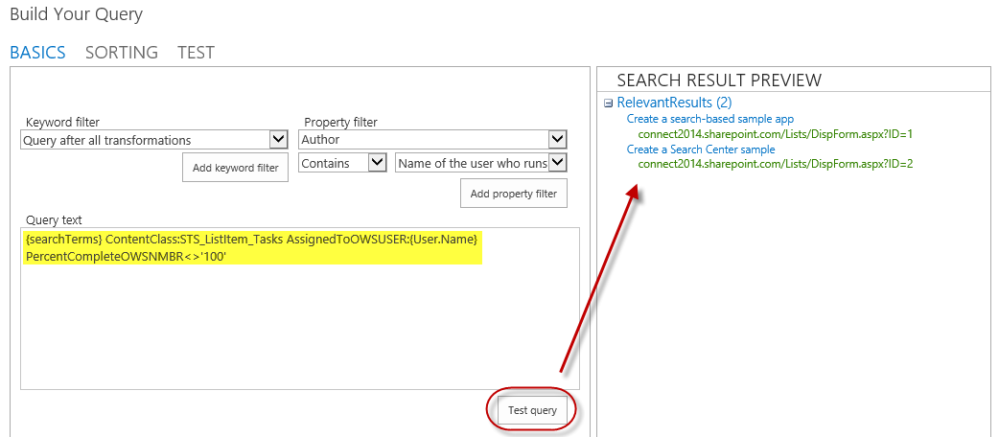
Result Sources
Select a Source
Local SharePoint Index
Remote SharePoint Index
OpenSearch
Exchange
Apply a Query Transformation
Defines a subset of the source

Slide 17
Query Rules
Applied to a given Result Source
Processed under specified conditions
Keyword match
Topic category match
Affects the query results
Alter the user’s query
Generate a Result Block

Slide 18
Query Rules
Intercept and change a users query
Promote Special Content
Best Bets
Detect the User
Act on user “intent”
Perform another query
Create banner ads
Change the rank of results
So much more…
Notes:
Query Rules allow you to promote content (we used to call these Best Bets), but they do so much more thanks to the powerful rules we can run on the query submitted by the user. For example, you can detect who the user is or what department they are in and use that in your rule to promote content.

Slide 19
Query Rules
Notes:
Query Rules for:
Banner
Experts
My Documents

Slide 20
Agenda
SharePoint 2013 Search Architecture
Managed Properties
Query Execution using KQL
Result Sources and Query Rules
Result Types and Custom Display Templates
Executing Searches Programmatically

Slide 21
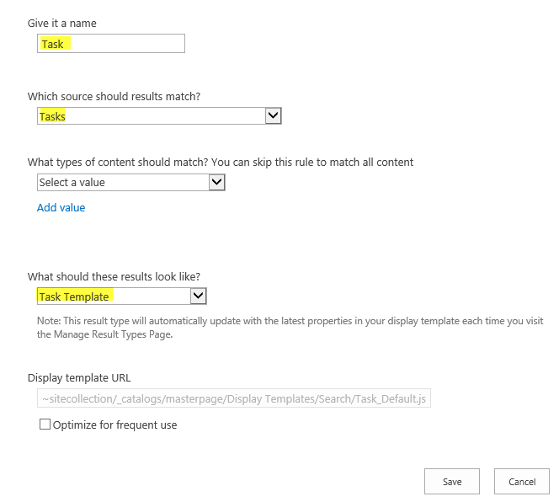
Result Types
Bound to a given Result Source
Defined by a rule
Associated with a template for display
Determines how Result Type appears
Created as an HTML file referencing Managed Properties

Slide 22
Display Templates
HTML Template for
Search Result
Refiner
Content By Search
Controls
Containers
Etc…
Upload HTML and SharePoint Converts it to *.JS
Use any editor
NotePad++, Dreamweaver…
even SharePoint Designer!
Notes:
Display Templates determine how a specific result should look. Out of the box you get a bunch of templates, and you can easily create more for your specific needs. They consist of a HTML file with specific markup that SharePoint understands. You don’t need SharePoint Designer for this either.

Slide 23
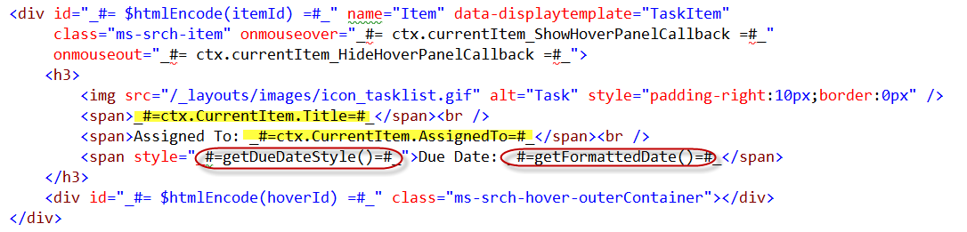
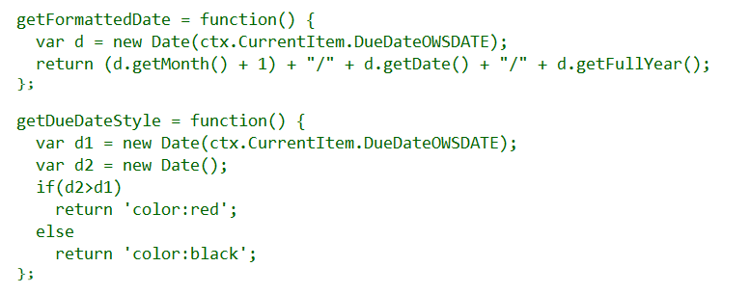
Display Templates

Slide 24
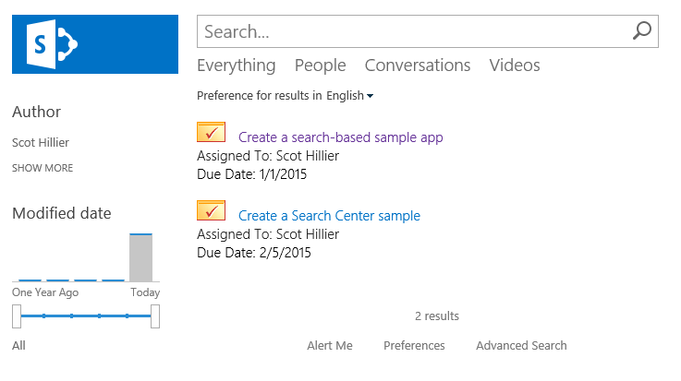
Custom Search Results
Use building blocks to create custom solutions in Search Center

Slide 25
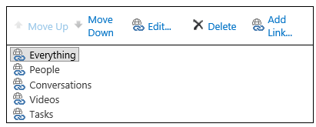
Search Navigation
Provides navigation across pages in Search Center

Slide 26
Export/Import Search Settings
Configuration export
SearchConfiguration.xml
Handles rules, sources, managed properties, etc.
Does not handle master pages, templates, and web parts
Configuration import
Import into site, site collection, tenancy
Programmatically import with app

Slide 27
Display Templates and Result Types
Notes:
Create a Display Template for the new Managed Properties
Create a Result Type
Discuss Refiners too.

Slide 28
Agenda
SharePoint 2013 Search Architecture
Managed Properties
Query Execution using KQL
Result Sources and Query Rules
Result Types and Custom Display Templates
Executing Searches Programmatically

Slide 29
REST Endpoint
Keywords
https://tenant/site/_api/search/query?querytext='{KQL Query}'
Selecting Properties
https://tenant/site/_api/search/query?querytext='test'&selectproperties='Title,Rank'
Sorting
https://tenant/site/_api/search/query?querytext='test'&sortlist='LastModifiedTime:descending'

Slide 30
JavaScript and REST
$.ajax(
{
url: "http://site/_api/search/" +
"query?querytext='{KQL Query}‘",
method: "GET",
headers: {
"accept": "application/json;odata=verbose",
},
success: onSuccess,
error: onError
}
);

Slide 31
JavaScript and CSOM
var context = SP.ClientContext.get_current();
var keywordQuery =
new Microsoft.SharePoint.Client.Search.Query.KeywordQuery(context);
keywordQuery.set_queryText("sharepoint");
var searchExecutor =
new Microsoft.SharePoint.Client.Search.Query.SearchExecutor(context);
results = searchExecutor.executeQuery(keywordQuery);
context.executeQueryAsync(onGetEventsSuccess, onGetEventsFail);

Slide 32
C# and REST
var spContext = SharePointContextProvider.Current.GetSharePointContext(HttpContext);
string accessToken = spContext.UserAccessTokenForSPAppWeb;
string url = "http://site/_api/search/query?querytext='sharepoint'";
HttpClient client = new HttpClient();
HttpRequestMessage request = new HttpRequestMessage(HttpMethod.Get, url);
request.Headers.Accept.Add(new MediaTypeWithQualityHeaderValue("application/xml"));
request.Headers.Authorization = new AuthenticationHeaderValue("Bearer", accessToken);
HttpResponseMessage response = await client.SendAsync(request);
string responseString = await response.Content.ReadAsStringAsync();

Slide 33
C# and CSOM
var spContext = SharePointContextProvider.Current.GetSharePointContext(Context);
using (var cctx = spContext.CreateUserClientContextForSPHost())
{
KeywordQuery query = new KeywordQuery(cctx);
query.QueryText = "{KQL}";
SearchExecutor executor = new SearchExecutor(cctx);
ClientResult<ResultTableCollection> results = executor.ExecuteQuery(query);
cctx.ExecuteQuery();
}

Slide 34
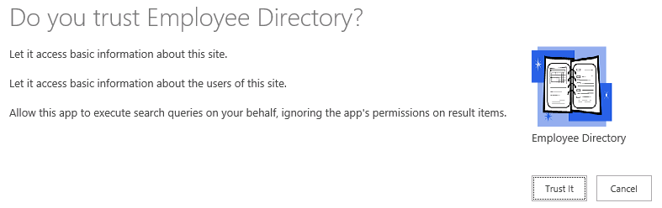
App Permissions
<AppPermissionRequest Scope=http://sharepoint/search Right="QueryAsUserIgnoreAppPrincipal" />

Slide 35
Summary
SharePoint 2013 Search Architecture
Managed Properties
Query Execution using KQL
Result Sources and Query Rules
Result Types and Custom Display Templates
Executing Searches Programmatically

