Slide 1
Programming the SharePoint REST API
Notes:
This module examines the new SharePoint REST API that is introduced in SharePoint 2013. Students will learn how to create REST URIs to target SharePoint objects such as sites, lists and list items. Students will also learn about the SharePoint-specific issues such as dealing with ETags and the request digest as well as passing the list item type whenever adding or updating a list item.

Slide 2
Agenda
The SharePoint REST API
Creating REST URIs for SharePoint Objects
Consuming OData Results from SharePoint
Paging SharePoint List Items
Adding and Updating Items

Slide 3
RESTful Web Services
RESTful Web Service
implemented using the principles of REST
REST URI = [base URI] + [resource path] + [query options]
Calls based on standard HTTP verbs (GET, POST, PUT, DELETE)
Passes data to and from client using representations
Can be designed to implement custom APIs and/or standard APIs
Data passed across network using representations
Representations model resources – but they’re different
Based on common formats: HTML, XML, ATOM and JSON
Based on specific Internet media types

Slide 4
OData Primer
What is OData?
A standardized REST API interface for common CRUD operations
Defined by Open Data Protocol specification
OData services becoming more popular on Internet (e.g. NetFlix)
SharePoint 2010 introduced a REST API for dealing with list items
SharePoint 2013 introduces new and expanded REST API
for an excellent resource go to
http://www.odata.org
Notes:
OData is quickly becoming the industry’s new data access API. It’s popularity is based on the fact that it is the first mainstream data access API for HTTP-based Clients. OData serves to standardize performing CRUD (Create, Read, Update, Delete) operations from across the network using HTTP verbs such as GET, PUT and POST.
OData services are becoming more popular on the Internet. Examples of OData services include NetFlix, Dallas, and the Azure Data Mart. Client application such as Excel 2010 and Excel 2013 are examples of client application that can consume data from any OData-based data source.

Slide 5
OData Query Option Parameters
$select
http://services.odata.org/OData/OData.svc/Products?$select=Price,Name
$filter
http://services.odata.org/OData/OData.svc/Products?$filter=startswith(CompanyName, 'Alfr')
$orderby
http://services.odata.org/OData/OData.svc/Products?$orderby=Rating
$top
http://services.odata.org/OData/OData.svc/Products?$top=5
$skip
http://services.odata.org/OData/OData.svc/Products?$skip=5
http://services.odata.org/OData/OData.svc/Products?$skip=5&$top=5
$expand
http://services.odata.org/OData/OData.svc/Categories?$expand=Products

Slide 6
Using the $filter Parameter

Slide 7
$filter Parameter String Functions

Slide 8
Remote Communications with SharePoint
In SharePoint 2003 and SharePoint 2007
SOAP-based web services (e.g. Lists.asmx)
In SharePoint 2010
Client-side Object Model (CSOM)
REST API for list items accessible through ListData.svc
In SharePoint 2013
Expanded CSOM Support
New SharePoint REST API replaces ListData.svc
Notes:
The SharePoint client-side object model (CSOM) debuted in SharePoint 2010 where it was made available as a WFC entry point named client.svc. However, SharePoint 2010 did not support developers accessing client.svc directly. Instead, the developer uses client-side proxy objects exposed by either a .NET assembly or a JavaScript library.

Slide 9
What About ListData.svc?
ListData.svc added REST support for reading & writing to SharePoint lists in SharePoint 2010
Still present in SharePoint 2013, but primarily only for backwards capability
Existing code won’t break
New development recommendation: use new SharePoint 2013 REST/OData API
Notes:
In SharePoint 2010, the product provided OData support through the Web server entry point ListData.svc. The ListData.svc Web service is available in SharePoint 2013. However, you should understand that it is mainly provided for backwards compatibility for older clients that are migrating to SharePoint 2013. When creating new projects for SharePoint 2013 and later, you should not be using ListData.svc. Instead, you should be using the newer remote APIs with OData support that are discussed later in this module.

Slide 10
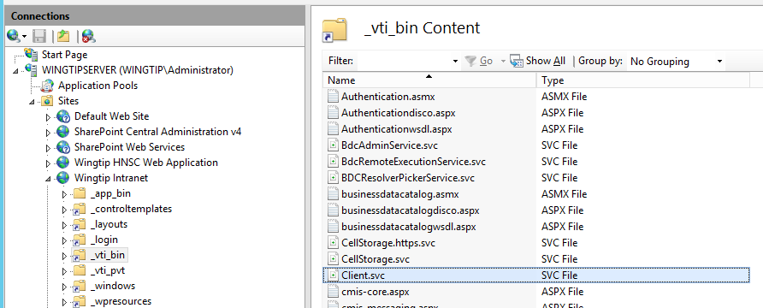
SharePoint REST API Architecture
REST API entry point is client.svc
In SharePoint 2010, client.svc only used by CSOM
In SharePoint 2013, client.svc used by CSOM and REST API
REST API Client
client.svc
CSOM Client

Slide 11
SharePoint REST URLs and the _api Alias
SharePoint REST API provides _api alias
The _api alias maps to _vti_bin/client.svc
Alias used to make SharePoint REST API URLs cleaner
Alias serves to decouple URLs from underlying architecture
This URL works but it is not recommended
http://intranet.wingtip.com/_vti_bin/client.svc/web
SharePoint REST API URLs should be created with _api
http://intranet.wingtip.com/_api/web
Notes:
In SharePoint 2013 the Service root URI contains the URI to the target SharePoint site and then the relative path to the client.svc entry point inside the _vti_bin virtual directory. After that you add the resource path to specify an object such as a site or list. Here's an example of a resource path for the current site.
http://wingtipserver/_vti_bin/client.svc/web
SharePoint 2013 allows REST URLs can go through the _api folder which cleans up the look of the URLs that need to be built and removes client.svc file name from URL. The URL below is equivalent to the one above and should be preferred.
http://wingtipserver/_api/web

Slide 12
Anatomy of a SharePoint REST URL
SharePoint REST made up of three parts
Base URI
http://intranet.wingtip.com/_api
Target SharePoint Object
web
Query String Parameter options
?$select=Id,Title,MasterUrl
Notes:
The collection of lists for the current site: /_api/web/lists
Get a specific list by its title: /_api/web/lists/getByTitle('Announcements')
Get all the Web templates within the current site which is based on US English: /_api/web/getAvailableWebTemplates(lcid=1033)
Refer to the following article on MSDN, specifically figure 9, to see how SharePoint constructs REST URLs:
http://msdn.microsoft.com/en-us/library/office/apps/fp142385(v=office.15).aspx
A fantastic resource for the detailed documentation for all REST APIs can be found in the protocol documents:
Web Versions:
http://msdn.microsoft.com/en-us/library/cc339475(v=office.12).aspx
ZIP of all protocol docs as PDFs:
http://download.microsoft.com/download/8/5/8/858F2155-D48D-4C68-9205-29460FD7698F/SharePointProtocols.zip

Slide 13
Mapping SharePoint Objects to URLs
SharePoint Object | Object mapping
Site Collection | site
Site | web
Lists collection | web/lists
List by ID | web/lists(guid'402cd788-9c5c-4931-92d6-09f18efb368c')
List by Title | web/lists/getByTitle('Customers')
List property | web/lists/getByTitle('Customers')/Title
List items collection | web/lists/getByTitle('Customers')/items
List item | web/lists/getByTitle('Customers')/items(1)
List item property | web/lists/getByTitle('Customers')/items(1)/FirstName

Slide 14
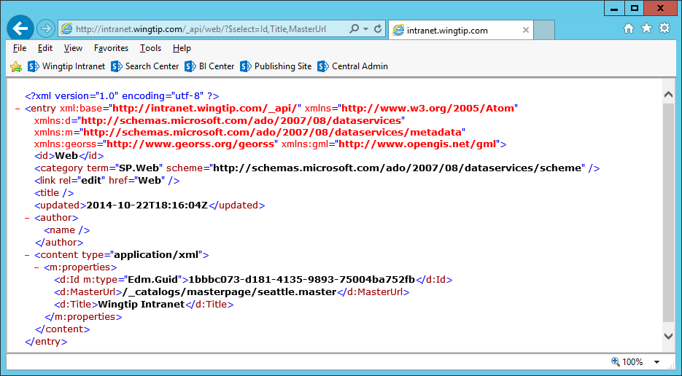
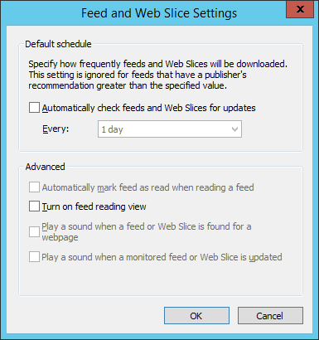
Testing REST Calls Through the Browser
It can be helpful to disable the Internet Explorer option feed reading view
Notes:
One of the best parts of REST is that it simplifies calling Web service operations. All you need is a browser that can authenticate against a SharePoint 2013 site and you can simply run queries by typing the REST-based URIs for HTTP GET operations. This becomes a fast and easy way for you to learn how to put together URIs that query, filter and sort content from SharePoint sites.

Slide 15
OData Support in SharePoint 2013
SharePoint Online supports ODATA v4.0
OData v4.0 support added in December of 2014
SharePoint 2013 On-premises supports ODATA v3.0
SharePoint 2013 OOB only supports verbose metadata format
PowerShell script must be run to enable all ODATA formats

Slide 16
ODATA Formats and the Accept Header
Verbose (aka Full Metadata)
accept: application/json; odata=verbose
Minimal Metadata
accept: application/json; odata=minimalmetadata
accept: application/json
No Metadata
accept: application/json; odata=nometadata

Slide 17
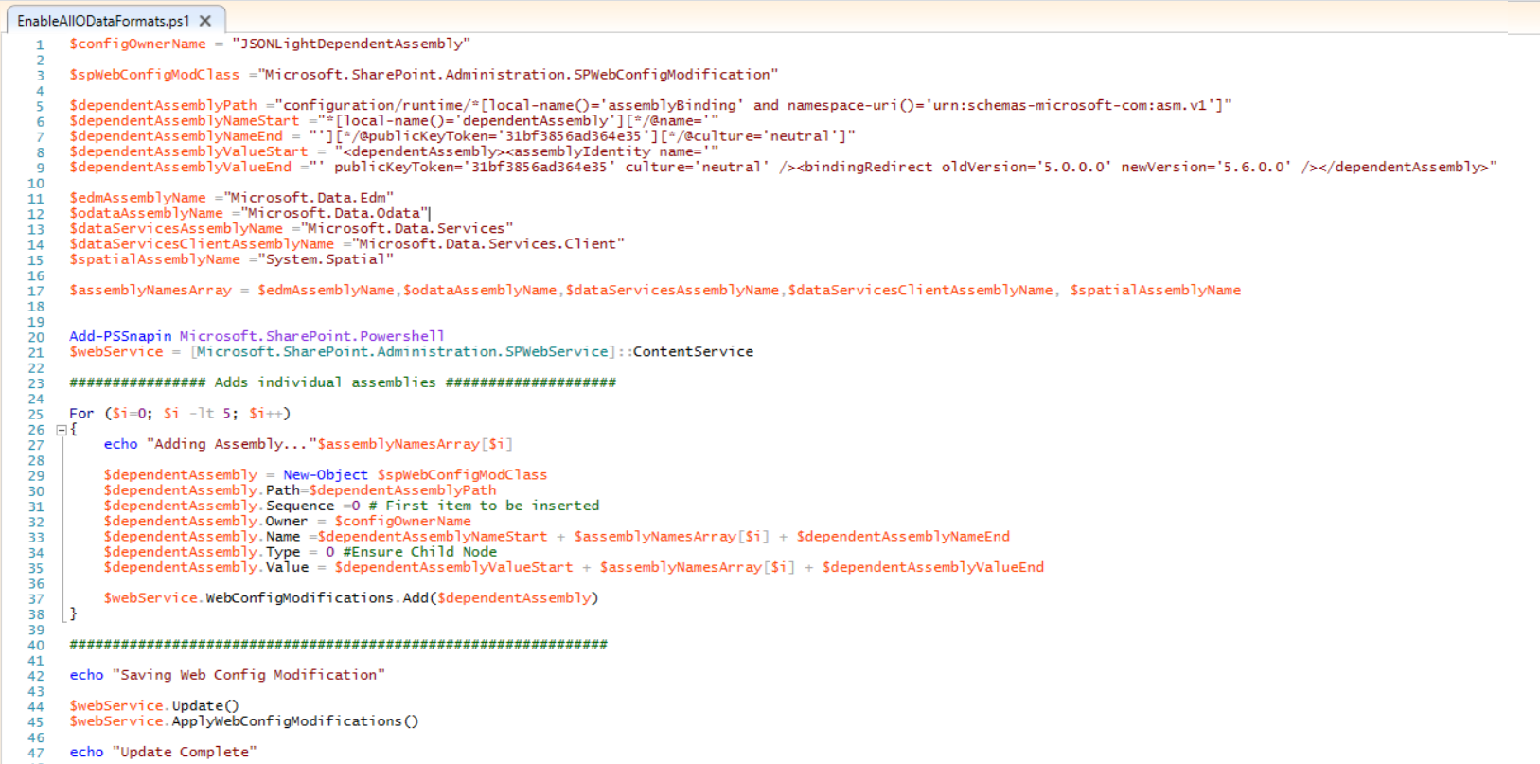
On-Premises PowerShell Script
You must run a script to enable all ODATA formats
Only verbose metadata is supported until you run this script

Slide 18
Agenda
The SharePoint REST API
Creating REST URIs for SharePoint Objects
Consuming OData Results from SharePoint
Paging SharePoint List Items
Adding and Updating Items

Slide 19
Service Root URI of the App Web
Creating the App Web’s Service Root URI
Use URL relative to Pages folder
Use URL created from SPAppWebUrl query string parameter
Use URL created from _spPageContextInfo.webAbsoluteUrl

Slide 20
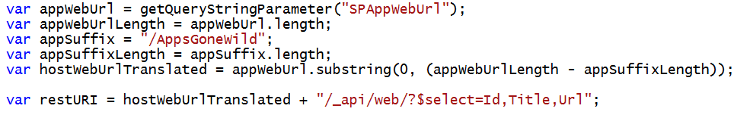
Finding the Service Root of the Host Web
Will it ever work?
Will it work when host web is not at top of domain
Will it work when app installed at tenancy scope
No
No
No
Yes
No
No
Yes
Yes
No
Yes
Yes
No
Yes
Yes
Yes

Slide 21
Reliable URIs for SharePoint REST Calls
For the app web
For the host web

Slide 22
Agenda
Creating REST URIs for SharePoint Objects
Consuming OData Results from SharePoint
Paging SharePoint List Items
Adding and Updating Items

Slide 23
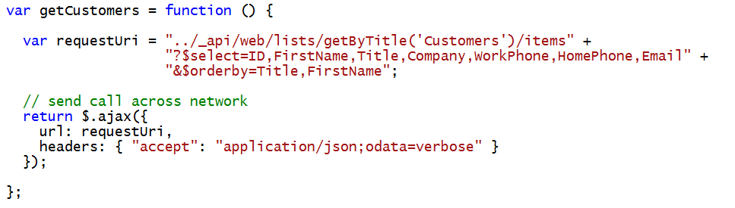
Querying a List in the App Web

Slide 24
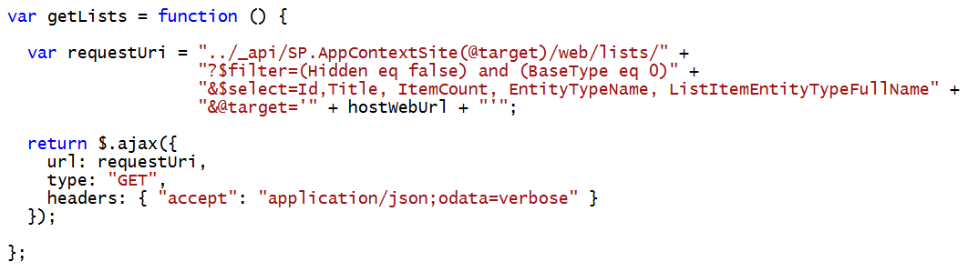
Querying for Lists within the Host Web

Slide 25
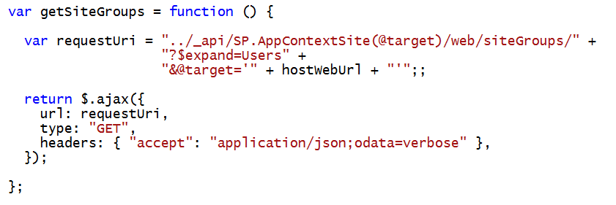
Using the $expand Query Option
$expand used to create more efficient code
Deferred content held back by default
$expand used to retrieve results with deferred content
Effectively reduces round trips

Slide 26
HostWebExplorer App
Ted Pattison

Slide 27
Agenda
Creating REST URIs for SharePoint Objects
Consuming OData Results from SharePoint
Paging SharePoint List Items
Adding and Updating Items

Slide 28
Paging with SharePoint Lists
SharePoint does not support $skip for list items
You cannot create typical OData paging scheme with a SharePoint list
What do you do instead?
Create a custom paging scheme using $filter
Create a paging scheme using $skiptoken

Slide 29
Paging with SharePoint List Items

Slide 30
Agenda
The SharePoint REST API
Creating REST URIs for SharePoint Objects
Consuming OData Results from SharePoint
Paging SharePoint List Items
Adding and Updating Items

Slide 31
Updating SharePoint Objects
All write operations must pass valid request digest value
You must include type metadata for inserts & updates
Sometimes you must pass ETags for updates & deletes

Slide 32
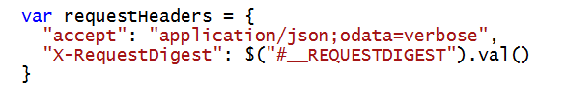
Understanding the Request Digest
All SharePoint write operations require Request Digest
Provides security mechanism to protect again replay attacks
Request digest known to SharePoint old timers as “Form Digest”
SharePoint adds request digest element with ID __REQUESTDIGEST
Request digest value passed using X-RequestDigest header

Slide 33
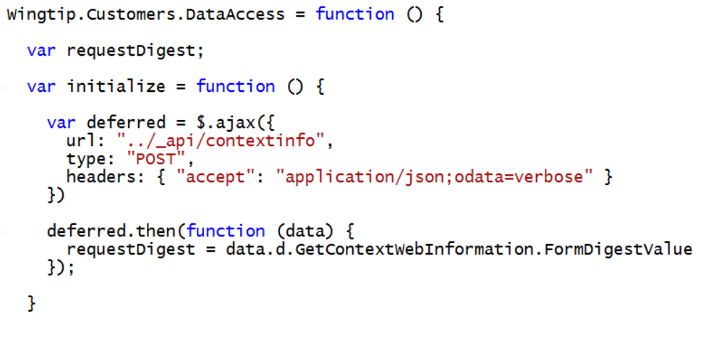
Caching the Request Digest
Request digest queried using /_api/contextinfo

Slide 34
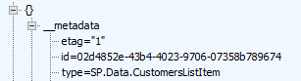
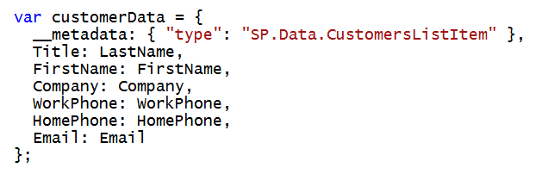
Working with List Item Type Metadata
Each SharePoint list has a unique type for its list items
type value must be passed with all inserts and updates
type discoverable using ListItemEntityTypeFullName property

Slide 35
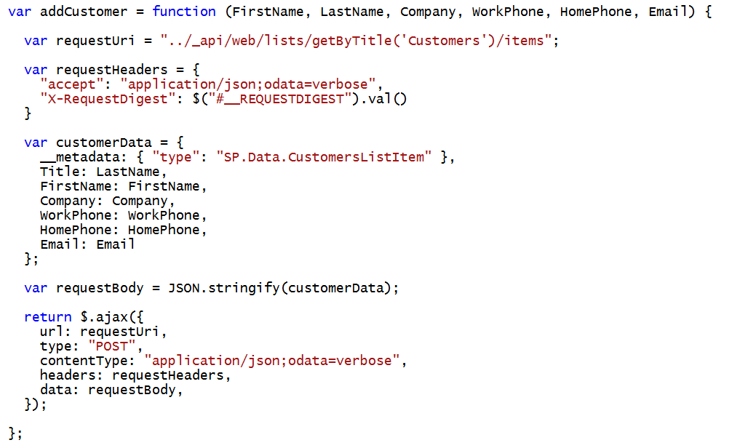
Adding a SharePoint List Item

Slide 36
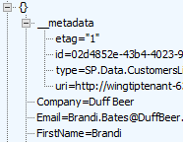

ETags and Optimistic Concurrency
OData v2 requires items to carry ETags
ETag is integer value in that it identities version of item
ETag is automatically incremented with each update
ETag use to support for optimistic concurrency control
ETag works to eliminate the “lost update” scenario
ETag must be tracked in order to post updates in most scenarios

Slide 37
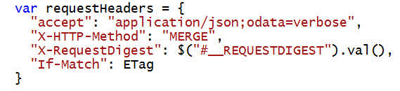
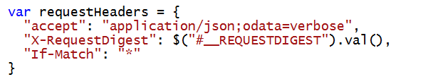
ETags and the If-Match Header
Update and Delete operations require If-Match Header
Allows you to pass ETag value during an update
Update fails if ETag value changed due to update by other user
You can pass wildcard (*) value inside If-Match Header
Done to disable optimistic concurrency control
This is commonly done with delete operations

Slide 38
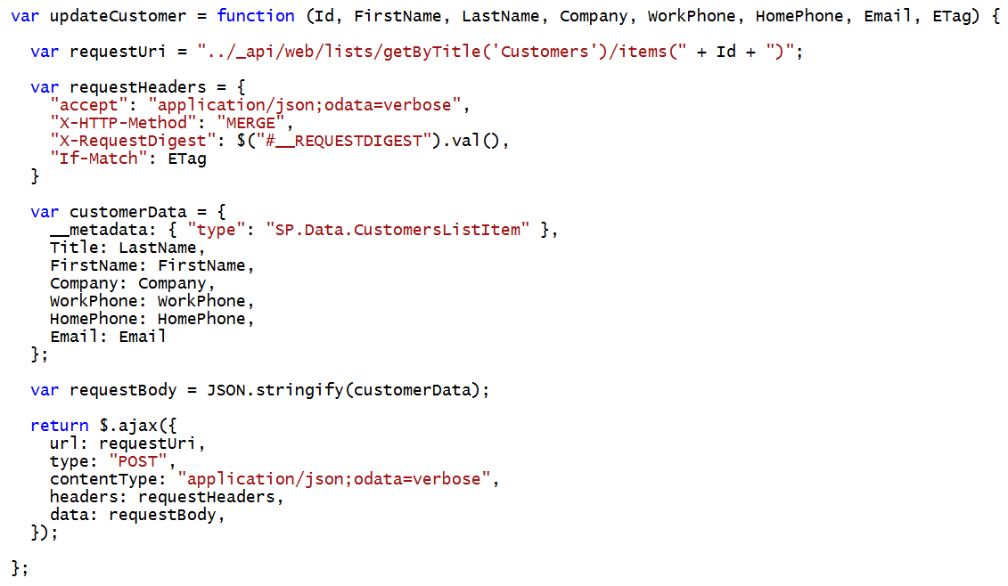
Updating a SharePoint List Item

Slide 39
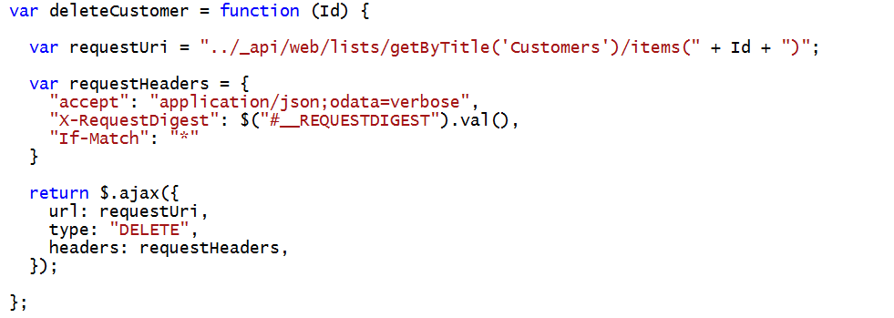
Deleting a SharePoint List Item

Slide 40
Exploring the SharePointCRM App

Slide 41
Summary
The SharePoint REST API
Creating REST URIs for SharePoint Objects
Consuming OData Results from SharePoint
Paging SharePoint List Items
Adding and Updating Items

