Slide 1
Web Content Management​
Notes:
SharePoint 2013 introduces a completely new approach Web Content Management (WCM). WCM sites (aka Publishing sites) are primarily search-based applications showing content from across a site collection, the SharePoint farm and/or external sources. In this module students will learn how to create Publishing sites that are based off search as well as how to implement custom brands using the new Design Manager.

Slide 2
Agenda
Publishing Sites
Publishing Site Navigation
Page Layouts
Design Manager
Cross-site Publishing
CSOM API for Publishing

Slide 3
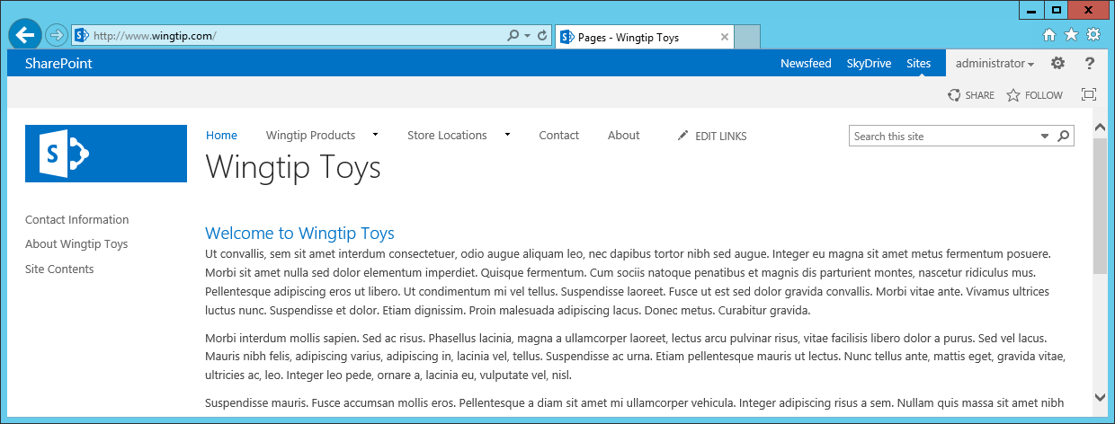
Publishing Sites
SharePoint 2013 supports WCM functionality with publishing sites
Requires hosting site collection to have publishing features activated
Often created using site template named Publishing Portal
Publishing sites can be used for public Internet-facing sites
Publishing sites provide features to collect and publish content
Publishing sites provide assistance with branding and friendly URLs
Site content created, edited and approved in terms of publishing pages

Slide 4
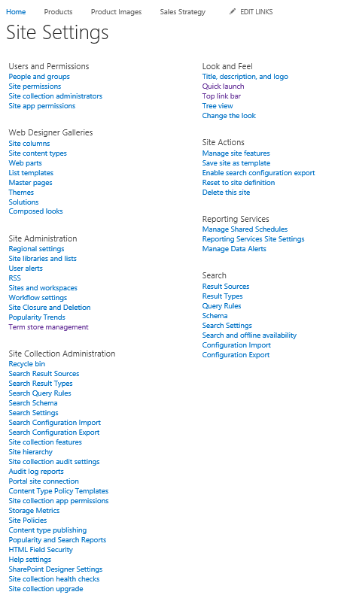
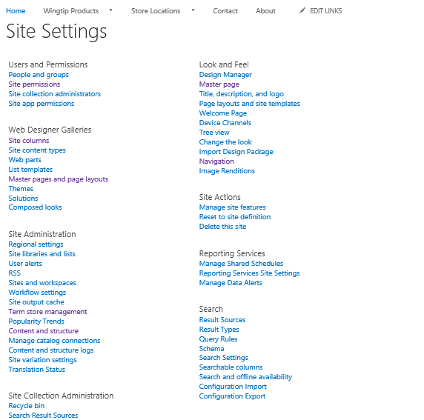
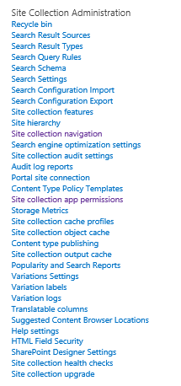
Which Site Settings Page Do You Like Better?
The Publishing features add a good deal of functionality
Site Settings page in Team Site
Site Settings page in Publishing Site

Slide 5
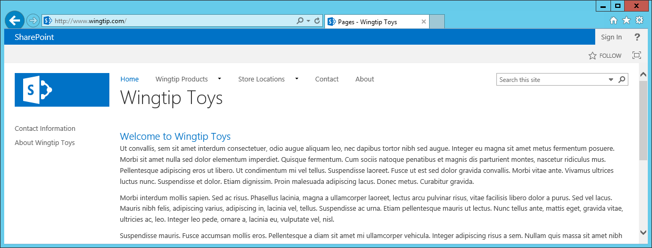
Security Trimming in Publishing Sites
Publishing sites has security trimming for visitors and anonymous access
Visitors do not see certain links such as Site Content and EDIT LINKS
Visitors do not see links to publishing pages until they have been published
Anonymous users do not see Suite bar links (Newsfeed, SkyDrive and Sites)
Anonymous users see the Sign in link instead of Welcome menu

Slide 6
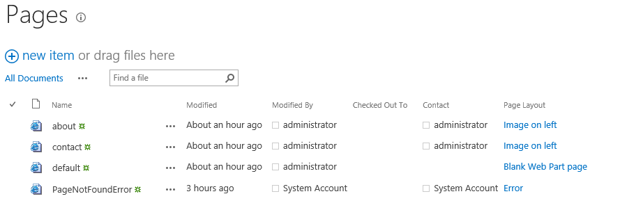
Publishing Pages and The Pages Library
Content added to publishing site using publishing pages
Every publishing site contains Pages Library
Publishing pages are always created in a Pages library
Pages library created with welcome page named default.aspx
You can add additional publishing pages to grow out site content

Slide 7
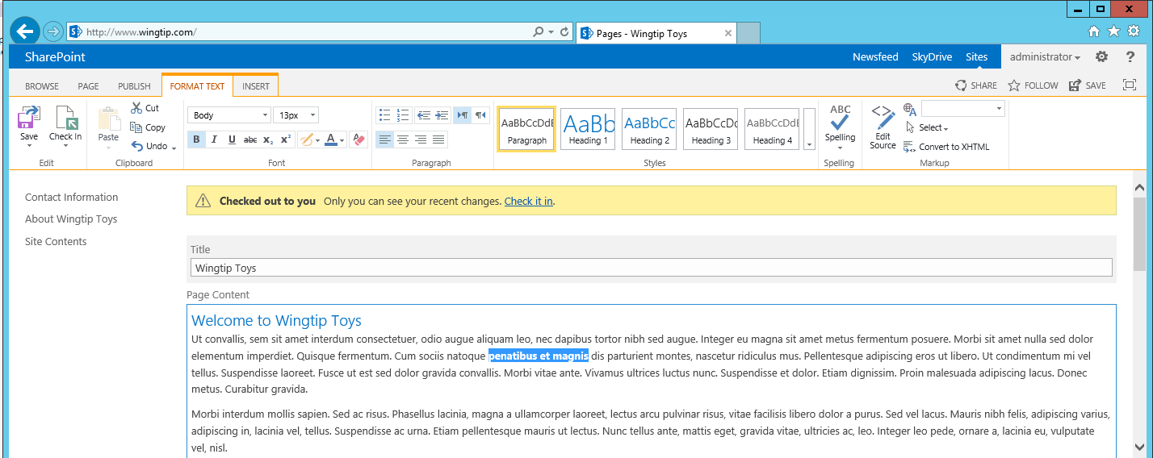
Editing an Existing Publishing Page
Experience is similar yet different from wiki page
Page content is split out into multiple site columns
Site column values edited using field controls
Publishing page has extra ribbon tabs such PAGE and PUBLISH

Slide 8
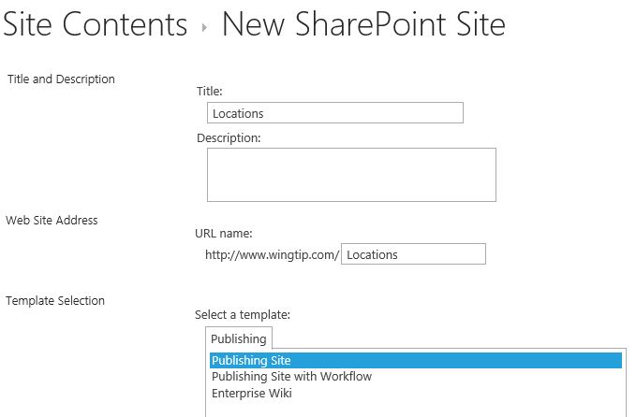
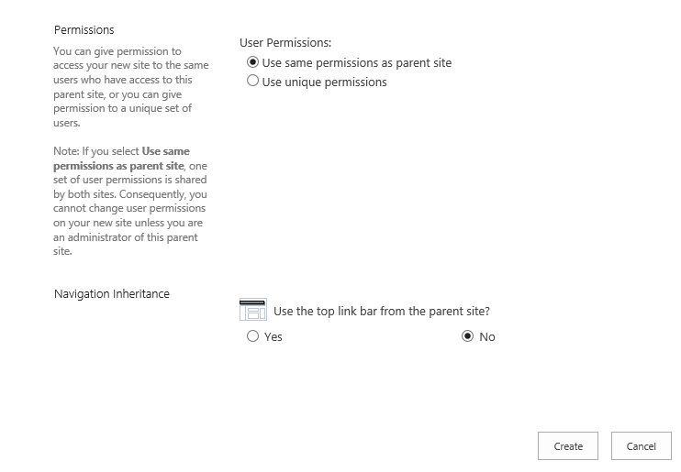
Adding Sites
You construct site hierarchy by adding subsites
Each site gets a welcome page (/Pages/default.aspx)
Secondary publishing pages added to site as needed
Subsites can be added under subsites
Subsite can inherit navigation and/or permissions
Notes:
When it is time to design the content for a new a publishing site collection, you construct site hierarchy by adding child sites. Each site that is added gets a landing page inside the Pages document library named default.aspx. By default, this landing page is configured as the home page for the new child site. Once you have created a new site, you then add extra publishing pages as needed.
Starting with SharePoint 2010, publishing sites support adding new publishing pages to folders created inside the Pages document library. By using folders efficiently, you can scale a single publishing site to contain 100s or even 1000s of pages. However, it should be noted that some of the stock functionality such a having SharePoint 2010 automatically provide navigational menus to publishing pages is only available to publishing pages at the root of the Pages document library.

Slide 9
Agenda
Publishing Sites
Publishing Site Navigation
Page Layouts
Design Manager
Cross-site Publishing
CSOM API for Publishing

Slide 10
Publishing Site Hierarchy of Sites and Pages
Publishing site is a hierarchy of sites and pages
Provides structure for exposing page using URLs
\ (root site)
\Pages
\default.aspx
\contact.aspx
\about.aspx
\Locations (child site)
\Pages
\default.aspx
\tampa.aspx
\jacksonville.aspx
http://www.wingtiptoys.com/Pages/default.aspx
Top-site home page
\Products (child site)
\Pages
\default.aspx
\trainst.aspx
\planes.aspx
http://www.wingtiptoys.com/Pages/contact.aspx
Top-site secondary page
requests
http://www.wingtiptoys.com/Locations/Pages/Tampa.aspx
Locations site secondary page
\Trains (child site)
\Pages
\default.aspx
\train1.aspx
\train2.aspx
http://www.wingtiptoys.com/Products/Pages/defaulkt.aspx
Products site home page
http://www.wingtiptoys.com/Products/Trains/Pages/train1.aspx
Products child site secondary page
\Planes (child site)
\Pages
\default.aspx
\plane1.aspx
\plane2.aspx
Notes:
When you design the hierarchy of sites and pages, you are also committing to the structure which determines the URL to each page. The slide above shows a hierarchy of sites where different types of products have been factored out into their own child sites such as Trains and Planes. This adds the product category into the URL of each product pages and provides a better way to take advantage of the out-of-the-box support for navigation.

Slide 11
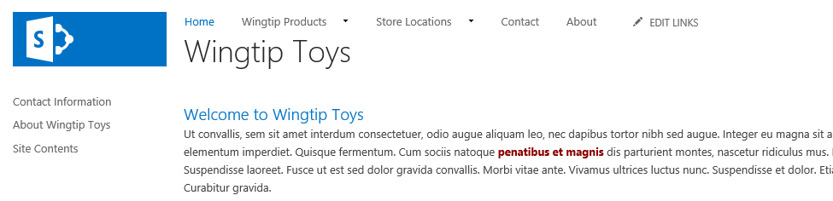
Navigation in a Publishing Site
Navigation in Publishing sites is different than Team sites
Enabling publishing features switches out navigation providers
Top Link Bar and Quick Launch continue to work the same
You can configure navigation using two different options
Structural navigation (carried over from SharePoint 2007 and SharePoint 2010)
Managed Navigation (new in SharePoint 2013)

Slide 12
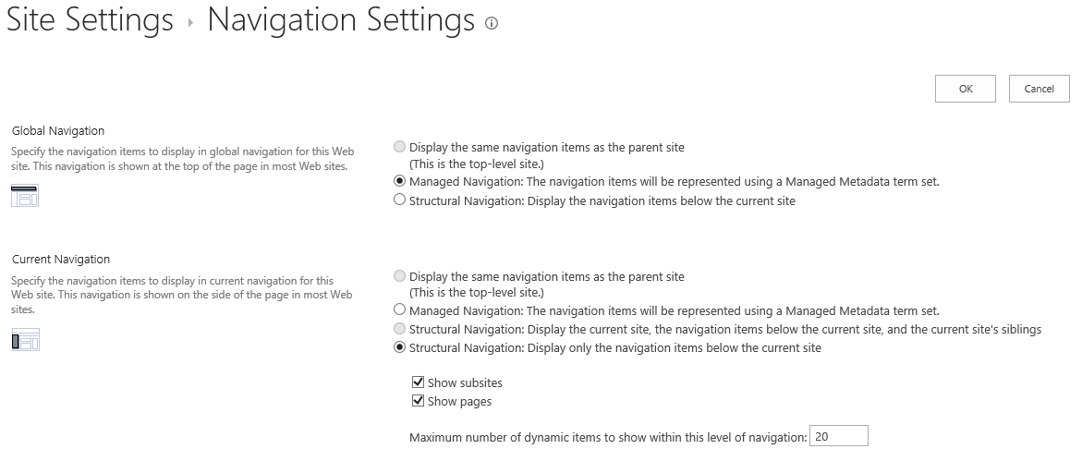
Site Navigation Settings
Global Navigation configured separately from Current Navigation
Global Navigation can used Structural Navigation or Managed Navigation
Current Navigation can used Structural Navigation or Managed Navigation
Subsites can inherit navigation from parent site

Slide 13
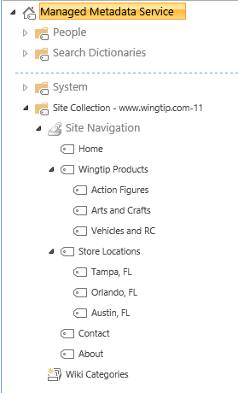
Managed Navigation
Managed navigation based on termset
Termsets managed by Managed Metadata Service
Termset can be created to store a hierarchy of terms
Site Navigation termset created atomically in new publishing site

Slide 14
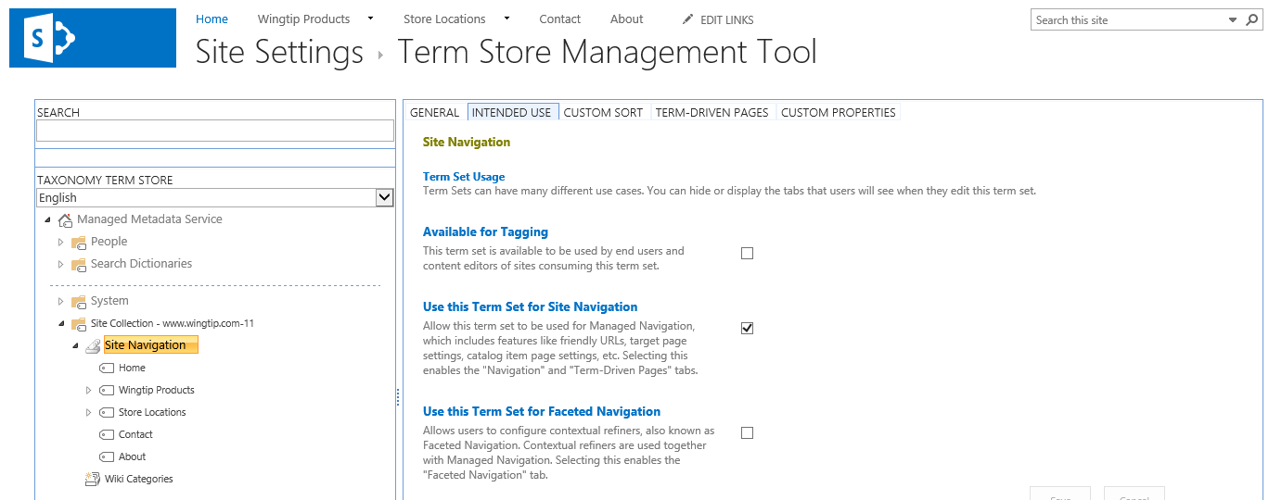
The Site Navigation Termset
Site Navigation termset provides navigation terms
Navigation terms can be added as pages are created
Navigation terms can be created and configured manually

Slide 15
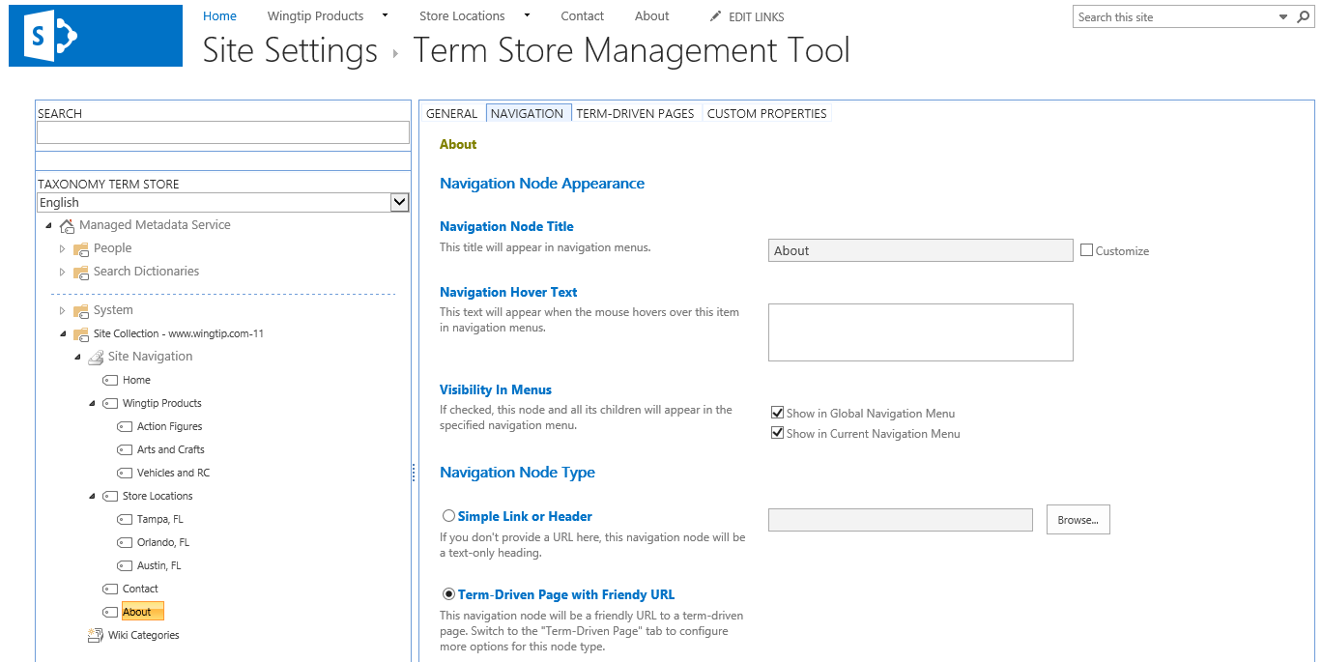
Understanding Navigation Terms
Navigation terms link to publishing pages
Can be configured to show in Global Navigation
Can be configured to show in Current Navigation
Links are added as Simple Links or Friendly URL links

Slide 16
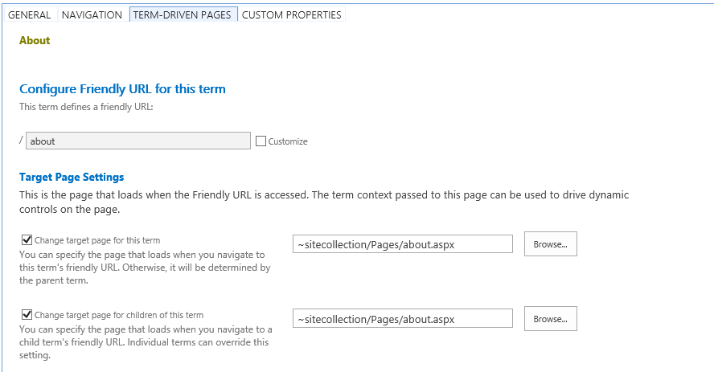
Configuring Friendly URLs
Navigation Term can be configured with friendly URLs
Incoming requested targeting friendly URL routed to target page
Supported with Managed Navigation but not with Structural Navigation
Examples of friendly URLs
http://www.wingtip.com/
http://www.wingtip.com/about
http://www.wingtip.com/contact
http://www.wingtip.com/store-locations
http://www.wingtip.com/store-locations/tampa
http://www.wingtip.com/store-locations/orlando
http://www.wingtip.com/store-locations/austin
http://www.wingtip.com/wingtip-products
http://www.wingtip.com/wingtip-products/action-figures
http://www.wingtip.com/wingtip-products/arts-and-crafts
http://www.wingtip.com/wingtip-products/vehicles-and-rc

Slide 17
Agenda
Publishing Sites
Publishing Site Navigation
Page Layouts
Design Manager
Cross-site Publishing
CSOM API for Publishing

Slide 18
Page Layouts
Page layouts are publishing page templates
They extend template layout of an existing master page
They define constrains for content to be added & edited
They define layout for editing mode and display mode
seattle.master
Products.aspx
Product Name
Product Description
Product Picture
Product Discounts
Notes:
Page layouts serve as a second layering of templates for publishing pages. That's because they extend template layout of an existing master page.
A page layout is based on a content type that defines the constrains for any content which is added and edited by content authors. The page layout itself defines a user interface with a layout for editing mode and for display mode.

Slide 19
Page Layouts and Content Types
Each page layout is based on a content type
Content type defines collection of site columns
Page layout has field control bound to each site column
Page layout may optionally include Web Part zone(s)
ProductLayout.aspx
Field control 1
Field control 2
Field control 3
Product Page content type
Field Control 4
Site Columns (aka Fields collection)
Site Column 1
Site Column 2
Site Column 3
Site Column 4
Web Part zone
Notes:
Each page layout is based on an associated content type. Whenever you create or upload a page layout, you must assign a content type to it at that point.
A content type defines the schema for form data using a collection of site columns. At a high level, the architecture for a page layout has field control that is bound to each site column in the underlying content type.
In addition to field controls, a page layout may optionally include Web Part zones. This provides flexibility as a content author has much more freedom to add all kinds of Web Parts and to customize them as desired.

Slide 20
Content Type Can Have Many Page Layouts
Multiple page layouts can use same content type
Provides alternative ways to layout the same content
Product Page content type
Site Columns (aka Fields collection)
Site Column 1
Site Column 2
Site Column 3
Site Column 4
ProductLayout1.aspx
ProductLayout2.aspx
ProductLayout3.aspx
Field control 1
Field control 1
Field control 1
Field control 2
Field control 3
Field control 3
Field control 2
Field control 2
Field Control 4
Field Control 4
Field control 3
Field Control 4
Notes:
Note that more than one page layouts can be associated with a single content type. This possibility makes it possible to show the same content in different ways.
For example, a content author can create a publishing page based on one page layout and then switch to another. As long as both page layouts are based on the same content type or the same set of columns, the displays the exact same information, just in different ways.

Slide 21
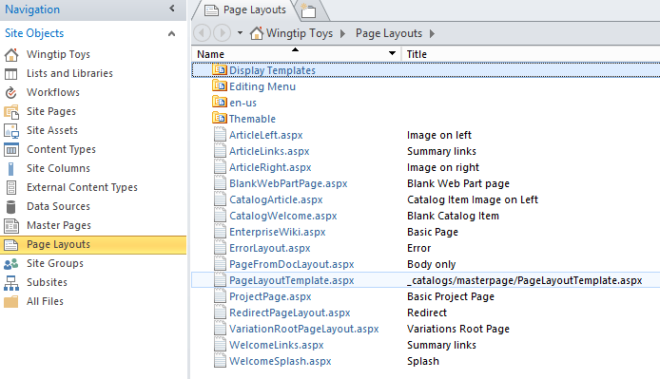
Where do Pages Layouts Live?
Page Layouts deployed to Master Page Gallery
Page layout can be used in current site
Page layout can be used in all descendant sites
Page layout in top site usable throughout site collection
Notes:
Page Layouts must be deployed to the Master Page Gallery. Once a page layout has been deployed to the Master Page Gallery of a specific site, it can be used in current site as well as in all descendant sites. A page layout that has been deployed in the top level site can be used in all sites throughout the current site collection.

Slide 22
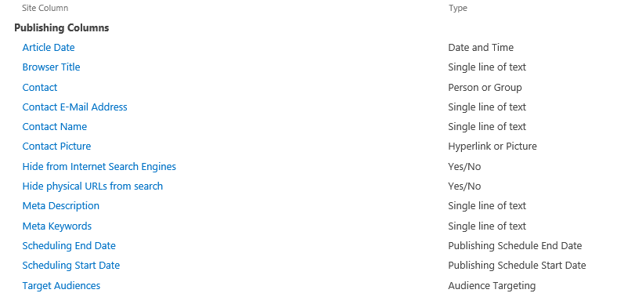
Publishing Site Columns
Notes:
This slides shows the site columns included with SharePoint 2010 that are specifically intended for use with publishing sites and page layouts. The site columns listed at the top with a Group value of Page Layout Columns are used by some of the out-of-the-box page layouts and you can optionally use them as well behind your custom page layouts.
The site columns listed at the top with a Group value of Publishing Columns are all part of the Page content type from which all other publishing content types must inherit. That means that each site column in the Publishing Columns group represents a column value that is guaranteed to exist behind every publishing page. In other words, these site columns are not optional. They are always used.

Slide 23
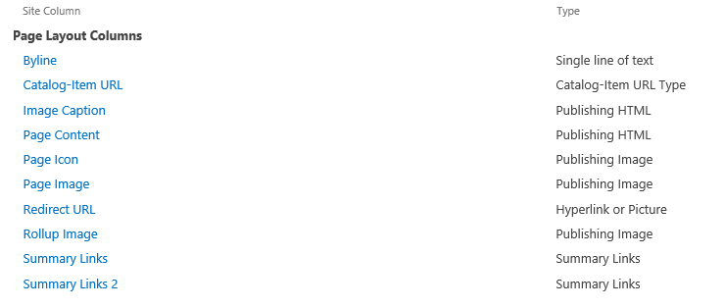
Page Layout Site Columns

Slide 24
Content Type Inheritance
Publishing page content types inherit from Page
Welcome Page and Article Page provides out of box
Custom content types should inherit from Page as well
Item
Document
System Page
Page
Welcome Page
Article Page
Landing Page
Custom Content Types
Product Page
Notes:
The content types associated with page layouts must inherit either directly or indirectly from a special content type named Page. As discussed earlier this lecture, the Page content type includes the following standard site columns which are automatically inherited by all Page-derived content types.
Article Date
Contact
Contact E-Mail Address
Contact Name
Contact Picture
Scheduling End Date
Scheduling Start Date
Target Audiences
There are content types provided out of the box such as Welcome Page and Article Page that demonstrate inheriting from the Page content type. Any custom content types you create for a page layout should inherit from the Page content type as well.

Slide 25
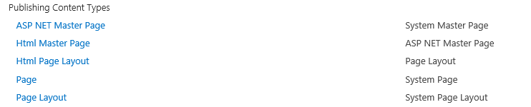
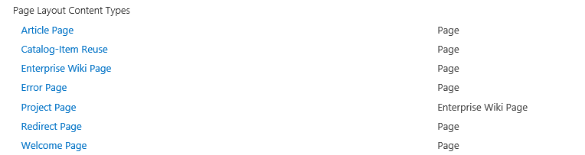
Publishing Content Types
Publishing Content Types
Page Layout Content Types

Slide 26
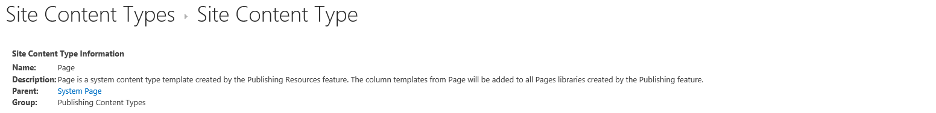
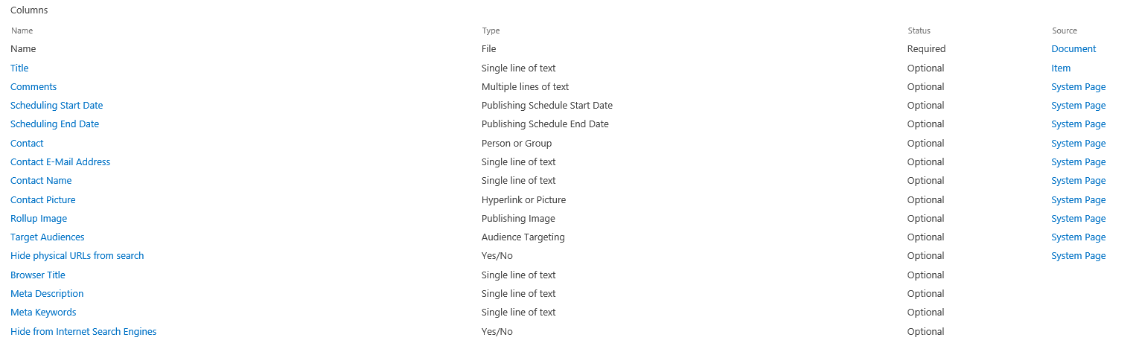
The Page Content Type
Provides common fields for all publishing pages
Most of these site columns not intended for display
Notes:
The slide shows a screenshot of the Page content type as shown through the standard user interface in a publishing site. As you can see, the Page content type includes the following standard site columns which become part of the content behind every publishing page.
Article Date
Contact
Contact E-Mail Address
Contact Name
Contact Picture
Scheduling End Date
Scheduling Start Date
Target Audiences

Slide 27
Steps to Create a New Page Layout
Create site columns
Create content type
Add created site columns to content type
In the Master Page Gallery
Create new Page Layout file
Check-out file and edit in SharePoint Designer
Populate the file with content fields
Check-in and approve
Use the new page layout file
Notes:
Once you have create the required Page-derived content type, you can then create the page layout itself using SharePoint Designer. SharePoint Designer provides a very friendly environment for create a page layout because you can drag and drop the site columns from the associated content type to easily create bound field controls.
Here are the steps you will go through in the lab
Create the extra site columns required for tracking content
Create the Page-derived content type
Add any required site columns to the Page-derived content type
Create a new page layout file in the master page gallery of target site
Check-out file and edit in SharePoint Designer
Populate the page layout with field controls associated with specific site columns
Check in the page layout and approve it
Configure publishing pages to use the new page layout

Slide 28
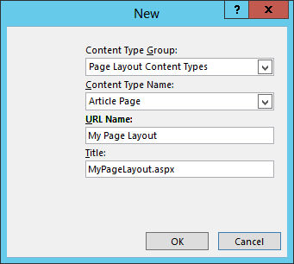
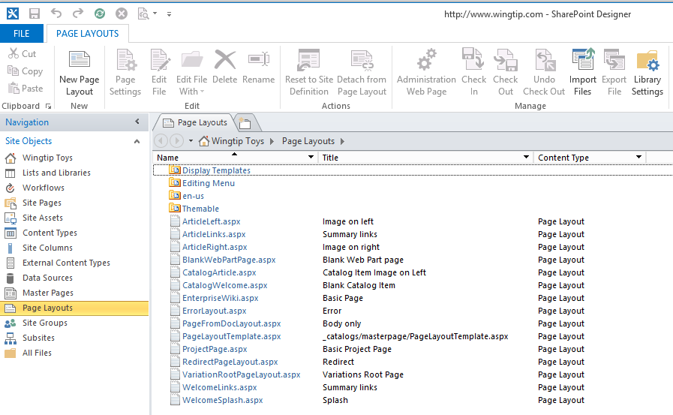
Creating a New Page Layout
SPD provides New Page Layout command
Select Page-derived content type
Creating Page Layout requires content type, URL and Title
Notes:
This slide shows the user interface experience in SharePoint Designer of creating a new page layout using the Page Layout command button in the ribbon. You are then prompted with a dialog that forces you to select a Page-derived content type and to type in a value for the new page layout's URL, Name and Title.

Slide 29
Create a Page Layout with SharePoint Designer

Slide 30
Agenda
Publishing Sites
Publishing Site Navigation
Page Layouts
Design Manager
Cross-site Publishing
CSOM API for Publishing

Slide 31
Implementing Custom Branding
Empowering Web Designers
Completely revamped CSS classes
Minimizing ramp up time
Develop SharePoint 2013 sites in any Web design tool
Expression Web, Adobe Dreamweaver, Notepad, etc…
New “Design Manager” tool makes it easier to implement custom branded sites
Notes:
Branding WCM sites is now much easier in SharePoint 2013 with the Design Manager. SharePoint allows developers and designers to copy non-SharePoint specific design assets and upload them to SharePoint. Then, with a behind-the-scenes automatic creation of SharePoint specific assets (*.MASTER & *.ASPX), designers can work with the HTML files in any tool they are comfortable with, getting a real design-time preview of the pages they are working within.

Slide 32
Design Manager: Implementing a Custom Brand
Wizard-like experience
Step-by-step Approach:
Upload design assets (HTML, CSS, images, etc.)
Create master pages
Create page layouts
Server preview of current state of design
Wizard like tool helps add SharePoint components
Content placeholders
Notes:
The design manager helps implement a custom brand in a wizard like approach. After uploading the assets the designer then connects, creates & customizes the master page(s) and page layout(s). Finally, when everything is complete, they can export a design package as a *.WSP to implement the custom brand in a production environment.

Slide 33
Snippet Manager: Adding SharePoint Components
Design Manager shows real-time preview of components
Ribbon helps adding necessary components
Generates HTML snippet that can be used in any Web design editor
Web design tools only render HTML; ASP.NET & SharePoint markup ignored
SharePoint ignores HTML; renders ASP.NET & SharePoint markup
Notes:
When customizing the master page & page layouts, SharePoint’s Design Manager provides a snippet gallery to make it easier to add SharePoint components to the page. For instance things like navigation controls, search boxes and Web Part Zones can be added using the snippet manager. It generates an HTML representation of the control so any design tool can render how it will look when it is used in SharePoint, even if the tool doesn’t understand SharePoint or ASP.NET.

Slide 34
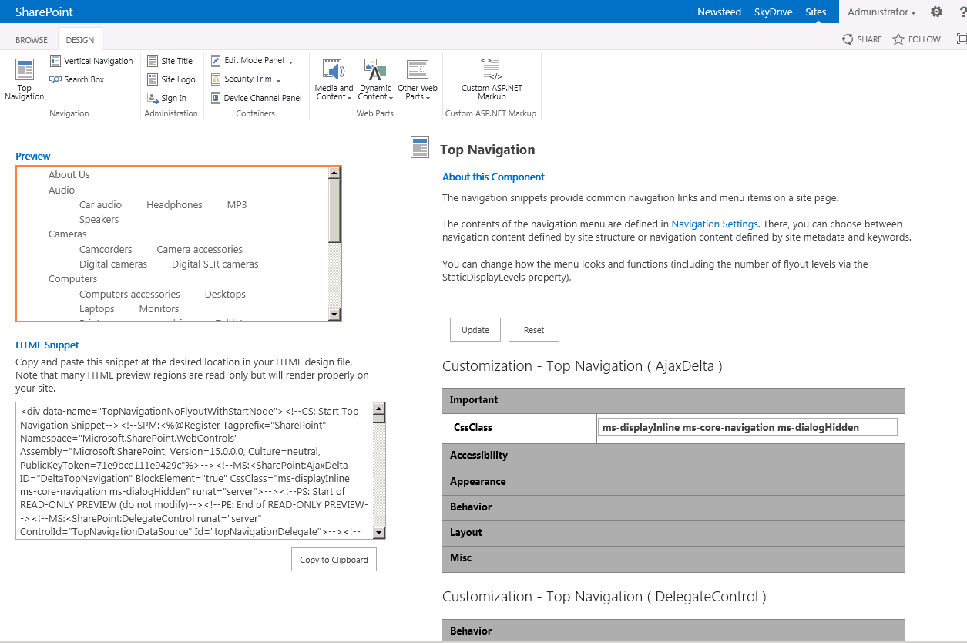
Adding SharePoint Components

Slide 35
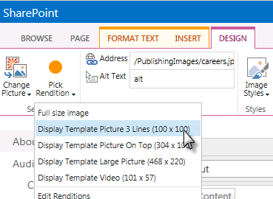
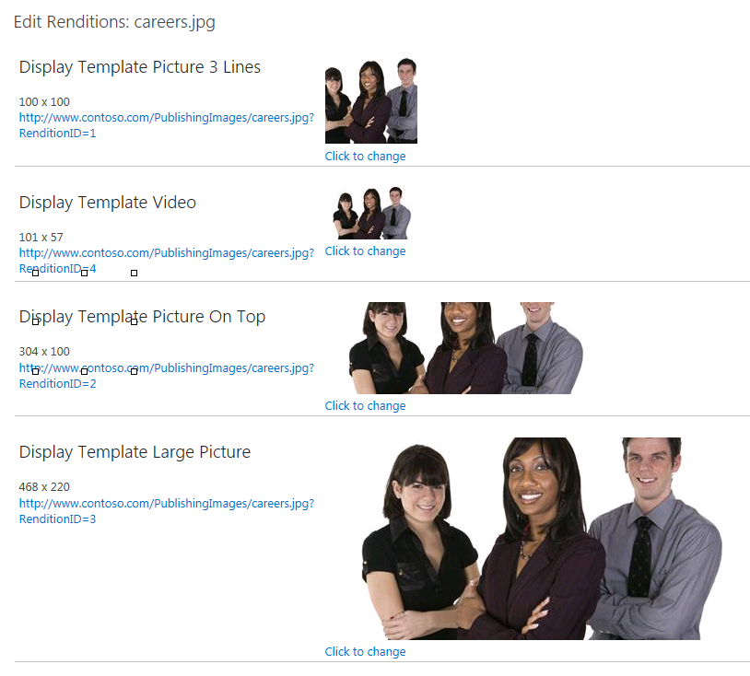
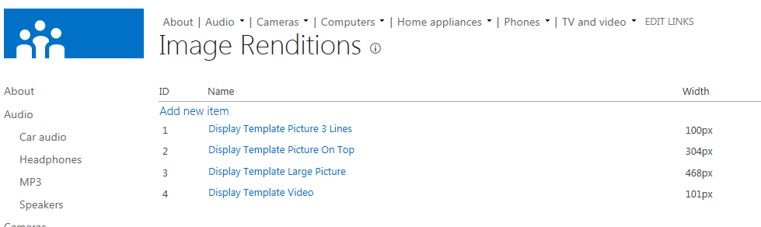
Image Renditions
Image transformation on demand
Thumbnails are actual thumbnails
Consistency sized images
Cropping for targetting areas of pictures
Notes:
Many times the same image needs to be used across a site in standard formats. What SharePoint now offers is something called Image Renditions. Site owners can create multiple renditions of an image and when content owners want to use an image on a page, they select the image and then the rendition they want. SharePoint then, when first requested, generates the image according to the rendition and saves it to the WFE disk for future requests.

Slide 36
Design Manager

Slide 37
Agenda
Publishing Sites
Publishing Site Navigation
Page Layouts
Design Manager
Cross-site Publishing
CSOM API for Publishing

Slide 38
Cross Site Publishing & Catalogs
New list functional characteristic: Catalog
Flagged in search for pre-defined search queries
Enables content to be “published” across site collections
Facilitates real content reuse
Content surfaced throughout site collections via Content by Search Web Part (CBS)
Notes:
WCM sites are driven by content which may be products, articles or anything else. With the new search and navigation capabilities added to SharePoint 2013 WCM sites, Microsoft has also made it easier to manage content by the introduction of Catalogs. A catalog is a special type of SharePoint list that is registered within search for pre-defined queries. Once a catalog has been created, it can be published and shared across site collections. This allows customers to have a content authoring site, working with products or articles or whatever type of content in a list-like fashion while rendering it in a different way.

Slide 39
Content by Search Web Part
Similar to Content by Query Web Part
Exposes results as JSON on page
Customize search results rending
Easier to customize than CBQ styles
Client-side solution using returned results as JSON
Server side via custom Display Templates
Content is only editable at the source, not in different presentations (presentation = search results)
Notes:
Previous version of SharePoint WCM sites included a powerful web part used for content aggregation and rollup: Content by Query Web Part (CBQ). New in SharePoint 2013 is the Content by Search Web Part (CBS).
The CBS, when placed on a page, allows developers & designers to pull content directly from the search index. The query can be designed to pull content based on values on the page or within the URL, such as terms in a term site. The results are then written to the page in JSON format and a display template is used to render the content in HTML.
When search engines hit the page, SharePoint detects this is not a regular user and instead renders the HTML server side so the engine does not parse through the JSON, rather it parses the standard HTML page. There is also a property on the CBS Web Part that allows developers to force server-side rendering if they choose as in the case for accessibility reasons.

Slide 40
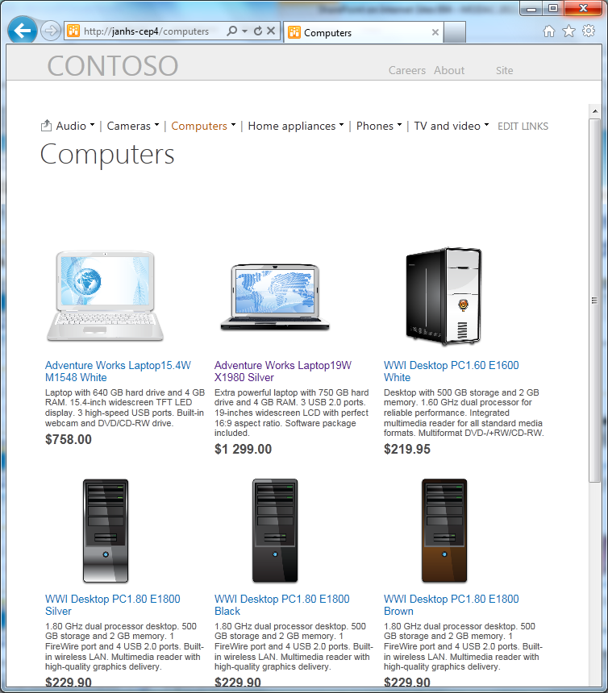
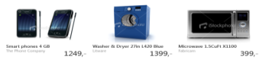
Navigation, Search and Topic Pages
Friendly URL
http://contoso.com/computers
TERM STORE
NAVIGATION TAXONOMY
CONTENT SEARCH WEB PART
Filter query by
CATEGORY: COMPUTERS
Audio
Cameras
Computers
Home appliances
Phones
TV and video
Search
Use page
maincategory.aspx
Product Catalog
Notes:
The picture in this slide shows how all the pieces of managed navigation, the Content Search Web Part (CSWP) and display templates. The search experience of all the pieces is able to come together to construct a dynamic page pulling products from a catalog using the CSWP and displaying them using a display template.

Slide 41
Content Catalogs, Topic Pages & Content By Search

Slide 42
Agenda
Publishing Sites
Publishing Site Navigation
Page Layouts
Design Manager
Cross-site Publishing
CSOM API for Publishing

Slide 43
SharePoint 2013 WCM CSOM
SharePoint 2010 content available off the server using same CSOM & REST as SharePoint Foundation
No context around Publishing
Required intimate knowledge how Publishing worked
SharePoint 2013 Publishing surfaced via CSOM
Microsoft.SharePoint.Publishing.dll
Microsoft.SharePoint.Taxonomy.dll
No for REST / OData API
Notes:
Because WCM sites are based on SharePoint sites, lists and libraries, developers could use all the standard APIs to interact with the content. This includes the server-side API and client-side APIs. However this means that developers had to have a firm understanding of how the content was managed in these libraries. A better approach was to leverage the Publishing namespace in the server side API. This was also true for the taxonomy which had a robust server-side API.
Unfortunately these special namespaces were only available in the server-side API in previous versions of SharePoint. SharePoint 2013 changes this by adding a Publishing and Taxonomy namespace to the client side object model (CSOM) enabling client-side and remote development opportunities.

Slide 44
Summary
Publishing Sites
Publishing Site Navigation
Page Layouts
Design Manager
Cross-site Publishing
CSOM API for Publishing

